Slide 1
Phonics
SSCs [ga], [go], [gu]
Y7 Spanish
Term 3.1 - Week 4
Author names: St James’ Hub Teachers /
Victoria Hobson/ Nick Avery / RachelHawkes
Date updated: 16/05/20

Slide 2
ga
regalo
jugar
gato
ganar
amiga
lugar
[place]
Notes:
Introduce and elicit the pronunciation of the individual SSC ‘ga’ and then the source word again (with gesture, if using). Then present and elicit the pronunciation of the five cluster words.
The cluster words have been chosen for their high-frequency, from a range of word classes, with the SSC (where possible) positioned within a variety of syllables within the words(e.g. initial, 2nd, final etc..) and additionally, we have tried to use words that build cumulatively on previously taught SSCs (see the Phonics Teaching Sequence document) and do not include new SSCs. Where new SSCs are used, they are often consonants which have a similar symbol-sound correspondence in English.

Slide 3
ga
regalo
jugar
gato
ganar
amiga
lugar
Notes:
Without the images, students focus this time again closely on the SSC and the cluster words.

Slide 4
ga
regalo
jugar
gato
ganar
amiga
lugar
Notes:
Without the images or sound, students have to pronounce the words themselves.

Slide 5
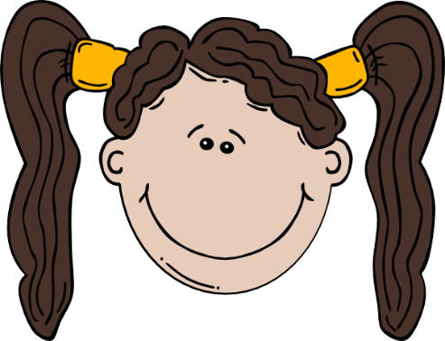
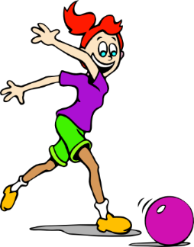
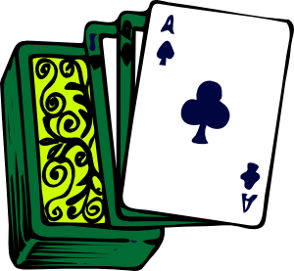
go
domingo
largo
SUNDAY
gol
juego (n)
conmigo
[with me]
algo
[something]
Notes:
Introduce and elicit the pronunciation of the individual SSC ‘go’ and then the source word again (with gesture, if using). Then present and elicit the pronunciation of the five cluster words.
The cluster words have been chosen for their high-frequency, from a range of word classes, with the SSC (where possible) positioned within a variety of syllables within the words(e.g. initial, 2nd, final etc..) and additionally, we have tried to use words that build cumulatively on previously taught SSCs (see the Phonics Teaching Sequence document) and do not include new SSCs. Where new SSCs are used, they are often consonants which have a similar symbol-sound correspondence in English.

Slide 6
go
domingo
largo
gol
juego (n)
conmigo
algo
Notes:
Without the images, students focus this time again closely on the SSC and the cluster words.

Slide 7
go
domingo
largo
gol
juego (n)
conmigo
algo
Notes:
Without the images or sound, students have to pronounce the words themselves.

Slide 8
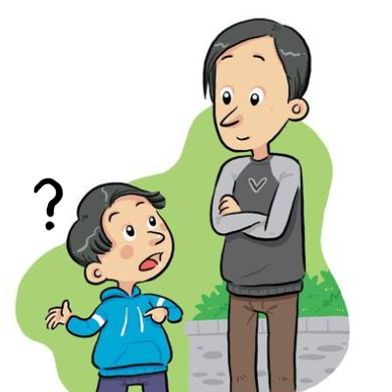
gu
segundo
seguro
[sure, certain]
preguntar
Notes:
Without the images, students focus this time again closely on the SSC and the cluster words.

Slide 9
gu
segundo
seguro
preguntar
Notes:
Introduce and elicit the pronunciation of the individual SSC ‘gu’ and then the source word again (with gesture, if using). Then present and elicit the pronunciation of the five cluster words.
The cluster words have been chosen for their high-frequency, from a range of word classes, with the SSC (where possible) positioned within a variety of syllables within the words(e.g. initial, 2nd, final etc..) and additionally, we have tried to use words that build cumulatively on previously taught SSCs (see the Phonics Teaching Sequence document) and do not include new SSCs. Where new SSCs are used, they are often consonants which have a similar symbol-sound correspondence in English.

Slide 10
gu
segundo
seguro
preguntar
Notes:
Without the images or sound, students have to pronounce the words themselves.

Slide 11
İTres segundos!
hablar / escuchar
jugar
domingo
amiga
largo
seguro
regalo
conmigo
preguntar
gato
juego
segundo
lugar
gol
ganar
algo
Notes:
Phonics revision.
Slides 11-12 (answers on slide 13) provide a few activities for further phonics practice. Teachers can do them all or select the most appropriate for their classes. This is a paired read aloud task. Teachers will need to print one sheet per pair.
Each student uses a different colour to play. Student A says one of the words and student B has 3 seconds to locate it and circle/highlight with their colour. If the student takes longer than 3 seconds student A can steal the point.
Teachers may need to think about student pairings to ensure friendly competition.
In addition to previously taught source and cluster words, this set of words includes previously taught vocabulary items with the target SSC ‘ga’: jugar (2.2.2), amiga (1.1.6), lugar (2.1.3), regalo (1.2.7)

Slide 12
İUn minuto!
hablar
jugar
domingo
60
amiga
largo
seguro
regalo
conmigo
preguntar
gato
juego
lugar
gol
segundo
ganar
algo
0
INICIO
Notes:
This is a choral alphabetical read aloud – the teacher sets the 60-second timer going (click on ‘inicio’). Individually (but all together at once) students read out the words in alphabetical order. They keep going for one minute. Challenge – translate into English orally with partner. Teachers can circulate to listen to students’ SSC knowledge and recall of English.
As the final activity, students should write the English for as many of the words as they can to reinforce their meanings. Students could have a minute individually then team up with a partner to see if they can achieve translations for all 15 words. The answers are provided on slide 13.

Slide 13
¿Qué significan las palabras?
jugar
?
conmigo
?
to play, playing
with me
amiga
?
juego
?
female friend
game
regalo
?
present
gol
?
goal
gato
?
cat
algo
?
something
lugar
?
place
preguntar
?
to ask, asking
ganar
to win, winning
?
seguro
?
sure, certain
domingo
?
Sunday
segundo
?
second
largo
?
long
Notes:
Click on the box with ‘?’ to reveal the answer for each word. In this way, answers can be volunteered in any order.

Slide 14
¿GA, GO o GU?
escuchar
Escucha.
Escucha otra vez.
Marca ‘GA’, ‘GO’ o ‘GU’.
Escribe las palabras.
 | GA | GO | GU
¿Cómo se dice en inglés?
1
gol
gana
goal
wins
segundo
lugar
second
place
2
3
jugar
domingos
playing
Sunday
4
regalo
pregunta
present
asks
algo
something
5
gato
cat
Notes:
Teachers should tell students that there will be more than one SSC per sentence.
TRANSCRIPT
1) İGol! Gana el Barça.
2) En segundo lugar es el Real Madrid.
3) Jugar los domingos es fantástico.
4) ¿Cual es el regalo?, pregunta Daniel.
5) Tener un gato es algo muy especial.
Answers are animated to support differentiation. Some students will simply focus on listening out for the correct SSC the first time they listen, while others will be able to also write the words with the target SSCs as they go.
Students could be asked to give the English. NB verbs from 1) and 4) and in 3rd person singular (and not infinitives as they appeared as source words). Try and elicit the correct meaning from students.

Slide 15
¿GA, GO o GU?
hablar
Go
Ga
İ___l! ___na el Barça.
1
Goal! Barca wins!
Notes:
OPTIONAL
Here, for further sentence level practice, the same sentences appears with target SSCs missing. Students have to read the sentence aloud in chorus, recalling the missing SSCs as they read aloud. Ask students if they can give the whole translation of the sentence in English. Audio is also included here for reinforcement of the pronunciation, if needed.

Slide 16
¿GA, GO o GU?
hablar
gu
ga
En se___ndo lu___r es el Real Madrid.
2
In second place is Real Madrid.

Slide 17
¿GA, GO o GU?
hablar
ga
Ju___r los domin___s es fantástico.
go
3
Playing on Sundays is fantastic.

Slide 18
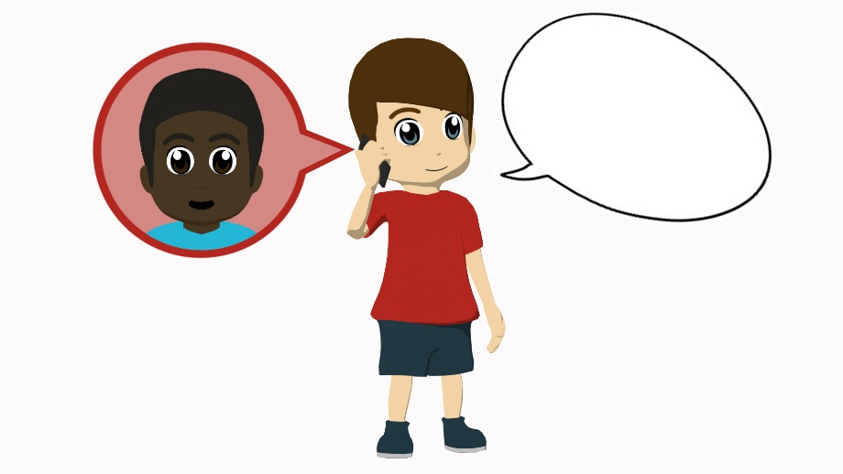
¿GA, GO o GU?
hablar
¿Cuál es el re___lo?, pre___nta Daniel.
ga
4
gu
“Which is the present?” asks Daniel.

Slide 19
¿GA, GO o GU?
hablar
ga
Tener un ___to es al___ muy especial.
go
5
Having a cat is something very special.

