Slide 1
The perfect tense (avoir)
‘s/he’ and ‘they’

Slide 2
Things that have happened in the past: The Perfect Tense (for most verbs!)
Who did it: s/he or they?
For what one person (‘he’ or ‘she’) did, use ‘a’ before the main verb.
For what more than one person (‘they’) did, use ‘ont’ before the main verb.
‘a’ and ‘ont’ are called an ‘auxiliary’. They are parts of the verb avoir (to have).
she / he: use ‘a’
Il a fait le lit.→
Marie a donné beaucoup.→
Ma soeur a pris le train.→
they: use ‘ont’
Ils ont fait le lit.→
Jean et Marie ont donné beaucoup.→
Mes parents ont pris le train.→
They made the bed.
He made the bed.
Marie gave a lot.
Jean and Marie gave a lot.
My sister took the train.
My parents took the train.
Emma Marsden / Victoria Hobson
Notes:
Teacher note: Short grammar explanations can never be fully complete. (For example, of course, some verbs don’t follow this pattern as they are verbs of movement or change of state). But the aim is to get pupils to learn a ‘default’, main pattern and then introduce the complexities and exceptions to the rule later. In any case, evidence suggests that it is the practice activities that are most helpful for learning (rather than these grammar explanations). But … these short grammar explanations do seem to speed up some learners in becoming accurate in the practice activities that follow.
Animations support an interactive explanation, in which the teacher encourages students to make form-meaning connections.

Slide 3
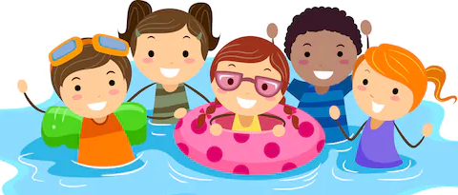
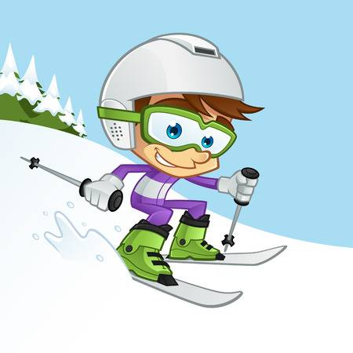
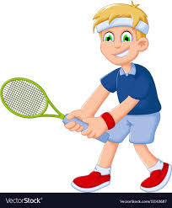
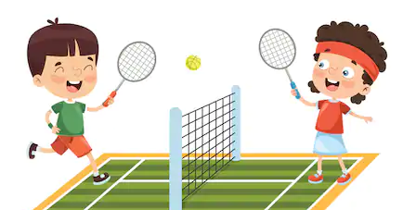
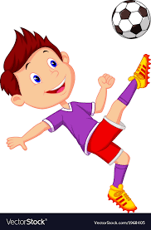
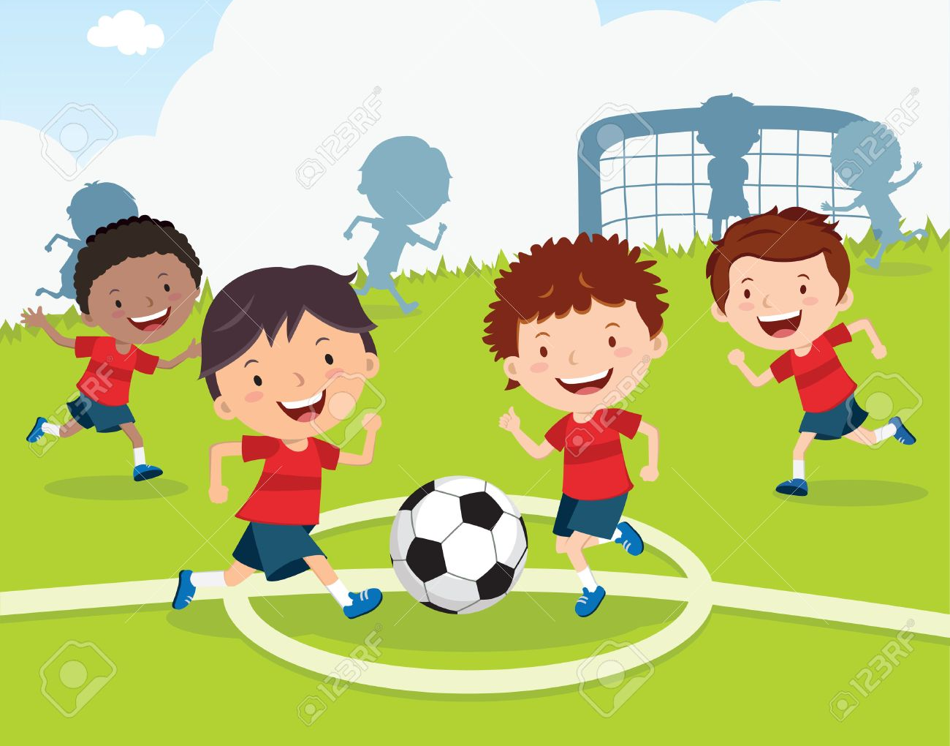
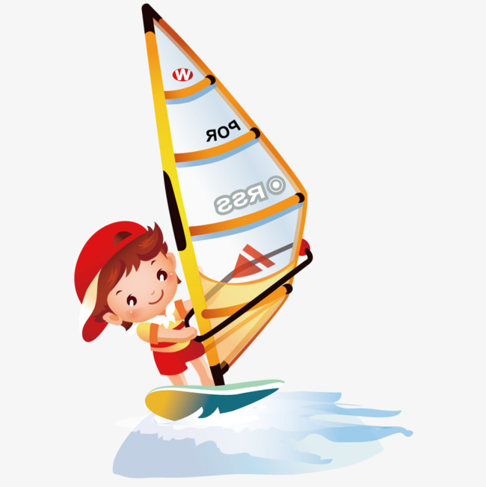
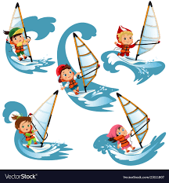
Les sports
Your French friend has just done activities week in his school. Some sports were done by one friend, others by more than one. He’s out in the country walking with his parents, and it’s very noisy, so you can’t hear every word he’s saying!
Écouter
How many people did each sport? Just one person or more than one? Choose A or B.
Pendant les vacances, il… / ils…
1
A
B
4
A
B
2
A
B
5
A
B
3
A
B
6
A
B
Emma Marsden / Victoria Hobson
Notes:
Click on each number to hear the audio, twice for each sentence. After the number, students hear a sheep noise in place of the pronoun ‘il’ or ‘ils’, indicated by [xxx] in the transcript, below. This is to focus their attention solely on the auxiliary verb form. Answers are animated to appear on a click, as ticks by the correct answers. The task has been designed to avoid the need for photocopies. Students number 1-6 and write A or B. However, if teachers prefer, the next slide has a version that can be copied.
Verb frequency rankings (1 is the most common word in French): jouer (219); faire (25); nager (>5000). Source: Londsale, D., & Le Bras, Y. (2009). A Frequency Dictionary of French: Core vocabulary for learners London: Routledge.
Transcript: les sports
[xxx] ont joué au golf.
[xxx] a fait du ski
[xxx] ont joué au foot
[xxx] a nagé dans la mer
[xxx] a joué au tennis
[xxx] ont fait de la planche à voile

Slide 4
Les sports
Écouter
How many people did each sport? Just one person or more than one? Choose A or B.
Pendant les vacances, il… / ils…
1
A
B
4
A
B
2
A
B
5
A
B
3
A
B
6
A
B
Notes:
Students can usually just work from the whiteboard, noting down the numbers 1-6 and letters A or B each time.
However these two slides could be printed, if necessary.
Printable student copy. Either print this slide and reduce to A5 on photocopies or select print 2 slides to a page. (Slides 3&4).

Slide 5
Les sports
Écouter
How many people did each sport? Just one person or more than one? Choose A or B.
Pendant les vacances, il… / ils…
1
A
B
4
A
B
2
A
B
5
A
B
3
A
B
6
A
B
Notes:
Printable student copy. Either print this slide and reduce to A5 on photocopies or select print 2 slides to a page. (Slides 3&4).

Slide 6
C’est énervant
Lire
Read what this French teenager has written about what his family did at the weekend that annoyed him. Select the correct part of ‘avoir’ according to who must have done the action – one person or more than one?
1 | Mon frère | a | utlisé ma tablette.
 |  | ont
2 | Mes parents | a | écouté de la musique terrible.
 |  | ont
3 | Mes grandparents | a | regardé un film ennuyeux.
 |  | ont
4 | Ma soeur | a | invité ses amies chez nous.
 |  | ont
Emma Marsden / Victoria Hobson
Notes:
Answers appear on each click. Students can complete the activity by writing 1-7 and ‘a’ or ‘ont’, print slides 7 & 8 two to a page.
Verb frequency rankings (1 is the most common word in French): utiliser (345); écouter (429) regarder (425); inviter (624); porter (105); prendre (43); poser (218).
Source: Londsale, D., & Le Bras, Y. (2009). A Frequency Dictionary of French: Core vocabulary for learners London: Routledge.

Slide 7
C’est énervant [cont’d]
Lire
5 | Il | a | porté ma chemise favorie.
 |  | ont
6 | Elle | a | pris trop de temps dans la salle de bains.
 |  | ont
7 | Ils | a | posé trop de questions.
 |  | ont
Emma Marsden / Victoria Hobson

Slide 8
Lire
C’est énervant Read what this French teenager has written about what his family did that annoyed him. Circle the correct part of ‘avoir’ according to who must have done the action – one person or more than one?
1 | Mon frère | a | utlisé ma tablette.
 |  | ont
2 | Mes parents | a | écouté de la musique terrible.
 |  | ont
3 | Mes grandparents | a | regardé un film ennuyeux.
 |  | ont
4 | Ma soeur | a | invité ses amies chez nous.
 |  | ont
5 | Il | a | porté ma chemise favorie
 |  | ont
6 | Elle | a | pris trop de temps dans la salle de bains.
 |  | ont
7 | Ils | a | posé trop de questions.
 |  | ont
Notes:
Students can often just work from the whiteboard, noting down the numbers 1-7 and writing ‘a’ or ‘ont’ each time. If printed copies are preferred, these are printable task slides, two to a page, slides 7 & 8.

Slide 9
Lire
C’est énervant Read what this French teenager has written about what his family did that annoyed him. Circle the correct part of ‘avoir’ according to who must have done the action – one person or more than one?
1 | Mon frère | a | utlisé ma tablette.
 |  | ont
2 | Mes parents | a | écouté de la musique terrible.
 |  | ont
3 | Mes grandparents | a | regardé un film ennuyeux.
 |  | ont
4 | Ma soeur | a | invité ses amies chez nous.
 |  | ont
5 | Il | a | porté ma chemise favorie
 |  | ont
6 | Elle | a | pris trop de temps dans la salle de bains.
 |  | ont
7 | Ils | a | posé trop de questions.
 |  | ont

Slide 10
Qui…?
Lire
These sentences describe what happened during a school trip to France. Decide whether the sentences are talking about what the teachers did or what the pupils did. Tick the one person or persons that must go before the verb.
Take care! Teachers or pupils could do all these things. Only the auxiliary verb tells you which is the right meaning.
1 | L’ élève Les professeurs | ont parlé dans les chambres très tard.
2 | Les professeurs L’ élève | a pris beaucoup de photos.
3 | Le prof de français Les élèves | a oublié le passeport.
Emma Marsden / Victoria Hobson
Notes:
ANSWERS Ticks appear on each mouse click. To complete the task, students could write 1-6 and the correct person or persons OR alternatively there are printable slides that follow.
Verb frequency rankings (1 is the most common word in French): parler (106); prendre (43); oublier (504); refuser (271); donner (46).
Source: Londsale, D., & Le Bras, Y. (2009). A Frequency Dictionary of French: Core vocabulary for learners London: Routledge.

Slide 11
Qui…? [cont’d]
Lire
4 | Les professeurs L’ élève | ont refusé de manger les fruits.
5 | La fille Les profs | a donné les instructions.
6 | Jean Monsieur Lebrun et Madame Hugo | ont parlé beaucoup en anglais.
Emma Marsden / Victoria Hobson

Slide 12
Qui…?
Lire
These sentences describe what happened during a school trip to France. Decide whether the sentences are talking about what the teachers did or what the pupils did. Tick the one person or persons that must go before the verb. Take care! Teachers or pupils could do all these things. Only the auxiliary verb tells you which is the right meaning.
1 | L’ élève Les professeurs | ont parlé dans les chambres très tard.
2 | Les professeurs L’ élève | a pris beaucoup de photos.
3 | Le prof de français Les élèves | a oublié le passeport.
4 | Les professeurs L’ élève | ont refusé de manger les fruits.
5 | La fille Les profs | a donné les instructions.
6 | Jean Monsieur Lebrun et Madame Hugo | ont parlé beaucoup en anglais.
Emma Marsden / Victoria Hobson
Notes:
Printable student copy. Select print 2 slides to a page. (Slides 11 & 12).

Slide 13
Qui…?
Lire
These sentences describe what happened during a school trip to France. Decide whether the sentences are talking about what the teachers did or what the pupils did. Tick the one person or persons that must go before the verb. Take care! Teachers or pupils could do all these things. Only the auxiliary verb tells you which is the right meaning.
1 | L’ élève Les professeurs | ont parlé dans les chambres très tard.
2 | Les professeurs L’ élève | a pris beaucoup de photos.
3 | Le prof de français Les élèves | a oublié le passeport.
4 | Les professeurs L’ élève | ont refusé de manger les fruits.
5 | La fille Les profs | a donné les instructions.
6 | Jean Monsieur Lebrun et Madame Hugo | ont parlé beaucoup en anglais.
Emma Marsden / Victoria Hobson
Notes:
Printable student copy. Select print 2 slides to a page. (Slides 11 & 12).

Slide 14
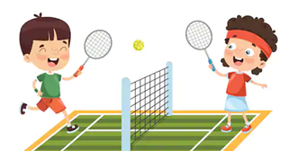
Les sports
Écrire
Write a sentence to describe what these people did on their holidays. Notice some pictures have one person and some have more than one, so use the correct part of avoir.
1
2
3
4
5
6
Emma Marsden / Victoria Hobson
Notes:
Consider modelling a worked example on the board and reminding the students this activity is about choosing the correct part of avoir plus the verb as a past participle.
At the very least, pupils should be able to write the auxiliary, plus some other parts of the sentence. Pupils should first try to write what they can and leave blanks, e.g. for any of the lexical verbs they don't know. This shows them what they don't know, a learning process known as "noticing the gap". The aim is to 'force recall', by not giving them all the language that they can then just manipulate mechanically. They have to 'pull out' the language from their memories. Teachers may decide that some learners will need the prompts on the next slide.

Slide 15
Écrire
Need help?
Vocabulaire
jouer au foot | to play football
jouer au tennis | to play tennis
jouer au golf | to play golf
faire de la planche à voile | to windsurf
faire du ski | to ski
nager dans la mer | to swim in the sea
Emma Marsden / Victoria Hobson

Slide 16
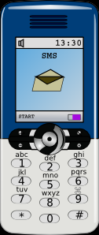
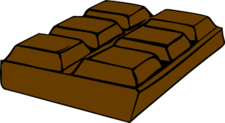
French Blank Template
Parler et écouter
French Blank Template
C’est énervant
Partner A: Tell your partner about what your family did last week. Sometimes you talk about what one person did, sometimes about more than one person. Your partner makes notes.
1 | Mes frères |  | parlé au trop longtemps.
2 | Mes parents |  | écouté de terrible.
3 | Mes grandparents |  | regardé ennuyeux.
4 | Ma soeur |  | invité les amies à .
5 | Mon frère |  | mangé tout .
Emma Marsden / Victoria Hobson
Notes:
Teacher note 1: It will never be possible to control for all the words that the learners don’t know in production activities (without giving learners a full writing frame, but such frames don’t push them to recall words and are unlikely to help create that ‘desirable difficulty’). The aim here is to focus on producing ‘a’ or ‘ont’ in order to express meaning so their partner can understand. They would probably have met the nouns before. If not, they are provided on the next slide for those who need support or could be learnt or revised quickly before this activity (they are almost all cognates with English). They may not have been taught mon/ma/mes at this stage, but it is unlikely that they won’t understand what they mean, and they are not having to produce them independently, as the focus here in firmly on the auxiliary.
Teacher note 2: It is also impossible in French to get rid of ALL other cues to who did an action, as the subject is obligatory in French (except in imperatives). So, in this example, the partner who is listening (partner B) might spot the difference between ‘mes’ and ‘mon/ma’and use that to work out who did the activity! It is unlikely because it comes right at the beginning of the sentence, but if they do, this is ok, and arguably a useful learning process too.
Verb frequency rankings (1 is the most common word in French): parler (106); écouter (429) regarder (425); inviter (624); (manger (1338).
Source: Londsale, D., & Le Bras, Y. (2009). A Frequency Dictionary of French: Core vocabulary for learners London: Routledge.

Slide 17
Parler et écouter
Need help?
Vocabulaire
téléphone / portable | phone
la musique | music
un film | a film
la maison | the house
le chocolat | chocolate
Emma Marsden / Victoria Hobson
Notes:
Re-order the slides or duplicate as necessary to print the combination of slides you want. Printing 2 to a page means that, once cut, they are the correct size to glue into exercise books and cuts down on the number of pages needed since 2 fit to a page.

Slide 18
French Blank Template
Parler et écouter
French Blank Template
C’est énervant
Partner B response grid Write down the detail of what your partner tells you.
 | Activity? | Who? | One person (1) or more than one >1)?
1
2
3
4
5
Emma Marsden / Victoria Hobson

Slide 19
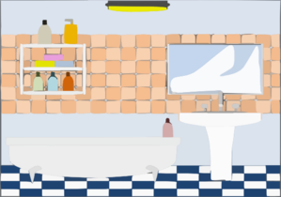
French Blank Template
Parler et écouter
C’est énervant
Partner B: Tell your partner about what your family did last week. Sometimes you talk about what one person did, sometimes about more than one person. Your partner makes notes.
1 | Mes soeurs |  | pris trop de temps dans .
2 | Mes parents |  | utilisé ma .
3 | Mes grandparents |  | passé beaucoup de temps dans .
4 | Ma soeur |  | mangé toute .
5 | Mon frère |  | regardé terrible.
Emma Marsden / Victoria Hobson

Slide 20
Parler et écouter
Need help?
Vocabulaire
la salle de bains | bathroom
tablette | tablet
le jardin | the garden
la pizza | the pizza
un film | a film
Emma Marsden / Victoria Hobson

Slide 21
French Blank Template
Parler et écouter
French Blank Template
Partner A response grid Write down the detail of what your partner tells you.
 | Activity? | Who? | One person (1) or more than one (>1)?
1
2
3
4
5
Emma Marsden / Victoria Hobson

