Slide 1
Grammar
MÖGEN - ich mag / du magst / er, sie, es mag
Y7 German
Term 2.1 - Week 3
Natalie Finlayson / Rachel Hawkes
Date updated: 14/01/19

Slide 2
mögen – to like, liking
Grammatik
Mögen ist an irregular verb used to talk about things you like and dislike.
Ich + mögen = ich mag. Du + mögen = du magst.
Remember!
To ask a yes/no question, swap the verb and subject.
Magst ___ Mathe, Mia?
du
Ja, ____ mag Mathe! Und du?
ich
To say you don’t like something, add nicht to the end of your statement.
Nein, ____ mag Mathe nicht!
ich
Notes:
Point out that students normally use the abbreviation Mathe, rather than the full form Mathematik.
Note: Students may wonder why nicht is used as a negation here rather than kein, as they have learned to negate nouns with kein. If asked, teacher explains that Ich mag kein Mathe is also correct, but less common (students have not yet learned that nouns used without articles may be negated using either nicht or kein. Nicht is chosen here as this is the more frequently used option).

Slide 3
Wer mag was?
hören
Wolfgang redet mit Mia über die Schule. Wer mag was?
ich
du
A
B
C
D
E
Notes:
In this listening exercise, students practise connecting the first and second person singular forms of mögen with the meaning. They also practise this week’s vocabulary, and revise use of nicht to make negative statements.
Teacher to highlight the plural forms of Fremdsprache and Naturwissenschaft used here. Teachers can relate this back to the rule for gender for most feminine nouns - add -n/-en.
Audio (with pronouns obscured) played on letter clicks.
Transcript
Note: the words in [ ] are not voiced. A. [Du] magst Naturwissenschaften nicht, aber [ich] mag Naturwissenschaften.
B. [Ich] mag Fremdsprachen nicht, aber [du] magst Fremdsprachen.
C. [Du] magst Kunst. [Ich] mag auch Kunst.
D. [Ich] mag den Lehrer. [Du] magst den Lehrer nicht.
E. [Du] magst Deutsch. [Ich] mag Deutsch leider nicht.
Note: If teachers have time, they could pick up on ‘leider’ from sentence E and elicit its meaning from students. It was revised for last lesson, but is one of those HF words that easily slips off the radar.

Slide 4
Wer mag was? (Antworten)
hören
Wolfgang redet mit Mia über die Schule. Wer mag was?
ich
du
A
✔
✖
B
✖
✔
C
✔
✔
D
✔
✖
E
✖
✔
Notes:
Full audio (including pronouns) played on letter clicks.
Answers (in pairs) revealed on clicks.
Transcript A. Du magst Naturwissenschaften nicht, aber ich mag Naturwissenschaften.
B. Ich mag Fremdsprachen nicht, aber du magst Fremdsprachen.
C. Du magst Kunst. Ich mag auch Kunst.
D. Ich mag den Lehrer. Du magst den Lehrer nicht.
E. Du magst Deutsch. Ich mag Deutsch leider nicht.
Note: If teachers have time, they could pick up on ‘leider’ from sentence E and elicit its meaning from students. It was revised for last lesson, but is one of those HF words that easily slips off the radar.

Slide 5
mögen – to like, liking
Grammatik
As you know, mögen is an irregular verb:
Ich mag Deutsch. (I like German). Du magst Deutsch. (You like German).
To say er/sie/es/name + mögen:
Er mag (he/it likes) Sie mag (she/it likes) Es mag ( it likes ) Mia mag (Mia likes)
The first and third person singular forms of mögen are identical.
Ich mag Deutsch. Mia mag Deutsch.
____ ____
____ ____
___ ___
___ ___
___ ___
___ ___

Slide 6
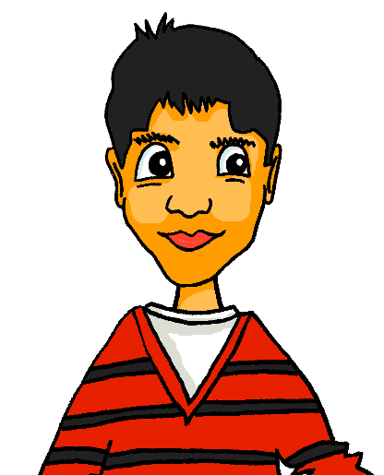
Das ist meine Schwester
lesen
Wolfgang introduces Mehmet to Mia. He does not think they will get on!
Wer mag was? Schreib du (Max) oder sie (Mia).
Das ist meine Schwester, Mia. Sie mag Mathe und Fremdsprachen. Du magst Naturwissenschaften und Kunst, nicht wahr? Magst du auch Fremdsprachen?
Du magst Rammstein. Sie mag Rockmusik nicht. Sie mag Popmusik! Ich verstehe es nicht.
Magst du Sport? Du magst Fußball, oder? Sie mag Fußball aber Sie mag Tennis nicht.
___
___
___
___
___
___
___
___
___
___
Notes:
Students can check their answers by listening to the recording of the text, which plays on clicking the speaker icon (pronouns included).
Answers revealed individually on clicks. These can be revealed while the audio plays. The audio is in two parts, for convenience.
Teacher to draw attention to use of oder? instead of nicht wahr?
Teacher to explain the use of es in Ich verstehe es nicht. Here, es does not refer to a neuter subject or object, but to a general idea, ‘it’. Students have encountered this before in structures such as Ist es warm/kalt heute and Wie geht es dir?

Slide 7
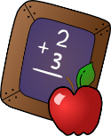
Und was magst du (nicht)?
sprechen / schreiben
Was mag dein Partner / deine Partner? Rede zusammen und schreib sechs Sätze.
1. _____________________________ 2. _____________________________
3. _____________________________ 4. _____________________________
5. _____________________________ 6. _____________________________
Magst du Sport?
Ja, ich mag Sport!
Mia mag Sport.
Notes:
In this exercise, students bring together the first, second and third person forms of mögen, and practise speaking and writing this week’s vocabulary.
The slide can be printed and given to pupils, or they can simply complete in their workbooks.
On completion, teacher can elicit oral responses, e.g. ‘Mag Mary Musik? Ja, Mary mag Musik‘ etc.

