Slide 1
Staying with a family in Germany
HABEN vs SEIN present (all persons)
Sie (you, formal) vs du
SSC [u] vs [ü]
Y8 German
Term 1.1 - Week 3 - Lesson 5
Natalie Finlayson / Rachel Hawkes
Artwork: Steve Clarke
Date updated: 10 / 08 / 21
Notes:
Learning outcomes (lesson 1):
Revision of SSCs [u] and [ü]
Revision of present tense forms of haben and sein (all persons)
Introduction of pronoun Sie
Word frequency (1 is the most frequent word in German):
8.1.1.3 (introduce) gefunden [103] Sie [10] Bad [1577] Brief [813] Hunger [2097] Kaffee [1299] Küche [960] Lust [1407] Schmerz [1483] Wohnung [418] müde [2000] noch¹ [33] oben [100] unten [590]
7.3.2.6 (revisit) Bahnhof [1953] Fluss [1551] Karte¹ [1191] an¹ [19] zwanzig [1030] dreißig [1456] dreizehn [3429] sechzehn [2859] siebzehn [3345] zweiundzwanzig [79/2/1032] einunddreißig [5/2/1458]
7.3.1.3 (revisit) fallen [278] springen [1468] Geschäft¹ [663] Kino [1825] Konzert [1721] Markt [508] Museum [1360] Party [3634] Stadt [186] Straße [355] angenehm [1748] in [4], auf¹ [17]

Slide 2
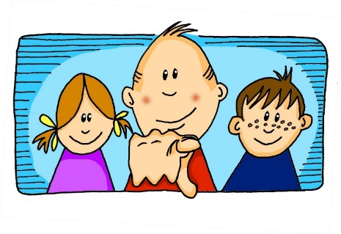
Phonetik
hören / schreiben
u
u
du
Punkt
ü
ü
Tür
fünf
Notes:
Timing: 1 minute Aim: To introduce/consolidate SSC long and short [u] and [ü] Procedure: 1. Present the letter(s) and say the [u] sound first, on its own. Students repeat it with you. 2. Bring up the source word ”du” on its own, say it, students repeat it, so that they have the opportunity to focus all of their attention on the connection between the written word and its sound.
3. A possible gesture for this would be to point out directly in front of you.
4. Repeat for the other three source words, with gesture suggestions as follows: short [u] - mime putting a full stop with your index finger in the air (point away from yourself, with a quick jabbing motion). long [ü] – hold both hands touching in front of your body, palms facing inward, thumbs to the ceiling. Then, with the right hand, mime a door opening by drawing it away from the left so that it finishes at a right angle, like a fully open door.
short [ü] - hold up your right hand, five digits spread apart.
Word frequency (1 is the most frequent word in German): du [52]; Punkt [427] Tür [400] fünf [272]
Source: Jones, R.L. & Tschirner, E. (2006). A frequency dictionary of German: core vocabulary for learners. Routledge

Slide 3
Phonetik
hören / schreiben
Hör zu. Schreib das Wort.
[u] du
[u] Punkt
1
absolut
unten
2
tun
nutzen
3
4
[ü] Tür
[ü] fünf
5
über
Glück
6
Küche
Rücken
7
8
Notes:
Timing: 4 minutes Aim: To practise SSC long and short [u] and [ü] Procedure: 1. Draw a 2 x 2 and write the source words. 2. Click to listen and write each word into the correct square. 3. Click to hear and see and word again. NB: Words will appear on clicks, so take care that the mouse is on action button when you click for audio (or the answers will appear too soon). Word frequency (1 is the most frequent word in German): absolut [993] tun [140];
unten [590] nutzen [463]; Küche [960]; über [48] Rücken [914] Glück [763];
Source: Jones, R.L. & Tschirner, E. (2006). A frequency dictionary of German: core vocabulary for learners. Routledge

Slide 4
Mütter und Brüder
sprechen
As you know, German vowels can be long or short.
Vowels followed by more than one consonant are short.
Other vowels are long.
Two important nouns Mutter and Bruder form their plurals by changing [u] → [ü].
[u]
Bruder
Mutter
long
short
Zungenbrecher!
Uschi’s Mutter Ute hat fünfundfünfzig Brüder!
Brüder
Mütter
[ü]
Notes:
Timing: 2 minutes Aim: To revise spelling rules governing vowel pronunciation, and to highlight the change in meaning that occurs when [u] becomes [ü] in the plural form of some high frequency nouns.

Slide 5
Finde die Fliege!
hören
Der Frosch hat Hunger! Er sucht eine Fliege. Kannst du helfen?
Beispiel
Was hörst du? Eine Person (1) oder zwei/viele Personen (2⁺)?
Wo bist du? Hast du eine
Fliege gefunden?
J
Mütter, Bruder
1
1
2⁺
H
2⁺
Z
1
2⁺
I
Notes:
Timing: 6 minutes for 3 slides Aim: To distinguish aurally between [u] and [ü], and to connect this difference in sound with a change in meaning (singular/plural). Procedure: 1. Use this example to prepare students for the full game on the slide that follows.
2. Explain to students that they will hear a ‘code’ in German which will direct them to the lily pad where the fly is. The ‘code’ will be two words long in the example (five words long in the game) and will consist of a mix of singular and plural forms of Mutter and Bruder. If they hear the singular form (no umlaut) they should follow the arrow labelled ‘1’. If they hear the plural form (with an umlaut), they should follow the arrow labelled ‘2⁺’.
3. Click on the arrow to hear the code.
4. Students hear Mütter. Starting on the lily pad with the frog on it, they move down one lily pad, following the ‘2⁺’ arrow. They then hear Bruder and move left one lily pad, following the ‘1’ arrow, hopefully ending on lily pad ‘Z’.
5. Click to reveal a transcript so that students can check their answer. Ask ‘Wo bist du’ to elicit (in German!) a letter.
6. Click on the lily pad with the letter the students call out. If they are correct, the lily pad disappears to reveal a fly. If they are incorrect, the lily pad disappears to reveal a net.
Transcript:
Mütter, Bruder

Slide 6
Finde die Fliege!
L
1
2⁺
K
hören / sprechen
2⁺
2⁺
2⁺
A
1
1
1
1
J
1
2⁺
1
1
1
B
2⁺
1
2⁺
2⁺
2⁺
Q
1
2⁺
1
1
C
2⁺
1
1
2⁺
M
2⁺
1
2⁺
2⁺
1
2⁺
1
2⁺
1
1
2⁺
P
1
2⁺
2⁺
D
1
Z
2⁺
1
2⁺
G
2⁺
1
1
2⁺
E
X
F
1
Notes:
Aim: To distinguish aurally and orally between [u] and [ü], and to connect this difference in sound with a change in meaning (singular/plural). Procedure: 1. Explain to students that they are now going to hear three longer codes consisting of five words (singular and plural forms of Bruder and Mutter).
2. Click on ‘1’ to play the first code. Starting on the lily pad with the frog on it, students trace the route with their fingers, or mini versions of the slide can be printed to trace with a pen.
3. Play the audio for a second time if necessary.
4. Ask ‘wo bist du?’ to elicit letters from the class.
5. Click on the lily pad to reveal whether the students were correct (fly) or incorrect (net).
6. Repeat steps 2-5 for the second and third codes (on the next two slides).
7. Now tell students they are going to work with a partner to direct them to a lily pad of their choice using a similar code. Give students 30 seconds to write down three codes using Bruder, Mutter, Brüder and Mütter.
8. Students take turns to read out their codes to their partner, and ask ‘wo bist du?’
Transcript: 1. Bruder, Mütter, Bruder, Mütter, Brüder (Answer = Q)

Slide 7
Finde die Fliege!
L
1
2⁺
K
hören / sprechen
2⁺
2⁺
2⁺
A
1
1
1
1
J
1
2⁺
1
1
1
B
2⁺
1
2⁺
2⁺
2⁺
Q
1
2⁺
1
1
C
2⁺
1
1
2⁺
M
2⁺
1
2⁺
2⁺
1
2⁺
1
2⁺
1
1
2⁺
P
1
2⁺
2⁺
D
1
Z
2⁺
1
2⁺
G
2⁺
1
1
2⁺
E
X
F
2
Notes:
This is part 2 of the activity outlined on slide 20.
Transcript:
Brüder, Mutter, Bruder, Mutter, Brüder (Answer = C)

Slide 8
Finde die Fliege!
L
1
2⁺
K
hören / sprechen
2⁺
2⁺
2⁺
A
1
1
1
1
J
1
2⁺
1
1
1
B
2⁺
1
2⁺
2⁺
2⁺
Q
1
2⁺
1
1
C
2⁺
1
1
2⁺
M
2⁺
1
2⁺
2⁺
1
2⁺
1
2⁺
1
1
2⁺
P
1
2⁺
2⁺
D
1
Z
2⁺
1
2⁺
G
2⁺
1
1
2⁺
E
X
F
3
Notes:
This is part 3 of the activity outlined on slide 20.
Transcript:
Mutter, Brüder, Mütter, Brüder, Mutter (Answer = F)

Slide 9
Haben oder sein?
Grammatik
As you know, haben means to have, having.
However, certain expressions with haben translate differently.
Compare:
Ich habe Hunger.
I am hungry.
Du hast Angst.
You are scared.
Sie hat Schmerzen.
She is in pain.
Wir haben Lust, …
We feel like, are keen to
Notes:
Timing: 3 minutes Aim: To introduce three further idiomatic uses of haben, and revisit Angst haben from Year 7.
Procedure: 1. Click through the animated explanation, eliciting the English when students know it.

Slide 10
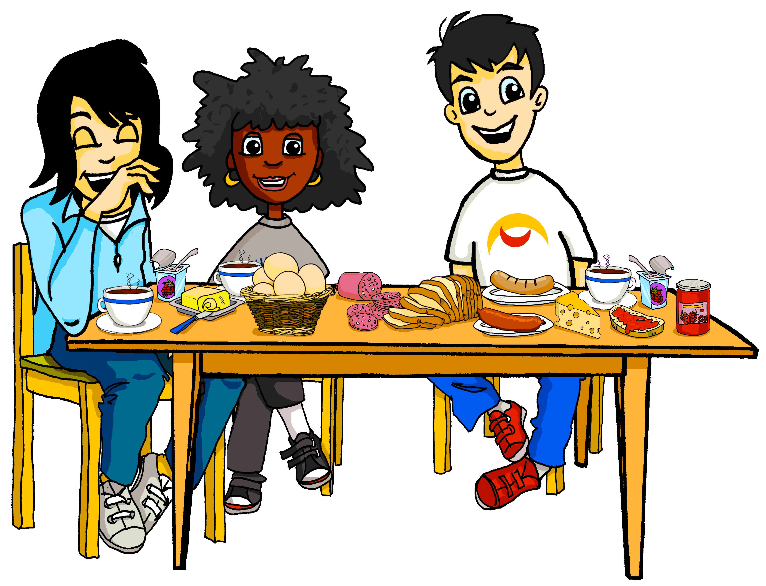
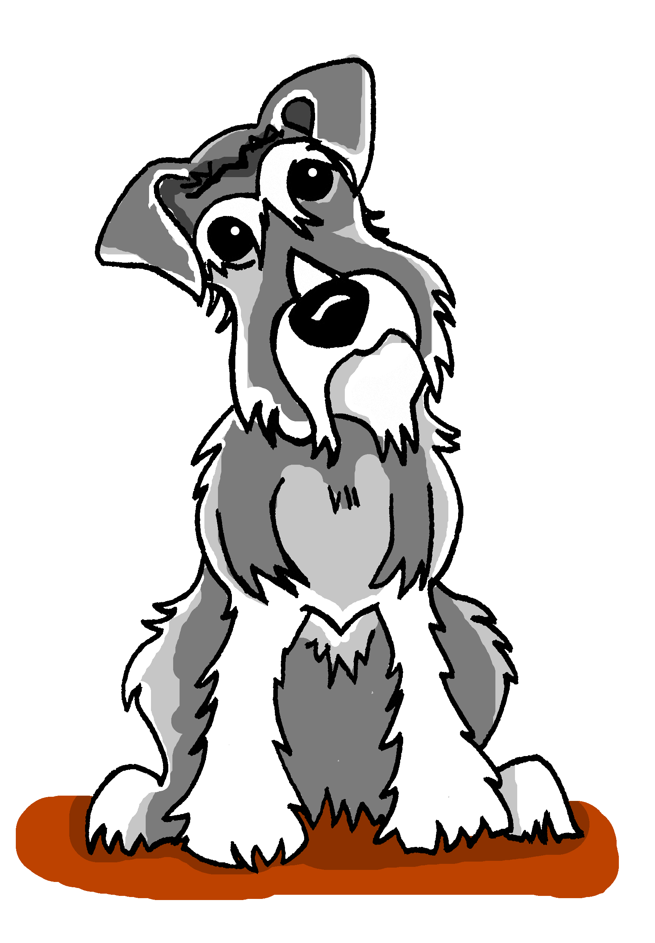
So viele Fragen!
Lesen
Bist du traurig ohne deine Mutter?
Hast du noch Hunger?
Hallo, Andrea! Bist du noch müde?
Und hast du gut geschlafen?
Sag mal, hast du Lust, Berlin zu sehen?
Hast du Angst vor Einstein*?
_____
_____
_____
_____
_____
_____
Wolfgang und Mias Mutter hat viele Fragen für Andrea. Schreib 1-6 und das Verb.
*Einstein ist der Hund.
Notes:
Timing: 3 minutes Aim: To practise differentiating between the uses of haben and sein, including its use in new expressions..
Procedure: 1. Click to bring up each question. Students decide which verb is correct. 2. Translate each question into English (orally or in written form).
Answers: 1. Bist du noch müde? 2. Hast du gut geschlafen? 3. Hast du Angst vor Einstein? 4. Hast du noch Hunger? 5. Bist du traurig ohne deine Mutti? 6. Hast du Lust, Berlin zu sehen?

Slide 11
Vokabel-Domino
lesen
Ich habe
Du bist
⁻1
Haben oder sein?
Finde die Paare und gewinne das Spiel!
⁺1
Ich habe
Wir sind
Richtig!
Hunger haben
eine Frau
Hunger
Falsch!
Hunger haben
Notes:
Timing: 10 minutes This slides models the activity Aim: To consolidate this week’s vocabulary set, revise forms and uses of haben and sein and revisit some Year 7 vocabulary. Procedure: 1. Click through to demonstrate a correct placement and an incorrect one. 2. Proceed to the next six slides to revisit the vocabulary. 8.1.1.3 (introduce) gefunden [103] Sie [10] Bad [1577] Brief [813] Hunger [2097] Kaffee [1299] Küche [960] Lust [1407] Schmerz [1483] Wohnung [418] müde [2000] noch¹ [33] oben [100] unten [590]
7.3.2.6 (revisit) Bahnhof [1953] Fluss [1551] Karte¹ [1191] an¹ [19] zwanzig [1030] dreißig [1456] dreizehn [3429] sechzehn [2859] siebzehn [3345] zweiundzwanzig [79/2/1032] einunddreißig [5/2/1458]
7.3.1.3 (revisit) fallen [278] springen [1468] Geschäft¹ [663] Kino [1825] Konzert [1721] Markt [508] Museum [1360] Party [3634] Stadt [186] Straße [355] angenehm [1748] in [4], auf¹ [17]

Slide 12
Vokabel-Domino [1/6]
lesen
Haben oder sein?
Finde die Paare und gewinne das Spiel!
1
2
Sie hat
Wir sind
Er hat
Ich bin
gesund
gefunden
Er hat
Ich bin
Hunger
unten
3
4
Er hat
Ich bin
Notes:
[1] Aim: To consolidate this week’s vocabulary set, revise forms and uses of haben and sein. Procedure: 1. Click through three dominoes. Elicit the English meanings of the collocations. i.e., Wir haben Kaffee. Er ist ein Mann. 2. Click to bring up a new domino in the game and some numbered outlines. 3. Ask students to think where it could go and to write down all the numbers that are possible. 4. Answers appear on next clicks. 5. Repeat for next five slides. Note: the dominoes can rotate 90 degrees in either direction but they can’t be turned upside down! 8.1.1.3 (introduce) gefunden [103] Sie [10] Bad [1577] Brief [813] Hunger [2097] Kaffee [1299] Küche [960] Lust [1407] Schmerz [1483] Wohnung [418] müde [2000] noch¹ [33] oben [100] unten [590]
7.3.2.6 (revisit) Bahnhof [1953] Fluss [1551] Karte¹ [1191] an¹ [19] zwanzig [1030] dreißig [1456] dreizehn [3429] sechzehn [2859] siebzehn [3345] zweiundzwanzig [79/2/1032] einunddreißig [5/2/1458]
7.3.1.3 (revisit) fallen [278] springen [1468] Geschäft¹ [663] Kino [1825] Konzert [1721] Markt [508] Museum [1360] Party [3634] Stadt [186] Straße [355] angenehm [1748] in [4], auf¹ [17]

Slide 13
Vokabel-Domino [2/6]
2
1
Du hast
Er ist
ein Mann
3
Ich bin
Wir haben
Kaffee
Lust
müde
4
5
Lust
müde
müde
müde
Lust
Lust
Notes:
[2]

Slide 14
Vokabel-Domino [3/5]
lesen
1
2
eine Küche
Sie sind
Du hast
eine Wohnung
oben
Angst
Er hat
Ich habe
Angst
eine Wohnung
3
4
Angst
eine Wohnung
Angst
eine Wohnung
5
Angst
eine Wohnung
Notes:
[3]

Slide 15
Vokabel-Domino [4/5]
lesen
1
2
Sie haben
Sie ist
schön
Schmerzen
schön
Schmerzen
ein Bad
eine Frau
3
Ich habe
4
Du bist
schön
Schmerzen
5
schön
Schmerzen
Notes:
[4]

Slide 16
Vokabel-Domino [5/5]
lesen
1
Sie sind
einen Brief
Sie ist
nett
Ich habe
schön
2
Du bist
Sie haben
3
gegessen
traurig
nett
einen Brief
Sie hat
Wir sind
4
5
nett
einen Brief
Notes:
[5]

Slide 17
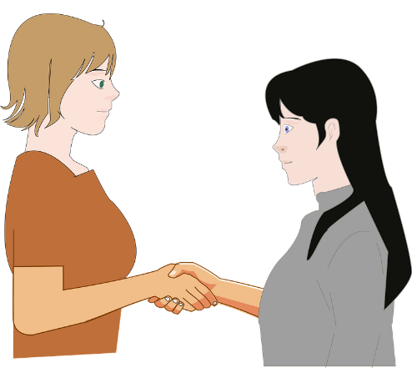
Talking to people you don’t know
Grammatik
As you know, the German word for ‘you’ is du. Verbs with du end in –st:
Du bist müde. You are tired. Hast du Haustiere? Do you have pets?
We use du to talk to friends, family, other children and other people we know well.
When we want to speak to adults we don’t know, we use a different word for ‘you’:
Sie – formal you
Sie is written with capital letter to show politeness and respect.
Verbs with Sie are in the infinitive (dictionary) form.
Sie sind müde. You (formal) are tired. Haben Sie Haustiere? Do you (formal) have pets?
____________
_______________
____________
_________________
Notes:
Timing: 3 minutes Aim: To revise 2nd person singular and 3rd person plural forms of sein and haben and to connect these with new meanings (formal and informal address).

Slide 18
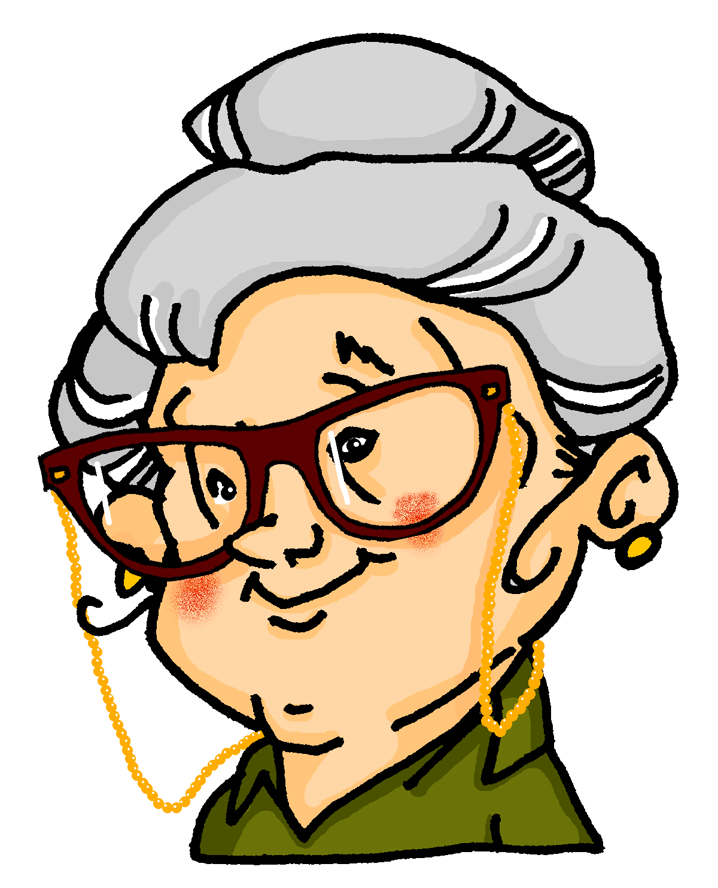
Wie ist die Gastfamilie?
hören
Andrea will etwas über ihre Gastfamilie wissen. Sie hat viele Fragen für Wolfgang und Oma!
Mit wem redet Andrea?
Mit Wolfgang (du) oder mit Oma (Sie?)
 |  | Wolfgang (du) | Oma (Sie)
 | Haben
 | Hast
 | Sind
te | Haben
 | Bist
 | Hast
 | Sind
 | Bist
1
2
3
4
5
6
7
8
Notes:
Timing: 6 minutes Aim: To distinguish orally between hast/haben and bist/sind in questions, and to connect these forms with meaning (formal and familiar you). Procedure: 1. Check that students understand the word Gastfamilie. Students met Gast [576] as a cluster word in Year 7, and they should also be able to work out the meaning from context.
2. Students write 1-8 in their books.
3. Click on the numbers to hear questions beginning with the pronoun obscured.
4. Students must listen to the form of the verb they hear after the beep to decide whether the question is addressed to Wolfgang (du), or Oma (Sie).
5. On a click, a transcription of the verb appears so that students can check their answer. On another click, the answer appears.
6. Elicit oral translations of the full questions. The full audio (with pronouns included) is provided on the next slide.
Transcript: 1. Haben [Sie] Haustiere?
2. Hast [du] eine Katze?
3. Sind [Sie] müde?
4. Haben [Sie] schon gegessen?
5. Bist [du] glücklich?
6. Hast [du] das Geschenk gefunden?
7. Sind [Sie] streng?
8. Bist [du] dreizehn? Word frequency of near-cognates used (1 is the most frequent word in German): Gast [576] Source: Jones, R.L. & Tschirner, E. (2006). A frequency dictionary of German: core vocabulary for learners. Routledge

Slide 19
Wie ist die Gastfamilie?
hören
Andrea will mehr über ihre Gastfamilie wissen. Sie hat viele Fragen für Wolfgang und Oma!
Mit wem redet Andrea?
Mit Wolfgang (du) oder mit Oma (Sie?)
 |  | Wolfgang (du) | Oma (Sie)
 | Haben
 | Hast
 | Sind
te | Haben
 | Bist
 | Hast
 | Sind
 | Bist
1
2
3
4
5
6
7
8
Notes:
Answer slides for the activity on the previous slide.
Full audio (without beeps) plays on number clicks.
Transcript: 1. Haben Sie Haustiere?
2. Hast du eine Katze?
3. Sind Sie müde?
4. Haben Sie schon gegessen?
5. Bist du glücklich?
6. Hast du das Geschenk gefunden?
7. Sind Sie streng?
8. Bist du dreizehn?

Slide 20
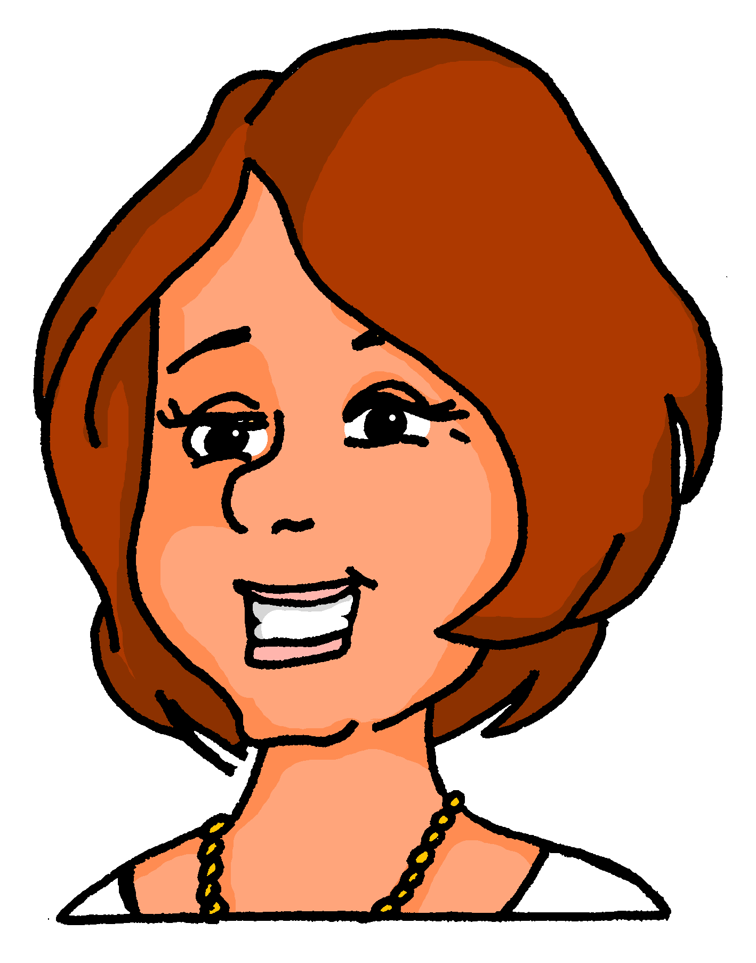
Mia schreibt E-Mails
lesen
Mia sitzt oben und schreibt E-Mails. Schreibt sie mit Katja (du) oder mit Katjas Mutter (Sie)?
An:
Katja.Nowak@hallo.de; Z.Nowak@hallo.de
Betreffs:
Party!
/
Magst du Jazzmusik?
Darfst du spät ins Bett gehen?
Benutzen Sie am Samstagabend die Küche?
Wir tanzen viel. Werden Sie leicht müde?
Können Sie am Samstagmorgen das Bad putzen?
Die Gäste kommen um 20.00. Wie findest du das?
Ich gehe später zum Geschäft. Brauchen Sie etwas?
Ich nehme den Zug. Kannst du zum Bahnhof kommen?
__
Wir planen eine Party für Katja! Sie wird dreizehn!
__
/
__
/
__
/
__
/
__
/
__
/
__
/
Notes:
Timing: 6 minutes Aim: To distinguish between informal and formal address by looking at the form of verbs other than haben and sein. Procedure: 1. Students write 1-8 in their books.
2. Students must look at the verb form to decide whether Mia is writing to Katja (du), or Katja’s mother (Sie).
3. Answers appear on clicks.
4. Elicit oral translations of the questions.
Word frequency of cognates used (1 is the most frequent word in German): E-Mail [2172], planen [579] Source: Jones, R.L. & Tschirner, E. (2006). A frequency dictionary of German: core vocabulary for learners. Routledge

Slide 21
Wie geht’s? [1/2]
sprechen
Du oder Sie?
Sind Sie müde?
Nein, ich bin nicht müde.
Partner A
Partner B
Notes:
Timing: 8 minutes Aim: To practise asking questions with formal and informal you, and to practise using structures with haben and sein in the affirmative and negative. Procedure: 1. Partner A decides that s/he is talking to an older person or a friend, and uses the formal or informal form of haben or sein to ask the question. 2. Partner B listens and responds according to the indicated answer, as in the example modelled here. 3. Then do the same process with the other five sets of pictures. Note that the sets of pictures are not numbered so that students also have to understand the vocabulary.
On the next slide students swap roles. Word frequency (1 is the most frequent word in German): Source: Jones, R.L. & Tschirner, E. (2006). A frequency dictionary of German: core vocabulary for learners. Routledge

Slide 22
Wie geht’s? [2/2]
sprechen
Du oder Sie?
Hast du Schmerzen?
Nein, ich habe keine Schmerzen.
Partner B
Partner A
Notes:
Note: the cues have been jumbled.

Slide 23
Staying with a family in Germany
Infinitive clauses with 'zu’
Compound nouns
Y8 German
Term 1.1 - Week 3 - Lesson 6
Natalie Finlayson / Rachel Hawkes
Artwork: Steve Clarke
Date updated: 25/09/20
Notes:
Learning outcomes (lesson 1):
Revision of SSCs [u] and [ü]
Revision of present tense forms of haben and sein (all persons)
Consolidation of pronoun Sie
Infinitive clauses with ‘zu’
Introduction to compound noun formation
Word frequency (1 is the most frequent word in German):
8.1.1.3 (introduce) gefunden [103] Sie [10] Bad [1577] Brief [813] Hunger [2097] Kaffee [1299] Küche [960] Lust [1407] Schmerz [1483] Wohnung [418] müde [2000] noch¹ [33] oben [100] unten [590]
7.3.2.6 (revisit) Bahnhof [1953] Fluss [1551] Karte¹ [1191] an¹ [19] zwanzig [1030] dreißig [1456] dreizehn [3429] sechzehn [2859] siebzehn [3345] zweiundzwanzig [79/2/1032] einunddreißig [5/2/1458]
7.3.1.3 (revisit) fallen [278] springen [1468] Geschäft¹ [663] Kino [1825] Konzert [1721] Markt [508] Museum [1360] Party [3634] Stadt [186] Straße [355] angenehm [1748] in [4], auf¹ [17]

Slide 24
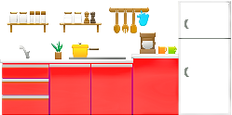
[u] oder [ü] im Plural?
hören
 |  | same | different
As you know, Mutter and Bruder add an umlaut in the plural form:
eine Mutter, zwei Mütter
ein Bruder, zwei Brüder
Some nouns with [u] add umlaut + e in plural. Others add only +e. Some don’t change at all.
Listen and decide whether the vowel changes in plural.
1
2
3
4
5
6
7
8
Notes:
Timing: 5 minutes Aim: to distinguish aurally between SSCs [ü] and [u], and revise plural formation patterns. Procedure: 1. Students write 1-8 in their books.
2. Click on a number to hear nouns said in the singular and plural.
3. Students listen to see whether the SSCs are the same or different.
4. Click to reveal
Transcript: 1. die Kunst, die Künste
2. die Küche, die Küchen
3. der Bus, die Busse
4. der Fluss, die Flüsse
5. die Küste, die Küsten
6. der Kuss, die Küsse
7. die Nuss, die Nüsse
8. der Hummer, die Hummer Word frequency (1 is the most frequent word in German): Bus [1562], Fluss [1551], Hummer [>5000], Kunst [554], Küste [2628], Küche [960], Nuss [>5000] Source: Jones, R.L. & Tschirner, E. (2006). A frequency dictionary of German: core vocabulary for learners. Routledge

Slide 25
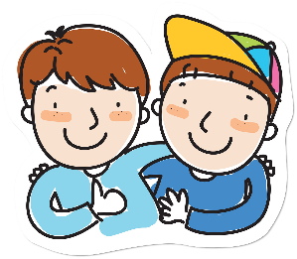
English → German → English
You can often make new nouns by joining two other nouns.
der Brief (letter) + der Freund (friend)
der Brieffreund (pen friend)
What would the following words be in German?
host dad / father
bedroom dining room
evening meal
Choose one and write a sentence in German.
Translate these sentences.
1. Meine Gastmutti ist sehr nett.
2. The living room is lovely.
Notes:
Timing: 8 minutes for two slides
Aim: Students following the NCELP SOW had a formal introduction to cognates in 7.2.2.3, and they had previously been taught the prefix ‘Lieblings-’ and combined it with several frequent nouns.
This task offers a further opportunity to practising recognising and producing compound nouns from familiar nouns and other cognates. It fits with the context of staying in a host family, at the start of the Y8 SOW. Word frequency: der Brief [838] der Freund [273] der Gast [576] die Mutter [218] der Vater [232] der Abend [342] das Brot [2095] das Essen [323-vb] das Zimmer [665] (Wohnzimmer / Schlafzimmer / Esszimmer)
Source: Jones, R.L. & Tschirner, E. (2019). A frequency dictionary of German: core vocabulary for learners. Routledge
[Friend] Image by eommina from Pixabay [Letter] Image by OpenClipart-Vectors from Pixabay
The main knowledge previously taught: 1] German combines nouns to make single, new words. 2] The gender of the new word is the gender of the final noun 3] Some additional letters can be required (the rules for these are complex and have many exceptions so will not be explicitly taught so students will not automatically be able to produce accurate new compound nouns themselves) 4] However, they will vastly increase their receptive vocabulary and often be able to comprehend compound nous, even if only one part is known, by using the surrounding context in addition. They should be encouraged, when faced with apparently unfamiliar, to try to separate them, as they may find they know both nouns, individually.

Slide 26
ANTWORTEN
Meine Gastmutti ist sehr nett.
The living room is lovely.
host dad/father
bedroom
dining room
evening meal
My host mum is very nice.
Das Wohnzimmer ist schön.
der Gastvati
das Schlafzimmer
das Esszimmer
das Abendessen
Verb stems are often used (without the -en).
What do you notice about the gender of these nouns?
The gender of the new noun is always the gender of the final noun.
Don’t forget to pronounce the words.
Notes:
Source: Jones, R.L. & Tschirner, E. (2019). A frequency dictionary of German: core vocabulary for learners. Routledge

Slide 27
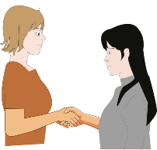
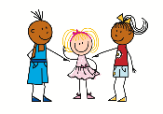
Sie, sie or sie?
Grammatik
As you know, Sie means ‘you’ (formal).
It sounds the same as sie (she).
You can tell who is being talked about by looking at the verb:
Sie sind groß! You (formal) are tall!
______ __________
Sie ist groß! She is tall!
____ ______
Notes:
Timing: 3 minutes (all three slides) Aim: To revise 3rd person singular and 3rd person plural forms of sein and haben and to distinguish between pronouns Sie, sie (she) and sie (they).

Slide 28
Sie, sie or sie?
Grammatik
Sie also sounds the same as sie (they!)
You can’t tell who is being talked about by looking at the verb, as it is in the infinitive with both sie and Sie:
You can tell who is being talked about by looking at the spelling: small ‘s’ vs capital ‘S’:
Wo sind sie? Where are they?
______ ________
Wo sind Sie? Where are you (formal) ?
_______ ____________

Slide 29
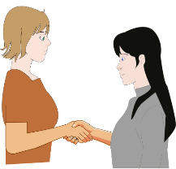
Sie, sie or sie?
Grammatik
This does not help you if Sie (formal) and sie (they) are at the start of a sentence, as both have a capital letter!
When this happens, you need to use other clues in the text to help you decide:
Sie sind nett! They are nice!
_______ ______
Sie sind nett! You (formal) are nice!
___________ ______

Slide 30
Wie ist die Gastfamilie?
hören
Andrea will noch etwas über ihre Gastfamilie wissen! Sie hat ein Paar fragen über Mia, und noch ein Paar Fragen für Oma.
Was will Andrea wissen? Etwas über Mia (sie) oder etwas über Oma (Sie)?
 |  | Mia (sie) | Oma (Sie)
 | Ist
 | Haben
 | Ist
te | Hat
 | Sind
 | Haben
 | Sind
 | Hat
1
2
3
4
5
6
7
8
Notes:
Timing: 6 minutes Aim: To distinguish orally between hat/haben and ist/sind in questions, and to connect these forms with meaning (formal and familiar). Procedure: 1. Students write 1-8 in their books.
2. Click on the numbers to hear questions.
3. Students must listen to the form of the verb they hear after the beep to decide whether Andrea is asking about Mia (sie), or Oma (Sie).
4. On a click, a transcription of the verb appears so that students can check their answer. On another click, the answer appears.
5. Elicit oral translations of the questions.
Transcript: 1. Ist sie nett?
2. Haben Sie Hunger?
3. Ist sie krank?
4. Hat sie Schmerzen?
5. Sind sie traurig?
6. Haben Sie eine Lieblingsband?
7. Sind Sie Sängerin?
8. Hat sie eine Gitarre?
Word frequency of near-cognates used (1 is the most frequent word in German): Gast [576] Source: Jones, R.L. & Tschirner, E. (2006). A frequency dictionary of German: core vocabulary for learners. Routledge

Slide 31
Ein Dankesbrief
lesen
Andrea hat einen Brief für Oma. Wer ist ‘Sie’? Wer ist ’sie’?
you (formal) | they | could be either
Liebe Frau X
1. Ich mag es hier und will Danke sagen. Ich finde Sie so nett!
2. Ich finde sie auch ganz toll! Wir haben viel Spaß zusammen.
3. Sie kochen so gut!
4. Die Wohnung ist perfekt. Ich denke, sie putzen oft!
5. Sie haben auch eine sehr schöne Katze!
6. Können sie nächstes Jahr zu mir in Cambridge kommen?
7. Morgen bekommen sie ein Geschenk aus England.
8. Und Sie bekommen auch ein Geschenk! Danke für alles ☺
Notes:
Timing: 6 minutes Aim: To apply knowledge of capitalisation rules to distinguish between Sie and sie (they), and draw attention to the fact that distinguishing between these at the beginning of a sentence is impossible without clear context. Procedure: 1. Check students understand the compound in the title. Explain that some compound nouns have a connecting letter in between, such as ‘s’ here.
2. Students write 1-8 in their books.
3. Using their knowledge of capitalisation rules, students decide whether Sie/sie means formal you, they or could be either.
4. Answers appear on clicks.
5. Elicit translations of sentences from students. Word frequency of near-cognates used (1 is the most frequent word in German): alles [alle – 36], perfekt [1567] Source: Jones, R.L. & Tschirner, E. (2006). A frequency dictionary of German: core vocabulary for learners. Routledge

Slide 32
zu + infinitive
Grammatik
You have seen how modal verbs work with a 2nd verb in the sentence:
All German modal verbs are followed directly by the infinitive.
Ich kann schwimmen.
I can swim. / I am able to swim.
A comma is often added to separate the verb phrases in zu + infinitive structures
I want to swim. / I am able to swim.
Ich will schwimmen.
With other verbs, we have to add zu when we use them with another verb in infinitive:
Ich habe keine Lust, zu arbeiten.
I don’t have any desire to work.
________.
Er vergisst immer, Kaffee zu kaufen.
He always forgets to buy coffee.
_____
Es ist wichtig, Deutsch zu lernen!
It is important to learn German!
________
Like in other two-verb structures, the second verb (with zu, in infinitive) is at the end.
Notes:
Timing: 3 minutes Aim: To introduce zu + infinitive structures, and illustrate the need for the addition of zu with comparison to modal verbs.

Slide 33
Ein Tag in der Stadt
hören
Mia und Andrea planen den Tag zusammen.
Was sagen sie?
 |  | wollen (want) | Lust haben (feel like)
 | machen
 | gehen
 | zu gehen
te | zu essen
 | essen
 | zu gehen
 | zu besuchen
 | zu lernen
1
2
3
4
5
6
7
8
Notes:
Timing: 6 minutes Aim: To distinguish orally between the use of modal verbs (wollen) and other verbs (haben) in two-verb structures by listening for the presence or absence of zu before the infinitive.
Procedure: 1. Students write 1-8 in their books.
2. Click on the numbers to hear sentences with the verb phrases obscured.
3. Students must listen for the presence of absence of zu to decide whether wollen or haben is used.
4. On a click, a transcription the verb phrase appears so that students can check their answer. On another click, the answer appears.
5. Elicit oral translations of the full questions. The full audio (with verb phrases included) is provided on the next slide.
Transcript: 1. Was [wollen wir] heute machen?
2. Gute Frage! [Ich will] ins Kino gehen.
3. Ja, okay, [ich habe Lust], in die Stadt zu gehen.
4. [Hast du auch Lust], Eis zu essen?
5. Mmmm nein, sorry, [ich will] Pizza essen.
6. [Ich habe Lust], in einen Restaurant zu gehen.
7. Okay, gute Idee! [Ich habe auch Lust], das Permagonmuseum zu besuchen.
8. Ach, nein, [ich habe keine Lust], am Wochenende zu lernen. Word frequency of near-cognates used (1 is the most frequent word in German): planen [579] Source: Jones, R.L. & Tschirner, E. (2006). A frequency dictionary of German: core vocabulary for learners. Routledge

Slide 34
Ein Tag in der Stadt
hören
Mia und Andrea planen den Tag zusammen.
Was sagen sie?
 |  | wollen (feel like) | Lust haben (feel like)
 | machen
 | gehen
 | zu gehen
te | zu essen
 | essen
 | zu gehen
 | zu besuchen
 | zu lernen
1
2
3
4
5
6
7
8
Notes:
Answer slides for the activity on the previous slide.
Full audio (without beeps) plays on number clicks.
Transcript: 1. Was wollen wir heute machen?
2. Gute Frage! Ich will ins Kino gehen.
3. Ja, okay, ich habe Lust, in die Stadt zu gehen.
4. Hast du auch Lust, Eis zu essen?
5. Mmmm nein, sorry, ich will Pizza essen.
6. Ich habe Lust, in einen Restaurant zu gehen.
7. Okay, gute Idee! Ich habe auch Lust, das Permagonmuseum zu besuchen.
8. Ach, nein, ich habe keine Lust, am Wochenende zu lernen. Word frequency of near-cognates used (1 is the most frequent word in German): planen [579] Source: Jones, R.L. & Tschirner, E. (2006). A frequency dictionary of German: core vocabulary for learners. Routledge

Slide 35
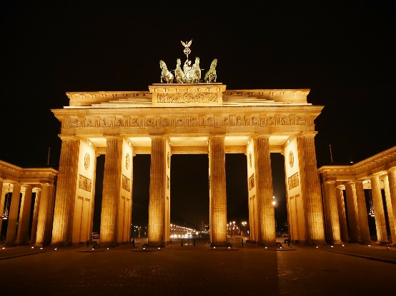
Eine Postkarte nach Hause
lesen
Andrea hat eine Postkarte für ihre Deutschlehrerin in Cambridge gekauft. Was schreibt sie?
Hallo Frau Hawkes!
1. Planst/Kannst du, nach Berlin zu kommen?
2. Die Stadt ist toll! Es gibt/du musst viel zu sehen.
3. Du wünschst dir/musst das Brandenburger Tor besuchen! Es ist so groß, und total schön!
4. Meine Gastfamilie ist sehr nett. Wolfgang und Mia helfen/wollen mir, Deutsch zu sprechen.
5. Heute schaffe/will ich auf den Markt gehen.
6. Wolfgang sagt, wir kochen/müssen eine Currywurst essen.
7. Ich vergesse/will nicht, meine Hausaufgaben zu machen!
8. Fahre/Darf ich nächstes Jahr nochmal nach Berlin reisen?? LG!
Das Brandenburger Tor ist ein Symbol für Berlin und Deutschland.
Notes:
Timing: 6 minutes Aim: To distinguish orally between the use of modal verbs and other verbs in two-verb structures by looking for the presence or absence of zu before the infinitive.
Procedure: 1. Students write 1-8 in their books.
2. Students must look for the presence of absence of zu before the infinitive, and decide based on this which verb completes the sentence,
3. Answers appear on clicks.
5. Elicit oral translations of the full sentences. Word frequency of near-cognates used (1 is the most frequent word in German): planen [579] Source: Jones, R.L. & Tschirner, E. (2006). A frequency dictionary of German: core vocabulary for learners. Routledge

Slide 36
Was sind deine Pläne?
schreiben
Und du? Was sind deine Pläne für den nächsten Urlaub? Schreib drei Sätze mit wollen und drei Sätze mit Lust haben.
1. Ich habe Lust, ….
Remember!
Both structures send the second verb (in infinitive) to the end of the sentence. Which one needs zu?
2. Ich will …
3.
4.
5.
6.
Notes:
Timing: 8 minutes Aim: Written practice in saying what you want to do using modal verbs and zu + infinitive structures. Procedure: 1. Work through one example of each kind of structure with the class.
2. Give students 3 minutes to write sentences of their own.
3. Give students 2 minutes to peer-correct with a partner.
4. Elicit some examples from students and add them to this slide. For an added challenge, ask students to read out their partner’s sentences in the third person.
Word frequency of near-cognates used (1 is the most frequent word in German): planen [954] Source: Jones, R.L. & Tschirner, E. (2006). A frequency dictionary of German: core vocabulary for learners. Routledge

Slide 37
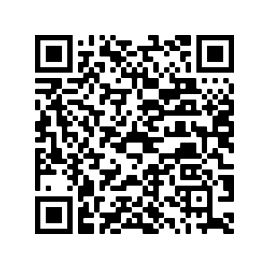
Hausaufgaben
Pre-learning for lesson: Year 7 Revision Mash up

