Slide 1
Vocabulary
Date updated: 26/11/2019
Nick Avery & Rachel Hawkes

Slide 2
Vocabulario
 | Español | Inglés
1 | hay | there is, there are
2 | la mesa | table
3 | la silla | chair
4 | la ventana | window
5 | la puerta | door
6 | la chica | girl
7 | el chico | boy
8 | aquí | here
9 | allí | there
10 | la persona | person
11 | la clase | class
60
Segundos
0
INICIO
Notes:
Vocabulary practice slide Pupils either work by themselves or in pairs, reading out the words and recapping their English meaning (1 minute). Then the English meanings are removed and they try to recall them, looking at the Spanish (1 minute). Then the Spanish meaning are removed and they to recall them, looking at the English (1 minute) Further rounds of learning can be facilitated by one pupil turning away from the board, and his/her partner asking him/her the meanings. This activity can work from L2 → L1 or L1 → L2.
Vocabulary frequency rankings (1 is the most common word in Spanish):
Numbers: hay [13]; mesa [525]; silla [1271]; ventana [752]; puerta [274]; chica [1129]; persona [108]; chico [727]; aquí [130]; allí [197]; clase [320]
Source: Davies, M. & Davies, K. (2018). A frequency dictionary of Spanish: Core vocabulary for learners (2nd ed.). London: Routledge.

Slide 3
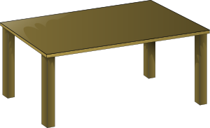
allí
la clase
la mesa
la puerta
aquí
la ventana
here
2
4
6
there
class
1
3
5
Notes:
Teacher elicits the vocabulary from students. Suggested routine:
Teacher: ¿Qué es el número 4’? Students: La mesa. Teacher: ¿Qué es el número 3’? Students: La clase. The number prompts are the trigger (i.e. click on the number) for the lines to connect the word to the picture.
This means that students are practising their understanding of a set of numbers at the same time.
You may need to hover the curser over the number until the hand icon appears before clicking. The teacher chooses which order to ask the numbers in – clearly, it would be easy to ask in numerical order, but this would be what students would naturally expect, so it reduces the need for them to listen attentively to them.
Pictures retrieved from www.clker.com (free to use)

Slide 4
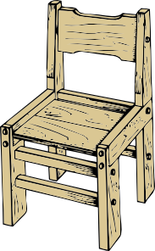
hay
el chico
la silla
la persona
la chica
9
7
10
8
11
there is, there are
person
Notes:
Pictures retrieved from www.clker.com (free to use)

Slide 5
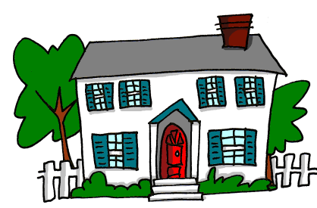
En la casa hay unas cosas.
Juan tiene una casa aquí, en Inglaterra.
Juan has a house here in England
__________________________________.
In the house there are some things
____________________________________.
Pero, ¿qué hay?
But what is there?
_________________
Notes:
Vocabulary revision task – the following slides can be used to elicit the translations of all 10 words taught this week.
This slide includes two new words from this week (aquí and hay).

Slide 6
¿Qué hay?
Hay…
una mesa
Notes:
Vocabulary revision task
Given that many of the items revisited here will be present in your classroom, you may wish to also do an interactive activity with classroom objects.
Ask ¿Qué hay? and ask students ‘¿Dónde? to elicit ‘aquí’ and ‘allí. Alternatively, you could ask ‘¿aquí?’ (pointing far away) so that students provide the correct answer (allí) and visa-versa.

Slide 7
¿Qué hay?
Hay…
una puerta
Notes:
Vocabulary revision task

Slide 8
¿Qué hay?
Hay…
una ventana
Notes:
Vocabulary revision task

Slide 9
¿Qué hay?
Hay…
una silla
Notes:
Vocabulary revision task

Slide 10
¡Tiene una casa en España también!
He has a house in Spain too!
______________________________
Hay unas personas allí.
There are some people there.
____________________________________
Pero, ¿quién está allí?
But who is there?
_________________
Notes:
Vocabulary revision
Elicit the translations. They include two new words from this week (aquí and hay).

Slide 11
¿Qué hay?
¿Cómo se dice en español?
‘He is strange’
Es raro.
Hay…
boy
un chico
Notes:
Vocabulary revision task
The speech bubble is included here because students will need to use ‘raro’ in a later activity in the sequence.

Slide 12
¿Qué hay?
¿Cómo se dice en español?
‘She is nice/friendly’
Es simpática.
Hay…
girl
una chica
Notes:
Vocabulary revision task
The speech bubble is included here because students will need to use ‘simpática’ in a later activity in the sequence.

Slide 13
¿Qué hay?
Hay…
a class
una clase
(¿Es normal?)
Notes:
Vocabulary revision task

