Slide 1
Practice assessment
Year 8 Spanish
Term 3 applying your knowledge test
Pete Watson / Nick Avery
Date updated: 07/06/21
Notes:
Artwork by Mark Davies. All additional pictures selected are available under a Creative Commons license, no attribution required.
Learning outcomes:
Familiarity with each part of the ‘applying your knowledge’ test.
Source: Davies, M. & Davies, K. (2018). A frequency dictionary of Spanish: Core vocabulary for learners (2nd ed.). Routledge: London
The frequency rankings for words that occur in this PowerPoint which have been previously introduced in NCELP resources are given in the NCELP SOW and in the resources that first introduced and formally re-visited those words.
For any other words that occur incidentally in this PowerPoint, frequency rankings will be provided in the notes field wherever possible.

Slide 2
Section A: Listening
There is one mark for each item.
PART A
You will hear Lucía talk about what she and Daniel enjoying doing during their holidays. Here are some activities she mentions (plus some that she does not mention!) You have 10 seconds to read the activities. Write one activity into each space in the grid below. You must decide who does the activity, and when.
You will hear the story twice, with a 20 second gap in between.
go to cinema read books buy presents visit museums go cycling go on a boat trip learn to horse ride do sport take art classes
When?
 | last year | normally | next year
Lucía | 1. Take art classes | goes out meets friends | 1. ___________________
Lucía and Daniel | 1. ____________________ |  | 1. travel to USA 2. ____________________
Who?
go on a boat trip
learn to horse ride
buy presents
Notes:
Timing: 5 minutes
Aim: practice listening task involving tense and verb form recognition
Procedure:
Read the instructions out to students. Note: In the actual test, the instructions will be part of the recording.
Click to show the marks available.
Click to speaker icon to play the recording. There will be a 20 second pause after the first reading of the text, and then the text will be heard again. There is no need to click the speaker button twice.
Click to show the answers one by one.
Transcript:
Durante las vacaciones yo salgo todos los días en mi ciudad, San Sebastián. Soy muy activa y además me gustan los deportes. Me encanta quedar con amigos en el parque o en el centro. Sin embargo, el año pasado monté a caballo con Daniel en el sur de Francia. También tomé clases de arte porque me interesa el dibujo y mi mamá ofreció pagar todo.
Pues, el verano próximo vamos a viajar a los Estados Unidos. Yo voy a hacer un viaje en barco pero a Daniel no le gusta mucho el mar, así que él va a visitar los museos de las ciudades. Vamos a comprar regalos para mis abuelos.

Slide 3
Section A: Listening
There is one mark for each item.
PART B
Now listen for a third time. Answer the questions in English.
 |  | Write as many details as you can (2 marks per question)
a) | Why does Lucía go out every day in the holidays?
b) | Why did Lucía take art classes?
She is very active.
She likes sports.
She is interested in drawing.
Her Mum offered to pay (for everything).
Notes:
Timing: 5 minutes
Aim: second listening comprehension task using the same text.
Procedure:
Read the instructions to the students. Click to show how many marks are available for each item.
Click the speaker icon to play the recording.
Click to show the answers one by one to allow teachers to elicit answers from the students.
Transcript:
Durante las vacaciones yo salgo todos los días en mi ciudad, San Sebastián. Soy muy activa y además me gustan los deportes. Me encanta quedar con amigos en el parque o en el centro. Sin embargo, el año pasado monté a caballo con Daniel en el sur de Francia. También tomé clases de arte porque me interesa el dibujo y mi mamá ofreció pagar todo.
Pues, el verano próximo vamos a viajar a los Estados Unidos. Yo voy a hacer un viaje en barco pero a Daniel no le gusta mucho el mar, así que él va a visitar los museos de las ciudades. Vamos a comprar regalos para mis abuelos.

Slide 4
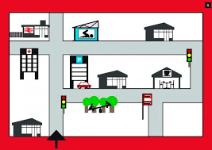
Section B: Reading comprehension
There is one mark for each item.
PART A The map isn’t very clear!
Read the text and write the English for the words in bold in the right places on the map.
1.
art museum
2.
cafe
tower
Hay muchos lugares interesantes en el pueblo. Por ejemplo, hay una torre antigua a la izquierda del café y delante del parque. También, hay un museo de arte. Está más lejos del parque que la torre.
park
Notes:
Timing: 4 minutes
Aim: reading comprehension practice task.
Procedure:
Click to show how many marks are available for the question and then again to reveal a short text.
Click again to show the answers for the two missing places.
Picture free from Clipart-library.com

Slide 5
Section B: Reading comprehension
There is one mark for each item.
Now read further details about the town and answer the questions that follow.
Es un pueblo muy tranquilo. No hay una estación de policía y no hay muchos coches. En marzo hay un concierto genial con músicos de toda España y en julio organizamos clases para aprender a bailar en parejas. Cerca del pueblo hay una isla preciosa. Puedes ir en barco y ver pájaros interesantes allí.
PART B
Put a tick next to the things that describe the town.
PART C
Number these events in the order they happen. Write numbers in the boxes on the right (1= happens first,
2 = happens second).
calm
police station
very few cars
no wildlife
2
Dance classes
Music concert
1
Notes:
Timing: 6 minutes
Aim: reading comprehension practice task.
Procedure:
Click to show how many marks are available for the question and then again to show the tables for the questions.
Click again to show the answers for the two tables in order.

Slide 6
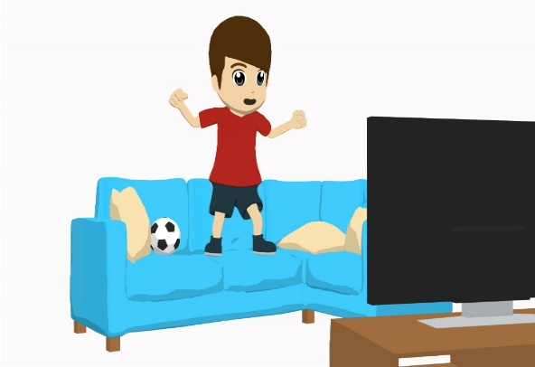
Section C: Writing
There is one mark for each item.
PART A Look at the picture and complete the missing words in the text.
The number of gaps tells you how many letters are missing.
Un sábado en casa
Esta tarde Daniel y Lucía están en casa. Lucía está aburrida porque d_ _ _
leer un libro de francés para los deberes. Sin embargo, Daniel está libre así que
p _ _ _ _ ver el partido de f_ _ _ _ _ en la televisión.
debe
puede
fútbol
Notes:
Timing: 4 minutes
Aim: writing practice exercise involving filling in gaps (some including a modal verb focus)
Procedure:
Click to show the marks for the exercise
Students fill in the gaps.
Answers are shown by clicking.

Slide 7
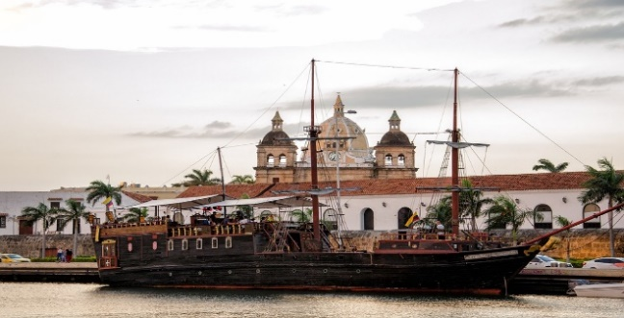
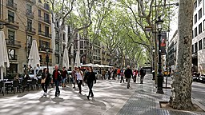
Section C: Writing
1 mark for each word. A mark is given for the use of a word where its meaning is fully and accurately communicated.
PART B What happened last Saturday? What will happen next Saturday?
Write between one and three sentences in Spanish for each picture.
Use all of the Spanish words under the pictures.
Write your sentences in the blank box on the right. Try to make interesting and varied sentences. Try to show that you know what the words mean by writing full, interesting, and varied sentences that make sense. You can use your imagination if you like!
Last Saturday
costa / visitar / barco / antiguo
Next Saturday
caminar / tiendas / centro / cerca
Notes:
Timing: 10 minutes
Aim: writing practice task in writing in past and future tenses.
Procedure:
Click to show the marks for the exercise
Students write sentences based on the picture stimuli. All of the words under the photos must be used. As this is a creative response, we have not added suggestions of answers. We suggest that teachers could perhaps prepare some of their own sentences and listen to a variety of student responses. Students could even share their answers in pairs or groups.
Picture 1: free from USA-Reiseblogger downloaded from https://pixabay.com/photos/colombia-caribbean-cartagena-ship-2466434/ (Pixabay License, free for commercial use, no attribution required)
Picture 2: free from Banja-Frans Mulder, from https://commons.wikimedia.org/wiki/File:Spain_-Barcelona,_La_Rambla_-_panoramio_(1).jpg This file is licensed under the Creative Commons Attribution 3.0 Unported license.

Slide 8
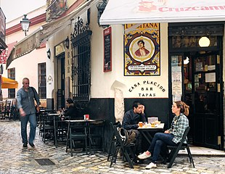
Section D: Speaking
For each idea in parts A and B there are 2 marks for meaning and 1 mark for accuracy. You will also be given marks for fluency.
Look at the photo and answer the questions below in Spanish.
For some questions, you will need to use your imagination to make up a possible answer.
Just try to keep going and say something that you know how to say! You have 2 minutes to prepare all of your answers before you speak.
PART A
What can you see in this photo?
Try to say at least 2 different things.
Here are some ideas about what you could say.
You can say different things if you wish!
• Say what you can see in the photo.
• Say what the man on the left is going to do later.
PART B
What did the woman at the table do this morning?
Try to imagine at least 2 different things.
Notes:
Timing: 8 minutes
Aim: speaking practice task using a photo stimulus.
Procedure:
Click to show the marks for the exercise.
Teachers can decide how best to carry out this exercise. It may be best for students to work in pairs, taking it in turns to give short answers. Teachers could time the activity to give a feeling of what it will be like in the test. We suggest that pairs could then work in small groups to listen to each other’s answers, and then the teacher can listen to more answers following that. Teachers may like to the prepare some other questions to stimulate other possible answers to show just how much could be said about the picture.
Picture: free from Pedro Szekely, from https://commons.m.wikimedia.org/wiki/File:Sevilla,_Spain_(45691233172).jpg. This file is licensed under the Creative Commons Attribution-Share Alike 2.0 Generic license.

Slide 9
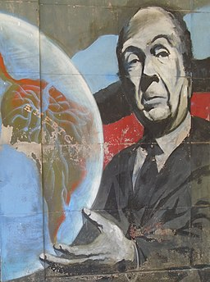
Section E: Reading aloud and comprehension
For each sentence in Part A there is 1 mark for comprehensibility and 1 mark for fluency, giving 2 points for each sentence in total.
PART A
Read the following text aloud.
You won’t know some of the words – don’t worry! Just do your best to read them aloud as you think they should sound in Spanish. You will get points for clear and understandable pronunciation.
PART B
Now say, in English, any 2 facts mentioned in the text.
Jorge Luis Borges es un autor famoso de Argentina. Escribió historias cortas y ganó muchos premios.
Creció en la ciudad de Buenos Aires y también vivió en otros países.
Award 1 point for each idea correctly identified in the text in Part B.
Notes:
Timing: 8 minutes
Aim: speaking practice task using a photo stimulus.
Procedure:
Click to show the marks for the exercise.
Teachers can decide how best to carry out this exercise. It may be best for students to work in pairs, taking it in turns to read the sentences to each other. Then the teacher can choose to listen to several students.
For Part B students could write down their own answers before the teacher asking for responses.
Picture free fromUlises Icardi, from, https://upload.wikimedia.org/wikipedia/commons/e/ef/Mural_en_homenaje_a_Jorge_Luis_Borges_%28Adrogu%C3%A9%29..jpg. This file is licensed under the Creative Commons Attribution-Share Alike 4.0 International license.

