Slide 1
Grammar
Using –er and –ir verbs in the infinitive and third person singular
Y7 Spanish
Term 3.1 - Week 4 – Lesson 55
Author names: St James’ Hub Teachers /
Victoria Hobson/ Nick Avery / RachelHawkes
Date updated: 16/05/20
Notes:
Source of frequency rankings: Davies, M. & Davies, K. (2018). A frequency dictionary of Spanish: Core vocabulary for learners (2nd ed.). London: Routledge

Slide 2
-er and -ir verbs: infinitive and 3rd person singular
Remember, the infinitive form of a verb is the form you see in a dictionary. It describes the general meaning of a verb.
In Spanish, infinitives often end in –ar, but also end in –er and –ir.
For example:
Es importante leer.
It’s important to read.
You can also begin a sentence with the infinitive:
Escribir es importante.
Writing is important.
Notes:
Because -er and -ir verbs behave alike in most cases, the scheme of work only separates them for teaching when they behave differently (e.g., in the 1st person plural).
Explain to students that you are now going to learn more about infinitives that end in –er and –ir. Students may tell you that they know some –er infinitives (of irregular verbs) that they have previously met.
ser
tener
querer
poder
hacer
If students do name these infinitives, explain that today you will be learning about regular -er verbs which follow a pattern and move onto the explanations in this and the next slide to exemplify this.
We use ‘leer’ and ‘escribir’ as examples as these two verbs have already been used extensively in task instructions.

Slide 3
-er and -ir verbs: infinitive and 3rd person singular
To mean ‘s/he’ or ‘it’ with an –er or –ir verb, remove –er/–ir and then add –e to the stem.
Escrib
Escribe
(escribir)
S/he writes
In English, we say ‘he’ or ‘she’ to say who does the action.
In Spanish, the verb ending tells us this. There is usually no need for the word ‘s/he’.
Le
Lee
(leer)
S/he reads
Escucha la pronuncación de ‘leer’ y ‘lee’.
1
leer
2
lee
Notes:
Audio recordings are included to model the pronunciation of ‘leer’ and ‘lee’, whose vowel sounds sometimes cause difficulty.

Slide 4
comer
[to eat | eating]
come
[eats]
Notes:
Students should know the meaning of this verb already, as it was set as (audio and quizlet) homework. It is re-presented here in the infinitive and short form to deepen students’ knowledge and model the use of both forms in sentences.
Introducing the verb comer more explicitly. Comer is one of the NCELP 15 prototypical verbs in Spanish. Prototypical verbs are common verbs that illustrate the typical characteristics of a class of verb. All 15 prototypical verbs will be introduced early on using the same format. Both long form (infinitive) and short form (3rd person singular) are introduced in order to familiarise students with various forms of the same verb.
Bring up the word comer on its own, say it, students repeat it, and remind them of the phonics. Draw attention to [co]
Try to elicit the meaning from the students.
Bring up the picture, and, if using gestures, a possible gesture would be to put your hand to your mouth, as if eating a sandwich.
Then bring up the English translations. Emphasise the two meanings for the infinitive.
Bring up the short form [come], say it, students repeat it. . Draw attention to [co]
Try to elicit the meaning from the students. Emphasise the two meanings for the short form.

Slide 5
comer
[to eat | eating]
come
[eats]
Notes:
Cycle through the long and short form again.

Slide 6
come
[eats]
Lucía come fruta.
[Lucía eats fruit.]
Notes:
Introduce the short form in a sentence.

Slide 7
comer
[to eat | eating]
Quiere comer fruta.
[S/he wants to eat fruit.]
Notes:
Introduce the long form in a sentence.

Slide 8
come
[eats]
come
Lucía _______ fruta.
[Lucía eats fruit.]
Notes:
Cycle through the short form in context again.

Slide 9
comer
[to eat | eating]
comer
Quiere ________ fruta.
[S/he wants to eat fruit.]
Notes:
Cycle through the long form in context again.

Slide 10
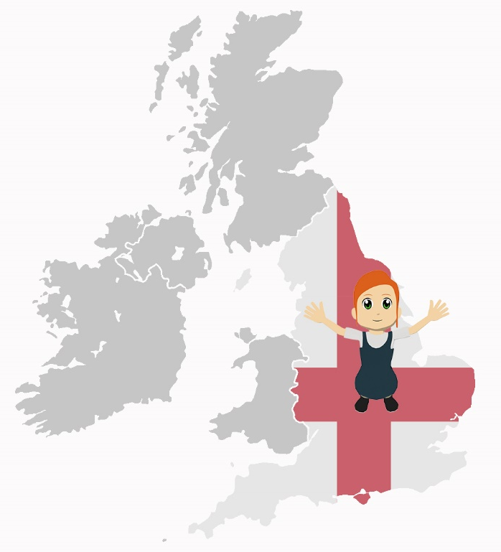
vivir
[to live | living]
vive
[lives]
Notes:
Because -er and -ir verbs behave alike in most cases, we will only separate them for teaching when they behave differently (e.g., in the 1st person plural - see Y8 SoW).
Students should know the meaning of this verb already, as it was set as (audio and quizlet) homework. It is re-presented here in the infinitive and short form to deepen students’ knowledge and model the use of both forms in sentences.
Introducing the verb vivir more explicitly. Vivir is one of the NCELP 15 prototypical verbs in Spanish. Prototypical verbs are common verbs that illustrate the typical characteristics of a class of verb. All 15 prototypical verbs will be introduced early on using the same format. Both long form (infinitive) and short form (3rd person singular) are introduced in order to familiarise students with various forms of the same verb.
Bring up the word vivir on its own, say it, students repeat it, and remind them of the phonics. Draw attention to [v]
Try to elicit the meaning from the students.
Then bring up the English translations. Emphasise the two meanings for the infinitive.
Bring up the short form vive, say it, students repeat it. . Draw attention to [v]
Try to elicit the meaning from the students. Emphasise the two meanings for the short form.

Slide 11
vivir
[to live | living]
vive
[lives]
Notes:
Cycle through the long and short form again.

Slide 12
vive
[lives]
Paula vive en Francia.
[Paula lives in France.]
Notes:
Introduce the short form in a sentence.

Slide 13
vivir
[to live | living]
Quiere vivir en Francia.
[S/he wants to live in France.]
Notes:
Introduce the long form in a sentence.

Slide 14
vive
[lives]
vive
Paula _______ en Francia.
[Paula lives in France.]
Notes:
Cycle through the short form in context again.

Slide 15
vivir
[to live | living]
vivir
Quiere ________ en Francia.
[S/he wants to live in France.]
Notes:
Cycle through the long form in context again.

Slide 16
Problemas con Siri
escuchar
 | the action in general | someone does the action
Siri doesn’t seem to be working on your phone! Can you work out what it’s talking about?
Escucha los mensajes.
Marca la opción correcta.
1
2
3
4
5
6
7
8
Notes:
This task aims to help learners understand the difference in meaning between the infinitive and the third person singular. Tell students to pay careful attention to the verb that they hear. The vocabulary other than the verbs in this activity is either already known to students or is a cognate.
[‘pling’ sound] Lee frases interesantes.
[‘pling’ sound] Vivir cerca del pueblo.
[‘pling’ sound] Bebe coca cola.
[‘pling’ sound] Come comida.
[‘pling’ sound] Leer juntos.
[‘pling’ sound] Vive lejos de aquí.
[‘pling’ sound] Comer mucho.
[‘pling’ sound] Beber limonada.
Ask students to translate the text extracts to ensure comprehension of meaning.

Slide 17
İEscribe!
leer / escribir
es importante
es bueno
es aburrido
leer juntos
es normal
es interesante
es excelente
es tonto
es fantástico
Notes:
This reading and writing activity gives students a chance to practise the difference between third person singular/infinitive sentences. It could be done on mini-whiteboards. It uses the infinitive sentences and verbs from the previous activity. Students have to complete the sentence starter in orange with their own creations. Having students write on mini-whiteboards allows the teacher to see all the different student responses (to see if they have selected a correct sentence finisher i.e. distinguished correctly between the infinitive and 3rd person singular) and then select and share with the group for translation into English. Animated examples also appear. Students can see if any of their responses appear. This offers lots of scope for differentiation. Higher ability students will naturally arrive at more complex/creative sentences. Examples are given but students will come up with other sentences, too.
Revisited words:
bueno (1.2.4)
aburrido (2.2.5)
tonto (1.1.2)
interesante (1.2.6)
importante (1.1.6)

Slide 18
İEscribe!
leer / escribir
es bueno
es caro
es excelente
comer mucho
es normal
es feo
por la noche es malo
puede ser algo bueno
Notes:
Revisited words:
Caro (1.2.4)
Bueno (1.2.4)
Malo (1.2.4)
Noche (2.1.4)
Puede (2.2.2)
Ser (1.1.3)
Feo (1.2.4)
Algo – phonics word

Slide 19
İEscribe!
leer / escribir
tarde
temprano
mucho
comida
fruta
come
carne
solo
un plato rico
en la escuela
fuera de la casa
debajo del árbol
Notes:
‘Fruta’, ‘carne’ and ‘rico’ will be introduced formally in lesson 2 this week.
Revisited words:
Mucho (1.2.1)
Comida (2.2.1)
Solo (2.2.1)
Plato (1.2.6)
Fuera (2.2.4)
Casa (1.1.4)
Debajo (2.2.4)
Árbol (2.1.3)
Escuela (1.2.5)
Temprano, tarde (1.1.6)

Slide 20
İEscribe!
leer / escribir
por la mañana
Coca-Cola
mucho
limonada
bebe
delante de la tienda
con amigos
cinco botellas de agua
solo
en clase
Notes:
‘Agua’ will be introduced formally in lesson 2. ‘Limonada’ is a near-cognate that has been included in receptive tasks in earlier lessons.
Revisited words
Delante – 2.2.4
Tienda – 1.2.5
Cinco – 1.2.2
Botella – 1.1.5
De – 1.2.6
Amigo – 1.1.5
Solo – 2.2.1
Clase – 1.2.3
Mañana – 2.1.4

Slide 21
İEscribe!
leer / escribir
es bonito
es barato
es aburrido
vivir cerca del pueblo
es bueno
es interesante
es malo
es fantástico
es excelente
es una buena idea
es caro
es importante
Notes:
Revisited words
Bonito – 1.2.4
Barato – 1.2.4
Aburrido – 2.2.5
Bueno – 1.2.4
Interesante – 1.2.6
Malo – 1.2.4
Caro – 1.2.4
Importante – 1.1.6
Idea – phonics word

Slide 22
İEscribe!
leer / escribir
mucho
en la escuela
libros famosos
lee
revistas interesantes
frases en español
el periódico cada día
por la tarde
en la cama
Notes:
Revisited words
Mucho – 1.2.1
Libro – 1.1.4
Importante – 1.1.6
Revista – 1.1.5
famoso – 1.2.4
Frase – 1.1.4
Espanol – 1.2.1
Periódico – 1.1.5
Cada – 3.1.1
Tarde – 2.1.4
Cama – 1.1.4

Slide 23
İEscribe!
en una isla
leer / escribir
fuera del centro
en el sur de Francia
delante de la plaza
detrás del banco
vive
lejos de aquí
cerca del mercado
con amigos
en España
en una casa antigua
en una ciudad grande
en el campo
en el norte
solo/a
en un pueblo pequeño
Notes:
Revisited words
Isla – 1.2.6
Fuera – 2.2.4
Centro – 1.2.5
Sur, norte – 1.1.1
Francia – 3.1.1
Delante – 2.2.4
Plaza – 1.2.5
Detrás -2.2.4
Banco – 1.2.5
Cerca – 1.2.5
Mercado – 1.2.5
Lejos – 1.2.5
Aquí – 1.2.3
Con –1.1.6
Amigo – 1.1.5
España -1.1.1
Casa – 1.1.4
Antigua – 1.2.4
Ciudad – 1.2.5
Grande – 1.2.6
Solo – 2.2.1
Campo – 2.2.1
Pueblo – 1.2.6
Pequeño – 1.2.4

Slide 24
İEscribe!
leer / escribir
es bueno
es malo
es barato
beber limonada
es caro
por la tarde es normal
es excelente
es fantástico
Notes:
Revisited words
Bueno – 1.2.4
Malo – 1.2.4
Barato – 1.2.4
Caro – 1.2.4
Tarde – 2.1.4

Slide 25
İEscribe!
escribir
1) Eating at night is bad. Comer por la noche es malo.
2) He eats a lot in the afternoon. Come mucho por la tarde.
3) Reading at school is important. Leer en la escuela es importante.
4) She reads famous books. Lee libros famosos.
5) Living in the centre is excellent. Vivir en el centro es excelente.
6) She drinks a bottle of Coca-Cola. Bebe una botella de Coca Cola.
Notes:
An optional final translation activity as a further plenary to this lesson.
There are 3 sentences that require the infinitive and 3 that require the third person singular. Answers are triggered. Teachers reveal each by clicking on the dark blue shape. This is to allow teachers to nominate students to respond, but give nominated students the flexibility to offer the answer they feel most confident about (out of order).

Slide 26
Grammar [2]
Using –er and –ir verbs in the infinitive and third person
Y7 Spanish
Term 3.1 - Week 4 – Lesson 56
Author names: St James’ Hub Teachers /
Victoria Hobson/ Nick Avery / RachelHawkes
Date updated: 16/05/20

Slide 27
hacer
[to do/make | doing/making]
hace
[does/makes]
Notes:
Hacer is already known to students (see 2.1.4 in SoW) and behaves like a regular –er verb in the 3rd person singular. It is re-presented here in the infinitive and short form to reactivate students’ knowledge and model the use of both forms in sentences. It also reminds students of this week’s learning focus: infinitive and third person singular –er and –ir verbs.
Consolidating the verb hacer more explicitly. Hacer is one of the 25 most frequently used verbs in Spanish. All 25 most frequent verbs will be introduced early on using the same format. Both long form (infinitive) and short form (3rd person singular) are introduced in order to familiarise students with various forms of the same verb.
Bring up the word hacer on its own, say it, students repeat it, and remind them of the phonics. Draw attention to [ce]
Try to elicit the meaning from the students.
Then bring up the English translations. Emphasise the two meanings for the infinitive.
Bring up the short form [hace], say it, students repeat it. . Draw attention to [ce]
Try to elicit the meaning from the students. Emphasise the two meanings for the short form.

Slide 28
hacer
[to do/make | doing/making]
hace
[does/makes]
Notes:
Cycle through the long and short form again.

Slide 29
hace
[does/makes]
Diego hace ejercicio.
[Diego does exercise.]
Notes:
Introduce the short form in a sentence.

Slide 30
hacer
[to do/make | doing/making]
Quiere hacer ejercicio.
[S/he wants to do exercise.]
Notes:
Introduce the long form in a sentence.

Slide 31
hace
[does/makes]
hace
Diego _______ ejercicio.
[Diego does exercise.]
Notes:
Cycle through the short form in context again.

Slide 32
hacer
[to do/make | doing/making]
hacer
Quiere ________ ejercicio.
[S/he wants to do exercise.]
Notes:
Cycle through the long form in context again.

Slide 33
leer
En una revista hablan sobre los hábitos de unas personas famosas.
Some of the verbs are referring to an athlete.
Which ones are they?
 |  | The action in general | Referring to the athlete
1 | Beber agua es importante.
2 | Vivir fuera de la ciudad es interesante.
3 | Lee periódicos en línea* y es práctico.
4 | Vive entre dos montañas y es perfecto.
5 | Hace ejercicio cada día con otros hombres.
6 | Nunca bebe Coca Cola por la noche.
7 | Comer fruta es bueno.
8 | Leer revistas puede ser informativo.
9 | Hacer deporte es difícil.
10 | A veces come carne. ¡Es una comida rica!
* online
Notes:
The title has been written using previously taught language, except for ‘sobre’. Clarify the meaning of this word if needed.
Several near-cognates have been included: práctico [2141], perfecto [1115] and informativo [4002]. The main reason for the inclusion of a range of adjectives is to avoid an incongruence between infinitive sentences, which often end in ‘es + adjective’, and the sentences with 3rd person singular. The risk would otherwise be that students rely on this part of the sentence, rather than the verb, to decide on the answer.
This task aims to help learners understand the difference in meaning between 3rd person singular and the infinitive form whilst recapping ‘es’ in infinitive sentences contextualised with this week’s vocabulary set or with previously learnt words.

Slide 34
escuchar / leer
You are listening to a podcast that talks about lifestyle in general and gives info about the athlete you have just read about.
Not all of it has downloaded. Which ending is needed?
…un plato rico es caro.
…un plato rico y es caro.
…en el centro y es muy práctico.
…en el centro es muy práctico.
…libros cada día y es interesante.
…libros cada día es interesante.
…la cama es tonto.
…la cama y es tonto.
…agua y es bueno.
…agua es bueno.
…en el este de España es fantástico.
…en el este de España y es perfecto.
…carne roja es malo.
…carne roja y es malo.
…revistas en línea es barato.
…revistas en línea y es barato.
…limonada, pero no es importante.
…limonada no es importante.
…los deberes por la tarde y es normal.
…los deberes por la tarde es normal.
1
6
2
7
3
8
4
9
5
10
Notes:
This task aims to help learners understand the difference in meaning between 3rd person singular and the infinitive form whilst recapping ‘es’ in infinitive sentences through listening and reading. Similar sentence types to the preceding reading activity are used.
Students listen to the verb and decide how the sentence must carry on.
The near-cognate ‘práctico’ [2141] was included as an additional adjective.
TRANSCRIPT
Come
Vivir
Leer
Hace
Bebe
Vive
Comer
Lee
Beber
Hacer

Slide 35
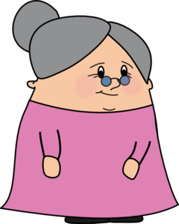
¿Cómo ser feliz?
hablar / escuchar
A friend needs advice! You are telling Agony Aunt ‘Tía Dolores’ about your friend Daniel, who is not happy. You tell her what Daniel does and what you think would be good for him to do.
Student A: tell Tía Dolores what Daniel does and what it’s good for him to do.
Student B: you are Tía Dolores. Listen and write in English:
what Daniel does.
what your friend thinks it’s good for Daniel to do.
Then swap roles. Your cards are different.
Notes:
Since it is not essential to correctly use the infinitive and 3rd person singular to complete the task, the listener should be encouraged to correct the speaker if s/he notices mistakes in use of –er/ –ir infinitive vs –e ending for 3rd person singular.

Slide 36
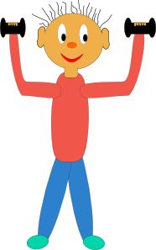
hablar / escuchar
Persona A
What Daniel does. |  |  |  | What it’s good for Daniel to do. (“Es bueno…”)
[never] |  | [sometimes] |  | [every day] |  | [at school]
[red meat] |  |  | [alone] |  |  |  | [with friends]
Notes:
Student A speaking cards (these are also available in Word format)

Slide 37
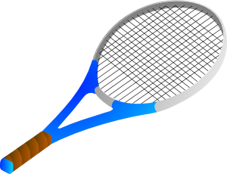
hablar / escuchar
Persona B
What Daniel does. |  |  |  | What it’s good for Daniel to do. (“Es bueno…”)
[never] |  | [sometimes] |  | [at school] |  | [every day]
[big dishes] | [in England] |  |  | [small dishes] | [in Spain]
Notes:
Student B speaking cards (these are also available in Word format)

Slide 38
hablar / escuchar
Student B answers
Daniel does it | It’s good to… (talking in general)
Never does homework | Do homework everyday
Sometimes does exercise | Do exercise at school
Eats red meat | Eat fruit
Drinks Coca Cola | Drink water
Lives alone | Live with friends

Slide 39
hablar / escuchar
Student A answers
Daniel does it | It’s good to… (talking in general)
Never does sport | Do sport at school
Reads sometimes | Read everyday
Eat big dishes | Eat small dishes
Lives in England | Live in Spain
Drinks lemonade | Drink water

