Slide 1
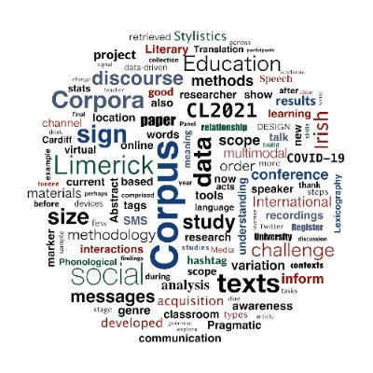
Profiling vocabulary in languages other than English
CL 2021 (July 13-16, 2021) University of Limerick / Mary Immaculate College
Natalie Finlayson National Centre for Excellence for Language Pedagogy University of York
Natalie.Finlayson@york.ac.uk; @natalie_eloise
https://www.multilingprofiler.net/; @MultiLingProf
Prof Laurence Anthony Waseda University
anthony@waseda.jp; @antlabjp
https://www.laurenceanthony.net/
Notes:
1. Hello, I’m Natalie Finlayson, and I work at the National Centre for Excellence for Language Pedagogy, or ‘NCELP’ for short, at the University of York. Thank you for watching this presentation on ‘Profiling vocabulary in languages other than English’.

Slide 2
MultiLingProfiler team
Presenters
Natalie Finlayson Project Lead
University of York (NCELP)
Laurence Anthony Consultant, Software Developer
Waseda University
Wider Research Team: Prof Emma Marsden, Dr Rachel Hawkes, Nick Avery (University of York)
Notes:
2. I’m presenting the project today with Professor Laurence Anthony from Waseda University, who is the brains behind the functionality and web design. I oversee the language-specific elements, alongside Prof Emma Marsden, Dr Rachel Hawkes and Nick Avery.

Slide 3
Overview
Background: the MFL Foreign Languages Pedagogy Review and the National Centre for Excellence for Language Pedagogy (NCELP)
Designing and content of the research-informed vocabulary strand
Existing resources for vocabulary profiling and limitations for non-English languages
MultiLingProfiler demonstration
Summary and next steps
Notes:
3. In this presentation, we’ll give you some background information about the Centre for Excellence and the principles underpinning the design and content of its vocabulary syllabi, briefly discuss the vocabulary profiling tools currently available to us and their applicability to languages other than English, present the main functions of our new MultiLingProfiler tool, and outline our plans for further development.

Slide 4
Overview
1. Centre for Excellence (NCELP)
Notes:
4. So, to kick off, what is the National Centre for Excellence for Language Pedagogy?

Slide 5
1. Centre for Excellence (NCELP)
MFL Pedagogy Review (Teaching Schools Council, 2016)
National Centre for Excellence for Language Pedagogy (ncelp.org)
Notes:
5. The Centre for Excellence is funded by the Department for Education to work with researchers and specialist practitioners to take forward recommendations made in the ‘Modern Foreign Languages Pedagogy Review.’ Curricula and teaching materials informed by the recommendations are currently being created at NCELP and piloted in over 100 schools across the country, with a view to improving language curriculum design and encouraging higher uptake and greater success in GCSE examinations.
To illustrate the need for a multilingual vocabulary profiling tool, I’m now going briefly summarise the recommendations for vocabulary teaching and show we operationalise them in NCELP resources.

Slide 6
1. Vocabulary Recommendations
Recommendations for Vocabulary Teaching
Practice in KS3 and KS4*:
to carefully plan vocabulary introduction and revision;
to incorporate varied teaching techniques into activities;
to pay special attention to building the verb lexicon;
to inform vocabulary selection by frequency of occurrence;
to break down memorised chunks of vocabulary and manipulate the words and grammar they contain.
MFL Pedagogy Review
*KS3 (Years 7-9, pre-GCSE, ages 11-14); KS4 (Years 10-11, GCSE, ages 14-16)
Notes:
6. The 5 key recommendations are:
to carefully plan vocabulary introduction and revision;
to incorporate varied teaching techniques into activities;
to pay special attention to building the verb lexicon;
to inform vocabulary selection by frequency of occurrence;
and to break down and understand memorised chunks to ensure students are able to manipulate the words and grammar they contain.

Slide 7
1. Systematic revisiting
Revisit 1
Revisit 2
wk
2
wk
5
pre-learning (wk 1)
spring test (wk 20)
summer test (wk 33)
year 8/9 revisiting
follow-up testing every year
wk
10
Notes:
7. To illustrate how all this comes together, here is snapshot from the French Y7 Scheme of Work which shows how the same set of words are revisited in a range of grammatical and semantic contexts throughout Years 7-11.
So, as you can see, implementing the recommendations requires very careful planning, and we need to be sure that we are providing students with learning and assessment materials that are fully in line with this very structured and systematic approach to vocabulary learning.

Slide 8
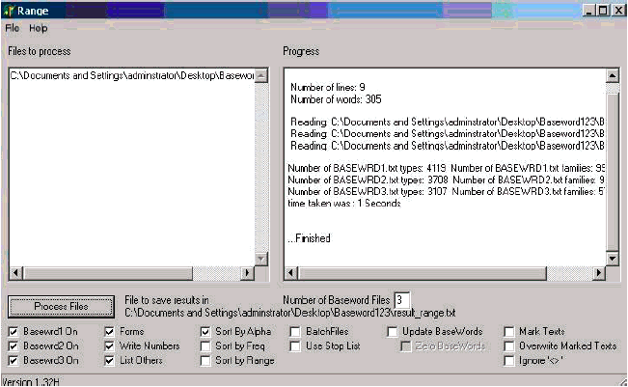
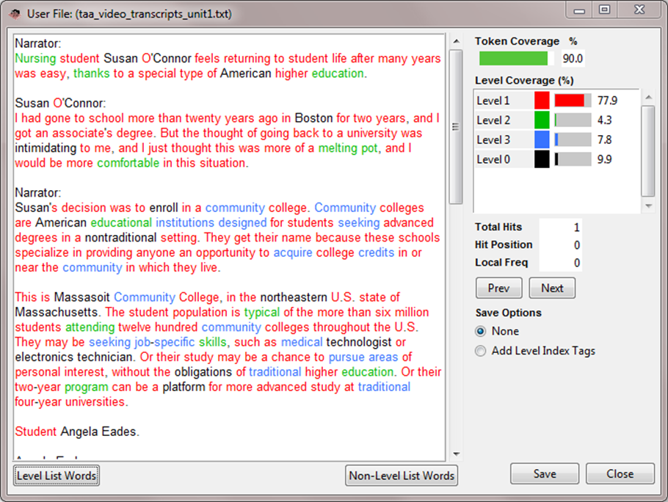
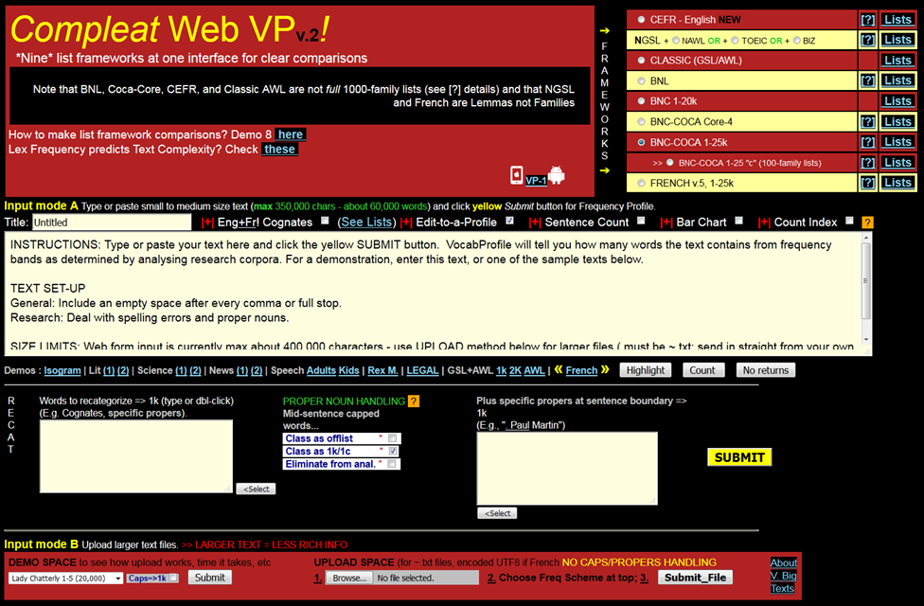
Overview
2. Resources for vocabulary profiling
Notes:
8. I’m going to briefly review existing computational tools designed to do just that and explain how we have expanded on this work to create a tool compatible with both languages other than English and the NCELP syllabi.

Slide 9
2. Tools for vocabulary research
Four types of resources for vocabulary research (Anthony, 2019)
corpora (as primary data sources)
software tools for collecting/building primary corpus sources
pre-built word lists (as secondary data sources)
software tools for probing/profiling/analysing primary and secondary data sources
"It is hard to imagine any area of vocabulary research into acquisition, processing, pedagogy, or assessment where the insights available from corpus analysis would not be valuable.”
Importance of corpus linguistics in vocabulary-related research (Schmitt, 2007, p. 307)
Notes:
9. Anthony mentions four types of resources available for vocabulary-related research:
- corpora, as primary data sources;
- software tools to build these, such as file conversion tools;
- pre-built word lists, as secondary data sources;
- tools for analysing these, such as AntLab, WordSmith Tools, or Sketch Engine.
So, the value of corpus linguistics in vocabulary-related research is clear! As Schmitt says, "It is hard to imagine any area of vocabulary research into acquisition, processing, pedagogy, or assessment where the insights available from corpus analysis would not be valuable”
So, what tools of this nature might we use to profile the vocabulary in multilingual resources?

Slide 10
2. Tools for vocabulary research
Range (Heatley, Nation and Coxhead, 2002) Desktop profiling tool, English
Notes:
10. Range is a straightforward desktop profiling tool that allows users to obtain statistical information, such as word family frequency and range, about English texts.

Slide 11
2. Tools for vocabulary research
AntWordProfiler (Anthony, 2021)
Desktop profiling tool, multiple languages
Notes:
11. The Range program was modernised by Anthony in 2014 in the form of AntWordProfiler, which allows users to obtain frequency and range information for a target text based on any set of word family, flemma, or lemma lists that they load into the system. It also gives colour-coded information about the word frequency bands into which words fall, allowing informed decisions to be made about the suitability of texts for language learners at different levels.

Slide 12
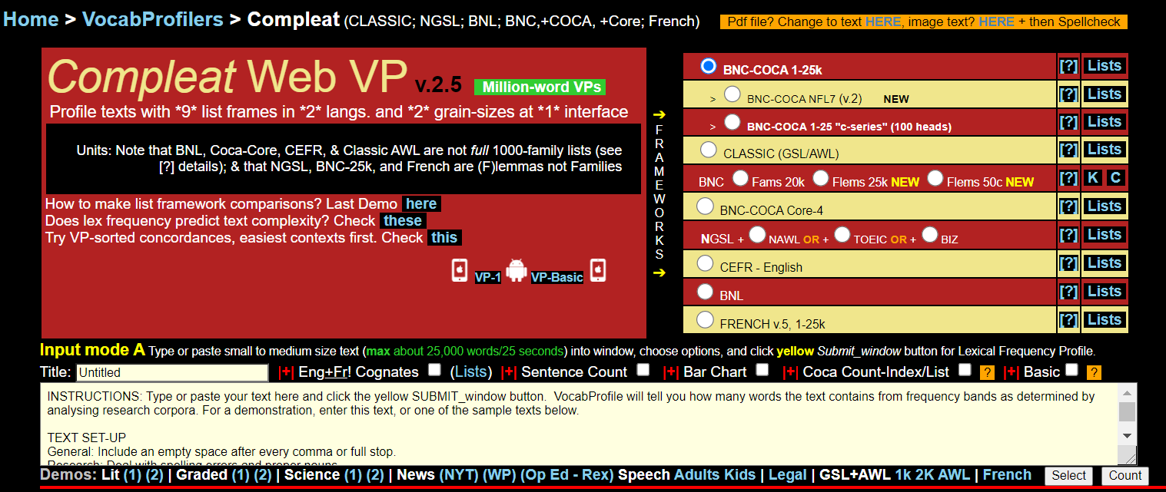
2. Tools for vocabulary research
Compleat Lexical Tutor (Web VP)(2020)
Online profiling tool, English and French
Notes:
12. Finally, Compleat Lexical Tutor allows you to carry out this work online, in both English and French.
These are all great tools which provided valuable insights for those interested in the vocabulary composition of texts. However, there are some limitations here for processing texts in other languages, and for analysing lower-level resources.

Slide 13
2. Limitations
1. What percentage of the words in this text are high-frequency ?
2. How many of the words in this text have students learned so far?
Not suitable for languages other than English
only English and French level lists readily available
rich inflectional morphology means lists take longer to create, e.g. German (singen, singt, singt, singst, sang, gesungen; Hund, Hunde, Hundes, Hunden)
morphological issues e.g. French (peut-être), German (Essen, essen) for processing …
… and counting (aujourd’hui – one word or two?)
Not suitable for lower-levels
existing profiling tools assume knowledge of all inflections of a word – grammar knowledge not considered
Notes:
13. Here are some questions that teachers, test developers and textbook publishers might ask when assessing the suitability of texts for inclusion in their classes, assessments and publications:
What percentage of the words in this text are high-frequency words?
How many of the words in this text do students already know?
Currently, lexical profiling tools are limited in the degree to which they can help with the first question as few existing tools can give frequency information about languages other than English and French. AntWordProfiler is flexible enough to work with other languages, but it doesn't come with lists for highly inflected languages such as German and Spanish. Making such lists is not trivial, so automated processes must be explored for reducing the time it takes to make level lists from scratch.
Morphological issues are posed by French words which include punctuation as part of their spelling system, while a capital letter is sometimes the only difference between a verb and noun in German. Such issues pose challenges to program design, as decisions have to be made about what counts as a word for the statistical function of the program. A decision to include an apostrophe as part of a word, for example, would allow aujourd’hui to be counted as a lexical item, but would have repercussions elsewhere in the text where apostrophes are used as punctuation.
In terms of question two, the main limitation lies in the fact that existing tools are, for the most part, designed for use by researchers rather than teachers and material designers. A particular challenge of this is that the tools assume knowledge of all inflected forms of a word, which is not the case at lower levels, especially with such highly-inflected languages. This limits the degree to which the tools can successfully assess texts for compatibility with a beginner or intermediate syllabus.

Slide 14
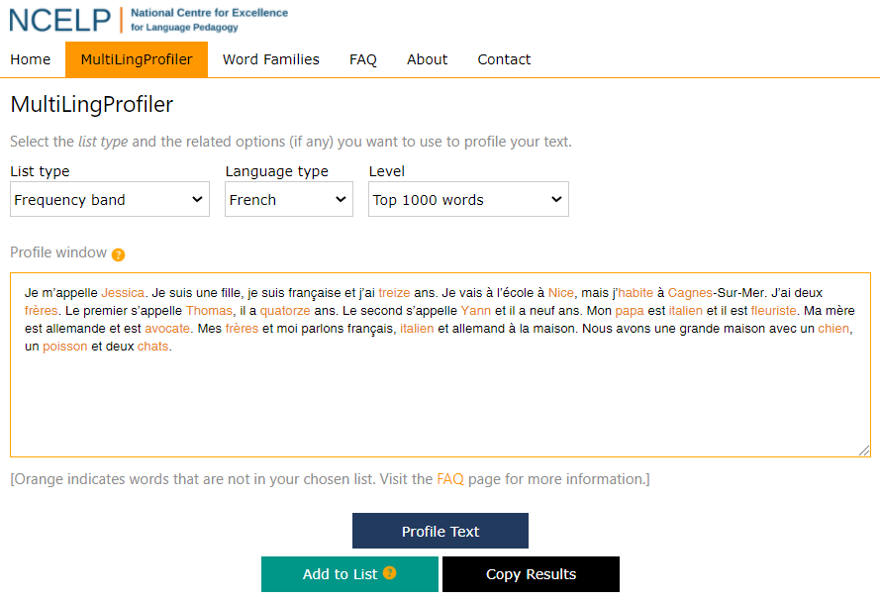
Overview
3. MultiLingProfiler
Notes:
14. Now, I’m going to present three short videos to show how we’ve addressed some of these issues by creating MultiLingProfiler, an online, open-access vocabulary profiling tool with two key functions, to profile texts by frequency of occurrence in French, Spanish and German, and to profile texts by stage in the NCELP syllabus.

Slide 15
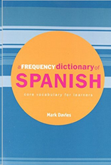
3. MultiLingProfiler
Profiling by frequency of occurrence
Routledge frequency dictionaries: Rationale
https://www.multilingprofiler.net/
Notes:
15. When you access MultiLingProfiler online, the default setting is to profile by frequency band. Currently, the profiler can profile texts at the 1000- and 2000-level.
In this demo, I'm going to show you how to profile a text to see how suitable it is for level A2 Spanish. You would expect, at that stage, that the large majority of the words in a text would fall within the top 2000 words in the language. The orange text here shows you how many words do not, and if you scroll down you can see all kinds of statistics about the percentage coverage of individual words, and also or word families, or ‘lemmas’.
Some of the words in the text are proper nouns, and you might want to exclude these from the count by adding them to the Extended List. You might want to gloss these words in your texts, or perhaps you've taught Spanish cities. If you do that, you'll see that the coverage figures in the statistics have gone up accordingly.
To make the level lists, we had to input into the profiler the headwords as listed in the Routledge frequency dictionaries pictured here, and expand these into word families ourselves. That's quite a laborious task, and it involved the creation of scripts which could recognise the regular forms of words, and add the inflections. This, of course, all had to be manually checked, and we had to manually program the irregular inflections of words in the top 2000 as well.

Slide 16
3. MultiLingProfiler
Profiling by custom list
Routledge frequency dictionaries: Rationale
https://www.multilingprofiler.net/
Notes:
16. If you teach a more advanced course, or perhaps a specialised course such as Medical German, you might want to profile texts using lists other than those that are embedded in the profiler. I'm going to show you two ways that you can do this.
The first way is to simply extend the list that's already there. If you select 'German' and 'top 2000 words', you can paste in your text and you will no doubt notice that there will be more orange words appearing this time, because there is low frequency vocabulary in there. To add words to the list, you simply open the 'Extend List' window again, and then you can paste in any additional word lists that you have.
This is a word list made of medical-specific vocabulary, again expanded into word families, and you'll see now that there are quite a lot more orange words going black there.
Just a note that to profile compound nouns in German you do have to add the space between the two parts of the compound, and then you can profile as normal.
If you select 'custom list' from the dropdown under 'List type', that allows you to profile texts only by the additional words you have pasted in. That can be useful if you have a full vocabulary list that is specific to your course, or perhaps you just want to highlight the topic-specific words in the text that way.

Slide 17
3. MultiLingProfiler
Profiling by week in a syllabus
Routledge frequency dictionaries: Rationale
https://www.multilingprofiler.net/
Notes:
17. Finally, I'm going to show you how to use the profiler to assess the suitability of a text for a certain week in the NCELP Scheme of Work. I'm just going to select a really simple text, and see how well it works with Term 1.2 week 4 in Year 7.
You can see it's just a simple little text with different forms of the verb parler. The first three lines are suitable, the last three lines are not. You can see that you can actually edit the text in the window, replace words, and profile those accordingly.
You'll see if you select week 5, they do now know that form of parler ... in week 6 they know that one ... and by week 7 they know all of the words in the text. So, you can see that this was a cumulative process, and I'm just going to show you how we've prepared the lists for this part of the profiler.
You can see here in week 7.1.2.4 that they know those three forms of parler, by week 1.2.5 they know another form, parlons, and by the time you get down to 1.2.7 they know the full paradigm of that verb in the present tense.
So, that's how we make the lists for the NCELP section of the profiler, starting in week 1 with just the handful of words that they know that week, and going all the way, at the moment, to halfway through year 9. You can see the list of cumulative word families is getting really complicated there, and those have all been input manually by Resource Developers working at NCELP.
Just a quick note on multiword units - you can see, if you scroll down to the stats part of the profiler, that aujourd’hui is counted as two words. This is because, as I mentioned previously, we have to keep the apostrophe as a piece of punctuation. So, bear in mind that the profiler does recognise multiword units - which again, have been input manually by NCELP Resource Developers for each language - but in the stats bar, the profiler counts everything on either side of a piece of punctuation as an individual word. It's just something to bear in mind when you're analysing your stats.

Slide 18
4. Summary and next steps
work of the National Centre for Excellence for Language Pedagogy
gap for a vocabulary profiling tool for non-English languages and lower-levels
limitations of existing tools
development of MultiLingProfiler
adding profiling lists at levels 3000, 4000 and 5000;
adding downloads of multi-level frequency-band profiles;
working with awarding bodies and textbook writers to create bespoke lists compatible with their courses;
POS tagging (?)
Thank you for listening!
Notes:
18. So, to summarise, we’ve discussed the work of the Centre for Excellence, and the need for a vocabulary profiling tool to assist with the creation of non-English materials compatible with vocabulary teaching recommendations. We’ve looked at existing profiling tools and their limitations for processing lower-level, non-English texts, and presented some solutions in MultiLingProfiler.
In the short term, we plan to further develop the tool by adding options to profile texts at the mid frequency level and download a multi-level frequency-band profile of a text. In the future, we hope to work with external stakeholders to add the option to profile texts by syllabi and word lists other than NCLELPs, and perhaps integrate part of speech tagging.
That’s the end of our presentation. Thank you very much for listening!

Slide 19
5. References
Anthony, L. (2014). AntWordProfiler (Version 1.4.1) [Computer Software]. Tokyo, Japan: Waseda University. Available from https://www.laurenceanthony.net/software
Anthony, L. (2019). Resources for researching vocabulary, in S. Webb (Ed.) The Routledge Handbook of Vocabulary Studies. Abingdon: UK. Routledge Press.
Anthony, L., Finlayson, N., Marsden, E., Avery, N., & Hawkes, R. (2020). MultiLingProfiler Version 1. [Computer Software]. Available at https://www.multilingprofiler.net/
Compleat Lexical Tutor. Accessed at: www.lextutor.ca/
Davies, M., & Davies, K. (2018). A frequency dictionary of Spanish: Core vocabulary for learners (2nd ed.). London: Routledge
Jones, R., & Tschirner, L. (2006). A frequency dictionary of German: Core vocabulary for learners. Oxford: Routledge
Heatley, A., Nation, I.S.P. and Coxhead, A. (2002). RANGE and FREQUENCY programs. http://www.vuw.ac.nz/lals/staff/Paul_Nation
Lonsdale, D. & Le Bras. Y. (2009). A frequency dictionary of French: Core vocabulary for learners. Oxford: Routledge
Nation, I. (2013). Learning Vocabulary in Another Language (Cambridge Applied Linguistics). Cambridge: Cambridge University Press.
Schmitt, N. (2004). Vocabulary in language teaching. Cambridge: Cambridge University Press.
Schmitt, N. (2010). Researching vocabulary: A vocabulary research manual. New York, NY: Palgrave Macmillan.
Webb, S. (2007). The effects of repetition on vocabulary knowledge. Applied Linguistics, 28 (1), pp. 46-65.

