Slide 1
The new GCSE – what needs doing now?
Rachel Hawkes
18 June 2022
Notes:
Hello. Good to be with you, today. ☺
Let’s look at what we are going to think about in this session.

Slide 2
Session overview
Rationale for the GCSE review
Issues with the current GCSE
Comparing 2015 and 2022: similarities and differences
The implications for teaching and assessment(s)
What we can do now
Notes:
[cue animation] We’ll start with a brief look at the rationale for the recent GCSE MFL review and...
[cue animation]
We set out the main issues that emerged with the current GCSE Subject Content
[cue animation] We then analyse the main similarities and differences overall, between the current GCSE Subject Content, published in 2015, and that for the new examinations,
[cue animation]
and draw out the headline implications for teaching and assessment.
[cue animation]
and then look at some practical things we can be doing now

Slide 3
Rationale for the GCSE review
make modern foreign language GCSEs more accessible
address teacher concerns about difficulty, particularly in the listening and reading exams
support the government ambition for higher uptake of GCSE languages
Notes:
Let’s now look briefly at the rationale for the GCSE Review.
In November 2019, the Department for Education announced that it would be convening an expert panel to test and develop potential changes to the subject content for French, German and Spanish MFL GCSEs only.
The review had the following aims: [cue animation]
to make languages GCSEs more accessible
[cue animation] to address teacher concerns about levels of difficulty, particularly in the listening and reading exams and
[cue animation] to support the government ambition for higher uptake at GCSE
The stated position is that the “vast majority” of young people should study a modern foreign language up to the age of 16 and yet, The British Council’s Language Trends 2019 report found that entries in GCSE French and German had both dropped by over 30 per cent since 2014.
The government’s stated ambition is for 90% of pupils in England to be taking all EBacc subjects for GCSE by 2025 (i.e. that 90% Y10 students are beginning their 2-year courses in Ebacc subjects in 2025, with their examination to be two years’ later in 2027). In languages, we are currently some considerable way off this ambition, with entry levels hovering around 40% of the whole cohort.

Slide 4
Session overview
Rationale for the GCSE review
Issues with the current GCSE
Comparing 2015 and 2022: similarities and differences
The implications for teaching and assessment(s)
What we can do now
Notes:
So what are the main issues with the current GCSE?

Slide 5
Issues identified with the current GCSE
substantial mismatch between what is taught and what is tested
disproportionate number of rarer words tested
requirement to test words ‘off list’ coincided with a ramping up of difficulty in listening and reading tasks
lack of precision in the grammar content
a lot of highly complex grammar content
ambiguous role play prompts (required to be in the target language)
washback of conversation element – substantial time spent drafting, re-drafting and memorising answers to questions
Notes:
Since the GCSE Review process started, several issues with the current GCSE have emerged more clearly.
These include:
[cue animation]
a real gap between what is taught and what is tested. For example, analysis of 4 years’ GCSE listening and reading papers (3 years plus the SAMS) across AQA and Edexcel exams shows that on average 49% (almost half) of words on the current vocabulary lists have never been used in an exam.
[cue animation]
a disproportionate number of rarer words is currently being tested and taught. More than 90% of our everyday speech (in any language) is made up of the most common 2000 words. If a GCSE is to live up to its communicative intent, this pattern should be closely reflected in the curriculum content. Currently the mean percentage of word families from the most frequent 2000 used in exams, across AQA and Edexcel, all languages, all tiers, is 62%.
[cue animation]
The extent of unknown words included in listening and reading exams was greater than expected, and a contributory factor in their perceived difficulty.
[cue animation]
The lack of precision in the prescribed grammar content made it difficult for meaningful subject regulation (i.e., for Ofqual to verify the sampling of it in examinations, year on year), and impossible for teachers to know how thoroughly to teach each feature.
[cue animation]
In addition, there was a lot of highly complex grammar included in the content
[cue animation]
The other two issues concern the speaking exam: first, students struggle with ambiguous role play prompts, which are required to be in the target language, yet must be framed in such a way so as not to give away any key vocabulary, and second,
[cue animation]
there is a substantial washback from the general conversation component, meaning that most students are directed to (or decide to) dedicate a large proportion of the learning time at KS4 to the drafting, re-drafting and memorising of answers to questions. Some teachers cite how beneficial this is for preparation for the writing exam, too, meaning that a large proportion of language production in the examinations is regurgitation.
These issues required more than tweaks.

Slide 6
Session overview
Rationale for the GCSE review
Issues with the current GCSE
Comparing 2015 and 2022: similarities and differences
The implications for teaching and assessment(s)
What we can do now
Notes:
Having looked at issues with the current GCSE, now let’s turn to comparing 2015 and 2022: similarities and differences.

Slide 7
Areas of continuity between 2015 and 2022
Broad subject aims
develop ability and ambition to communicate in speech and writing
expand students’ horizons
encourage them to step beyond familiar cultural boundaries
develop new ways of seeing the world
provide a strong foundation for further study
Tests of listening & reading comprehension and of spoken & written production with a broadly equal emphasis on each, as before
Language teaching rooted in contexts where language is spoken
Learning will build on knowledge outlined in KS2 and KS3 PoS
Grammar and vocabulary are significant areas of knowledge
Speaking will include role play and talk about visual stimulus/stimuli and conversation elements
Notes:
The new GCSE Subject Content tries to address these issues.
But of course there are some key areas of continuity with the 2015 (the current) subject content.
Let’s look at these first.
[cue animation]
The broad subject aims have not changed. The aims are still to: [cue animation for each bullet]
develop ability and ambition to communicate in speech and writing
expand students’ horizons
encourage them to step beyond familiar cultural boundaries
develop new ways of seeing the world
provide a strong foundation for further study
[cue animation]
There is a stated broadly equal emphasis on listening, speaking, reading and writing as before.
[cue animation]
Language teaching will be embedded in the contexts where the language is spoken.
[cue animation]
Teaching and learning will build on the knowledge set out in the KS2 and KS3 National Curriculum Programmes of Study
[cue animation]
Grammar and vocabulary remain significant areas of knowledge, though, as we will see, they are more clearly specified
[cue animation]
The speaking component of the exam will still include role play and question and answer based on one or more visual stimuli, and there will still be conversation
Let’s now turn to the main differences.

Slide 8
Main differences in 2022 Subject Content [1/2]
Sound-spelling correspondences (phonics) now included, so students demonstrate ability in:
transcription (dictation) and
decoding (reading aloud)
Vocabulary is specified (1200 [F],1700 [H] words, 85% from most common 2000 words, plus 30 multi-word phrases (of up to five words) and 20 cultural / geographical terms
no assumptions are made about KS2/3 vocabulary
Grammar is much more clearly defined, and reduced overall
Ofqual’s assessment objectives now accommodate the ‘mixed skills’ of transcription and read aloud:
45% understand and respond to written language in speaking and in writing;
35% understand and respond to spoken language in speaking and in writing;
20% demonstrate knowledge and accurate application of the grammar and vocabulary prescribed in the specification
Notes:
There are a number of key differences. We summarise them briefly here, and draw out their implications in more detail in the next part of the session. [cue animation]
Moving beyond the isolated skills of listening, speaking, reading and writing, sound-spelling correspondences (or SSC) are now included in the Subject Content. Students will need to demonstrate ability in
[cue animation]
transcription and
[cue animation]
decoding (i.e., reading aloud).
(This is the first time that multi-modal assessments have been deliberately and explicitly included in the GCSE, i.e. listening and writing, reading and speaking. Of course, we have long recognised that some of the current GCSE assessments have mixed-skill elements, but this was not explicitly acknowledged or taken account of in the mark schemes – for example, written comprehension of target language role play prompts in the speaking, or target language questions in the listening.)
[cue animation]
There will be a defined vocabulary list for the first time. The composition of the list -1200 words at Foundation, 1700 words at higher - with 85% words from the most common 2000 and 15% words of any frequency, plus 30 multi-word phrases e.g. ‘il y a’, and 20 cultural items) gives a total word count of 1250 and 1750 words for F and H respectively. There is a lot more detail provided in the Subject Content about this, so we will explore this further in the next part of the presentation.
[cue animation]
And it’s important to note that no assumptions are made about vocabulary learnt at KS2 or KS3.
[cue animation]
The grammar content has been much more clearly defined. Overall the content has reduced, as we will see in more detail later in the session.
[cue animation]
Ofqual’s assessment objectives now accommodate the ‘mixed skills’ of transcription and read aloud, so they break down like this:
[cue animation]
45% understand and respond to written language in speaking and in writing;
[cue animation]
35% understand and respond to spoken language in speaking and in writing;
[cue animation]
20% demonstrate knowledge and accurate application of the grammar and vocabulary prescribed in the specification
However, the experience of students taking the exam is likely to feel broadly similar, in terms of listening, speaking, reading and writing tasks.

Slide 9
Main differences in 2022 Subject Content [2/2]
Listening extracts will be at no faster than moderate pace, and contain only language from the defined list
In Reading:
unknown language in H tier and F/H crossover reading texts (up to 2% of a text) will be glossed
cognates can be included, making up to 2% of a text
infer meaning of words that are not on the list, when they are embedded in written sentences that have all other words on the list
derived or base forms of words (where the base or derived form is on the list), following patterns specified in the grammar annexes, can be included
no requirement to include, specifically, literary, authentic texts but they may be included
Comprehension questions will be in English
Comprehension and production tasks may be at word and sentence level, and longer, as appropriate
Tasks to understand and produce language can be accomplished with language only from the defined vocabulary and grammar lists
Full credit will be given for successful production that uses language beyond the required content
Speaking:
Role Play rubrics in English; question prompts can also be in English;
short, unprepared conversations follow (a) the read aloud and (b) the description of the visual stimulus/stimuli
In the Subject Content, cognates are defined as “words in which the substantial majority of letters are the same in English and the assessed language; they have the same meaning in both languages and any difference in spelling should not impede understanding for students entered for GCSE MFL (French, German, Spanish) qualifications.”
Notes:
Continuing with key differences
[cue animation]
In Listening there is a specific requirement limiting the speed of listening passages. There is also the stipulation that listening comprehension questions and the listening extracts themselves will contain only language from the defined list. [cue animation]
There are a few new elements to the reading.
[cue animation]
First, the permission to gloss up to 2% unknown words in Higher and crossover tier texts. To give you an idea, in a text of 125 words, up to 3 unknown words could be included and glossed.
[cue animation]
Second, cognates not on the defined word list may be included, again up to 2% of a text.
I’ll just take a moment to give you the full definition of cognates.
[Cue animation]
In the Subject Content, cognates are defined as “words in which the substantial majority of letters are the same in English and the assessed language; they have the same meaning in both languages and any difference in spelling should not impede understanding for students entered for GCSE MFL (French, German, Spanish) qualifications.”
[cue animation]
So quite a comprehensive description there which you can return to a later date to digest in more detail
Sticking with key differences:
[cue animation]
There is the requirement for students to infer plausible meanings of single unknown words when embedded in written sentences. This is somewhat different from the 2015 requirement for students to be able to deduce meaning and draw conclusions. [cue animation]
Derived forms of words are created by the addition of affixes (for example, the suffix -able in English, added to comfort(able) or report(able). Developing an understanding of these affixes is less mental work than learning members of the same word family as individual words and is particularly useful in receptive use. The new GCSE Subject Content includes several derivational affixes which are frequent, regular, productive and predictable and these can be tested in reading exams only.
[cue animation]
Finally in reading, there is no requirement to include specific types of text, but these may of course be included as long as they contain words from the defined list, and within the parameters for glossing, cognates, inference and derived forms that we’ve just seen.
[cue animation]
Broader changes then are that comprehension questions will all be in English and
[cue animation]
there is no stipulation to have all tasks at sentence level, which was new to 2015, so there may be both comprehension and production tasks at word and sentence level, as appropriate.
[cue animation]
A key change is that all tasks, both comprehension and production, will be able to be carried out successfully with language drawn only from the defined vocabulary and grammar lists
[cue animation]
However, full credit will be given for any successful production that uses language beyond the required content.
[cue animation x 2]
Finally, in speaking, rubrics and question prompts can be in English. Remember that this has often been an issue highlighted with the current Subject Content.
[cue animation]
In addition, there are two conversational elements. The first follows the read aloud and is based on the text itself. The second develops from the talk about the visual stimulus/stimuli. This addresses the issue of over-preparation and memorisation in the current general conversation.
The key wording heading up all three elements in the speaking section is ‘speak using clear and comprehensible language’.
This is because, when speaking is unscripted at this (or perhaps any!) level, it will not be highly polished or disproportionately elaborate or sophisticated. The criteria for its assessment need to reflect that, and the stipulation that students speak clearly and comprehensibly provides the necessary safeguarding to support the requirement for unprepared conversation.

Slide 10
Session overview
Rationale for the GCSE review
Issues with the current GCSE
Comparing 2015 and 2022: similarities and differences
The implications for teaching and assessment(s)
What we can do now
Notes:
Now we move on to the implication for teaching and assessment.
The Subject Content documentation clearly has a direct influence on assessment. In 2015 for the current GCSE amongst the consequences were the inclusion of translation from and into the target language, the use of literary texts in the reading exam, the requirement to use unfamiliar language in the assessments (i.e., ensure that listening and reading exams contained words (and grammar?) that were not on the awarding body vocabulary lists), the stipulation for the listening material to be at near normal speed, the expectation that the RP questions/prompts would be in the target language, the expectation of spontaneity and fluency in the speaking, and so on.
So what are the implications for assessment of the new Subject Content?
Let’s look at the most salient differences in a bit more detail and how they will impact assessment and teaching and learning: [move to next slide]

Slide 11
The specificity about the nature and amount of vocabulary (1/2)
Assessment implications
Teaching & learning implications
removes the unpredictable guesswork for all stakeholders
rigorous and consistent approach
unlisted language will not be tested
reduces the native speaker advantage / is a social leveller
facilitates a broad range of contexts and types of text (without prescribing or ruling any out)
allows assessments to reward secure word knowledge
powerful leveller for teaching
joins up KS2, KS3 and KS4
is an incentive to learn, knowing efforts will be rewarded (and on to KS5)
‘most used’ words enhance relevance for communication, which is motivational
promotes independent manipulation of language and disprefers a reliance on unanalysed chunks
ensures that the most useful words (i.e., ‘most used’ words) are to the fore
gives individual words back their value
Notes:
First, the nature and amount of vocabulary and how much can be tested… The specificity of the vocabulary to be included in assessments has the following implications:
[cue animation]
First, it removes the mystery and guesswork about which words will be in the assessment tasks and therefore which words to teach.
[cue animation]
For assessment setters and textbook writers this means that a much more rigorous and consistent approach to creating assessments and materials will be taken, year on year, but also between languages. [cue animation]
And no unlisted language will be tested (note that the unknown words that will be included in dictation are testing the sound-spelling correspondence knowledge, and all the SSC are listed in the grammar appendices, and the inference of plausible meanings of individual unknown words is reading is really testing the depth of knowledge of the surrounding words in the sentence).
Research suggests that vocabulary knowledge is the biggest single factor in determining the achievement in exams. But for the current GCSE a factor in that success is students’ ability to guess meanings of words that they haven’t been taught. And which students are most likely to succeed in that?
[cue animation]
Number 1 – native speakers, number 2 – very literate students with a broad, sophisticated vocabulary in English, together with a wide general knowledge of the world, both of which as we know are facilitated by more affluent homes with books, newspapers, discussion at mealtimes etc… The privileging of these two cohorts of students has been an (almost certainly) unintentional consequence of the requirement to include unknown language in the current GCSE examinations. An intentional consequence of the proposed content is a levelling of the social playing field with regard to content.
[cue animation]
And turning to the teaching and learning implications, the absence of mystery is a powerful leveller for teachers. Currently departments with skilled teachers with the most years of experience with a given exam are more likely to achieve the grades with their students because they have learnt to interpret the hidden messages. They have built their practice on years of assimilating the ‘surprises’ from successive years of exams and adapting their practice accordingly. The new Subject Content is, therefore, truly a leveller.
[cue animation]
It also joins up KS2, 3 and 4 because the list is comprehensive and makes no assumptions about prior knowledge.
There are also positive implications for planning learning from KS2 onwards here, and the real prospect of achieving a more coherent sequence of learning from Y3 – Y11.
[cue animation]
And let’s not overlook the motivational factor of knowing that your learning efforts will be rewarded. This is as true for teachers as it is for students. Greater clarity and precision over content obviously make teachers’ planning easier, it means as teachers we will know when we have finished teaching the course, and we can be clear and transparent about this with our students. [cue animationx3]
The stipulation for 85% words in the defined list to be drawn from the 2000 most common words ensures that the most useful words (i.e., the words that are most in use in countries and contexts where the language is spoken) are to the fore. [cue animation]
Finally, it gives individual words back their value.
[cue animation]
In assessment, this means that awarding organisations are once again allowed (and indeed, required) to reward secure, individual word knowledge. [cue animation]
As teachers, we can be glad, too, as this allows us to focus on teaching independent manipulation of words to build sentences, and it disprefers too-heavy a reliance on chunks.

Slide 12
The specificity about the nature and amount of vocabulary (2/2)
Assessment implications
Teaching & learning implications
promotes individually generated and more varied written and spoken outcomes
less incongruity (i.e., fewer highly sophisticated turns of phrase with basic errors that render them meaningless)
makes the writing of tasks at the appropriate level much more straightforward to do, and transparent to see
removes pressure to teach ahead of competence
leaves room for individualisation in word choice (for production)
makes the teaching of all students (but particularly mixed ability classes) easier to plan for
draws a clearer distinction between the level of challenge for F/H students
Notes:
[cue animation]
The changes also mean that there will be more individually generated and therefore more varied output in terms of writing and speaking –
[cue animation]
for assessors this is good news as it has proved awkward over the years to know how to reward highly sophisticated strings of speech or paragraphs of text, where a missing verb early on renders the whole utterance or phrase meaningless. We know that memorising chunks that are beyond the individual’s generative capability leaves students prone to making slips in the exam that can cost them whole grades in a writing or speaking paper. This in turn makes it very hard to predict student outcomes, as they stand and fall on how accurately under pressure students can regurgitate the chunks they have memorised.
[cue animation]
For teachers it means that we are now no longer under pressure to teach students ahead of their competence level, so no need to start practising the subjunctive with Y7 via sentence frames and the like.
[cue animation]
Having such detail and clarity in the vocabulary content also leaves ample room for individualisation and choice (for production tasks). Students will have more time to build in their own personalised vocabulary choices to their repertoire because teachers are no longer having to second guess and overload students with the vocabulary that might be in the exam.
[cue animation]
Finally, F/H tiers are more clearly differentiated in terms of the level of challenge and the ‘size’ of the body of knowledge that will be tested at each level, with 1250 words at F and 1750 words at H.
[cue animation]
This makes assessment creation more straightforward but also more intelligible to teachers and students.
[cue animation]
This in turn makes it easier for teachers to plan and teach all students, but especially those in mixed ability classes.

Slide 13
The inclusion of sound-spelling correspondence (phonics)
Assessment implications
Teaching & learning implications
knowledge of the sound-writing relationship will be tested
ability to decode (sound out/read aloud)
ability to transcribe words
knowledge of the sound-writing relationship will be taught
decoding (going from print to sound) is positively associated with motivation
improves confidence in speaking and writing
supports vocabulary learning
promotes autonomous learning
teaches the significance to meaning of small differences in sound
facilitates variety in vocabulary teaching
unlocks learning and joins up knowledge from different modalities (e.g., recognise the written version of a word that was known orally; or transcribe an unknown word and then be able to look up its meaning or recognise it as a cognate!)
does not seem to delay progress in other areas
See here: Rationale for teaching phonics
Notes:
Let’s move on from vocabulary to think about the implications for assessment and teaching and learning of including phonics in the Subject Content.
[cue animation]
Very simply, it means that the sound-writing relationship will be tested
[cue animation]
from print to sound in a read aloud task
[cue animation]
and from sound to print in a dictation task [cue animation]
The teaching and learning implications are firstly that the knowledge of the sound-writing relationship will be taught
And we should anticipate the substantial benefits associated with its teaching, such as
[cue animation]
the motivation that is associated with the ability to decode
[cue animation]
as well as an upturn in confidence in speaking and writing
[cue animation]
a boost to vocabulary learning
[cue animation]
and student autonomy
[cue animation]
a greater awareness of the differences in meaning that small sound differences make
[cue animation]
access to a wider variety of vocabulary learning activities, most particularly independent learning activities
[cue animation]
integration of knowledge across different modes and modalities
[cue animation]
no downturn in progress in other aspects of language knowledge
Search for ‘Rationale phonics’ on the NCELP resource portal for more information on this.
…………………………………………………………………………………………………………………………………………………………………………….
Additional notes for information (not to be spoken)
Taken from the rationale for teaching phonics: https://resources.ncelp.org/concern/resources/kd17cs85f?locale=en Rationale for teaching phonics 1. Teaching phonics develops phonological decoding (the ability to sound out accurately), and without explicit phonics teaching, decoding is limited. 2. Decoding is positively associated with motivation and improves confidence in production (speaking and writing). 3. Phonics teaching supports vocabulary learning, which is key to making progress in language learning. 4. Decoding enables learners to access new language autonomously; learners can engage with vocabulary learning more successfully in and beyond the classroom, even ahead of the lesson (flipped learning), allowing more lesson time to focus on language practice and use. 5. Teaching phonics teaches phonemes and each phoneme carries meaning; the function of the different sounds really matters. This links not only to vocabulary but also to grammar (je vs j’ai, aller vs allait, hablo vs habló). 6. Without teaching the sound-writing relationship, teachers logically confine themselves to presenting vocabulary first orally to their beginner learners, and only subsequently provide the written forms, which limits variety in teaching methodology. 7. Teaching phonics teaches the sound system; learners do not have enough exposure to become familiar with the sound system incidentally (i.e., without intentionally trying to learn it). Even an ‘all oral’ approach at primary would only give them a maximum of 120 hours (the equivalent of a few weeks in the womb in L1 acquisition!). So, explicit decoding teaching allows teachers to ‘short-cut’ to teaching the sound and writing at the same time. 8. The ability to sound out words accurately on first exposure supports errorless learning, avoiding an inaccurate initial representation which, if persistent, can lead to problems later. 9. Accurate decoding may allow learners to see that a written word is in fact a word that they already know orally. 10. Alternatively, learners’ ability to spell an unknown word they hear means that they can then find out its meaning (via a dictionary, peer, teacher, books); having the correct or nearly (possibly) correct spelling unlocks the meaning! 11. In addition, learners can ask orally about the meaning of a word that they have read; you need to be able to pronounce a word to ask about it confidently in class (What does ‘XXX’ mean?). 12. The time spent on teaching phonics does not seem to delay progress in other areas (e.g., reading comprehension). 13. Decoding facilitates the recognition of cognates in the sound stream; learners are able to picture the spelling, and the spelling of cognates is easier to recognise than the sound. At GCSE, there is an expectation that learners will understand unfamiliar cognates in context, in both reading and listening. (AQA specification p.21).

Slide 14
Grammar
Assessment implications
Teaching & learning implications
removes the guesswork for all stakeholders
rigorous and consistent approach
no unlisted language will be tested
reduces the native speaker advantage / is a social leveller
makes awarding organisations more accountable
no redundancy on the list
much more precision required in the creation of assessments
powerful leveller for teaching
joins up KS2, KS3 and KS4
is an incentive to learn, knowing efforts will be rewarded (and on to KS5)
all content can be taught
very few surprises in exam (other than a ‘planned’ vocabulary inference test)
explicit teaching of fewer structures to be practised in more depth
year on year sampling of the content
receptive and productive knowledge of grammar content will be tested
Notes:
Moving on to consider the assessment implications for the changes to the grammar content and way it is defined in the grammar annexes
[cue animation x 4]
Note the re-statement of the same opening implication as on the vocabulary slide. It applies here, equally.
Just as with vocabulary, the clarity and precision in the content means that it will be much clearer to teachers what the tests will contain and it reduces the native speaker advantage.
[cue animation x 3]
And for teaching we see the same levelling effect, the prospect of joining up provision more coherently across the three key stages and the all important incentive to put effort into learning, knowing that what is taught and learnt will be tested. [cue animation x 2]
Awarding organisations are expected to sample the content fully over the life of a qualification, and Ofqual is responsible for overseeing that they do.
[cue animation]
This may not have previously been entirely straightforward, leading to both some redundancy on the list – i.e. features there that may have never been or only rarely been tested or alternatively the inclusion of features that were not listed.
[cue animation x 2]
Now, what is there in the appendices is to be tested (albeit not everything every year, but a principled and verifiable sample)
[cue animation]
It’s important to note that grammar comprehension will be tested, not just production.
[cue animation]
The degree of detail and the overall reduction of grammar content contribute to a much greater degree of precision in the creation of assessments
[cue animation]
meaning also for teaching that there will be fewer structures taught but that they will be taught and practised in more depth, leading to a higher level of confidence and proficiency with them.

Slide 15
Session overview
Rationale for the GCSE review
Issues with the current GCSE
Comparing 2015 and 2022: similarities and differences
The implications for teaching and assessment(s)
What we can do now
Notes:
Now let’s move on to what we can do now.

Slide 16
What we can do now
Focus on phonics
Consider high-frequency vocabulary
Teach grammar for creative manipulation
Develop unscripted speaking opportunities
Develop knowledge of word patterns and cognate recognition

Slide 17
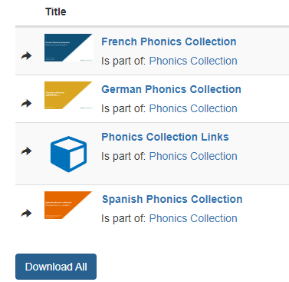
Phonics
Add the sound-symbol correspondences to SOW
Gather ideas and resources for practising them
Notes:
A useful point of departure for this is the NCELP portal.
There are resources for all of the SSC in the new subject content.

Slide 18
Phonétique: SSC [r]
Qui va avec chaque phrase?
lire/parler
Catherine
Arthur
Rosalie
Laurent
Beatrice
Rachid
Béatrice
1
Catherine
2
Laurent
3
…veut être
une vraie actrice.
…va travailler dur
dans l’usine*.
…roule en rond*
dans le vent.
Rosalie
4
Rachid
5
Arthur
6
…a nourri un wallaby en Australie.
…est sportif et
très rapide.
…fait un dessin
pur sur le mur*.
*usine = factory, rouler en rond = ride in circles, dessin = drawing, pur = pure, mur = wall
Notes:
Timing: 4 minutes
Aim: Consolidation of SSC [r]
Procedure:
Students read the phrases aloud in pairs and match them to each person.
Click on buttons to play the audio.
Students listen and check their answers.
Click to reveal answers.
Transcript:
Beatrice veut être une vrai actrice.
Catherine va travailler dur dans l’usine.
Laurent roule en rond dans le vent.
Rosalie a nourri un wallaby en Australie.
Rachid est sportif et très rapide. [re-recording in progress]
Arthur fait un dessin pur sur le mur.
Word frequency of cognates used (1 is the most frequent word in French): wallaby [>5000], solide [1414], pur [1643]
Source: Lonsdale, D., & Le Bras, Y. (2009). A Frequency Dictionary of French: Core vocabulary for learners London: Routledge.
Word frequency (1 is the most frequent word in French): usine [1482], rouler [2599], rond [2268], dessin [2624], mur [1335]
Source: Lonsdale, D., & Le Bras, Y. (2009). A Frequency Dictionary of French: Core vocabulary for learners London: Routledge.

Slide 19
Aquí tienes un mensaje de Lucía. ¡Faltan letras! Escucha y completa con las letras que no están.
escuchar / escribir
El año pasado viajamos a 1) Mála _ _ . El primer día nadamos en la Playa de la 2) Mala _ _ _ ta, y después visitamos el 3) Casti_ _o de 4) _ _ bralfaro. Luego
5) co _ _ mos el autobús hasta La 6) Va _ _ ada para hacer compras.
ga
*pescado = fish
*chiringuito = beach bar
*alquilar = to rent
*sombrilla = beach umbrella
gue
ll
Gi
gi
gu
También pasamos unos días en 7) To_ _emolinos, en el Hotel La 8) Ba_ _a _ _ da. Disfrutamos mucho la zona de la 9) _ _ ri _ uela porque comimos mucho 10) pes _ _ do en los 11) _ _ irin _ _ _ tos. En la Playa 12) Ba _ _ ndi_ _o
13) al _ _ _ lamos unas 14) sombri_ _as para evitar el
15) da _ o del sol.
rr
rr
cu
Ca
h
ca
ch
gui
jo
ll
qui
ll
ñ
Notes:
Timing: 5 minutes
Aim: to identify a range of SSCs.
Procedure:
1. Students listen to the recording and try to write the missing letters.
2. The teacher shows the answers one by one.
3. Then, students in pairs read out the text, paying attention to the pronunciation of the SSCs.
Notes:
Note that a callout will appear at the end inclidung all of the unkonw words in this activity.
Transcript:
El año pasado viajamos a Málaga. El primer día nadamos en la Playa de la Malagueta y después visitamos el Castillo de Gibralfaro. Luego
cogimos el autobús hasta La Vaguada para hacer compras.
También pasamos unos días en Torremolinos, en el Hotel La Barracuda. Disfrutamos mucho la zona de la Carihuela porque comimos mucho pescado en los chiringuitos. En la Playa Bajondillo
alquilamos unas sombrillas para evitar el daño del sol.
Frequency of unknown vocabulary:
pescado [3449]; chiringuito [>5000]; alquilar [3786]; sombrilla [>5000]
Sources:
Photo of la Malagueta by Reiseuhu, taken from unsplash.com.

Slide 20
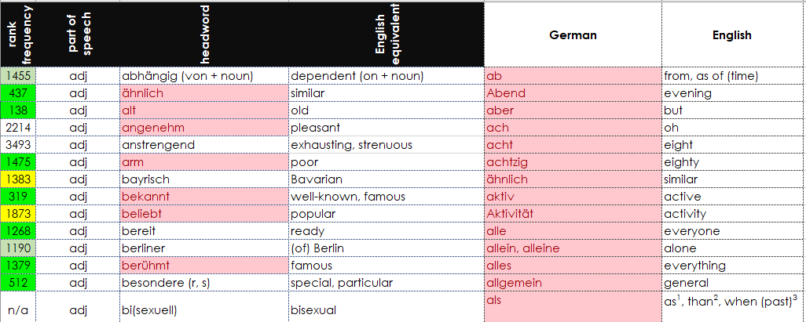
Vocabulary
Pink shows the words taught at KS3 which are also on the exemplar GCSE list.
Download the NCELP exemplar GCSE list
Paste your KS3 SOW vocabulary into it
Select columns C and E
Use Conditional formatting 🡪 Highlight rules 🡪 Duplicate cells
Do a manual check of any unhighlighted cells in column E
Notes:
We want to know how much of the current KS3 vocabulary we teach is likely to be on the GCSE word list. It will be some months before we have AO word lists BUT we do know that all lists must have 85% of the 1200 and 1700 words within the most common 2000 so there is likely to be a large degree of overlap. One quick check we can do is to compare the NCELP exemplar GCSE list with our own KS3 SOW list of words. This is a rough and ready way to do it (without formulae!) The reason for the manual check is that the format of your KS3 list won’t be exactly the same. E.g. remove any articles from nouns. If any of your words have additional punctuation or brackets within the cell then it won’t show up as an exact duplicate, so worth spending a little time tidying it up to get a more accurate picture. We can use the highlighted KS3 list to prioritise vocabulary for learning and testing.
Even without any other changes to vocabulary content, this initial step is useful. Individual depts will need to decide if to make any further changes (i.e. take out particular vocabulary, put in other high frequency).
Regular vocabulary learning and testing seems important, too.

Slide 21
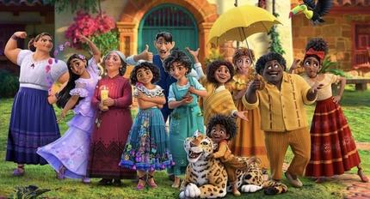
La familia Madrigal
*el don mágico = magical gift, talent
[1/2]
leer
*curar = to cure
Escucha y comprueba las respuestas de los deberes.
En la 1) ________ escena de la película, 2) ________ ver la casa Madrigal. Es una casa bonita de color 3) __________. Está 4) ________ de flores. La protagonista, Mirabel, 5) __________ a sus familiares:
• La madre, Julieta, tiene 50 años. Ella 6) ________ curar* a la gente enferma con su comida.
• El 7) ________, Agustín, no tiene un don mágico*. Es parte de la familia 8)________ es el esposo de Julieta. Él la 9) ______ y la apoya.
• La 10) ________ se llama Alma. Tiene 70 años. Ella es la “jefa” de la 11)________.
primera
puedes
amarillo
llena
ama | porque
fuerte | abuela
padre | amarillo
muchas | presenta
prima | primera
puede | pelo
está | primo
llena | ver
familia | puedes
presenta
puede
2. La mala calidad del medio ambiente causa 12,6 millones de muertes al año
padre
porque
ama
abuela
familia
Notes:
Homework tasks that are vocabulary focused don’t just need to be on Quizlet or similar. By Y8 and Y9 students will have quite a bunch of words that they are revisiting each week – these could be revisited via a reading gap fill like this. The key thing is to set the revisiting schedule. And to ensure that students are learning new and revisiting previously taught vocabulary every week. Trying to produce vocabulary from memory will be an important part of the learning routine.
Timing: 8 minutes
Aims:
i) to review the answers for the homework task set last week (9.3.2.1).
ii) to develop fluency in decoding by reading aloud the student versions. iii) to revisit Y7 and Y8 vocabulary in a new context
Procedure:
It is assumed that students begin class having completed last week’s homework activity, either on the word doc or simply as notes in their books (e.g. 1=primera, 2=puedes).
Students listen to the audio and check their answers.
Click to reveal each answer.
Note: the HW task set a time limit and asked students to try to replace at least ten of the words, so it’s to be expected that they might not have got them all.
Word frequency (1 is the most frequent word in Spanish):
curar [2449]; don [2854]; mágico [2518]
Source: Davies, M. & Davies, K. (2018). A frequency dictionary of Spanish: Core vocabulary for learners (2nd ed.). Routledge: London
Image by Disney at: https://en.wikipedia.org/wiki/Encanto_(film) and usable under the Fair Dealing Law in the UK.

Slide 22
Vocabulario
*la forma = way, shape
[2/2]
leer
• La 12) ________, Dolores, es una chica que puede oír ruidos muy bajos.
• El 13) ________, Camilo, es un chico que puede cambiar de forma* para parecer una persona diferente.
• El tío, Bruno, puede 14) ________ el futuro.
• La hermana mayor, Luisa, es muy 15) ________. Puede levantar 16)_________ cosas sin problema.
• La otra hermana mayor, Isabela, tiene el 17) ________ largo y negro. Las plantas crecen mágicamente cuando ella 18) ________ cerca.
prima
ama | porque
fuerte | abuela
padre | amarillo
muchas | presenta
prima | primera
puede | pelo
está | primo
llena | ver
familia | puedes
primo
ver
fuerte
muchas
pelo
está
Notes:
See instructions below the previous slide

Slide 23
Grammar for manipulation
Consider very short explicit explanations (as a leveller)
Make the grammar task essential in L, S, R and writing tasks
Build sentences from the outset 🡪 desirable difficulty

Slide 24
Aktivitäten im Schwarzwald [16/8]
schreiben
[Schwarzwalder
Kirschtorte]
[durch den Park]
I / I have
you / you have
she / she has
[ins Kanu]
[mit der Bahn]
travel / travelled
he / he has
Did I / Have I
[schöne Lieder]
[Tee]
Did you / Have you
Bist du mit der Bahn gefahren?
Did she / Has she
[mit dem Flugzeug]
[Tischtennis]
Did he / Has he

Slide 25
Aktivitäten im Schwarzwald [8/8]
schreiben
[Schwarzwalder
Kirschtorte]
[durch den Park]
I / I have
you / you have
she / she has
[ins Kanu]
[mit der Bahn]
play / played
he / he has
Did I / Have I
[schöne Lieder]
[Tee]
Did you / Have you
Did she / Has she
Hat er Tischtennis gespielt?
[mit dem Flugzeug]
[Tischtennis]
Did he / Has he

Slide 26
Wie heißt das auf Deutsch? [5/6]
schreiben
Letzte Woche
vor 3 Wochen
Schloss
dass
schnell
gefallen
schwer
gern
Hobby
ihm
Leid
tun
meinen
langsam
andere(r,s)
vor 9 Wochen
rund
Letztes Jahr
haben
Zeit
gemeinsam
Schüler
Keks
ähnlich
viel
arbeiten
verbringen
neu
Aufgabe
zusammen
He thinks that the other task is difficult.
Er meint, dass die andere Aufgabe schwer ist.
Notes:
[5/6]

Slide 27
Wie heißt das auf Deutsch? [6/6]
schreiben
Letzte Woche
vor 3 Wochen
Schloss
dass
schnell
gefallen
schwer
gern
Hobby
ihm
Leid
tun
meinen
langsam
andere(r,s)
vor 9 Wochen
rund
Letztes Jahr
haben
Zeit
gemeinsam
Schüler
Keks
ähnlich
viel
arbeiten
verbringen
neu
Aufgabe
zusammen
He worked slowly and he is sorry.
Er hat langsam gearbeitet und es tut ihm Leid.
Notes:
[6/6]

Slide 28
Una tarde en el parque de atracciones
*cafe = el café
escribir / hablar
*ride = la atracción
Usa las palabras para hacer una frase en español.
That (m) | boy | is (trait) | less full than | the cafe*
That (f) | ride* | is (state) | less expensive than | the first one (f)
 | size | seems | bigger than | the Mexican food
 | food |  | less happy than | the t-shirt
 | souvenir |  | healthier than | the price in your city
 | place |  | worse than | his friend (f)
 | restaurant |  | faster than | the park in my town
 |  |  | better than | the other one (f)
Ese chico está menos contento que su amiga.
Ese recuerdo es menos caro que la camiseta.
Esa atracción es más rápida que la otra.
Esa talla parece mejor que la primera.
Ese sitio es más grande que el parque en mi pueblo.
Esa comida parece más sana que la comida mexicana.
Ese restaurante está menos lleno que el café.
Notes:
Rather than building sentences with frames that have too large a ‘grain size’ – i.e. they rely too much on the notion that eventually they will just remember the phrases rather than understanding how the individual words link together, consider more finely tuned tasks that compel the learner to make key grammatical choices when they complete them. Here, for example, students have to produce (with TL words in the frame, it would be a case of selecting) the words indicated – i.e. the correct form of ‘that’, the correct verb and appropriate sentence endings.
Timing: 10 minutes
Aim:
to write sentences using the demonstrative adjectives ‘ese’ and ‘esa’ and comparatives, using the prompts.
to practise producing new and revisited vocabulary in writing.
Procedure:
The teacher brings up each combination of sentence parts
Students can be asked to write the Spanish on mini-whiteboards or in their books, then volunteer the answer orally.
Students could then create a number of their own sentences, using new combinations of words in the grid. Students can be encouraged to use the rectangles that haven’t yet been used (‘worse than’, ‘in price in your city’).
After writing the even sentences, the teacher could encourage an oral simultaneous translation task, where students say a sentence and their partner translates it. Some may find this challenging to do on the spot, so this oral component could be done by some students, while other students continue to practise writing.
A final question could involve the teacher writing a sentence down from the elements provided, but not showing it. Every student also writes down one sentence, trying to use their sixth sense to make it as similar as possible to the teacher’s sentence. Great minds think alike!
Sentences:
That food seems healthier than the Mexican food. (Esa comida parece más sana que la comida mexicana.)
That place is bigger than the park in my town. (Este sitio es más grande que el parque en mi pueblo.)
That ride is faster than the other one. (Esta atracción es más rápida que la otra.)
That souvenir is less expensive than the t-shirt. (Ese recuerdo es menos caro que la camiseta.)
That boy is less happy than his friend (m). (Ese chico está menos contento que su amigo.)
That size is better than the first one. (Esa talla es mejor que la primera).
That restaurant is less full than the café. (Ese restaurante está menos lleno que el café.)
Frequency of unknown words:
atracción [3473]; café [961]

Slide 29
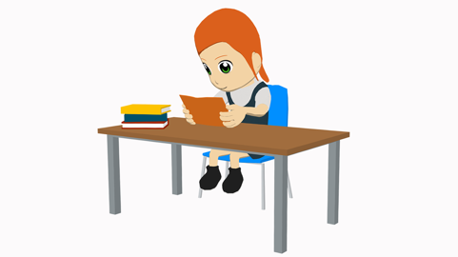
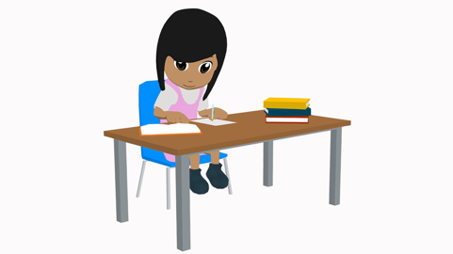
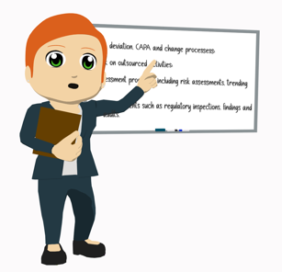
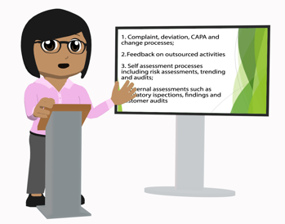
Imagina que estamos en el año 2040. Escribe 6 frases sobre la vida de Lucía y Nadia.
escribir
Pasado
Puedes usar estos verbos
estudiar destacar aprobar practicar jugar ganar trabajar dirigir explicar organizar enseñar analizar descubrir
Presente
Notes:
Timing: 8 minutes
Aim: to practise the use of verb forms in the 3rd person plural, both in present and in preterite.
Procedure:
Students look at the images and write phrases using the 3rd person plural in the corresponding tense.
Teachers walk around the classroom monitoring students’ work.
Notes:
Students can be encouraged to make up some extra information. They can expand their answers as much as they like/are able.
Note that this activity is in a similar format to the NCELP Applying your Knowledge Test.
Example phrases:
Pasado
Estudiaron/aprendieron ciencias.
Destacaron en clase por sus buenas notas.
Aprobaron los exámenes con buenas notas.
Practicaron deporte.
Jugaron a fútbol.
Ganaron premios.
Trabajaron en un bar/restaurante.
Ganaron dinero para...
Presente
Trabajan en una oficina/en el ordenador.
Explican objetivos/información a su equipo.
Enseñan ciencias/tecnología.
Analizan plantas/flores/la naturaleza. Descubren información nueva.

Slide 30
Unscripted speaking
Information gap tasks compel one student to listen and understand and the other to speak
Incremental speaking development from structured to freer tasks is important
Speaking without reliance on written prompts helps students to learn the language and retain it
Anticipate greater tolerance than currently for spoken errors to reward more independent production
Alter KS3 tasks and assessments from pre-learnt answers to conversation questions to unscripted tasks
Notes:
Instead of rehearsing answers to conversation questions, the new GCSE will require students to speak in unrehearsed situations, composing sentences themselves from individual words that they know. They will be able to complete all tasks using words from the word list (but if they have learnt other words and use them successfully they will receive equal credit for them). Because the context for speaking will be largely unprepared, (but with short preparation time to read the read aloud text (in inner voice), to look at the picture(s) and make some notes, and to prepare their responses to the role play prompts). Two unprepared interactions are included, one about the picture and one following the read aloud.
This means that quite a lot of the speaking will be about interaction – students will need to understand what is being said to them, and then use clear, comprehensible speech when they talk.
We should anticipate more thoughtful communication than currently (likely to be somewhat slower, likely to contain more errors than the delivery of memorised material does) and we should expect the markschemes to reflect this. There won’t be a way to know the questions in advance, so this will come closer to a ‘real’ world conversation in terms of the skills and knowledge needed than we have previously experienced.

Slide 31
hablar / escuchar
¿Quién es? – QUIZ QUIZ TRADE
Elige un personaje. Escribe tres pistas* para describir la persona en español. La primera pista no debe ser obvia*. Después escribe otras dos frases más fáciles. Debes esconder tu trabajo - ¡es secreto!
Estudiante A lee las pistas* a Estudiante B.
Después de cada pista* Persona B puede intentar decir quién es el personaje.
Ejemplo:
Estudiante A :
Estudiante B :
Es joven.
¿María?
No, es moreno.
Es joven.
Es moreno.
Tiene el pelo negro.
[Quique]
¿Adrián?
No, tiene el pelo negro.
¿Quique?
¡Sí!
la pista = clue
Notes:
OPTIONAL – ALTERNATIVE FINAL ACTIVITY
This alternative final activity gives the option for students to be more creative with their language.
Timing: 10 min.
Aim:
i) to practise producing and understanding sentences describing a person’s appearance, personality and/or mood
ii) to practise producing and understanding vocabulary
Procedure:
After going through this instruction slide, display the following slide. Students choose a character and write down 3 clues on a piece of paper which will describe the character they have chosen. They should write the clues in order of difficulty, i.e., with the least obvious clue first and the most obvious clue last. They should also write the character’s name. They should not show their work their classmates.
Students then move around the room with their clues and find somebody to speak to.
Student A reads their clues to Student B.
After each clue, the student B can guess which character they think is being described.
Students then swap roles.
Once both students have read out their clues, they swap their pieces of paper and then move on to another student in the class and repeat steps 3-6.
Notes:
Alternatively, rather than using the characters on the following slide, students could describe another member of their class.
Slide 16 is an optional support slide that gives students ideas of what clues they could give and slide 17 gives the answers to those clues.
Students can challenge themselves to refer less to their written notes as they go through the activity.
Slide 18 has an alternative version of the activity using characters from the film ‘Encanto’.
Frequency of unknown words:
pista [2150]

Slide 32
hablar
1
2
3
4
5
6
[Marta]
[Enrique]
[Pablo]
[Quique]
[Irene]
[David]
7
8
9
10
11
12
[Alba]
[Adrián]
[Nerea]
[Pepa]
[Pablo]
[Marta]
*rubio/a = blonde
Notes:
DISPLAY THIS SLIDE DURING THE ACTIVITY
See previous slide for task instructions
Word frequency (1 is the most frequent word in Spanish):
rubio [2861]; gafas [>5000]

Slide 33
hablar
1
2
3
4
5
6
She is excited.
She is young.
She is blond.
[Marta]
He is calm.
He is old.
He doesn’t have much hair.
[Enrique]
He is sad.
He is tired.
He is bored.
[Pablo]
He’s young.
He’s happy.
He has black hair.
[Quique]
She’s thinking.
She has long hair.
She’s sad.
[Irene]
He’s dark-skinned.
He wears glasses.
He is proud.
[David]
7
8
9
10
11
12
She has blue eyes.
She is serious.
She is blond.
[Alba]
He has brown hair.
He is calm.
He’s greeting somebody.
[Adrián]
She has long hair.
She is strange.
She’s angry.
[Nerea]
She is calm.
She wears glasses.
She has grey hair.
[Pepa]
He is old.
He has glasses.
He is angry.
[Pablo]
She is calm.
She is beautiful.
She is not sad.
[Marta]
*rubio/a = blonde
Notes:
OPTIONAL SUPPORT SLIDE
This slide can be used to give students ideas for the descriptions that they could give in Spanish.
Word frequency (1 is the most frequent word in Spanish):
rubio [2861]; gafas [>5000]

Slide 34
Articulate! Un juego
Jugáis en grupos de cuatro.
Una pareja juega contra otra pareja.
El primer jugador elige una palabra de la lista.
Tiene que describir la palabra a su pareja sin decir la palabra.
Su pareja debe decir la palabra correcta.
La pareja con más palabras correctas gana.
Por ejemplo: moderno:
“Describe una idea o un producto que es nuevo.”
You can give your partner some clues:
”Empieza con la letra…”
“es un adjetivo/verbo/nombre”
Notes:
A task from towards the end of Y9
[1/3]
Timing: 6 minutes
Aim: Oral and written production of this week’s new and revisited vocabulary; circumlocution practice.
This task can be done with three levels of challenge:
High challenge: Students take a Spanish word and describe it in Spanish without the aid of additional clues.
Medium challenge: Students translate the printed English clues (slide 29) to their partner, who guesses the Spanish word.
Low challenge: Students can read the printed Spanish clues to their partner (slide 30), who guesses the Spanish word.
Procedure: 1. Students work in pairs together with another pair.
2. The first player in each pair chooses a word on the list and tries to describe it without using the word itself (use the example on the slide to demonstrate).
3. The listening player in each pair tries to guess which word on the list is being described. They can have two guesses at most! If the word is guessed correctly, it is crossed off the list and the team scores a point. The opposing team can police this!
4. Play passes to the listening player who now chooses a new word.
5. Students repeat steps 2-4 for a total of three minutes. The easiest words will be snapped up first, so the game gets harder as it goes on.
6. The team with the most points after 3 minutes is the winner.
Word frequency of unknown words (1 is the most frequent word in Spanish):
medio [395]

Slide 35
Articulate! English clues
hablar
la sed
You have it when you need to drink.
cierto, cierta
Another word for ‘true’.
el restaurante
You go to this place to have diner with your family or friends.
la cola
When you wait with other people, one behind the other.
gratis
It describes something that you don’t have to pay.
la hambre
You have it when you need to eat.
único, única
When there is only one.
el dueño
This words describes a person who has something, a house, a car, a bar...
moderno, moderna
Another word to describe something that is new.
la talla
When you buy clotes you look at this information to know if it’s big or small.
el recuerdo
Something that people have to remember the holidays.
maravilloso, maravillosa
Another word for great.
el aire
Where birds and planes can fly.
normal
It describes something that is not strange or something that happens everyday.
optimista
A person with a lot of hope that sees the glass half* empty.
*medio
el transporte
An example is the metro, or the train.
la escritora
A woman that writes books.
eras
Like ‘eres’ but in the past.
México
A country famous for the Day of the Dead.
popular
It describes something that a lot of people like.
Notes:
[3/4] For printing: clues in English

Slide 36
Articulate! Spanish clues
hablar
la sed
La tienes cuando necesitas beber.
cierto, cierta
Otra palabra para ‘verdadero’.
el restaurante
Vas a ese sitio para cenar con tu familia o amigos.
la cola
Cuando esperas con otras personas, una detrás de la otra.
gratis
Describe algo que no debes pagar.
el hambre
La tienes cuando necesitas comer.
único, única
Cuando solo hay uno.
el dueño
Esta palabra describe una persona que tiene algo: una casa, un coche, un bar...
moderno, moderna
Otra palabra para describir algo que es nuevo.
la talla
Cuando compras ropa miras esta información para saber si es grande o pequeña.
el recuerdo
Algo que compra la gente para acordarse de las vacaciones.
maravilloso, maravillosa
Otra palabra para ‘genial’.
el aire
Donde los pájaros y los aviones pueden volar.
normal
Describe algo que no es raro o una cosa que ocurre cada día.
optimista
Una persona con mucha esperanza, Ve el vaso medio* lleno.
*half
el transporte
Un ejemplo es el metro o el tren.
la escritora
Una mujer que escribe libros.
eras
Como ‘eres’ pero en el pasado
México
Un país famoso por el Día de Muertos
popular
Un adjetivo para describir algo que le gusta a mucha gente.
Notes:
[2/4] For printing: clues in Spanish

Slide 37
L’école au Sénégal
parler
Partenaire A
Ask your partner about their life at school. Use you plural.
What is your school like?
What are your French lessons like?
Are your maths exercises easy?
What is your favourite sport?
Answer your partner’s questions about your life at school. Use the we form in full sentences.
yelllow
strict but funny
science and maths
Wolof
Partenaire B
Answer your partner’s questions about your life at school. Use the we form in full sentences.
small
useful
difficult
football
Ask your partner about their life at school. Use you plural.
What are your uniforms like?
Is your teacher strict?
What are your favourite subjects?
What is your first language?
Notes:
Timing: 5 minutes [slide 1/2]
Aim: Oral production of inversion questions and possessive adjectives
Procedure:
1. Pupils take the roles of Senegalese pupils and ask and answer each other questions.
2. Suggested answers are on the next slide.
Word frequency of cognates used (1 is the most frequent word in French): wolof [>5000]
Source: Lonsdale, D., & Le Bras, Y. (2009). A Frequency Dictionary of French: Core vocabulary for learners London: Routledge.

Slide 38
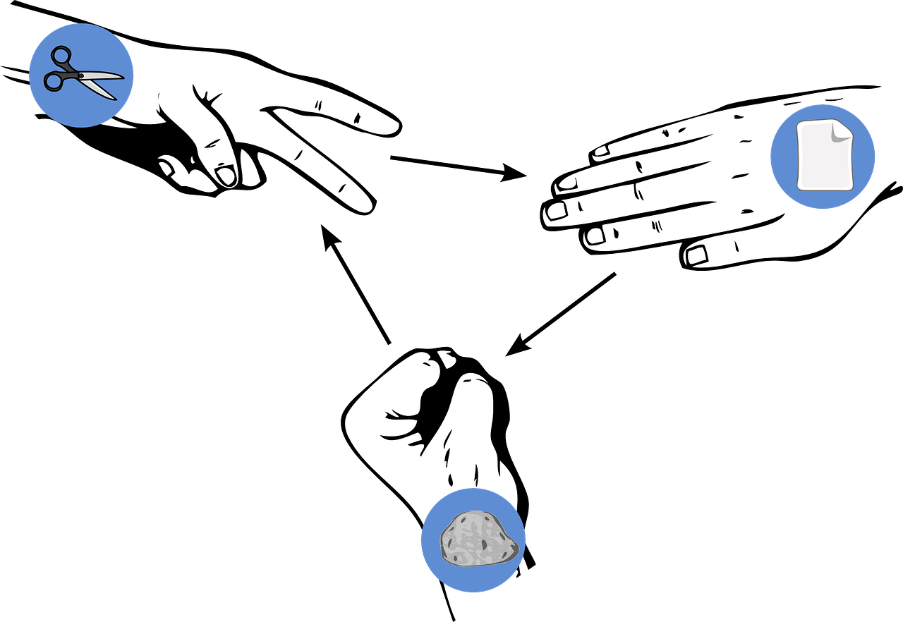
Follow up 4
Pierre-feuille-ciseaux*
Choose three objects and write three sentences in French saying what you have: ‘I have…’
écrire
parler
Choose three more objects and write three sentences saying what your partner has: ‘You have…’
Read your sentences. If your partner has the same sentence as you, play rock-paper-scissors. The loser must write/say a different sentence. Play until you have successfully said all your sentences.
Exemple:
J’ai un chat gris.
J’ai un chat gris, aussi !
J’ai une maison verte.
Partenaire A
Partenaire B
[a grey cat]
*Rock-paper-scissors
Notes:
Timing: 5-10 minutes (two rounds of speaking activity)
Aim: to practise oral production and comprehension of singular nouns with indefinite articles and adjectives, and two parts of the verb AVOIR.
Note: This slide shows how the speaking task is intended to work. The stages are animated to support the teacher in modelling the task.
Procedure:
After modelling this example, display the next slide with 10 item choices.
Partner As ask first and Bs answer.
Then swap roles for Round 2.

Slide 39
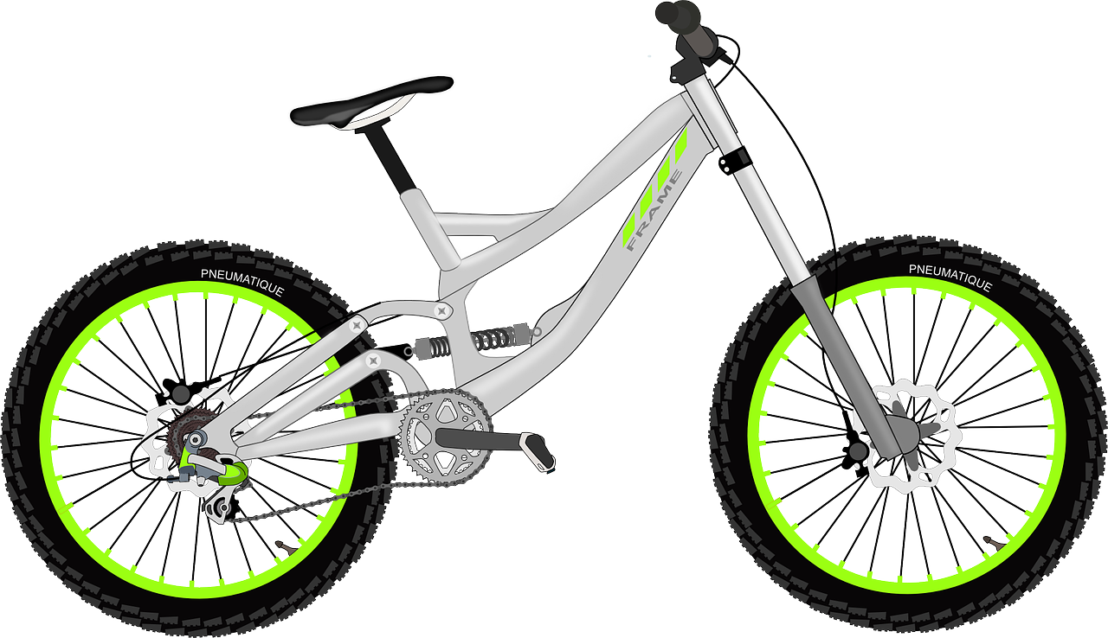
Follow up 4
pierre-feuille-ciseaux*
écrire
parler
[a funny book]
[a grey bike]
[an English game]
[a fast dog]
[a slow song]
Ça va ?
[a modern car]
[an expensive house]
[a French phrase]
[a green present]
[a grey horse]
*rock-paper-scissors
Notes:
DISPLAY THIS SLIDE FOR PUPILS DURING THE TASK.

Slide 40
Word patterns
Look up the GCSE word patterns resources on the NCELP portal
Check own KS3 word list for any words that are examples of these patterns

Slide 41
Lieblings-, Haupt-
Remember!
Lieblings- means favourite Haupt- means main
_________
_________
These prefixes can be added to almost any noun to make a new word.
favourite language 🢧
die Lieblingssprache
main place 🢧
der Hauptort
Note: two words in English become one word in German.
The gender of the new noun is the gender of the base word.
The gender of the new noun is the gender of the base word.
Notes:
Timing: 1 minute
Aim: to revisit the meaning of two known prefixes in German and their function in creating new nouns.
Procedure:
Click through the animations and elicit the meaning of the German as indicated.
Click to bring up callouts to compare German and English noun formation.

Slide 42
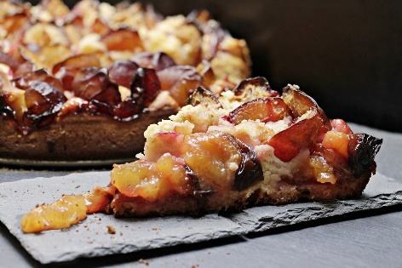
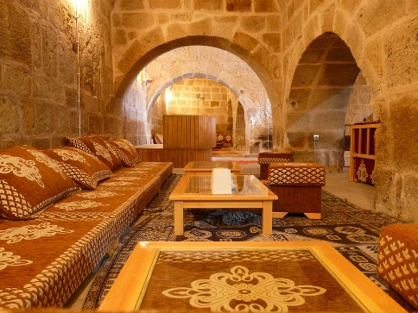
Vokabeln [1/2]
Hör zu. Ist es A, B, ? Schreib das englische Wort.
hören
C
A,B,C? Englisch
1
C
favourite animal
A
2
B
main door
B
A
main street
3
4
H
favourite course
E
D
F
main building
5
6
G
favourite room
7
E
favourite food
G
8
D
main language
F
H
Notes:
Timing: 15 minutes (three slides) – 10 minutes listening, 5 minutes spoken recall
Aim: to practise aural comprehension of vocabulary from this week’s revisited set from Y7 and Y8.
Procedure:
1. Give students a minute in pairs to look at the pictures and anticipate the vocabulary items they will hear.
2. Click the number triggers to play the audio.
3. Students match to the correct picture and write the word in English if they are able.
4. Click to bring up the answers.
Transcript:
1] Lieblingstier 2] Haupttür 3] Hauptstraße 4] Lieblingskurs 5] Hauptgebäude 6] Lieblingsraum 7] Lieblingsessen 8] Hauptsprache 9] Lieblingswald 10] Lieblingszeitung 11] Lieblingstag 12] Hauptessen 13] Hauptmoschee 14] Hauptberg 15] Lieblingsbild 16] Hauptarbeit

Slide 43
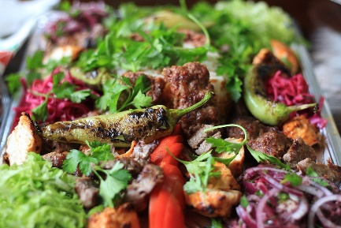
Vokabeln [2/2]
hören
A,B,C? Englisch
K
I
J
9
P
favourite wood
10
I
favourite newspaper
11
L
favourite day
L
12
J
main meal
M
N
13
K
main mosque
14
M
main mountain
15
N
favourite picture
O
P
16
O
main work

Slide 44
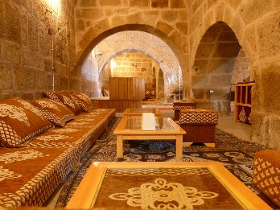
Vokabeln
sprechen
Sag die Wörter so schnell wie möglich.
A
B
C
D
favourite wood/forest
main door
favourite food
main meal
E
F
G
H
main language
main street
main mosque
favourite day
I
J
K
L
favourite room
favourite course
main mountain
favourite animal
M
N
O
P
main building
main work
favourite newspaper
favourite picture
Notes:
Timing: 5 minutes Aim: to practise spoken recall of compound nouns with Lieblings- and Haupt- prefixes and known vocabulary base words from this week’s vocabulary set.
Procedure:
Students work in pairs.
One says a random letter and the other says the word in German as fast as possible.
Students take turns.

Slide 45
German compound nouns
Separate unfamiliar words to try to understand them.
German often combines two (or more!) nouns to make one word, a compound noun.
Beispiel:
der Urlaub 🡪 der Campingurlaub
___ Camping + ___ Urlaub 🡪
das
der
der
camping holiday 🡪
?
___ Campingurlaub
The gender of the new noun is the gender of the final noun.
Sometimes, extra letters join the two nouns to make the new noun easier to say: -s-, -es-, -e-, -n-, -en-, -(e)r-
What is the definite article (‘the’) for these compound nouns?
holiday money 🡪
Urlaub + Geld 🡪
das
____ Urlaubsgeld
daily newspaper 🡪
Tag + -es- + Zeitung 🡪
die
____ Tageszeitung
market place 🡪
Markt + Platz 🡪
der
____ Marktplatz
So, German has some very long words. For example…
das Rindfleischetikettierungsüberwachungsaufgabenübertragungsgesetz
Notes:
Developing vocabulary knowledge One of the most fascinating things about German is its habit of joining nouns to make new words, new meanings. This is the first formal introduction to compound nouns in German. It is taken from a lesson in the second half of term 2. In Term 1.1 Week 7 students previously learnt the prefix ‘Lieblings-’ and the way it combines with other nouns: Lieblingsband, Lieblingsbuch, Lieblingsfilm, Lieblingslehrerin, Lieblingslied, Lieblingssäanger, Lieblingssängerin die Band [<4034] das Buch [295] der Film [524] die Lehrerin [2696] das Lied [1726] der Sänger [3916] die Sängerin [3916] Lieblings- [>4034]
This slide looks busy but the animations break the content into very small steps. It is designed to work interactively, with the teacher eliciting responses from students at every stage to gauge their understanding. The main knowledge is that: 1] German combines nouns to make single, new words. 2] The gender of the new word is the gender of the final noun 3] Some additional letters can be required (the rules for these are complex and have many exceptions so will not be explicitly taught so students will not automatically be able to produce accurate new compound nouns themselves) 4] However, they will vastly increase their receptive vocabulary and often be able to comprehend compound nous, even if only one part is known, by using the surrounding context in addition. They should be encouraged, when faced with apparently unfamiliar, to try to separate them, as they may find they know both nouns, individually. The final item is for fun, and teachers may omit, if preferred. The information point is that German places no limits on the number of nouns that can be combined, which leads to some very long German words. This particular example has 63 letters. Word for word in English it means ‘beef-meat labelling monitoring tasks legislative law’
Or, slightly more freely translated, it means: ‘legislative law for the monitoring of beef labelling’

Slide 46
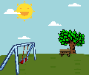
3 Lieblingsurlaube. Separate the words. Was ist das auf Englisch?
1 Schreib den Artikel (der, die, das, die). Schreib das Wort auf Englisch, auch.
Sometimes the English is NOT a word-for-word translation, and could also be one word: das Haustier 🡪 house animal 🡪 pet! Try exercise 2. The pictures may help.
1 ____ Lieblingsnummer
2 ____ Deutschunterricht
3 ____ Frühzug
4 ____ Sprachschule
5 ____ Wochentag
Winterurlaub
Aktivurlaub
Rucksackurlaub
Familienurlaub
Tagesurlaub
Bootsurlaub
Strandurlaub
winter holiday
die
favourite number
der
German lesson
activity holiday / active holiday
der
early train
backpacking holiday
die
language school
family holiday
der
week day
day’s holiday
boating holiday
beach holiday
2 Schreib den Artikel (der, die, das, die). Schreib das Wort auf Englisch, auch.
4 Urlaubssachen Separate the words. Was ist das auf Englisch?
die
____ Haustür
____ Liebespaar
____ Spielplatz
____ Grünblau
____ Schlafzimmer
front door
____ Urlaubstag
____ Urlaubsideen
____ Urlaubsort
____ Urlaubshotel
____ Urlaubsgeld
der
holiday day
das
(romantic)couple
die
holiday ideas
der
playground
der
holiday place / location
das
greeny blue
das
holiday hotel
das
bedroom
das
holiday money
Notes:
Vocabulary development - compound nouns Note: This task also includes three words from the revisited sets for this week: der Zug [613] der Platz [344] grün [556] In tasks 1 and 2, all words have been previously taught within the SOW, although some featured as verbs - e.g. lieben (Liebe as phonics source word), schlafen.
Lieblings- [>4037] Nummer [1048] Deutsch [105] Unterricht [1107] früh [322] Sprache [1791] Schule [208] Woche [209] Tag [108] Haus [159] Tür [400] Liebe [843] lieben [816] Paar [284] Spiel [500] Platz [344] grün [556] blau [1016] schlafen [787] Zimmer [609] There is a clear overlap with word families work, here, though the focus is on compound nouns. Subsequent lessons will explore links between word classes: how verbs become nouns, nouns become verbs etc.. Task 1:
We first practise the application of gender knowledge of previously taught nouns, combining them to make new compound nouns, which students should then also know the meaning of, without reference to a dictionary. This reinforces the importance of gender knowledge, which is a theme running right through this SOW! Task 2: Using previously-taught words, students are again asked to provide the gender and the English meaning. This time, however, the English meanings are less transparent, and require further thinking. This represents a very important opportunity for developing vocabulary depth - many high-frequency words have multiple meanings. Students have been taught these words previously in one context. The way they are combined here is often with a slightly different meaning. Task 3: This task moves us into the theme of holidays. Second, we practise segmentation of some compound nouns, all starting or ending with the word Urlaub. Some of these will feature previously taught language, some will contain cognates, and finally, others with have unfamiliar words. With the unfamiliar words, it is not expected that students guess the meaning. They are to segment the word, and then look up the unfamiliar part to try to work out its meaning. Note: in good online dictionaries many compound nouns will be listed. However, typically school paper dictionaries may not, and either way, it is helpful for students to recognise the usefulness of breaking compound nouns down into their component nouns, as a comprehension strategy. Ask the students why they don’t need to work out the articles in Task 3 (answer - they will all be ‘der’ like ‘der Urlaub’). der Urlaub [1192] is in this week’s vocabulary set. Winter [1288] is a cognate and was met in the Christmas lesson sequence; aktiv [861] a near cognate; Rucksack [3915] cognate and previously met; Familie [310] previously taught; Tag [108] is known but the -es may confuse at first; Boot [1927] not yet met - will need looking up; Strand [2047] not yet met - will need looking up.
Task 4 This task continues the focus on holidays, but this time, Urlaub- is the first word, meaning that the genders need to be worked out, as well as the English meanings. All words were previously taught, except the cognate Hotel. Tag [108], Idee [641] Ort [383] Hotel - cognate [1129] Geld [249] Note: Not all tasks need to be completed in one lesson. Teachers to differentiate for their own classes.

Slide 47
and later… inference and depth of word knowledge

Slide 48
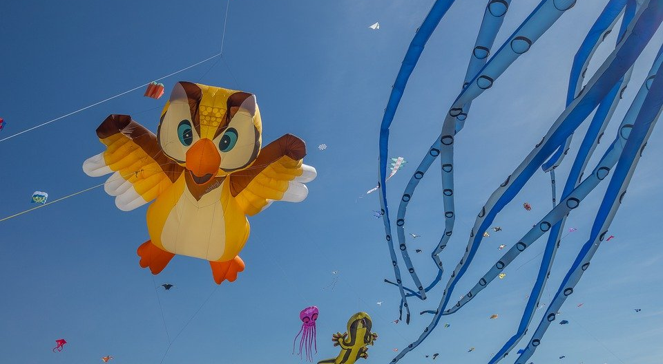
Le festival de Dieppe
lire
*le plus grand =
the biggest
*le cerf-volant = kite
*le son = sound
Comment dit-on les mots orange en anglais ?
What noun does this word look like?
What adjective does this word look like?
What noun does this word look like?
Le festival de Dieppe est le plus grand* festival de cerfs-volants* au monde.
On trouve le festival sur la plage.
Les visiteurs viennent de beaucoup de pays pour regarder des cerfs-volants traditionnels, de l'art et des acrobates. Un aspect important du festival est qu’on peut visiter sans acheter de billet. Il est gratuit !
Il y a beaucoup d'activités pour les enfants et le festival encourage l'imagination. Cet événement culturel célèbre les relations internationales. Pendant le dernier week-end du festival, on regarde les cerfs-volants illuminés pendant un show son* et lumière. Je pense à visiter le festival. Tu veut voyager au festival avec ma famille ?
visitors
What does this sentence tell you about the festival?
acrobats
traditional
The start of this word looks like the English
free
What adjective does this look like?
This word has the same stem as the previous one you worked out. What might it mean?
event
illuminated
light
What words that you already know could you use instead of the words in orange?
Answer the question at the end.
Notes:
Here is a text about a kite-festival in Dieppe with lots of language awareness activities to help learners understand cognates
Then drawing on their current lexicons – which we know what they are precisely as they have been tracked so carefully - to replace the words
Then giving their reaction to the content of the text by answering a question about whether they would like to go to the festival
----------
Timing: 5 minutes
Aim: Developing inferencing skills by using surrounding context to work out meaning of unknown words; word substitution with known words.
Procedure:
Students try to work out the meaning of the highlighted words based on context (text and images) and similarity to English words.
If students need some help, click to bring up a clue
Click gain to reveal the translations.
Click to bring up the extension. Students think of known words that could replace the orange words to make a sensible sentence.
Some suggested answers:
visiteurs -> gens, enfants, personnes … any relevant noun to describe people
traditionnels -> grands, nouveaux… any relevant adjective to describe kites
acrobates -> artistes, chanteurs … any relevant noun to describe performers
événement -> lieu, festival … (note that any relevant masculine noun works here but ‘cet’ would need to change to agree)
illuminés -> verts, bons … any relevant adjective to describe kites
lumière -> musique, film … any relevant noun to describe a show

Slide 49
Hanoucca
Inferencing, in curriculum and assessment?
Use the words you know to choose the general meaning of the words in bold.
Pour la communauté juive, la fête importante de décembre est Hanoucca. C’est une fête de lumières et on utilise des bougies pour célébrer. La fête est de huit jours, et on allume une bougie le premier jour, deux bougies la deuxième jour … Les bougies sont un symbole de la bonté de Dieu. Dans une vieille histoire juive, une petite bouteille d’huile a nourri une lampe pendant huit jours, beaucoup plus de temps que normalement. On mange des beignets comme un symbole de l’huile. Les enfants jouent avec des toupies qui contiennent une phrase religieuse. Hanoucca est plus familial et spirituel que religieux.
bonté : part of body / personality / room / song
huile : a type of wood / plant / liquid / shoe
beignet : a type of drink / chair / cup / food
toupie : a type of toy / book / hat / sweet
goodness
oil
doughnut
spinning top
Notes:
Here is a text about Hanoucca
Followed by some practice at inferencing the meaning of words by using the words that we know they have already met several times and have been tested on
At this stage, lexical inferencing becomes possible because we are confident that they have a critical mass of vocabulary to start doing this.
Timing: 5 minutes Aim: to practise lexical inferencing; the written comprehension of known words to arrive at a general understanding of one unknown word in a sentence context. In addition, to revise previously learnt vocabulary in new contexts. Procedure: 1. Ensure that students understand the task (as this is the first time they are doing this type of activity). Students need to know that they are aiming to understand the general meaning, rather than specific meaning (though they may in some cases also arrive at this).
2. Students read each text and decide which of the four options is most likely, depending on their understanding of the surrounding words.
3. Click to reveal answers.
4. Proceed to the next slide for the comprehension part of the activity.
Word frequency of unknown words used (1 is the most frequent word in French):
lumière [1059], allumer [3169], bougie [>5000], deuxième [427], bonté [>5000], huile [2340], beignet [>5000], toupie [>5000]
Word frequency of cognates used (1 is the most frequent word in French): Hanoucca [>5000], bouteille [2979], lampe [4699], normal [833], familial [1622], spirituel [3047]
Source: Lonsdale, D., & Le Bras, Y. (2009). A Frequency Dictionary of French: Core vocabulary for learners London: Routledge.

Slide 50
Session overview
Rationale for the GCSE review
Issues with the current GCSE
Comparing 2015 and 2022: similarities and differences
The implications for teaching and assessment(s)
What we can do now
Notes:
Now let’s move on to what we can do now.

Slide 51
Further resources and support from NCELP
Sound-symbol correspondences are systematically taught and revisited from Y7-Y9, with frequent read aloud and transcription opportunities 🡪 phonics collection
Vocabulary selection for the fully resourced SOW is frequency-informed, comprises at least 90% words from a list of the most frequent 2000, and is systematically revisited 🡪 SOW
Grammar is explicitly taught, thoroughly practised in listening, reading, speaking and writing activities, and regularly revisited
Texts and listening extracts are carefully designed for 100% readability, with unknown words glossed
There are sample GCSE word lists available
Link to all resource collections
Notes:
In terms of further resources and support from NCELP, it’s probably helpful to flag some sets of resources that are worth exploring on the NCELP portal.
[cue animation] For departments that don’t currently teach phonics, or who want to enrich their resources for so doing, there is a new phonics collection on the portal, which comes with an excel list of each of the SSCs, the sound-spelling correspondences that are listed in the new GCSE grammar appendices, with links to all of the resources that exist so far for teaching and practising that SSC. The full collection can be downloaded with one click OR just the excel document which itself contains the URLs to each resource.
[cue animation]
There are fully resourced, lesson by lesson SOW for Y7, 8 and most of Y9 already available on the resource portal.
[cue animation]
In those lesson resources grammar is explicitly taught from Y7, thoroughly practised in listening, reading, speaking and writing activities, and regularly revisited across KS3.
[cue animation]
The texts and listening extracts included are carefully designed for 100% readability, and unknown words are glossed, as per the approach in the new GCSE.
[cue animation]
There are examples of word lists in line with the parameters of the GCSE Subject Content for French, German, and Spanish. Note that the awarding organisations themselves are responsible for creating the word lists. These are just prototype exemplars.
In terms of next steps, one thing that we can strongly recommend is that you sign up for the NCELP CPD course for the autumn term. [Move to next slide]

Slide 52
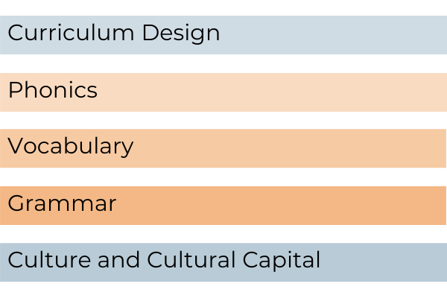
CPD offer
CPD course is free
Content is research-informed languages teaching at KS3 and KS4
5 remote learning sessions of 2.5 hours
Course leaders are NCELP Specialist Teachers
Additional online peer and instructor support
An online self-study version of the course will be available for anyone to access for free (and to facilitate a cascade model)
There is a link to register for the course here: www.ncelp.org/cpd
Notes:
So, finally, just to say that I hope that the session has been interesting and useful.
Time in one session is obviously limited and I would therefore really strongly encourage you to sign up for our next round of CPD course taking place in the autumn term.
The NCELP CPD course is free to schools that receive public funding from the government.
The content is research-informed languages teaching at KS3 and KS4. The central purpose of the Centre’s work is to bring teachers and teaching and researchers and research into closer collaboration.
The Centre’s pedagogy aligns strongly with the new GCSE, the Ofsted Framework, the ECF and Rosenshine principles.
As much as possible, participants will be assigned to courses regionally - led by an NCELP Course Leader near them, with other participants from their region. This offers the potential to make the most of local networking and peer support, both online and potentially also face-to-face. We also have a self-study version of the course (with certification) for anyone who is unable to access a ‘live’ place.
(Finally please kindly complete the feedback poll/evaluation.)

Slide 53
Coffee 🡪 share ideas, think about next steps, questions

Slide 54
FAQ about vocabulary in the new GCSE
Why is it this number of words for F (1200/1250) and H (1700/1750)?
How many words can you know by GCSE?
Curriculum time available = 168 weeks (36 weeks/year over 5 years, minus one term in year 11)
Based on acquisition of ca. 10 new words/week (slightly lower than the rate of '10 words per 1-hour lesson' considered reasonable by Schmitt 2000, to allow for sufficient teaching, practising and revisiting in L, R, W, and S) ca. 1680 words if all are retained and can be both understood and produced in different contexts, with different grammar
Informing the 1700 target for top of Higher tier
Notes:
Note: not part of the presentation, but available with the slides SET OF FAQS
There will be time for questions in the session but here are some questions that have been asked specifically about the vocabulary and the defined word list.
Firstly, [cue animation x 3] why is it this number of words for F (1200/1250) and H (1700/1750)?
To know words – to fix them in long-term memory – we have to revisit them, a lot. They do not stick otherwise.
So, how many words can you realistically know by GCSE? [cue animation] If we take the total curriculum time over KS3 and KS4 [cue animation] and base the number of new words per week on a recommendation by Schmitt (which is also mentioned in the Pedagogy Review) which is 10 words per week
[cue animation]
We get a 1700 target for the top end of higher tier, plus the 30 additional multiword units and 20 geographical/cultural terms
[cue animation]
which is what informed the expectation for the new GCSE content.
Schmitt, N. (2008). Review Article. Instructed second language vocabulary learning. Language Teaching Research, 12(3), 329–363. https://doi.org/10.1177/1362168808089921
Schmitt, N. (2000). Vocabulary in language teaching. Cambridge: Cambridge University Press.

Slide 55
FAQ about vocabulary in the new GCSE
What is meant by ‘word families’ in the new Subject Content?
FRENCH: FOUNDATION
Grammar | Headword | Word family | English
Noun | président | président, présidente, présidents, présidentes | president (m), president (f), presidents (m, mixed gender), presidents (f)
Adjective | grand | grand, grande, grands, grandes | big, tall (m), big, tall (f), big, tall (mpl, mixed gender), big, tall (fpl)
Verb (-er) | jouer | jouer | (to) play | playing
 |  | joue | (I) play | (I) am playing | (she, he, it, one) plays | (she, he, it, one) is playing | (we (informal, impersonal)) play | (we (informal, impersonal)) are playing
 |  | joues | joues ! | (you (sing informal)) play | (you (sing informal)) are playing | play! (sing informal)
 |  | jouons | (we) play | (we) are playing
 |  | jouez | jouez ! | (you (pl, sing formal)) play | (you (pl, sing formal)) are playing | play! (pl, sing formal)
 |  | jouent | (they) play | (they) are playing
 |  | (aux) joué | played | (have, has) played
 |  | jouais | (I) used to play | (I) was playing | you (sing informal)) used to play | (you (sing informal)) were playing
 |  | jouait | (she, he, it, one) used to play | (she, he, it, one) was playing | we (informal, impersonal)) used to play | (we (informal, impersonal)) were playing
Word family, in the context of the new GCSE defined word list, refers to families of regular inflected (not derived) words.
Individual forms of these words are not listed as separate items on the vocabulary list because they follow regular patterns, as laid out in the grammar in Annex E.
Examples of word families are provided in Annex D. E
Notes:
[cue animation x 2]
Word family in this context is talking about regular inflections, and regular means included in the grammar annex E.
[cue animation]
Individual forms of these words are not listed as separate words on the vocabulary list because their regular patterns will be taught.
[cue animation]
The Subject Content includes examples of word families in Annex D. Let’s have a quick look at the French Foundation example. [cue animation x 2 to highlight ‘Headword’]
Headword means one entry on the vocabulary list – i.e. one of the 1250 or 1750 words. [cue animation]
Word family means all the forms of that headword that are understood to be included within it, because of the grammar set out in Annex E, and could therefore be included in the exam.
[cue animation]
The English column of the vocabulary list is also important as it will stipulate any and all translations of a headword that could be tested.
This is because forms, such as irregular stems, are likely to be learnt and retrieved as individual items rather than as part of a broader grammatical system. Listing them in the Vocabulary List, therefore, reflects the pedagogical attention required for these highly irregular forms.

Slide 56
FAQ about vocabulary in the new GCSE
What is Annex E for? I thought the Awarding Organisations were creating the word lists.
Words marked Y in the Required list will be common to all Awarding Organisations.
For example, highly irregular verb forms (e.g., forms of être, ser, sein) are listed because they are likely to be learnt and retrieved as individual words.
Words marked Y† indicate that there must be an entry on the list, to give an exemplar word to illustrate a pattern from the grammar annex. However, the choice of exemplar word is a matter for the list creator.
The optional lists provide a ‘master list’ of words from the most common 2,000 words with patterns that are NOT covered by the grammar appendices. See, for example, principal, principaux. If awarding organisations want to use these words, they would have to list them both, because they are ‘irregular’ (have grammar beyond the subject content).
Notes:
[cue animation x 2]
Third question relating to vocabulary, what is Annex E for? I thought the Awarding Organisations were creating the word lists.
[cue animation]
Annex E is part of the GCSE word list and the words marked Y in the ‘required’ list will be common to all Awarding Organisations. All Awarding Organisations will start from this list and build on it.
This is because some words must be listed according to the grammar annexes. Words in this category include, for example, all the pronouns. [cue animation]
To give another example, highly irregular verb forms such as parts of être, ser, sein must be listed, because they are likely to be learnt and retrieved as individual items rather than as part of a broader grammatical system. Listing them in the Vocabulary List, therefore, reflects the pedagogical attention required for them.
[cue animation] Entries with the dagger symbol on the required list indicate that an entry is needed on the Vocabulary List to provide an exemplar word that illustrates a regular pattern from the grammar annex, but that the choice of exemplar word is at the discretion of the list creator.
[cue animation]
Finally, the optional lists provided in the Subject Content provide the patterns and irregularities which occur in the most frequent 2,000 words but are not covered by the grammar appendices. It is a ‘master list’ from which to choose forms of words. For example – there is no requirement for the Awarding Organisations to choose the French word principal meaning head teacher (m) for their GCSE vocabulary list. However, if they do want to include that word, they must also separately list the plural form principaux because the –al 🡪 -aux plural pattern is not one of the plural nouns patterns listed in the grammar annexes (though the addition of –x to words endings in –au/eu is).
For teachers this obviously means that we can already see part of the list that we know will be in use. There are between 250 – 350 items that are on the required list for each language in Annex E.

Slide 57
FAQ about vocabulary in the new GCSE
What are the implications if we organise our content in phrases rather than individual words?
The Subject Content sets out required knowledge, not how to teach it.
The requirement is that the (majority) individual words are known in depth (i.e., for comprehension and production, in different sentences, in different contexts).
The content to be tested is the linguistic content, not thematic knowledge. The ability to manipulate language at word level and across topics, in lots of different contexts, is key.
The requirements for unplanned spoken and written production demand a substantial degree of independent manipulation from word to sentence to paragraph.
Only learning fixed phrases, each with just a small number of predefined slots that can be replaced, is unlikely to give learners enough practice at independently manipulating language and creating genuine meaning.
Notes:
[cue animation x 2]
How teachers teach is a matter for them and their departments. The Subject Content sets out the required knowledge, not how teachers should teach it.
[cue animation]
It is however important to know that the requirement is that the (majority) individual words are known in depth (i.e., for comprehension and production) and also that
[cue animation]
the content to be tested is the linguistic content, the words, the grammar and the phonics, not specific thematic or topic knowledge. Therefore, the ability to manipulate language at word level and beyond topics is key.
This is why it says that the themes and topics are not intended to be specifically reflected in texts selected for terminal assessment. The texts in the assessments could be on any theme or topic, as long as the words are on the defined word list. This militates against the ‘lexical silos’ that we observe when students only recognise words if they are embedded in the phrases in which they first encountered and practised them.
So, themes and topics provide the rich contexts in which language is encountered and practised in the classroom, and because the majority of the words are high frequency, they will be encountered and practised in multiple contexts, combining with different words each time.
[cue animation]
The requirements for unplanned spoken and written production also suggest a substantial degree of independent manipulation from word to sentence (to paragraph).
[cue animation]
Just learning fixed phrases, each with only a small number of predefined slots that can be replaced, probably doesn’t give learners enough practice at independently manipulating language and creating genuine meaning.

Slide 58
FAQ about phonics in the new GCSE
What is the most reliable way to teach phonics?
The Subject Content sets out the required knowledge, not how teachers should teach it.
However, learning to read and write are conscious processes, achieved via intentional effort.
In time-limited classroom settings, a lot of knowledge is most reliably and accurately embedded via a process of explicit teaching and systematic revisiting.
More difficult to see this happening for all students, and all SSC, by chance or an ‘incidental’ focus on sounds-spelling relations.
Notes:
What is the most reliable way to teach phonics?
[cue animation x 3]
Again, remember that the Subject Content sets out the required knowledge, not how teachers should teach it.
[cue animation]
However, it is clear that learning to read and write (in any language, including our first language) are conscious processes and achieved via intentional effort.
[cue animation]
In time-limited language learning classroom settings like ours, for knowledge to become embedded in long-term memory, knowledge is most reliably and accurately embedded via a process of explicit teaching and systematic revisiting, for most learners most of the time.
[cue animation]
It is hard to see how this could happen for all students, for all the sound-symbol correspondences, if we leave this to chance or incidental focus.

Slide 59
FAQ about grammar in the new GCSE
How exactly has the grammar content changed from the 2015 Subject Content?
There is now much greater transparency about what will be taught and tested
Some Foundation features have moved to Higher
Some Higher features have been removed
Some entries in the grammar appendices have been moved to vocabulary
There is no (R) category (though note that derived words [using the listed derivational morphology] and cognates are for Reading only)
Notes:
How exactly has the grammar content changed from the 2015 Subject Content?
[cue animation x 2]
To summarise the changes
[cue animation]
There is now much greater transparency about what will be taught and tested
[cue animation]
Some Foundation features have moved to Higher
[cue animation]
Some Higher features have been removed
[cue animation]
Some entries in the grammar appendices have been moved to vocabulary
[cue animation]
There is no (R) category though note that derived words [using the listed derivational morphology] and cognates are for Reading only)

Slide 60
Greater detail in 2022 [1/2]
Significance and implications for teaching and assessment
2015 | 2022
gender; singular and plural forms | Formation of feminine person nouns (highly frequent irregulars will be listed in the Vocabulary List as separate items, e.g., chef, cheffe; héros, héroïne; Juif, Juive) Add -e No change (article changes only) -eur ➜ -rice and / or -euse depending on which relevant base words (masculine forms) are included in the Vocabulary List -en ➜ -nne Formation of plural nouns (highly frequent irregulars will be listed in the Vocabulary List as separate items, e.g., madame, mesdames, monsieur, messieurs, œil, yeux) Add -s to most nouns Add -x to masculine nouns ending in -(e)au and -eu No change for nouns ending in -s, -x
Notes:
Let’s look at some examples comparing the 2015 and the 2022 grammar appendices.
We will focus here on the French grammar appendices, but the principles apply to all three languages. At first glance, we might be forgiven for thinking that the proposed Subject Content just got bigger! That’s misleading, though. Hidden beneath the 2015 descriptor here are all of the forms listed in the 2022 document. The difference is that the new grammar appendices set out exactly what is contained with the single word ‘gender’ with relation to nouns.
Note the stipulation that any feminine person or plural nouns that are formed differently from these stated patterns will be either listed separately on the vocabulary list, or not included in any assessment.

Slide 61
Greater detail in 2022 [2/2]
Significance and implications for teaching and assessment
2015 | 2022
Interrogative forms | Interrogatives Interrogatives expressed through: intonation with SV word order, including when followed by a wh-word (qui, quand, quoi, pourquoi, comment, combien, où); wh-word (qu’, quand, pourquoi, comment, combien, où) followed by est-ce que followed by SV word order; wh-word (que/qu’, quand, pourquoi, comment, combien, où) followed by VS word order
Notes:
Here is the same level of detail given for interrogatives.

Slide 62
Moved from Foundation🡪 Higher
Significance and implications for teaching and assessment
2015 (Foundation) | 2022 (Higher)
superlatives
superlatives
depuis + present tense
depuis + present tense
future (R)
inflectional future (-ER, & 4 irregular only)
present passive (R)
present passive
Notes:
These are grammar features that have moved from Foundation to Higher tier.
[Click to animate]

Slide 63
Cut
Significance and implications for teaching and assessment
2015 (Foundation (R)/Higher) | 2022 (omitted)
pluperfect
pluperfect
future, imperfect, perfect passive
future, imperfect, perfect passive
subjunctive
subjunctive
position and order of object pronouns
juxtaposed object pronouns
depuis + imperfect tense
depuis + imperfect tense
dont (R)
dont (R)
Notes:
And here are some features that have been removed from the grammar appendices, entirely.
[Click to animate]

Slide 64
Moved to vocabulary
Significance and implications for teaching and assessment
2015 (grammar) | 2022 (vocabulary)
number
number
quantity
quantity
dates
dates
times
times
list of conjunctions
list of conjunctions
list of prepositions
list of prepositions
adverbs of time and place
adverbs of time and place
pronouns
pronouns
Notes:
Certain elements have aspects of grammar associated with them. Where this is the case, that aspect (morphology or syntax) has been included in the grammar list. So, for example, appropriate usage of en / à with proper nouns for places (countries, regions/states, cities), or the position of adverbs of time, manner and place, or the position of pronouns in relation to the verb. However, where the listing was clearly vocabulary rather than grammar, it has been removed from the list entirely and moved into vocabulary.
[Click to animate]

Slide 65
Different ways to simplify, clarify, and sequence content
Some features removed entirely from foundation and/or higher tier
Some features have been divided into sub-components, part taught at foundation and part at higher
partitive
reflexive use of verbs
present tense irregular verbs
imperative
Some features are given tolerance in production at foundation (e.g., minor spelling changes in present tense stems), and are then credit bearing at Higher
Notes:
Finally the R (receptive knowledge only) category has been removed.
In its place, there are several ways in which content has been simplified:
[cue animation]
As we have seen, some grammar features have been removed entirely from one or other tier.
[cue animation]
Some features have been sub-divided so that part of the knowledge is taught for Foundation and part for Higher. Some examples of that are:
[cue animation x 4]
Finally, [cue animation] other features have been given tolerance in production at foundation, but are then credit-bearing at Higher.

Slide 66
FAQ about the new GCSE and A level
Do the changes mean that students are less well prepared for studying A level?
No. On average, a new GCSE list has 13% fewer word families, but provides 34% more coverage of the word families in typical A level exam, relative to current word lists (averaging across AQA and Edexcel).
There are fewer grammar structures in the new GCSE but they all need to be known more thoroughly (for use in comprehension and production, across different topics and contexts).
Notes:
[cue animation x 2]
We have been asked if the changes at GCSE make the gap wider between GCSE and A level, relative to the current GCSE specifications.
[cue animation]
In fact, analysis comparing the coverage of current GCSE word lists of all the A level listening and reading papers with coverage of the same by a new GCSE list made up of 85% most common 2000 words and 15% other words, shows that on average, a new GCSE list has 13% fewer word families, but provides 34% more coverage of the word families in typical A level exam, relative to current word lists (averaging across AQA and Edexcel).
[cue animation]
In terms of grammar, there are fewer structures but they all need to be more thoroughly known (for use in comprehension and production).

