Slide 1
Vocabulary: what’s in a word?
ALL Yorkshire Winter Series 19-20 - Session 5
Wed 26th February 17:30-19:00
David Shanks NCELP Subject Specialist
Lead MFL Consultant, Harris Federation
ALL Council
w_ _ _ _ _ t g_ _ _ _ _ _ very little can be conveyed,
w_ _ _ _ _ _ v_ _ _ _ _ _ _ _ _ n_ _ _ _ _ _ can be conveyed.
David Wilkins
Rachel Hawkes / Robert Woore
Notes:
What’s in a word? Every languages teacher knows that vocabulary teaching and learning is vital. Learners can’t understand, say or write anything without knowing some words. So what is there to know? This session sets out to address all the Ws and the Hs of vocabulary learning – Why is vocabulary so important? What does it mean to know a word? Which words do learners need to know? How many words do they need to know? How can they best learn those words? Answers come from research and practice, and include (freely available) resources for the classroom.
Why is vocabulary so important? What does it mean to know a word? Which words do learners need to know? How many words do they need to know? How can they best learn and retain those words?
Quotation: Wilkins, David A. (1972). Linguistics in language teaching. Edward Arnold, London. p.111-112 British Professor (Linguistics) Emeritus Reading University

Slide 2
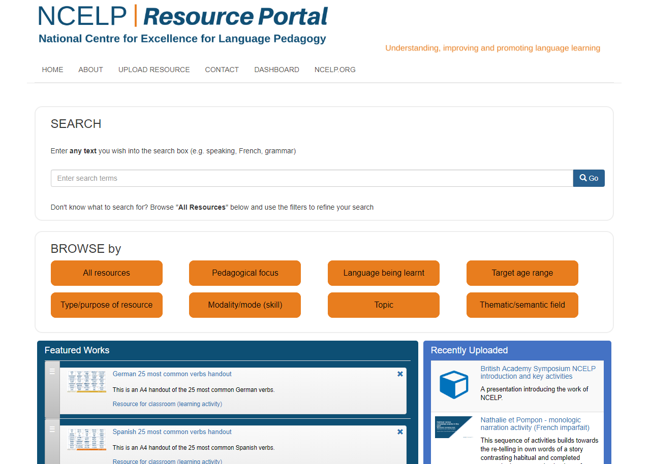
https://resources.ncelp.org/
Notes:
Slide 2 will be a brief introduction to NCELP – fusing research and practice more closely than has previously been possible. Stress the importance of both practitioner knowledge and research – one is no substitute for the other, both are necessary and complementary.
In November 2016, the Teaching Schools Council published the Report of the MFL Pedagogy Review .
The report noted that only a third of pupils achieves a languages GCSE at grade 4 or above and that less than a half of pupils even takes a language GCSE.
Research has shown that poor motivation in studying a language is partly due to pupils feeling that they do not know the language and feeling that they are not making progress.
The National Centre for Excellence for Language Pedagogy (NCELP)’ s approach to FL pedagogy is both research- and practice-informed, taking into account the time-poor context of curriculum FL learning in English classrooms.
The pedagogy helps pupils establish, early in their course, a robust knowledge of basic vocabulary, grammar, and the sound and spelling systems (phonics). The pedagogy then reinforces this knowledge via planned practice in using the knowledge during meaningful activities Anon. 2016. Modern Foreign Languages Pedagogy Review. A review of modern foreign languages teaching practice in key stage 3 and key stage 4. (Chair: Ian Bauckham). Teaching Schools Council

Slide 3
Why is vocabulary learning important?

Slide 4
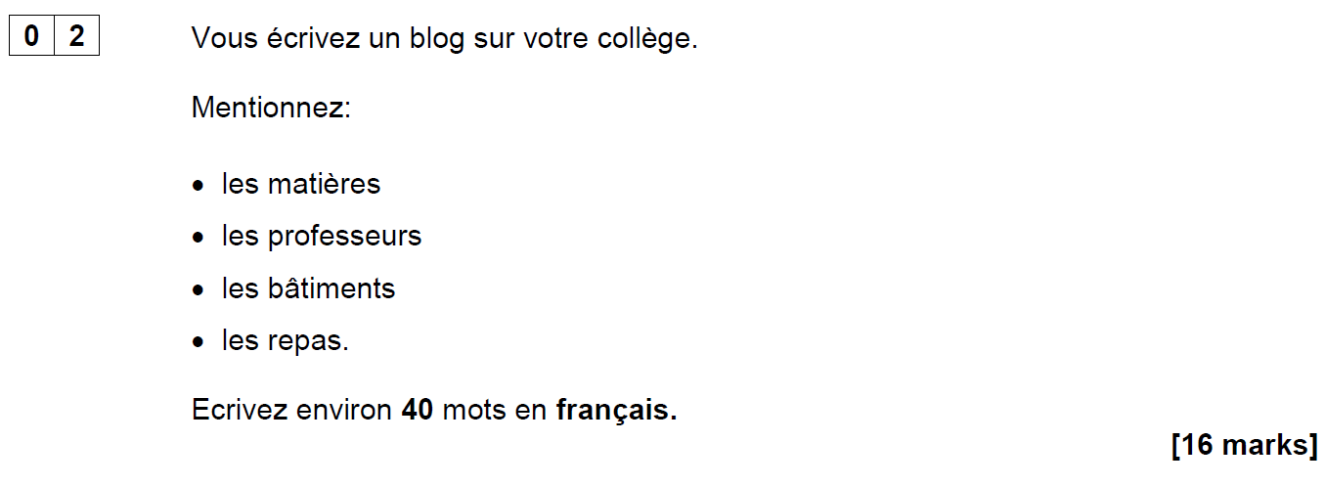
AQA French Foundation Writing Paper Q2 (June 2018)
Notes:
Opening sequence: Slides 1-6. 10 minutes Let’s start with something that confronts us with some of the issues…! This question (the 2nd easiest on the Foundation Writing paper – aimed at Grade 2/3 (old Grade E, bottom of D) required learners to know these four words (as well as the word ‘college’ of course). It’s easy to spot the words which caused problems for many foundation candidates in June 2018!

Slide 5
Are all these words…
562
1150
1952
2948
les matières
les professeurs
les bâtiments
les repas
on a list of 2000 most frequently-occurring French words?
on the AQA Foundation French Core Vocabulary list?
in the most popular French Foundation GCSE textbook?
Notes:
What do we think? Do all these words…
come into the top 2000 most frequent words in French? If you don’t think so, which one(s) don’t? Can you rank them in order of frequency?
appear on the AQA Foundation French Core Vocabulary list?
appear in the most popular GCSE textbook?
Answer a) b) c) consecutively. After a) reveal the 4 word frequencies. Ask colleagues to match them to the words.
ANSWERS a) matière (562), professeur (1150), bâtiment (1952), repas (2948) b) Yes c) Yes
OK – given that we’ve said ‘yes’ to b) and c), why do we think many students just didn’t know or recognise them?

Slide 6
Possible reasons…
an over-reliance on cognates for comprehension?
vocabulary knowledge is too context-dependent?
absence of additional contextual clues?
(Macaro & Erler, 2008)
“Vocabulary listed under a particular theme should be considered transferable, as appropriate, to the other themes.” AQA-8658-Specification 2016 French, p.22.
The words appear as individual items in a list, without the support of other words in a sentence to aid understanding.
Notes:
OK – given that we’ve said ‘yes’ to b) and c), why do we think many students just didn’t know or recognise them? Possible reasons to consider: 1) Some learners’ comprehension is limited by an over-reliance on cognates. If the word is not similar to English, it is more effort to acquire it (even receptively) and some learners, after five years, acquire relatively few non-cognate words. (Reference for this: Raising the Achievement of Young-beginner Readers of French through Strategy Instruction. (Macaro,E. & Erler, L., 2008). Applied Linguistics 29/1: 90–119. So, when we set out to improve the breadth of learners’ vocabulary, we need perhaps to consider focusing on the ‘harder to acquire’ non-cognates? 2) Two of these words (batiments and repas) are not listed in the topic of school/education on the AQA vocabulary list (they are in Home town, neighbourhood etc.. and Free time activities, respectively). The AQA vocabulary guidance states very clearly that words learnt in one topic context may be expected to be tested in another! “Vocabulary listed under a particular theme should be considered transferable, as appropriate, to the
other themes.” p.22 AQA-8658-Specification 2016 French
GO TO NEXT SLIDE: In the text book, they are also learnt in contexts other than school If learners encounter the words in one context only they may find it much harder to recognise the word in a different context. Their knowledge of certain words is too context-dependent. The other important point is that, in two cases here, the key words are the ‘category’ words, rather than the specific content words – it can be the case that these words are sometimes overlooked (or at least ‘under-worked’) in our teaching – if they are both non-cognates and category words, they are often not known by less-proficient learners.
GO BACK TO PREVIOUS SLIDE: 3) These words appear as individual words in a list, without the support of a sentence to give additional contextual clues.
The suggests that we need also to work on the depth of vocabulary knowledge – at least with respect to developing learners’ ability to know the meaning of words (readily) when they appear in a variety of different thematic contexts, but also when there are limited contextual clues – i.e. when words are presented in isolation, as individual words in a list, without the support of a sentence.

Slide 7
Studio AQA GCSE French Foundation (Pearson)
Module 6 p.132
Module 4 p.90
Module 3 p.70
Notes:
Slide

Slide 8
Possible responses…
J’adore les repas!
Je déteste les bâtiments!
Our aim should be ‘to give students the language they need in order to read texts, not to teach them to manage as well as they can without that language'. (Swan, 2008:267)
Talking sense about learning strategies, Swan (2008), RELC, Vol. 39(2), 262-273.
Notes:
Final important point to make… As teachers, when faced with a scenario like this, we search around for solutions to help our students succeed, as indeed we should. However… this particular exam question led to suggestions within the teaching community that students should be taught simply to put an opinion phrase in front of any nouns they don’t understand, in a question like this: So we might have seen: J’adore les repas or Je déteste les bâtiments
And there’s no denying that this would enable students to gain a significantly better mark than if they omit these two (unknown) words from their answer. As a examination strategy it therefore has some validity. As a communication strategy for real life, we can be less convinced…! If learners go into conversations prepared to say they like / dislike things without knowing what they’re referring to, they could get into all sorts of interesting situations…! At the end of Y11, as a last-ditch attempt to support our students’ GCSE outcomes, and compensate for a lack of knowledge, this might be justifiable (!?!). However, in the earlier stages of language learning, we have time to do more than teach compensatory approaches.
Swan (2008) in an article which critiques the over-reliance on teaching reading strategies says that the aim should be 'to give students the language they need in order to read texts, not to teach them to manage as well as they can without that language'. p.267 Talking Sense about Learning Strategies, Swan (2008). RELC, Vol 39(2) 262-273 So, just by this preliminary look at one Foundation GCSE writing task, we can conclude that there’s quite a lot to know about vocabulary!

Slide 9
There’s quite a lot to know!
Why is vocabulary important?
How many words do learners need to know?
Which words do learners need to know?
How can they best learn the words?
What does it mean to know a word?
Notes:
[3 mins max]
Having warmed up by thinking about some of the issues, can we suggest a list of questions? The first one was explicitly demonstrated in our opening discussion… Some of the others might not be as deducible but let’s see how we do…

Slide 10
How many words do learners need to know?

Slide 11
What’s in a number? If this is the answer, …?
Answers
What is…
5-10
98%
1772
8
2000
3
4222
…the lexical frequency ranking of the verb SER in Spanish?
…the expected size of vocabulary needed to function adequately at CEFR Threshold B1 level?
…the number of new words learners might be expected to learn on average each lesson?
…the lexical coverage needed for comfortable comprehension of a text?
…the lexical frequency ranking of the verb SEIN in German?
…the number of words on the AQA Spanish Higher Minimal Core Vocabulary list?
…the lexical frequency ranking of the noun POULET in French?
Notes:
What’s in a word (in numbers!)?
If this is the answer…
5-10
98%
1772
8
2000
3
4222
what is the question?
…the lexical frequency rating of the verb SER in Spanish? [8]
…the expected size of vocabulary needed to function adequately at CEFR Threshold B1 level? [2000]
…the number of new words learners might be expected to learn each lesson? [5-10] NB: with 38 teaching weeks per year, 2 x lessons per week, if you take 7.5 new words per lesson, this suggests 570 words per year, which would give 2,850 words after 5 years. But the Milton (2006) study suggests learners learn on average 170 words per year up to GCSE (a little over 2 new words per lesson), and 530 words in two years to A level.
…the lexical coverage needed for comfortable comprehension of a text? [98%]
…the lexical frequency rating of the verb SEIN in German? [3]
…the number of words on the AQA Spanish Higher Minimal Core Vocabulary list? [1772]
…the lexical frequency rating of the noun POULET in French? [4222]
The point of this slide is to introduce (again) the different elements into the discussion: 1) What are the expectations for vocabulary size set by UK examination system? 2) How does this expectation match up to other measures of vocabulary size requirement for functioning at a similar level? 3) What is the expectation for rate of vocabulary learning, as laid out in the Pedagogy Review? 3) What is the relationship between coverage and comprehension? 4) What role does the word frequency play in our decision-making?
Some of these numbers are more secure than others… which? i.e. 98% (Schmitt, Jiang & Grabe, 2011) The Percentage of Words Known in a Text and Reading Comprehension The Modern Language Journal, 95, i,

Slide 12
'According to standard frequency lists, the first 1000 words make up approximately 75% word tokens of a text, and the first 2000 approximately 85% (Meara 1995, 33). The Common European Framework of References for Language Learning and Teaching (CEFR) suggests a vocabulary of 500 words for its first level, A1 (‘Breakthrough’), 1200 words for its second level, A2 (‘Waystage’), and 2000 words for its third level, B1 (‘Threshold’) (Council of Europe 2001).’
(Häcker, 2008:215)
Notes:
Eleven pets and 20 ways to express one's opinion: the vocabulary learners of German acquire at English secondary schools. (Häcker, M. (2008). Language Learning Journal,
36:2, 215-226

Slide 13
Actually, I have _____ my mind and heart for what I _____ to say to you today. I have asked myself what I _____ I had known at my own _____, and what important _____ I have learned in the number of years that have _____ between that day and this.
I have come up with two answers on this _____ day, when we are _____ together to _____ your _____ success. I have decided to talk to you about the benefits of _____; and, as you stand on the _____ of what is sometimes called real life, I want to _____ the _____ _____ of _____.
Words ≥ 1K removed (85.0% coverage)

Slide 14
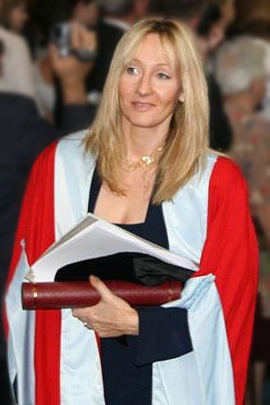
Full text: J. K. Rowling – Harvard Commencement Address, 2011: The Fringe Benefits of Failure and the Importance of Imagination.
Actually, I have wracked my mind and heart for what I ought to say to you today. I have asked myself what I wish I had known at my own graduation, and what important lessons I have learned in the number of years that have expired between that day and this.
I have come up with two answers on this wonderful day, when we are gathered together to celebrate your academic success. I have decided to talk to you about the benefits of failure; and, as you stand on the threshold of what is sometimes called real life, I want to extol the crucial importance of imagination.
Word frequencies based on the Corpus of Contemporary American English.
Notes:
Even a relatively small number of unknown words can interfere with comprehension. So, on the one hand, our goal must be for learners to learn as many words as possible in their 5-year (9-year with KS2) learning to GCSE, whilst on the other hand we must be mindful that, the GCSE reading sets out to include some unknown words (or at least, some words which are not on the Minimum Core Vocabulary list!).
We will return to this aspect later….

Slide 15
Which words do learners need to know? And why?

Slide 16
VOCABULARY
the frequency principle
the verb lexicon
mixed word class vocabulary sets
developing depth (e.g. through information gaps and rich texts)
planned four-stage revisiting
Davies, M, & Davies, K.H. (2018). A Frequency Dictionary of Spanish: Core Vocabulary for Learners. Routledge. Häcker, M. (2008). Eleven pets and 20 ways to express one's opinion: the vocabulary learners of German acquire at English secondary schools, The Language Learning Journal, 36:2, 215-226. Jones, R.L. & Tschirner, E. (2006). A frequency dictionary of German: core vocabulary for learners. Routledge. Lonsdale, D. & Le Bras, Y. (2009) A Frequency dictionary for French. Routledge. Milton, J. (2006). Language Lite? Learning French Vocabulary in School. Journal of French Language Studies, 16,187-205. Milton, J. (2009). Measuring second language vocabulary acquisition. Multilingual Matters Milton, J. (2013). Measuring the contribution of vocabulary knowledge to proficiency in the four skills. Eurosla Monographs Series 2, 57-78. http://www.eurosla.org/monographs/EM02/Milton.pdf
Schmitt, N. (2008). Review Article. Instructed second language vocabulary learning. Language Teaching Research, 12(3), 329–363. https://doi.org/10.1177/1362168808089921 Swan, M. (2008). Talking Sense about Learning Strategies, RELC, Vol 39(2), 262-273.

Slide 17
Which words?
Vocabulary to be taught should be informed by frequency of occurrence in the language, and special attention should be paid to common verbs in the early stages... A consequence of not attending to frequency of occurrence in vocabulary choice is pupils realising that they cannot say or understand basic things in the language.
Anon. 2016. Modern Foreign Languages Pedagogy Review. A review of modern foreign languages teaching practice in key stage 3 and key stage 4. (Chair: Ian Bauckham). Teaching Schools Council.
Vocabulary lists, rationale and uses
https://resources.ncelp.org/concern/resources/t722h880z?locale=en
Rachel Hawkes / Emma Marsden
Notes:
Vocabulary We start from the Pedagogy Review recommendation about ‘frequency’ and ‘common verbs’.
Ask ‘So how do we do this?’ Do we know the frequency of the words we are teaching? Do we have any way of knowing? What determines our vocabulary choice currently? The text book at KS3/4, the GCSE specification vocabulary list?
Do we know what informs the vocabulary choices in these resources?

Slide 18
En la ciudad [in town]
¿Qué hay en tu ciudad? |  | What is there in your town?
Hay… | There is… | En… | In…
un castillo | a castle | mi barrio | my neighbourhood
un centro comercial | a shopping centre | mi ciudad | my town/city
un estadio | a stadium | mi pueblo | my village/town
un mercado | a market | No hay museo. | There isn’t a museum.
un museo | a museum | No hay nada. | There’s nothing.
un parque | a park | unos museos | some museums
una piscina | a swimming pool | unas tiendas | some shops
una plaza | a square | muchos museos | a lot of museums
un polideportivo | a sports centre | muchas tiendas | a lot of shops
un restaurante | a restaurant
una tienda | a shop
una universidad | a university
 | Word | Frequency ranking | Part of speech
1 | la plaza | 806 | noun
2 | la iglesia | 437 | noun
3 | el teatro | 605 | noun
4 | ser | 7 | verb
5 | grande | 66 | adjective
6 | pequeño/a | 202 | adjective
7 | estar | 21 | verb
8 | cerca (de) | 1042 | adverb
9 | lejos (de) | 833 | adverb
10 | el museo | 1114 | noun
Notes:
So, it’s the notion that the first introductory lesson to a new theme, topic would not be one ‘verb starter’ and 12 nouns but instead a set of mixed word class vocabulary.
Later, as appropriate, more nouns would be added from the same semantic field (more places in the town for example) but the core words would be these, as ultimately pupils can express more and varied meanings with these, than they can with ‘Hay’ and a set of places in the town.
This is the slide of 10 words pupils are going to learn.
Note the mixed word class selection, and the frequency (all well within the top 2000 more frequently occurring words in Spanish).

Slide 19
Mixed word class sets
Y7 French, T1.1, Week 1
Y7 German, T1.1, Week 1
Y7 Spanish, T1.1, Week 1
sein [3] ist [3] das Heft [3598] das Fenster [634] der Tisch [494] die Tafel [3660] die Flasche [1762] wo? [94] hier [71] da [35] der, die, das [1] Hallo! [1375] Tschüs! [>4034]
estar [21]; estoy; estás; está; norte [624]; sur [661]; Inglaterra [proper noun - N/A]; España [proper noun - N/A]; ¿dónde? [161] en [5]; ¡hola! [1245], ¡hasta luego! [N/A]; deberes [2187]
être [5], suis, es, est, je [22], tu [112], il [13], elle [38], anglais [784], français [251], grand [59], petit [138], et [6], au revoir [1274], bonjour [1972], oui [284], non [75]
1 verb, 4 pronouns, 4 adjectives, 1 conjunction, 4 other
1 verb, 5 nouns, 1 pronoun, 2 adverbs, 3 articles, 2 other
1 verb, 3 nouns, 2 proper nouns, 1 adverb, 1 preposition, 2 other
Sources: A Frequency Dictionary of French (Londsale & Le Bras, 2009), A Frequency Dictionary of Spanish(2nd ed.) (Davies, M. & Davies, K., 2018), A frequency dictionary of German (Jones, R.L. & Tschirner, E., 2006). All published by Routledge.
Notes:
Mixed word class sets There is some research evidence that teaching vocabulary in topic-based lists of words with a single word class (e.g. a list of just nouns) is not optimal (Häcker, 2008).
Teaching mixed word class sets provides the means for learners to encounter words in sentences, as well as individually, at present stage, but without running the risk of cognitive overload if too much language (new and previously taught) is presented at once.
Working with words in context is identified by Schmitt as an important strategy for embedding and developing word knowledge.
As mentioned previously, NCELP has been tasked with KS3 pedagogy, but given the very mixed picture of provision nationally, has had to start from a position of ‘ab initio’ learner in its curriculum planning. However, were there to be a KS2 SOW it is likely not only that the same overarching principles would apply, but also that some of the Y7 SOW could be repurposed for earlier years.
Here are just examples of a week’s vocabulary set from each of the three languages, Fr, Gm and Sp, showing the mixed word class composition.

Slide 20
Which words?
In the early stages of a language course, particular attention should be paid to the planned building of pupils’ verb lexicon, focussing on the meaning of the stem or infinitive form of common verbs. A strong basic verb lexicon has been found to relate positively to pupils’ ability to effectively manipulate those verbs at later stages.
Anon. 2016. Modern Foreign Languages Pedagogy Review. A review of modern foreign languages teaching practice in key stage 3 and key stage 4. (Chair: Ian Bauckham). Teaching Schools Council.
Rachel Hawkes / Emma Marsden
Notes:
Which words? The verb lexicon
Handout 2: Focusing on the verb lexicon: Why and how to teach a verb vocabulary.
Again, people will have to read this later!
https://resources.ncelp.org/concern/resources/cj82k728n?locale=en

Slide 21
Which verbs do Y7 learners learn?

Slide 22
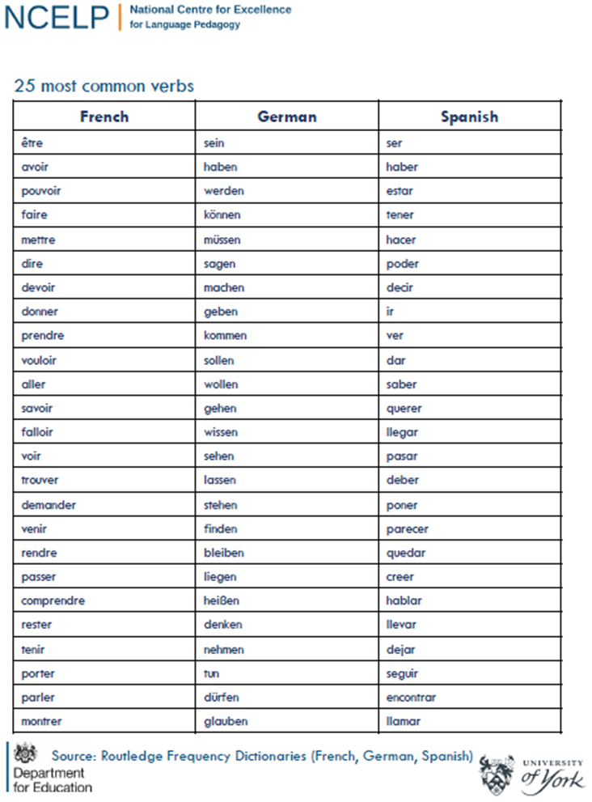
Which verbs do Y7 learners learn?
Notes:
Handout 1. Cross reference with list from previous slide’s activity – where are the gaps?

Slide 23
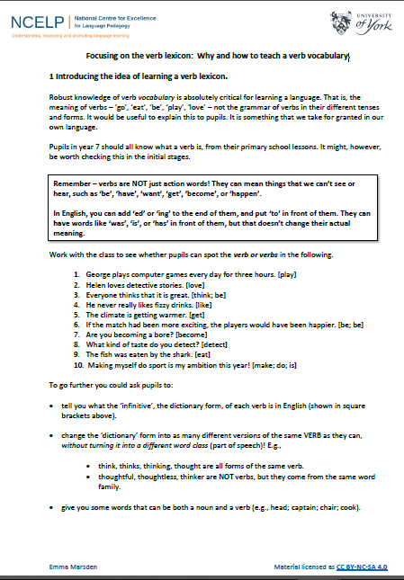
Why and how to teach a verb vocabulary
https://resources.ncelp.org/concern/resources/cj82k728n?locale=en
Notes:
Handout 2 (time allowing). Highlight sections 2 and 4.

Slide 24
First encounters with high-frequency verbs
25 highest frequency verbs
15 high frequency prototype verbs
Long form (infinitive) and short form (3rd person singular)
Sentences (revisiting high-frequency (phonics) vocabulary)
NB: these are for first encounters with these important verbs. Further practice and gradual extension to working with further pairs of forms/meanings would follow (e.g. next step - 1st and 2nd person singular)
Notes:
Which words? The verb lexicon
This slide describes the essential features of the sets of verb resources, a sample of which will follow this slide. French 25 and 15 verbs and sentences https://resources.ncelp.org/concern/resources/7w62f8209?locale=en German 25 and 15 verbs and sentences https://resources.ncelp.org/concern/resources/qf85nb285?locale=en Spanish 25 and 15 verbs and sentences https://resources.ncelp.org/concern/resources/0p0966881?locale=en

Slide 25
sein
haben
sagen
denken
machen
3
7
46
124
49
to be | being
to have | having
to say, tell | saying | telling
to think | thinking
to do, make | doing, making
ist
hat
sagt
denkt
macht
is
has
says, tells | is saying, is telling
thinks | is thinking
does, makes | is doing, is making
kommen
gehen
finden
heißen
geben
61
69
110
123
57
to come | coming
to go | going
to find | finding
to be called
to give | giving
kommt
geht
findet
heißt
gibt
comes | is coming
goes | is going
finds | is finding
is called
gives | is giving
wissen
sehen
87
bleiben
liegen
79
81
stehen
112
118
to know | knowing
to see | seeing
to stand | standing
to stay, remain | staying
to lie | lying
weiß
sieht
steht
bleibt
liegt
knows
sees | is seeing
stands | is standing
stays | is staying
lies | is lying
nehmen
glauben
können
müssen
wollen
139
143
23
45
65
to take | taking
to believe | believing
to be able | can
to have to | must
to want
nimmt
glaubt
kann
muss
will
takes | is taking
believes | is believing
is able | can
has to | must
wants
sollen
142
werden
tun
63
dürfen
9
140
82
lassen
to ought | should
to be allowed | may
to become | becoming
to do | doing
to let, allow | letting, allowing
soll
darf
wird
tut
lässt
ought | should
is allowed | may
becomes | is becoming
does | is doing
lets, allows | is letting, is allowing
25 most common German verbs
Source: Jones, R.L. & Tschirner, E. (2006). A frequency dictionary of German: core vocabulary for learners. Routledge

Slide 26
142
281
328
428
198
vivir
escuchar
ayudar
aprender
escribir
to live | living
to listen | listening
to help | helping
to learn | learning
to write | writing
vive
escucha
ayuda
aprende
escribe
lives
listens
helps
learns
writes
114
718
246
347
1323
salir
cantar
abrir
comer
bailar
to go out | going out
to sing | singing
to open | opening
to eat | eating
to dance | dancing
sale
canta
abre
come
baila
goes out
sings
opens
eats
dances
361
1085
343
886
1749
comprar
beber
correr
celebrar
descansar
to buy | buying
to drink | drinking
to run | running
to celebrate | celebrating
to rest | resting
compra
bebe
corre
celebra
descansa
buys
drinks
runs
celebrates
rests
15 high-frequency prototype Spanish verbs
Source: Davies, M, & Davies, K.H. (2018). A Frequency Dictionary of Spanish: Core Vocabulary for Learners. Routledge.

Slide 27
faire
[to do, make | doing, making]
fait
[does, makes | is doing, is making]
Stephen Owen / Emma Marsden

Slide 28
faire
[to do, make | making, doing]
fait
[does, makes | is doing, is making]
Stephen Owen / Emma Marsden

Slide 29
fait
[does, makes | is doing, is making]
Zara fait le lit.
[Zara makes | is making the bed.]
Stephen Owen / Emma Marsden

Slide 30
faire
[to do, make | doing, making]
Zara aime faire le lit.
[Zara likes making the bed.]
Stephen Owen / Emma Marsden

Slide 31
fait
[does, makes | is doing, making]
Zara ____ le lit.
fait
[Zara makes | is making the bed.]
Stephen Owen / Emma Marsden

Slide 32
faire
[to do, make |doing, making]
Zara aime ____ le lit.
faire
[Zara likes making the bed.]
Stephen Owen / Emma Marsden

Slide 33
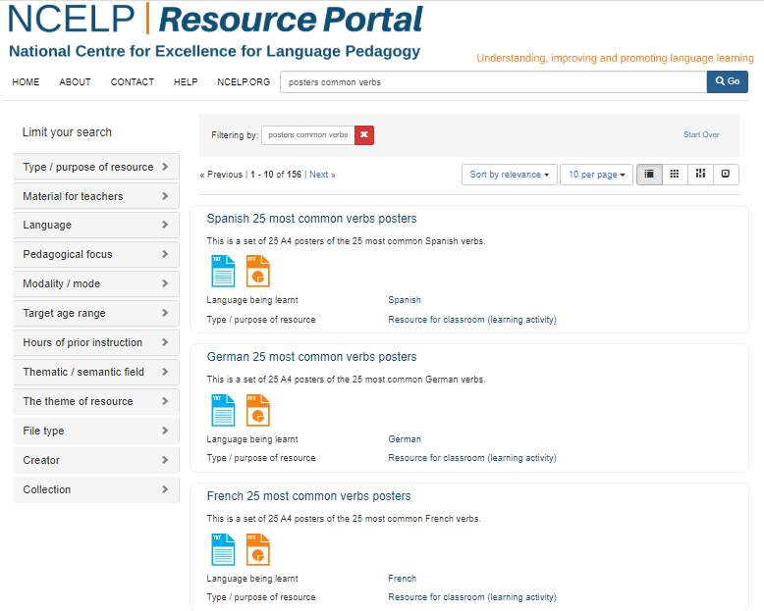

Slide 34
Word Class Summary
Updated 06.1.20
 | adj | adv | conj | prep | noun (m) | noun (f) | other | pron | verb | Total | %
1.1 | 22 | 0 | 3 | 0 | 20 | 16 | 11 | 10 | 11 | 93 | 25%
1.2 | 8 | 3 | 2 | 4 | 17 | 19 | 0 | 4 | 24 | 81 | 22%
2.1 | 5 | 7 | 1 | 1 | 15 | 10 | 14 | 0 | 13 | 66 | 18%
2.2 | 0 | 1 | 0 | 5 | 3 | 5 | 6 | 1 | 17 | 38 | 10%
3.1 | 5 | 3 | 1 | 3 | 11 | 4 | 1 | 0 | 22 | 50 | 14%
3.2 | 10 | 8 | 0 | 0 | 8 | 8 | 0 | 0 | 8 | 42 | 11%
Total | 50 | 22 | 7 | 13 | 74 | 62 | 32 | 15 | 95 | 370
% | 14% | 6% | 2% | 4% | 20% | 17% | 9% | 4% | 26%
Across Y7 the rough proportions are, as follows:
Nouns: |  |  |  | 37%
Verbs: |  |  |  | 26%
Adjectives: |  |  |  | 14%
Adverbs, conjunctions, prepositions, pronouns: |  |  |  | 15%
Other: |  |  |  | 9%
SOW French Year 7 (UK): https://resources.ncelp.org/collections/6q182k249?locale=en
SOW German Year 7 (UK): https://resources.ncelp.org/concern/resources/gt54kn19s?locale=en
SOW Spanish Year 7 (UK): https://resources.ncelp.org/concern/resources/3197xm241?locale=en
Rachel Hawkes / Emma Marsden

Slide 35
GCSE frequency lists
https://resources.ncelp.org/
Frequency data have been added to AQA GCSE vocabulary lists for French, German and Spanish [Sources: A Frequency Dictionary of Spanish: Core Vocabulary for Learners (Davies & Davies, 2018); A Frequency Dictionary of German (Jones & Tschirner, 2006) and A Frequency Dictionary of French (Londsale & Le Bras, 2009), published by Routledge.]
The lists are available in a variety of formats: Excel (full list), Word – A-Z, by topic, by parts of speech
Teachers may use the frequency data to:
inform the SOW design
stimulate interest amongst pupils (and teachers!)
teach multiple meanings of the same word
teach vocabulary in multiple word class clusters
teach relations between words within word families
teach cognate patterns
highlight differences between high frequency words and awarding body lists
Notes:
GCSE Frequency lists are on the NCELP portal for French, German, Spanish

Slide 36
How can they best learn the words?

Slide 37
How?
‘Most vocabulary tasks focus their attention almost solely on introducing the meaning of new words.’ (Schmitt, 2008:343)
Learning new words (breadth)
Consolidating and extending word knowledge (depth)
Using words more quickly (automaticity/fluency)
Different tasks are needed to develop these different aspects. (Schmitt, 2008)

Slide 38
How?
L1 translation can be efficient for establishing form-meaning link initially.
Seeing and hearing words in context then becomes important to develop depth of knowledge (collocation, shades of meaning, etc.).
Multiple exposures and use are important to consolidate knowledge and develop fluency, anywhere between 5 – 20 encounters. (Nation, 2001:81)
This could be done at home, even in advance of a lesson (‘flipped learning’) and mediated by technology (e.g. Memrise, Quizlet)
For high-frequency words, spontaneous target language interaction and ‘reading for interest’ may help with this.
Notes:
As regards the initial establishment of the initial form-meaning link, there is substantial evidence supporting the provision of L2-L1 pairs, rather than L2-picture pairs (Lotto & de Groot, 1998) or L2-based context or meanings (Prince, 1996; Ramachandran & Rahim, 2004).
Once the link is established, attention can be given to learning more contextualised types of word knowledge, and it becomes important to encounter the new lexical items in L2 contexts. An important finding is that reading-while-listening is generally superior to reading-only in promoting vocabulary learning (Amer, 1997; Brown, Waring & Donkaewbua, 2008) Where a word is often used across different topics, care should be taken to build these links explicitly, building depth – ensuring that learners recognise them readily in more than one topic area. A useful approach here is to use a range of texts of different styles (literary extracts, poems, songs) which provide additional exposures in less familiar contexts, allowing the form-meaning link to strengthen.
5-20 is quite some range - It is not straightforward to say how many repeated encounters with a given word are necessary to learn it. Nation's (2001, p.81) review of several studies gives a range of 5 - 20 encounters. Most important, however, is that recycling of language is crucial, if it is not to be forgotten. Most forgetting occurs soon after the learning session, so the first recyclings are particularly important and need to occur quickly (Baddeley, 1990). Schmitt suggests we think in terms of 8-10 exposures. Planning for and monitoring this is important.

Slide 39
Quizlet
https://quizlet.com/NCELP
Notes:
Quizlet – Mention limited curriculum time context, flipped learning, need for structured vocabulary outside of the classroom, possibilities for easier systematic revisiting (integral to SoW), give a preview of the vocabulary banks and show the flashcard functionality

Slide 40
Stages of vocabulary learning
Topic-based vocabulary lists of one single word class are not optimal.
Introduction (i.e. first encounters with new words, and initial memorisation routines)
Consolidation (i.e. speed of retrieval building, controlled production, e.g. sentence-building)
Developing use (i.e. revisiting across different contexts, modalities, synthesising with previously-learnt language)
Assessment
Victoria Hobson

Slide 41
Peer or self introduction
 | Word | English meaning
1 | le français | French
2 | faire | to do / doing
3 | facile | easy
4 | seulement | only
5 | avoir | to have / having
6 | nouveau/nouvelle | new
7 | tous les jours | everyday
8 | le cours | lesson
9 | la semaine | week
10 | l’espagnol | Spanish
60
Secondes
0
DÉBUT
Victoria Hobson
Notes:
Peer or self-introduction Pupils either work by themselves or in pairs, reading out the words and studying their English meaning (1 minute). Then the English meanings are removed and they try to recall them, looking at the Spanish (1 minute). Then the Spanish meaning are removed and they to recall them, looking at the English (1 minute) NB: It is not expected that they will be able to do them all. However, in a mixed ability class, some pupils will come close to being able to do this, whilst others may just manage one or two. It is important to have open-ended routines for first encounters of new words, where learners are ‘self-serving’, as it prevents the frustration hat can be caused by a mismatched pace of presentation.
Further rounds of learning can be facilitated by one pupil turning away from the board, and his/her partner asking him/her the meanings. This activity can work from L2 → L1 or L1 → L2.

Slide 42
Listening: Individual words
1
2
3
4
5
6
7
8
9
10
Stephen Owen
Notes:
Pupils are looking away anyway, but if desired, this slide can be hidden, so pupils cannot see which number the teacher is clicking (because s/he will repeat the words several times).
1 individual words recorded
Use these in conjunction with the self-made flashcards, in several ways. First, pupils look at French side facing up, and when they hear the word, they just turn it over to the English side (simple recognition). The turn it back. Second, pupils look at English side facing up and select the correct card in response to what they hear [individual words]. Then turn it back.
Transcript:
1) le français
2) faire
3) seulement
4) facile
5) avoir
6) nouveau/nouvelle
7) le cours
8) tous les jours
9) l’espagnol
10) la semaine

Slide 43
Listening: Sentences
1
2
3
4
5
6
Stephen Owen
Notes:
2 Sentences recorded SET 1a Third, with French side up, pupils hear sentences with 2-3-4 of the items in them and they place them down in order – this might sound easy, but remember they will be seeing the infinitive, but hearing the short form, so there is still some significant processing to do (plus the fact that you will have several items together in an order, so not as easy as it might seem). Fourth, a bingo game. Pupils place 6 of their cards English side up in a 3 x 2 formation and they turn them to French when they hear the word called. Winner is i) a complete row then ii) a full house. Fifth, with English side up, pupils listen to a set of sentences containing 2-4 of the items and have to put them in order. E.g. La fille est jeune (they would need to place ‘daughter/girl’, then ‘to be(description)’ then ‘young’. This is challenging (sentences will be slow and careful). It is worth varying the speed of delivery of the sentences. I normally do this just with my voice.
TRANSCRIPT
1 Je fais de l’espagnol tous les jours
2 J’ai trois cours de français
3 Je fais seulement de l’espagnol
4 Le français est nouveau pour moi
5 Je fais cinq cours par semaine
6 L’espagnol est facile

Slide 44
Listening: Sentences
1
Elle _________ du français tous les jours.
2
Elle _________ un nouveau cours.
3
Il __________ un cours facile.
4
Il __________ seulement de l’espagnol
5
Je/J’ ________ une nouvelle école.
6
Je/J’_________ du français et de l’espagnol.
Stephen Owen
Notes:
SET 1e
This focuses pupils’ attention on the verb form and meaning. Pupils have to identify the correct verb and write it in the gap. Check students’ understanding of the complete sentences as you conduct the feedback.
TRANSCRIPT
Elle fait du français tous les jours Elle a un nouveau cours.
Il a un cours facile
Il fait seulement de l’espagnol
J’ai une nouvelle école
Je fais du français et de l’espagnol.

Slide 45
Listening: Sentences
ANSWERS
1
fait
Elle _________ du français tous les jours.
2
a
Elle _________ un nouveau cours.
3
a
Il __________ un cours facile.
4
fait
Il __________ seulement de l’espagnol
5
ai
Je/J’ ________ une nouvelle école.
6
fais
Je/J’_________ du français et de l’espagnol.
Stephen Owen
Notes:
SET 1e
This focuses pupils’ attention on the verb form and meaning. Pupils have to identify the correct verb and write it in the gap. Check students’ understanding of the complete sentences as you conduct the feedback.
TRANSCRIPT
Elle fait du français tous les jours Elle a un nouveau cours.
Il a un cours facile
Il fait seulement de l’espagnol
J’ai une nouvelle école
Je fais du français et de l’espagnol.

Slide 46
Sentence level production
1
faire - seulement - espagnol
2
faire - espagnol - tous les jours
3
avoir - nouveau - cours
4
avoir - seulement - cours
5
faire - français - facile
Stephen Owen
Notes:
Give two/three words – pupils create sentences

Slide 47
der, die, oder das?
60
die Flasche
der Mann
der Tisch
die Tafel
Sekunden
das Heft
das Fenster
das Paar
die Klasse
0
der Tag
ANFANG
Inge Alferink / Rachel Hawkes
Notes:
Ist es der, die oder das?
This starter presents the nouns with their genders covered up. All nouns were introduced during the previous week and should be familiar to the students. Students have a minute to try to recall them with a partner.
The activity focuses the attention on the take-away grammar point from week 1: grammatical gender. It also revisits the vocabulary that was introduced. Click on ‘Anfang’ when in presentation mode to start the 60 second timer.

Slide 48
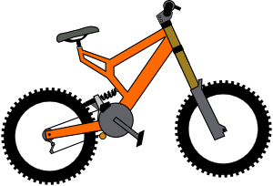
Vocabulario
un
una
Victoria Hobson / Nick Avery
Notes:
Students have to predict which pacman will eat the object depending on the noun’s gender.

Slide 49
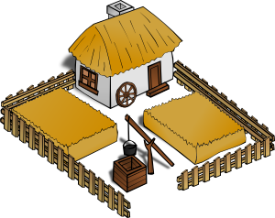
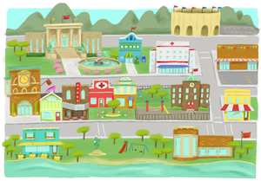
Vocabulary introduction
Vocabulaire
Trouve l’intrus!
1.
4.
le
le
la
le
la
la
??
2.
5.
le
la
le
la
le
le
3.
6.
der
la
la
le
la
la
le
Victoria Hobson / Emma Marsden
Notes:
Presentation/introduction to the nouns from the tasks that follow.
Here, pupils find the odd one out by identifying the gender of each noun.

Slide 50
1
to be [location]
museum
near (to)
A
B
C
to be [permanent]
big
theatre
D
E
F
far (from)
small
church
town square
G
H
I
J
Notes:
Listening task 1 [Note: the three rounds of this activity look the same when in presentation mode, so the slides have been numbered for clarity.]
Explain to students that they are going to hear ten Spanish words, and that they should arrange their cards in a 3x3 grid as shown (working from A-I, with J as the spare), English-side up, in the order they hear the words.
NB: Students don’t add letters to their flashcards, these are just to show the order that they need to place the cards in, according to the order in which the teacher says the words. It’s easier to model this task than explain too much about it. The first time students do it, a few might be unsure, but after the first time, they will immediately know from this slide exactly what they have to do. It’s worth reassuring them of this, the first time you do it!
Teacher reads the transcript.
Teacher then asks the students ‘Qué es A? to elicit the response ‘A es ‘estar’, Note: The answers appear in English on the screen under each letter, so all can see/read/check their answers and know if they heard correctly, BUT this task additionally elicits the Spanish from students that can already produce it, so it offers ideal differentiation. On the other hand, if the whole class is already able to produce the language, then the teacher can elicit the answers chorally from the whole class.
Answers revealed by clicking the letter.
Transcript
estar, el museo, cerca de, ser, grande, el teatro, lejos de, pequeño/pequeña, la iglesia (la plaza)

Slide 51
2
far (from)
town square
to be [permanent]
A
B
C
small
church
near (to)
D
E
F
museum
to be [location]
theatre
big
G
H
I
J
Notes:
Transcript: lejos de, la plaza, ser, pequeño/pequeña, la iglesia, cerca de, el museo, estar, el teatro (grande)

Slide 52
¿SER o ESTAR?
1
1. El teatro ________ cerca de la iglesia.
2
2. La plaza ________ muy pequeña.
3
3. ¿Dónde _________ la plaza?
4
4. El museo no __________ aburrido.
5
5. La iglesia, que ________ grande, _________ en la plaza mayor.
6
6. La plaza, que _____ en el centro, ______ pequeña.
Notes:
This focuses pupils’ attention on the two verbs to be. A sound effect obscures the verb – pupils have to fill in their choice of ‘es’ or ‘está’
TRANSCRIPT
1 El teatro ________ cerca de la iglesia.
2 La plaza ________ muy pequeña.
3 ¿Dónde _________ la plaza?
4 El museo no __________ aburrido.
5 La iglesia, que ________ grande, _________ en la plaza mayor.
6 La plaza, que _____ en el centro, ______ pequeña

Slide 53
RESPUESTAS
¿SER o ESTAR?
1
está
1. El teatro ________ cerca de la iglesia.
2
es
2. La plaza ________ muy pequeña.
3
está
3. ¿Dónde _________ la plaza?
4
es
4. El museo no __________ aburrido.
5
es
está
5. La iglesia, que ________ grande, _________ en la plaza mayor.
6
está
es
6. La plaza, que _____ en el centro, ______ pequeña.
Notes:
This focuses pupils’ attention on the two verbs to be. A sound effect obscures the verb – pupils have to fill in their choice of ‘es’ or ‘está’
TRANSCRIPT
1 El teatro está cerca de la iglesia.
2 La plaza es muy pequeña.
3 ¿Dónde está la plaza?
4 El museo no es aburrido.
5 La iglesia, que es grande, está en la plaza mayor.
6 La plaza, que está en el centro, es pequeña

Slide 54
Sentence-level production tasks [1]
en la plaza
grande pequeño/a aburrido/a interesante
en la calle González
a la derecha
a la izquierda
lejos cerca
viejo/a nuevo/a
al lado del parque
1 | la iglesia | 1 | es
2 | el museo | 2 | está
3 | la plaza | 3 | es
4 | el teatro | 4 | está
5 | el parque | 5 | es
6 | la oficina de correos | 6 | está
Notes:
Player A rolls the dice to generate 1) a place and 2) a verb. They then choose a word from the oval to finish their sentence. Each word from the oval can only be used once. Players keep a tally of their correctly formed sentences. Once a word is used it can be crossed out. As the number of possible words decreases, players may have to ‘knock’ if there is no appropriate word to finish their sentence. In this case, play passes to their partner. E.g. Player A throws 1)el museo and 2) está but there are only adjectives remaining. No correct sentence can be formed and play passes to the Player B. The player who is able to make the most sentences within the time or until all the words run out is the winner.
You could use up to 11 places by using 2 dice together – in that case, just no number one and add extra rows to the first column.
The sheets could be laminated so that players could cross out the words but then wipe clean the sheets and re-use.

Slide 55
Was bin ich?
hören / sprechen (1/2)
bekommen
im Unterricht
die Idee
die Kirche
schön
zu Hause
die Familie
der Montag
schreiben
im Garten
früh
in der Schule
machen
das Fahrrad
am Marktplatz
lernen
die Woche
die Aufgabe
spät
Notes:
Vocabulary revisit using the Was bin ich? role cards, which can be found on the portal alongside this resource.
Here, Partner A reads the sentences on their role card. Partner B listens and answers ‘Du bist …’ followed by one of the words on the board.
Prompts (Partner(in) A)
1) Ich bin ein Vater, eine Mutter, ein Junge und ein Mädchen. Was bin ich? (die→ eine Familie)
2) Ich bin sieben Tage. Was bin ich? (die → eine Woche)
3) Ich bin Arbeit. Was bin ich? (die → eine Aufgabe)
4) Ich bin nicht hässlich. Was bin ich? (schön)
5) Ich habe eine Tür. Was bin ich? (die → eine Kirche)

Slide 56
Was bin ich? (Antworten)
hören / sprechen (1/2)
Ich bin ein Vater, eine Mutter, ein Junge und ein Mädchen. Was bin ich? Ich bin ... eine Familie!
Ich bin sieben Tage. Was bin ich? Ich bin ... eine Woche!
Ich bin Arbeit. Was bin ich? Ich bin ... eine Aufgabe!
Ich bin nicht hässlich. Was bin ich? Ich bin ... schön!
Ich habe eine Tür. Was bin ich? Ich bin ... eine Kirche!
Notes:
Answers revealed on clicks.

Slide 57
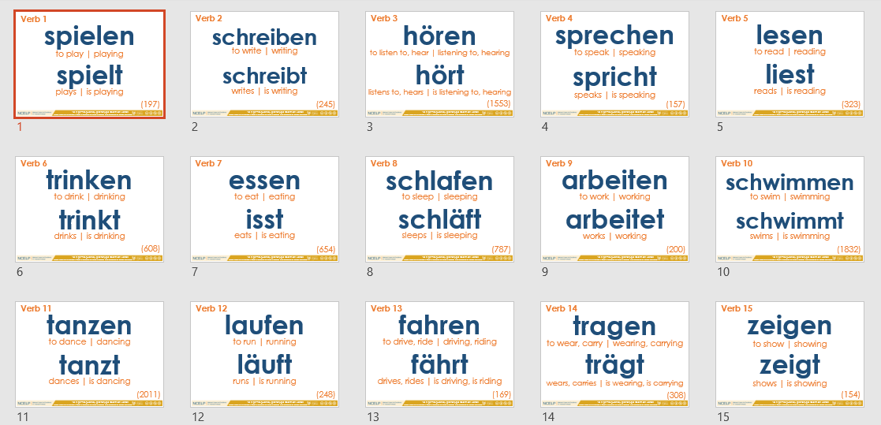
5
1
7
8
A
4
2
6
3
9
Inge Alferink / Rachel Hawkes
Notes:
This one is for the 15 concrete German verbs
A collaborative information gap exercise to practise the verbs introduced in the 15 concrete verbs PowerPoint resource/
Work in pairs.
Pupils each have a set of pictures and ask each other questions about what is in their pictures in order to find out which pictures occur in both sets.
Each picture/ person is numbered in order to reduce cognitive load and focus attention on verbs rather than nouns.
For example, Eins schläft.
NB. the numbers do not match across the sets so as not to give the solution away that way.

Slide 58
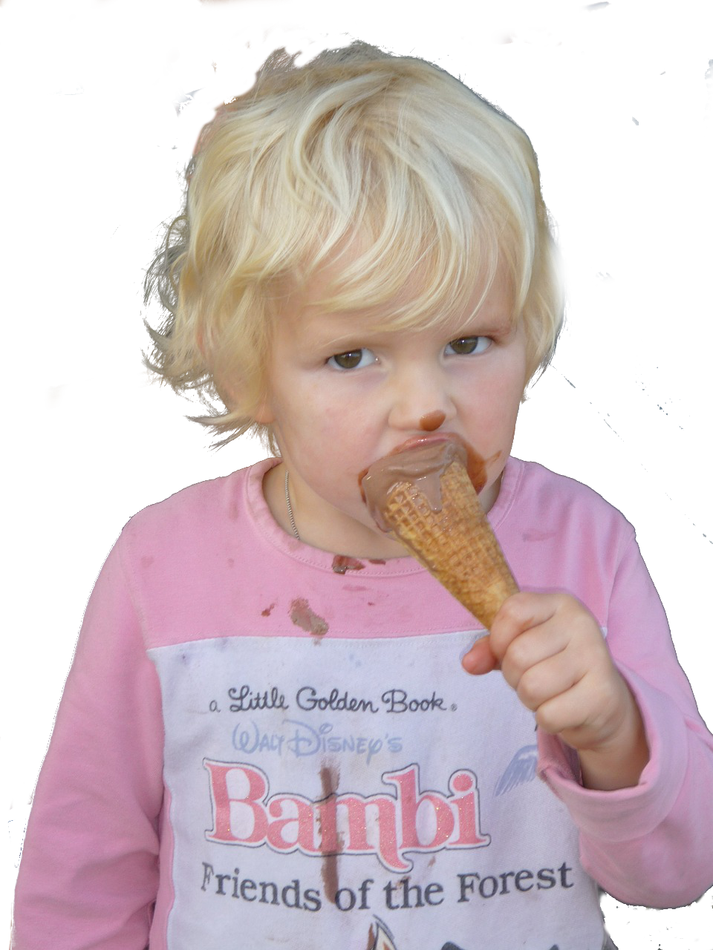
4
7
6
8
1
B
2
5
2
3
Inge Alferink / Rachel Hawkes

Slide 59
Dictogloss
 | Word | Frequency | PoS
1 | être | 5 | verb
2 | matière (f) | 562 | noun
3 | facile | 822 | adjective
4 | anglais (m) | 784 | noun
5 | car | 176 | conjunction
6 | classe (f) | 778 | noun
7 | aimer | 242 | verb
8 | beau/belle | 393 | adjective
9 | langue (f) | 712 | noun
10 | espagnol (m) | 1666 | noun
Rachel Hawkes
Notes:
https://www.audio-lingua.eu/spip.php?article1416
When pupils have already spent some time learning and using the verb ‘etre’, and they are very familiar with ‘J’aime… parce que’ they could complete this very short dictogloss task. This is authentic audio. It contains many familiar words but also a couple of words that may be unfamiliar, which they can listen out for, and ask the teacher, about meaning or spelling. This is not a test. Pupils are able to try to note things down or remember them, and ask questions of their teacher. It is a very good way for them to try to put their phonics knowledge into practice. For example, they might ask: Comment dit-one ‘belle’ en anglais? Comment s’écrit ‘bilingue’? ‘Plutôt, c’est quoi en anglais? Qu’est-ce que c’est ‘langue’?
They then need to work in pairs to try to reconstruct the text. It is only 33 words long.
NB: Vocabulary table for the teacher and would not be displayed to pupils.
Dictogloss Pupils listen and make notes in English. They can listen several times to the passage.
Transcript: Mes deux matières préfèrés sont l’anglais et l’espagnole car je suis dans une classe bilingue. J’aime bien l’espagnole parce que c’est une belle langue et c’est plutôt facile. L’anglais j’aime bien parce que… The transcript fades out. Pupils who finish early could be encouraged to continue the passage a bit further.

Slide 60
Text title | L’homme qui te ressemble
Author | René Philombe
Suggested teaching slot | Year 7 Term 3 Week 2
Number of lessons | Two lessons of 50 - 60 minutes
Text composition
Total number of words (including words that are repeated) | 136
% known words (if following NCELP SOW) | 70%
% words in most frequent 1000 words* | 85%
% words in most frequent 2000 words* | 91%
% words in most frequent 3000 words* | 95.3%
% words outside of most frequency 5000 words* | 4.7%
*Word-frequency data source: Londsale, D., & Le Bras, Y. (2009). A Frequency Dictionary of French: Core vocabulary for learners London: Routledge.

Slide 61
Vers 1
J’ai frappé à ta porte
J’ai frappé à ton cœur
Pour avoir bon lit
Pour avoir bon feu
Pourquoi me repousser?
Ouvre-moi, mon frère.
Notes:
Attribution: Please emoji
Twitter [CC BY 4.0 (https://creativecommons.org/licenses/by/4.0)] https://upload.wikimedia.org/wikipedia/commons/f/ff/Twemoji_1f64f.svg
Whole class opportunity to read verse 1 aloud with the teacher. Elicit meanings and clarify any unknown vocabulary that has not yet been understood, i.e. arrive at a working English translation orally with the whole class. Pay particular attention to the translation of ‘à’ which students have met as ‘to’. Here it means ‘at’ (or possibly even ‘on’ with heart). Draw out also the meaning of ‘ton/ta’ and clarify the two forms seen here. Students have met ‘mon, ma, mes’ and should be encouraged to make the link and explain their understanding.
Give students another opportunity to read aloud the first verse in pairs, a line each. Encourage them to read expressively, thinking about the meaning.

Slide 62
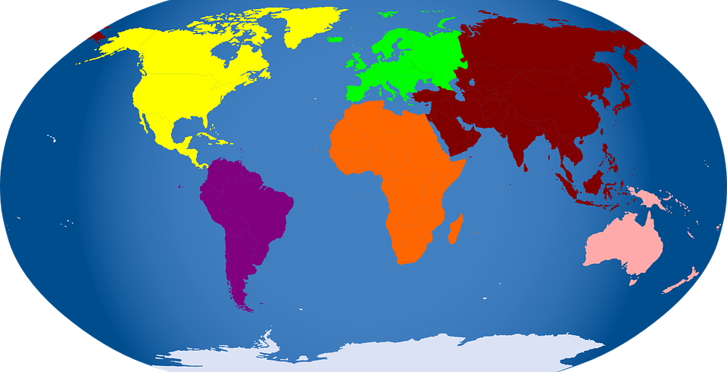
Pourquoi me demander
Si je suis d’Afrique
Si je suis d’Amérique
Si je suis d’Asie
Si je suis d’Europe?
Ouvre-moi, mon frère.
Vers 2
Notes:
Whole class opportunity to read verse 2 aloud with the teacher. Pictures give additional cues to meaning. Pay particular attention to the new word ‘si’and ‘de’, which students only know as ‘faire de la/du’ or as negative particle e.g. Je n’ai pas de pommes. Here they need to recognise that d’ = de and that the meaning is ‘from’. It is worth asking if they remember other uses/meanings of ‘de’. They will learn that it means ‘of’ from the next verse.

Slide 63
Ouvre-moi ta porte
Ouvre-moi ton cœur
Car je suis un homme
l’homme de tous les temps
l’homme de tous les cieux
l’homme qui te ressemble!....
Vers 5
Notes:
Text comprehension
Many words are repeated from earlier in the poem in different combinations in the final verse. The new words are: car, tous les temps, tous les cieux, and the phrase ‘qui te ressemble’.

Slide 64
Exploiting texts
http://all-literature.wikidot.com/
Un hombre sin cabeza
Un hombre sin cabeza
no puede usar sombrero.
Pero éste no es
su mayor problema:
no puede pensar,
no puede leer,
no puede cantar,
no puede comer
No puede escuchar,
ni puede entender,
que para amar y besar
cabeza se debe tener.
all-literature.wikidot.com/dataentry:un-hombre-sin-cabeza
Armando José Sequera
Notes:
Original source: http://www.doslourdes.net/Un%20hombre%20sin%20cabeza.htm
Flag the ALL Literature wiki, and ALL in general!
Exploiting texts Remind STs that there are 8 rich texts from the Phonics resources (from FLEUR) that are available for French>
Tell them also that at the next residential we will be starting a strand on literature and authentic texts, when there will be a lot more available. This is just an example here, and one which fits very well with developing a verb lexicon. NB: Handout not available – permission process just getting underway, currently.
Students brainstorm in groups (big sheet of paper / big pens!) all the possible infinitives that they think could be in the poem. Tell them that they will get points for anticipating correctly, but also (a different number of) points for coming up with infinitives that no other group has. After 8 minutes to work on their list, ask the class to read the poem aloud up to the first gap. Then reveal each infinitive, one by one, telling students to mark off any that they have in common with the poem. When finished, tell them they get 3 points for every infinitive they’ve matched. Bonus points: Then ask for any additional infinitives that they had. Ask for one from each group. If no other group has it, the group gets 5 points. If other groups have it, those that do get 1 point each. Keep going until all the verbs are accounted for. There will then be a count up to identify the winning team. Pupils then decide on their own favourite version of the poem, adding/deleting verbs from the original. They practise a performance version of the poem in their groups, acting out the verbs.
There are some other things we could do here, if we played around with taking out the ‘puede’ or leaving it in. We could turn it into a minimal pairs elicited task, whereby one pupil has an adapted version, where the structure is varied, either puede + infinitive OR just 3rd person sigular. If the pupil hears ‘no puede’ s/he has to finish the sentence with the infinitive, if s/he hears ‘no’ only, s/he has to give the short verb form.

Slide 65
Someone decided that the original version was repetitive and had too many ‘no puede’s in it. She decided to change it, so that sometimes it just has ‘no’ and a short form verb. The difference in meaning is this: 1) no puede cantar – s/he cannot sing 2) no canta – s/he doesn’t sing The difference in verb form is: 1) … cantar – infinitive 2) … canta – 3rd person singular [s/he form] Work with a partner. S/he will read an adapted version of this poem to you. Every time s/he stops you need to complete the line with either the infinitive OR the 3rd person singular form of the verb. Then swap and read your version to your partner.

Slide 66
A
B
Un hombre sin cabeza
1 Un hombre sin cabeza
2 no puede usar sombrero.
3 Pero éste no es
4 su mayor problema:
5 no puede hablar,
6 no puede ver,
7 no canta,
8 no quiere,
9 No escucha,
10 ni puede creer,
11 que para amar y besar
12 cabeza se debe tener.
Un hombre sin cabeza
1 Un hombre sin cabeza
2 no puede usar sombrero.
3 Pero éste no es
4 su mayor problema:
5 no … [hablar / habla],
6 no … [ver / ve],
7 no … [cantar / canta],
8 no … [querer / quiere],
9 No …[escuchar / escucha],
10 ni …[creer / cree],
11 que para amar y besar
12 cabeza se debe tener.
Armando José Sequera
Armando José Sequera
Notes:
You wouldn’t display these to the class, obviously. It’s just for display, here.
Partner A reads but stops short and doesn’t say the words in orange (they are there so that s/he is 100% which form it should be and can give feedback) Partner B has to complete the incomplete utterances with either the long or short form of the verb, whichever is correct.

Slide 67
How?
Allowing time to forget and then deliberately and systematically revisiting and recycling is crucial.
This requires more planning and monitoring than a space-limited textbook course can display on its pages.
‘Recycling is necessary, and if it is neglected, many partially learned words will be forgotten, wasting all the effort already put into learning them ... Recycling has to be consciously built into vocabulary learning programs, and teachers must guard against presenting lexical items once and then forgetting about them, or else their students will likely do the same.’ (Schmitt, 2008:343)

Slide 68
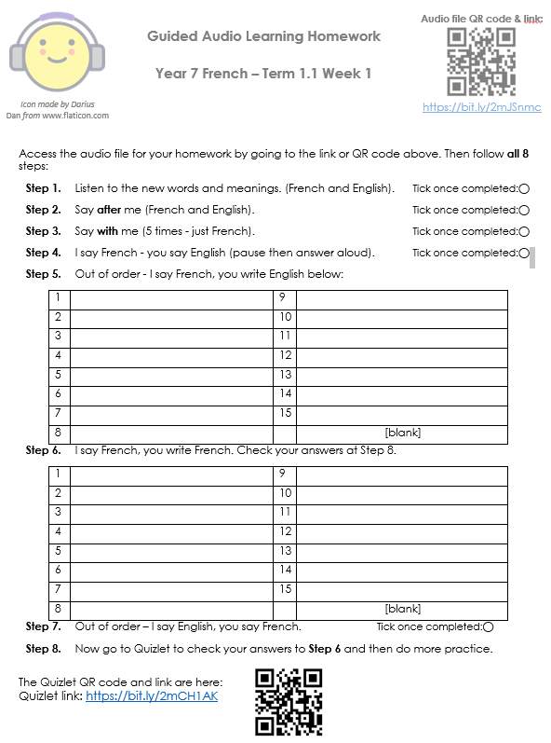
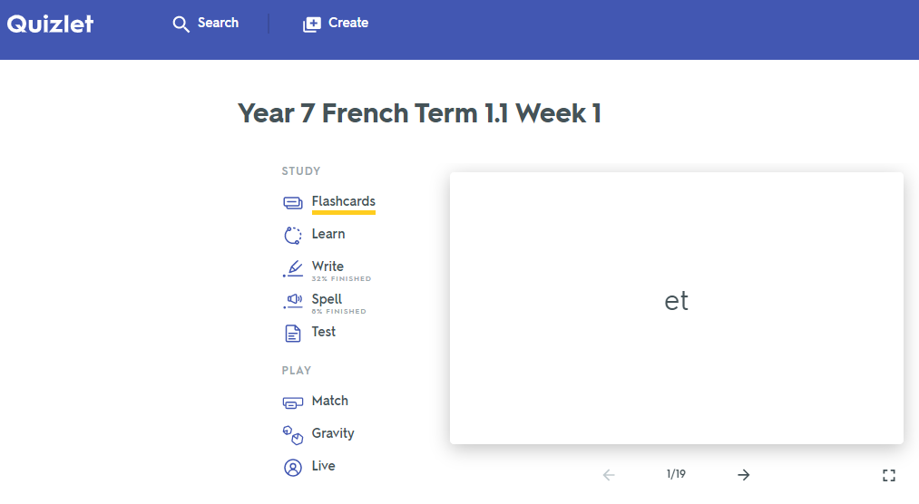
Quizlet / Audio learning homework
Notes:
Link to Quizet vocabulary set: https://quizlet.com/gb/422582995/year-7-french-term-11-week-1-flash-cards/
Link to audio file: http://www.ncelp.org/audio/FY7T1-1W1
Public Audio: https://drive.google.com/drive/folders/1zxJJBpbhes4xCWqkDk0Jmhg11ZwqeQPv

Slide 69
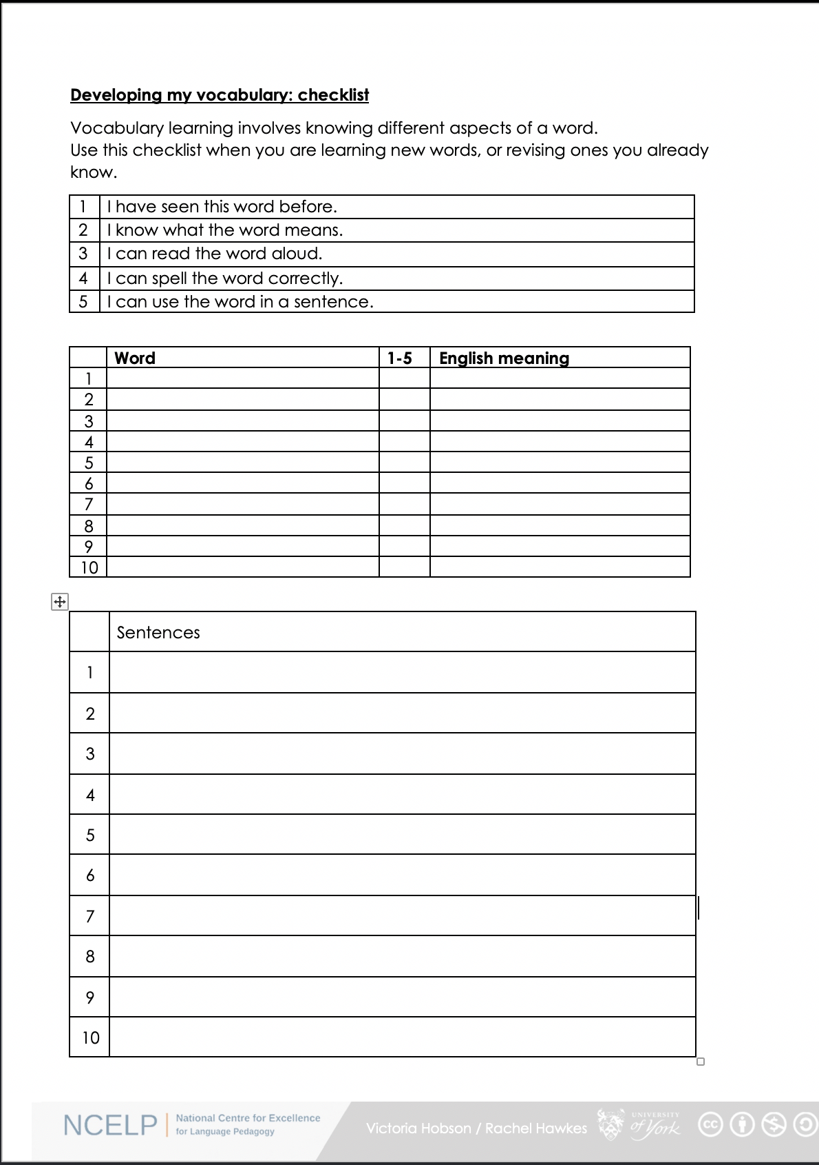
Vocabulary checklist
1. I have seen this word before.
2. I know what the word means.
3. I can read the word aloud.
4. I can spell the word correctly.
5. I can use the word in a sentence.
6. For nouns, I know the gender and the correct word for ‘the’
Notes:
This sheet could be part of a homework task for Week 7 vocabulary, if desired (or a previous week – In week 7 students should also be revisiting Week 3 vocabulary). Scroll down for the link to this resource.
Vocabulary learning involves knowing different aspects of a word. Students can use this checklist when to check what they know when they are learning new words, or revising ones they already know.
For each word the checklist asks students to asses whether the following statement apply:
1. I have seen this word before.
2. I know what the word means.
3. I can read the word aloud.
4. I can spell the word correctly.
5. I can use the word in a sentence.
Students then translate the word and try to use it in a sentence.
We suggest giving students a print out of the template they can refer to throughout the year.
A word template is available on the NCELP resource portal.
https://resources.ncelp.org/concern/resources/gf06g264k?locale=en

Slide 70
What do we know about vocabulary learning?

Slide 71
Some research- and practice-informed answers
Vocabulary learning is a strong indicator of performance, in aural and written modalities.
Currently, learners appear to know (after five years’ secondary learning) far fewer words than is ideal.
Learners need to know as many words as possible(!), but 2000 would indicate a much stronger basis for GCSE proficiency.
Vocabulary selection should balance frequency, GCSE specification, range and personal interest.
Verbs can be under-represented in text books.
Topic-based vocabulary lists of one single word class are not optimal
Rachel Hawkes / Robert Woore

Slide 72
Some answers [cont’d]
There is no single, best strategy for learning vocabulary
Errorless teaching techniques (when pupils are unambiguously told the meaning of a new word) are effective…
providing they are followed by opportunities to use the new words in comprehension, and then productively.
The more times a pupil is required to recall a word, the more securely it will move into the long term memory.
Production tasks in which pupils use new words in sentences they compose themselves serve to strengthen vocabulary knowledge.
Genuine information gap activities are very helpful in assisting memorisation.
Plentiful opportunities to encounter words in multiple contexts deepen vocabulary knowledge
Careful, planned use of ICT can be effective.
Rachel Hawkes / Robert Woore

Slide 73
FAQs in school this year!
What is the essential knowledge in your subject?
Why are you teaching it in this order?
Is teaching clear and do learners understand?
Do they remember more, know more and can they do more? (And how do you know?)

Slide 74
Ofsted new framework
NCELP
Vocabulary
teaching of ten new words, on average, per week (assuming a curriculum model of two lessons per week),
in sets of words from different parts of speech,
including the most common verbs,
and selected on the basis of word frequency
and additionally informed by scrutiny of the awarding body vocabulary lists, learner choice, context appropriateness
revisited systematically within a week, a month, a term, a year
making strategic, planned use of CALL (quizlet / audio learning homework)
400 words end Y7, 1000-1200 end Y9, 2000 end Y11
careful thinking about what students will know and be able to do at the end points
subject content that has been identified as most useful
logical progression, systematic and sufficiently explicit teaching to enable all pupils to acquire the intended knowledge and skills (p.44, Ofsted, 2019).
Judgements about impact will come from the following sources:
the progress that students make in terms of knowing more, remembering more and being able to do more
discussions with students about what they remember from the content they have studied
Notes:
Ofsted, (2019). School Inspection Handbook, September 2019, 190024, www.gov.uk/government/organisations/ofsted.
What are you teaching them? Why teach that?
What order are you teaching it in? Why in that order?
How do you know they’re learning it / remembering it / able to use it?

Slide 76
Vocabulary: what’s in a word?
ALL Yorkshire Winter Series 19-20 - Session 5
Wed 26th February 17:30-19:00
David Shanks NCELP Subject Specialist
Lead MFL Consultant, Harris Federation
ALL Council
Without grammar very little can be conveyed,
Without vocabulary nothing can be conveyed.
David Wilkins
Rachel Hawkes / Robert Woore
Notes:
What’s in a word? Every languages teacher knows that vocabulary teaching and learning is vital. Learners can’t understand, say or write anything without knowing some words. So what is there to know? This session sets out to address all the Ws and the Hs of vocabulary learning – Why is vocabulary so important? What does it mean to know a word? Which words do learners need to know? How many words do they need to know? How can they best learn those words? Answers come from research and practice, and include (freely available) resources for the classroom.
Why is vocabulary so important? What does it mean to know a word? Which words do learners need to know? How many words do they need to know? How can they best learn and retain those words?
Quotation: Wilkins, David A. (1972). Linguistics in language teaching. Edward Arnold, London. p.111-112 British Professor (Linguistics) Emeritus Reading University

Slide 77
What’s in a word?
Davies, M, & Davies, K.H. (2018). A Frequency Dictionary of Spanish: Core Vocabulary for Learners. Routledge. Häcker, M. (2008). Eleven pets and 20 ways to express one's opinion: the vocabulary learners of German acquire at English secondary schools, The Language Learning Journal, 36:2, 215-226. Jones, R.L. & Tschirner, E. (2006). A frequency dictionary of German: core vocabulary for learners. Routledge. Lonsdale, D. & Le Bras, Y. (2009) A Frequency dictionary for French. Routledge. Milton, J. (2006). Language Lite? Learning French Vocabulary in School. Journal of French Language Studies, 16,187-205. Milton, J. (2009). Measuring second language vocabulary acquisition. Multilingual Matters Milton, J. (2013). Measuring the contribution of vocabulary knowledge to proficiency in the four skills. Eurosla Monographs Series 2, 57-78. http://www.eurosla.org/monographs/EM02/Milton.pdf
Schmitt, N. (2008). Review Article. Instructed second language vocabulary learning. Language Teaching Research, 12(3), 329–363. https://doi.org/10.1177/1362168808089921 Swan, M. (2008). Talking Sense about Learning Strategies, RELC, Vol 39(2), 262-273.
Without grammar very little can be conveyed,
without vocabulary nothing can be conveyed.
David Wilkins
Rachel Hawkes

