Slide 1
French word patterns collection
Date updated: 13/12/22
Notes:
Artwork by Chloé Motard. All additional pictures selected are available under a Creative Commons license, no attribution required.
Native teacher feedback provided by Sarah Brichory.
Learning outcomes (lesson 1):
Introduction of SSC [e]
Introduction of [first, second and third person plural forms of être]
Word frequency (1 is the most frequent word in French):
7.2.1.2 (introduce) frère [1043], sœur [1558], parent [546], ouvert [897], prudent [1529], strict [1859], jeune [152]
7.1.2.6 (revisit) jouer [219], manger [1338], écouter [429], chanter [1820], étudier [960], ils, elles, fruit [896], radio [1526], histoire [263]
7.1.2.1 (revisit) ciel [1538], comme [32], couleur [1211], rêve [1313], sable [3263], vague [1493], bleu [1216], jaune [2585], rouge [987], vert [1060], violet [>5000]
Source: Londsale, D., & Le Bras, Y. (2009). A Frequency Dictionary of French: Core vocabulary for learners London: Routledge.
The frequency rankings for words that occur in this PowerPoint which have been previously introduced in NCELP resources are given in the NCELP SOW and in the resources that first introduced and formally re-visited those words.
For any other words that occur incidentally in this PowerPoint, frequency rankings will be provided in the notes field wherever possible.

Slide 2
Cognates: French word adds -e (modern ➜ moderne)
Introduction: 9.1.1.1

Slide 3
Les mots avec ‘-e’
grammaire
we can add -e to some nouns and adjectives that end with a consonant in English to make the French word
text
texte
modern
moderne
What would the following words be in French?
artist (m)
symbol (m)
terrorism (m)
Choose one and write a sentence in French.
Translate these sentences.
1. Je traduis le texte.
2. My family’s house is very modern.
I translate the text.
La maison de ma famille est très modern.
l’artiste (m)
le symbole (m)
le lerrorisme (m)
Notes:
Timing: 4 minutes Aim: To introduce cognates that are created by adding -e to English nouns or adjectives. Procedure: 1. Introduce the word pattern, clicking to reveal explanation and examples. 2. Students translate sentences to practise.
3. Click to reveal answers.
4. Students apply the rule to the English words in the pink box.
5. Click to reveal answers.
6. Students write a sentence incorporating a word of their choice

Slide 4
Suffixes: English '-ly' ➜ French '-ment’ (première ➜ premièrement)
Introduction: 9.1.1.3

Slide 5
Quel est l’adverbe ?
*sûr = safe
parler
Forme des adverbes en –ment.
Adjective base
Feminine form
Adverb
generally
sadly
lastly
surely
quickly
ambitiously
strictly
naturally
général
générale
généralement
1
general
sad
2
triste
triste
tristement
dernier
dernière
dernièrement
3
last
sure*
4
sûr
sûre
sûrement
rapide
rapide
rapidement
5
quick
ambitious
6
ambitieux
ambitieuse
ambitieusement
strict
stricte
strictement
7
strict
natural
8
naturel
naturelle
naturellement
Notes:
Timing: 4 minutes
Aim: Oral production of adverbs containing SSC [en/an]; applying word pattern knowledge (creating adverbs by adding –ment to feminine adjective form); vocabulary recall.
Procedure:
1. Students read the list of English words. Explain that although they don’t yet know these words in French, they have all the knowledge they need to produce them.
2. Guide students through the first example. First, ask them what the adjectival form of ‘generally’ is, and have them recall the French (all the adjectives needed to complete the activity have been taught previously).
3. Second, ask students to produce the feminine form of the adjective.
4. Third, ask them to add the –ment ending and say the word aloud.
5. Students repeat steps 2-4 for seven further examples.
6. Click to bring up answers one by one. Click on the audio button to hear the adverb said by a native speaker. Students repeat.
Transcript
généralement
tristement
dernièrement
sûrement
rapidement
ambitieusement
strictement
naturellement
Word frequency of unknown words (1 is the most frequent word in French): généralement [1710], dernièrement [>5000], tristement [>5000], sûrement [1750], rapidement [593], ambitieusement [>5000], strictement [2813], naturellement [2036]
Source: Londsale, D., & Le Bras, Y. (2009). A Frequency Dictionary of French: Core vocabulary for learners London: Routledge.
Word frequency of cognates (1 is the most frequent word in French): former [486], adverbe [>5000], sûr [270]
Source: Londsale, D., & Le Bras, Y. (2009). A Frequency Dictionary of French: Core vocabulary for learners London: Routledge.

Slide 6
Suffixes: English '-ive' ➜ French '-if' (active ➜ actif)
Introduction: 9.1.1.5

Slide 7
La féminisation des adjectifs
grammaire
You already know various ways to make a masculine adjective feminine.
Here is another rule:
masculine feminine
change –if to –ive actif active
négatif négative
Notes:
Timing: 1 minute
Aim: To introduce –if/-ive adjective endings.
Procedure:
1. Introduce –if/-ive adjective endings.
2. Ensure students connect them with masculine/feminine.

Slide 8
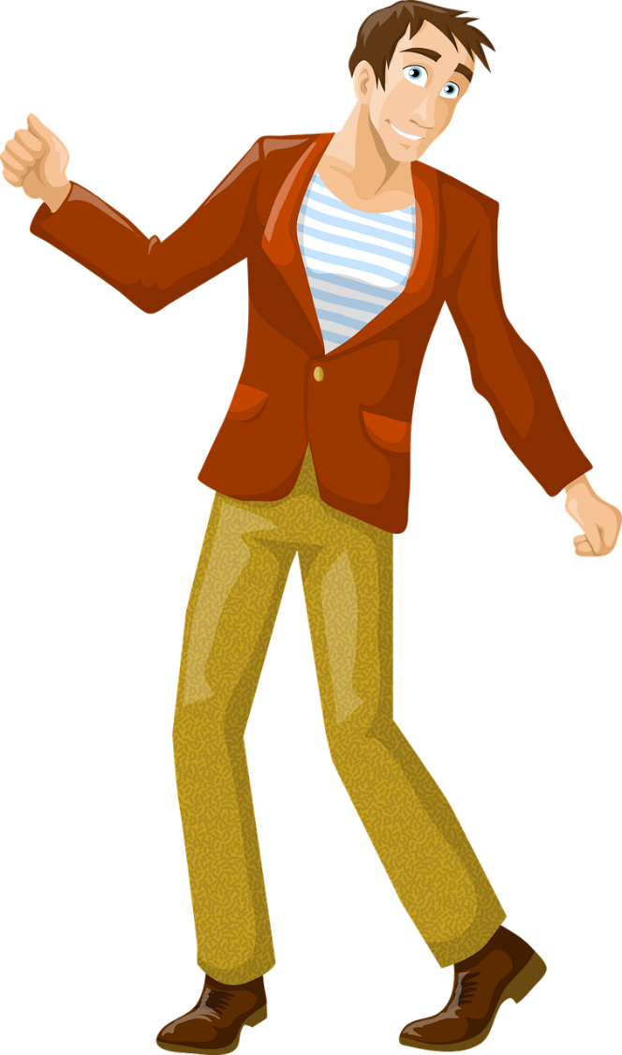
C’est qui ?
lire
Jennifer
Yannick
__________ est active.
Jennifer est active.
Notes:
Timing: 2 minutes (This is slide 1/4).
Aim: Written recognition of –if/-ive adjectives and connecting these with meaning (masculine/feminine).
Procedure:
1. Students read the sentence and decide whether it refers to the male character or the female character.
2. Click to reveal the answer.
3. Click again to reveal the full sentence.
Word frequency (1 is the most frequent word in French):
Source: Londsale, D., & Le Bras, Y. (2009). A Frequency Dictionary of French: Core vocabulary for learners London: Routledge.

Slide 9
C’est qui ?
lire
*compréhensif = understanding
This links to a verb you already know: ‘comprendre’ = to understand
__________ est compréhensif.
Jeanne
Simon est compréhensif.
Simon
Notes:
This is slide 2/4.
Word frequency of unknown words used (1 is the most frequent word in French):
compréhensif [<5000]
Source: Londsale, D., & Le Bras, Y. (2009). A Frequency Dictionary of French: Core vocabulary for learners London: Routledge.

Slide 10
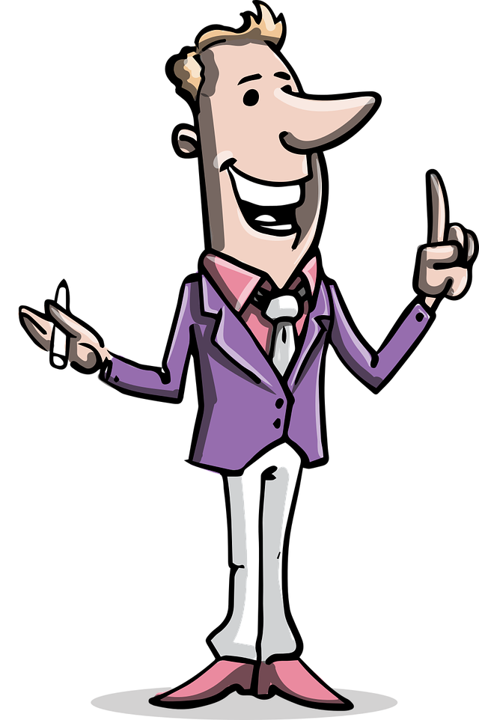
C’est qui ?
lire
Pascal
Thérèse
__________ est créatif.
Pascal est créatif.
Notes:
This is slide 3/4.
Word frequency of cognates used (1 is the most frequent word in French):
créatif [<5000]
Source: Londsale, D., & Le Bras, Y. (2009). A Frequency Dictionary of French: Core vocabulary for learners London: Routledge.

Slide 11
C’est qui ?
lire
Denise
Francis
Denise est sportive.
__________ est sportive.
Notes:
This is slide 4/4.

Slide 12
Les collègues
écouter / écrire
Léa et Sophie décrivent ses collègues. De qui parlent-elles ?
Écris des phrases pour décrire Anne et Christophe.
 | Anne | Christophe | English | les réponses
 |  |  | athletic
 |  |  | active
 |  |  | creative
 |  |  | a bit aggressive
 |  |  | understanding
 |  |  | active
1
1
Christophe est sportif.
2
2
Anne
Anne est toujours active.
3
3
Anne est créative.
4
4
Christophe est un peu agressif.
5
5
Anne est compréhensive.
6
6
Christophe
Christophe est actif.
Notes:
Timing: 5 minutes
Aim: Aural recognition of adjectives ending in -if/-ive and connecting these with meaning (people identifying as male/female). Written production adjectives ending in -if/-ive.
Procedure:
1. Click the numbers to hear audio with the name of the character obscured. Note cognates (rather than known words) are used in examples 3., 4. and 5.
2. Students listen and decide based on the adjective they hear whether they think Léa and Sophie are describing Anne or Christophe.
3. Students listen again and note the adjective in English.
4. Click to reveal English.
5. Students reconstruct the original French sentences from their notes to describe Anne and Christophe.
6. Listen and check. Click the numbers in the last column to play the full audio.
Differentiation: Classes who need more support could listen to the full audio first, then try to reconstruct the French from their notes (i.e., swap steps 5 & 6 in the list above).
Transcript:
1. [Christophe] est sportif.
2. [Anne] est toujours active.
3. [Anne] est créative.
4. [Christophe] est un peu agressif.
5. [Anne] est compréhensive.
6. [Christophe] est actif.
Word frequency of cognates used (1 is the most frequent word in French): agressif [3059], créatif [>5000]
Source: Lonsdale, D., & Le Bras, Y. (2009). A Frequency Dictionary of French: Core vocabulary for learners London: Routledge.

Slide 13
Prefixes: re- + verb (to do again) (faire ➜ refaire)
Introduction: 9.1.1.7

Slide 14
re- + verbe
phonétique
We can add re- to many verbs to create a new verb.
Like in English, re- before a verb often means doing the action again. e.g.:
re- + faire (to do, doing) → refaire (to do again/to redo)
Here, we add re- in English too. Notice the difference in pronunciation!
re- + mettre (to put, putting) → remettre (to put back, putting back)
Here, the new verb has a more specific meaning.
Notes:
Timing: 2 minutes
Aim: To introduce the re- + verb word pattern and connect this prefix with SSC [e]; to ‘break’ the association between English prefix re- and the sound ‘ree’. NB: this word pattern will not feature in NCELP assessments.
Procedure:
1. Click to animate the explanation.
2. Highlight that the prefix re- has the SSC [e].
3. Click on the verbs to hear them pronounced by a native speaker. Students repeat.
4. Draw attention to the difference in pronunciation between the re- in refaire and the re- in ‘redo’. Have students say the English and French side by side several times.
5. Students already know the verb remettre as it is introduced as part of this week’s vocabulary set. If students ask why the translation given is a little different, explain that remettre can have the general meaning to put again’ mettre encore), but it is most commonly used to mean specifically putting something back (again) where it came from.

Slide 15
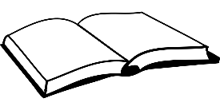
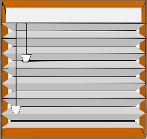
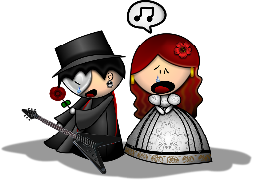
re- + verbe
*à haute voix = aloud
lire / parler
 | English | French
 | to reread, rereading | relire
 | to reshow, reshowing | remontrer
 | to leave again, leaving again | repartir
 | to win again, winning again | regagner
 | to find again, finding again | retrouver
 | to reclose, reclosing | refermer
 | to replay, replaying | rejouer
 | to recreate, recreating | recréer
Utilise la règle re- + verbe pour traduire ces verbes.
Ensuite, dis le mot à haute voix*.
1
2
3
4
5
6
7
8
Notes:
Timing: 3 minutes
Aim: Oral production of words containing SSC [e]; applying word pattern knowledge by adding the prefix re- to known words to create a new word; vocabulary recall.
Procedure:
1. Students read the list of English words. Explain that even though they don’t know these words in French, they will be able to produce them by recalling the ‘main verb’ (the part of the verb phrase after ‘re-’ or before ‘again’) and adding the re- prefix.
2. Once students have created the new word, ask them to say the word aloud. This will give them the opportunity to practise producing the SSC [e]. Depending on regional accent, the re- prefix may be pronounced similarly to French (‘rih-’) or differently (‘ree-’). Draw attention to this and ask students to say the verbs side by side.
3. Click the number button on the left to hear the new word said by a native speaker. Students repeat.
Transcript:
relire
remontrer
repartir
regagner
retrouver
refermer
rejouer
recréer
Word frequency (1 is the most frequent word in French): relire [4170], remontrer [>5000], repartir [2150], regagner [3491], retrouver [244], refermer [3759], rejouer [>5000], recréer [<5000]
Source: Londsale, D., & Le Bras, Y. (2009). A Frequency Dictionary of French: Core vocabulary for learners London: Routledge.

Slide 16
Cognates: English -c, -ck, -k or -ical ➜ French -que)
Introduction: 9.1.2.1

Slide 17
qu
quatre
musique
?
question
expliquer
unique
[to explain]
manquer
[unique; only]
[to miss/be missing]
Notes:
Timing: 2 minutes
Aim: To introduce/consolidate SSC [qu]
Procedure:
1. Introduce and elicit the pronunciation of the individual SSC [qu] and then the source word again ‘question’ (with gesture, if using). 2. Then present and elicit the pronunciation of the five cluster words.
The cluster words have been chosen for their high-frequency, from a range of word classes, with the SSC (where possible) positioned within a variety of syllables within the words (e.g. initial, 2nd, final etc.). Additionally, we have tried to use words that build cumulatively on previously taught SSCs (see the Phonics Teaching Sequence document) and do not include new SSCs. Where new SSCs are used, they are often consonants which have a similar symbol-sound correspondence in English.
Word frequency (1 is the most frequent word in French): quarte [283]; musique [1139] expliquer [252]; manquer [583]; unique [402]; question [144]. Source: Londsale, D., & Le Bras, Y. (2009). A Frequency Dictionary of French: Core vocabulary for learners London: Routledge.

Slide 18
Mots qui finissent par -que
écouter / écrire
As you know, we can translate the French word ending -que with the English word endings -c, -ck and –k.
We can also translate French word ending -ique with the English ending -ical:
magique (magic OR magical)
historique (historic OR historical)
Note: fantastic (great) and fantastiscal (strange, unreal) have different meanings.
fantastique (fantastic OR fantastical)
The only difference in these cognates is the word ending.
In French it’s -ique, but in English it’s -ical. How are these endings pronounced?
Notes:
Timing: 2 minutes
Aim: To revise and expand knowledge of the French word ending –que and its English equivalent equivalents; to introduce the English ‘-ical’ ➜ French ‘-ique’ word pattern and connect these with SSCs [i] and [qu].
1. Click to reveal the explanation.
2. Remind students that SSC [i] sounds different in English and French. Practise pronouncing the endings French ‘-ique’ and English ‘-ical’, focusing on the [i] pronunciation and the [qu] spelling.
3. Click on the French word to hear it said by a native speaker. Students repeat, and then say the English.
Transcript:
fantastique
historique
magique
Word frequency (1 is the most frequent word in French): magique [3530]
Source: Londsale, D., & Le Bras, Y. (2009). A Frequency Dictionary of French: Core vocabulary for learners London: Routledge.

Slide 19
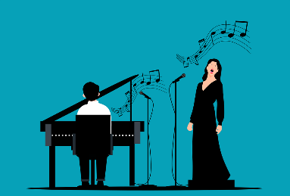
Mots qui finissent par -ique
écrire / parler
C’est quoi en français ?
 | English | French
 | statistical | statistique
 | political | politique
 | physical | physique
 | economical | économique
 | technical | technique
 | logical | logique
 | typical | typique
 | classical music | musique classique
1
2
3
4
5
6
7
8
Notes:
Timing: 5 minutes
Aim: Oral production of words containing SSC [qu]; application of English-French word patterns.
Procedure:
1. Students translate the English words into French, applying the knowledge of French-English word patterns covered on the previous slide.
2. Click to reveal answers.
3. Click on the audio button to hear the words pronounced by a native speaker.
4. Students repeat and then say the English translation aloud, focusing on the pronunciation of –ic(al)/-ique.
Transcript:
statistique
politique
physique
économique
technique
logique
typique
musique classique
Word frequency of cognates used (1 is the most frequent word in French):
statistique [1901], politique [128], physique [1146], économique [261], technique [592], logique [1107], typique [4178], classique [1845],
Source: Londsale, D., & Le Bras, Y. (2009). A Frequency Dictionary of French: Core vocabulary for learners London: Routledge.

Slide 20
Vocabulaire
Vocabulaire
parler
A
B
C
D
E
[to respect, respecting]
[useful]
[to prevent, preventing]
[essential]
[fantastic]
F
G
H
I
J
[to practise, practising]
[to risk, risking]
[castle, palace]
[historic]
[region]
Notes:
Timing: 5 minutes
Aim: To revise in oral modality 10 items of vocabulary, within a limited time frame.
Procedure:
1. Write A-J in books. (or treat as a whole class oral activity)
2. Click / press enter to flash an English word. It will disappear after 3 seconds.
3. Students try to say the French equivalent before the 3 seconds is up.
Answers:
a. respecter
b. utile
c. fantastique
d. empêcher
e. essentiel
f. historique
g. la région
h. pratiquer
i. risquer
j. le château

Slide 21
Noun and adjective pairs: adjective + article ➜ noun (+/- capital letter) (nouveau ➜ le nouveau;
Introduction: 9.1.2.2

Slide 22
Adjectives used as nouns
Nouns for nationalities begin with a capital letter in French.
vocabulaire
Remember, nationality adjectives can become nouns if we add an article:
français → le Français canadien → le Canadien
French (adj.) → French person (m.) Canadian (adj.) → Canadian person (m.)
Religion adjectives follow the same pattern:
chrétien → le chrétien musulman → le musulman
Christian (adj.) → Christian (person) Muslim (adj.) → Muslim (person)
Many other adjectives also follow this pattern:
nouveau → le nouveau petit → le petit
new → the new one small → the small one
Remember, we don’t use a word for ‘a’ after ‘être’ with nouns for nationalities or jobs. The same applies to nouns for religious identities, or any other nouns to describe identities.
Religious identities don’t begin with a capital letter in French.
Notes:
Timing: 2 minutes
Aim: Introduction of adjectives used as nouns.
Procedure:
1. Click to reveal explanations.
2. Ensure understanding.
3. Draw attention to the English translation of more general adjectives used as nouns (adjective + ‘one’)

Slide 23
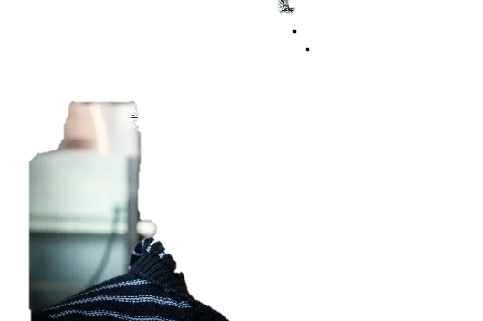
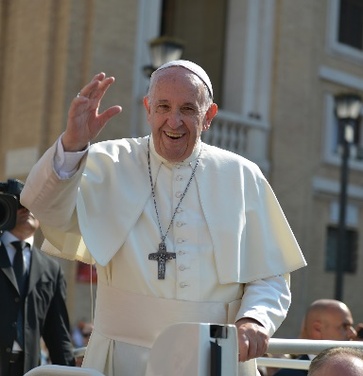
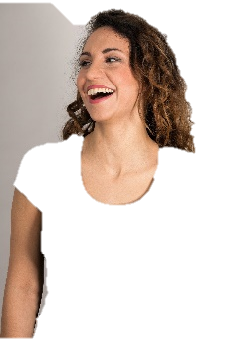
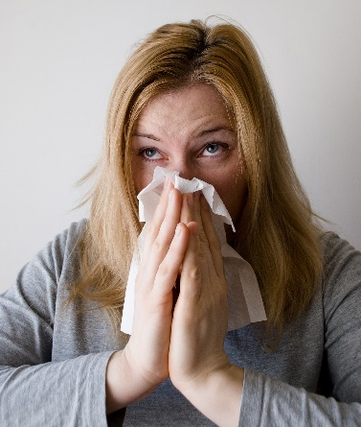
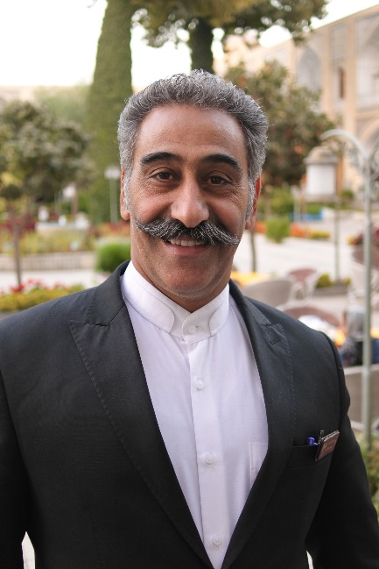
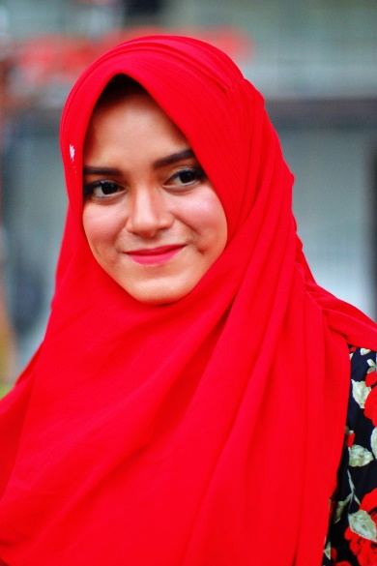
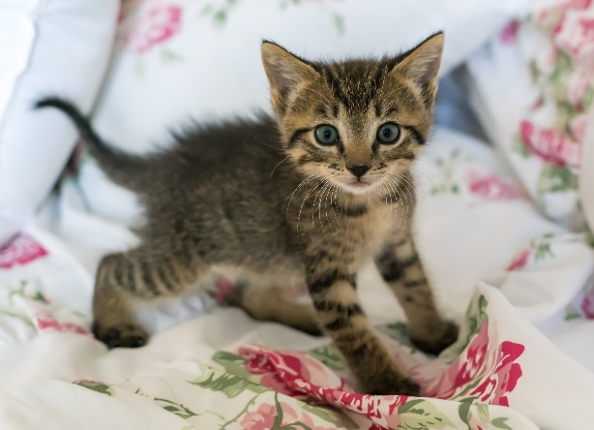
C’est qui ?
écouter
A
B
C
D
Q | R
1
C
2
A
3
D
E
G
H
4
G
F
5
H
6
F
7
B
8
E
Notes:
Timing: 5 minutes
Aim: Aural recognition of (known) adjectives used as (unknown) nouns.
Procedure:
1. Ensure recognition of flags. (A – Québec, D – Italy)
2. Click the buttons to play the audio.
3. Students write 1-8 and write the letter of the picture that matches the word they hear.
4. Click to reveal the answers.
5. Elicit suggestions of translations into English. (Suggestions: A – man from Quebec, B – the young girl, C – Christian (man), D – Italian (woman), E – ill woman, F – little one, G – happy man, H – Muslim (woman)
Transcript:
1. le chrétien
2. le québécois
3. l’italienne
4. l’heureux
5. la musulmane
6. le petit
7. la jeune
8. la malade

Slide 24
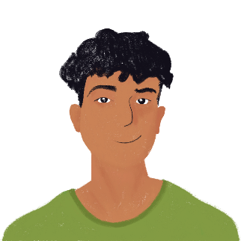
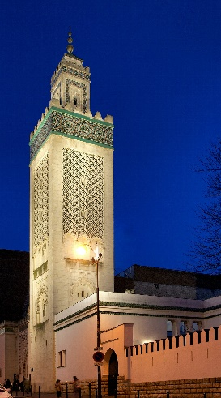
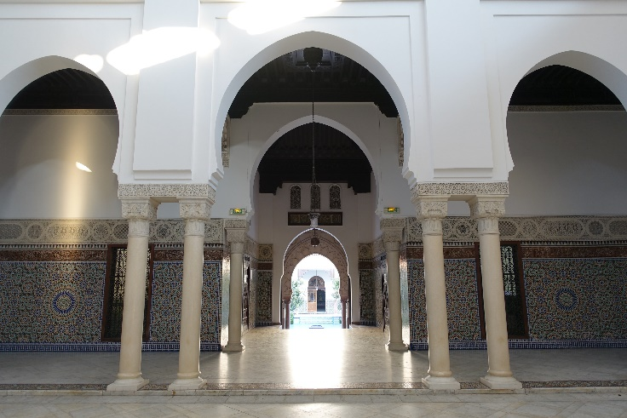
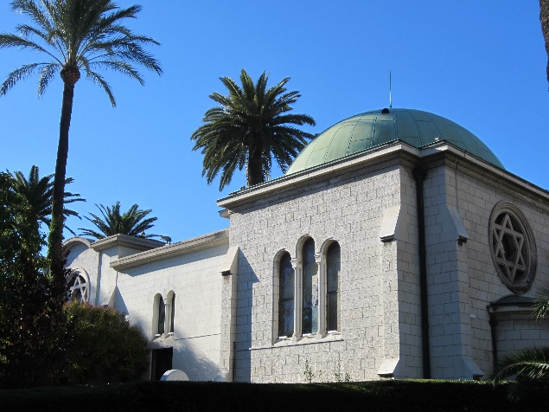
La religion en France
*prier = to pray
lire
Are the words in bold nouns or adjectives?
TIPS
Adjectives usually come before or after nouns.
Nouns usually have an article, and sometimes have a capital letter.
Nouns are usually before a verb.
 | noun | adjective
1. Il y a beaucoup de bâtiments religieux en France.
2. Chaque ville a une église pour les chrétiens.
3. Les musulmans prient* dans une mosquée.
4. Il y a des écoles juives à Paris.
5. Le chef de la Grande Mosquée de Paris est Algérien.
La Grande Mosquée de Paris
La Synagogue de Cannes
Notes:
Timing: 5 minutes [slide 1/2]
Aim: Written recognition of adjectives and nouns in context; reading comprehension.
Procedure:
1. Remind students of clues that can help to distinguish between adjectives and nouns.
2. Bubble disappears on click.
3. Students write 1-10 and note whether the word in bold in each sentence is used as a noun or an adjective, using the sentence context to help them.
4. Click to reveal answers.
5. Oral translation of sentences.
6. Present the types of religious buildings.
Word frequency of unknown words used (1 is the most frequent word in French):
prier [1645], basilique [>5000], cathédrale [>5000]
Word frequency of cognates used (1 is the most frequent word in French): mosquée [>5000], catholique [1578], certain [110], synagogue [>5000]
Source: Lonsdale, D., & Le Bras, Y. (2009). A Frequency Dictionary of French: Core vocabulary for learners London: Routledge.
Courtyard @ Grande Mosquée de Paris @ Paris by Guilhem Vellut is licensed under CC BY 2.0

Slide 25
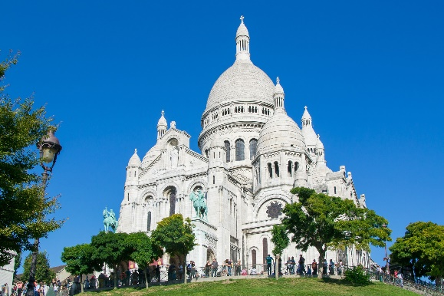
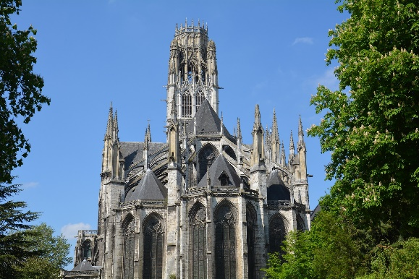
La religion en France
*la basilique = basilica (important church)
lire
Are the words in bold nouns or adjectives?
 | noun | adjective
6. La Basilique* du Sacré Cœur est une grande église catholique à Paris.
7. Il y a des écoles pour les catholiques dans les grandes villes.
8. Les écoles pour les gens religieux coûtent de l’argent.
9. Dans les grandes villes, on peut acheter des livres musulmans.
10. Les juifs et les musulmans ne mangent pas certains produits de viande.
La Basilique du Sacré-Cœur à Paris
La Cathédrale Notre-Dame de Rouen
Notes:
Slide 2/2

Slide 26
Nouns and adjectives
écrire
Use nouns you already know to work out the missing adjectives, and use adjectives you already know to work out the missing nouns.
Elle étudie l’histoire __________ de la France. (political)
Le bus a déjà quitté. J’attends ___________. (the next one)
Tu es __________ ! (the last one (m.))
Ils travaillent avec __________. (young people)
40% des __________ ne sont pas religieux. (French people)
Il faut aider __________ ! (the ill woman)
J’ai parlé avec __________. (a Jewish man)
Beaucoup de ___________ sont chrétiens. (Canadians)
politique
le prochain
le dernier
les jeunes
Français
la malade
un juif
Canadiens
Notes:
Timing: 5 minutes
Aim: Applying knowledge of noun and adjective use in writing; recalling known vocabulary items (nouns and adjectives) and applying these in a new context (nominal and adjectival usage).
Procedure:
1. Students write 1-8.
2. Students recall known adjectives and nouns and use their knowledge to write the opposite part of speech.
3. Click to reveal answers.
4. Oral translation of sentences if time allows.

Slide 27
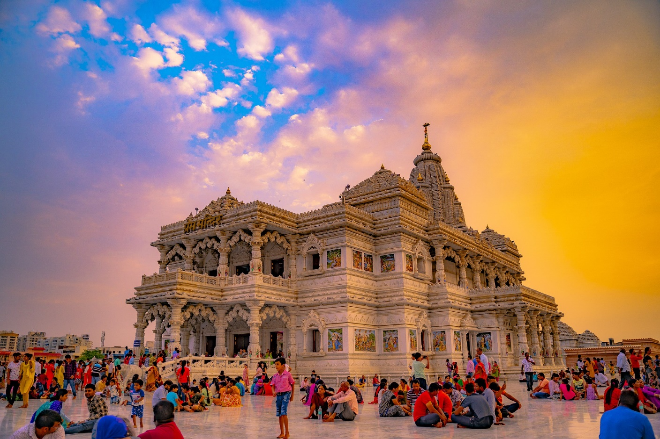
Nouns and adjectives
parler
[a Hindu woman]
_____ _____
un lieu hindou une hindoue
Notes:
Timing: 5 minutes [slide 1/8]
Aim: Oral production of nouns and adjectives using existing knowledge of the other part of speech.
Procedure:
1. Students read the word on the left out loud, focusing on the SSCs. Ensure students are clear on the English meaning.
2. Students orally translate the word or phrase on the right.
3. Extension: Students also write the words.
Word frequency of unknown words used (1 is the most frequent word in French):
suédois [4647], drapeau [2582], polonais [3660]
Word frequency of cognates used (1 is the most frequent word in French): hindou [>5000], sikh [>5000], bouddhiste [>5000], irlandais [3963], protestant [3489], mexicain [4541]
Source: Lonsdale, D., & Le Bras, Y. (2009). A Frequency Dictionary of French: Core vocabulary for learners London: Routledge.

Slide 28
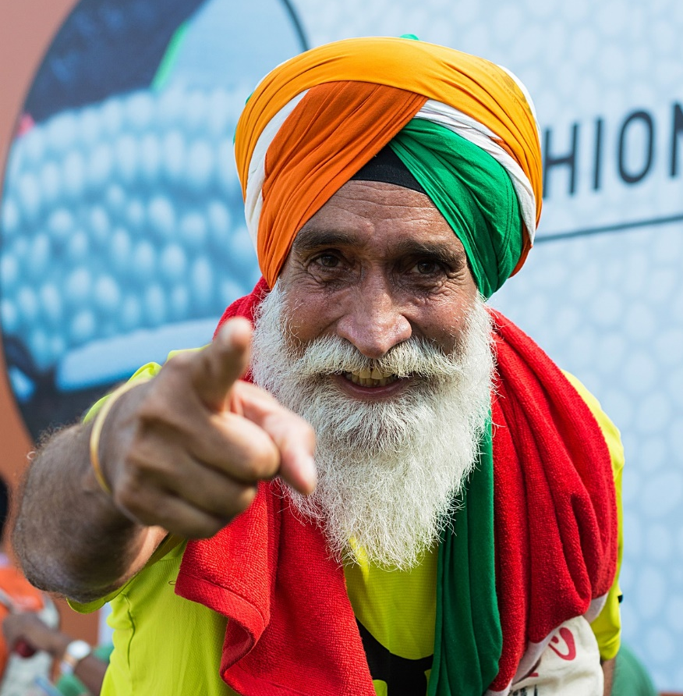
Nouns and adjectives
parler
un sikh un texte sikh
[a Sikh text]
Notes:
Timing: 5 minutes [slide 2/8]
Aim: Oral production of nouns and adjectives from the other part of speech; applying knowledge to unknown words.
Procedure:
1. Students read the word on the left out loud, focusing on the SSCs. Ensure students are clear on the English meaning.
2. Students orally translate the word or phrase on the right.
3. Extension: Students also write the words.
Word frequency of unknown words used (1 is the most frequent word in French):
suédois [4647], polonais [3660]
Word frequency of cognates used (1 is the most frequent word in French): hindou [>5000], sikh [>5000], bouddhiste [>5000], irlandais [3963], protestant [3489], mexicain [4541]
Source: Lonsdale, D., & Le Bras, Y. (2009). A Frequency Dictionary of French: Core vocabulary for learners London: Routledge.

Slide 29
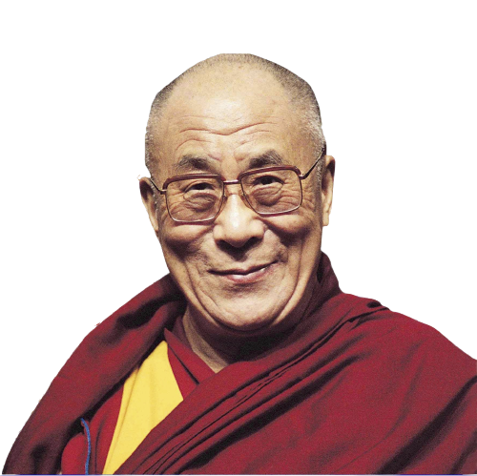
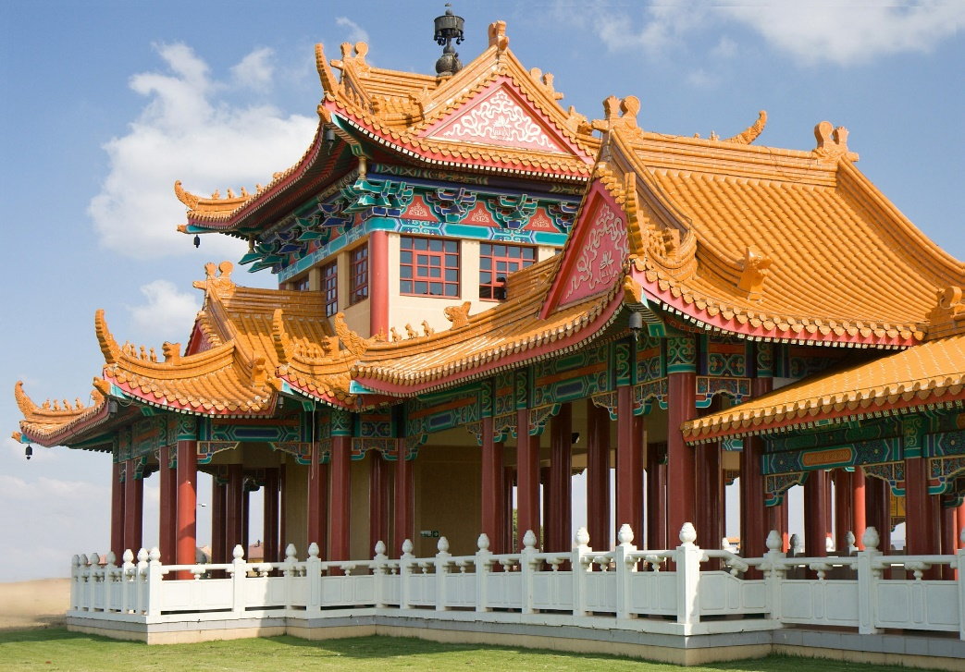
Nouns and adjectives
parler
[a Buddhist man]
_____ _____
un bâtiment bouddhiste un bouddhiste
Notes:
Timing: 5 minutes [3/8]

Slide 30
Nouns and adjectives
parler
[a Swedish song]
un Suédois une chanson suédoise
Notes:
Timing: 5 minutes [4/8]

Slide 31
Nouns and adjectives
parler
[a Polish woman]
_____ _____
un drapeau polonais une Polonaise
Notes:
Timing: 5 minutes [slide 5/8]

Slide 32
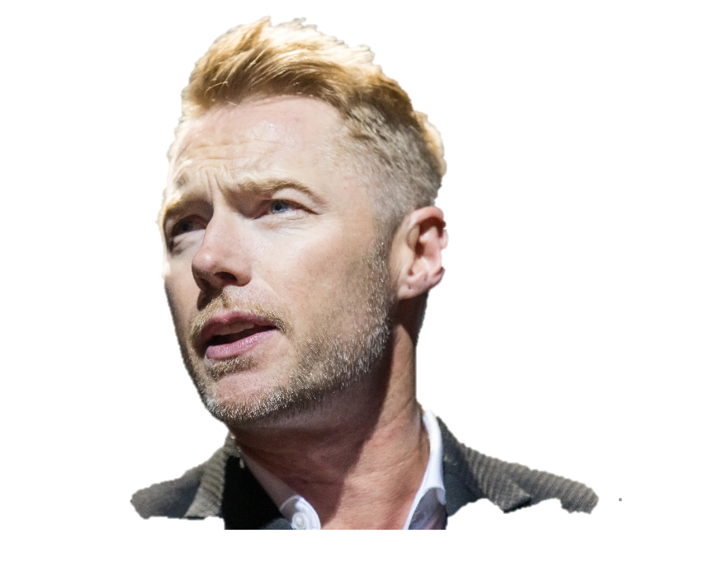
Nouns and adjectives
parler
[an Irish man]
_____ _____
un drapeau irlandais un Irlandais
Notes:
Timing: 5 minutes [slide 6/8]

Slide 33
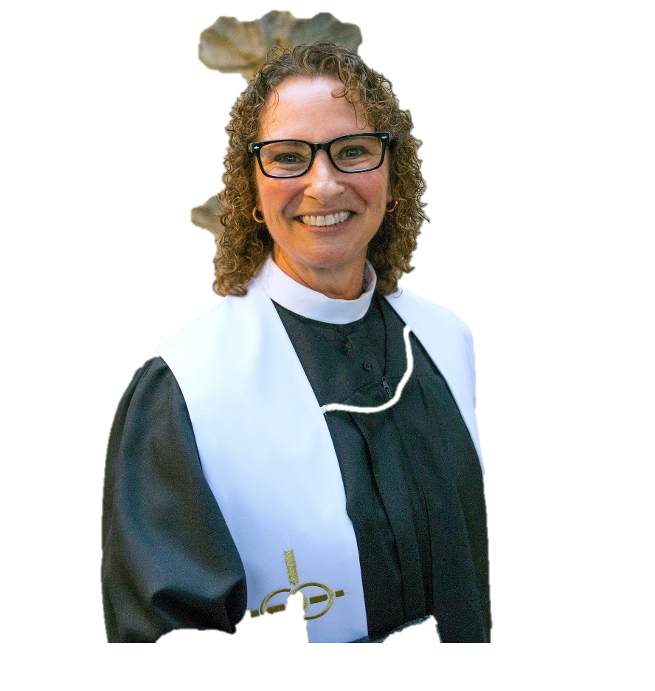
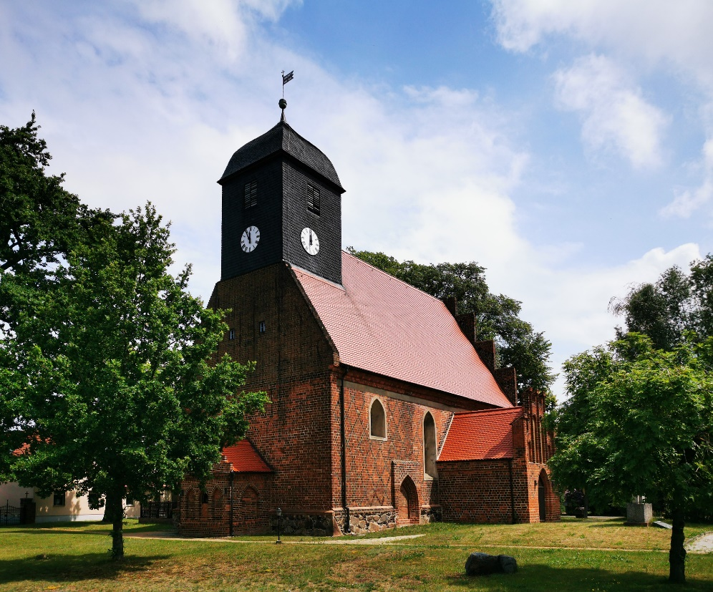
Nouns and adjectives
parler
[a Protestant woman]
_____ _____
une église protestante une protestante
Notes:
Timing: 5 minutes [slide 7/8]

Slide 34
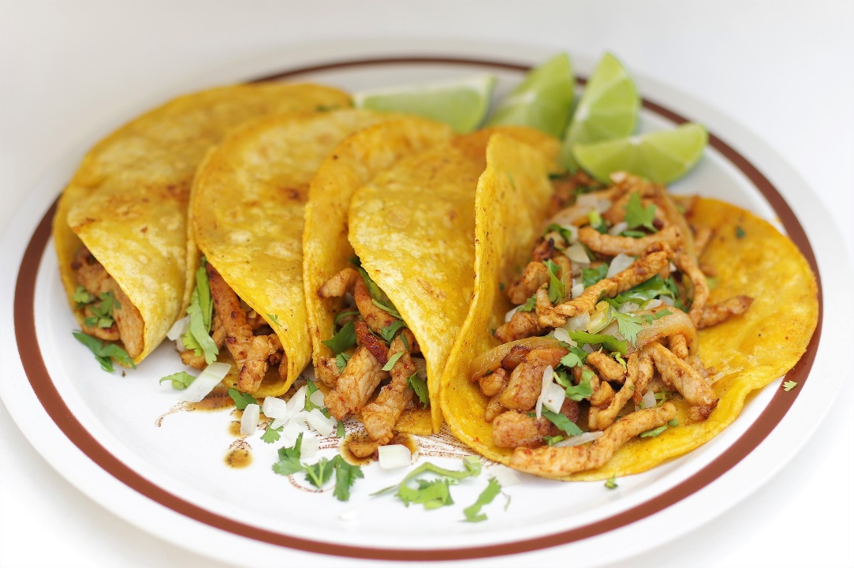
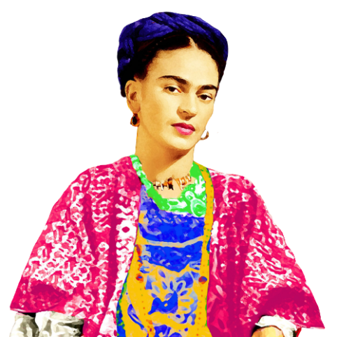
Nouns and adjectives
parler
[a Mexican meal]
une Mexicaine un repas mexicain
Notes:
Timing: 5 minutes [slide 8/8]

Slide 35
Cognates: 'English '-or/-our' ➜ French '-eur' (actor ➜ acteur)
Introduction: 9.1.2.3

Slide 36
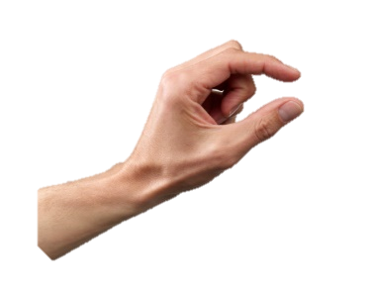
Mots qui finissent par -eur
écouter / écrire
Compare these two words:
The SSC [eu] is closed.
The SSC [eu] is open.
peu (bit)
peur (fear)
How are these words pronounced? Is the SSC [eu] open or closed?
The SSC [eu] is always open before an -r in French.
Notes:
Timing: 1 minute
Aim: To highlight the difference in pronunciation between open and closed SSC [eu].
Procedure:
1. Click to reveal the explanation.
2. Click on the French words to hear them said by a native speaker. Students repeat, and then say the English.
3. Remind students that the SSC [eu] can be open or closed depending on its position within a word (long if before a pronounced consonant, short if not). In preparation for the following slide, tell students that the SSC [eu] is always open before an -r in French.
Transcript:
peu
peur
Word frequency of unknown words used (1 is the most frequent word in French):
peur [755]
Source: Londsale, D., & Le Bras, Y. (2009). A Frequency Dictionary of French: Core vocabulary for learners London: Routledge.

Slide 37
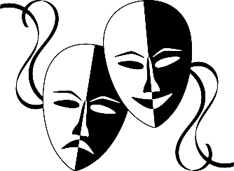
Mots qui finissent par -eur
écouter / écrire
Here are some words ending with -eur in French.
acteur (actor)
honneur (honour)
These words are spelled similarly in English and French and have the same meaning. This is because they are cognates.
The only spelling difference is the word ending. It looks different.
In French it’s -eur, but in English it’s -or or -our.
The SSC [eu] is always open before -r in French.
How are these endings pronounced?
Notes:
Timing: 2 minutes
Aim: To introduce the English ‘-or’ or ’-our’ ➜ French ‘-eur’ word pattern and connect this with SSC open [eu]. This phonics focus prepares students to correctly pronounce the possessive pronouns leur and leurs, introduced this week.
Procedure:
1. Click to reveal the explanation.
2. Click on the French words to hear them said by a native speaker. Students repeat, and then say the English.
3. Highlight that the SSC [eu] is always open before -r in French.
Transcript:
acteur
honneur
Word frequency of cognate words used (1 is the most frequent word in French):
honneur [1141]
Source: Londsale, D., & Le Bras, Y. (2009). A Frequency Dictionary of French: Core vocabulary for learners London: Routledge.

Slide 38
Mots qui finissent par -eur
French words ending in -eur often end in -or or -our in English.
écouter / écrire
C’est quoi en anglais ?
Use your knowledge
of French words ending in -eur to predict the English.
 | French | English
 | extérieur | exterior
 | splendeur | splendour
 | humeur | humour
 | moteur | motor
 | intérieur | interior
 | faveur | favour
 | odeur | odour
 | inspecteur | inspector
1
2
3
4
5
6
7
8
Notes:
Timing: 3 minutes
Aim: Oral production of words containing SSC open [eu]; application of English-French word pattern knowledge.
Procedure:
1. Students translate the French words into English, applying the knowledge of French-English word patterns covered in the last slide.
2. Click on the audio button to hear the words pronounced by a native speaker.
3. Students repeat and then say the English translation aloud, focusing on the pronunciation of -or/-our.
4. Click to bring up the bubble with information about the range of English spelling variations equivalent to the French -eur.
Transcript:
extérieur
splendeur
humeur
moteur
intérieur
faveur
odeur
inspecteur
Word frequency of cognates used (1 is the most frequent word in French):
extérieur [625], intérieur [433], inspecteur [2694], humeur [3188], odeur [3273], moteur [1164], faveur [994], splendeur [>5000]
Source: Londsale, D., & Le Bras, Y. (2009). A Frequency Dictionary of French: Core vocabulary for learners London: Routledge.

