Slide 1
Phonics
Silent ‘h’
Revision of other SSCs
Y7 Spanish
Term 2.1 - Week 3 - Lesson 33
Author name(s): Nick Avery / Victoria Hobson / Rachel Hawkes
Date updated: 17/01/2020

Slide 2
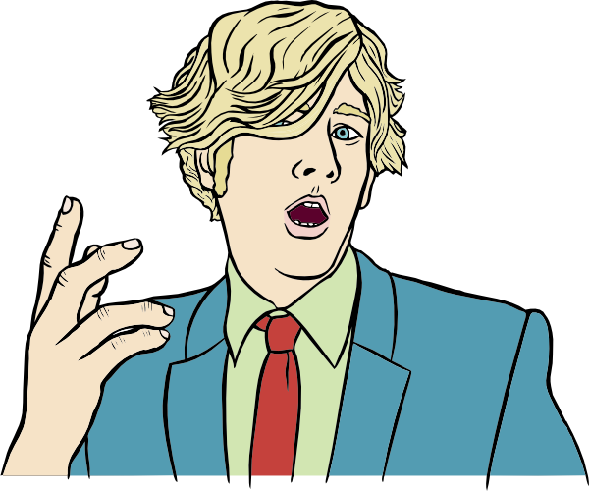
h
X
hablar
Notes:
Introduce and elicit the pronunciation of the individual SSC ‘h’ In this case, there is no sound, which can be demonstrated by producing an English ‘h’ and then immediately shaking your head ‘no’ and putting your fingers to your lips for ‘shhh’… and then present and practise the pronunciation of the source word ‘hablar’.
A possible gesture for this source word would be to open your mouth and your hand

Slide 3
h
X
hablar
Notes:
Repeat the gesture for silent ‘h’ and elicit the source word.

Slide 4
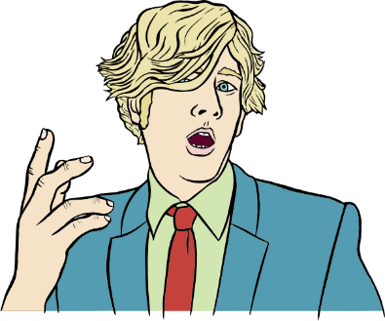
X
h
hijo
helado
hospital
hasta luego
hablar
hacer
[to do; to make]
Notes:
Introduce and elicit the gesture forthe individual SSC, silent ‘h’ and then the source word again (with gesture, if using). Then present and elicit the pronunciation of the five cluster words.
The cluster words have been chosen for their high-frequency, from a range of word classes, with the SSC (where possible) positioned within a variety of syllables within the words(e.g. initial, 2nd, final etc..) and additionally, we have tried to use words that build cumulatively on previously taught SSCs (see the Phonics Teaching Sequence document) and do not include new SSCs. Where new SSCs are used, they are often consonants which have a similar symbol-sound correspondence in English.

Slide 5
X
h
hijo
helado
hospital
hasta luego
hablar
hacer
Notes:
Without the images, students focus this time again closely on the SSC and the cluster words.

Slide 6
X
h
hijo
helado
hospital
hasta luego
hablar
hacer
Notes:
Without the images or sound, students have to pronounce the words themselves.

Slide 7
H?
escuchar / escribir
Es ‘H’, ¿sí (✔) o no (✖)?
Escribe la palabra en español.
A
✔
helado
F
✖
ocho
B
✖
once
G
✔
hacer
C
✖
autor
H
✔
hospital
D
✔
hablar
I
✖
uno
✔
hijo
✔
hasta luego
E
J
Notes:
Transcript: 1. helado; 2. once; 3. autor; 4. hablar; 5. hijo; 6. ocho; 7. hacer; 8. hospital; 9. uno; 10. hasta luego
Students need to learn which words which begin with a vowel and which begin with a silent ‘h’. This is why both types of word are included in the activity.
The ‘h’ words used here are source/cluster words and the other words are vocabulary items from 1.2.2 – one of the weeks to be revisited as part of students’ vocabulary learning homework.

Slide 8
İPilla al intruso!
hablar / escuchar / escribir
Persona A
✄
Persona B
 | hola / hasta luego / amigo |  | hermano / abuelo / hijo
 | hablar / estudiar / estar |  | hermosa / hermana / escuela
 | hermano / español / helado |  | hacer / usar / estudiar
 | hay / alto / arte |  | iglesia / hospital / escuela
 | once / ocho / hola |  | usar / hablar / hacer
A
A
B
B
- - - - - - - - - - - - - - - - - - - - - - - - - - - - - - - - -
C
C
D
D
E
E
Notes:
Student worksheets to print (these are available in Word format). Do not display in class.
Pairs take it in turns to say their set of words to their partner who has to listen for the odd one out and write it down in Spanish.
All the vocabulary used here has been seen in previously taught vocabulary sets or phonics practice. Note: Explain to students that the task’s focus is the silent ‘h’. Otherwise, they may think that the odd one out might be the meaning rather than the spelling of words. They may need to write down ALL three words before they can determine which is the odd one out.

Slide 9
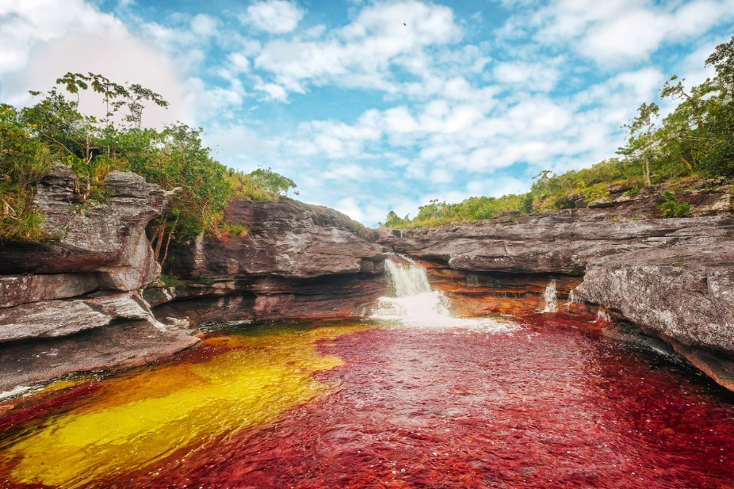
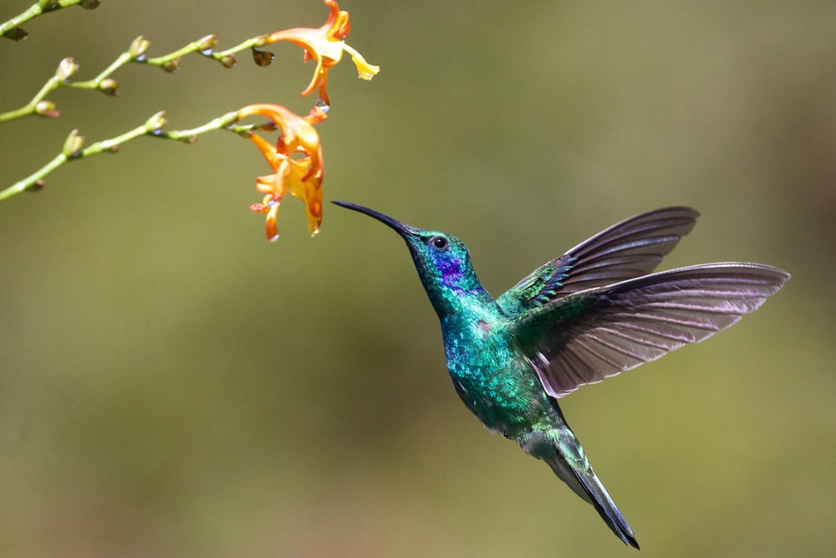
Caño Cristales: un lugar espectacular
leer
Caño Cristales es un río hermoso en el centro de Colombia. Está en un parque nacional cerca de Los Andes y lejos de las ciudades grandes.
El río es muy especial porque es de cinco colores: rojo, verde, azul, amarillo, y negro. Es un lugar perfecto para* tomar fotos de la naturaleza.
No hay cosas feas allí; sólo plantas, flores, árboles, animales, y también pájaros pequeños.
El pájaro azul y verde en la imagen es una especie nativa: el ‘colibrí’. ¿Cómo se dice en inglés? Hummingbird!
* para = for
* la especie = species
Notes:
Picture credit: Mario Carvajal CC by 4.0; photo by James Wainscoat on Unsplash
This text can be exploited in different ways:
Grammatical awareness – students read text and identify how many examples of the ‘adjective following noun’ they can find. Answer: 7 (río hermoso, parque nacional, ciudad grande, lugar perfecto, cosas feas, pájaro azul y verde; especie nativa). The title ‘un lugar espectacular’ includes another example of this.
Phonics revision – listen to the text and write the missing words (see next slide), which contain words with challenging SSCs.
Paired read aloud with prompts to force production of post-nominal adjective (see slide 38).
Two words that haven’t been previously taught are included as a gloss: ‘para and ‘especie’. Students will be taught the bsaic meaning of ‘para’ in next week’s class. They will learn ‘para’ + infinitive in the Year 8 Spanish scheme of work

Slide 10
Caño Cristales: un lugar espectacular
escuchar
Caño Cristales es un río _________ en el centro de Colombia. Está en un parque nacional cerca de Los Andes y ______ de las ciudades grandes.
El río es muy especial porque es de cinco colores: rojo, verde, _____, _______, y negro. Es un lugar perfecto para tomar fotos de la naturaleza.
No hay cosas feas allí; sólo plantas, flores, árboles, animales, y también pájaros _____________.
El pájaro en la ____________ es una especie nativa: el ‘colibrí’. ¿Cómo se dice en inglés? Hummingbird!
Notes:
Phonics revision: students write the missing words. The text has been adapted slightly to not give away the answers by repeating key words.
The missing words were selected because they contain a range of previously taught SSCs that can sometimes be challenging for students.
hermoso – SSC [silent ‘h’]
lejos – SSC [j]
azul – SSC [z]
amarillo – SSC [ll]
pequeños – SSC [ñ]
imagen – SSC [ge]

Slide 11
En parejas. Read the text aloud to your partner, translating into Spanish when necessary.
hablar
Caño Cristales es un ………………………….en el centro de Colombia. Está en un ……………………….. cerca de Los Andes y lejos de las ciudades grandes.
El río es muy especial porque es de cinco colores: rojo, verde, azul, amarillo, y negro. Es un ……………………………para tomar fotos de la naturaleza.
No hay………………..…..allí; sólo plantas, flores, árboles, animales, y también pájaros pequeños.
El …………………………….en la imagen es una ………..…………..: el ‘colibrí’. ¿Cómo se dice en inglés? Hummingbird!
beautiful river
national park
perfect place
ugly things
blue and green bird
native species
* nacional = national
* especie = species
Notes:
Students take turns to read the text aloud with English prompts to force production of post-nominal adjective in Spanish.
Students haven’t previously learnt ‘especie’, ‘nativa’ or ‘nacional’ as vocabulary items so make sure these words are understood from the original text. All 3 are near-cognates but students might not be sure of the spoken form. ‘Especie’ and ‘nacional’ are provided as a gloss to support practice.

