Slide 1
Phonics
Why teach phonics?
Robert Woore

Slide 2


Discuss
In your opinion, is it important to teach phonics (the relationship between letters and their sounds) in languages? Why/why not?
Is phonics currently taught in your school? If so, how well?
In your school, (a) how accurately and (b) how fluently can students pronounce written words in the foreign language? (consider both familiar and unknown words)
How much progress do they make in this area?
Notes:
Slides 2-3: Total time [12 mins]
Reflect on initial conceptions and practice in own schools
Initial reflection questions as a warm-up: 4 minutes to talk to your partner, 5 minutes for initial feedback
Key advantage in terms of learner autonomy: good L2 GPC mean they can see a new word, sound it out, start the learning process asap and independently
Through the session we aim to develop a deeper understanding of the answers to these questions and provide research evidence underpinnings

Slide 3
Session Outline
What is ‘phonics teaching’? Definitions of key terms.
The role of phonics in learning to read in L1 English
Learning to read / decode in different writing systems
Phonics in language teaching
  Is phonological decoding important in L2? Why?
  Is phonics instruction effective in L2 learning?
  If so, ‘effective’ in what ways? What are the outcomes?
Summary and key messages
Notes:
Slides 2-3: Total time [12 mins]

Slide 4
1. Definitions
Phonics teaching: explicit teaching of the relationships between letters and their sounds in written words
Grapheme-Phoneme Correspondences (GPC)
Phoneme: “minimal sound unit … capable of contrasting word meaning” (Katamba, 1989:21)
你好
Grapheme:
written unit corresponding to a phoneme
broader meaning, “essentially as a synonym for ‘written symbol’” (Cook & Bassetti, 2005:4)
GPC = the systematic relationships between the graphemes (in sense ‘a’) and phonemes in a given writing system.
ch
au
d
ch
aud
ʃ
o
-
ʃ
o
Symbol-sound correspondences (SSC): the systematic relationships between the written symbols and sounds (at any unit of size) in a given writing system.
Notes:
Slides 4-6: [5 mins] Total: 17 mins
Understand definitions of key terms
Attention to ‘decoding’ in particular – phonological decoding versus lexical access.
Note that decoding is used in other senses too (sometimes including meaning access) but we are using it in a narrow sense.
On slide 4 (diagram with cat): emphasize different routes of word recognition (phonological versus lexical) and also note that development of fluency eventually leads to tight interconnections between all three basic elements of word knowledge (→ sight vocabulary)

Slide 5

1. Definitions
Phonological decoding (or ‘recoding’): “the ability to convert the visual print into its corresponding spoken form” Nassaji (2013)
< c a t >
/ k a t /
CC0 license – pixabay.com
Word recognition / identification (or ‘lexical access’): “the skill with which readers process the visual symbols in the print in order to recognize and access its meaning in the mental lexicon” Nassaji (2013)
Notes:
Slides 7-9 [5 mins] Total: 22 mins
Know something about the policy, evidence and controversy surrounding phonics teaching in L1 English
Note the current emphasis on Phonics in teaching early literacy in L1 English (UK and US)
Briefly explain background to this (‘reading wars’)
searchlights model: use of a range of cues to identify unknown words: phonics, context, grammatical context, graphic shape from previous encounters.
DfE2010 is ‘The Importance of Teaching: the schools white paper 2010’
Note current policy and Phonics screening check (pseudowords). Key things to note from this for languagesL: (1) Emphasis on phonics at primary likely to influence teaching of literacy in FL; but (2) we need to be aware of some differences between phonics in L1 and L2, in terms of rationale and methods (see later); (3) Children will be increasingly familiar with the idea of phonics teaching (though interference from their L1 decoding may become stronger!); (4) lots of Phonics expertise at primary level that we may be able to draw on.
Briefly note that there are alternative (competing) approaches – synthetic versus analytic. mention evidence here that learners spontaneously use ‘analogies’ to known words (Goswami) and that they may transfer this to L2.
Briefly note controversy in terms of overemphasis on phonics – we believe the UKLA statement on the need for a varied and interesting diet of reading also applies to all language teaching!

Slide 6
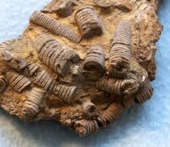

1. Definitions
un crinoïde
Phonological decoding
jerette
Familiar words: phonological representations already stored in mental lexicon – may be accessed as wholes
Unfamiliar words / pseudowords: phonological forms must be generated at point of naming, using knowledge of the language’s symbol-sound correspondences
l’ulmaire
tirôt
Robert Woore

Slide 7

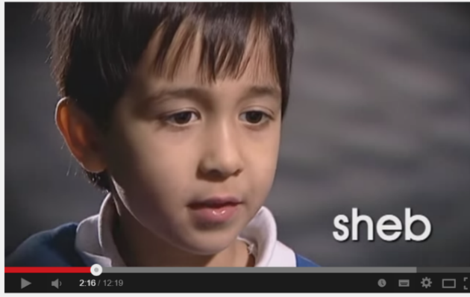
2. The Role of Phonics to Read in L1 English
“The case for systematic phonic work is overwhelming and much strengthened by a synthetic approach” (Rose, 2006:20)
“We will improve early numeracy and literacy, promoting systematic synthetic phonics and assessing reading at age six to make sure that all children are on track” (DfE, 2010:43)
Year 1 ‘Phonics Screening Check’ in England
Notes:
Slides 7-9 [5 mins] Total: 22 mins
Know something about the policy, evidence and controversy surrounding phonics teaching in L1 English
Note the current emphasis on Phonics in teaching early literacy in L1 English (UK and US)
Briefly explain background to this (‘reading wars’)
searchlights model: use of a range of cues to identify unknown words: phonics, context, grammatical context, graphic shape from previous encounters.
DfE2010 is ‘The Importance of Teaching: the schools white paper 2010’
Note current policy and Phonics screening check (pseudowords). Key things to note from this for languagesL: (1) Emphasis on phonics at primary likely to influence teaching of literacy in FL; but (2) we need to be aware of some differences between phonics in L1 and L2, in terms of rationale and methods (see later); (3) Children will be increasingly familiar with the idea of phonics teaching (though interference from their L1 decoding may become stronger!); (4) lots of Phonics expertise at primary level that we may be able to draw on.
Briefly note that there are alternative (competing) approaches – synthetic versus analytic. mention evidence here that learners spontaneously use ‘analogies’ to known words (Goswami) and that they may transfer this to L2.
Briefly note controversy in terms of overemphasis on phonics – we believe the UKLA statement on the need for a varied and interesting diet of reading also applies to all language teaching!

Slide 8
Types of Phonics Teaching
Synthetic phonics
Analytic phonics
c –a – t → cat
Common exception words also taught – e.g. ‘of’, ‘the’
Children taught to recognize whole words first
Then recognize patterns – e.g.
  cat, cake, car, cup all start with <c>
  cap, rip, flap all end in <p>
Emphasis on synthetic phonics is controversial
“The available research evidence supports systematic tuition in phonics at a variety of levels (e.g. phoneme, onset-rime) combined with meaningful experiences with print” (Wyse & Styles 2007:40)
Notes:
Just brief mention of this but it is worth bearing in mind if we ‘borrow’ pedagogy from primary – especially with older learners who might have more propensity for analysis.

Slide 9

Evidence for the benefits of phonics is more established
…but over-emphasis on phonics is controversial!
“If we want England’s children to get better at reading and to do more of it, we have to give them a diet that is attractive, nutritious and satisfying. Restricting them to an unbalanced diet, the thin gruel of a phonics-dominated approach, is a recipe for lowering standards and turning children against the written word. (…) Children certainly need instruction in the techniques, but they only become effective and committed readers through reading texts that interest them” (Dombey, 2010:13)

Slide 10


Theorectical Underpinnings
Gough & Tunmer (1986): ‘Simple View of Reading’ (SVR)
Reading comp. = Decoding (of written words) x Language comprehension
Sounding out →
  ‘sine qua non of reading acquisition’ (Share, 1995)
  Allows children to ‘discover’ the meaning of words
  Acts as a ‘self-teaching mechanism’
< c a t >
/ k a t /
In L1: beginner readers have a large bank of oral language knowledge to draw upon!
Cat image: CC0 license – pixabay.com
Notes:
Slide 10: [3 mins] Total 25 mins
Understand the theoretical underpinnings of Phonics teaching in L1 English
Phonics → sounding out → discover meaning → self-teaching mechanisms
Important point: Relies on large bank of oral vocabulary knowledge – absent in L2!!

Slide 11





Learning To Read In Different Writing Systems
‘Orthographic depth’ / ‘Phonological transparency’
The extent to which a writing system (‘orthography’) adheres to the principle of one-to-one mapping between written symbols and sounds
(→ How consistent are the symbol-sound mappings?)
I.e. in a completely shallow orthography:
each grapheme represents one and only one phoneme;
each phoneme is represented by one and only one grapheme
Can you think of one such writing system?
→ Can you put these writing systems in order of orthographic depth?
Deep
Shallow
Notes:
[Slides 11-16: 8 mins] Total 33 mins
Understand the concept of orthographic depth and how this applies to various European languages
(Mention very briefly here that we are talking here about a subset of writing systems – alphabetic (there are others – e.g. logographic Chinese, consonantal Arabic and Hebrew, syllabic Japanese Kana)
Discuss orthographic depth of various EU orthographies; quick ‘place in order’ exercise. Visual analogies for Spanish, English and French; the ‘many-to-many’ slide for English spellings of /u/ and pronunciations of <ough> is done as an audience participation exercise (with a whiteboard / flipchart, or could be typed up in ppt).
Suggest that these kinds of visual analogies may be useful as awareness raising exercises for learners.

Slide 12


Orthographic Depth
música
<u> <i> <a>
Orthographic depth: a measure of how consistent / transparent the mappings are between graphemes and phonemes in a given writing system. European languages differ in their orthographic depth!
/u/ /i/ /a/

Slide 13
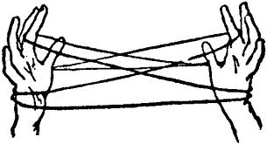
Orthographic Depth
In English, how many ways can you think of to spell the sound /u/?
to
moo
two
through
shoe
flew
flu
blue
/u/ (through)
How many different ways can you pronounce the grapheme <ough>?
/ɒf/ (cough)
/əʊ/ (though)
/ɔː/ (thought)
/aʊ/ (bough)
/ə/ (thorough)
/ɒx/ (lough)
Robert Woore

Slide 14


Orthographic Depth
vers
verre
ver
verres
verts
* vaire
vert
* vaires
vair
* verd

Slide 15
Awareness-raising tasks and analogies like these may be useful for MFL pupils!

Slide 16
Learning To Read In Different Writing Systems
Children learn to read faster in ‘shallow’ alphabetic writing systems (e.g. Seymour, Aro & Erskine, 2003). Why?
Psycholinguistic Grain Size Theory (Ziegler & Goswami, 2005): Children use different ‘grain sizes’ of orthographic unit when learning to read
Smallest grain size (individual GPC) is most efficient. GPC are consistent and there is a small number of symbol-sound correspondences (SSC) to learn. Children learn to decode (and spell) quickly.
Smallest grain size (GPC) is unreliable. Learners use a range of larger grain sizes as well (e.g. GPC, rimes, whole words), because this gives greater consistency. However, this means learning a greater number of individual symbol-sound correspondences. Learning to read and spell take longer.
head
ea
heap
-ead
-eap
people
c
a
t
head
dread
tread
bread
heap
cheap
leap
reap
yacht
Notes:
Slides 17-18: [2 mins] Total 35 mins
Understand that the nature of a writing system shapes the process of learning to decode that writing system
Evidence on speed of learning to read in different L1 writing systems
Theoretical underpinning – grain size
Leads on to the important point about terminology: prefer SSC to GPC because learners may not always decode at the level of individual graphemes and phonemes. (Nb. this is also why I wanted to cover synthetic versus analytic phonics earlier, because it relates to this point. It may be helpful to learners to focus on analysis of SSC at different grain sizes rather than always insisting on synthetic GPC work).
Handout 1: Research summary Goswami (2005)

Slide 17
It might sometimes be useful to teach students the relationships between larger orthographic unit beyond individual graphemes.
For example, in French:
-tion
-sion
-eur
-er
-aine
-aille
-ille
-ine
-ez
-euille
-ail
→ Hence, we’re using the term ‘SSC’ (symbol-sound correspondences) rather than ‘GPC’

Slide 18
Session Outline
✓
What is ‘phonics teaching’? Definitions of key terms.
The role of phonics in learning to read in L1 English
Learning to read / decode in different writing systems
Phonics in language teaching
  Is phonological decoding important in L2? Why?
  Is phonics instruction effective in L2 learning?
  If so, ‘effective’ in what ways? What are the outcomes?
Summary and key questions for my own classroom
✓
✓
Notes:
Slide 19: [5 mins] Total 40 mins
Brief overview of what we’ve done so far and what is left to cover (using initial ‘outline’ slide)
Any questions so far?

Slide 19
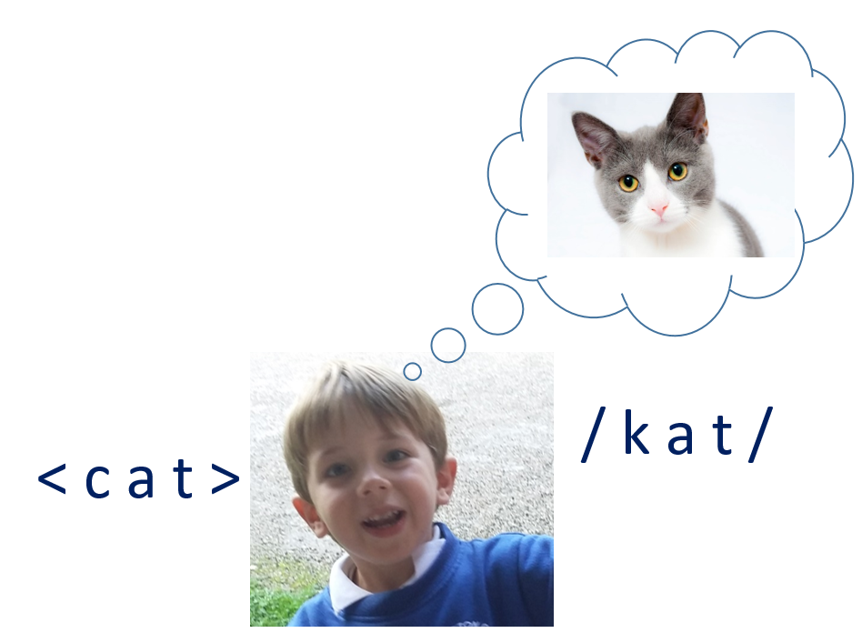
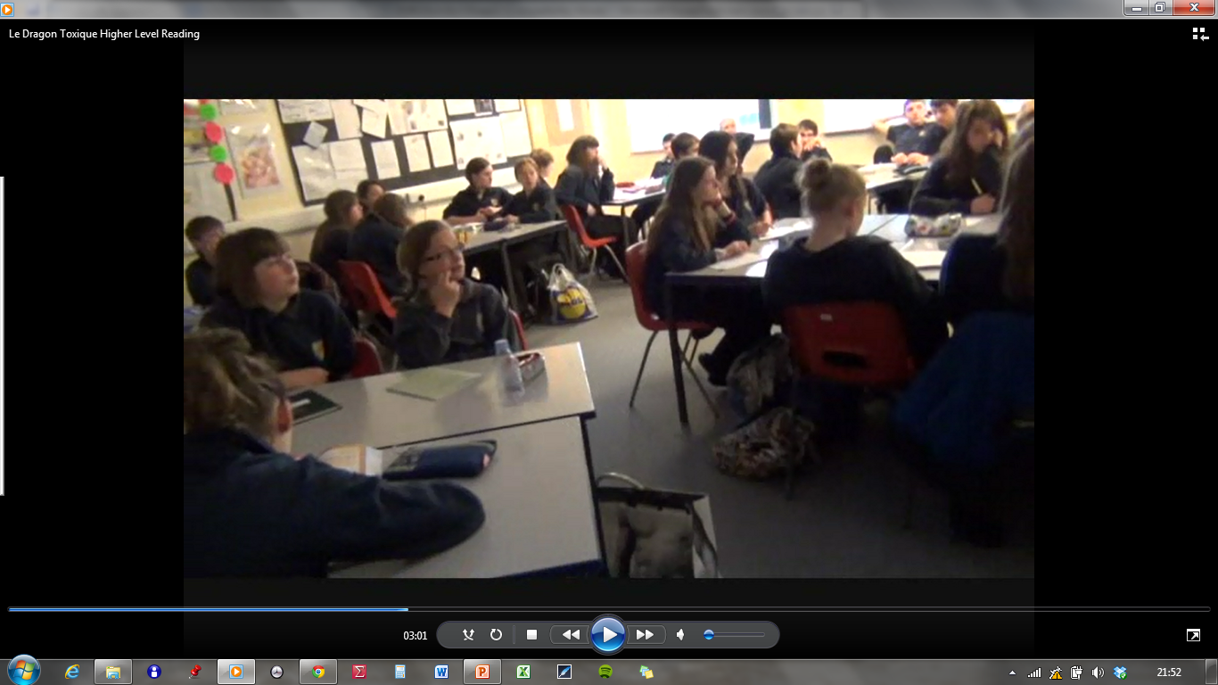
The importance of decoding L2 Learning
In L1 – it’s all about reading comprehension!
→ ‘discovering’ the meaning of words you already know orally.
BUT – in many instructed contexts (including MFL), learners make contact with written forms at the very onset of learning the language
Notes:
Slides 20 – 25: [15 mins] Total 55 mins
Understand the rationale for phonics teaching in L2
In L1, the key rationale for phonics (as we saw earlier) are the ideas of ‘discovering meaning’ and ‘self-teaching mechanism’
In some contexts, this may also apply in L2 – e.g. Alghamdi’s learners of Arabic
However, in MFL (as in many other instructed L2 contexts), this idea is problematic in L2
Nonetheless, there are good reasons (and growing empirical evidence) to support the value of Phonics teaching in L2
Any comments / questions?

Slide 20
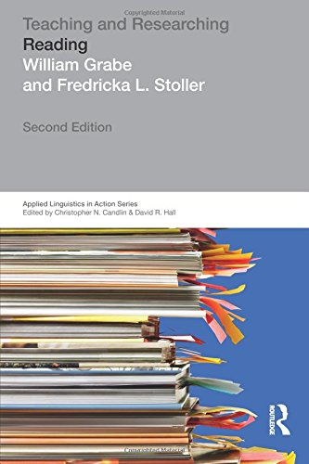
The importance of decoding L2 Learning
One benefit of developing accurate letter-sound correspondences is lost in most L2 settings; that is, L2 students cannot match a sounded-out word to a word that they know orally because they do not yet know the word orally.
Grabe and Stoller, 2011
But! Emerging evidence that there being able to decode accurately in L2 may have a positive impact on many aspects of language learning, including:
Reading comprehension, Vocabulary learning (Hamada & Koda, 2008, 2011; Li, in progress), Learner autonomy, Grammar learning (Erler, 2003), Motivation (Erler & Macaro, 2011), Speaking, Listening, Writing (Macaro, 2007)
Notes:
Handout 2: Research summary Erler & Macaro (2011)

Slide 21
The importance of decoding L2 Learning
Possible impact (awaiting further research) on various aspects of L2 learning, including:
Vocabulary learning (Hamada & Koda, 2008, 2011; Li, in progress)
Grammar learning (Erler, 2003)
Motivation (Erler & Macaro, 2011)
Speaking
Listening
Writing (Macaro, 2007)
Je regarde / J’ai regardé – may sound the same
inventé
Lay geographeea. Lay collage

Slide 22
The importance of decoding L2 Learning
Vocabulary learning
Incidental learning: when meeting new words in written form, proficient decoders can (a) see the written form, (b) infer / look up the meaning, (c) decode the sound.
< ulmaire >
/ ylmɛʁ /
→ 3 key components of vocab knowledge = learner autonomy
Intentional learning: memorizing vocabulary from written lists (even if heard previously in class – stored phonological form may be unreliable)
Inaccurate decoders may store incorrect forms in long-term memory (spelling pronunciations).
Can you think of any examples?

Slide 23
The importance of decoding L2 Learning
Each encounter with a written word also increases ‘depth’ of knowledge and fluency (rapid, automatic recognition)
breadth
fluency
depth
Diagram from Daller et al., 2007:8
Eventually, automatic word recognition is essential for successful language comprehension
Accuracy is a prerequisite for fluency!
Otherwise, learners may entrench & automatize incorrect pronunciations!

Slide 24
The importance of decoding L2 Learning
Fear of spelling pronunciations underlies the teaching approach of:
Always introduce and drill spoken forms first
Then once this is secure: present the word’s global written form
Learners associate this written form with the sound of the word as a whole
Based on mistrust of the learner?
Empowering learners with decoding skills allows this method to be flipped
They can learn words more effectively at home
They can then come to class ready to use the words!
Class time can be spent on more valuable tasks that learners cannot do on their own at home!

Slide 25

Pause for reflection!
Talk to the person next to you about the ideas so far.
Notes:
Slide 26: [2 mins] Total 57 mins
2 minute break – talk to the person next to you about the ideas

Slide 26
How Good are UK L2 Learners at Decoding?
Think about pupils in your own classrooms, in different year groups.
How accurately (and fluently) can they pronounce L2 words?
Research in UK MFL classrooms suggests that, in the absence of explicit instruction:
students are not very good at phonological decoding (reading aloud);
they seem to make little progress in this area;
English spelling-sound links remain stubbornly entrenched;
Students may know that words should sound different to English, but not know how they should sound.
(Sources: Erler, 2003, 2004; Erler & Macaro, 2012; Porter, 2014, forthcoming; Woore, 2009, 2010, 2011, 2014, 2018)
Robert Woore
Notes:
Slides 27 – 30: [6 mins] Total 1h03 mins
Reflect on current levels of attainment in phonological decoding in MFL
Invite to reflect on own learners’ decoding proficiency – 30 seconds thinking time for your different classes and year groups.
Present wider evidence – could limit this to slide 26 if time is short; or if time, could include slides 27-29

Slide 27
Cross-Linguistic Influence or’Transfer’
“the influence resulting from similarities and differences between the target language and any other language that has been previously acquired” (Odlin, 1989:27)
enormous
out
touch
four
you
could
through
Both positive & negative transfer between European writing systems:
Familiarity with alphabetic principle; phonemic awareness
Some GPC are very similar – others very different
Different grain sizes may be needed
vous
atout
touche
pour
acajou
foule
roux
le théâtre
un scout
gaz

Slide 28
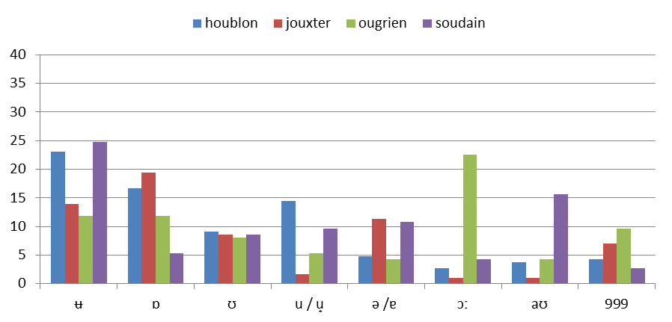
<ou>
houblon jouxter ougrien soudain
(Woore, 2014)

Slide 29

These words get more ridiculous as we go along
Some of these don't even look like real words. I reckon you're just trying to trick me
I don't know because most of them look like gibberish basically
They're like really weird words, like they don't exist
Notes:
This can be linked to adaptive / maladaptive notions of success / failure. If it’s all because the writing system is ‘gibberish’ there is little hope of mastering it! But it’s NOT in fact gibberish – it is more consistent than English and so can be mastered!

Slide 30
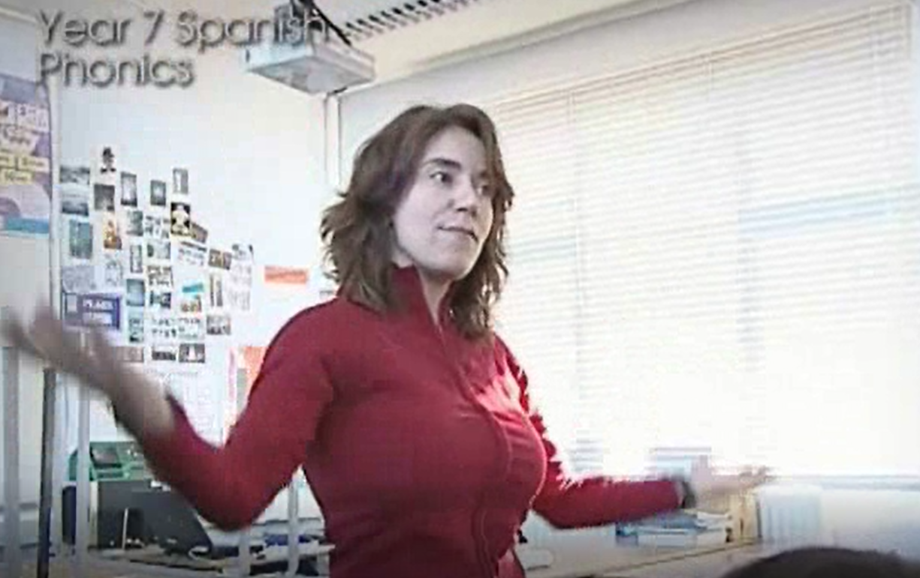
Can we Teach Phonics in Languages?
“There is significant evidence, including from the most effective practitioners, that direct and systematic teaching of phonics in the new language is a more reliable method for assuring accurate pronunciation and spelling. However, this is still relatively rare practice in classrooms” (TSC, 2016:12)
Phonics is the cornerstone of the approach to language teaching in my school and it works… The consequence is also a learner who is able to understand more text containing unfamiliar language, a learner who is more confident in speaking and reading out loud in the foreign language, and a more autonomous learner who is able to make links between words and apply patterns.
www.rachelhawkes.com/Resources/Phonics/Phonics.php
Notes:
Slides 31 – 33: [5 mins] Total 1h08 mins
Be aware of the evidence supporting phonics teaching in L2
TSC quotation – ‘most effective practitioners’ – Rachel’s website
Research evidence: present three small-scale doctoral studies

Slide 31
Can we Teach Phonics in Languages?
What is the research evidence?
Limited research evidence on teaching Phonics in foreign languages
Three small-scale examples: doctoral studies (2 in UK MFL context)
Recent larger-scale study: ‘FLEUR’ project (see pdcinmfl.com)
1. Woore (2011)
Method: Quasi-experimental study: 200 x Year 7 students, 4 schools, 6 intervention classes and 6 control. Year-long Phonics programme in Y7.
Findings: Small but ‘significant’ advantage for Phonics group over control group in decoding progress.
Limitations: Effects on other outcomes not measured – “at what cost?”
Little opportunity to practise SSC as part of a wider programme of L2 reading
No delayed post-test: was learning sustained?
Notes:
Handout 3: Research summary Woore (2009)

Slide 32
2. Porter (2014)
Method. Combined oracy-and-literacy intervention (including phonics) in 2 primary school classrooms, lasting 24 weeks. Pre-, post-, delayed post-tests.
Findings. Children improved at reading aloud over the intervention – but the learning faded once the teaching stopped.
Limitations. No control group – therefore cannot know whether the improvements resulted from the intervention or other teaching
3. Li (forthcoming)
Method. Chinese university students learning English as a Foreign Language. 12 weeks of systematic phonics covering 101 English GPC. Control group had phonology training, but no Phonics.
Findings. Phonics group made significantly more progress than control group in (a) phonological decoding and (b) intentional vocabulary learning.
Limitations. No delayed post-tests. Teaching done by the researcher, not by ‘usual’ teachers: is this scalable?
Notes:
Handout 4: Research summary Porter (2014)

Slide 33
French Language Education: Unlocking Reading (FLEUR)
Woore et al. (2018)
Experimental study (Randomized Control Trial)
Pre-, post-, delayed post-test design
c. 900 students in 36 schools nationally (33 comprehensive, 3 grammar)
Intervention phase lasted 16 weeks, c.25 minutes per week
Interventions delivered by usual class teachers
Phonics
Strategy instruction
Challenging texts
Challenging texts
Challenging texts
Reading comprehension
Vocabulary
Phonological decoding
Strategic behaviour
Self-efficacy
Motivation
Teachers’ / students’ views
Notes:
Slides 34 – 56: [15 mins] Total 1h22 mins
Handout 5: FLEUR
Present FLEUR study in greater depth
Some detail of the teaching materials and approach:
Examples of phonics presentation slides: (a) awareness raising 1 (b) qu / ch / ç
Mention the approach: of drilling these words with the images (and if teachers wished, with actions) to point of automaticity – similar approach to Rachel
If time could also show: ou / u and idea of minimal pairs; silent final consonants
Mention wallchart as reminder in classroom
Present findings. Emphasize positive effects of phonics: gains in decoding (and we know that this is unlikely to develop without explicit instruction); gains in vocabulary (answered this is a key predictor of all language skills, as will be shown later in the vocabulary presentation); equal gains in reading comprehension – no detriment compared to other groups, despite time spent on phonics that was not spent on other things;

Slide 34
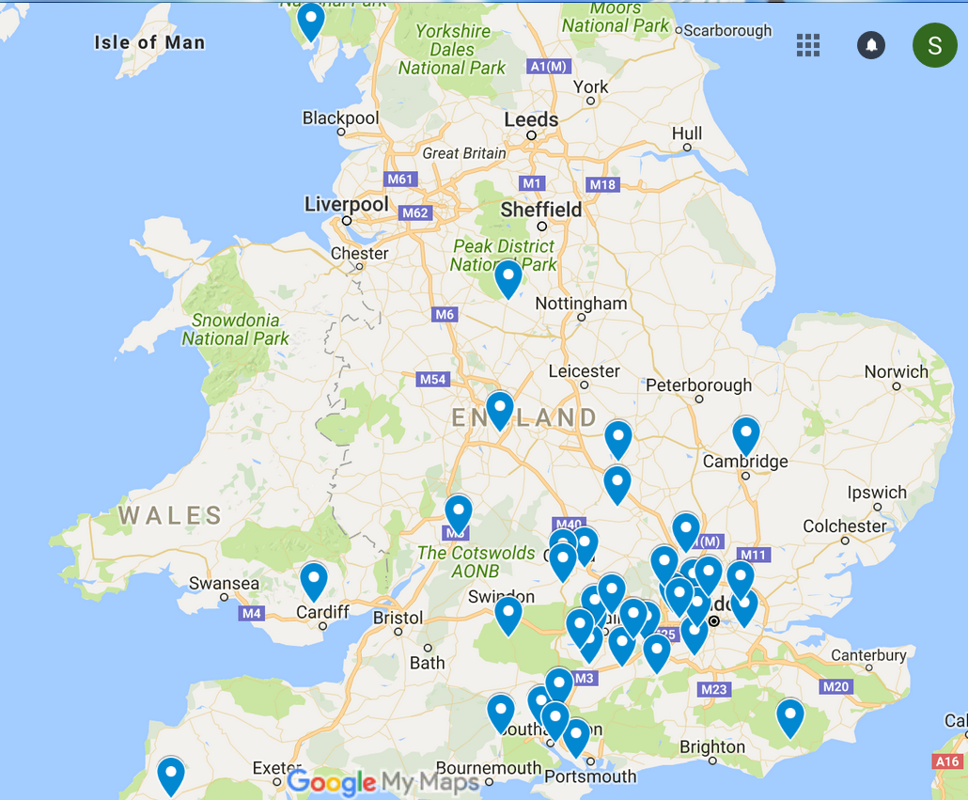

Slide 35
Fleur Project- Phonics Programme
Target graphemes:
1. SFC* & SFe*
2. i/ie
3. SFe*
4. é (+ ez ée er)
5. ou / u
6. en / an
7. qu / ch / ç
8. eau / au
9. -ation, -ition
10. in / ain / ien
11. oi / eu
12. eu
13. è / ê / ai
Choice of target graphemes made collaboratively with teachers
Based on: (a) difficulty for English speakers; (b) frequency in the language (more detail on this in half-day sessions!)
4 aspects of instruction:
Awareness raising – differences between English and French writing systems
Introducing new SSC
Practising new SSC – controlled practice and ‘open-ended’ practice (challenging texts)
Recapping of SSC already covered
Note: SFC = Silent Final Consonants; SFe = Silent Final <e>
Robert Woore

Slide 36
 | anglais | français |  | anglais | français
1 | rat | rat | 11 | loin | loin
2 | vent | vent | 12 | son | son
3 | pain | pain | 13 | queue | queue
4 | signal | signal | 14 | theatre | théâtre
5 | nation | nation | 15 | television | télévision
6 | fiction | fiction | 16 | chat | chat
7 | mine | mine | 17 | jungle | jungle
8 | sale | sale | 18 | rare | rare
9 | nutrition | nutrition | 19 | grand | grand
10 | train | train | 20 | Paul | Paul
These English and French words are homographs (or quasi-
homographs)
This means that they have the same spelling (or nearly).
Listen to the pronunciations of the English and French words. Note
the similarities and differences.
Ces mots anglais et français sont des homographes (ou quasi homographes).
Ça veut dire qu’ils ont la même orthographe (ou presque).
Écoutez les prononciations des mots anglais et français. Notez les similarités et les différences.

Slide 37




Les lettres et les sons en français
qu – ch – ç
un chat
une question
des glaçons
comme ci, comme ça
Images from top left:
1. “A red cat” by Alexandra is licensed under CC0 1.0
2. “Question-question-mark-help-2309040” by Peggy and Marco Lachmann-Anke is licensed under CC0 1.0.
3. “Ice-cubes-ice-water-cold-frozern-3506782” by Bruno Glätsch is licensed under CC0 1.0.
4. “Twemoji2 1f937-1f3fd” by Twitter, Inc. and other contributors is licensed under CC-BY 4.0.
Notes:
Some detail of the teaching materials and approach:
Examples of phonics presentation slides: (a) awareness raising 1 (b) qu / ch / ç
Mention the approach: of drilling these words with the images (and if teachers wished, with actions) to point of automaticity – similar approach to Rachel
If time could also show: ou / u and idea of minimal pairs; silent final consonants
Mention wallchart as reminder in classroom

Slide 38
Les lettres et les sons en français
qu – ch – ç
Vous pouvez trouver d’autres exemples?

Slide 39
Les lettres et les sons en français
qu – ch – ç
  1. Ça alors ! Qui a choisi un chat aussi charmant ?
  2. Les garçons qui aiment les glaçons sont agaçants.
3. Charline a un chien qui sait chuchoter.
https://www.youtube.com/watch?v=ttE66jOGGpM&feature=player_embedded

Slide 40
Les lettres et les sons en français
qu – ch – ç
  1. Ça alors ! Qui a choisi un chat aussi charmant ?
  2. Les garçons qui aiment les glaçons sont agaçants.
3. Charline a un chien qui sait chuchoter.
https://www.youtube.com/watch?v=ttE66jOGGpM&feature=player_embedded

Slide 41
Les lettres et les sons en français
qu – ch – ç
Défi (challenge): deux virelangues (two tongue-twisters)
1. « Un chasseur sachant chasser sans son chien est un bon chasseur »
2. « Les chaussettes de l’archiduchesse, sont-elles sèches, archi-sèches ? »

Slide 42
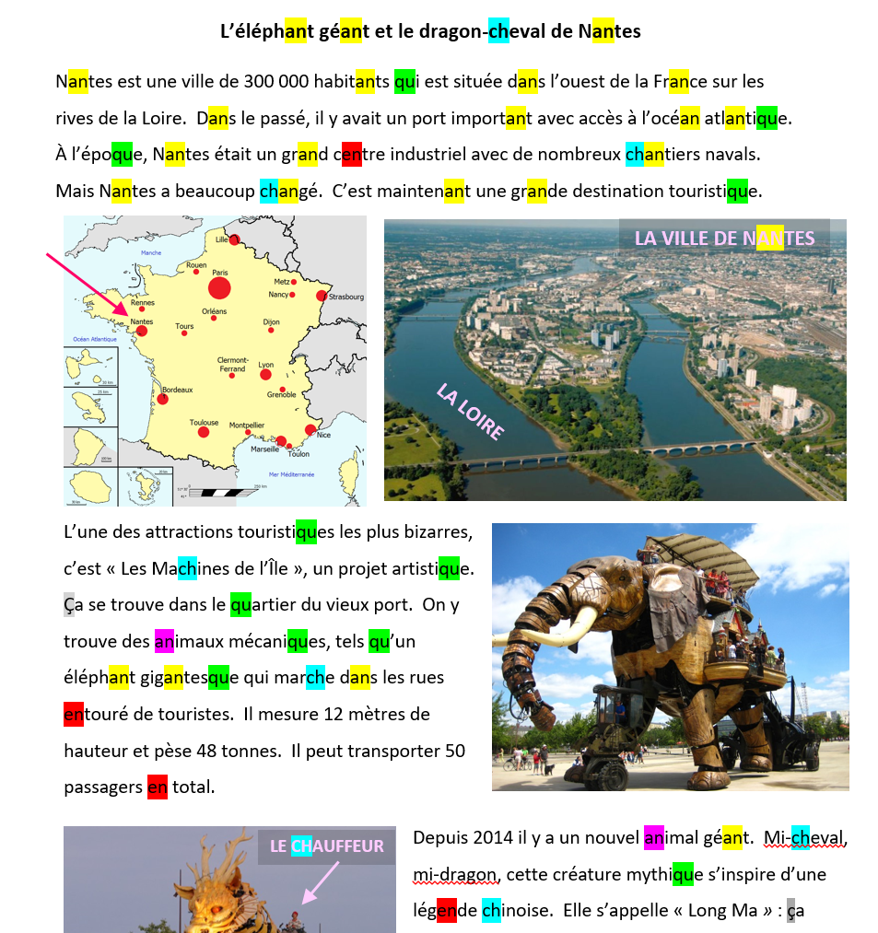

Slide 43
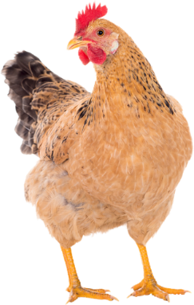



Les lettres et les sons en français
ou – u
une poule
la lune
le cou
tortue
Images from top left:
1. “Chicken-hens-pullet-307851” by Viet is licensed under CC0 1.0.
2. “Moon-full-moon-sky-nightsky-lunar-1859616” by Robert Karkowski is licensed under CC0 1.0.
3. “Giraffe-long-neck-zoo-animal-1124451” by Melanie van de Sande is licensed under CC0 1.0.
4. “Turtle-tortoise-swim-sea-turtle-863336” by Free-Photos is licensed under CC0 1.0.

Slide 44
Les lettres et les sons en français
ou – u
Vous pouvez trouver d’autres exemples?

Slide 45
Les lettres et les sons en français
ou – u
– des exercices
  1. Vous jouez dans la boue ? Vous êtes fou !
  2. j’ai trouvé douze cailloux sous la poule !
3. Tu es dans la rue
4. Julie a vu une prune brune

Slide 46
Les lettres et les sons en français
ou – u
– des exercices
  1. Vous jouez dans la boue ? Vous êtes fou !
  2. j’ai trouvé douze cailloux sous la poule !
3. Tu es dans la rue
4. Julie a vu une prune brune

Slide 47
Les lettres et les sons en français
Letters and sounds in French
Les consonnes finales muettes
Silent final consonants (SFC)
En général, à la fin d’un mot, ces lettres ne se prononcent pas:
z x p d t s
Generally, at the end of a word, these letters are not pronounced:
z x p d t s
Perhaps they have gone off on zoo expeditions!
Par contre, à la fin d’un mot, ces lettres se prononcent:
c r f l
By contrast, at the end of a word, these letters are pronounced:
c r f l
Be careful with these ones!

Slide 48




Les lettres et les sons en français
Letters and sounds in French
c r f l : exemples
c r f l : examples
c’est nul!
un canif
la mer
un sac
Images from top left:
1. “SMirC-thumbsdown.svg” by Cäsium137 (T.) is licensed under CC BY-SA 3.0
2. “Penkife_Swiss-Army-Knife__51220” by Emilian Robert Vicol is licensed under CC BY 2.0
3. “Wave-sea-spray-foam-motion-boat-2532794” by Dimitris Vetsikas is licensed under CC0 1.0
4. “Das orange Spiegel Leder Dual-Use-Paket” by Mathilda Sameulsson is licensed under CC BY-SA 2.0

Slide 49

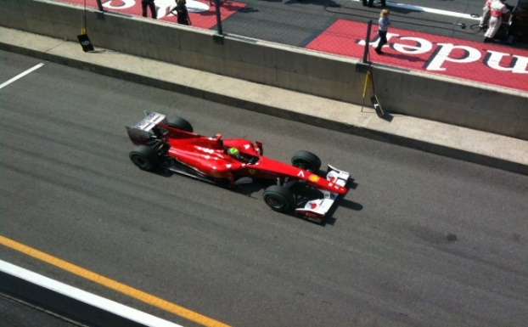


Les lettres et les sons en français
Letters and sounds in French
z x p d t s : exemples
z x p d t s : examples
français
le grand prix
un loup
le nez du chat
Images from top left:
1. “French Flag” by Liv G is licensed under CC0 1.0
2. “Formula 1 Grand Prix” by David Orban is licensed under CC BY 2.0
3. “nature-animal-wolf-wilderness” by www.Pixel.la Free Stock Photos is licensed under CC0 1.0
4. “A red cat” by Alexandra is licensed under CC0 1.0

Slide 50
Les lettres et les sons en français
Letters and sounds in French
z x p d t s : exemples
z x p d t s : examples
français
le grand prix
un loup
le nez du chat
Images from top left:
1. “French Flag” by Liv G is licensed under CC0 1.0
2. “Formula 1 Grand Prix” by David Orban is licensed under CC BY 2.0
3. “nature-animal-wolf-wilderness” by www.Pixel.la Free Stock Photos is licensed under CC0 1.0
4. “A red cat” by Alexandra is licensed under CC0 1.0

Slide 51
Les lettres et les sons en français
Letters and sounds in French
z x p d t s
z x p d t s
Vous pouvez trouver d’autres exemples?
Can you find any other examples?

Slide 52
Les lettres et les sons en français
Letters and sounds in French
z x p d t s
exercices
z x p d t s
exercises
1. Bertrand est grand mais Norbert est petit
2. J’ai les yeux bleus et les cheveux frisés
3. Il pleut des cordes mais le lac est sec!

Slide 53
Les lettres et les sons en français
Letters and sounds in French
z x p d t s
exercices
z x p d t s
exercises
1. Bertrand est grand mais Norbert est petit
Bertrand est grand mais Norbert est petit
2. J’ai les yeux bleus et les cheveux frisés
J’ai les yeux bleus et les cheveux frisés
3. Il pleut des cordes mais le lac est sec!
Il pleut des cordes mais le lac est sec!

Slide 54
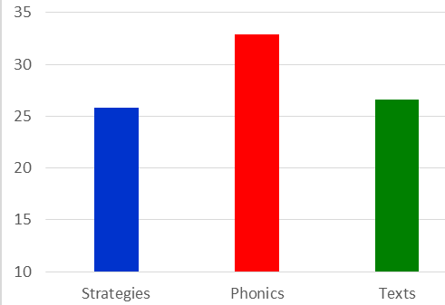
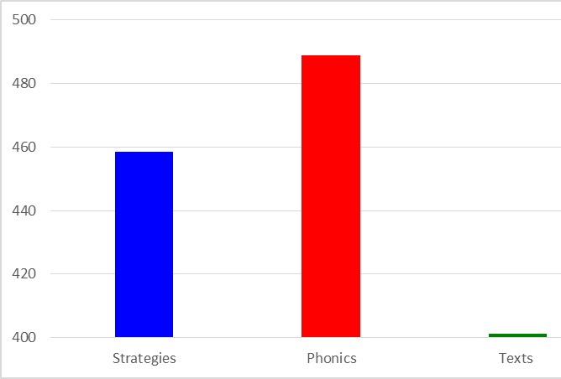
Fleur Study- Findings (pre- / post- tests
Explicit phonics instruction led to significantly greater progress in phonological decoding (after controlling for prior attainment)
Pen-and-paper decoding test: less sensitive than Reading Aloud Task, so actual gains may have been greater!
No difference between groups in reading comprehension outcomes
Phonics group made significantly more gains in vocabulary knowledge
Vocab knowledge is known to be a key contributor to all language skills!
Decoding score 6-7 percentage points higher
Estimated vocabulary knowledge (t2): 2000 most frequent French words

Slide 55

Delayed Post-Tests (December, Year 8
Considerable attrition (lost 1/3 of sample)
For all variables:
Levelling off of progress
No statistically significant advantage for any of the groups over the others
Summer holidays, plus change of instructional approach (and teacher)
→ Instruction needs to be maintained!

Slide 56
Summary of Key Points Arising From Research
Phonics can be taught in languages – it helps develop phonological decoding
Without phonics, progress in phonological decoding may be limited
Teaching needs to be sustained. SSC in the foreign language need to be mastered and stable – and ultimately, automatized
There is no apparent detriment to reading comprehension, despite the time spent on explicit phonics teaching.
In L1, Phonics is all about reading comprehension. But in L2/3, the benefits appear to be wider.
Phonics may benefit learner autonomy and vocabulary learning in particular
…and vocabulary knowledge is key to foreign language learning!
Notes:
Slides 57-58 [5 mins] Total 1h27 mins
Present findings. Emphasize positive effects of phonics: gains in decoding (and we know that this is unlikely to develop without explicit instruction); gains in vocabulary (answered this is a key predictor of all language skills, as will be shown later in the vocabulary presentation); equal gains in reading comprehension – no detriment compared to other groups, despite time spent on phonics that was not spent on other things;

Slide 57
Summary of Key Points Arising From Research
More work is needed to identify the most effective ways of teaching phonics in MFL, but these likely include:
  Awareness raising of differences between L1/L2 writing systems
  Explicit teaching of key symbol-sound correspondences (SSC) (not necessarily only GPC!) focussing on those most different from L1
  Plenty of practice, to reinforce SSC knowledge and develop automaticity
  A rich diet of reading material alongside any focussed phonics practice – to promote motivation
Phonics may be easier to teach in shallow orthographies (e.g. Spanish, German, Italian) than in French. In French, more sustained effort may be needed, but there is a payback for the learner.

Slide 58
Session Outline
✓
What is ‘phonics teaching’? Definitions of key terms.
The role of phonics in learning to read in L1 English
Learning to read / decode in different writing systems
Phonics in language teaching
  Is phonological decoding important in L2? Why?
  Is phonics instruction effective in L2 learning?
  If so, ‘effective’ in what ways? What are the outcomes?
Summary and key questions for my own classroom
✓
✓
✓
✓
✓
Robert Woore

Slide 59
Why Teach Phonics?
Teaching phonics develops phonological decoding
Without explicit phonics teaching, decoding may be limited
The ability to decode is associated positively with motivation
Decoding enables learners to access new language autonomously and accurately
Phonics teaching supports vocabulary learning, which is key to making progress in language learning
The time spent on teaching phonics does not seem to delay progress in other areas, i.e. reading comprehension
Notes:
Handout 6: Rationale for teaching phonics
Slides 59-60 [3mins] Total 1h30
At this point, it would be worth outlining what we will do next in order to support phonics teaching development (i.e. the half-day and TRG CPDs), including
1. A list of suggested sound-writing relationships to focus on (in French, German, Spanish)
2. A concrete list of tasks and strategies to use (set out in the most logical order)
3. Resources for teaching phonics
4. A SOW for phonics (Fr,Gm,Sp), indicating how the key sound-symbol correspondences could be introduced and integrated within the first year of language learning (and reinforced subsequently thereafter).
But here are some ideas to get you started:
Handout 7: Ideas for teaching phonics
These are the sorts of resources which will be available on the portal – and which specialist teachers (STs) will create, too.

Slide 60
Session Outline
What do you consider to be the key questions for your own classroom, in respect of phonics teaching?
Some suggestions:
(a) How accurate and (b) how fluent are your students at decoding (reading aloud) in the L2?
Which approaches to teaching phonics (would) work best in my classroom? How do I need to vary the approach according to the age / stage of learners?
Which symbol-sound correspondences are the most important ones to teach in the L2?
How can I monitor and record progress in decoding and use this information to inform my teaching?
Notes:
Just flag up this slide as a ‘next steps – and, together with the support that you’ve just mentioned from the centre, this represents the focus of our development work for phonics in Y1 of the project...
What key questions does this presentation raise for you, in your classroom practice?
Invite participants to think about this and (if time) talk to the person next to them
Some suggestions on ppt

Slide 61
References
Cook, V. and Bassetti, B. (2005b) ‘An introduction to researching Second Language Writing systems’, in V. Cook & B. Bassetti (eds.) (2005) Second Language Writing systems. Clevedon: Multilingual Matters, pp. 1-70.
Daller, H., Milton, J. and Treffers-Daller, J. (2007) ‘Editors’ introduction: conventions, terminology and an overview of the book’. In H. Daller, J. Milton and J. Treffers-Daller (Eds.), Modelling and Assessing Vocabulary Knowledge. Cambridge: Cambridge University Press, pp. 1-32
DfE (2010) The Importance of Teaching: The Schools white paper 2010. London: Department for Education.
Dombey, H. (2010) Teaching Reading: What the Evidence Says. Leicester: UKLA.
Erler, L. (2003) Reading in a Foreign Language – Near-Beginner Adolescents’ Experiences of French in English Secondary Schools. DPhil Thesis, Oxford University.
Erler, L. (2004) ‘Near-Beginner Learners of French Are Reading at a Disability Level’. Francophonie, vol. 30, pp. 9-15.
Erler, L. and Macaro, E. (2012) ‘Decoding Ability in French as a Foreign Language and Language Learning Motivation’. The Modern Language Journal, 95(4): 496-518.
Gough, P. B. and Tunmer, W. E., 1986. Decoding, reading, and reading disability. Remedial and special education, 7(1), pp.6-10.
Grabe, W. and Stoller, F. L. (2011) Teaching and researching reading. London: Longman.
Hamada, M. and Koda, K. (2008) ‘Influence of First Language Orthographic Experience on Second Language Decoding and Word Learning’. Language Learning, vol. 58, no. 1, pp.1-31.

Slide 62
References
Hamada, M. and Koda, K. (2011) ‘The role of the phonological loop in English word learning: A comparison of Chinese ESL learners and native speakers’. Journal of Psycholinguistic Research, 40(2), pp.75-92.
Katamba, F. (1989) An Introduction to Phonology. London:Longman.
Macaro, E. (2007) ‘Do beginner learners of French have any writing strategies?’ Language Learning Journal, 35, pp. 23–36.
Nassaji, H. (2014) ‘The role and importance of lower-level processes in second language reading’. Language Teaching, 47(1): 1-37.
Odlin, T. (1989) Language Transfer: Cross-linguistic influence in language-learning. Cambridge: Cambridge University Press.
Porter, A.M. (2014) An early start to French literacy: Learning the spoken and written word simultaneously in English primary schools. PhD thesis, University of Southampton.
Rose, J. (2006) Independent review of the Teaching of Early Reading: Final Report. London: DfES.
Seymour, P. H. K., Aro, M. and Erskine, J. M. (2003) ‘Foundation Literacy Acquisition in European Orthographies’. British Journal of Psychology, vol. 94, pp. 143–174.
Share, D. L. (1995) ‘Phonological recoding and self-teaching: sine qua non of reading acquisition’. Cognition, vol. 55, pp. 151-208.
Woore, R. (2007) ‘“Weisse Maus in Meinem Haus”: Using Poems and Learner Strategies to Help Learners Decode the Sounds of the L2’. Language Learning Journal, vol. 35, no. 2, pp. 175-188.

Slide 63
References
Woore, R. (2009) ‘Beginners’ progress in decoding L2 French: some longitudinal evidence from English Modern Foreign Languages classrooms’. Language Learning Journal, vol. 37, no. 1, pp. 3-18.
Woore, R. (2010) ‘Thinking aloud about L2 decoding: an exploration into the strategies used by beginner learners when pronouncing unfamiliar French words’. Language Learning Journal, vol. 38, no. 1, pp. 3-17.
Woore, R. (2011) Investigating and developing beginner learners’ decoding proficiency in second language French: an evaluation of two programmes of instruction. Unpublished PhD thesis, University of Oxford.
Woore, R. (2014) ‘Beginner learners’ progress in decoding L2 French: transfer effects in typologically similar L1-L2 writing systems’. Writing Systems Research, volume 4(2): 167-189.
Woore, R (2018) ‘Learners’ pronunciations of familiar and unfamiliar French words: what can they tell us about phonological decoding in an L2?’ The Language Learning Journal, 46(4):456-69.
Woore, R., Graham, S., Porter, A., Courtney, L. and Savory, C. (2018) Foreign Language Education: Unlocking Reading (FLEUR) - A study into the teaching of reading to beginner learners of French in secondary school. https://ora.ox.ac.uk/objects/uuid:4b0cb239-72f0-49e4-8f32-3672625884f0
Wyse, D. and Styles, M. (2007) ‘Synthetic phonics and the teaching of reading: the debate surrounding England’s “Rose Report”’. Literacy, 41(1), pp. 35-42
Ziegler, J. and Goswami, U. (2005) ‘Reading Acquisition, Developmental Dyslexia and Skilled Reading Across Languages: A Psycholinguistic Grain Size Theory’. Psychological Bulletin, vol. 131, no. 1, pp. 3-29.

