Slide 1
Activities and interests
Lesson 1
Verbs ending in –ER (present) (verbs like parler)
aimer + infinitive
SSCs [-er/-ez], [SFE], [SFC], [on]
Y10 French
Term 1.1 - Week 1 - Lesson 1
Author name(s): Louise Bibbey
Artwork by: Chloé Motard
Date updated: 17/10/22
Notes:
Artwork by Chloé Motard. All additional pictures selected are available under a Creative Commons license, no attribution required.
Native speaker feedback provided by Stéphanie Schmitt.
With thanks to Rachel Hawkes for her input on lesson material.
Learning outcomes (lesson 1):
Consolidation of SSCs [SFE], [SFC], [é/ez/er], [on]
Revision of verbs ending in -ER (present) (verbs like parler)
Revision of aimer + infinitive
Revision of subject pronouns
Word frequency (1 is the most frequent word in French):
(vocabulary introduced) échanger [1452], danser [2934], dessiner [2086], nager [n/a], mail/e-mail [n/a], texto [n/a], produire (H) [367], rendre (H) [85], centaine (H) [1417], véhicule (H) [1959], rare (H) [1233], c’est-à-dire (H) [560]
(revisited function words) écrire, écris, écris! (aux) écrit (H) [382], entendre [149], jouer (à/de + noun) [219], parler [106], prendre [43], traduire [1125], elle, elles [38], il, ils [13], je [22], nous [31], on [29], tu [112], vous [50]
(spaced repetition 1) (se) laver [3503], (s')appeler [157], journée [587], paix [579], fier/fière [1331], officiel/officielle [996], (se) présenter (H) [209], accord (H) [496], membre (H) [390], efficace (H) [1243]
(spaced repetition 2) oublier [504], payer [537], le2 [1], la2 [1], coût [830], client [917], mode [1137], cent [704], mille [1008], quatre-vingt-dix [>5000], soixante-dix [4887], livrer (H) [613], marque (H) [1344]
(thematic revisited vocabulary) aimer [242], apprendre (à) [327], [1820], construire [793], écrire, écris, écrit [382], écouter [429], jouer (à) [119], lire [278], pratiquer (H) [1268], prendre [43], raconter [820], répondre (à) [200], regarder [425], télévision/télé [1179], voyager [2194], club [1860], film [848], football/foot [2602], piscine [n/a], texte [631], parce que [adv]
Source: Lonsdale, D., & Le Bras, Y. (2009). A Frequency Dictionary of French: Core vocabulary for learners London: Routledge.
The frequency rankings for words that occur in this PowerPoint which have been previously introduced in NCELP resources are given in the NCELP SOW and in the resources that first introduced and formally re-visited those words.
For any other words that occur incidentally in this PowerPoint, frequency rankings will be provided in the notes field wherever possible.

Slide 2
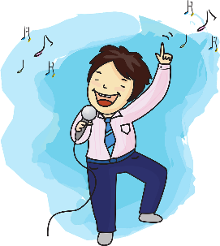
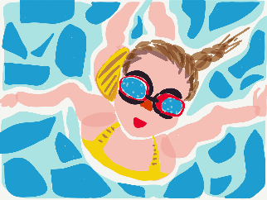
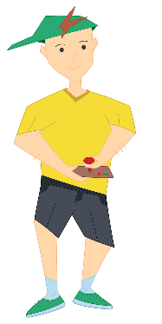
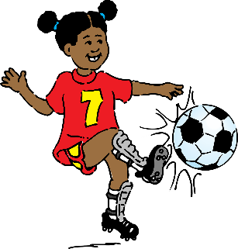
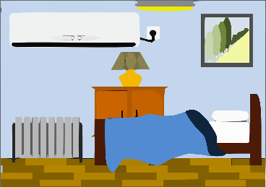
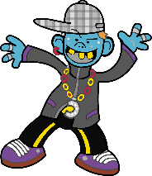
Qu’est-ce que tu aimes faire?
j’aime…
vocabulaire
je n’aime pas…
voyager à l’étranger
chanter des chansons
construire des véhicules radiocommandés*
rendre service à la communauté
nager dans la piscine
pratiquer un sport
dessiner des animaux rares
écouter de la musique
jouer au foot
échanger des messages
écrire des centaines de textos et emails
lire des livres
véhicule radiocommandé =
radio-controlled vehicle
danser dans ma chambre
produire des films
Notes:
Timing: 6 minutes
Aim: To set the scene for the lesson by practising new and some revisited vocabulary relating to activities and interests (Identity, Everyday living themes) in reading.
Procedure:
Students sketch a table with two columns, one headed J’aime… and other entitled Je n’aime pas…
The teacher reminds the students of the structure aimer + infinitive to talk about likes and dislikes.
Students complete the table in French according to their personal preferences.
The teacher elicits verbal translations of each verb and activity from students. This can be done on mini-whiteboards if time allows.
Note:
On this slide, there are several items of Higher vocabulary (see notes under title slide). Teachers with Foundation only classes could remove these, and those with mixed Foundation/Higher classes, and particularly in classes where the tier of entry will be determined later, will want to work with the full slide.
Word frequency of unknown words used (1 is the most frequent word in French): radiocommandé [>5000]
Source: Lonsdale, D., & Le Bras, Y. (2009). A Frequency Dictionary of French: Core vocabulary for learners London: Routledge.

Slide 3
Révision: les pronoms
grammaire
I
you, sing. informal
he/it, m.
she/it, f.
je
tu
il
elle
you, sing. formal
you, pl.
they, m. or mixed m/f
(people or things)
they, f.
(people or things)
we
on/nous
vous
ils
elles
Notes:
Timing: 5 minutes
Aim: To revise the subject pronouns.
Procedure:
Click to reveal each image with its associated English meaning.
Students say the correct French pronoun for each picture. Click to reveal answers.
Remind the students that il/elle and ils/elles refer to things as well as people.
Click again to remove the text.
The teacher then calls out different pronouns in random order, and students must point to themselves or others in the classroom to indicate who each pronoun refers to:
Je (point at themselves)
tu (point at another students)
il/elle (point at a boy/girl)
on/nous (point at themselves and those close by
vous (point to a group or the teacher)
ils/elles (point at groups of boys/mixed gender/girls). To differentiate between il/ils and elle/elles, the teacher can say “il with no s” or “ils with an s”
Transcript:
je, tu, il, elle, on, nous, vous, ils, elles

Slide 4
SFE
Silent final -e
[shy]
timide
Notes:
Timing: 30 seconds
Teachers can choose either or both SSC slides – the first is with audio, the second is without.
Aim: To consolidate SSC [SFE] in preparation for revising endings of -ER verb forms.
Procedure: 1. Present the letter(s) and say the [SFE] sound first, on its own. Students repeat it with you. 2. Bring up the word ”timide” on its own, say it, students repeat it, so that they have the opportunity to focus all of their attention on the connection between the written word and its sound.
3. A possible gesture for this would be to cower and cover one’s face slightly, simulating shyness. 4. Roll back the animations and work through 1-3 again, but this time, dropping your voice completely to listen carefully to the students saying the [SFE] sound, pronouncing ”timide” and, if using, doing the gesture.
Word frequency (1 is the most frequent word in French):
timide [3835]
Source: Londsale, D., & Le Bras, Y. (2009). A Frequency Dictionary of French: Core vocabulary for learners London: Routledge.

Slide 5
SFE
Silent final -e
[shy]
timide
Notes:
Without sound to elicit pronunciation (without first hearing the teacher).
Teacher to elicit pronunciation by asking “Comment dit-on …"

Slide 6
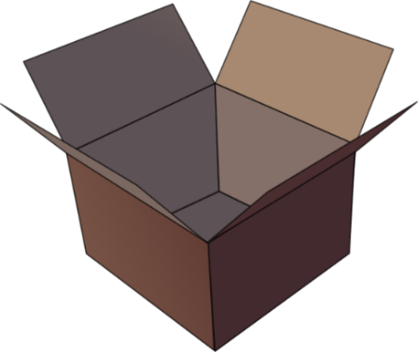
SFC
Silent final consonant
dans
X
Notes:
Timing: 30 seconds
Teachers can choose either or both SSC slides – the first is with audio, the second is without.
Aim: To consolidate SSC [SFC] in preparation for revising endings of -ER verb forms.
Explanation in English, if desired: Something that makes French sounds very different from English is that some consonants at the ends of words are silent. This means you don’t pronounce/sound them out at all. As in the word ‘dans’ in French.
Procedure: 1. Present the letter(s) and say the [SFC] sound first, on its own. Students repeat it with you. 2. Bring up the word ”dans” on its own, say it, students repeat it, so that they have the opportunity to focus all of their attention on the connection between the written word and its sound.
3. A possible gesture for this would be to hold ones finger to ones lips to indicate ‘Shhhh!’. 4. Roll back the animations and work through 1-3 again, but this time, dropping your voice completely to listen carefully to the students saying the [SFC] sound, pronouncing ”dans” and, if using, doing the gesture.
Word frequency (1 is the most frequent word in French):
dans [11] Source: Londsale, D., & Le Bras, Y. (2009). A Frequency Dictionary of French: Core vocabulary for learners London: Routledge.

Slide 7
SFC
Silent final consonant
dans
X
Notes:
Without sound to elicit pronunciation (without first hearing the teacher).
Teacher to elicit pronunciation by asking “Comment dit-on …"

Slide 8
é/-er/-ez
écrire
Notes:
Timing: 30 seconds
Teachers can choose either or both SSC slides – the first is with audio, the second is without.
Aim: To consolidate SSC [é] in preparation for revising endings of -ER verb forms.
Procedure: 1. Present the letter(s) and say the [é] sound first, on its own. Students repeat it with you. 2. Bring up the word ”écrire” on its own, say it, students repeat it, so that they have the opportunity to focus all of their attention on the connection between the written word and its sound.
3. A possible gesture for this would be to mime the act of writing (onto the palm of the other hand perhaps). 4. Roll back the animations and work through 1-3 again, but this time, dropping your voice completely to listen carefully to the students saying the [é] sound, pronouncing ”écrire” and, if using, doing the gesture.
Word frequency (1 is the most frequent word in French):
écrire [382] Source: Londsale, D., & Le Bras, Y. (2009). A Frequency Dictionary of French: Core vocabulary for learners London: Routledge.

Slide 9
é/-er/-ez
écrire
Notes:
Without sound to elicit pronunciation (without first hearing the teacher).
Teacher to elicit pronunciation by asking “Comment dit-on …"

Slide 10
on
non!
Notes:
Timing: 30 seconds
Teachers can choose either or both SSC slides – the first is with audio, the second is without.
Aim: To consolidate SSC [on] in preparation for revising endings of -ER verb forms.
Procedure: 1. Present the letter(s) and say the [on] sound first, on its own. Students repeat it with you. 2. Bring up the word ”non” on its own, say it, students repeat it, so that they have the opportunity to focus all of their attention on the connection between the written word and its sound.
3. A possible gesture for this would be to shake ones head whilst waggling one’s index finger, to indicate ‘no!’ 4. Roll back the animations and work through 1-3 again, but this time, dropping your voice completely to listen carefully to the students saying the [on] sound, pronouncing ”non” and, if using, doing the gesture.
Word frequency (1 is the most frequent word in French):
onze [2447]
Source: Londsale, D., & Le Bras, Y. (2009). A Frequency Dictionary of French: Core vocabulary for learners London: Routledge.

Slide 11
on
non!
Notes:
Without sound to elicit pronunciation (without first hearing the teacher).
Teacher to elicit pronunciation by asking “Comment dit-on …"

Slide 12
Révision: les verbes -er
grammaire
Remember that to form the present tense of verbs ending with -er, we take the following steps:
Which of these verb forms sound the same?
Verb infinitive
Remove -er to leave the stem
Add endings to the stem…
…et voilà !
parler
[to speak]
parl-
je: -e
tu: -es
il/elle/on: -e
nous: -ons
vous: -ez
ils/elles: -ent
je parle
tu parles
il/elle/on parle
nous parlons
vous parlez
ils/elles parlent
Quiz rapide! Voici d’autres verbes comme parler: traduis en anglais
aimer
oublier
to listen, listening
to play, playing
to like, liking
to sing, singing
to forget, forgetting
écouter
jouer
chanter
Notes:
Timing: 5 minutes
Aim: To revise the formation of -ER verbs in the present tense.
Procedure:
Click to reveal the information.
Ask students to identify the verb endings that sound the same.
Say each word form aloud. Students repeat.
Click to reveal answers.
Click on the audio button to hear the verb conjugated by a native speaker.
Click to reveal the quick verb revision quiz, eliciting verbal translations into English of the eight verbs.
Click to reveal the answers.
Transcript:
je parle
tu parles
il parle, elle parle, on parle
nous parlons
vous parlez
ils parlent, elles parlent

Slide 13
Quel pronom?
Écoute le verbe:
c’est ‘je’ ou ‘nous’ ?
écouter
je
nous
Nous jouons au basket au collège.
[We play basketball at school.]
Notes:
Timing: 3 minutes
Slide 1 of 5
Aim: To practise identifying pronouns by listening to -ER verb endings; connecting SSCs with meaning (sentence subjects)
Procedure:
Click on the audio button to hear a sentence with the pronoun removed.
Students pay attention to the verb endings to determine which pronoun is correct.
Click to reveal the answer and full audio.
Audio transcript:
[beep] jouons au basket au collège.
Nous jouons au basket au collège.
Word frequency of cognates used (1 is the most frequent word in French): basket [>5000]
Source: Londsale, D., & Le Bras, Y. (2009). A Frequency Dictionary of French: Core vocabulary for learners London: Routledge.

Slide 14
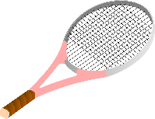
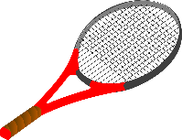
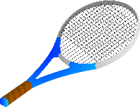
Quel pronom?
Écoute le verbe:
c’est ‘on’ ou ‘vous’ ?
écouter
on
vous
On joue au tennis au parc.
[We play tennis at the park.]
Notes:
Slide 2 of 5
Audio transcript:
[beep] joue au tennis au parc.
On joue au tennis au parc.
Word frequency of cognates used (1 is the most frequent word in French): tennis [3867]
Source: Londsale, D., & Le Bras, Y. (2009). A Frequency Dictionary of French: Core vocabulary for learners London: Routledge.

Slide 15
Quel pronom?
Écoute le verbe:
c’est ‘vous’ ou ‘tu’ ?
écouter
vous
tu
Vous aimez dessiner tous les jours.
[You (plural) like to draw every day]
Notes:
Slide 3 of 5
Audio transcript:
[beep] aimez dessiner tous les jours.
Vous aimez dessiner tous les jours.

Slide 16
Quel pronom?
Écoute le verbe:
c’est ‘nous’ ou ‘elle’ ?
écouter
nous
elle
Elle parle sur un portable.
[She talks on a mobile phone.]
Notes:
Slide 4 of 5
Audio transcript:
[beep] parle sur un portable.
Elle parle sur un portable.

Slide 17
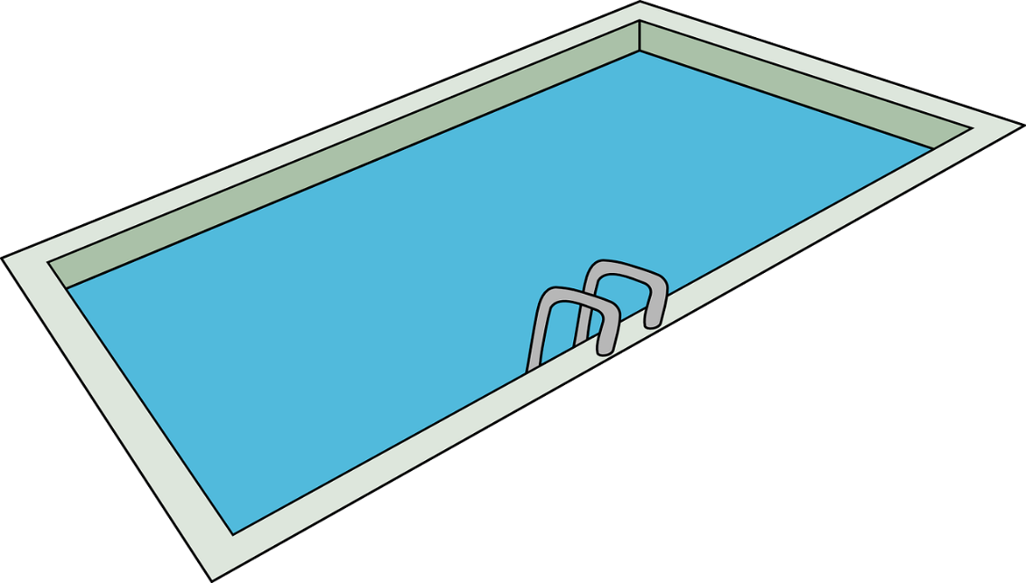
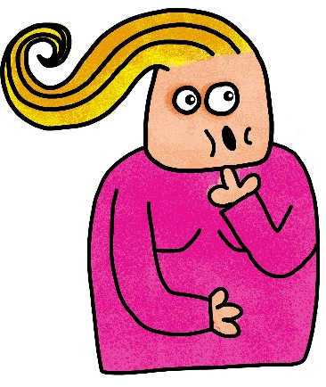
Quel pronom?
Écoute le verbe:
c’est ‘elles’ ou ‘vous’ ?
écouter
elles
nous
Elles tombent dans la piscine.
[They (les glaces, f.) fall into the swimming pool.]
Notes:
Slide 5 of 5
Audio transcript:
[beep] tombent dans la piscine.
Elles tombent dans la piscine.

Slide 18
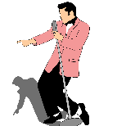
Quel pronom?
Écoute et complète le verbe. C’est quel pronom?
écouter/écrire
Une chose ou plusieurs choses? | Complete le verbe |  | pronom?
Le garçon | dessine | bien. | il
Les chiens | jouent | avec les chats. | ils
Les filles | dansent | dans le jardin. | elles
La femme | regarde | un film. | elle
Les parents | chantent | une chanson. | ils
1
/
?
?
2
/
?
?
3
/
?
?
4
/
?
?
5
/
?
?
Remember that when a group contains both masculine and feminine people or things,
the pronoun ils is used. e.g. Les parents ➔ ils
Notes:
Timing: 3 minutes
Aim: To practise identifying -ER verb endings and pronouns through listening to complete sentences.
Procedure:
Click on the audio buttons to hear sentences.
Students pay attention to the subject of each sentence to determine whether it is singular or plural.
Students identify the correct verb ending (singular or plural) and the correct pronoun associated with each subject.
Click to reveal answers.
Audio transcript:
Le garçon dessine bien.
Les chiens jouent avec les chats.
Les filles dansent dans le jardin.
La femme regarde un film.
Les parents chantent une chanson.

Slide 19
Les verbes -er
Dis les verbes: c’est quel SSC à la fin ?
parler
Sound 2: é/er/ez
Sound 3: on
Sound 2
[SSC: é/er/ez]
-er endings:
verb infinitive
-ez endings:
vous [you, sing. formal; plural]
Sound 1: SFe/SFC
Sound 1
[SSC: SFe/SFC]
-e endings:
je [I]
il [he/it, m.] elle [she/it, f.]
on [we]
-es endings:
tu [you, sing.]
-ent endings:
ils [they, m.]
elles [they, f.]
dessinent
dessiner
nages
échangent
dessinez
danse
dessine
dessines
dansons
dessinons
échangeons
dansent
Sound 3
[SSC: on]
-ons endings:
nous [we]
danses
nager
échangez
dansez
danser
nage
Notes:
Timing: 5 minutes
Aim: To revise saying the sounds in -ER verb endings
Procedure:
The verb forms listed can be divided into three groups in which the endings sound the same.
In pairs, students say the verb forms on the screen and identify the three sound groups, constructing a quick table
The students then work together to identify the pronouns associated with each sound:
je, tu, il(s), elle(s), on - SSC: [SFe] and [SFC]
vous, infinitives - SSC [é/er/ez]
nous - SSC [on]
The teacher elicits answers from the students and clicks to complete the table.

Slide 20
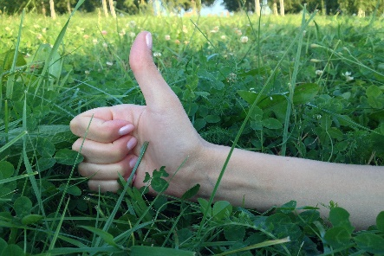
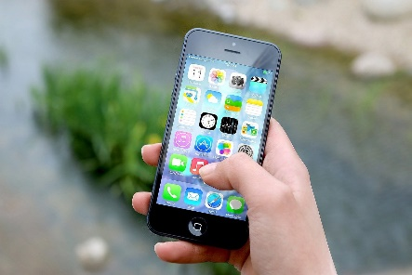
Aimer + infinitive
grammaire
Remember that when we talk about activities we like to do in French, we use the verb aimer [to like] followed by the infinitive of the activity verb.
She likes to send text messages to her friends.
Elle aime envoyer des textos à ses amis.
To talk about activities we don’t like to do, remember to put the ne…pas either side of the short form of aimer, followed by the infinitive.
He doesn’t like playing football.
Il n’aime pas jouer au foot.
Notes:
Timing: 2 minutes
Aim: To revise the use of aimer + infinitive to talk about likes and dislikes
Procedure:
Click to reveal information and first sentence in English.
Elicit French translations from the students to verify understanding of the construction of aimer + infinitive.
Click to reveal the answers.

Slide 21
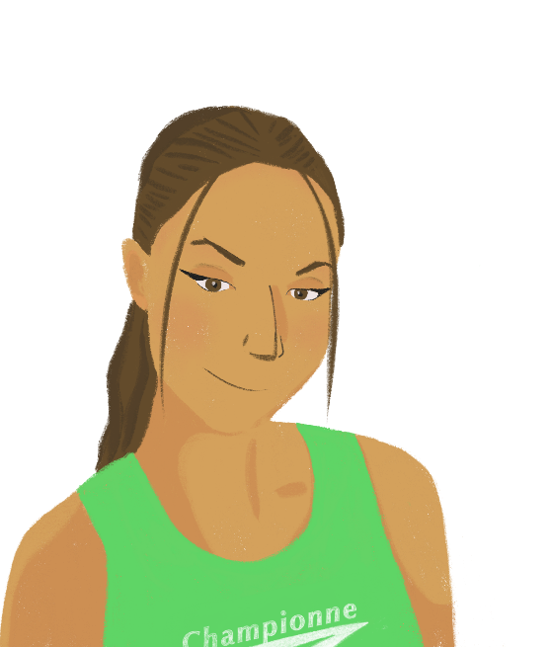
Océane: mon temps libre
Écris les bons pronoms.
lire
voyager
[to travel]
Verbs ending with -ger have a spelling change in the nous form: nous voyageons. Why do you think this is done?
Alors, moi je dessine des animaux, et
je regarde parfois des films à la télé. Je suis membre d’un club de tennis, comme mon frère, et on joue souvent ensemble dans des compétitions. J’ai deux sœurs. Elles dansent et chantent dans un groupe avec moi. Ma mère, elle parle avec ses amis tout le temps ! En famille, nous voyageons chaque été à l’étranger, et on nage dans la mer.
?
?
?
?
?
The g in voyager is the SSC [j/soft g]. In French, g before o is the SSC [hard g], so the e is inserted in the nous form to soften the g.
?
?
Notes:
Timing: 12 minutes
Slide 1/4
This slide is accompanied by a handout, with a choice of Higher or Foundation.
For Higher students, the pronoun has to be chosen based on the associated verb short form and sentence context.
For Foundation students, the pronoun has to be chosen from two possible options for additional support, but is still based on the associated verb short form and sentence context.
Aim: Written recognition of -ER verbs forms in the present tense and connecting these with pronouns; verbs with spelling changes
Procedure:
Foundation version: the students read the text on the worksheet and decide which of the two pronoun options is correct, based on the verb endings and other information in the sentence.
Higher version: the students read the text on the worksheet and fill the gaps with the correct pronoun, based on the verb endings and other information in the sentence.
The teacher elicits verbal (or mini-whiteboard) responses.
Click to reveal the answers.
The worksheets can be collected by the teacher to gain feedback on students’ understanding.
Click to reveal the additional information about exceptions to the spelling of some -ER verbs such as voyager.
Ask the students to think about why there is an extra ‘e’ in the nous form, based on their knowledge of phonics.
Click to reveal the answer, and if time, ask students to think of other -GER verbs they have already learned which would follow this pattern. (e.g., manger, changer, partager, nager, corriger, encourager, obliger, loger)
Word frequency of cognates used (1 is the most frequent word in French): compétition [2651]
Source: Londsale, D., & Le Bras, Y. (2009). A Frequency Dictionary of French: Core vocabulary for learners London: Routledge.

Slide 22
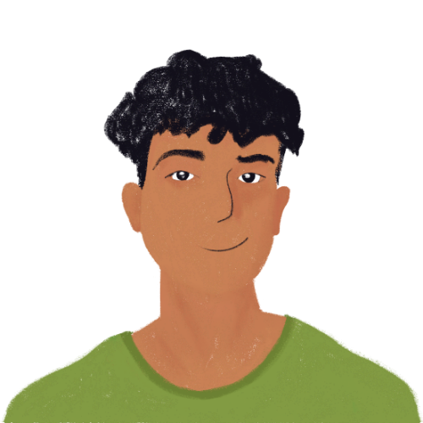
Amir: mon temps libre
Écris les verbes en français.
écrire
Alors moi, qu’est-ce que j’aime faire dans mon temps libre ? J’aime bien le sport. Moi et ma sœur, nous jouons au foot, et je vais souvent à la piscine près de la maison parce que j’aime nager. J’ai beaucoup d’amis au collège. Mon ami Baptiste écoute de la musique tous les jours, et mon amie Océane chante dans un groupe avec ses sœurs. Elles dansent aussi. Et toi, qu’est-ce que tu aimes faire dans ton temps libre ?
like
play
like
to swim
listens
sings
dance
like
Notes:
Slide 2/4
This slide is available as a handout in two forms:
For Higher students, the verb form is chosen based on the subject of the clause.
For Foundation students, the verb form is chosen based on the subject of the clause, which has been circled for additional support.
Aim: Written production of different forms of -ER verbs in the present tense.
Procedure:
Higher: The students read the text on the worksheet and circle the pronouns and sentence subjects, then write the French translations of the –ER verbs in the gaps, using the circled words to inform the verb forms.
Foundation: The pronouns and sentence subjects are already circled for extra support, then students write the French translations of the –ER verbs in the gaps, using the circled words to inform the verb forms.
The teacher elicits answers from the students (verbal or mini-whiteboards) and clicks to reveal answers.
The worksheets can be collected by the teacher to gain feedback on students’ understanding.

Slide 23
Le temps libre
Réponds aux questions avec des phrases complètes.
lire / écrire
Alors moi, qu’est-ce que j’aime faire dans mon temps libre ? J’aime bien le sport. Moi et ma sœur, nous jouons au foot, et je vais souvent à la piscine près de la maison parce que j’aime nager. J’ai beaucoup d’amis au collège. Mon ami Baptiste écoute de la musique tous les jours, et mon amie Océane chante dans un groupe avec ses sœurs. Elles dansent aussi. Et toi, qu’est-ce que tu aimes faire dans ton temps libre ?
Alors, moi je dessine des animaux, et je regarde parfois des films à la télé. Je suis membre d’un club de tennis, comme mon frère, et on joue souvent ensemble dans des compétitions. J’ai deux sœurs. Elles dansent et chantent dans un groupe avec moi. Ma mère, elle parle avec ses amis tout le temps ! En famille, nous voyageons chaque été à l’étranger, et on nage dans la mer.
Océane joue à quel sport, et avec qui ?
Qui aime écouter de la musique ?
Océane a combien de sœurs ?
Amir nage où ?
La famille d’Océane voyage où et quand ?
Qui aime beaucoup parler ?
Et toi ? Est-ce que tu aimes dessiner? Pourquoi?
Que penses-tu du foot?
Notes:
Slide 3/4
Aim: Written comprehension of the texts about free-time activities and written production of –ER verb forms in full sentences.
Procedure:
Students re-read the paragraphs from the previous slides and write answers to the questions in full sentences in French.
For an additional level of challenge, students should be encouraged to replace the subjects in their answers with the relevant pronouns where possible.
Students should also be encouraged to use the two more open questions 7 and 8 for writing extended answers using vocabulary they have previously learned (dictionaries can be used if needed). For example, students may write about a person other than themselves and discuss their like or dislike of the activities (drawing or football), and include details such as when, where, how often, and with whom the activity is done.
The teacher asks students to read out their responses, or this can also be in the form of a teacher-marked written exercise.
Suggested answers are on the following slide.

Slide 24
Le temps libre
Suggested answers
lire / écrire
1. Océane joue à quel sport, et avec qui ?
Océane/Elle joue au tennis avec son frère.
6. Qui aime beaucoup parler ?
2. Qui aime écouter de la musique ?
La mère d’Océane/Elle aime beaucoup parler.
Baptiste, l’ami d’Amir, aime écouter de la musique.
7. Et toi? Est-ce que tu aimes dessiner ? Pourquoi?
3. Océane a combien de sœurs ?
Je n’aime pas dessiner, parce que c’est difficile.
Océane/Elle a deux sœurs.
4. Amir nage où ?
8. Que penses-tu du foot?
Amir/Il nage à la piscine près de sa maison.
Je pense que le foot c’est amusant.
5. La famille d’Océane voyage où et quand ?
La famille d’Océane/Elle voyage à l’étranger chaque été.
Notes:
Slide 4/4
Suggested answers to the previous slide

Slide 25
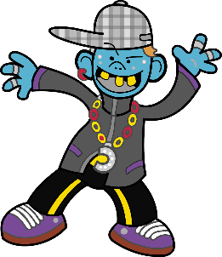
Qu’est-ce que tu aimes faire?
parler
to dance
Tu aimes danser ?
to play
[football]
Non, je n’aime pas danser.
Pourquoi pas ?
Parce que je ne danse pas bien !
Tu aimes jouer au foot?
Oui. J’aime bien jouer au foot.
Moi aussi ! C’est mon sport préféré.
Notes:
Timing: 7 minutes
Aim: Spoken production of yes/no questions and statements with –ER verbs to talking about liking and disliking different activities, and giving justifications.
Procedure:
Click through the example, hearing the conversation spoken by native speakers.
At foundation level, you may wish to constrain the activity to the practice of yes/no questions and statements only (and remove the third and fourth bubbles in this example slide).
At higher level, the additional prompts in brackets allow students to create longer sentences and practise using additional previously learned vocabulary.
Students work in pairs to talk about likes and dislikes of different leisure activities on the picture board on the following slide.
Transcript:
A: Tu aimes danser ?
B: Non, je n’aime pas danser.
A: Pourquoi pas?
B: Parce que je ne danse pas bien ! Tu aimes jouer au foot?
A: Oui. J’aime bien jouer au foot.
B: Moi aussi ! C’est mon sport préféré.

Slide 26
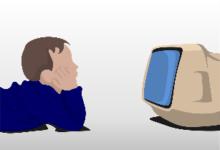
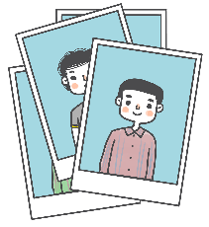
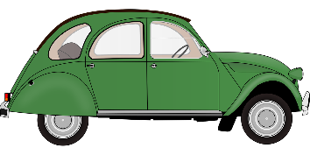
Qu’est-ce que tu aimes faire?
parler
to listen
[to music]
to speak
[French]
to travel
[to France]
to watch
[a film on TV]
to read
[a book]
to sing
[a funny song]
to take
[photos]
to dance
[at a party]
to play
[(au) football]
to exchange
[photos]
to go
[to the cinema]
to visit
[museums]
to draw
[a cat]
to practise
[a sport]
to swim
[at the pool]
to wash
[the car]
to write
[a story]
to produce
[films]
Notes:
Picture board to display on screen, and can be printed as a handout
Note:
On this slide, there are items of Higher vocabulary (to practise = pratiquer, to produce = produire). Teachers with Foundation only classes could remove these, and those with mixed Foundation/Higher classes, and particularly in classes where the tier of entry will be determined later, will want to work with the full slide.
However, we anticipate that students will self-select questions to put to their partners and will focus on the vocabulary they know.

Slide 27
Activities and interests
Lesson 2
Verbs ending in –RE (present)
(Verbs like entendre and prendre)
SSCs [e/er/ez] [en/an], [e], [ê/è]
Y10 French
Term 1.1 - Week 1 - Lesson 2
Author name(s): Louise Bibbey
Artwork by: Chloé Motard
Date updated: 17/10/22
Notes:
Artwork by Chloé Motard. All additional pictures selected are available under a Creative Commons license, no attribution required.
Native speaker feedback provided by Stéphanie Schmitt.
With thanks to Rachel Hawkes for her input on lesson material.
Learning outcomes (lesson 1):
Consolidation of SSCs [e/er/ez], [en/an], [e], [ê/è]
Revision of verbs ending in –RE (present) (verbs like entendre and prendre)
Talking about regular activities and chores
Word frequency (1 is the most frequent word in French):
(vocabulary introduced) échanger [1452], danser [2934], dessiner [2086], nager [n/a], mail/e-mail [n/a], texto [n/a], produire (H) [367], rendre (H) [85], centaine (H) [1417], véhicule (H) [1959], rare (H) [1233], c’est-à-dire (H) [560]
(revisited function words) écrire, écris, écris! (aux) écrit (H) [382], entendre [149], jouer (à/de + noun) [219], parler [106], prendre [43], traduire [1125], elle, elles [38], il, ils [13], je [22], nous [31], on [29], tu [112], vous [50]
(spaced repetition 1) (se) laver [3503], (s')appeler [157], journée [587], paix [579], fier/fière [1331], officiel/officielle [996], (se) présenter (H) [209], accord (H) [496], membre (H) [390], efficace (H) [1243]
(spaced repetition 2) oublier [504], payer [537], le2 [1], la2 [1], coût [830], client [917], mode [1137], cent [704], mille [1008], quatre-vingt-dix [>5000], soixante-dix [4887], livrer (H) [613], marque (H) [1344]
(thematic revisited vocabulary) aimer [242], apprendre (à) [327], [1820], construire [793], écrire, écris, écrit [382], écouter [429], jouer (à) [119], lire [278], pratiquer (H) [1268], prendre [43], raconter [820], répondre (à) [200], regarder [425], télévision/télé [1179], voyager [2194], club [1860], film [848], football/foot [2602], piscine [n/a], texte [631], parce que [adv]
Source: Lonsdale, D., & Le Bras, Y. (2009). A Frequency Dictionary of French: Core vocabulary for learners London: Routledge.
The frequency rankings for words that occur in this PowerPoint which have been previously introduced in NCELP resources are given in the NCELP SOW and in the resources that first introduced and formally re-visited those words.
For any other words that occur incidentally in this PowerPoint, frequency rankings will be provided in the notes field wherever possible.

Slide 28
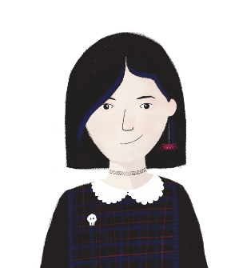
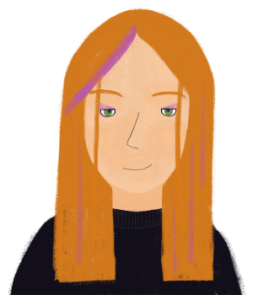
Qui aime faire quoi?
Écoute: Sophie et ses amis aiment faire quelles activités?
écouter
Sophie | Léa | Amir | Antoine | Élodie | Group of friends
learning English, drawing rare animals, selling clothes in a shop | giving back to the community | playing football, swimming at the pool | producing films on mobile | dancing | exchanging messages on phones, sending hundreds of texts and emails
Bonjour ! Je me présente. Je suis Sophie et je vais parler de mes activités préférées et des activités favorites de mes amis.
Bonjour ! Je m’appelle Léa.
Bonjour !
Je m’appelle Amir.
Bonjour !
Je m’appelle Antoine.
Bonjour !
Je m’appelle Élodie.
Notes:
Timing: 10 minutes
Higher version
Aim: Aural comprehension of new vocabulary in the context of someone talking about activities they and their friends like.
Procedure:
Students sketch a table following the example on the screen.
Click to listen to Sophie talking about the activities she and her friends like to do.
In the table, students write the English translations of the activities they hear for each person.
Click to reveal the answers.
If time allows, the teacher can ask the students to translate their tables back into French.
Note:
In mixed Foundation/Higher classes, it will work in BYOD (Bring Your Own Device) settings for students to simultaneously access the version of the task most appropriate for them. In other classrooms, the teacher will need to select one or the other – perhaps the Higher version, but giving Foundation students the Higher vocabulary glossed on a support sheet or written on a whiteboard in the classroom.
Transcript:
Bonjour! Je m’appelle Sophie. J’aime apprendre l’anglais et j’aime dessiner des animaux rares. J’aime aussi vendre des vêtements dans un magasin le samedi. Mes amis sont sympas. Ils aiment échanger des messages sur leur portable, et ils aiment envoyer des centaines de textos et emails. Élodie aime danser, et Léa aime rendre service à la communauté, c’est-à-dire qu’elle donne de son temps aux autres personnes. Antoine est un garçon très intéressant. Il n’aime pas le sport, mais il aime produire des films sur son portable. Amir aime jouer au foot et nager à la piscine.

Slide 29
Qui aime faire quoi?
Écoute: Sophie et ses amis aiment faire quelles activités?
écouter
Bonjour ! Je me présente. Je suis Sophie et je vais parler de mes activités préférées et des activités favorites de mes amis.
Sophie | Léa | Amir | Antoine | Élodie | Group of friends
learning English, listening to music | watching TV | playing football, swimming | drawing, reading | dancing | using mobile phones, sending texts and emails
Bonjour ! Je m’appelle Léa.
Bonjour !
Je m’appelle Amir.
Bonjour !
Je m’appelle Antoine.
Bonjour !
Je m’appelle Élodie.
Notes:
Foundation version
Aim: Aural comprehension of new vocabulary in the context of someone talking about activities they and their friends like.
Procedure:
Students sketch a table following the example on the screen.
Click to listen to Sophie talking about the activities she and her friends like to do.
In the table, students write the English translations of the verb infinitives they hear for each person e.g., to watch, with additional information if they wish, e.g., to watch television.
Click to reveal the answers.
Note:
In mixed Foundation/Higher classes, it will work in BYOD (Bring Your Own Device) settings for students to simultaneously access the version of the task most appropriate for them. In other classrooms, the teacher will need to select one or the other – perhaps the Higher version, but giving Foundation students the Higher vocabulary glossed on a support sheet or written on a whiteboard in the classroom.
Transcript:
Bonjour! Je m’appelle Sophie. J’aime apprendre l’anglais et écouter de la musique. Mes amis sont sympas. Ils aiment utiliser leurs portables, et ils aiment envoyer des textos et emails. Élodie aime danser, et Léa aime regarder la télévision. Antoine aime dessiner et lire, mais il n’aime pas le sport. Amir aime jouer au foot et nager à la piscine.

Slide 30
en/an
enfant
Notes:
Timing: 30 seconds
Teachers can choose either or both SSC slides – the first is with audio, the second is without.
Aim: To consolidate SSC [en/an] in preparation for revising all forms of verbs like entendre
Procedure: 1. Present the letter(s) and say the [en/an] sound first, on its own. Students repeat it with you. 2. Bring up the word ”enfant” on its own, say it, students repeat it, so that they have the opportunity to focus all of their attention on the connection between the written word and its sound.
3. A possible gesture for this would be to mime patting a child on the head/back 4. Roll back the animations and work through 1-3 again, but this time, dropping your voice completely to listen carefully to the students saying the [en/an] sound, pronouncing ”enfant” and, if using, doing the gesture.
Word frequency (1 is the most frequent word in French):
enfant [126]. Source: Londsale, D., & Le Bras, Y. (2009). A Frequency Dictionary of French: Core vocabulary for learners London: Routledge.

Slide 31
en/an
enfant
Notes:
Without sound to elicit pronunciation (without first hearing the teacher).
Teacher to elicit pronunciation by asking “Comment dit-on …"

Slide 32
Les verbes comme entendre
grammaire
Remember that to form the present tense of verbs like entendre, we take the following steps:
Which of these verb forms sound the same?
Verb infinitive
Remove -re to leave the stem
Add endings to the stem…
Did you notice that the singular forms entends/entend sound different from the plural entendent ?
In the singular forms, the d and s are SFCs, but in the plural form, the -ent is silent (SFe), so the preceding d is pronounced.
…et voilà !
entendre
entend-
je: -s
tu: -s
il/elle/on: -
nous: -ons
vous: -ez
ils/elles: -ent
j’entends
tu entends
il/elle/on entend
nous entendons
vous entendez
ils/elles entendent
Quiz rapide! Voici d’autres verbes comme entendre: traduis en anglais
attendre
to lose, losing
répondre (à + noun)
perdre
to sell, selling
to wait (for), expect; waiting (for), expecting
to answer, reply to (+ noun); answering, replying to (+ noun)
vendre
Notes:
Timing: 5 minutes
Aim: To revise the construction in the present tense of -RE verbs like entendre.
Procedure:
Click to reveal the information.
Ask students to identify the verb endings that sound the same.
Say each word form aloud. Students repeat.
Click to reveal answers.
Click audio button to hear the whole verb conjugated by a native speaker.
Click to reveal the quick verb revision quiz, eliciting verbal translations into English of the four verbs.
Click to reveal the answers.
Click to reveal further information about the difference between the SFCs in the singular forms, versus the SFe in the plural form.
Transcript:
j’entends
tu entends
il entend, elle entend, on entend
nous entendons
vous entendez
ils entendent, elles entendent

Slide 33
e
je
Notes:
Timing: 30 seconds
Teachers can choose either or both SSC slides – the first is with audio, the second is without.
Aim: To consolidate SSC [e] in preparation for revising nous and vous forms of verbs like prendre (prenons, prenez)
Procedure: 1. Present the letter(s) and say the [e] sound first, on its own. Students repeat it with you. 2. Bring up the word ”je” on its own, say it, students repeat it, so that they have the opportunity to focus all of their attention on the connection between the written word and its sound.
3. A possible gesture for this would be to point to oneself. 4. Roll back the animations and work through 1-3 again, but this time, dropping your voice completely to listen carefully to the students saying the [e] sound, pronouncing ”je” and, if using, doing the gesture.
Word frequency (1 is the most frequent word in French):
je [22]. Source: Londsale, D., & Le Bras, Y. (2009). A Frequency Dictionary of French: Core vocabulary for learners London: Routledge.

Slide 34
e
je
Notes:
Without sound to elicit pronunciation (without first hearing the teacher).
Teacher to elicit pronunciation by asking “Comment dit-on …"

Slide 35
ê/è
[head]
tête
Notes:
Timing: 30 seconds
Teachers can choose either or both SSC slides – the first is with audio, the second is without.
Aim: To consolidate SSC [ê/è] in preparation for revising ils/elles form of verbs like prendre (prennent)
Procedure: 1. Present the letter(s) and say the [ê/è] sound first, on its own. Students repeat it with you. 2. Bring up the word ”tête” on its own, say it, students repeat it, so that they have the opportunity to focus all of their attention on the connection between the written word and its sound.
3. A possible gesture for this would be to point to one’s head.
4. Roll back the animations and work through 1-3 again, but this time, dropping your voice completely to listen carefully to the students saying the [ê/è] sound, pronouncing ” tête” and, if using, doing the gesture.
Word frequency (1 is the most frequent word in French):
tête [343]. Source: Londsale, D., & Le Bras, Y. (2009). A Frequency Dictionary of French: Core vocabulary for learners London: Routledge.

Slide 36
ê/è
[head]
tête
Notes:
Without sound to elicit pronunciation (without first hearing the teacher).
Teacher to elicit pronunciation by asking “Comment dit-on …"

Slide 37
Les verbes comme prendre
grammaire
Remember that to form the present tense of verbs like prendre, we take the following steps:
Which of these verb forms sound the same?
Verb infinitive
Add endings to the stems…
Did you notice that the singular forms prends/prend sound different from the plural prennent ?
In the singular forms, the d and s are SFCs, but in the plural form, the -ent is silent (SFe), and the extra n lengthens the e.
Form the stems
…et voilà !
prendre
je/tu/il/elle/on:
remove
-re
prend-
je: -s
tu: -s
il/elle/on: -
je prends
tu prends
il/elle/on prend
nous prenons
vous prenez
ils/elles prennent
nous/vous/
ils/elles:
remove -dre
nous: -ons
vous: -ez
ils/elles: -nent
Quiz rapide! Voici d’autres verbes comme prendre: traduis en anglais
comprendre
apprendre
to surprise (someone), surprising (someone)
to understand, understanding
to learn, teach; learning, teaching
surprendre
Notes:
Timing: 5 minutes
Aim: To revise the construction of –RE verbs like prendre in the present tense
Procedure:
Click to reveal the information.
Draw attention to the removal of the last three letters in the nous, vous, ils/elles forms of verbs like prendre.
Ask students to identify the verb endings that sound the same.
Say each word form aloud. Students repeat.
Click to reveal answers.
Click audio button to hear the whole verb conjugated by a native speaker.
Click to reveal the quick verb revision quiz, eliciting verbal translations into English of the three verbs.
Click to reveal the answers.
Click to reveal further information about the difference between the SFCs in the singular forms, versus the SFe in the plural form.
Transcript:
je prends
tu prends
il prend, elle prend, on prend
nous prenons
vous prenez
ils prennent, elles prennent

Slide 38
SSC slam dunk !
Écoute: tu entends quel SSC ?
écouter
apprenez
prenons
surprennent
apprends
e
prennent
entendons
en
ê/è
Notes:
Timing: 3 minutes
Slide 1 of 2
Aim: To aurally differentiate between [e], [è/ê] and [en] sounds in verbs ending -RE.
Procedure:
Click to hear short forms of a selection of -RE verbs.
Ask students if they hear [e], [è/ê], or [en]. This can be done orally, or on mini-whiteboards.
For a higher level of challenge, students can be asked to write the whole word they hear on a mini-whiteboard before the teacher clicks to reveal the answers.
Click to launch the basketball into the correct hoop and reveal the written form of the verb heard to verify answers.
Transcript:
apprenez
apprends
entendons
surprennent
prenons
prennent

Slide 39
L’agenda de la semaine
Lis les textes et remplis l’agenda en anglais.
lire
Exemple: mercredi/Élodie, ‘Élodie's brother does housework’
Le dimanche, je lave la voiture pour mes parents. Le lundi, je joue au foot avec les autres membres de mon club.
Mon frère fait le ménage le mercredi. Le samedi, moi et ma mère, nous vendons des vêtements au marché.
Léa
Élodie
Le mardi et le jeudi, je fais la cuisine pour ma famille. Le samedi, je fais mes devoirs.
Le dimanche, mes sœurs et moi, on lave les vêtements. Le vendredi, on danse. Le jeudi, je prépare le petit-déjeuner.
Le mardi soir, mon père fait les courses avec moi. Le samedi, je pratique plusieurs sports. Le dimanche, je nage.
Stéphanie
Amir
Le samedi, mes deux frères travaillent à la piscine. Le mercredi, j’apprends l’anglais, et le lundi, je joue au tennis.
Le vendredi, ma grande sœur
livre des journaux aux maisons
près de chez nous. Le samedi, j’aide mon père à faire le ménage. Le dimanche, je dessine.
Antoine
agenda = planner/diary
Sophie
Océane
Notes:
Timing: 10 minutes
Slide 1 of 5
Higher version: The texts on this version are longer, with some higher vocabulary, and students enter more detailed information on the planner.
Aim: Written recognition of a selection of this week’s -ER and -RE verb forms in the present tense in the context of young people talking about daily activities and chores.
Procedure:
Print the blank daily planner for each student, or the activity can be done in pairs.
The teacher reminds students that in French the definite article is used before days of the week to indicate something which is done regularly on that day: le lundi = on Mondays
Students read the statements made by each person and complete the planner in English for each person, giving the person doing the activity, the verb and brief details of each activity, e.g., in the box Élodie/mercredi, students write ‘Élodie’s brother does housework’.
If time allows, students can also be asked to write or say the infinitive form of each verb used.
Word frequency of cognates used (1 is the most frequent word in French):
agenda [3882], tennis [3867]
Source: Lonsdale, D., & Le Bras, Y. (2009). A Frequency Dictionary of French: Core vocabulary for learners London: Routledge.

Slide 40
L’agenda de la semaine
Lis le texte et remplis l’agenda en anglais.
lire
Exemple: lundi/Élodie: ‘Élodie’s brother prepares breakfast’
Le dimanche, je lave la voiture. Le lundi, je joue au foot.
Mon frère prépare le petit-déjeuner le lundi. Le samedi, moi et ma mère, nous vendons des vêtements au marché.
Léa
Élodie
Le mercredi je fais la cuisine avec ma mère. Le samedi, je réponds à mes emails.
Le mardi soir, mon père fais les courses. Le samedi, je nage.
Le dimanche, mes sœurs et moi, on lave les vêtements. Le jeudi, je dessine.
Stéphanie
Amir
Le mercredi, mes deux frères travaillent à la piscine. Le lundi, je joue au tennis.
Le vendredi, ma grande sœur apprend l’anglais. Le samedi, je fais le ménage avec mon père.
agenda = planner/diary, pratiquer = to practise
Sophie
Antoine
Océane
Notes:
Slide 2 of 5
Foundation version: The texts on this version are shorter, with foundation vocabulary.
Aim: Written recognition of a selection of this week’s –ER and –RE verb forms in the present tense in the context of young people talking about daily activities and chores.
Procedure:
Print the blank daily planner for each student, or the activity can be done in pairs.
Remind the students that the definite article is used before days of the week to indicate something which is done regularly on that day: le lundi = on Mondays
Students read the statements made by each person and complete the planner in English for each person, giving the person doing the activity, the verb and brief details of each activity, e.g., in the box Élodie/mercredi, students write ‘Élodie’s brother prepares breakfast’.
Word frequency of cognates used (1 is the most frequent word in French):
agenda [3882]
Source: Lonsdale, D., & Le Bras, Y. (2009). A Frequency Dictionary of French: Core vocabulary for learners London: Routledge.
Word frequency of unknown words used (1 is the most frequent word in French):
pratiquer [1268]
Source: Lonsdale, D., & Le Bras, Y. (2009). A Frequency Dictionary of French: Core vocabulary for learners London: Routledge.

Slide 41
L’agenda de la semaine
Answers
lire
Élodie
Léa
Stéphanie
Amir
Océane
Sophie
Antoine
lundi
mardi
mercredi
jeudi
vendredi
samedi
dimanche
Notes:
Slide 3 of 5
Blank daily planner for printing

Slide 42
L’agenda de la semaine
Answers
lire
Élodie
Léa
Stéphanie
Amir
Océane
Sophie
Antoine
lundi
Léa plays football with her club
Sophie plays tennis
mardi
Stephanie cooks for family
Amir does food shopping with dad
mercredi
Élodie’s brother does housework
Sophie learns English
jeudi
Stephanie cooks for family
Océane prepares the breakfast
vendredi
Océane dances with sisters
Antoine’s sister delivers newspapers
samedi
Élodie and mum sell clothes at the market
Stephanie does homework
Amir practises several sports
Sophie’s brothers work at the swimming pool
Antoine helps dad with housework
dimanche
Léa washes car for parents
Amir swims
Océane washes clothes with sisters
Antoine draws
Notes:
Slide 4 of 5
Answers for Higher version

Slide 43
L’agenda de la semaine
Answers
lire
Élodie
Léa
Stéphanie
Amir
Océane
Sophie
Antoine
lundi
Élodie’s brother prepares breakfast
Léa plays football
Sophie plays tennis
mardi
Amir’s dad does the food shopping
mercredi
Stéphanie does cooking with mum
Sophie’s brothers work at the swimming pool
jeudi
Océane draws
vendredi
Antoine’s sister learns English
samedi
Élodie sells clothes at the market with mum
Stéphanie replies to emails
Amir swims
Antoine does the housework with dad
dimanche
Léa washes the car
Océane washes clothes with sisters
Notes:
Slide 5 of 5
Answers for Foundation version

Slide 44
Qui fait quoi dans ta famille ?
écrire
Et toi ? Qui fait quoi dans ta famille chaque jour ? Maintenant, tu vas écrire 90 mots sur les tâches de ménage et les activités que toi et ta famille faites chaque jour.
Mais attention ! Il faut utiliser un verbe de chaque groupe, et plusieurs pronoms:
je, il/elle/on, ils/elles, nous.
Exemple: Le lundi, ma mère fait les courses. Le samedi, mes frères prennent le train pour aller à la piscine…
Groupe 1:
-ER
laver, dessiner,
jouer (à), échanger, écouter, nager, regarder, voyager, danser, pratiquer, livrer
Groupe 2:
faire…
the shops (to go shopping)
the housework
the cooking
the shopping (food)
the homework
Groupe 3:
verbs like entendre
répondre (à + noun), vendre
Groupe 4:
verbs like prendre
apprendre, comprendre
Notes:
Timing: 8 minutes
Aim: To write a 90-word paragraph about who does what activities and chores in the household.
Procedure:
Using the same type of sentence construction as in the previous task, students write about who does what activities/chores in their household.
The text should contain a verb from each of the four boxes, and all short verb forms except tu and vous should be used.
Remind students that using sentences such as ‘moi et mes sœurs’ or ‘ma mère et moi’ will allow them to form constructions using ‘on’ and ‘nous’.
If required, the previous reading task (either higher or foundation) ‘L’agenda de la semaine’ can be printed out as a guide to support students in their writing.
Higher students may be encouraged to enhance their writing by giving justifications and opinions, such as aimer + infinitive and using parce que.
Optional extension: if time permits, students can swap texts with a partner, and complete a copy of the blank daily planner using their partner’s text.
Note:
On this slide, there are some items of Higher vocabulary (see notes under title slide). Teachers with Foundation only classes could remove these, and those with mixed Foundation/Higher classes, and particularly in classes where the tier of entry will be determined later, will want to work with the full slide.

Slide 45
Qui fait quoi dans ta famille ?
parler
Des mots importants
qui ?
pourquoi ?
est-ce que ?
quel(le) ?
comment ?
quand ?
parce que
aimer
Chez toi, qui fait le ménage ?
Chez moi, je fais le ménage avec mon frère.
Pourquoi ?
Parce que j’aime aider ma mère.
Elle est toujours travailleuse.
Est-ce que tu aimes faire le ménage ?
Non !
Notes:
Slide 1 of 2
Timing: 8 minutes
Aim: Spoken production of questions and answers with –ER and –RE verbs and faire relating to household tasks and interests, and giving justifications.
Procedure:
Click through the example, hearing the conversation spoken by native speakers.
At foundation level, you may wish to constrain the activity to one simple question and answer, using only the first two bubbles in this example slide as a model.
At higher level, students may create longer sentences and practise using additional previously learned vocabulary, using a variety of question words.
Students work in pairs to talk about tasks carried out by themselves and other family members, using prompts from the picture board on the following slide.
For additional support, you may wish to suggest some question starters using the question words provided on screen, e.g., qui fait…, pourquoi travailles-tu…, est-ce que tu aimes…, quelle est ta tâche préférée?, comment fais-tu… quand est-ce que tu…
Transcript:
A: Chez toi, qui fait le ménage ?
B: Chez moi, je fais le ménage avec mon frère.
A: Pourquoi ?
B: Parce que j’aime aider ma mère. Elle est toujours travailleuse.
A: Est-ce que tu aimes faire le ménage ?
B: Non !

Slide 46
Qui fait quoi dans ta famille ?
parler
respond to emails
wash
the car
make
the bed
work in the garden
do the cooking
wash the clothes
do the housework
prepare the breakfast
learn a language
Notes:
Slide 2 of 2
Picture prompt cards to be printed, or to be displayed on the screen if desired

Slide 47
Activities and interests
Lesson 3
Verbs ending in –RE (present)
(Verbs like traduire and écrire)
SSCs [soft s], [hard s]
Y10 French
Term 1.1 - Week 1 - Lesson 3
Author name(s): Louise Bibbey
Artwork by: Chloé Motard
Date updated: 17/10/22
Notes:
Artwork by Chloé Motard. All additional pictures selected are available under a Creative Commons license, no attribution required.
Native speaker feedback provided by Word frequency (1 is the most frequent word in French):
(vocabulary introduced) échanger [1452], danser [2934], dessiner [2086], nager [n/a], mail/e-mail [n/a], texto [n/a], produire (H) [367], rendre (H) [85], centaine (H) [1417], véhicule (H) [1959], rare (H) [1233], c’est-à-dire (H) [560]
(revisited function words) écrire, écris, écris! (aux) écrit (H) [382], entendre [149], jouer (à/de + noun) [219], parler [106], prendre [43], traduire [1125], elle, elles [38], il, ils [13], je [22], nous [31], on [29], tu [112], vous [50]
(spaced repetition 1) (se) laver [3503], (s')appeler [157], journée [587], paix [579], fier/fière [1331], officiel/officielle [996], (se) présenter (H) [209], accord (H) [496], membre (H) [390], efficace (H) [1243]
(spaced repetition 2) oublier [504], payer [537], le2 [1], la2 [1], coût [830], client [917], mode [1137], cent [704], mille [1008], quatre-vingt-dix [>5000], soixante-dix [4887], livrer (H) [613], marque (H) [1344]
(thematic revisited vocabulary) aimer [242], apprendre (à) [327], [1820], construire [793], écrire, écris, écrit [382], écouter [429], jouer (à) [119], lire [278], pratiquer (H) [1268], prendre [43], raconter [820], répondre (à) [200], regarder [425], télévision/télé [1179], voyager [2194], club [1860], film [848], football/foot [2602], piscine [n/a], texte [631], parce que [adv]
Source: Lonsdale, D., & Le Bras, Y. (2009). A Frequency Dictionary of French: Core vocabulary for learners London: Routledge.
The frequency rankings for words that occur in this PowerPoint which have been previously introduced in NCELP resources are given in the NCELP SOW and in the resources that first introduced and formally re-visited those words.
For any other words that occur incidentally in this PowerPoint, frequency rankings will be provided in the notes field wherever possible.

Slide 48
Vocabulaire
vocabulaire
échanger
[to exchange, exchanging]
danser
[to dance, dancing]
dessiner
[to draw, drawing]
nager
[to swim, swimming]
produire
[to produce/
make, producing/
making]
rendre
[to give back,
giving back]
mail,
email (m)
[email]
texto (m)
[text/SMS]
c’est-à-dire
[in other words, that is to say]
véhicule (m)
[vehicle]
centaine (f)
[about 100]
rare
[rare]
Notes:
Timing: 5 minutes
Higher vocabulary
Picture cards to be printed from this slide
Slide not to be on the screen during the game but can be displayed for quick vocabulary revision as a lesson starter.
Aim: To practise saying and writing the new vocabulary using a picture card game.
Procedure:
Students work in pairs using printed picture cards.
Shuffle the cards and place them face-down on the table.
Partner A takes a card and does not show it to partner B. Partner A says the English word on the card, and partner B says the word in French and writes it on a mini-whiteboard or paper.
Partner A verifies the answer. If partner B said the word correctly, they get five points, and if they spell it correctly, they get a further 10 points.
Continue until all the cards have been used, then add the scores to find the winner.
If time allows, re-shuffle the cards and repeat the exercise to give opportunities for students to reinforce the vocabulary and spelling acquisition.

Slide 49
Vocabulaire
vocabulaire
échanger
[to exchange, exchanging]
danser
[to dance, dancing]
échanger
[to exchange, exchanging]
danser
[to dance, dancing]
dessiner
[to draw, drawing]
nager
[to swim, swimming]
dessiner
[to draw, drawing]
nager
[to swim, swimming]
email (m)
[email]
texto (m)
[text/SMS]
email (m)
[email]
texto (m)
[text/SMS]
Notes:
Foundation vocabulary
Picture cards to be printed from this slide
Slide not to be on the screen during the game but can be displayed for quick vocabulary revision as a lesson starter.
Aim: To practise saying and writing the new vocabulary using a picture card game.
Procedure:
Students work in pairs using printed picture cards.
Shuffle the cards and place them face-down on the table.
Partner A takes a card and does not show it to partner B. Partner A says the English word on the card, and partner B says the word in French and writes it on a mini-whiteboard or paper.
Partner A verifies the answer. If partner B said the word correctly, they get five points, and if they spell it correctly, they get a further 10 points.
Continue until all the cards have been used, then add the scores to find the winner.
If time allows, re-shuffle the cards and repeat the exercise to give opportunities for students to reinforce the vocabulary and spelling acquisition.

Slide 50
-s-
[hard]
maison
Notes:
Timing: 30 seconds
Teachers can choose either or both SSC slides – the first is with audio, the second is without.
Aim: To consolidate SSC [-s-] in preparation for revising endings of –RE verb forms like traduire (traduisons, traduisez, traduisent).
Procedure: 1. Present the letter(s) and say the [-s-] sound first, on its own. Students repeat it with you. 2. Bring up the word ”maison” on its own, say it, students repeat it, so that they have the opportunity to focus all of their attention on the connection between the written word and its sound.
3. A possible gesture for this would be to trace the outline of a house in the air with two fingers. 4. Roll back the animations and work through 1-3 again, but this time, dropping your voice completely to listen carefully to the students saying the [-s- between vowels] sound, pronouncing ”maison” and, if using, doing the gesture.
Word frequency (1 is the most frequent word in French):
maison [325]
Source: Londsale, D., & Le Bras, Y. (2009). A Frequency Dictionary of French: Core vocabulary for learners London: Routledge.

Slide 51
-s-
maison
Notes:
Without sound to elicit pronunciation (without first hearing the teacher).
Teacher to elicit pronunciation by asking “Comment dit-on …”

Slide 52
Les verbes comme traduire
grammaire
Remember that to form the present tense of verbs like traduire, we take the following steps:
Which of these verb forms sound the same?
Verb infinitive
Add endings to the stems…
Form the stem
…et voilà !
traduire
remove -re
tradui-
add -s- to the stem in the nous/vous/ils/elles forms
je: -s
tu: -s
il/elle/on: -t
nous: -sons
vous: -sez
ils/elles: -sent
je traduis
tu traduis
il/elle/on traduit
nous traduisons
vous traduisez
ils/elles traduisent
Quiz rapide! Voici d’autres verbes comme traduire: traduis en anglais
dire
to say, tell;
saying, telling
lire
to read, reading
construire
to build, building
conduire
to drive, driving
Notes:
Timing: 5 minutes
Aim: To revise the construction in the present tense of –RE verbs like traduire.
Procedure:
Click to reveal the information.
Draw attention to the spelling change in the stem for the je, tu, il/elle/on, ils/elles forms.
Ask students to identify the verb endings that sound the same.
Say each word form aloud. Students repeat.
Click to reveal answers.
Click audio button to hear the whole verb conjugated by a native speaker.
Click to reveal the quick verb revision quiz, eliciting verbal translations into English of the four verbs.
Click to reveal the answers.
Transcript:
je traduis
tu traduis
il traduit, elle traduit, on traduit
nous traduisons
vous traduisez
ils traduisent, elles traduisent

Slide 53
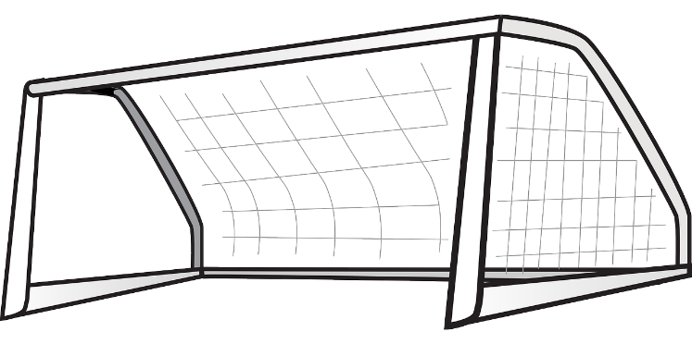
On joue au foot !
Écoute le verbe et mets le ballon au bon but.
écouter
Bravo !
Champions du monde !
I , you (singular informal), he/she
we (impersonal)
we (personal)
disons
lis/lit
conduisons
construis/construit
you
(plural/
singular formal)
produisez
traduisent
they
(m/f)
lisez
disent
Notes:
Timing: 5 minutes
Note: this slide contains one verb from the Higher vocabulary list (produire), but this does not affect the purpose or understanding of the task, as the focus is on listening to verb endings.
Aim: Aural recognition of the forms of -RE verbs like traduire and connecting them with meaning (subjects)
Procedure:
Click to hear a short form of verbs like traduire.
Students are asked to say choose the correct associated pronouns, then decide which goal the ball should be sent to. Clockwise from left bottom: vous, nous, je/tu/il/elle/on, ils/elles.
Click to make the ball travel to the correct goal to verify responses.
Transcript:
lis / lit
traduisent
produisez
disons
construis / construit
conduisons
disent
lisez
Word frequency of unknown words used (1 is the most frequent word in French): but [441]
Source: Lonsdale, D., & Le Bras, Y. (2009). A Frequency Dictionary of French: Core vocabulary for learners London: Routledge.

Slide 54
Les verbes comme écrire
grammaire
Remember that to form the present tense of verbs like écrire, we take the following steps:
Which of these verb forms sound the same?
Verb infinitive
Add endings to the stems…
Form the stem
…et voilà !
écrire
remove -re
écri-
add -v- to the stem in the nous/vous/ils/elles forms
je: -s
tu: -s
il/elle/on: -t
nous: -vons
vous: -vez
ils/elles: -vent
j’écris
tu écris
il/elle/on écrit
nous écrivons
vous écrivez
ils/elles écrivent
Quiz rapide! Voici d’autres verbes comme écrire: traduis en anglais
to describe, describing
to write down, writing down
décrire
inscrire
Notes:
Timing: 5 minutes
Higher only
Aim: To revise the construction in the present tense of -RE verbs like écrire.
Procedure:
Click to reveal the information.
Draw attention to the spelling change in the stem (added v) for the nous, vous, ils/elles forms.
Ask students to identify the verb endings that sound the same.
Say each word form aloud. Students repeat.
Click to reveal answers.
Click audio button to hear the whole verb conjugated by a native speaker.
Click to reveal the quick verb revision quiz, eliciting verbal translations into English of the two verbs.
Click to reveal the answers.
Transcript:
j’écris
tu écris
il écrit, elle écrit, on écrit
nous écrivons
vous écrivez
ils écrivent, elles écrivent

Slide 55
Tony Parker
Lis le texte, remplis le tableau* et réponds aux questions en français.
tableau = table
lire
Tony Parker joue au basket aux États-Unis et en France. Son père est américain, et sa mère est néerlandaise*, mais Tony habite en France. Tony comprend et parle le français et l’anglais, c’est-à-dire qu’il est bilingue*. Tony est fier d’être français et américain. Son équipe ne perd pas souvent de matchs parce qu’elle est très efficace. Dans le journal, Paris Match, les journalistes décrivent Tony comme l’un des « meilleurs joueurs* européens de l’histoire ».
Partout en France, les magasins vendent de l’équipement pour jouer au basket, comme des ballons*, des vêtements, des baskets* et des paniers*. Dans les collèges et lycées, beaucoup d’enfants portent des vêtements de basket parce que c’est à la mode. Mais attention au coût ! On paie beaucoup plus de cent euros pour les baskets. Les marques sont chères!
Did you notice the use of l’un des…?
In formal French, when un functions as a pronoun, it is replaced by l’un.
So here, to say ‘one of the best’,
we use l’un des meilleurs
On aime bien le basket en France, et il y a des clubs dans toutes les villes. Les enfants apprennent à jouer quand ils sont très jeunes, souvent à l'âge de quatre ou cinq ans. Les clubs produisent des joueurs et joueuses qui représentent* la France aux Jeux Olympiques*, comme Tony en 2012 à Londres.
néerlandaise = Dutch, bilingue = bilingual, joueur/joueuse = player, ballon = ball, baskets = trainers, panier = basket/hoop, représenter = to represent, Jeux Olympiques = Olympic Games
Notes:
Timing: 12 minutes
Higher version
The printable worksheet containing the text, table and comprehension questions can be downloaded from the resource portal for students to work on individually.
Aim: To practise reading and identifying the -RE verb forms in a longer text, and to answer comprehension questions.
Procedure:
Print the accompanying worksheet from the resource portal for each student.
The first task is to read through the text and circle the -RE verbs.
The teacher can, if they wish, draw students’ attention to the use of l’un de in formal French, when un becomes a pronoun (click to reveal the pop-up).
On the table below the text, students write the short form of each verb, then the infinitive, and the group of -RE verbs it belongs to (like entendre, prendre, traduire or écrire.).
The final task is to answer the six comprehension questions on the text in full sentences in French, replacing subjects with the relevant pronouns where possible.
Suggested answers are on the following slides.
Online articles:
Tony Parker est-il le plus grand sportif français de tous les temps ? (parismatch.com)
Tony Parker — Wikipédia (wikipedia.org)
Word frequency of unknown words used (1 is the most frequent word in French): tableau [1456], néerlandais(e) [>5000], bilingue [>5000], joueur, joueuse [2003], baskets [>5000], panier [4461], jeu [291]
Source: Lonsdale, D., & Le Bras, Y. (2009). A Frequency Dictionary of French: Core vocabulary for learners London: Routledge.
Word frequency of cognates used (1 is the most frequent word in French):
américain [374], basket [>5000], journaliste [1337], équipement [1704], ballon [3692], représenter [293], olympique [3199]
Source: Lonsdale, D., & Le Bras, Y. (2009). A Frequency Dictionary of French: Core vocabulary for learners London: Routledge.

Slide 56
Tony Parker
Lis le texte, remplis le tableau* et réponds aux questions en anglais.
tableau = table
lire
Tony Parker joue au basket aux États-Unis et en France. Son père est américain, et sa mère est néerlandaise*, mais Tony habite en France. Tony comprend et parle le français et l’anglais, et il est fier d’être français et américain. Son équipe ne perd pas souvent de matchs. Dans le journal, Paris Match, les journalistes* disent que Tony est l’un des « meilleurs joueurs* européens de l’histoire ».
Did you notice the use of l’un des…?
In formal French, when un functions as a pronoun, it is replaced by l’un.
So here, to say ‘one of the best’,
we use l’un des meilleurs
Partout en France, les magasins vendent de l’équipement pour jouer au basket, comme des ballons*, des vêtements, des baskets* et des paniers*. Dans les collèges et lycées, beaucoup d’enfants portent des vêtements de basket parce que c’est à la mode. Mais attention au coût ! Souvent on paie beaucoup plus de cent euros pour les baskets !
On aime bien le basket en France, et il y a des clubs dans toutes les villes. Les enfants apprennent à jouer quand ils sont très jeunes, souvent à l'âge de quatre ou cinq ans. C’est un rêve de participer aux Jeux Olympiques*, comme Tony en 2012 à Londres.
néerlandaise = Dutch, joueur/joueuse = player, ballon = ball, baskets = trainers,
panier = basket/hoop, Jeux Olympiques = Olympic Games
Notes:
Foundation version
The printable worksheet containing the text, table and comprehension questions can be downloaded from the resource portal for students to work on individually.
Aim: To practise reading and identifying the different -RE verb forms in a longer text, and to answer comprehension questions.
Procedure:
Print the accompanying worksheet from the resource portal for each student.
The first task is to read through the text and circle the -RE verbs.
The teacher can, if they wish, draw students’ attention to the use of l’un de in formal French, when un becomes a pronoun (click to reveal the pop-up).
On the table below the text, students write the short form of each verb, then the infinitive, and the group of -RE verbs it belongs to (like entendre, prendre, traduire or écrire.).
The final task is to answer the six comprehension questions on the text in full sentences in English.
For an additional level of challenge, Foundation students who are more confident can answer the questions in French.
Suggested answers are on the following slides.
Online articles:
Tony Parker est-il le plus grand sportif français de tous les temps ? (parismatch.com)
Tony Parker — Wikipédia (wikipedia.org)
Word frequency of unknown words used (1 is the most frequent word in French): tableau [1456], néerlandais(e) [>5000], joueur, joueuse [2003], baskets [>5000], panier [4461], jeu [291]
Source: Lonsdale, D., & Le Bras, Y. (2009). A Frequency Dictionary of French: Core vocabulary for learners London: Routledge.
Word frequency of cognates used (1 is the most frequent word in French):
américain [374], basket [>5000], journaliste [1337], équipement [1704], ballon [3692], représenter [293], olympique [3199]
Source: Lonsdale, D., & Le Bras, Y. (2009). A Frequency Dictionary of French: Core vocabulary for learners London: Routledge.

Slide 57
Les réponses
Short form | Infinitive | Group
comprend | comprendre | like prendre
perd | perdre | like entendre
décrivent | décrire | like écrire
vendent | vendre | like entendre
apprennent | apprendre | like prendre
produisent | produire | like traduire
lire
Quelle est la nationalité du père de Tony ?
Son père est américain.
Pourquoi l’équipe de Tony ne perd pas souvent de matchs ?
Parce qu’elle est très efficace.
Qu’est-ce que les journalistes disent sur Tony ?
Il est l’un des meilleurs joueurs de l’histoire.
Les magasins vendent quel équipement de basket ?
Ils vendent des ballons, des vêtements, des baskets et des paniers.
Les baskets coûtent combien d’euros ?
Elles coûtent plus de cent euros.
Souvent, les enfants apprennent à jouer au basket à quel âge ?
Ils apprennent à jouer au basket à l'âge de quatre ou cinq ans.
Notes:
Answers to the Higher worksheet

Slide 58
Les réponses
lire
Short form | Infinitive | Group
comprend | comprendre | like prendre
perd | perdre | like entendre
disent | dire | like traduire
vendent | vendre | like entendre
apprennent | apprendre | like prendre
Quelle est la nationalité du père de Tony ?
His father is American.
He is one of the best European players in history.
Qu’est-ce que les journalistes disent sur Tony ?
Qui porte souvent des vêtements de basket ?
Children in French secondary schools and sixth-form colleges.
Les magasins vendent quel équipement de basket ?
Basketballs, clothes, trainers, hoops.
Les baskets coûtent combien d’euros ?
More than one hundred euros.
Souvent, les enfants apprennent à jouer au basket à quel âge ?
Four or five years old.
Notes:
Answers to the Foundation worksheet

Slide 59
Que penses-tu du sport ?
écrire
Joues-tu au basket, ou préfères-tu un autre sport ?
Selon toi, Tony Parker est une personne intéressante ?
Que penses-tu du basket ?
Notes:
Timing: 4 minutes
Optional additional questions to be answered in French about Tony Parker and basketball in general

Slide 60
Une personne intéressante?
Écoute Sophie et Amir et réponds aux questions
écouter
Cameroun = Cameroon
l’Algérie
Pourquoi Amir aime-t-il le basket ?
Tony Parker
Parce qu’il aime jouer en équipe.
le Cameroun
Quel est le sport préféré d’Amir et son équipe préférée ?
Le sport préféré d’Amir c’est le foot. Son équipe préférée, c’est la France.
Kylian Mbappé
Pourquoi Sophie pense-t-elle que Tony Parker est intéressant ?
Parce qu’il comprend deux langues.
Quelle est la nationalité de la mère de Kylian Mbappé ?
Champions du monde!
Sa mère est algérienne.
Notes:
Timing: 6 minutes
Aim: This is an optional extra listening task to aid preparation for the written task by listening to someone talking about someone they find interesting, and answering comprehension questions.
Procedure:
Click on the audio button to hear Sophie and Amir talking about sports and people they find interesting.
Students answer the questions either by speaking or writing short sentences in French (this can be done on mini-whiteboards to enable the teacher ascertain the level of comprehension).
Note that Cameroun is unknown vocabulary, but non-essential to comprehension of the task.
Click to reveal the answers.
Transcript:
Sophie: Joues-tu au basket, ou préfères-tu un autre sport ? Amir: Je joue parfois au basket parce que j'aime jouer en équipe avec mes amis. Mais mon sport préféré, c'est le foot. Mon équipe préférée, c'est la France. On est les champions du monde! Selon toi, Tony Parker est une personne intéressante ?
Sophie: Tony Parker est une personne intéressante pour moi, parce qu’il comprend deux langues. Qui est une personne intéressante pour toi ? Amir: Kylian Mbappé est pour moi une personne très intéressante. Il joue au foot pour la France, et comme Tony Parker, ses parents ne sont pas français. Sa mère est algérienne, et son père vient du Cameroun.
Word frequency of unknown words used (1 is the most frequent word in French): Cameroun [>5000]
Source: Lonsdale, D., & Le Bras, Y. (2009). A Frequency Dictionary of French: Core vocabulary for learners London: Routledge.
Word frequency of cognates used (1 is the most frequent word in French):
champion [2443]
Source: Lonsdale, D., & Le Bras, Y. (2009). A Frequency Dictionary of French: Core vocabulary for learners London: Routledge.

Slide 61
Une personne intéressante
écrire
Et toi ? Est-ce que tu peux écrire 100 mots sur une personne intéressante ?
Mais attention ! Il faut essayer d’utiliser:
deux verbes -ER (Groupe 1) et un verbe -RE de chaque groupe (2, 3, 4, 5)
Exemple:
Pour moi, KSI est une personne intéressante. Il produit des films sur YouTube et TikTok, il dit des choses très drôles et il aime chanter…
Groupe 1: -ER
jouer (à), danser, aimer + infinitive, écouter, dessiner, échanger,
nager, chanter, regarder, pratiquer, voyager
Groupe 2:
verbs like entendre
vendre, attendre, répondre (à)
Groupe 3:
verbs like prendre
comprendre, apprendre, rendre
Groupe 4:
verbs like traduire
dire, lire, construire, produire, conduire
Groupe 5:
verbs like écrire
(s’)inscrire, décrire
Notes:
Timing: 10 minutes
Higher version
Aim: Semi-structured writing about a person you find interesting.
Procedure:
Using the text on the Tony Parker worksheet as a model, students write approximately 100 words about a person they find interesting, using a dictionary if required.
The text should contain at least one verb from each groups. The verb groups have been sub-divided into each verb-like group to assist students with conjugation.
Higher students may be encouraged to enhance their writing by giving justifications and opinions, such as aimer + infinitive and using parce que.

Slide 62
Une personne intéressante
écrire
Et toi ? Est-ce que tu peux écrire 100 mots sur une personne intéressante ?
Mais attention ! Il faut essayer d’utiliser:
deux verbes -ER (Groupe 1) et un verbe -RE de chaque groupe (2, 3, 4).
Exemple:
Pour moi, KSI est une personne intéressante. Il dit des choses drôles dans ses films sur YouTube et TikTok, et il aime chanter…
Groupe 1: -ER
jouer (à), danser, aimer + infinitive, écouter, dessiner, échanger,
nager, chanter, regarder, voyager
Groupe 2:
verbs like entendre
vendre, répondre (à), attendre
Groupe 3:
verbs like prendre
comprendre,
apprendre
Groupe 4:
verbs like traduire
dire, lire, construire, conduire
Notes:
Foundation version
Aim: Semi-structured writing about a person you find interesting.
Procedure:
Using the text on the Tony Parker worksheet as a model, students write approximately 100 words about a person they find interesting, using a dictionary if required.
The text should contain at least one verb from each group. The verb groups have been sub-divided into each verb-like group to assist students with conjugation.

Slide 63
Le jeu des phrases drôles!
Fais des phrases drôles avec les cartes.
parler
le chien
construire
J’ai le mot construire
J’ai le mot chien
Je construis une piscine pour mon chien !
J’ai le mot
prendre
J’ai le mot
facteur
Tu prends une photo du facteur !
le facteur
prendre
Notes:
Timing: 6 minutes
A more challenging version is available, with words in English
Aim: Spoken production of sentences containing verbs from all –ER and –RE groups covered in this series of lessons through a picture card game; revisiting vocabulary through spoken recall.
Procedure:
Print and distribute the picture cards to pairs of students.
Make one pile of verbs and one pile of other words (these are a selection of previously learned nouns and numbers).
Partner A chooses a verb, then partner B chooses a noun.
Partner A must make a sentence using the verb and the noun. The sentences can be nonsense, but must be grammatically correct, paying particular attention to verb forms.
The partners take it in turns to pick verbs and nouns and make sentences until all the cards are used.
Transcript:
J’ai le mot construire.
J’ai le mot chien.
Je construis une piscine pour mon chien!
J’ai le mot prendre.
J’ai le mot facteur.
Tu prends une photo du facteur!

Slide 64
Le jeu des phrases drôles!
parler
jouer (à)
danser
dessiner
nager
chanter
voyager
échanger
aimer
regarder
parler
oublier
dire
prendre
lire
construire
apprendre
vendre
écrire
Notes:
French version: Verb picture cards to be printed

Slide 65
Le jeu des phrases drôles!
parler
le facteur
le médecin
le marché
le collège
le poisson
soixante-dix
l’espace (f)
le petit-déjeuner
la montagne
quatre-vingts
les légumes
la fête
mille
le professeur
l’accord (m)
le bateau
la paix
le chien
Notes:
French version: Other words picture cards to be printed

Slide 66
Le jeu des phrases drôles!
parler
to play
to dance
to draw
to swim
to sing
to travel
to exchange
to like
to watch
to speak
to forget
to say
to take
to read
to build
to learn
to sell
to write
Notes:
English version: Verb picture cards to be printed

Slide 67
Le jeu des phrases drôles!
parler
postman
doctor
market
school
fish
seventy
space
breakfast
mountain
eighty
vegetables
party
thousand
teacher
agreement
boat
peace
dog
Notes:
English version: Other words picture cards to be printed

