Slide 1
Asking about future intentions
aller + infinitive (nous and vous)
SSC [j] / soft [g] [revisited]
Y7 French
Term 3.2 - Week 4 – Lesson 65
Adeline Charlton / Natalie Finlayson
Date updated: 16/08/21
Notes:
Artwork by Chloé Motard. All additional pictures selected are available under a Creative Commons license, no attribution required.
Learning outcomes (lesson 1)
Revisiting the use of aller plus the infinitive to express future intentions (je, tu, il and elle)
Introducing the use of aller plus the infinitive to express future intentions (nous and vous)
Consolidation of SSC [j] / soft [g]
Word frequency (1 is the most frequent word in French): 3.2.4 (introduce) avion [1409], allemand^{1, 2} [844], lettre [480], différent [350], prochain [380], bientôt [1208], demain [871], Allemagne [n/a] 3.1.5 (revisit) café¹ [1886], cinéma [1623], plage [2693], rue [598], devant [198], derrière [805], entre [55]
2.2.5 (revisit) arriver [174], changer [283], créer [332], gagner¹ [258], habiter [1186], monde [77], pays [114], politique [128], vêtements [2383], à³[2], chez² [206], comme² [32]
The frequency rankings for words that occur in this PowerPoint which have been previously introduced in NCELP resources are given in the NCELP SOW and in the resources that first introduced and formally re-visited those words.
For any other words that occur incidentally in this PowerPoint, frequency rankings will be provided in the notes field wherever possible.

Slide 2
j/soft g
X
jour
Notes:
Timing: 1 minute
Aim: To consolidate SSC [j/soft g]
Procedure: 1. Present the letter(s) and say the [j/soft g] sound first, on its own. Students repeat it with you. 2. Bring up the word ”jour” on its own, say it, students repeat it, so that they have the opportunity to focus all of their attention on the connection between the written word and its sound.
3. A possible gesture for this would be to mime waking up at daybreak, by stretching out ones arms and yawning. 4. Roll back the animations and work through 1-3 again, but this time, dropping your voice completely to listen carefully to the students saying the [j/soft g] sound, pronouncing ”jour” and, if using, doing the gesture.
Word frequency (1 is the most frequent word in French):
jour [78].
Source: Londsale, D., & Le Bras, Y. (2009). A Frequency Dictionary of French: Core vocabulary for learners London: Routledge.

Slide 3
j/soft g
jour
Notes:
With sound and no pictures to focus all attention on the sound-symbol correspondence.

Slide 4
j/soft g
X
jour
Notes:
Without sound to elicit pronunciation (without first hearing the teacher).
Teacher to elicit pronunciation by asking “Comment dit-on …"

Slide 5
j/soft g
j’ai
génial
[I have]
X
jour
sujet
jamais
[subject]
[never]
déjà
[already]
Notes:
Timing: 2 minutes
Aim: To consolidate SSC [j/soft g]
Procedure:
1. Introduce and elicit the pronunciation of the individual SSC [j/soft g] and then the source word again ‘jour’ (with gesture, if using). 2. Then present and elicit the pronunciation of the five cluster words.
The cluster words have been chosen for their high-frequency, from a range of word classes, with the SSC (where possible) positioned within a variety of syllables within the words (e.g. initial, 2nd, final etc.). Additionally, we have tried to use words that build cumulatively on previously taught SSCs (see the Phonics Teaching Sequence document) and do not include new SSCs. Where new SSCs are used, they are often consonants which have a similar symbol-sound correspondence in English.
Word frequency (1 is the most frequent word in French): j’ai [8 - avoir]; génial [3872] sujet [353]; déjà [58]; jamais [179]; jour [78]. Source: Londsale, D., & Le Bras, Y. (2009). A Frequency Dictionary of French: Core vocabulary for learners London: Routledge.

Slide 6
j/soft g
j’ai
génial
jour
sujet
jamais
déjà
Notes:
With sound and no pictures to focus all attention on the sound-symbol correspondence.

Slide 7
j/soft g
j’ai
génial
jour
sujet
jamais
déjà
Notes:
Without sound to elicit pronunciation (without first hearing the teacher).
Teacher to elicit pronunciation by asking “Comment dit-on …"

Slide 8
Phonétique
écouter / écrire
 | hard [g] | [j] / soft [g]
 | gagner
 |  | jaune
 | la vague
 | l’anglais
 |  | le déjeuner
 |  | jouer
 | le garçon
 |  | rouge
 |  | la plage
 |  | le ménage
 | le magasin
 |  | le jardin
Écoute les mots.
Contiennent-ils hard [g] ou [j]/soft [g] ?
Écris les mots dans les colonnes correctes.
1
2
3
4
5
Remember!
[g] is hard (like English golf) when it comes before the letters a, o, u or a consonant.
[g] is soft (like English jog) when it comes before the letters e, i or y.
6
7
8
9
10
11
12
Notes:
Timing: 5 minutes
Aim: To raise awareness of SSCs [j]/soft [g] and hard [g] by hearing these pronounced in known vocabulary items. Known words containing [j] and soft [g] are Groupeed in the same column to strengthen the connection between these alternate spellings of the same sound. Students are then encouraged to consider the spelling differences which separate words containing hard [g] and [soft g].
Procedure:
1. Ensure students understand the task instructions – they may need some help with unknown near-cognates contenir [1033] and colonne [2931].
2. Click on the numbers to hear a known word.
3. Students decide whether the word they hear contains hard [g] or soft [g]. As students have met all words in the activity before, they are encouraged to try to write them out in full for additional spelling practice.
4. Answers revealed on clicks.
5. Recap the rules for triggering hard [g] and soft [g] by asking students what they notice about the spelling of words in the column.
6. Click to reveal the bubble summarising the hard vs soft distinction
Transcript:
1. gagner
2. jaune
3. la vague
4. l’anglais
5. le déjeuner
6. jouer
7. le garçon
8. rouge
9. la plage
10. le ménage
11. le magasin
12. le jardin

Slide 9
Solitaire
parler 1/8
lire/parler
Dis les mots anglais.
Dis les mots français.
l'avion
aeroplane
l’Allemagne
Germany
l’allemand
prochain
German
next
la lettre
letter
demain
bientôt
différent
tomorrow
soon
different
Notes:
Timing: 4 minutes
Aim: Spoken recall of vocabulary introduced this week.
Suggested procedure: Whole class activity
Part 1. French to English recall
(Order of answers = top line of cards left to right, then bottom line of cards left to right)
Elicit answers orally from student by asking: ‘Comment dit-on…’ or ‘en anglais, c’est quoi?’
Students provide the English word prompted by the French word displayed
Click to reveal answers
Click to ‘reshuffle’ cards and move on to part 2
Part 2. English to French recall
(Order of answers is randomised)
Proceed as above

Slide 10
Trouvez l’intrus
parler 1/8
lire
5
Quel est le mot différent?
lettre
Allemagne
bientôt
avion
secondes
nom
nom
adverbe
nom
0
DÉBUT
Notes:
Timing: 3 minutes for slides 6-10
Aim: Grammatical categorisation. In these 5 slides, students revisit the vocabulary with a focus on grammatical categories by finding the odd one out.
Suggested procedure:
Click to reveal the words to analyse.
Click the 5 second timer.
Students have 5 seconds to spot the odd word out.
Click to reveal the answer.
Click again to show the category difference.
Students can translate into English for vocabulary consolidation.

Slide 11
Trouvez l’intrus
parler 1/8
vocabulaire
Trouvez l’intrus
5
Quel est le mot différent?
allemand
avion
différent
prochain
secondes
adjectif
nom
adjectif
adjectif
0
DÉBUT
Notes:
As previous

Slide 12
Trouvez l’intrus
parler 1/8
vocabulaire
Trouvez l’intrus
5
Quel est le mot différent?
allemand
allemande
différente
prochaine
secondes
masculin
féminin
féminin
féminin
0
DÉBUT
Notes:
As previous

Slide 13
Trouvez l’intrus
parler 1/8
Trouvez l’intrus
vocabulaire
5
Quel est le mot différent?
prochain
demain
bientôt
secondes
adjectif
adverbe
adverbe
0
DÉBUT
Notes:
As previous

Slide 14
Trouvez l’intrus
parler 1/8
vocabulaire
Trouvez l’intrus
5
Quel est le mot différent?
allemand
allemande
l’allemand
secondes
German (m)
German (f)
German
language
0
DÉBUT
Notes:
As previous
In this slide, teachers can alert students to the difference between the meaning for nationality and language and highlight the formation of the feminine adjective from the masculine. This

Slide 15
Langue, adjectif ou nationalité?
Attention!
After parler, the definite article is normally missing:
Elle parle allemand.
parler 1/8
grammaire
If you look up the word German in the dictionary, the first translation you will see is allemand.
With a definite article, l’allemand is a noun meaning the German language:
Léa apprend l’allemand à l’école. Lea is learning German at school.
Without an article, allemand is an adjective describing someone or something that comes from Germany. Like other adjectives, it adds an –e when describing feminine nouns.
Ralf est allemand et il a une voiture allemande. Ralf is German and he has a German car.
With a capital letter, un Allemand is a noun meaning a person from Germany. Like other nouns referring to people, it adds an –e when a female person is talked about.
Il y a deux Allemands dans ma classe. There are two German people in my class.
Compare …
Je suis anglaise(e) - I am English
Je suis Anglais(e) - I am an Englishman/Englishwoman
Notes:
Timing: 4 minutes
Aim: To teach students the difference between words for languages, adjectives and nationalities, which look very similar. Teacher may wish to introduce this topic by asking students to recall what the already know about l’anglais, anglais, anglaise and le français, français and française.

Slide 16
Langue, adjectif ou nationalité?
parler 1/8
lire
This is also the case with anglais, français and other languages!
Lis les phrases. Les mots en orange sont-ils des langues, des adjectifs ou des personnes?
Coche le verbe correct!
 |  | apprendre (langue) | avoir + noun (adjectif) | parler avec (personne)
1. | Léa apprend l’anglais.
2. | Elle parle avec un Anglais sur Internet.
3. | Il aime parler avec une Française.
4. | Il apprend le français.
5. | Il fait ça parce qu’il a des amis français.
6. | Il a des livres français aussi.
7. | Et Léa, elle a des films anglais.
8. | Parfois, ils parlent avec les Allemands aussi.
___________
___________
___________
___________
___________
___________
___________
___________
Notes:
Timing: 5 minutes
Aim: To help students distinguish between languages, adjectives and nationalities using their knowledge of word forms, rather than context.
Procedure:
Check that students understand the task instructions. They have not yet met souligner. Students should be encouraged to work out the meaning of this unknown verb from their knowledge of sous and the near-cognate ligne.
Check that students understand that a form of apprendre fits a gap before a language, a form of avoir + noun fits a gap before an adjective, and a form of parler avec fits a gap before a person.
Remind students that it is the form of the word after the gap that will give them the information they need to complete the sentence.
Give students 3 minutes to complete the task. They can sketch a table in their answer books.
Answers revealed on clicks.
Word frequency of cognates used in the task instructions: (1 is the most frequent word in French): orange [3912]
Source: Londsale, D., & Le Bras, Y. (2009). A Frequency Dictionary of French: Core vocabulary for learners London: Routledge.

Slide 17
Future intention with aller (nous, vous)
grammaire
As you know, you can use aller in the short form followed by a second verb in the long form (infinitive) to talk about the future:
Je vais partir tôt.
I am going to leave early.
__ _____ ______
Tu vas sortir demain.
You are going to go out tomorrow.
__ _____ _____
__ _____ ______
Elle va dormir dans le train.
She is going to sleep in the train.
we
nous
you
vous
The short form of aller changes for nous (allons) and vous (allez). So …
Nous allons habiter à Paris.
We are going to live in Paris.
___ _____ __________
Vous allez arriver en retard.
You (plural) are going to arrive late.
___ _____ __________
Vous allez partir.
Notes:
Timing: 3 minutes
Aim: This slide revisits briefly two-verb structures with aller encountered in the previous week, and the meaning of plural pronouns nous and vous, before introducing the new short form of aller.

Slide 18
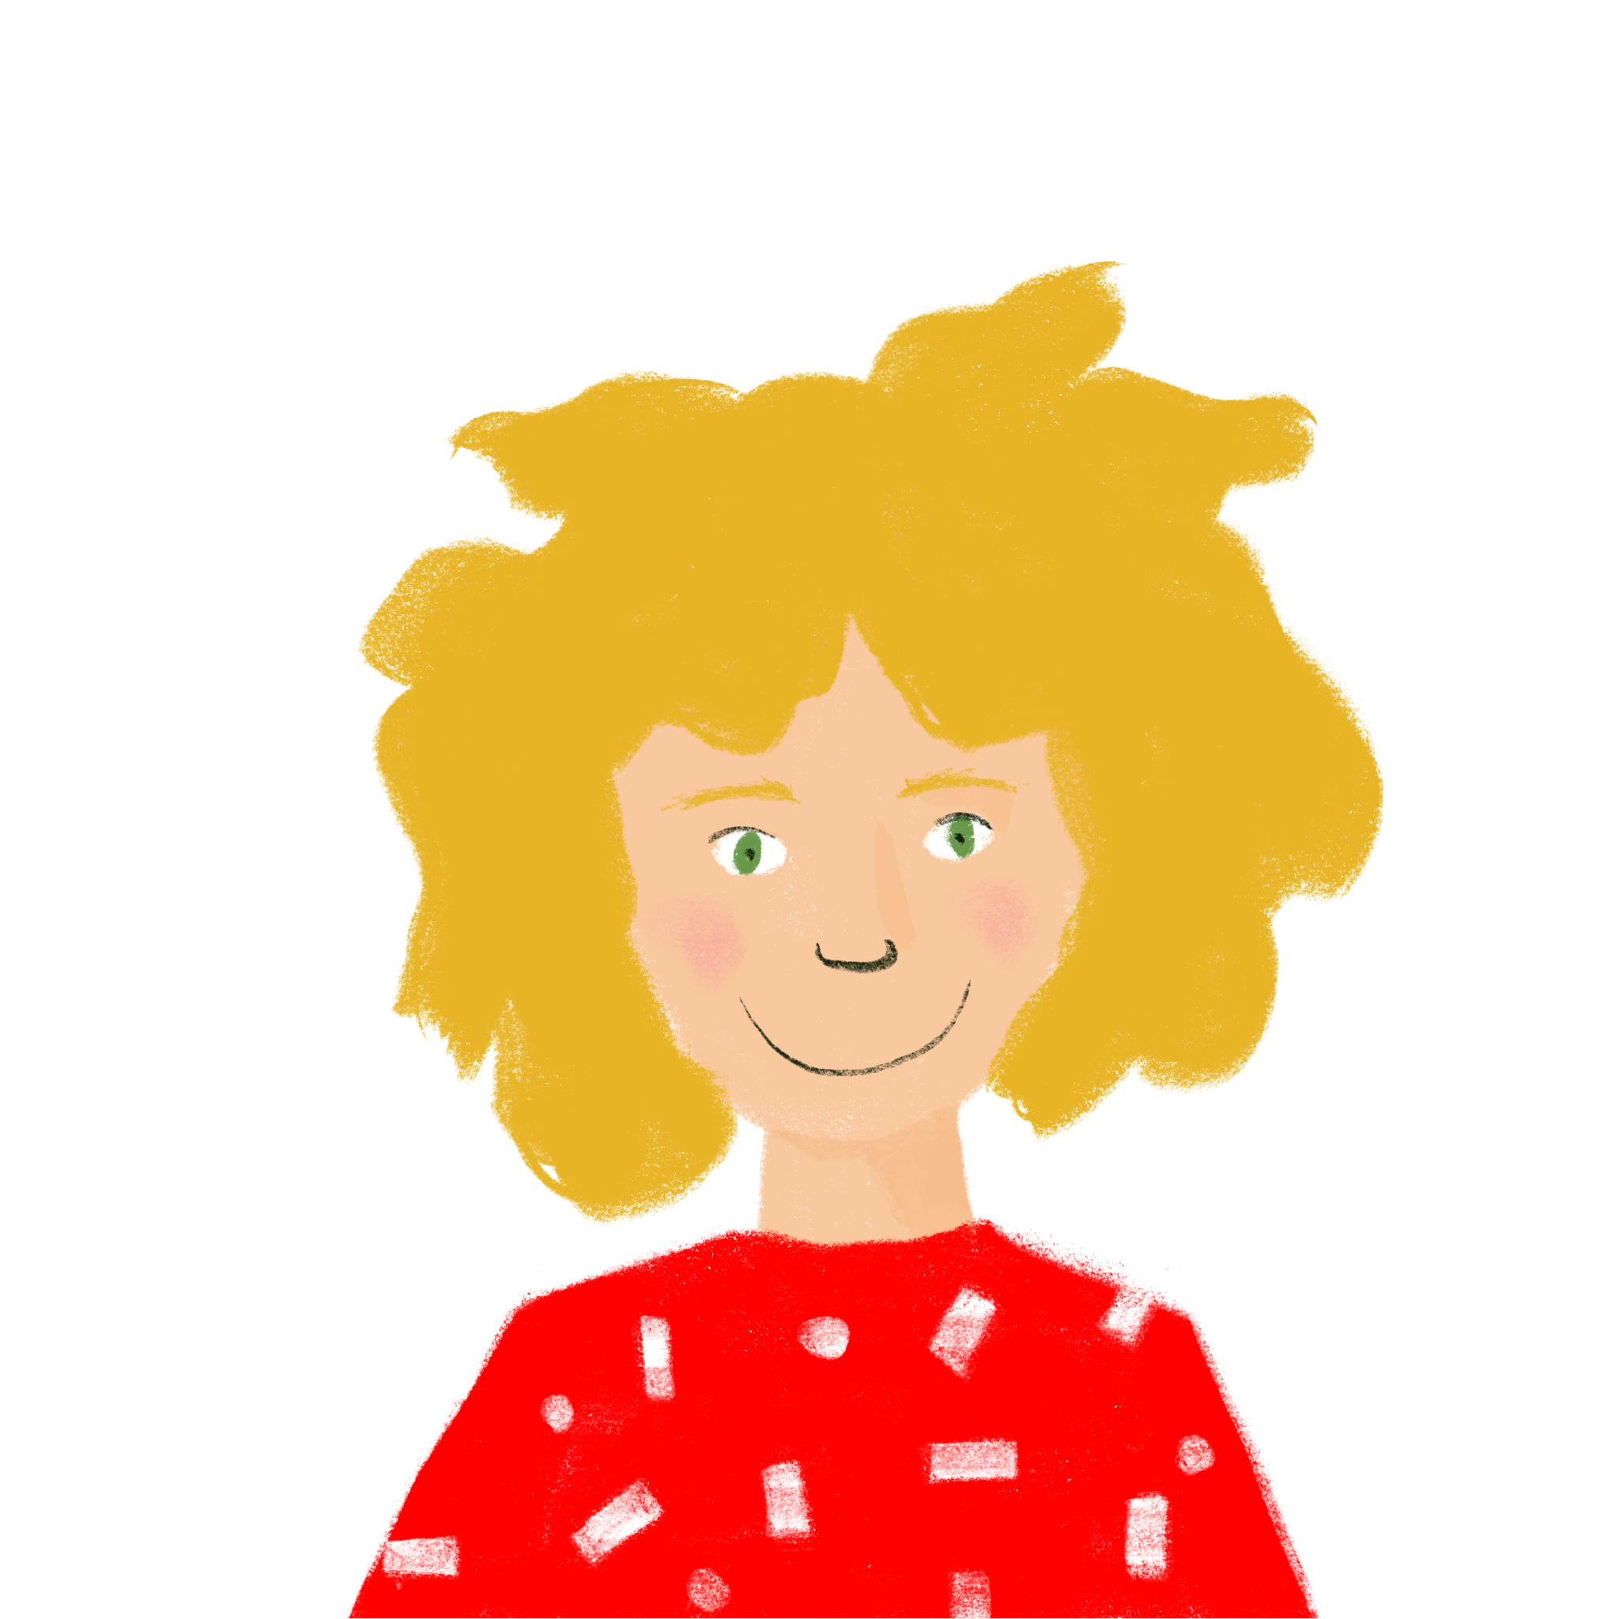
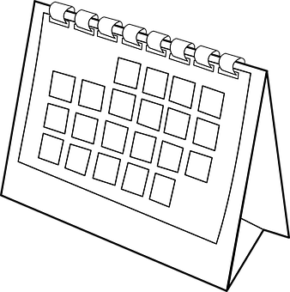
Le week-end de Léa
* l’habitude (f)
habit
parler 1/8
lire
La mère de Léa organise les activités de la famille. Que dit-elle? Écris en anglais.
vendredi (Friday)
samedi
dimanche (Sunday)
1. We are going to do homework.
1. Nous allons faire les devoirs.
2. Vous allez travailler, comme d’habitude.*
2. You (pl) are going to work as usual.
3. Nous allons voir chez un ami.
3. We are going to a friends’ place.
4. Vous allez rester à Paris.
4. You (pl) are going to stay in Paris.
5. Nous allons faire les magasins.
5. We are going to go shopping.
6. Nous allons faire la fête.
6. We are going to go to a party.
7. Vous allez cuisiner.
7. You (pl) are going to cook.
8. Vous allez lire un livre sur le monde politique.
8. You (pl) are going to watch a film.
9. Nous allons manger.
9. We are going to eat.
10. Nous allons dire au revoir.
10. We are going to say good-bye.
Notes:
Timing: 8 minutes
Aim: This slide provides reading practice in using pronouns nous and vous with the correct short form of aller to indicate future intention only, in preparation for the present vs future contrast in subsequent activities.
Procedure:
Students work through the sentences in pairs.
Teachers click to reveal the pronoun in each sentence.
Students then practise further the 2-verb structure of future intention with aller by translating into French. They may need some addition help with the phrase comme d’habitude. Ask them to use their knowledge of the words comme and de, together with the gloss given, to think of an equivalent English phrase.
Word frequency (1 is the most frequent word in French):
habitude [1221]
Source: Londsale, D., & Le Bras, Y. (2009). A Frequency Dictionary of French: Core vocabulary for learners London: Routledge.

Slide 19
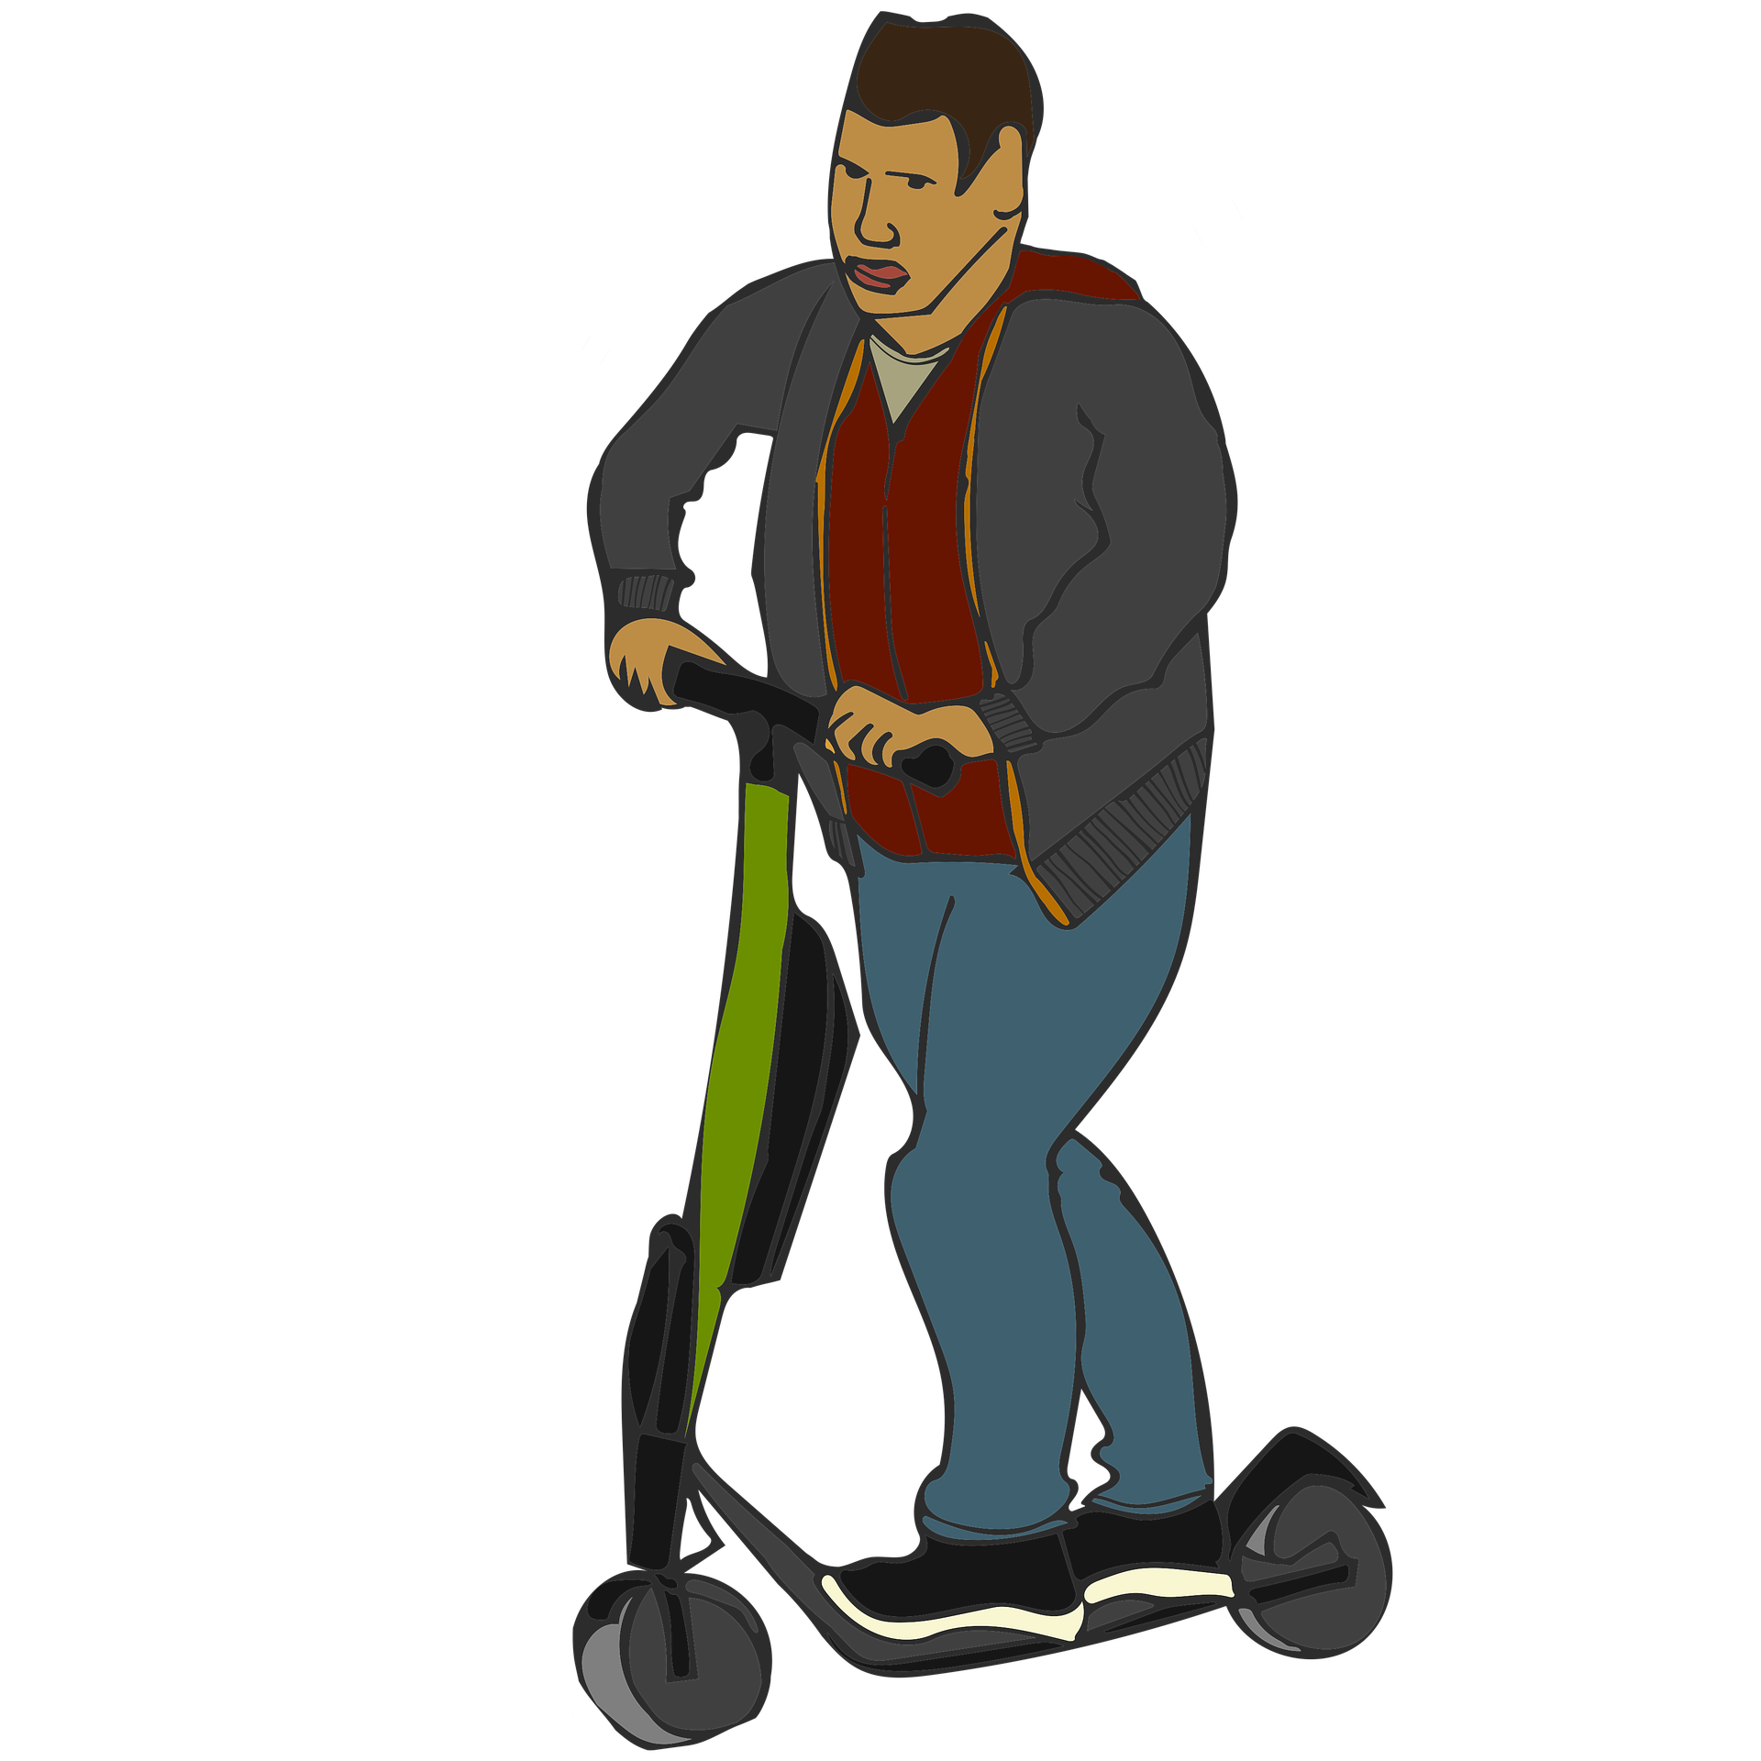
En ce moment ou bientôt ? (1/2)
écouter
Abdel sort à Alger avec des amis. La mère d’Abdel a des questions !
Écoute la conversation téléphonique. Les phrases sont-elles au présent ou au futur?
Abdel’s mum asks him ‘Are you going to the shops (now)? Vous allez dans les magasins She is not talking about the future, as there is no infinitive after Vous allez...
en ce moment
bientôt
1
vous allez aller
en ce moment
bientôt
2
en ce moment
bientôt
nous sommes
3
vous allez
en ce moment
bientôt
4
nous allons aller
en ce moment
bientôt
5
vous allez prendre
nous allons
bientôt
commencer
to begin
6
nous allons commencer
Notes:
Timing: 10 minutes for slides 15 and 16
Aim: To help students distinguish aurally between present tense and future intention with avoir in the nous and vous forms.
Procedure:
Check that students understand task instructions – they may need some help with unknown near-cognates concerner [324].
Remind students that it is the presence or absence of a form of aller followed (or not) by an infinitive that will give them the information they need.
Click to play audio.
Students decide, based on the verb form they hear, whether Abdel and his mother are talking about something that is happening now, or something that is happening soon.
Answers and a transcription of the relevant part of the sentence are revealed on clicks.
Transcript
1. Vous allez aller en ville?
2. Nous sommes en ville!
3. Ah bon ! Vous allez dans les magasins ?
4. Non, nous allons aller à la plage.
5. Super ! Vous allez prendre des photos!
6. Oui, nous allons commencer tôt.
Word frequency of cognates used (1 is the most frequent word in French): commencer [139], photo [1412]
Source: Londsale, D., & Le Bras, Y. (2009). A Frequency Dictionary of French: Core vocabulary for learners London: Routledge.

Slide 20
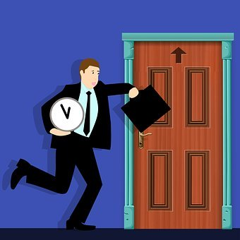
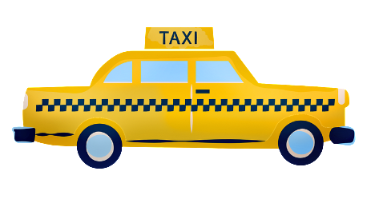
En ce moment ou bientôt ? (2/2)
écouter
La mère d’Abdel a encore des questions !
Écoute et coche.
7
en ce moment
bientôt
vous êtes
en ce moment
bientôt
8
en ce moment
bientôt
nous allons
9
vous allez
en ce moment
bientôt
10
nous allons
en ce moment
bientôt
11
vous allez arriver
nous allons
bientôt
12
nous allons prendre
Notes:
Timing: 10 minutes for slides 15 and 16
Aim: To help students distinguish aurally between present tense and future intention with aller in the nous and vous forms.
Procedure:
Check that students understand task instructions – they may need some help with unknown near-cognates concerner [324].
Remind students that it is the presence or absence of a form of aller followed (or not) by an infinitive that will give them the information they need.
Click to play audio.
Students decide based on the verb form they here whether Abdel and his mother are talking about something that is happening now, or something that is happening soon.
Answers and a transcription of the relevant part of the sentence are revealed on clicks.
Transcript
7. Vous êtes à la plage?
8. Non, nous allons à la plage.
9. Vous allez en voiture ?
10. Non, nous allons en train.
11. Vous allez arriver en retard!
12. C’est vrai, nous allons prendre un taxi.

Slide 21
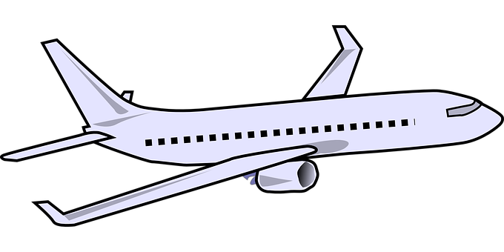
Les prochaines vacances
parler 1/8
écrire
Écris une phrase pour les activités des prochaines vacances.
1
soon
take
Bientôt, vous allez prendre l’avion.
next week-end
go
2
Le week-end prochain, nous allons aller en Allemagne.
3
speak
Nous allons parler allemand.
4
go out
next Saturday
Vous allez sortir samedi prochain.
5
eat
café
Vous allez manger au café.
Notes:
Timing: 5 minutes
Aim: To consolidate this week’s new vocabulary and grammar in written modality.
Procedure:
Click to reveal each number and prompt.
Students take 1 minute to write their sentence.
Click to reveal answers.
Possible extension: Students express future intentions about their own holiday in written or spoken modality

Slide 22
Asking about future intentions
aller + infinitive (ils/elles) in questions
SSC [j] / soft [g] [revisited]
Y7 French
Term 3.2 - Week 4 – Lesson 66
Adeline Charlton / Natalie Finlayson
Date updated: 09/07/21
Notes:
Artwork by Chloé Motard. All additional pictures selected are available under a Creative Commons license, no attribution required.
Learning outcomes (lesson 2)
Consolidating the use of aller plus the infinitive to express future intentions (je, tu, il/elle, nous and vous)
Introducing the use of aller plus the infinitive to express future intentions (ils/elles)
Introducing the use of aller plus the infinitive to express questions with future intention
Consolidation of SSC [j] / [soft g]
Word frequency (1 is the most frequent word in French): 3.2.4 (introduce) avion [1409], allemand^{1, 2} [844], lettre [480], différent [350], prochain [380], bientôt [1208], demain [871], Allemagne [n/a] 3.1.5 (revisit) café¹ [1886], cinéma [1623], plage [2693], rue [598], devant [198], derrière [805], entre [55]
2.2.5 (revisit) arriver [174], changer [283], créer [332], gagner¹ [258], habiter [1186], monde [77], pays [114], politique [128], vêtements [2383], à³[2], chez² [206], comme² [32]
The frequency rankings for words that occur in this PowerPoint which have been previously introduced in NCELP resources are given in the NCELP SOW and in the resources that first introduced and formally re-visited those words.
For any other words that occur incidentally in this PowerPoint, frequency rankings will be provided in the notes field wherever possible.

Slide 23
Phonétique
parler 1/8
lire / parler
Dis les noms.
Attention! C’est hard [g] ou [j]/soft [g] ?
Mon nom est …
1
Gérard
5
Gilles
9
Jacques
2
Gaelle
6
Julien
10
Jérôme
3
Angéline
7
Joséphine
11
Margaux
4
Agathe
8
Morgane
12
Georges
Notes:
Timing: 8 minutes
Aim: To raise awareness of [j]/soft [g] and hard [g] by using known spelling rules to pronounce these correctly in unknown vocabulary items.
Procedure:
1. Explain that these are popular French names that look like names students may recognise from English, but are pronounced differently.
2. Give students four minutes to work with a partner to decide how to pronounce [j] or [g], and to have a go at sounding out the names. All other SSCs in the words are either known or transferable from English, with the exception of the [ô] in Jérôme.
3. Click on the numbers to hear the names pronounced. The voices indicate whether the name is traditionally a male or female one. Students repeat chorally.
4. Now, teachers encourage students to read the names in increasing speed intervals (30 seconds, 20 seconds, 10 seconds … may vary according to the individual needs of the class) to work on fluency.
Transcript
1. Gérard
2. Gaelle
3. Angéline
4. Agathe
5. Gilles
6. Julien
7. Joséphine
8. Morgane
9. Jacques
10. Jérôme
11. Margaux
12. Georges

Slide 24
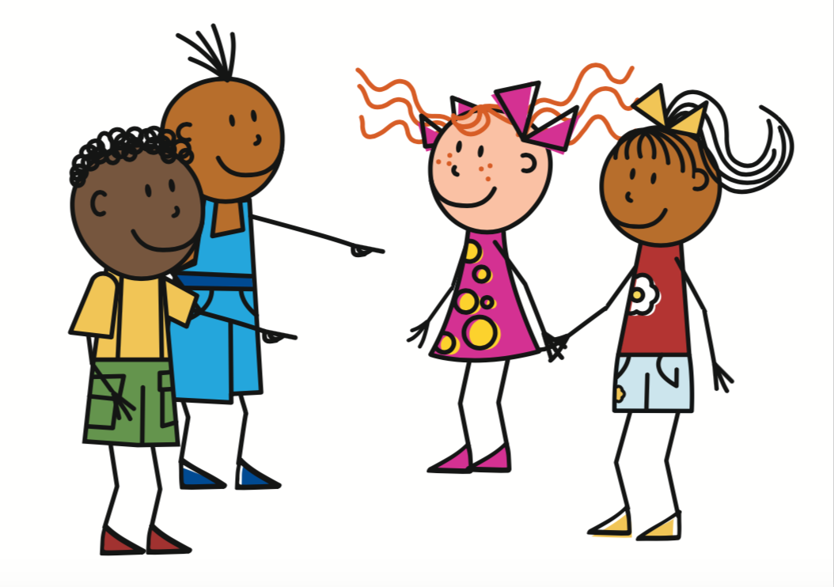
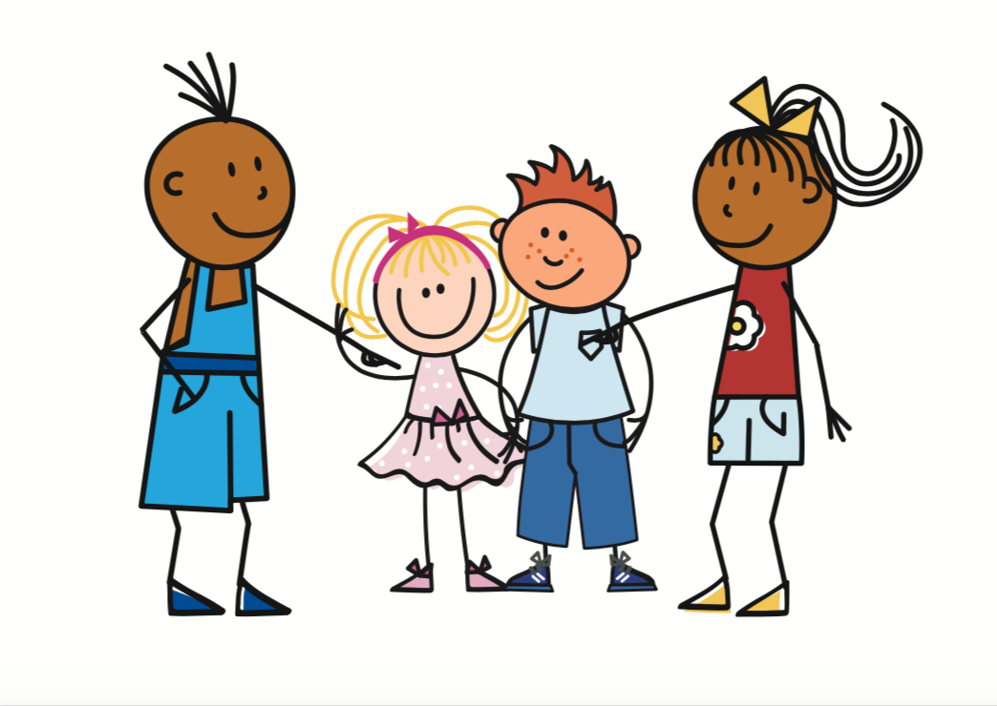
Future intention with aller (ils/elles)
grammaire
As you know, they means two things in French:
ils is also used for a Groupe with both female and male.
ils
elles
Vont is the short form for aller with ils / elles.
Elles vont partir.
__ _____ _______
They (f) are going to leave.
Ils vont partir.
They (m/f, m) are going to leave.
__ _____ _______
Notes:
Timing: 1 minute
Aim: This slide revisits the short form of aller plus the infinitive in the context of future intentions. Teachers briefly recap the short form of aller with ils/elles while also pointing out the French use of ils for mixed gender Groupes

Slide 25
En ce moment ou demain?
parler 1/8
écouter
C’est samedi! Léa et Sophie passent le week-end ensemble. Que font-ils en ce moment? Que font-elles demain? Écoute et coche.
 |  | en ce moment | demain
1
2
3
4
5
6
7
8
Notes:
Timing: 5 minutes
Aim: To help students distinguish aurally between present tense and future intention with aller in the ils/elles form.
Procedure:
Check that students understand task instructions.
Remind students that it is the presence or absence of a form of aller followed (or not) by an infinitive that will give them the information they need.
Click to play audio. The time phrase is obscured.
Students decide based on the verb form they hear whether Léa and Sophie are talking about something that is happening now, or something that is happening tomorrow.
Answers on the next slide.
Transcript
1. [Demain], Léa et Sophie vont aller en ville.
2. [En ce moment], elles restent à la maison.
3. [En ce moment], elles font la cuisine.
4. [Demain], elles vont prendre le déjeuner à la Brioche Dorée.
5. [Demain], elles vont lire des livres.
6. [En ce moment], elles regardent la télé.
7. [Demain], elles vont faire des exercises en anglais.
8. [En ce moment], elles font les devoirs de maths.

Slide 26
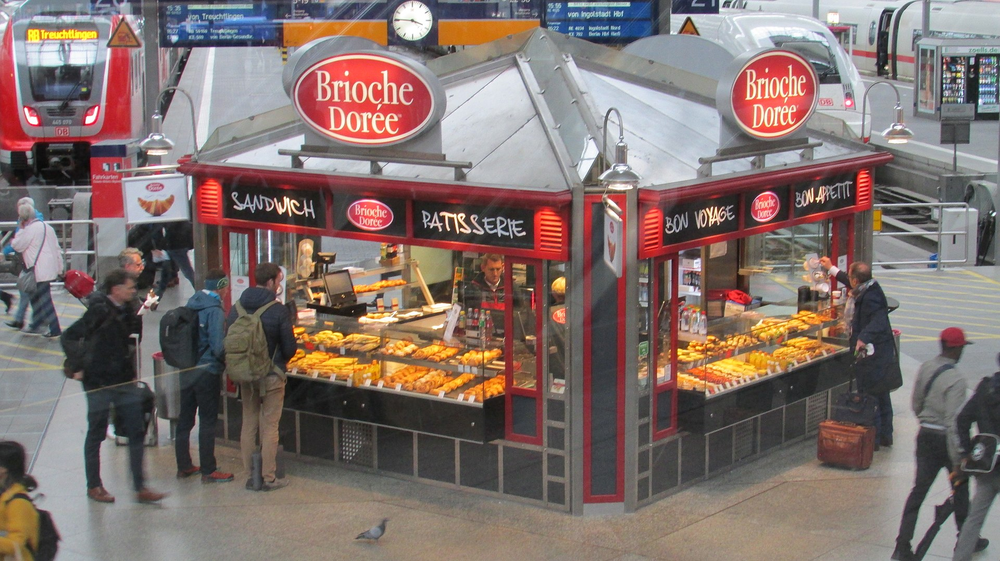
En ce moment ou demain?
parler 1/8
écouter
C’est samedi! Léa et Sophie passent le week-end ensemble. Que font-elles en ce moment? Que font-elles demain? Écoute et coche.
 |  | en ce moment | demain
 | vont aller
 | restent
 | font
 | vont prendre
 | vont lire
 | regardent
 | vont faire
 | font
1
La Brioche Dorée
2
3
4
5
C’est une chaîne française populaire. Elle propose des pâtisseries et des sandwichs.
6
7
8
Notes:
ANSWER SLIDE for activity on slide 20.
Full audio, including time phrases, plays on number clicks.
On a click, a transcription of the verb phrase first appears, which students can use to check their answers. On a second click, the answer appears.
Transcript
1. Demain, Léa et Sophie vont aller en ville.
2. En ce moment, elles restent à la maison.
3. En ce moment, elles font la cuisine.
4. Demain, elles vont prendre le déjeuner à la Brioche Dorée.
5. Demain, elles vont lire des livres.
6. En ce moment, elles regardent la télé.
7. Demain, elles vont faire des exercises en anglais.
8. En ce moment, elles font les devoirs de maths.
Word frequency (1 is the most frequent word in French): chaîne [1159], proposer [338], pâtisserie [>5000], sandwich [>5000]
Source: Londsale, D., & Le Bras, Y. (2009). A Frequency Dictionary of French: Core vocabulary for learners London: Routledge.

Slide 27
Questions about future intentions with aller
In an intonation question, the question word comes at the end.
In an inversion question, the question word comes at the start.
grammaire
Questions about future intentions follow the patterns you know for forming questions.
Yes/no question
intonation question
Ils vont venir?
Are they going to come?
with subject-verb swap
Vont-ils venir?
Only aller and the subject swap
Information question
intonation question
Ils vont arriver quand?
When are they going to arrive?
with subject-verb swap
Quand vont-ils arriver ?
Only aller and the subject swap
Notes:
Timing: 2 minutes
Aim: This slide revisits question formation and introduces it in the new context of future intentions. Teachers briefly recap the types of question formation studied so far, while also pointing out that with future intention, only the short form of aller and the subject/subject pronoun swap places when using the inversion type of question.

Slide 28
Le week-end prochain
lire
Que demande Stéphane? Écris les questions en anglais.
Stéphane: Bonjour Amir, vous allez passer le week-end avec qui?
Amir: Nous allons être en famille.
Stéphane: Vous allez faire quoi ensemble?
Amir: Mes parents, ils vont aller à la plage. Ma sœur et ma mère, elles vont aller dans un café.
Stéphane: Vous allez aller où ?
Amir: Nous allons venir devant le cinéma.
Stéphane: Vous allez voir un film ?
Amir: Non, nous allons aller dans les nouveaux magasins de vêtements dans la rue derrière le café, entre la poste et le cinéma.
Stéphane: Les magasins sont-ils ouverts?
Amir: Non. Ils vont ouvrir* la semaine prochaine.
1. Hello Amir, who are you going to spend the week-end with?
2. What are you going to do together?
3. Where are you going to go?
4. Are you going to watch a film ?
5. Are the shops open?
Notes:
Timing: 5 minutes
Aim: Comprehension practice with texts incorporating different kinds of question about future intention, all plural subject pronouns and revisited vocabulary sets.
Suggested procedure:
Students are given 5 minutes to read the text and translate questions. They have not yet met the irregular verb ouvrir, but should be encouraged to work out the meaning from their knowledge of the adjective ‘ouvert’, and the –ir verb ending which they have encountered in sortir, venir, dormir and partir.
Teachers click to reveal answers.
Word frequency (1 is the most frequent word in French): ouvrir [257]
Source: Londsale, D., & Le Bras, Y. (2009). A Frequency Dictionary of French: Core vocabulary for learners London: Routledge.

Slide 29
Le week-end prochain
lire
Que va faire Amir? Écris les réponses en anglais.
Stéphane: Bonjour Amir, vous allez passer le week-end avec qui?
Amir: Nous allons être en famille.
Stéphane: Vous allez faire quoi ensemble?
Amir: Mes parents, ils vont aller à la plage. Ma sœur et ma mère, elles vont aller dans un café.
Stéphane: Vous allez aller où ?
Amir: Nous allons venir devant le cinéma.
Stéphane: Vous allez voir un film ?
Amir: Non, nous allons aller dans les nouveaux magasins de vêtements dans la rue derrière le café, entre la poste et le cinéma.
Stéphane: Les magasins sont-ils ouverts?
Amir: Non. Ils vont ouvrir* la semaine prochaine.
1. What does Amir say about plans for the beach?
His parents are going to the beach.
2. What does Amir say about his mother and sister’s plans?
They are going to go to a café.
3. Where exactly are the shops?
The shops are behind the café, between the post office and the cinema.
4. What else does Amir say about the shops?
The shops are going to open next week.
Notes:
Timing: 5 minutes
Aim: Further comprehension practice with texts incorporating different kinds of question about future intention, all plural subject pronouns and revisited vocabulary sets.
Suggested procedure:
Students are given 5 minutes to read the text and answer questions.
Teachers click to reveal answers

Slide 30
Questions sur l’avenir
écrire
Change les phrases en questions ‘yes’ / ‘no’. Écris 2 questions pour chaque phrase.
 | Raised intonation | Subject-verb swap
1.
2.
3.
4.
5.
6.
Ils vont habiter dans un pays différent?
Vont-ils habiter dans un pays différent?
Ils vont habiter dans un pays différent.
Elles vont gagner un voyage?
Vont-elles gagner un voyage?
Elles vont gagner un voyage.
Ils vont aller en Allemagne.
Ils vont aller en Allemagne?
Vont-ils aller en Allemagne?
Elles vont partir samedi prochain?
Vont-elles partir samedi prochain?
Elles vont partir samedi prochain.
Ils vont créer des vêtements?
Vont-ils créer des vêtements?
Ils vont créer des vêtements.
Elles vont étudier la politique?
Vont-elles étudier la politique?
Elles vont étudier la politique.
Notes:
Timing: 10 minutes
Aim: To practise yes/no question formation with future intention.
Procedure:
1. Remind students of the two types of yes/no question (raised intonation, subject-verb inversion).
2. Students turn statements into questions.
3. Teachers display the answers and clicks - left column = intonation question; right column = inversion question
4. Teachers check/point out the swapping of form of aller only in the inversion questions.

Slide 31
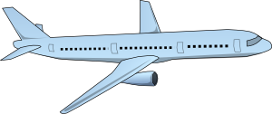
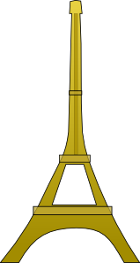
Questions sur l’avenir
écrire
Écris les questions en français.
1
Where are they (f, m) going to live?
Ils vont habiter où?
Où vont-ils habiter?
2
How are they (f) going to go to Paris?
Elles vont aller à Paris comment?
Comment vont-elles aller à Paris?
3
When are they (m) going to arrive in Paris ?
Ils vont arriver quand à Paris?
Quand vont-ils arriver à Paris?
4
What are they (f, m) going to do in France?
Ils vont faire quoi en France?
Que vont-ils faire en France?
Notes:
Timing: 5 minutes
Aim: To practise information question formation with future intention.
Procedure:
1. Remind students of the two types of information question (raised intonation + question word at end; question word + subject-verb inversion).
2. Students turn statements into questions.
3. Teachers display the answers and clicks - left = intonation question; right = inversion question
4. Teachers check/point out the swapping of form of aller only with pronoun in the inversion questions.

Slide 32
Aujourd’hui ou le week-end?
parler / écrire
Et vous? Que faites-vous aujourd’hui? Qu’allez-vous faire le week-end? Travaillez en paires !
Et tes amis? Que font-ils aujourd’hui? Que vont-ils faire le week-end? Parlez et écrivez les activités dans les colonnes correctes !
nous
aujourd’hui | demain
1. Nous faisons les devoirs. 2. 3. | 1. Nous allons faire une promenade. 2. 3.
ils/elles
aujourd’hui | demain
1. Ils … 2. 3. | 1. Ils vont … 2. 3.
Notes:
Timing: 10 minutes
Aim: To practice oral production and comprehension of personalised statements about the present and the future
Procedure
Students sketch out a table following the model on the slide, and work in pairs to write three present tense sentences about what they did today, and three sentences with future intention about what they are doing at the weekend. Teacher circulates and corrects.
Click to reveal the second set of task instructions. Students sketch out a second table following the model.
Working with another pair, students take it in turns to read the six statements they have written in a random order. To ensure the order is random, teachers can distribute the role cards on slide 30, which tell students the order in which to read their statements. The listening pair notes down the activities in the appropriate column. Students must not say the words demain or aujourd’hui! Remind them that the verb form tells us whether events are happening today or tomorrow.
Students check with the other Groupe to ensure they have written the words in the correct columns.
Students turn their notes into full sentences with ils/elles.
Teacher can elicit some oral answers from stronger pairs by asking e.g. ‘Que font Andrew et Louise aujourd’hui? Que vont faire Sarah et Richard le week-end?’

Slide 33
Aujourd’hui ou le week-end?
parler / écrire
Groupe 1
demain 1
demain 2
aujourd’hui 1
demain 3
aujourd’hui 2
aujourd’hui 3
Groupe 1
demain 1
demain 2
aujourd’hui 1
demain 3
aujourd’hui 2
aujourd’hui 3
Groupe 1
demain 1
demain 2
aujourd’hui 1
demain 3
aujourd’hui 2
aujourd’hui 3
Groupe 1
demain 1
demain 2
aujourd’hui 1
demain 3
aujourd’hui 2
aujourd’hui 3
Groupe 1
demain 1
demain 2
aujourd’hui 1
demain 3
aujourd’hui 2
aujourd’hui 3
Groupe 1
demain 1
demain 2
aujourd’hui 1
demain 3
aujourd’hui 2
aujourd’hui 3
Groupe 2
demain 1
aujourd’hui 1
aujourd’hui 2
demain 2
demain 3
aujourd’hui 3
Groupe 2
demain 1
aujourd’hui 1
aujourd’hui 2
demain 2
demain 3
aujourd’hui 3
Groupe 2
demain 1
aujourd’hui 1
aujourd’hui 2
demain 2
demain 3
aujourd’hui 3
Groupe 2
demain 1
aujourd’hui 1
aujourd’hui 2
demain 2
demain 3
aujourd’hui 3
Groupe 2
demain 1
aujourd’hui 1
aujourd’hui 2
demain 2
demain 3
aujourd’hui 3
Groupe 2
demain 1
aujourd’hui 1
aujourd’hui 2
demain 2
demain 3
aujourd’hui 3
Notes:
Role cards to accompany the activity on slide 28.

Slide 34
En ce moment ou la semaine prochaine?
parler 1/8
écouter
Abel parle avec Amir et Noura. Ils planifient les vacances. Que dit-il? Qui fait quoi et quand?
qui?
quand?
Abdel et des amis (nous) | Amir et Noura (vous) | Les parents (ils)
en ce moment | la semaine prochaine
1
2
3
4
5
6
Notes:
Timing: 5 minutes (optional extra for advanced levels)
Aim: This advanced double referential listening activity contrasts present tense and future intention with aller with all three plural persons (nous, vous and ils/elles). It is suitable for use with more advanced groups
Procedure:
Check that students understand task instructions.
Remind students that it is the presence or absence of a form of aller followed (or not) by an infinitive and the form of the first verb they hear that will give them the information they need.
Click to play audio. The subject pronouns are obscured.
Students decide based on the verb form they hear whether Abdel is talking a) about himself and his friends, about Amir and Noura or about his parents; b) something that is happening now, or something that is happening next week.
Answers on the next slide.
Frequency rankings of unknown cognates used (1 is the most frequent word in French): discuter [737]
Source: Londsale, D., & Le Bras, Y. (2009). A Frequency Dictionary of French: Core vocabulary for learners London: Routledge.
Transcript
1. [Mes parents] vont à l’hotel.
2. [Nous] allons au café en ville.
3. [Mes parents] vont faire le tour d’Allemagne.
4. [Vous] allez aller à Alger.
5. [Nous] allons regarder le match à la télé.
6. [Vous] allez à l’aéroport.

Slide 35
En ce moment ou la semaine prochaine?
parler 1/8
écouter
Abel parle avec Amir et Noura. Ils planifient les vacances. Que dit-il? Qui fait quoi et quand?
qui?
quand?
Abel et des amis (nous) | Amir et Noura (vous) | Les parents (ils)
en ce moment | la semaine prochaine
1
2
3
4
5
6
Notes:
ANSWER SLIDE for activity on slide 30.
Full audio, including time phrases, plays on number clicks.
Answers appear on clicks.
Transcript
1. Mes parents vont à l’hotel.
2. Nous allons au café en ville.
3. Mes parents vont faire le tour d’Allemagne.
4. Vous allez aller à Alger.
5. Nous allons regarder le match à la télé.
6. Vous allez à l’aéroport.

Slide 36
Gaming Grammar
Gaming Grammar
Relevant mini game(s):
Verbs (present): 1st person singular/plural (Verb agreement (present))
Verbs (present): 2nd person singular/plural (Verb agreement (present))
Verbs (present): 3rd person singular/plural (Verb agreement (present))
Questions: subject-verb inversion (Question formation)
Notes:
This slide links to Gaming Grammar login screen. The appropriate mission can then be selected from the menu page.
Students will progress through the game at their own rate; teachers should use the teacher interface to check progress. This will help to inform future lesson planning.

Slide 37
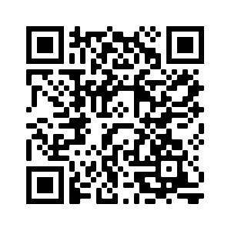
Devoirs
Vocabulary Learning Homework (Term 3.2, Week 5)
Audio file
Audio file QR code:
Student worksheet
Quizlet link
In addition, revisit: Term 3.1 Week 6
Term 3.1 Week 1

