Slide 1
Phonics
Half-day CPD session

Slide 2
Session outline
Quick recap of what we covered in the residential
Key take home messages
Pre-empting Hub teachers’ concerns
Recap of rationale for teaching Phonics
Practicalities:
Which SSC to teach and in what order
Look at some more approaches to teaching Phonics
Assessing and monitoring progress
Planning and preparing for the TRG
Comments / questions on the Phonics articles
Conclusions and next steps
Robert Woore

Slide 3
1. /ə kwɪk ˈɹiːkap/
For you, what were the key points to emerge in relation to Phonics at the residential?
Did you leave the residential with any particular questions about Phonics in MFL?
Robert Woore

Slide 4
/ˈfiːdbak fɹəm ɹɛzɪˈdɛnʃəl - ˈwɪʃlɪst/
A list of target graphemes for each of 3 languages
Idea about order and frequency of phonics teaching
More examples of resources to teach it
Bank of sentences that could be used to test different sounds
How to assess and track phonics knowledge development
Ideas for how phonics teaching continues beyond beginner level
Elaborate the principles of resource design – I am keen to be producing resources within a guided framework
Feedback on any resources we have produced so far
Recommendations for resources to be looking at prior to the next phonics session
How to ‘sell it’ to hub schools and colleagues
→ We’ll try to address these points in today’s session!
Robert Woore

Slide 5
/kiː tɛɪk həʊm ˈmɛsɪdʒəz/ – Phonics for Y7-Y9
(TSC Review, 2016)
Plan and teach it, as it seems to help a LOT of things
Keep going with it (especially French)
Keep testing it (especially French)
Any reflections on these ‘key messages’?
In relation to these points, what does current practice look like in your hub schools?
What are likely to be the main opportunities and threats?
Robert Woore

Slide 6
/ɹaʃəˈnɑːl fə ˈtiːtʃɪŋ ˈfɒnɪks/
Pre-empting some possible objections and concerns
What kinds of objections or concerns might Hub teachers raise?
How would you respond?
I think it will confuse my lower attaining learners.
There’s no point teaching Phonics. They will pick it up on their own.
I can see the point in Spanish and German, but in French it is too complicated.
Ideally, I would like to teach this, but there is no time in the Scheme of Work.
My students would find this boring or babyish.
This is not my priority – my students are already OK at reading. The other skills are more important to focus on.
Robert Woore

Slide 7
Rationale for teaching phonics
Research evidence: findings and gaps
Research (mainly L2 French) suggests:
Poor decoding, and limited progress, if not taught.
Learners tend to get stuck on ‘read it as if it’s English’
Some learners try to move beyond this, but lack knowledge to decode more accurately
Phonics can be taught successfully in French – but it’s not quick or easy!
Teaching Phonics must be sustained
The benefits of accurate L2 decoding go beyond reading comprehension and include a range of areas
Particular benefits for vocabulary learning and learner autonomy
No detriment for other areas of MFL learning
More research is needed into:
Learners’ progress in decoding other L2s besides French
The most effective teaching approaches – e.g. synthetic versus analytic
Whether different approaches are more effective for different groups of learners and for different languages.
Robert Woore

Slide 8
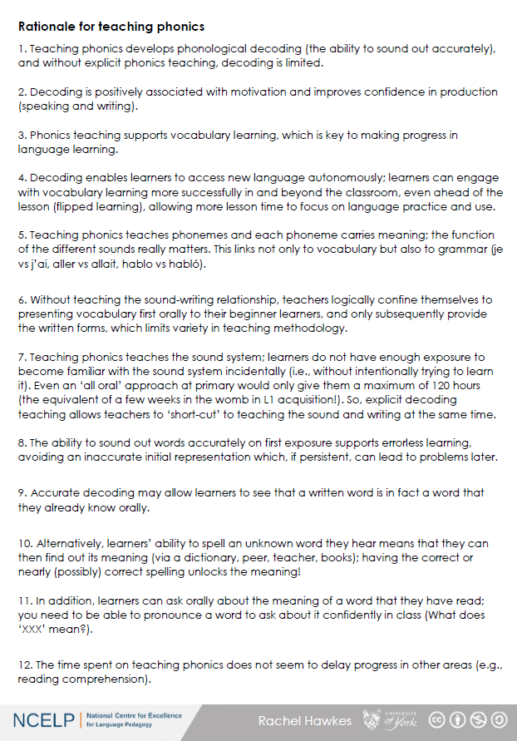
Rationale for teaching
Now read through ‘Handout 6: Rationale for teaching phonics’
This is a key document to use with your Hub Schools
Any questions about the points raised in this document?
Robert Woore

Slide 9
/pɹaktɪˈkalɪtiz/ (1): choice and order of SSC
Which SSC (Sound-Symbol Correspondences) should we teach?
Why are we using the term ‘SSC’ rather than the more widely used ‘GPC’ (grapheme-phoneme correspondences’?
→ Larger ‘grain sizes’ (orthographic units) may sometimes be more helpful than individual GPC. For example, in French:
-eur
-aine
-aille
-er
-tion
-ille
-ez
-sion
-euille
-ail
-ine
Robert Woore

Slide 10
Choice of target SSC
We lack clear research evidence on which SSC are the most important to teach, and in what order
We have based our selection on a ‘bang for buck’ principle, drawing on evidence concerning:
Difficulty – how hard is it for students to decode the SSC accurately
Frequency – how often the SSC occur in the language
Teacher expertise and judgment
We have also adopted a ‘cumulative’ principle in ordering sounds and their ‘source words’
We have made a ‘working selection’ – this may be refined over time (with help from your feedback)

Slide 11
SSC Difficulty
In your experience, which are the most difficult French SSC for students to pronounce (i.e. which do they get wrong most often)?
How do your intuitions match the following empirical data?
Robert Woore

Slide 12
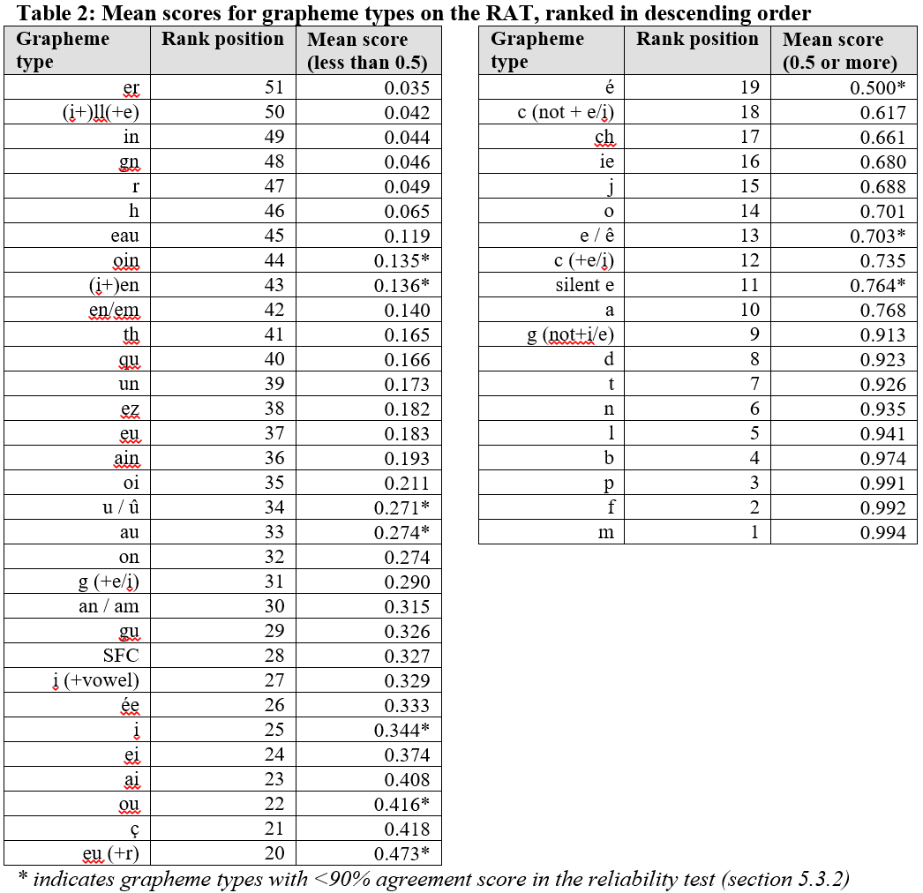
Data from Woore (2006)
N=188 Year 7 and Year 9
One comprehensive school
English L1
Robert Woore

Slide 13
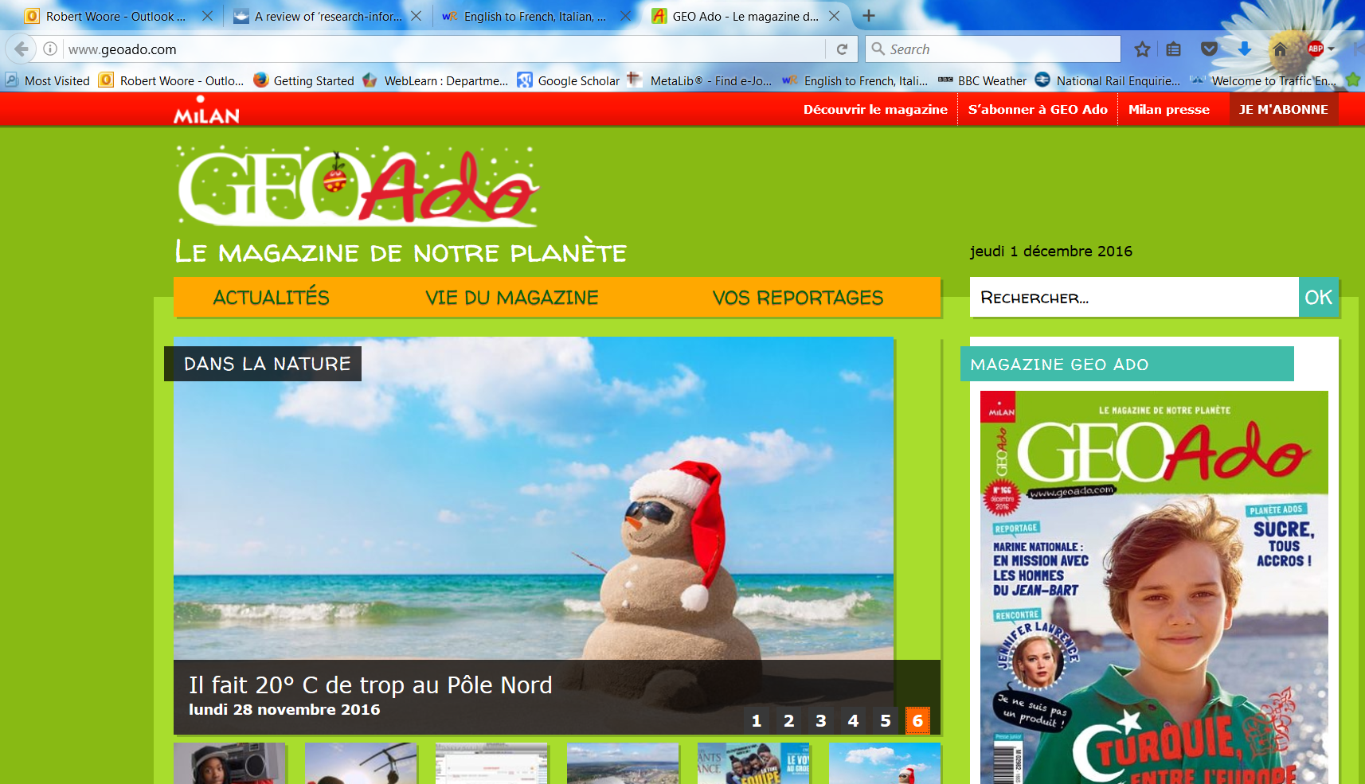
SSC frequency
Analysis of two small corpora:
first 200 words of six ‘featured texts’ from an on-line magazine for French young people (www.geoado.com)
Analysis of words in Dynamo 1 Module 1
Robert Woore

Slide 14
SFC(all) | 339 | SFCt | 76 | tion | 24 | o[O] | 12 | ph | 4 | aî | 1
r | 302 | en | 73 | ll[L] | 22 | h | 11 | x[KS] | 4 | aill | 1
a | 245 | c[+i/e] | 61 | est | 19 | mm | 11 | e[e] | 3 | am | 1
d | 240 | ou | 60 | in | 19 | om | 11 | eau | 3 | aon | 1
SFCs | 235 | an | 59 | oi | 19 | em | 10 | ei | 3 | cc[+i/e] | 1
l | 228 | e[O] | 58 | è | 18 | SFCd | 10 | gu | 3 | eil | 1
i | 221 | es | 58 | nn | 17 | ent[3PV] | 9 | SFCp | 3 | œu | 1
SFe | 219 | on | 57 | ss | 17 | j | 9 | x[GZ] | 3 | oy | 1
t | 167 | f | 43 | à | 16 | tt | 9 | z | 3 | s[finalSOUNDED] | 1
p | 164 | qu | 43 | ch | 16 | ê | 7 | eill | 2 | SFCc | 1
e[SCHWA] | 143 | SMe | 40 | u[G] | 16 | rr | 7 | ein | 2 | th | 1
m | 117 | i[G] | 39 | un | 16 | ain | 6 | ez | 2 | tielle | 1
s | 117 | b | 38 | ée | 15 | ç | 5 | im | 2 | tien | 1
o[C] | 114 | s[IV] | 38 | eur | 15 | ff | 5 | ô | 2 | y[CONS] | 1
é | 113 | ai | 35 | g | 15 | ien | 5 | oin | 2
u | 96 | et | 30 | y | 15 | ay | 4 | pp | 2
n | 94 | g[+i/e] | 29 | eu | 14 | cc | 4 | tio | 2 | 4393 graphemes
c | 86 | au | 27 | SFCx | 14 | gn | 4 | um[NN] | 2
v | 79 | er | 24 | ie | 13 | ill[Y] | 4 | â | 1
Robert Woore

Slide 15
 | Totals Dynamo | Total Géoado | Dynamo ranking | Géoado ranking
SFC | 60 | 339 | 1 | 1
a / à / â / as | 51 | 262 | 2 | 2
i / ie / y | 42 | 249 | 4 | 3
SFe | 45 | 219 | 3 | 4
e / eu / oeu | 34 | 179 | 6 | 5
é/ et / ez / er / les | 37 | 152 | 5 | 6
en / em / an | 25 | 151 | 7 | 7
o /eau(x) / au(x) | 20 | 141 | 8 | 8
u | 20 | 112 | 8 | 9
on | 9 | 57 | 11 | 11
ou | 7 | 60 | 15 | 10
-in / -ain / ym | 9 | 27 | 11 | 14
è / ê | 9 | 25 | 11 | 15
qu / q | 7 | 43 | 15 | 12
oi | 9 | 21 | 11 | 17
un /um | 10 | 18 | 10 | 18
j / g (soft) | 4 | 38 | 17 | 13
-tion | 0 | 24 | 21 | 16
ch | 3 | 16 | 18 | 19
ç | 3 | 5 | 18 | 20
-ien | 1 | 5 | 20 | 20
Robert Woore

Slide 16
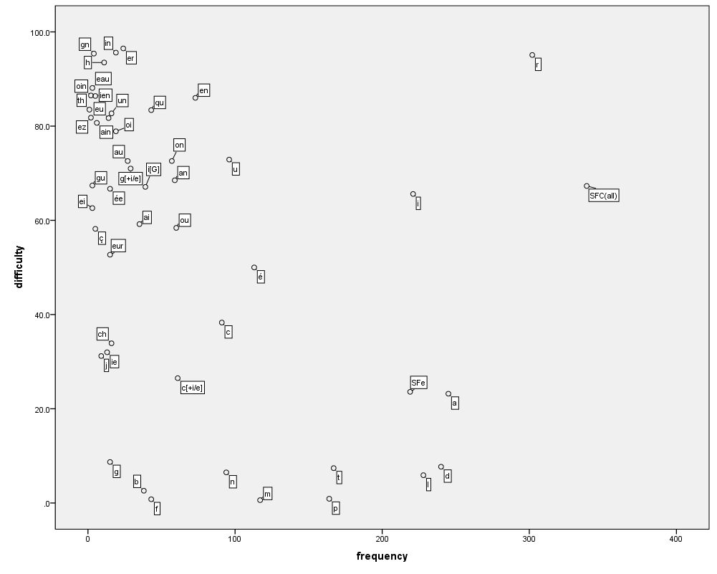
Robert Woore

Slide 17
Target SSC in French
Teaching order | Frequency order | SSC | Teaching order | Frequency order | SSC
1 | 1 | SFC | 13 | 12 | -in / -ain
2 | 2 | a | 14 | 13 | è / ê
3 | 3 | i | 15 | 13 | ai (ais / ait)
4 | 5 | eu | 16 | 15 | oi
5 | 5 | e | 17 | 19 | ch
6 | 8 | o /eau / au | 18 | 20 | ç (and soft -c)
7 | 9 | u | 19 | 14 | qu
8 | 11 | ou | 20 | 17 | j
9 | 4 | SFe | 21 | 18 | -tion
10 | 6 | é | 22 | 21 | -ien
11 | 7 | en / an | 23 | 16 | un
12 | 10 | on
Robert Woore

Slide 18
Target SSC In German
Teaching order | SSC | IPA
Group 1 | a (long), a (short) e (long), e (short) ei w z | /a:/ /a/ /e:/ /ɛ/ /ai/ /v/ /ts/
Group 2 | i (long), i (short) ie ch sch | /i:/ /ɪ/ /i:/ /ç/ /x/ /ʃ/
Group 3 | o (long), o (short) u (long), u (short) | /o:/ /ɔ/ /u:/ /ʊ/
Group 4 | er (stressed) er (unstressed) r (vocalic), r (consonantal) v | /eːɐ/ /ɐ/ /ɐ/ /r/ /f/
Teaching order | SSC | IPA
Group 5 | s (start/middle) ss / ß / -s | /z/ /s/
Group 6 | ü (long), ü (short) ö (long), ö (short) ä (long), ä (short) | /y:/ /ʏ/ /ø:/ /ø/ /ɛ:/ /ɛ/
Group 7 | au eu äu | /au/ /ɔɪ/ /ɔɪ/
Group 8 | -d -ig st-, sp- j th | /t/ /ç/ /ʃt/ /ʃp/ /j/ /t/
1) The long vowels a,e,i,o,u in German are less straightforward than the short vowels. They are presented together for contrast purposes. Later they can be contrasted with the trickier ä, ö, ü. 2) Likewise the ‘er’ unstressed sound is very similar to the –er at the end of ‘mother’, but the ‘er’ stressed is a rather different sound, so the two are presented together. 3) A tentative, suggested time frame might be to spend 10-12 minutes each lesson on phonics. So, for example, a / e would be lesson 1, ei/w/z in lesson 2. The following week would revisit all of these, before starting in Week 3 with Group 2. This would put the initial introduction and practice phase at 16 weeks, just over one term. After that, specific contrasts would be practised regularly: u/ü, o/ö, a,ä, ei/ie, z/s-, sch/st/sp, v/w and sch/ch, as well as other tasks that combine several SSCs. This would run over the spring term. The summer term of Y1 would continue to develop and apply SSC knowledge, including through the use of more extended, authentic texts. 4) Diagnostic assessment of pupils’ development would also inform the re-visiting of specifically challenging SSCs.
Robert Woore

Slide 19
Target SSC in Spanish
Teaching order | SSC
Group 1 vocales | a e i o u
Group 2 LL/L * | ll vs l
Group 3 C/Z *** | ca, co, cu vs ce, ci, z
Group 4 | que, qui
Teaching order | SSC
Group 5 | ga, go, gu vs j, ge, gi (gue, gui)
Group 6* | n vs ñ
Group 7** | v, b
Group 8* | rr vs r
Group 9 | h
1) Spanish is clearly a much shallower language, phonetically. The pace of introduction and practice is likely to be somewhat quicker than in French, as a result. 2) * Note that some straightforward SSCs are introduced, predominantly to contrast with other less straightforward ones (ll/l, n/ñ, r/rr). 3) ** B is presented with V because these are the same sound – different spelling pair. 4) A tentative, suggested time frame for teaching might be to spend 10-12 minutes each lesson on phonics. So, for example, each group would be introduced and practised in lesson 1, and further practised in lesson 2. In week 2, we would present and practise group 2. After that, specific contrasts would be practised regularly, as well as other tasks that combine several SSCs. This fairly controlled introduction/practice would probably run until the end of the spring term. The summer term of Y1 would continue to develop and apply SSC knowledge, including through the use of more extended and richer texts. 5) Diagnostic assessment of pupils’ development would also inform the re-visiting of specifically challenging SSCs.
6) Seseo / ceceo. Whether the ce / ci/ z are pronounced seseo (e.g., as in Latin America/the Canary Islands) or ceceo (e.g., as in most parts of Spain) does not make a difference to meaning or to the SSCs, but learners should be exposed to and understand both versions at later stages. Given GCSE requirements, ‘ceceo’ is probably the most sensible starting point.
Robert Woore

Slide 20
Target SSC in other languages
In any other languages you teach: what do you consider to be the key SSC to teach, and why?
What information (if any) would you need in order to feel more confident in this decision?
Robert Woore

Slide 21
Teaching approaches & resources
What approaches / resources are you currently using to teach phonics in MFL?
What do you consider to be their strengths / limitations?
Robert Woore

Slide 22
Teaching approaches & resources
https://resources.ncelp.org
Awareness raising
Introducing new SSC
Consolidating SSC knowledge
Applying SSC knowledge
Browse the NCELP Phonics resources on the portal
What do you think are the key strengths / limitations of these resources?
Which do you think are the key resources you could use?
What changes (if any) might be needed?
Robert Woore

Slide 23
/pɹaktɪˈkalɪtiz/ (3): Assessing & monitoring progress
What approaches / resources are you currently using to assess your students’ Phonics knowledge (phonological decoding) in MFL?
What do you consider to be their strengths / limitations?
Robert Woore

Slide 24
Assessing & monitoring progress
Two main approaches:
Reading aloud
Pen-and-paper test
Greater validity: direct measure of the construct we are interested in
Time consuming to administer and mark
Quicker and easier to administer and mark
Difficult to create valid tests of this kind
Cf. Year 1 Phonics Screening Check in English primary schools
Beware pitfalls of reading aloud. How can this be handled sensitively?
E.g. individual work with teacher; paired reading; self-recording (homework)
Robert Woore

Slide 25
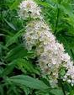
Assessing & monitoring progress
Two main classes of item:
Familiar real words
Pseudowords
Unfamiliar real words
< chat >
< ulmaire >
Familiar words: students may have pre-stored phonological forms which they can access as wholes.
Unfamiliar words / pseudowords: students have to generate the phonological forms by applying SSC knowledge.
To test SSC knowledge, tests need to include unfamiliar items
Decontextualized (isolated) words: this prevents the use of context to identify words, and therefore isolate decoding skills
Phonological decoding (reading aloud) of flowing text is also important!
Robert Woore

Slide 26
Woore (2018)
Familiar versus unfamiliar words
<pain> - /pæ̃/
<chat> /ʃa/
p < .001, d = 0.33
<grain> - /ɡɹɛɪn/.
<fat> - /fat/
Robert Woore
Notes:
…even though (a) spelling bodies used as unit of analysis and (b) these were identical across the two groups of words
Consistent with idea of different ‘routes’ to decoding the items

Slide 27
Assessing & monitoring progress
Consider sample tests provided by NCELP (more will follow)
(How) could you use these tests?
What changes (if any) might be needed?
How could you use the test results to inform teaching and learning?
Robert Woore

Slide 28
/dɪˈvɛləpɪŋ ɡʊd ˈpraktɪs/ in hub schools
Reflection. In your view, in your Hub schools:
What are some of the key opportunities and threats of integrating Phonics teaching?
How might you respond to these opportunities and threats?
Opportunities | → Maximizing opportunities
Challenges | → Addressing challenges
Robert Woore

Slide 29
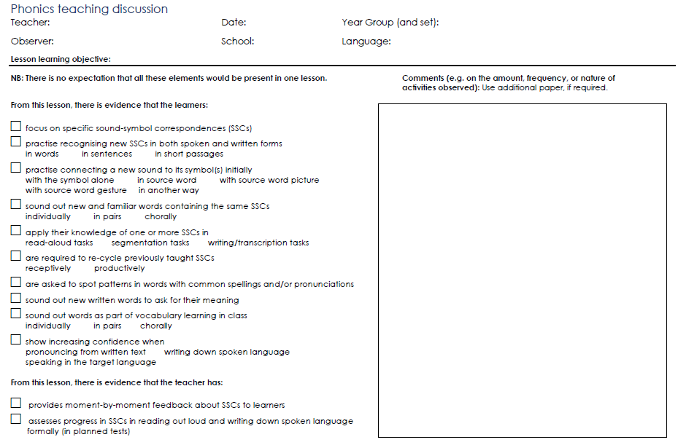
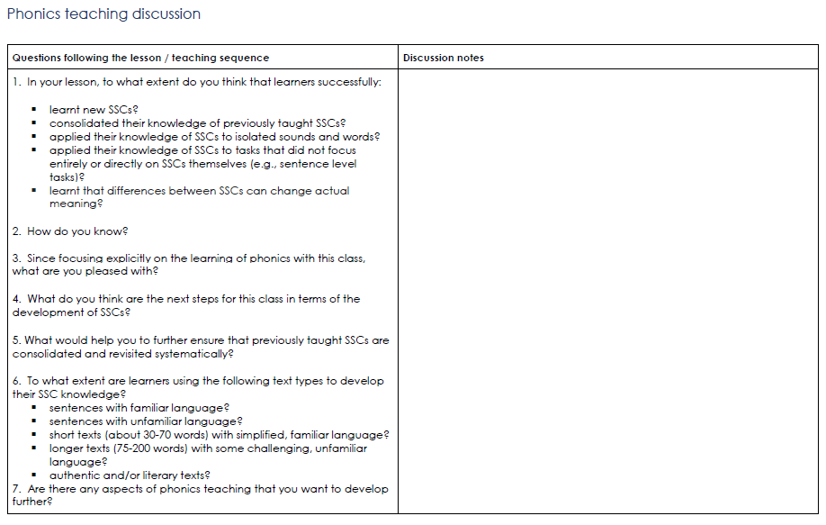
Developing good practice in school hubs
Phonics teaching discussion proforma: principles and use
Robert Woore

Slide 30
/ˈplanɪŋ əˈhɛd/ for the TRG
Suggested outline and Powerpoint
Your thoughts?
Feel free to adapt / personalise!
Robert Woore

Slide 31
/ˈɑːtɪkəlz/
?
Any comments / questions on any of the phonics articles?
Robert Woore

Slide 32
/kənˈkluːʒənz/ and next steps
Robert Woore

Slide 33
Conclusions and next steps
Have we covered everything you wanted us to cover?
Do you have any other questions?
Robert Woore

Slide 34
Conclusions and next steps
Teacher Research Group (TRG) Communicate early via email – directing teachers to the Phonics research summaries, inviting them to bring along any existing phonics resources they use, and suggesting they might like to trial the read-aloud tasks with a couple of students
Video parts of lessons where you focus on phonics If possible ahead of the TRG, so you can share as part of that session. Upload to VEO and tag. Let your link specialist know that the video is there, and s/he will also tag.
Plan and resource Following the TRG, keep in touch with your Hub schools, sharing anything you create (or adapt from an NCELP resource). Resources will be added frequently to the website (and from end March to the Resource Portal). Encourage Hub teachers to share with you (and us). Send resources to Enquiries@ncelp.org.uk in the first instance – we are happy to help with copyright free images / audio recordings etc..
Teach and reflect Make phonics teaching the focus of your next planned visit / observation. Use the observation schedule as the framework for feedback. Share the document with us Enquiries@ncelp.org.uk .
Remind yourself of your next key dates: Vocabulary Half-Day CPD and Vocabulary TRGs NB: All Lead Schools should have submitted their action planning documentation by 1 March.
Robert Woore

