Slide 1
Examples
Examples
production
Role play tasks (including transactional)
Notes:
7.1.1.1
Speaking activity
Timing: 10 minutes
Aim: to use sentences with ‘estoy’ and ‘está’ in oral production
Procedure:
See separate set of cards (word doc) Students play the game as described below:
1 Separate the cards into two piles – verbs and cities.
2 Partner A picks a verb and then a city, says the Spanish sentence. 3 Partner B translates into English. 4 Players then swap roles. If pairs time themselves, they can then repeat the activity to see how quickly they can complete all the sentences and translations. With each new game, different sentences will be generated.
Note: Students could make these cards themselves i.e. fold A4 paper so it makes 12 rectangles - write 'I' x 3, he/she x 3, (this will be a cue/prompt to recall the correct verb in Spanish), then 6 cities that they remember. They could all do this so that they have 24 playing cards in total, when put together. This is good practice for spelling / memory / sounding out city names as they write them.

Slide 2
Puissance 4! (Connect 4)
parler
porter une
chemise
manger à
l’école
bien travailler en classe
jouer à l'ordinateur
A: Tu portes une chemise normalement ?
B: Oui, je porte une chemise normalement.
OU:
A: Portes-tu une chemise en ce moment ?
B: Non, je ne porte pas une chemise en ce moment.
parler avec mes amis
étudier l’allemand
arriver en retard
aimer les chiens
préparer mon déjeuner
chanter dans une chorale
habiter à [name of town]
écouter la radio
regarder la télé
ressembler à ton ami(e)
gagner des matchs
rester à la maison le week-end
Notes:
8.1.1.7
Timing: 8 minutes
Aim: To practise spoken question production (intonation alone or subject-verb inversion) and answering in either the affirmative or negative, as appropriate
Procedure:
1. The aim of the game is to cross off four adjacent squares in a row. Each student picks his/her own colour to do this.
2. Student A picks a square, and asks a question as suggested by the verb phrase in the square – see animated example on slide, which should be played through for students before starting.
3. The question should contain either normalement or en ce moment, at the choice of Student A, who is trying to elicit both affirmative and negative responses.
4. Upon production of a valid question in correct French, Student A crosses off the relevant square in his/her own colour.
5. Student B responds to the question honestly, in either the affirmative or the negative as required, as per the examples on the slide.
6. Upon production of a valid answer in correct French, Student B crosses off the relevant square in his/her own colour
7. The winner is the first student to cross off four boxes in a row, either vertically, horizontally or diagonally.
8. If all questions and answers are produced correctly in a given round, then obviously Student A will win, having started first. When partners swap roles, this advantage will be reversed. Clearly, any mistake gives the advantage to the opposing side.
9. Partners swap roles after four questions have been asked. If the previous round resulted in a win, they start again; if not, they play on until there is a winner.

Slide 3
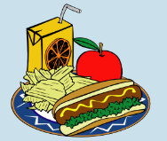
Tu fais quoi ? Tu as fait quoi ? (A)
parler
A | aujourd’hui | l’année dernière
B | aujourd’hui | l’année dernière
1.
2.
3.
4.
5.
Notes:
8.1.2.2
Timing: 5 minutes
Aim: To provide production (speaking) practice in contrasting present and perfect tense forms with –ER verbs (first and second person singular)
Procedure:
Student A faces the board. Student B turns away from the board and sketches a 6x2 grid.
Student A says s/he does/did each thing pictured in turn, using the first person present or perfect tense according to whether the tick appears in the ‘today’ or ‘last year’ column.
Student B writes down what the activity is/was in English, ticking the appropriate column on his/her blank copy of the grid.
Student B then tells Student A what s/he has recorded: ‘Tu as...’
Students compare cards to check answers.
Students swap roles and use the second set of cards on the next slide.

Slide 4
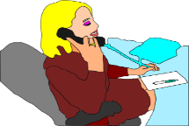
Tu fais quoi ? Tu as fait quoi ? (B)
parler
B | aujourd’hui | l’année derniere
A | aujourd’hui | l’année derniere
1.
2.
3.
4.
5.
Notes:
This is the second set of cards, for when partners swap roles.

Slide 5
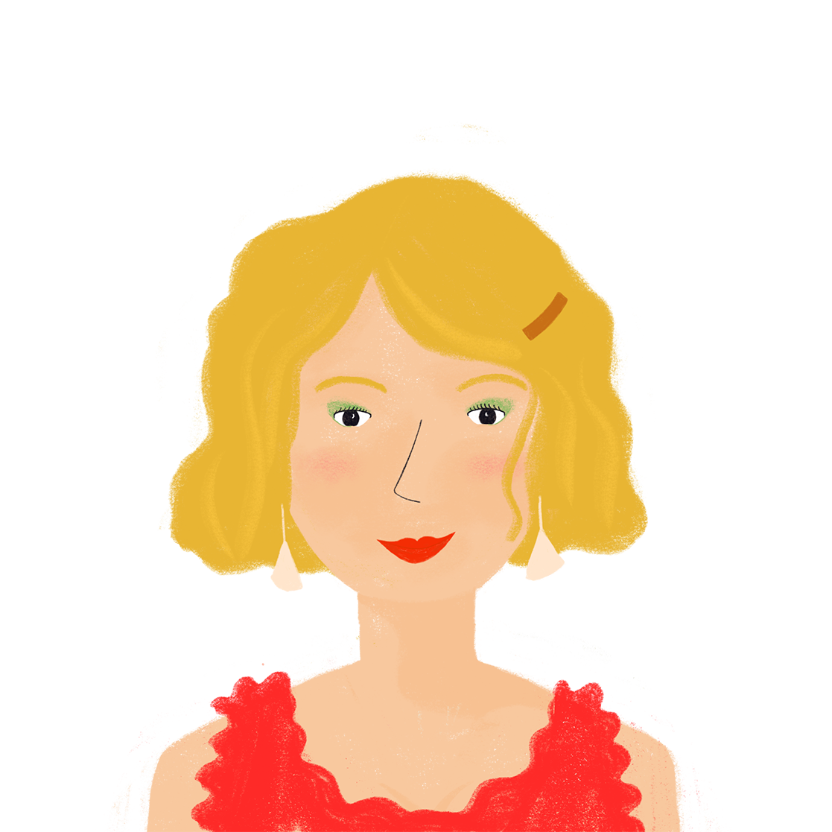
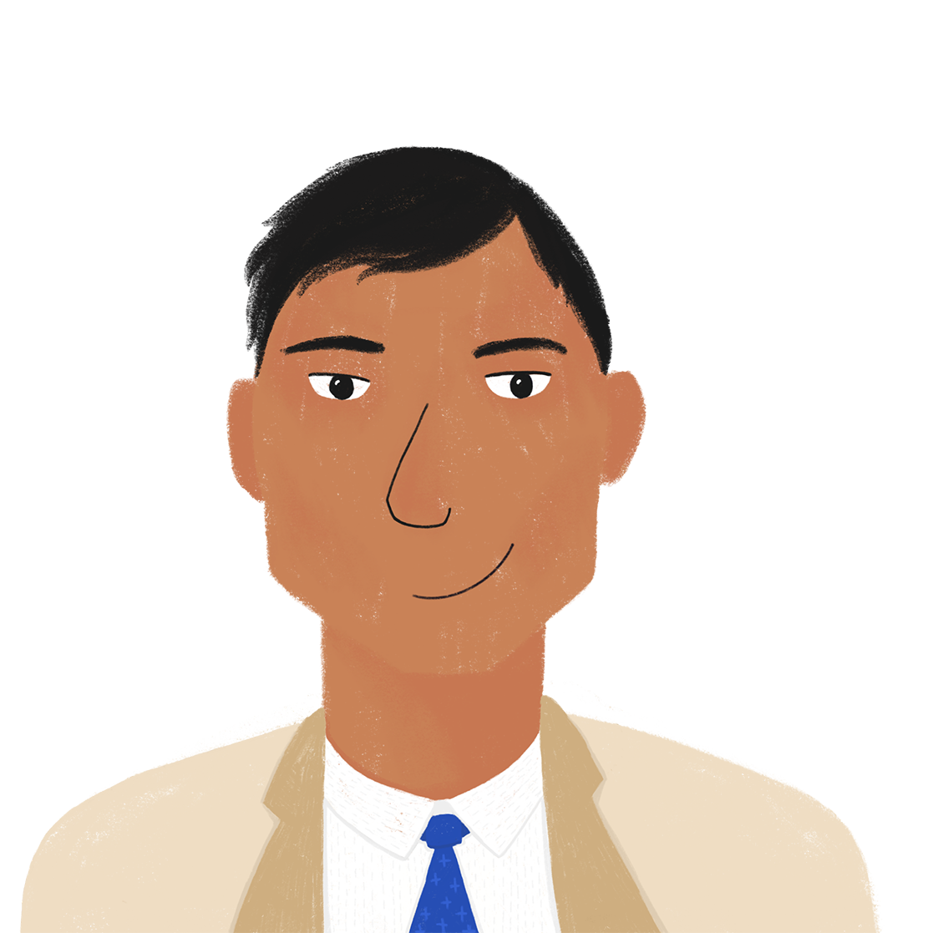
Que font les parents ?
écrire / parler
Partenaire A
Que fait Amandine pendant les vacances ?
Écris des phrases en français avec elle.
 | quoi ? | quand ?
1. | _________ un hôtel à Genève. (trouver) | hier
2. | _________ une amie suisse. (visiter) | hier
3. | _________ un livre au parc. (emporter) | en ce moment
4. | _________ une promenade. (proposer) | en ce moment
Écoute les activités de Bilal. C’est en ce moment, ou hier ?
Complète les phrases avec il y a ou il y avait.
 | quand ? | quoi ?
1. |  | … des projets pour chaque jour.
2. |  | … des vues excellentes de la fenêtre.
3. |  | … un match de la ligue nationale.
4. |  | … il y avait un grand lac. (le lac = lake)
Notes:
8.1.2.3
Timing: 10 minutes for 3 slides
Aim: practising written production of the il/elle form of avoir as the auxiliary in the perfect tense, practising oral production of il y avait, connecting past actions with past descriptions
Procedure:
1. Each partner completes the sentences in the top table of their rolecards using pronouns il/elle and a form of the verb to match the tense indicated by the time phrase on their rolecard (see next slide for Partner B’s rolecard).
2. Partner A reads out their first sentence (without the time phrase) to Partner B.
3. Partner B notes in their bottom table whether Partner A’s sentence refers to the present or the past, and responds with the description in their bottom table on their rolecard, using il y a or il y avait as appropriate.
4. Partners swap roles.
5. Continue until both partners have said their four sentences and given four descriptions in response.
6. Check answers on the réponses slide.
7. English translations can also be elicited.
Word frequency of revisited vocabulary (1 is the most frequent word in French): visiter [1378], national [227]
Source: Londsale, D., & Le Bras, Y. (2009). A Frequency Dictionary of French: Core vocabulary for learners London: Routledge.
Word frequency of cognates used (1 is the most frequent word in French): compléter [2034], lac [3121], ligue [>5000]
Source: Londsale, D., & Le Bras, Y. (2009). A Frequency Dictionary of French: Core vocabulary for learners London: Routledge.

Slide 6
Que font les parents ?
écrire / parler
Partenaire B
Que fait Bilal pendant les vacances ?
Écris des phrases en français avec il.
 | quoi ? | quand ?
1. | _________ des activités pour la famille. (organiser) | en ce moment
2. | _________ la Suisse en voiture. (traverser) | hier
3. | _________ l’équipe de football locale. (regarder) | en ce moment
4. | _________ à Lausanne. (voyager) | hier
Écoute les activités d’Amandine. C’est en ce moment, ou hier ?
Complète les phrases avec il y a ou il y avait.
 | quand ? | quoi ?
1. |  | … une chambre sympa avec trois lits.
2. |  | … une fête pour son anniversaire.
3. |  | … douze parcs différents dans la ville.
4. |  | … une belle forêt à la frontière.
Notes:
Word frequency of revisited vocabulary (1 is the most frequent word in French): organiser [701], billet [1916], anniversaire [2043]
Source: Londsale, D., & Le Bras, Y. (2009). A Frequency Dictionary of French: Core vocabulary for learners London: Routledge.
Word frequency of cognates used (1 is the most frequent word in French): compléter [2034], football [2602], local [622], Internet [N/A]
Source: Londsale, D., & Le Bras, Y. (2009). A Frequency Dictionary of French: Core vocabulary for learners London: Routledge.

Slide 7
Que font les parents ?
Réponses
écrire / parler
 | A | B
1. | Elle a trouvé un hôtel à Genève. | Il y avait une chambre sympa avec trois lits.
2. | Elle a visité une amie suisse. | Il y avait une fête pour son anniversaire.
3. | Elle emporte un livre au parc. | Il y a douze parcs différents dans la ville.
4. | Elle propose une promenade. | Il y a une belle forêt à la frontière.
 | B | A
1. | Il organise des activités pour la famille | Il y a des projets pour chaque jour.
2. | Il a traversé la Suisse en voiture. | Il y avait des vues excellents de la fenêtre.
3. | Il regarde l’équipe de football locale. | Il y a un match de la ligue nationale.
4. | Il a voyagé à Lausanne. | Il y avait un grand lac. (le lac = lake)

Slide 8
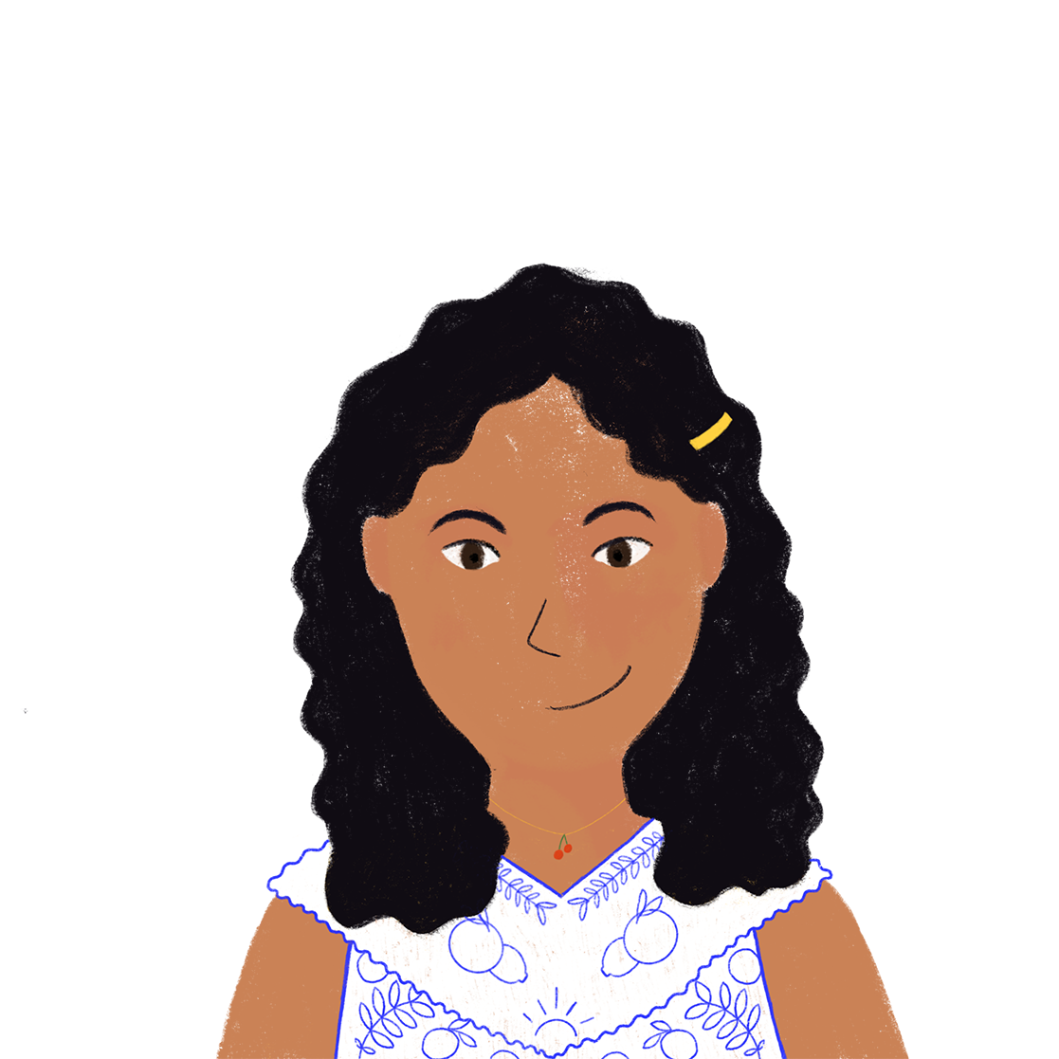
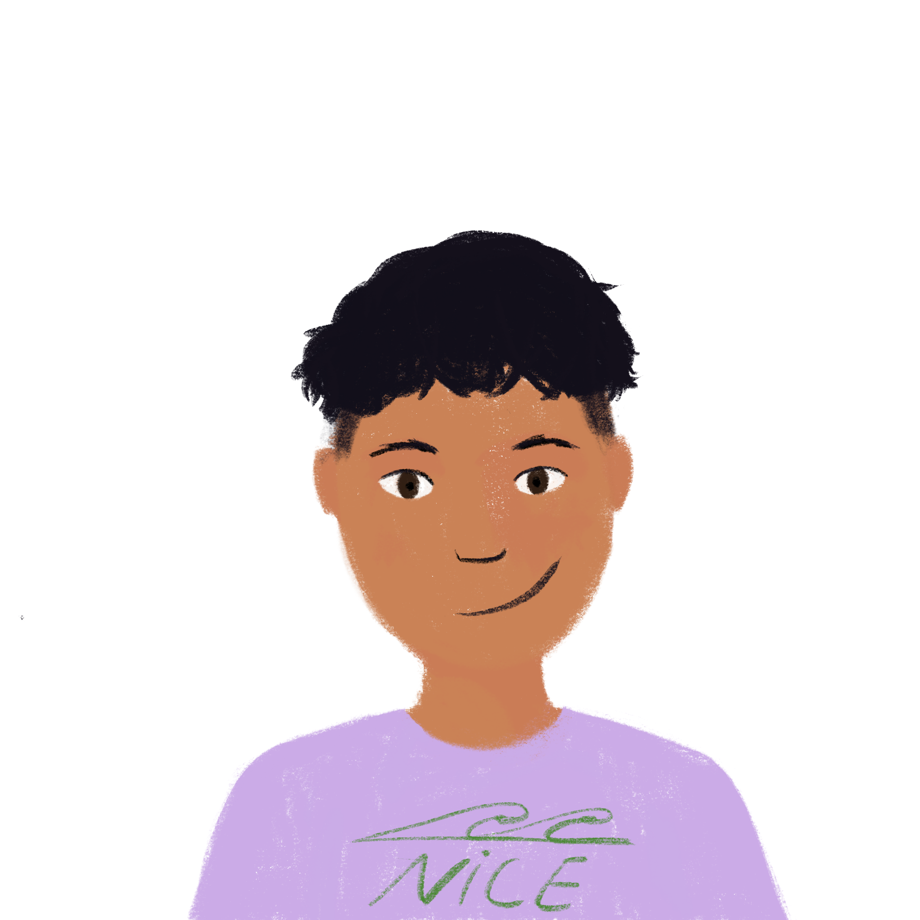
Est-ce que c’est une question?
*la carte = card
*la partie = part
parler
Travaille à deux pour faire des phrases ensemble.
Partenaire A utilise sa carte* pour dire la première partie* de la phrase.
Partenaire B utilise sa carte pour compléter la phrase.
Elle a …
fait ses devoirs.
(statement)
fait ses devoirs ?
(question)
Notes:
8.1.2.4
Timing: 5 minutes
Aim: Oral production of perfect tenses statements and yes/no questions using appropriate intonation.
Procedure:
1. Teacher distributes role cards on slide 20 to pairs of students.
2. Partner A uses their role card to begin a sentence. Some sentences start with est-ce que, others with a pronoun.
3. Partner B then uses the role play card to complete the second half of the sentence. Remind students that if the sentence starts with est-ce que, then it must be a question and Partner B must raise their intonation at the end of the sentence. If the sentence starts with a pronoun, it could be either a question or a statement and students should practise use both types of intonation to create statements and questions.
4. After four sentences, students to swap roles (Partner B starts the sentence and then Partner A completes it).
Word frequency of unknown words used (1 is the most frequent word in French): carte [955], partie [118]
Source: Londsale, D., & Le Bras, Y. (2009). A Frequency Dictionary of French: Core vocabulary for learners London: Routledge.
Word frequency of cognates used (1 is the most frequent word in French): compléter [2034]
Source: Londsale, D., & Le Bras, Y. (2009). A Frequency Dictionary of French: Core vocabulary for learners London: Routledge.

Slide 9
Question or Statement ?
parler
Partner A
Partner B
Est-ce que tu as …
Il a …
Elle a …
Est-ce qu’on a …
 | fermé la porte
 | regardé le film
 | fait un voyage en Suisse
 | visité la montagne
 | organisé la fête
 | fait une promenade dans la forêt
 | traversé la frontière
 | emporté des sandwichs
Tu as …
Est-ce qu’il a …
Est-ce qu’elle a…
On a …
Est-ce que tu as …
Il a …
Elle a …
Est-ce qu’on a …
 | fermé la porte
 | regardé le film
 | fait un voyage en Suisse
 | visité la montagne
 | organisé la fête
 | fait une promenade dans la forêt
 | traversé la frontière
 | emporté des sandwichs
Tu as …
Est-ce qu’il a …
Est-ce qu’elle a…
On a …
Notes:
Role play cards for the previous slide.
This is slide 2/2.

Slide 10
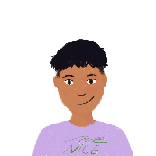
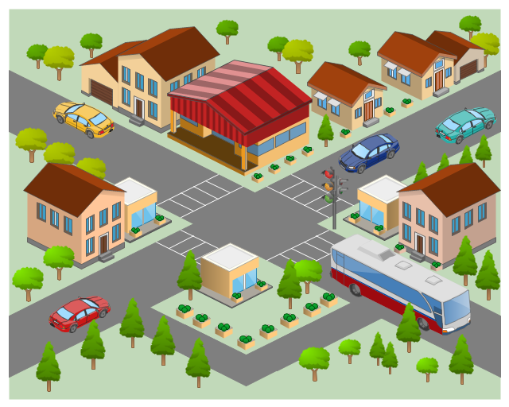
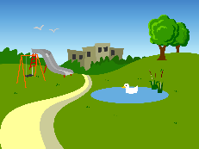
Vrai ou faux ?
parler
Dis les phrases à un(e) partenaire.
C’est vrai ou faux ?
Si c’est faux, dis la phrase correcte.
Notes:
8.1.2.6
Timing: 5 minutes for 2 slides
Aim: practising oral production of agreement with the singular contracted forms of de + definite article
Procedure:
1. Partner A reads out the first French sentence they wrote in the previous activity.
2. Partner B looks at the map to decide if the sentence is true or false. If it is false, they provide the correct sentence.
3. Partners swap roles until all 10 sentences have been read out.
4. Answers are provided on the next slide.
5. The activity can be extended by having students come up with their own true and false sentences.
Word frequency of cognates used (1 is the most frequent word in French): correct [2617]
Source: Londsale, D., & Le Bras, Y. (2009). A Frequency Dictionary of French: Core vocabulary for learners London: Routledge.

Slide 11
Vrai ou faux ?
Réponses
parler
La maison d’Océane est à gauche du magasin.
Le magasin est près du parc. (loin du)
La banque est à côté de la maison d’Amir.
La maison d’Amir est loin de l’école. (près de l’)
L’hôtel est à droite de la poste. (à gauche de la)
La poste est à côté de l’hôtel.
Le musée est à gauche de la maison d’Océane. (loin de la)
Le café est loin de la banque. (près de la)
L’école est à droite du café.
Le parc est près du musée.
Notes:
Procedure:
1. Click to reveal the French sentences from the English prompts.
2. Click again to reveal if each sentence is true (tick) or false (cross), according to the map.
3. Alternatives to the false sentences can be elicited (suggested answers are given, but more than one answer is possible).
4. English translations can also be elicited.

Slide 12
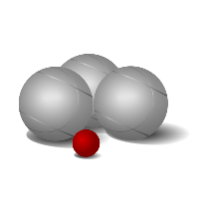
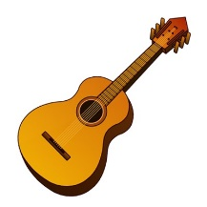
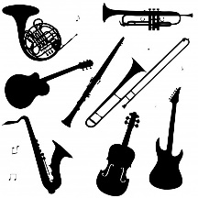
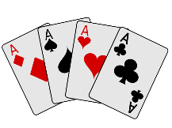
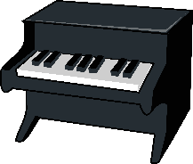
Qui fait quoi ? (A)
parler
Demande si ton / ta partenaire fait les activités et donne des réponses.
 |  | ? | A | B
1.
2.
3.
 |  | ? | A | B
4.
5.
6.
(sing.)
Notes:
8.1.2.6
Optional additional speaking activity
Timing: 7 minutes
Aim: practising oral production of jouer à + sport / game and jouer de + instrument
Procedure:
1. Partner A asks Partner B a yes/no question about each activity using the question type indicated in the ‘?’ column (using the rolecard on this slide).
2. Partner B answers with ‘oui’ / ‘non’ according to the response in the ‘B’ column (using the rolecard on the next slide). At more advanced levels, students could be encourages to respond in full affirmative or negative sentences.
3. Partner A makes a tick or cross in the ‘B’ column.
4. Partners swap roles. Continue until the tables are complete.
5. Answers are provided on the réponses slide, after a follow-up writing activity.

Slide 13
Qui fait quoi ? (B)
parler
Demande si ton / ta partenaire fait les activités et donne des réponses.
 |  | ? | B | A
1.
2.
3.
 |  | ? | B | A
4.
5.
6.
(sing.)
Notes:
DO NOT DISPLAY

Slide 14
Qui fait quoi ?
Réponses
écrire
Parle à ton/ta partenaire. Faites-vous des activités similaires ?
Écris des phrases en français avec je et il / elle.
Use linking words like aussi and mais to compare your activities.
Partenaire A:
Je ne joue pas à la pétanque.
Je joue aux cartes.
Je ne joue pas du piano.
Je joue de la guitare.
Je joue d’un / de l’instrument.
Je ne joue pas au foot.
Partenaire B:
Je joue au foot.
Je ne joue pas de la guitare.
Je joue aux cartes.
Je joue du piano.
Je ne joue pas à la pétanque.
Je ne joue pas de l’ / d’instrument.
Notes:
8.1.2.6
Timing: 7 minutes
Aim: practising written production of jouer à + sport / game and jouer de + instrument
Procedure:
1. Students write sentences comparing the activities they and their partner do. Encourage the use of linking words.
2. Click to reveal the answers for each partner (note that question 5 can take a definite or indefinite article, depending on interpretation of the question).
Word frequency of cognates used (1 is the most frequent word in French): similaire [2632]
Source: Londsale, D., & Le Bras, Y. (2009). A Frequency Dictionary of French: Core vocabulary for learners London: Routledge.

Slide 15
Qui fait quoi ?
parler / écrire
Trouve une personne dans la classe qui fait chaque activité. Écris des phrases.
 |  | qui ?
1.
2.
3.
 |  | qui ?
4.
5.
6.
(pl.)
Notes:
Alternative / optional extension activity
Timing: 10 minutes
Aim: practising oral and written production of jouer à + sport / game and jouer de + instrument
Procedure:
1. Students ask each other questions to find one person in the class who does each activity. (Teacher can call out the method of question formation, perhaps varying for each question at advanced levels).
2. Students write one sentence for each activity with the person they found.

Slide 16
Parle en français ! (A)
écouter / parler / écrire
Demande quand, où et comment ton / ta partenaire fait les choses.
Vous êtes similaires ? Écris des phrases en français avec je et il / elle.
 |  | ? | A | B
1. | sortir en ville | quand ? | on Saturday
2. | venir | où ? | here
3. | partir pour le collège | quand ? | early
4. | devenir malade | quand ? | sometimes
5. | dormir | comment ? | quite well
6. | revenir des vacances | quand ? | at the moment
Notes:
8.2.1.2
Timing: 8 minutes for 3 slides
Aim: aural recognition of adverbs and time phrases, oral and written production of verbs like sortir and venir, adverb placement
Procedure:
1. Partner A asks Partner B a question using the prompts in the first columns of their role card (eg. ‘Quand sors-tu en ville?).
2. Partner B responds with a sentence using the prompt in the ‘B’ column of their role card (see next slide) (eg. ‘Je sors en ville chaque jour’).
3. Partner A notes the response in the ‘B’ column of their role card.
4. Continue until Partner A has noted responses for all 6 questions.
5. Partners swap roles. Repeat steps 1-4.
6. Then, each partner writes sentences in French, comparing their own responses with their partners’.
7. Answers are provided on the réponses slide.
Word frequency of cognates used (1 is the most frequent word in French): similaire [2632]
Source: Londsale, D., & Le Bras, Y. (2009). A Frequency Dictionary of French: Core vocabulary for learners London: Routledge.

Slide 17
Parle en français ! (B)
écouter / parler / écrire
Demande quand, où et comment ton / ta partenaire fait les choses.
Vous êtes similaires ? Écris des phrases en français avec je et il / elle.
 |  | ? | A | B
1. | sortir en ville | quand ? |  | every day
2. | venir | où ? |  | outside
3. | partir pour le collège | quand ? |  | late
4. | devenir malade | quand ? |  | often
5. | dormir | comment ? |  | very well
6. | revenir des vacances | quand ? |  | today

Slide 18
Parle en français !
Réponses
écouter / parler / écrire
Change verbs to –s for ‘je’ phrases.
Demande quand, où et comment ton / ta partenaire fait les choses.
Vous êtes similaires ? Écris des phrases en français avec je et il / elle.
 | Partenaire A... | Partenaire B...
1. | … sort en ville le samedi. | … sort en ville chaque jour.
2. | … vient ici. | … vient dehors.
3. | … part tôt pour le collège. | … part en retard pour le college.
4. | … devient parfois malade. | … devient souvent malade.
5. | … dort assez bien. | … dort très bien.
6. | … revient des vacances en ce moment. | … revient des vacances aujourd’hui.

Slide 19
Qu’est-ce que Léa a fait ?
parler
You can put est-ce que at the start of a sentence to make a question.
Ne … pas surrounds the form of avoir in the perfect tense.
Question:
Partner A
Est-ce que Léa a mangé des chips ? Did Léa eat some crisps?
Réponse:
Partner B
Non, Léa n’a pas mangé de chips. Elle a mangé une glace.
No, Léa didn’t eat any crisps. She ate an ice cream.
Notes:
_{8.2.1.3}
_{Timing: 10 minutes}
Aim: Oral production of est-ce que questions and answers in the perfect tense.
_{Procedure:}
1. Cycle through the reminder on this slide using the animation sequence, eliciting the French for the question and answer.
2. Print and distribute the pair-work speaking cards on the next slide.
3. Explain that Partner A goes first, forming the questions represented in picture form at the top of his/her card.
4. Partner B, responds, gives the answers at the top of his/her card. In some cases, the pictures match, and no negative sentence is needed. Where the pictures do not match, students should give a negative sentence first, followed by an affirmative sentence with the correct noun.
5. Partners then swap roles, using the questions/answers at the bottom of their cards.
6. Given the complexity of the language here, the teacher will need to circulate to assist and to assess progress/common problem areas for individual and class feedback.
7. Suggested questions and answers are provided on slides 34 and 35.
Word frequency of unknown words (1 is the most frequent word in French): _{chips [>5000]}
Source: Londsale, D., & Le Bras, Y. (2009). A Frequency Dictionary of French: Core vocabulary for learners London: Routledge.

Slide 20
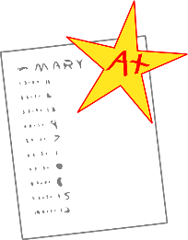
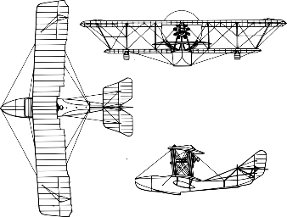
Partenaire A
parler
[play]
[do]
Réponses:
6
8
[eat]
[watch]
Questions:
1
4
3
10
[buy]
[study]
[sing]
5
[listen]
7
[eat]
2
9
[bring]
Partenaire B
[talk]
Questions:
Réponses:
[study]
[do]
[listen]
9
1
[eat]
6
8
3
5
10
7
4
[make]
2
[do]
[bring]
[eat]
[buy]
Notes:
_{Speaking Cards}
_{Additional English prompts:}
_{Partner A:}
_{1. Did Léa eat some meat?}
_{2. Did she bring a list?}
_{3. Did she study science?}
_{4. Did she watch a film?}
_{5. Did she listen to music?}
_{6. Yes, she did some sport.}
7. No she didn’t eat any cheese. She ate some pizza.
8. No she didn’t listen to music. She played an instrument.
9. No she didn’t talk with friends. She sang with friends.
_{10. Yes, she bought a book.}
_{Partner B:}
_{1. Yes, she ate some meat.}
2. No she didn’t bring a list. She brought a letter.
3. No she didn’t study science. She studied maths.
4. No she didn’t watch a film. She made a model.
5. No she didn’t listen to music. She did her homework.
_{6. Did Léa do some sport?}
_{7. Did Léa eat some cheese?}
_{8. Did she listen to music?}
9. Did she talk with her friends?
_{10. Did she buy a book?}

Slide 21
Qu’est-ce que Léa a fait ?
parler
Est-ce que Léa a mangé
de la viande ?
Oui, elle a mangé de la viande.
Est-ce qu’elle a apporté une liste?
Non, elle n’a pas apporté une liste.
Elle a apporté une lettre.
Est-ce qu’elle a étudié la science?
Non, elle n’a pas étudié la science.
Elle a étudié les maths.
Est-ce qu’elle a
regardé un film ?
Non, elle n’a pas regardé
un film. Elle a fait un modèle.
Est-ce qu’elle a écouté
de la musique ?
Non, elle n’a pas écouté de
la musique. Elle a fait ses devoirs.
Partner A
Partner B
Notes:
_{Answers 1-5}
_{Procedure:}
1. Click to reveal questions and answers in French one by one

Slide 22
Qu’est-ce que Léa a fait ?
parler
Est-ce que Léa a fait du sport?
Oui, elle a fait du sport.
Est-ce qu’elle a mangé
du fromage?
Non, elle n’a pas mangé du fromage. Elle a mangé de la pizza.
Est-ce qu’elle a écouté
de la musique?
Non, elle n’a pas écouté de la musique. Elle a joué d’un instrument.
Est-ce qu’elle a parlé avec ses amis?
Non, elle n’a pas parlé avec ses amis. Elle a chanté avec ses amis.
Est-ce qu’elle a acheté un livre?
Oui, elle a acheté un livre.
Partner B
Partner A
Notes:
_{Answers 6-10}
_{Procedure:}
1. Click to reveal questions and answers in French one by one

Slide 23
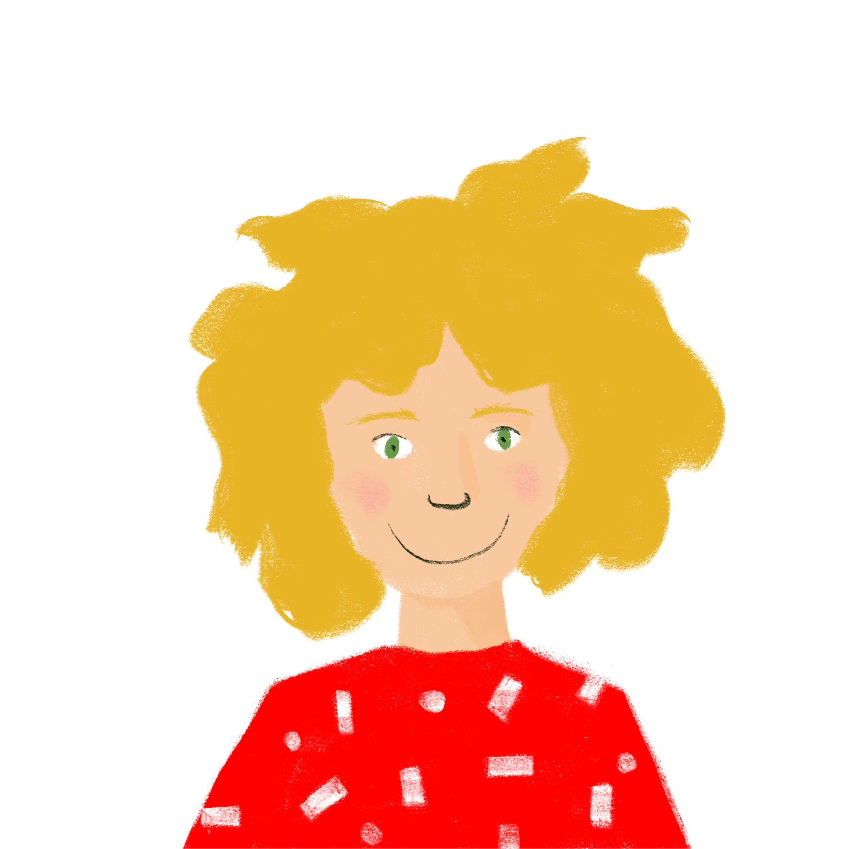
Qui fait quoi ?
Exemple
parler
[…] venez de …
… Suisse !
 | Start these sentences (don’t say the pronoun!) |  | Finish your partner’s sentences with a word that fits
A. | (Vous) venez [venir] de … | A. | Alice: Belgique M. Faure: Suisse
____
Notes:
8.2.1.6
Timing: 10 minutes
Aim: aural recognition of verbs in the tu, vous, on and nous forms, and practice in connecting form with meaning. This slide models the task. Rolecards and answers on the following slides.
Procedure:
Work through the example on this slide. Ask ‘which form of the verb does Amir need to say?’ Click to reveal the answer.
Say the sentence as the students will say it in the activity (without the pronoun). Put your finger over your lips instead of saying vous, and then say venez de …
Ask students whether they think Amir is addressing Alice or M. Faure, and to finish the sentence based on the answer.
Click to reveal answer.
Print and distribute the role cards found on slides 48 and 49.
Students take it in turns to read the beginning of a sentence, using the verb form they think is correct in place of the blank. Remind them not to say the pronoun as this gives their partner an additional clue!
The listening partner completes the sentence with the ending they think is correct, based on the level of formality indicated by the verb form.
Answers found on slides 50 and 51.
Word frequency of cognates used (1 is the most frequent word in French): flûte [>5000]
Source: Londsale, D., & Le Bras, Y. (2009). A Frequency Dictionary of French: Core vocabulary for learners London: Routledge.

Slide 24
Printable rolecards – Partner A
 | Start these sentences (don’t say the pronoun!) |  | Finish your partner’s sentences with a word that fits
A. | (Vous) _______ [avoir] un nouveau … | A. | Manon: dehors M. Paquet: à la maison
B. | (On) _______ [sortir] ensemble … | B. | Antoine et Élodie: en ce moment M. et Mme. Gauthier: maintenant
C. | (Nous) _______ [partir] souvent … | C. | Sara: vélos du garage M. et Mme. Sartre: documents
D. | (Tu) _______ [organiser] une fête … | D. | Mme. Aziz: heureuse Emilie: intelligente
E. | (Vous) _______ [devenir] rarement … | E. | Amir: guitare Mme. Meunier: flûte
 | Start these sentences (don’t say the pronoun!) |  | Finish your partner’s sentences with a word that fits
A. | (Vous) _______ [avoir] un nouveau … | A. | Manon: dehors M. Paquet: à la maison
B. | (On) _______ [sortir] ensemble … | B. | Antoine et Élodie: en ce moment M. et Mme. Gauthier: maintenant
C. | (Nous) _______ [partir] souvent … | C. | Sara: vélos du garage M. et Mme. Sartre: documents
D. | (Tu) _______ [organiser] une fête … | D. | Mme. Aziz: heureuse Emilie: intelligente
E. | (Vous) _______ [devenir] rarement … | E. | Amir: guitare Mme. Meunier: flûte
 | Start these sentences (don’t say the pronoun!) |  | Finish your partner’s sentences with a word that fits
A. | (Vous) _______ [avoir] un nouveau … | A. | Manon: dehors M. Paquet: à la maison
B. | (On) _______ [sortir] ensemble … | B. | Antoine et Élodie: en ce moment M. et Mme. Gauthier: maintenant
C. | (Nous) _______ [partir] souvent … | C. | Sara: vélos du garage M. et Mme. Sartre: documents
D. | (Tu) _______ [organiser] une fête … | D. | Mme. Aziz: heureuse Emilie: intelligente
E. | (Vous) _______ [devenir] rarement … | E. | Amir: guitare Mme. Meunier: flûte
 | Start these sentences (don’t say the pronoun!) |  | Finish your partner’s sentences with a word that fits
A. | (Vous) _______ [avoir] un nouveau … | A. | Manon: dehors M. Paquet: à la maison
B. | (On) _______ [sortir] ensemble … | B. | Antoine et Élodie: en ce moment M. et Mme. Gauthier: maintenant
C. | (Nous) _______ [partir] souvent … | C. | Sara: vélos du garage M. et Mme. Sartre: documents
D. | (Tu) _______ [organiser] une fête … | D. | Mme. Aziz: heureuse Emilie: intelligente
E. | (Vous) _______ [devenir] rarement … | E. | Amir: guitare Mme. Meunier: flûte
Notes:
Answers for partner A

Slide 25
Printable rolecards – Partner B
 | Start these sentences (don’t say the pronoun!) |  | Finish your partner’s sentences with a word that fits
A. | (Tu) _______ [dormir] bien … | A. | M. Faure: piano Amélie: bureau
B. | (On) _______ [revenir] de la plage … | B. | Kirsten et Natalie: aujourd’hui M. et Mme. Laurent: chaque jour
C. | (Nous) _______ [sortir] les … | C. | Amir et Noura: en retard M. Page et M. Barre: pour 3 jours.
D. | (Tu) _______ [être] une personne … | D. | Léa: pour ton anniversaire. M. Blanchard: pour Antoine.
E. | (Vous) _______ [jouer] de la … | E. | Sophie: malade Mme. Richard: triste
 | Start these sentences (don’t say the pronoun!) |  | Finish your partner’s sentences with a word that fits
A. | (Tu) _______ [dormir] bien … | A. | M. Faure: piano Amélie: bureau
B. | (On) _______ [revenir] de la plage … | B. | Kirsten et Natalie: aujourd’hui M. et Mme. Laurent: chaque jour
C. | (Nous) _______ [sortir] les … | C. | Amir et Noura: en retard M. Page et M. Barre: pour 3 jours.
D. | (Tu) _______ [être] une personne … | D. | Léa: pour ton anniversaire. M. Blanchard: pour Antoine.
E. | (Vous) _______ [jouer] de la … | E. | Sophie: malade Mme. Richard: triste
 | Start these sentences (don’t say the pronoun!) |  | Finish your partner’s sentences with a word that fits
A. | (Tu) _______ [dormir] bien … | A. | M. Faure: piano Amélie: bureau
B. | (On) _______ [revenir] de la plage … | B. | Kirsten et Natalie: aujourd’hui M. et Mme. Laurent: chaque jour
C. | (Nous) _______ [sortir] les … | C. | Amir et Noura: en retard M. Page et M. Barre: pour 3 jours.
D. | (Tu) _______ [être] une personne … | D. | Léa: pour ton anniversaire. M. Blanchard: pour Antoine.
E. | (Vous) _______ [jouer] de la … | E. | Sophie: malade Mme. Richard: triste
 | Start these sentences (don’t say the pronoun!) |  | Finish your partner’s sentences with a word that fits
A. | (Tu) _______ [dormir] bien … | A. | M. Faure: piano Amélie: bureau
B. | (On) _______ [revenir] de la plage … | B. | Kirsten et Natalie: aujourd’hui M. et Mme. Laurent: chaque jour
C. | (Nous) _______ [sortir] les … | C. | Amir et Noura: en retard M. Page et M. Barre: pour 3 jours.
D. | (Tu) _______ [être] une personne … | D. | Léa: pour ton anniversaire. M. Blanchard: pour Antoine.
E. | (Vous) _______ [jouer] de la … | E. | Sophie: malade Mme. Richard: triste
Notes:
Answers for partner A

Slide 26
Qui fait quoi ? (A)
Réponses
parler
 | Start these sentences (don’t say the pronoun!) |  | Finish your partner’s sentences with a word that fits
A. | (Vous) avez [avoir] un nouveau … | A. | Manon: dehors M. Paquet: à la maison
B. | (On) sort [sortir] ensemble … | B. | Antoine et Élodie: en ce moment M. et Mme. Gauthier: maintenant
C. | (Nous) partons [partir] souvent … | C. | Sara: vélos du garage M. et Mme. Sartre: documents
D. | (Tu) organises [organiser] une fête … | D. | Mme. Aziz: heureuse Emilie: intelligente
E. | (Vous) devenez [devenir] rarement … | E. | Amir: guitare Mme. Meunier: flûte
___
___
___
___
___
Notes:
Answers for partner A.
Procedure
Answers revealed on clicks (left-hand column answers appear first).
Elicit from students the verb form that is needed to create sentences with the unused items.

Slide 27
Qui fait quoi ? (B)
Réponses
parler
 | Start these sentences (don’t say the pronoun!) |  | Finish your partner’s sentences with a word that fits
A. | (Tu) dors [dormir] bien … | A. | M. Faure: piano Amélie: bureau
B. | (On) revient [revenir] de la plage … | B. | Kirsten et Natalie: aujourd’hui M. et Mme. Laurent: chaque jour
C. | (Nous) sortons [sortir] les … | C. | Amir et Noura: en retard M. Page et M. Barre: pour 3 jours.
D. | (Tu) es [être] une personne … | D. | Léa: pour ton anniversaire. M. Blanchard: pour Antoine.
E. | (Vous) jouez [jouer] de la … | E. | Sophie: malade Mme. Richard: triste
___
___
___
___
___
Notes:
Answers for partner B

Slide 28
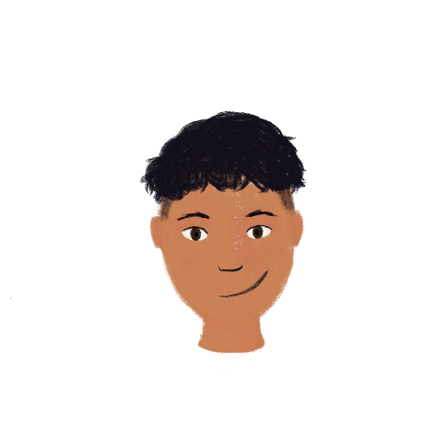
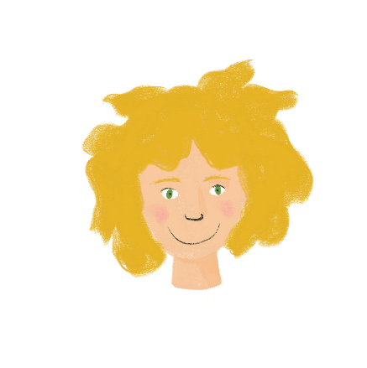
La vie au collège
*vocabulary = le vocabulaire
lire / parler / écouter
Personne B
Personne A
Who…?
is choosing English
is passing a guitar exam
is defining English words
is choosing German
is filling in the gaps
is defining German vocabulary*
Who…?
is choosing ‘pétanque’
is defining words for an exam
is filling their exercise book with important vocabulary*
is choosing football
passes difficult exams
is filling their maths exercise book with answers
Example: Qui choisit l’anglais ?
Notes:
8.2.2.1
Timing: 10 minutes
Aim: To practise oral production and aural recognition of 3rd person singular forms of verbs like choisir in the present tense. In addition, students practise written recognition of vocabulary / reading comprehension.
Procedure:
In pairs, one student takes the role of A, the other is B.
Give students a couple of minutes to consider how they will construct their set of questions in French. Work through the first example as a class (a suggested question with qui appears on a click). Give students time to make some notes if they wish (either in French or English). This could be done in exercise books. There is no need to print this sheet. Also encourage recourse to reference materials if students cannot readily recall the necessary vocab.
Display the next slide, asking student B to turn away from the board.
Student A uses the text (on the following slide) as the stimulus to give the appropriate answers to student B.
Student B faces away from the board and asks student A the questions in French from their prompt sheet.
Student A listens to the question in French and then gives the answer – either Amir or Léa.
Student B ticks the correct column on his/her sheet.
Partners then swap roles (see following slide).
Go through the answers on the final slide of the sequence to bring the activity to a close.
Word frequency of cognates used (1 is the most frequent word in French): vocabulaire [4159]
Source: Londsale, D., & Le Bras, Y. (2009). A Frequency Dictionary of French: Core vocabulary for learners London: Routledge.

Slide 29
La vie au collège
lire / parler / écouter
Partenaire A
La vie au collège est très bien. Dans ma famille, on aime des langues étrangères ! Je choisis l’anglais et Léa choisit l’anglais et l’allemand aussi. Aujourd’hui je définis les mots difficiles en anglais. J’ai des bonnes notes en anglais ! Léa définit le vocabulaire allemand. Souvent je remplis les blancs mais je préfère écrire des phrases complètes. Léa reussit l’examen de guitare. Elle adore la musique. Je veux jouer d’un instrument aussi !
Notes:
Student A stimulus text.
Word frequency of cognates used (1 is the most frequent word in French): vocabulaire [4159], complète [>5000]
Source: Londsale, D., & Le Bras, Y. (2009). A Frequency Dictionary of French: Core vocabulary for learners London: Routledge.

Slide 30
La vie au collège
lire / parler / écouter
Partenaire B
La vie au collège est assez bien. Dans ma famille, on n’aime pas beaucoup faire du sport, mais je choisis le foot et Amir choisit la pétanque. En ce moment je définis les mots pour réussir les examen d’anglais. En allemand, je remplis mon cahier avec le vocabulaire important. Amir est intelligent - il réussit les examens difficiles. Il remplit son cahier de maths avec les réponses aux problèmes difficiles. Il adore les maths – c’est bizarre !
Notes:
Student B stimulus text Word frequency of cognates used (1 is the most frequent word in French): vocabulaire [4159], bizarre [>5000]
Source: Londsale, D., & Le Bras, Y. (2009). A Frequency Dictionary of French: Core vocabulary for learners London: Routledge.

Slide 31
La vie au collège
Réponses
lire / parler / écouter
Partenaire B
Partenaire A
Who…?
is choosing English
is passing a guitar exam
is defining English words
is choosing German
is filling in the gaps
is defining German vocabulary
Who…?
is choosing ‘pétanque’
is defining words for an exam
is filling their exercise book with important vocabulary
is choosing football
passes difficult exams
is filling their maths exercise book with answers
Notes:
Answer slide.

Slide 32
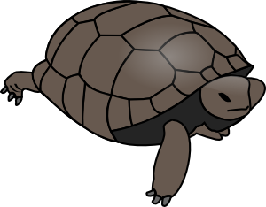
Vous faites quoi ?
écouter / écrire / parler
Vous nourrissez quoi ?
Nous nourrissons une tortue !
 | Ask your partners a question (vous) and write a sentence (ils/elles)
A. | nourrir ________________________
 | Tell your partners you are doing this (nous)
A. | nourrir, une tortue
Ils nourrissent une tortue.
Notes:
8.2.2.2
Timing: 8 minutes
Aim: Oral production of verbs like choisir in the nous, vous and ils/elles forms.
Procedure:
1. Students work in pairs with another pair to facilitate production of sentences in the nous and vous forms.
2. Print and distribute the rolecards, found on the following slides.
3. Use this slide to demonstrate the task. Explain that students are going to address the pair they are working with in the plural form to find out what is written on their card.
4. Ask students which question Léa and Sophie need to ask in order to get a response from Amir and Noura. Click to reveal.
5. Ask students how Amir and Noura respond. Click to reveal.
6. Ask students how Léa and Sophie will note their response. Click to reveal.
7. Students proceed with the task. Within the pairs, each student should ask two questions, answer two questions and write two setences.
8. Check answers on slides 39-40.

Slide 33
Printable rolecards – Group A
 | Tell your partners you are doing this (nous) |  | Ask your partners a question (vous) and write a sentence (ils/elles)
E. | finir, nos devoirs | A. | nourrir _________________________
F. | définir, les mots | B. | choisir _________________________
G. | remplir, les verres | C. | réussir _________________________
H. | choisir, des livres | D. | finir _________________________
 | Tell your partners you are doing this (nous) |  | Ask your partners a question (vous) and write a sentence (ils/elles)
E. | finir, nos devoirs | A. | nourrir _________________________
F. | définir, les mots | B. | choisir _________________________
G. | remplir, les verres | C. | réussir _________________________
H. | choisir, des livres | D. | finir _________________________
 | Tell your partners you are doing this (nous) |  | Ask your partners a question (vous) and write a sentence (ils/elles)
E. | finir, nos devoirs | A. | nourrir _________________________
F. | définir, les mots | B. | choisir _________________________
G. | remplir, les verres | C. | réussir _________________________
H. | choisir, des livres | D. | finir _________________________
 | Tell your partners you are doing this (nous) |  | Ask your partners a question (vous) and write a sentence (ils/elles)
E. | finir, nos devoirs | A. | nourrir _________________________
F. | définir, les mots | B. | choisir _________________________
G. | remplir, les verres | C. | réussir _________________________
H. | choisir, des livres | D. | finir _________________________
 | Tell your partners you are doing this (nous) |  | Ask your partners a question (vous) and write a sentence (ils/elles)
E. | finir, nos devoirs | A. | nourrir _________________________
F. | définir, les mots | B. | choisir _________________________
G. | remplir, les verres | C. | réussir _________________________
H. | choisir, des livres | D. | finir _________________________
Notes:
Answers for partner A

Slide 34
Printable rolecards – Group B
 | Tell your partners you are doing this (nous) |  | Ask your partners a question (vous) and write a sentence (ils/elles)
A. | nourrir, nos chats | E. | finir _________________________
B. | choisir, les cahiers | F. | définir ______________________
C. | réussir, nos examens | G. | remplir ______________________
D. | finir, le ménage | H. | choisir _________________________
 | Tell your partners you are doing this (nous) |  | Ask your partners a question (vous) and write a sentence (ils/elles)
A. | nourrir, nos chats | E. | finir _________________________
B. | choisir, les cahiers | F. | définir ______________________
C. | réussir, nos examens | G. | remplir ______________________
D. | finir, le ménage | H. | choisir _________________________
 | Tell your partners you are doing this (nous) |  | Ask your partners a question (vous) and write a sentence (ils/elles)
A. | nourrir, nos chats | E. | finir _________________________
B. | choisir, les cahiers | F. | définir ______________________
C. | réussir, nos examens | G. | remplir ______________________
D. | finir, le ménage | H. | choisir _________________________
 | Tell your partners you are doing this (nous) |  | Ask your partners a question (vous) and write a sentence (ils/elles)
A. | nourrir, nos chats | E. | finir _________________________
B. | choisir, les cahiers | F. | définir ______________________
C. | réussir, nos examens | G. | remplir ______________________
D. | finir, le ménage | H. | choisir _________________________
 | Tell your partners you are doing this (nous) |  | Ask your partners a question (vous) and write a sentence (ils/elles)
A. | nourrir, nos chats | E. | finir _________________________
B. | choisir, les cahiers | F. | définir ______________________
C. | réussir, nos examens | G. | remplir ______________________
D. | finir, le ménage | H. | choisir _________________________
Notes:
Answers for partner A

Slide 35
Vous faites quoi ? (A)
Réponses
parler
 | Ask the questions |  | Write your partners’ answers
A. | Vous nourrissez [nourrir] quoi ? | A. | Ils nourrissent un chat.
B. | Vous choisissez [choisir] quoi ? | B. | Ils choisissent un lycée.
C. | Vous réussissez [réussir] quoi ? | C. | Ils réussissent l’examen.
D. | Vous finissez [finir] quoi ? | D. | Ils finissent le ménage.
_______
_______
_______
_____
Notes:
8.2.2.2
Answers for partner A.
Procedure
Answers revealed on clicks (left-hand column answers appear first).
Elicit from students the verb form that is needed to create sentences with the unused items.

Slide 36
Vous faites quoi ? (B)
Réponses
parler
 | Ask the questions |  | Write your partners’ answers
E. | Vous finissez [finir] quoi ? | E. | Ils finissent les devoirs.
F. | Vous définissez [définir] quoi ? | F. | Nous définissent le mot.
G. | Vous remplissez [remplir] quoi ? | G. | Ils remplissent les blancs.
H. | Vous choississez [choisir] quoi ? | H. | Ils choississent des livres.
_____
_______
_______
_______
Notes:
Answers for partner A.
Procedure
Answers revealed on clicks (left-hand column answers appear first).
Elicit from students the verb form that is needed to create sentences with the unused items.

Slide 37
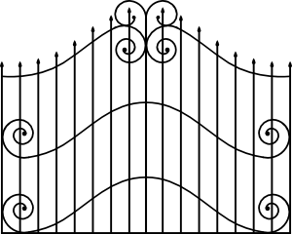
Une interview
parler
Un(e) journaliste fait une interview avec des visiteurs au zoo.
Partenaire A [le/la journaliste] :
Le zoo est comment ?
Partenaire B [le visiteur/la visiteuse] : idéal/locaux
Le zoo est idéal.
ZOO
Notes:
8.2.2.3
Timing: 5 minutes
Aim: Oral production of masculine nouns and adjectives in singular and plural. Connecting adjectives with gender and number. Consolidating knowledge by applying rules to unknown cognates.
Procedure:
1. Print the rolecards from the next two slides (two or even four cards could fit on one page). Check students understand the meaning of all the adjectives on their cards (many of these are cognates).
2. Model the task with the example on this slide.
3. Partner A forms questions about the things pictured on their card.
4. Partner B answers by choosing the adjective that agrees with the noun they have been asked, about and using it in a sentence.
5. Partners swap roles.
Word frequency of cognates used(1 is the most frequent word in French):
zoo [>5000], journaliste [1337], lion [<5000], panda [<5000], interview [3186], fondamental [1291], oriental [2715], visiteur [2266], commercial [906], royal [2290], tropical [>5000], exotique [>5000], énorme [663]
Source: Londsale, D., & Le Bras, Y. (2009). A Frequency Dictionary of French: Core vocabulary for learners London: Routledge.

Slide 38
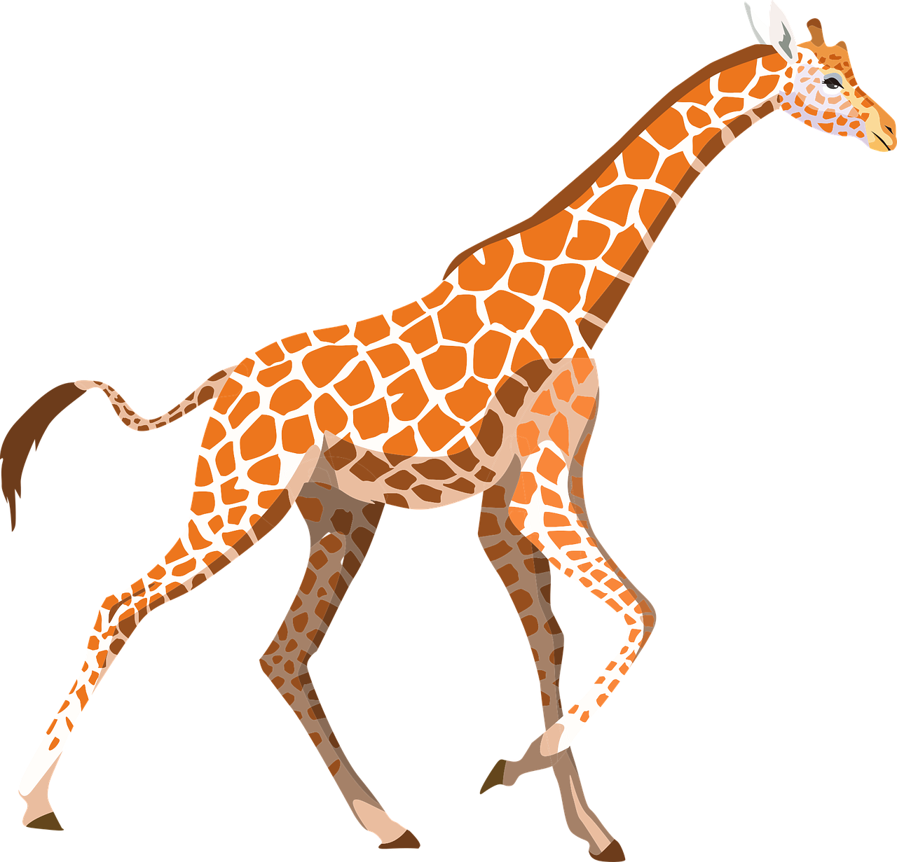
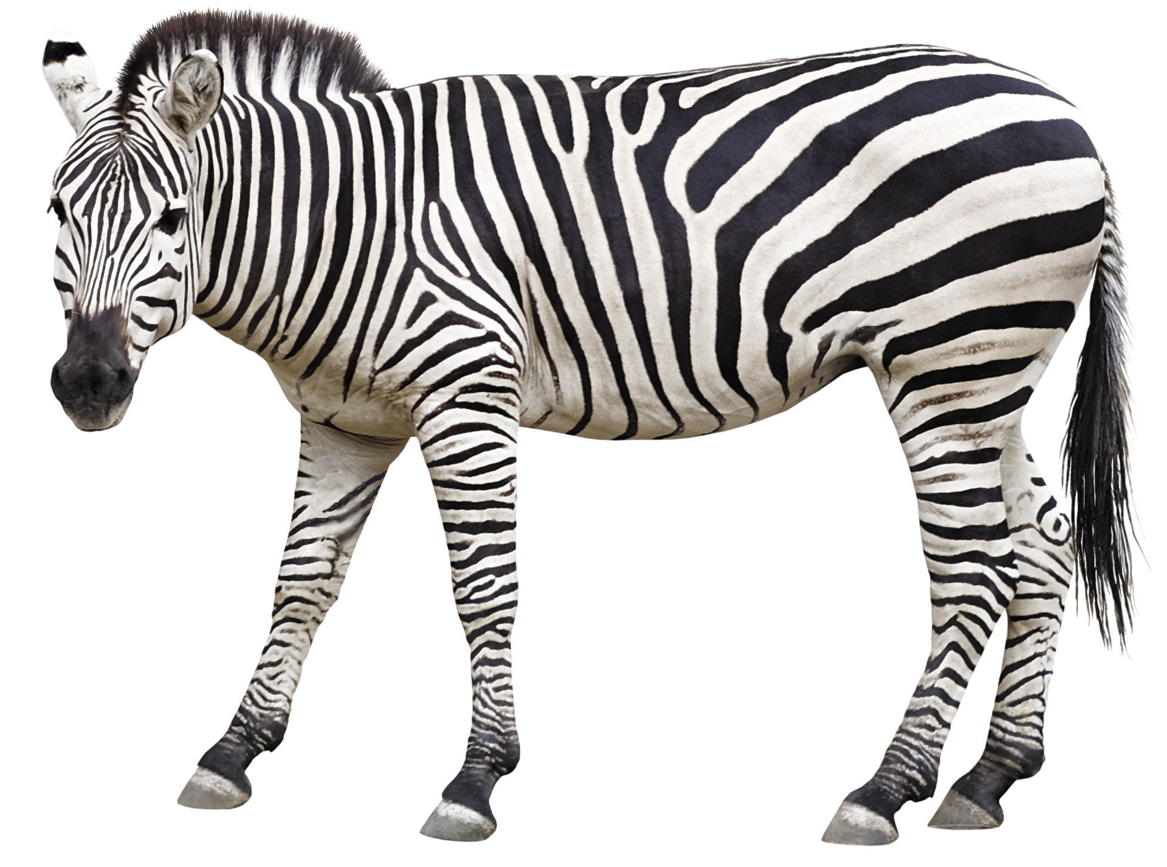
Partenaire A
parler
← Ask your partner about these things.
1. | 4.
2. [le lion] | 5.
3. [les visiteurs]
↓ Answer your partner’s question using the adjective which matches the noun.
6. heureux/difficile
7. idéal/internationaux
8. local/orientaux
9. jeunes/local
10. fondamentaux/commercial
Notes:
Rolecards for printing
(Journalist role on the left and secretary role on the right)

Slide 39
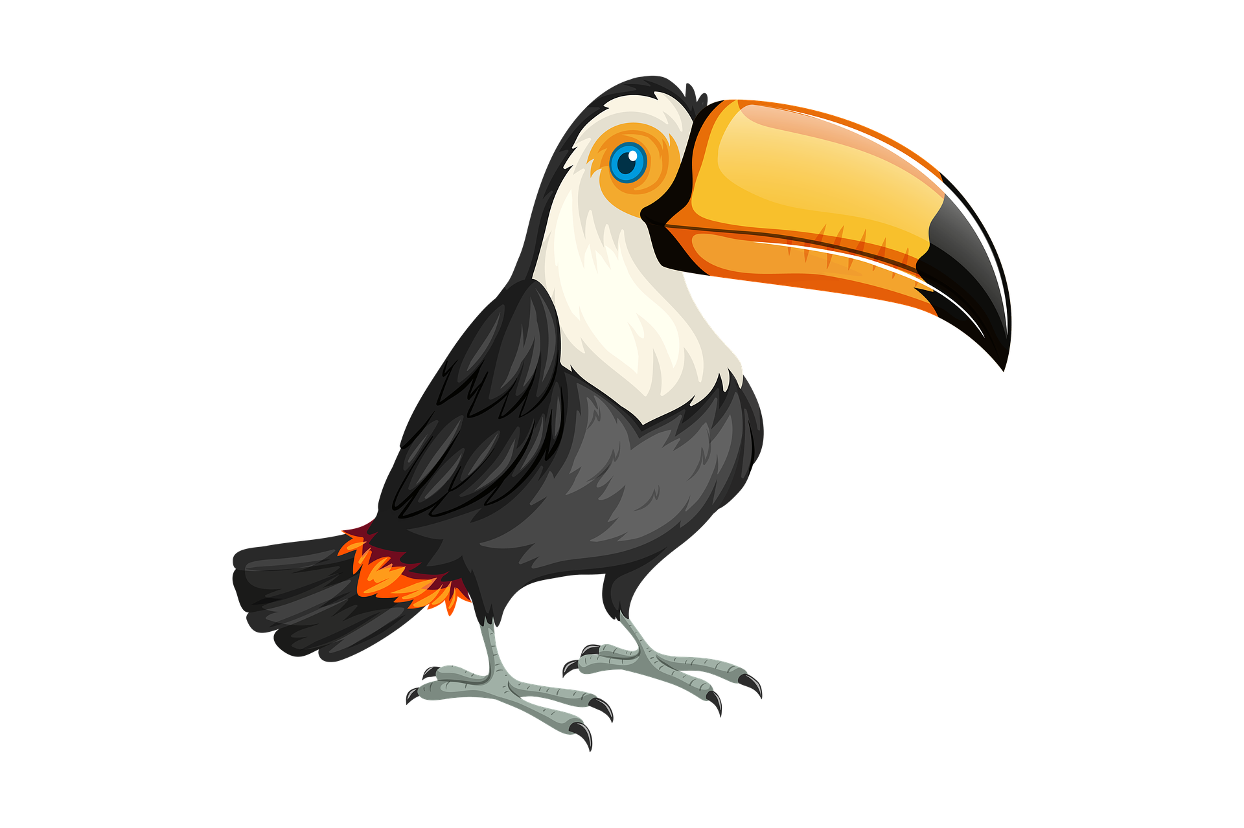
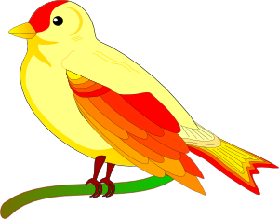
Partenaire B
parler
← Ask your partner about these things.
6. [la situation] | 9. [les pandas]
7.
8. | 10. [works]
↓ Answer your partner’s question using the adjective which matches the noun.
1. dangereux/grande
2. royal/dangereuse
3. royal/internationaux
4. local/énormes
5. tropical/exotiques
Notes:
Rolecards for printing
(Journalist role on the left and secretary role on the right)

Slide 40
Une visite à l’étranger !
parler
Tu vas visiter un nouveau pays. Ton/ta partenaire va poser des questions pour savoir les détails. Réponds aux questions avec l’information sur ta carte. Utilise seulement des phrases négatives.
Questions de partenaire A:
Réponses de partenaire B:
Où ?
Quand ? | demain | l’année prochaine
demain | l’année prochaine
Vas-tu aller en France ou aux États-Unis?
Je ne vais pas aller aux États-Unis.
Vas-tu voyager demain ou l’année prochaine?
Je ne vais pas voyager l’année prochaine.
Notes:
8.2.2.5
Aim: Asking and answering on future plans using the structure aller + infinitive. Oral production of two-verb constructions in the negative, preposition à with the verb aller, au(x) and en to mean to with masculine and feminine countries.
Procedure:
1. Click to bring up the model questions and answers for the example task.
2. Remind students that the short form of aller and the subject pronoun swap places when using the inversion type of question.
NB – although the question word is given, students do no include this in their questions. It is only included for the purposes of categorising on the prompt sheets. They should follow the model provided in order to elicit a reply from their partner containing a negative structure. They must then process that negative answer to arrive at the correct information.
3. Print and distribute the roles cards on slides that follow (2 sets of rolecards per sheet). To avoid printing, the answering student could quickly write down their prompts while the asking student turns away from the board. Then, the asking student’s slide is displayed during the task.

Slide 41
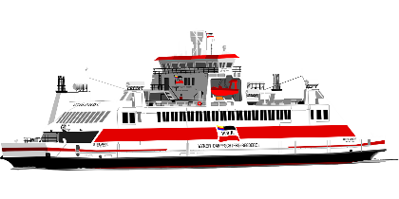
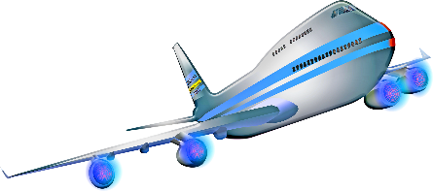
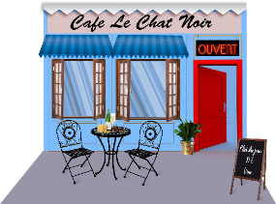
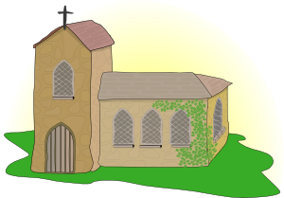
Partenaire A: questions
parler
Donne les réponses
à ton/ta partenaire:
Où ?
Quand ? | demain | le week-end prochain
Comment ?
Samedi ?
Dimanche ?
demain | à l’avenir
Notes:
Procedure:
1. Students ask and answer as per the information on their cards.

Slide 42
Partenaire B: questions
parler
Donne les réponses
à ton/ta partenaire:
Où ?
Quand ? | demain | à l’avenir
Comment ?
Samedi ?
Dimanche ?
demain | le week-end prochain
Notes:
Partner B prompt card.

Slide 43
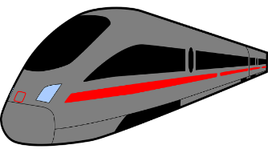
Quelle est la question ?
parler
la réponse
Partenaire A:
“Nous attendons le train.”
Partenaire B:
“Vous attendez quoi ?”
la question
Échangez de rôles !
Notes:
8.3.1.1
Timing: 8 minutes
Aim: Oral production of intonation questions with verbs like entendre in all forms.
Procedure: 1. Cycle through the example on this slide to illustrate how the paired speaking activity on the following slide is intended to work. Ensure students realise the pronouns and verb forms need to change when forming questions to answers in the 1st and 2nd person (tu → je, je → tu, nous → vous pl, vous pl → nous).
2. Partners are given a copy of the relevant card printed on the next slide. The slide may be printed out and cut into two sets of prompt cards, one for each partner. Alternatively, the slide may be displayed on the board, with Partner B’s cards hidden. Partner B then turns away from the board. 3. Explain that Partner A says the answer first, following which Partner B formulates the question that would lead to that answer. Possible question words are listed below the answers for each partner.
4. The teacher can circulate and listen in to check.
5. After Partner A has given all six answers on the card, partners swap roles.

Slide 44
A
Nous attendons le train pour voyager à Londres.
Ils entendent une annonce à l’aéroport.
Tu dépends des moniteurs du ski.
Vous descendez les pistes rouges.
Je réponds aux messages.
Elle attend la décision.
quoi ? –qui ? – où ? – quand ? – pourquoi ?
------------------------------------------------------------------------------------------------------------
B
Vous répondez mal à la question.
Nous entendons un gros oiseau.
Tu dépends du portable.
Je descends pour boire un café.
Ils attendent en ville.
Il entend l’avion.
quoi ? – qui ? – où ? – quand ? – pourquoi ?
Notes:
Do not display this slide during the activity. It provides the ANSWERS that the partners give when it is their turn to lead the activity.
This slide may be printed out and cut into two sets of prompt cards, one for each partner.

Slide 45
Quelle est la question ?
parler
Les réponses:
Les questions:
Nous attendons le train pour voyager à Londres.
Vous attendez quoi ?
Vous attendez le train pour voyager où ?
Ils entendent une annonce à l’aéroport.
Ils entendent quoi ? /
Ils entendent une annonce où ?
Tu dépends des moniteurs du ski.
Je dépends de qui ?
Je réponds aux messages.
Tu réponds à quoi ?
Vous (pl) descendez les pistes rouges.
Nous descendons quoi ?
Elle attend la décision.
Elle attend quoi ?
Notes:
8..3.1.2
Suggested answers for the activity on the previous slide.
Procedure: 1. Elicit answers from students.
2. Click to reveal answers one by one.
[answers to partner B set on next slide]

Slide 46
On parle ! (Exemple)
parler / écouter
Partner A:
Say ONLY the words in bold in French. Don’t say the pronoun or noun.
Your partner will say the noun in French.
A. [We] often read … [letters].
… lisons souvent …
Partner B:
Listen carefully to what your partner says.
Choose the correct picture and say
the word (noun) that completes the sentence!
… des lettres !
A
Notes:
Timing: 10 minutes [5 slides]
Aim: Oral production and aural recognition of plural forms of verbs like dire and écrire.
Procedure:
1. Use this slide to model the activity.
2. Print and distribute the role cards on slide 45.
3. Partner A reads the words in bold from a sentence on this slide. The pronoun is omitted from what is said, in order to focus Partner B’s attention on the verb ending. The noun is omitted so that Partner B can identify this by association with the person as depicted on his/her card (next slide).
4. Partner B determines what the missing noun at the end of the sentence is, by looking at the pictures on his/her card (next slide). Partner A affirms/corrects as necessary.

Slide 47
Partenaire A
Partenaire B
Say ONLY the words in bold in French.
Don’t say the pronoun or noun.
Your partner will say the noun in French.
A. [We] often write … [messages].
B. [She] is saying ... [hello].
C. [You (singular)] sometimes
translate ... [into English].
D. [They(f.pl.)] are describing ... [the weather].
E. [You (plural)] now read ... [books].
F. [I] am writing ... [letters].
Say ONLY the words in bold in French.
Don’t say the pronoun or noun.
Your partner will say the noun in French.
A. [You (plural)] now translate … [books].
B. [He] writes well... [in Spanish].
C. [You (singular)] are describing... [the sun].
D. [We] are reading ... [messages].
E. [I] am writing ... [in my exercise book].
F. [They (m.pl.] are saying ... [goodbye].
Notes:
Partner A 1&2 cards – do not display during the activity.

Slide 48
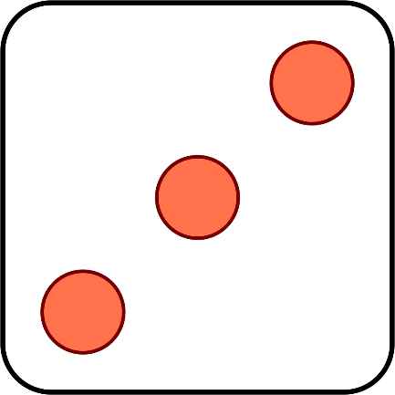
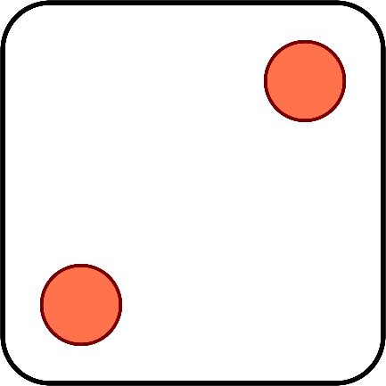
À vous de jouer !
Translate your partner’s sentence into English!
parler
Tense:
When did it happen:
Remember! If you know exactly when something happened, use the simple past in English.
1, 3, 5 = au présent
2, 4, 6 = au passé
1, 3, 5 = à un moment précis
2, 4, 6 = à un moment imprécis
verbes | à un moment précis | à un moment imprécis
commencer (je) | la semaine dernière | déjà
acheter (tu) | en ce moment | enfin
expliquer (il) | hier | toujours
emprunter (on) | maintenant | souvent
quitter (nous) | le 1 novembre | plusieurs fois
faire (vous) | jeudi dernier
dire (elles)
manger (Amir)
Notes:
8.3.1.3
Timing: 5 minutes
Aim: Oral production of sentences in the French perfect tense with a focus on adverb placement. Oral translation French – English.
Procedure:
1. Click to ‘roll’ the dice.
2. Students use the numbers shown on the two dice to randomly select the tense (first) and the type of adverb (second), according to the key. The first dice roll tells them whether they need to make a sentence in the past or present. The second dice roll tells them whether they need to make a sentence with an adverb indicating a specified or non-specified point in time.
3. Students use one verb (and a complement of their choice) from the first column and one adverb from the relevant adverb column.
4. Listening student translates what their partner says into English, paying attention to the tense used.
5. The student should back-translate what they heard to check whether their partner made a sentence with the correct English tense.
6. Click again to move on to the next pair of numbers.
Word frequency of cognates used (1 is the most frequent word in French): précis [643], imprécis [>5000]
Source: Londsale, D., & Le Bras, Y. (2009). A Frequency Dictionary of French: Core vocabulary for learners London: Routledge.

Slide 49
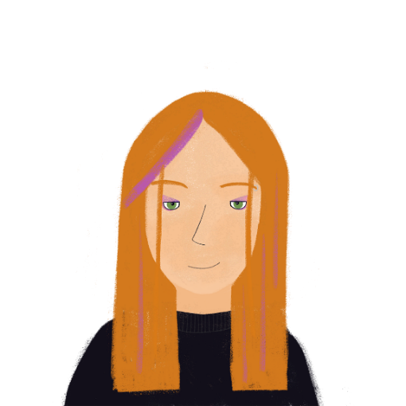
Un conte de fées*
*le conte de fees = fairy tale
parler / écrire
Tes partenaires ont visité une vieille femme dans la forêt.
Use the role play card to ask them questions about their visit in the past tense.
Make notes (in the third person) on what you hear.
Vous avez frappé à quoi ?
Nous avons frappé à la porte.
frapper à quoi Vous _______ ?
 | frapper à la porte Nous ______ .
Ils/elles ont frappé à la porte.
Notes:
8.3.2.4
Timing: 8 minutes
Aim: Oral and written production of the plural forms of –ER verbs in the perfect tense.
Procedure:
1. Print and distribute the cue cards on slides 24-25. Tell students they are going to work in pairs with another pair to co-create two fantasy stories.
2. Use this slide to model the task. Students take it in turns to ask and answer questions on behalf of their pair. Pair A begins by asking the question indicated on their role card in the perfect tense, using the vous form. At this stage, students to use intonation or est-ce que questions (inversion questions in the perfect tense will be introduced in lesson 2).
3. Pair B responds in the perfect tense using the nous form, following the prompt on their card.
4. Pair A make notes on what they hear in the ils/elles form.
5. After four turns, one member of pair A reads the full story aloud (4 sentences in the 3rd person plural). See slide 26 for the solution.
6. Pairs swap roles.
Word frequency of cognates used (1 is the most frequent word in French): interview [3186]
Source: Londsale, D., & Le Bras, Y. (2009). A Frequency Dictionary of French: Core vocabulary for learners London: Routledge.

Slide 50
Un conte de fées (A)
parler / écrire
Ask these questions |  | Give these answers
1. frapper à quoi ? Vous _______ ? |  | 5. écouter la femme Nous ______ .
2. parler à qui ? Vous _______ ? |  | 6. manger du fromage Nous ______ .
3. expliquer quoi ? Vous _______ ? |  | 7. quitter sa maison Nous ______ .
4. donner quoi à la femme? Vous _______ ? |  | 8. fermer la porte Nous ______ .
Notes:
Role play card for group A.

Slide 51
Un conte de fées (B)
parler / écrire
 | Give these answers | Ask these questions
 | 5. frapper à la porte Nous ______ . | 1. écouter qui ? Vous _______ ?
 | 6. parler à la femme Nous ______ . | 2. manger quoi ? Vous _______ ?
 | 7. expliquer l’histoire Nous ______ . | 3. quitter où ? Vous _______ ?
 | 8. donner le livre à la femme Nous ______ . | 4. fermer quoi ? Vous _______ ?
Notes:
Role play card for the previous slide.

Slide 52
Un conte de fées (réponses)
parler / écrire
Groupe A
Ils ont écouté la femme. Ils ont mangé du fromage. Ils ont quitté sa maison. Ils ont fermé la porte.
Groupe B
Ils ont frappé à la porte. Ils ont parlé à la femme. Ils ont expliqué l’histoire. Ils ont donné le livre à la femme.
Notes:
Role play card for the previous slide.

Slide 53
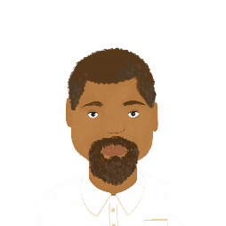
Amir et ses professeurs
parler
Continue la conversation entre Amir et son professeur. Dis des questions et des réponses au passé composé. Voici des verbes que vous pouvez utiliser.
organiser
envoyer
utiliser
proposer
commencer
expliquer
écouter
parler
trouver
montrer
penser à
travailler
chercher
partager
visiter
Notes:
8.3.2.4
Timing: 8 minutes
Aim: Semi-structured oral production of inversion questions and statements using plural forms of –ER verbs in the perfect tense.
Procedure:
1. Begin by recapping placement rules for ne…pas in the perfect tense.
2. Students take on the role of either Amir or the teacher.
3. The student playing Amir begins by asking a question in the past tense using one of the verbs provided (or another verb). Students should use a different verb each time. At lower levels, the teacher may wish to provide some nouns to go with the suggested verbs.
4. The student playing the teacher replies with a statement using the same verb. Encourage students to use a mix of affirmative and negative sentences.
5. Continue steps 3-4 for 5 questions in total.
6. Students swap roles. Repeat steps 3-5.
Word frequency of cognates used (1 is the most frequent word in French): continuer [113], verbe [>5000], composer [858]
Source: Londsale, D., & Le Bras, Y. (2009). A Frequency Dictionary of French: Core vocabulary for learners London: Routledge.

Slide 54
Trouve les paires
parler
Groupe A
Groupe B
hear the announcement
takes the train
hear the announcement
takes the bus
Vous entendez l’annonce ?
Oui, nous entendons l’annonce.
Vous prenez le train ?
Non, nous prenons le bus.
Notes:
8.3.1.6
Timing: 8 minutes (this slide models the activity) Aim: Oral production of verbs like entendre covered in this lesson in the nous/vous form and revision of the prendre group which take the same endings (with a spelling change). This is a spot the difference task (information gap). Students work in pairs with another pair. Each pair has 10 cards. Speakers exchange information to find the differences together.
Procedure: 1. Remind students of the stem changes in the prendre group. Use this slide to model the task by checking students can form questions and responses in the nous and vous forms (click to reveal pictures and model questions/answers).
2. Distribute the rolecards on slides 12-13.
3. Students in pair A take turns asking a question about one of the cards to the other pair, addressing them in the vous forms (e.g., Vous prenez le train ?).
4. Students in pair B check whether the information on their card is the same (Oui, nous prenons le train / Non, nous prenons le bus).
5. Then students in pair B offers a piece of information and so on until all cards have been discussed and the differences found.
Word frequency of unknown words and cognates used (1 is the most frequent word in French):
bus [4027]
Source: Londsale, D., & Le Bras, Y. (2009). A Frequency Dictionary of French: Core vocabulary for learners London: Routledge.

Slide 55
Trouve les paires – groupe A
parler
learn new Spanish words
take the car
understand the conversations
hear the announcements
depend on a mobile
reply to messages
go down the ski slope
wait for a boat
Salut!
Salut!
Notes:
NOT FOR DISPLAY DURING THE ACTIVITY

Slide 56
Trouve les paires – groupe B
parler
learn difficult Spanish words
take the train
understand the conversations
hear the announcements
depend on social media
reply to messages
go down the street
wait for a plane
Salut!
Salut!
Notes:
NOT FOR DISPLAY DURING THE ACTIVITY

Slide 57
Quelle est la question ?
parler
la réponse
Partenaire A:
“Nous attendons le train.”
Partenaire B:
“Vous attendez quoi ?”
la question
Échangez de rôles !
Notes:
8.3.1.6
Timing: 8 minutes
Aim: Oral production of intonation questions with verbs like entendre in all forms.
Procedure: 1. Cycle through the example on this slide to illustrate how the paired speaking activity on the following slide is intended to work. Ensure students realise the pronouns and verb forms need to change when forming questions to answers in the 1st and 2nd person (tu → je, je → tu, nous → vous pl, vous pl → nous).
2. Partners are given a copy of the relevant card printed on the next slide. The slide may be printed out and cut into two sets of prompt cards, one for each partner. Alternatively, the slide may be displayed on the board, with Partner B’s cards hidden. Partner B then turns away from the board. 3. Explain that Partner A says the answer first, following which Partner B formulates the question that would lead to that answer. Possible question words are listed below the answers for each partner.
4. The teacher can circulate and listen in to check.
5. After Partner A has given all six answers on the card, partners swap roles.

Slide 58
A
Nous attendons le train pour voyager à Londres.
Ils entendent une annonce à l’aéroport.
Tu dépends des moniteurs du ski.
Vous descendez les pistes rouges.
Je réponds aux messages.
Elle attend la décision.
quoi ? –qui ? – où ? – quand ? – pourquoi ?
------------------------------------------------------------------------------------------------------------
B
Vous répondez mal à la question.
Nous entendons un gros oiseau.
Tu dépends du portable.
Je descends pour boire un café.
Ils attendent en ville.
Il entend l’avion.
quoi ? – qui ? – où ? – quand ? – pourquoi ?
Notes:
Do not display this slide during the activity. It provides the ANSWERS that the partners give when it is their turn to lead the activity.
This slide may be printed out and cut into two sets of prompt cards, one for each partner.

Slide 59
Quelle est la question ?
parler
Les réponses:
Les questions:
Nous attendons le train pour voyager à Londres.
Vous attendez quoi ?
Vous attendez le train pour voyager où ?
Ils entendent une annonce à l’aéroport.
Ils entendent quoi ? /
Ils entendent une annonce où ?
Tu dépends des moniteurs du ski.
Je dépends de qui ?
Je réponds aux messages.
Tu réponds à quoi ?
Vous (pl) descendez les pistes rouges.
Nous descendons quoi ?
Elle attend la décision.
Elle attend quoi ?
Notes:
Suggested answers for the activity on the previous slide.
Procedure: 1. Elicit answers from students.
2. Click to reveal answers one by one.
[answers to partner B set on next slide]

Slide 60
Quelle est la question ?
parler
Les réponses:
Les questions:
Ils attendent en ville.
Ils attendent où ?
Vous (pl) répondez mal à la question.
Nous répondons mal à quoi ?
Nous répondons comment à la question ?
Nous entendons un gros oiseau.
Vous entendez quoi ?
Tu dépends du portable.
Je dépends de quoi ?
Je descends pour boire un café.
Tu descends pourquoi ?
Tu descends pour boire quoi ?
Il entend l’avion.
Il entend quoi ?
Notes:
Answers
Procedure: 1. Elicit answers from students.
2. Click to reveal answers one by one.

Slide 61
On parle ! (Exemple)
parler / écouter
Partner A:
Say ONLY the words in bold in French. Don’t say the pronoun or noun.
Your partner will say the noun in French.
A. [We] often read … [letters].
… lisons souvent …
Partner B:
Listen carefully to what your partner says.
Choose the correct picture and say
the word (noun) that completes the sentence!
… des lettres !
A
Notes:
8.3.2.1
Timing: 8 minutes [5 slides]
Aim: Oral production and aural recognition of plural forms of verbs like dire and écrire.
Procedure:
1. Use this slide to model the activity.
2. Print and distribute the role cards on slide 45.
3. Partner A reads the words in bold from a sentence on this slide. The pronoun is omitted from what is said, in order to focus Partner B’s attention on the verb ending. The noun is omitted so that Partner B can identify this by association with the person as depicted on his/her card (next slide).
4. Partner B determines what the missing noun at the end of the sentence is, by looking at the pictures on his/her card (next slide). Partner A affirms/corrects as necessary.

Slide 62
Partenaire A
Partenaire B
Say ONLY the words in bold in French.
Don’t say the pronoun or noun.
Your partner will say the noun in French.
A. [We] often write … [messages].
B. [She] is saying ... [hello].
C. [You (singular)] sometimes
translate ... [into English].
D. [They(f.pl.)] are describing ... [the weather].
E. [You (plural)] now read ... [books].
F. [I] am writing ... [letters].
Say ONLY the words in bold in French.
Don’t say the pronoun or noun.
Your partner will say the noun in French.
A. [You (plural)] now translate … [books].
B. [He] writes well... [in Spanish].
C. [You (singular)] are describing... [the sun].
D. [We] are reading ... [messages].
E. [I] am writing ... [in my exercise book].
F. [They (m.pl.] are saying ... [goodbye].
Notes:
Partner A 1&2 cards – do not display during the activity.

Slide 63
Partenaire B
parler / écouter
Listen carefully to what partner A says. Choose the correct picture and say the word (noun) that completes the sentence!
A
C
E
@
[vous]
[tu]
[tu]
@
[nous]
[vous]
[ils]
B
Bonjour !
D
F
[elle]
[il]
[je]
Au revoir !
[ils]
[elles]
[the weather]
[elles]
Notes:
Display this slide when partner A is speaking.

Slide 64
Partenaire A
parler / écouter
Listen carefully to what partner B says. Choose the correct picture and say the word (noun) that completes the sentence!
A
C
E
[tu]
[tu]
[je]
[vous]
[vous]
[elles]
B
D
F
@
Au revoir !
[ils]
[nous]
[ils]
Bonjour !
[il]
[ils]
[elle]
Notes:
Display this slide when partner B is speaking.

Slide 65
On parle ! (réponses)
parler / écouter
Partner A:
Nous écrivons souvent des messages.
Elle dit bonjour.
Tu traduis parfois en anglais.
Elles décrivent le temps.
Vous lisez maintenent des livres.
J’écris des lettres.
Partenaire B:
Vous traduisez maintenant des livres.
Il écrit bien en espagnol.
Tu décris le soleil.
Nous lisons des messages.
J’écris dans mon cahier.
Ils disent au revoir.
Notes:
Answers

Slide 66
Un conte de fées*
*le conte de fees = fairy tale
parler / écrire
Tes partenaires ont visité une vieille femme dans la forêt.
Use the role play card to ask them questions about their visit in the past tense.
Make notes (in the third person) on what you hear.
Vous avez frappé à quoi ?
Nous avons frappé à la porte.
frapper à quoi Vous _______ ?
 | frapper à la porte Nous ______ .
Ils/elles ont frappé à la porte.
Notes:
8.3.2.4
Timing: 8 minutes
Aim: Oral and written production of the plural forms of –ER verbs in the perfect tense.
Procedure:
1. Print and distribute the cue cards on slides 24-25. Tell students they are going to work in pairs with another pair to co-create two fantasy stories.
2. Use this slide to model the task. Students take it in turns to ask and answer questions on behalf of their pair. Pair A begins by asking the question indicated on their role card in the perfect tense, using the vous form. At this stage, students to use intonation or est-ce que questions (inversion questions in the perfect tense will be introduced in lesson 2).
3. Pair B responds in the perfect tense using the nous form, following the prompt on their card.
4. Pair A make notes on what they hear in the ils/elles form.
5. After four turns, one member of pair A reads the full story aloud (4 sentences in the 3rd person plural). See slide 26 for the solution.
6. Pairs swap roles.
Word frequency of cognates used (1 is the most frequent word in French): interview [3186]
Source: Londsale, D., & Le Bras, Y. (2009). A Frequency Dictionary of French: Core vocabulary for learners London: Routledge.

Slide 67
Un conte de fées (A)
parler / écrire
Ask these questions |  | Give these answers
1. frapper à quoi ? Vous _______ ? |  | 5. écouter la femme Nous ______ .
2. parler à qui ? Vous _______ ? |  | 6. manger du fromage Nous ______ .
3. expliquer quoi ? Vous _______ ? |  | 7. quitter sa maison Nous ______ .
4. donner quoi à la femme? Vous _______ ? |  | 8. fermer la porte Nous ______ .
Notes:
Role play card for group A.

Slide 68
Un conte de fées (B)
parler / écrire
 | Give these answers | Ask these questions
 | 5. frapper à la porte Nous ______ . | 1. écouter qui ? Vous _______ ?
 | 6. parler à la femme Nous ______ . | 2. manger quoi ? Vous _______ ?
 | 7. expliquer l’histoire Nous ______ . | 3. quitter où ? Vous _______ ?
 | 8. donner le livre à la femme Nous ______ . | 4. fermer quoi ? Vous _______ ?
Notes:
Role play card for the previous slide.

Slide 69
Un conte de fées (réponses)
parler / écrire
Groupe A
Ils ont écouté la femme. Ils ont mangé du fromage. Ils ont quitté sa maison. Ils ont fermé la porte.
Groupe B
Ils ont frappé à la porte. Ils ont parlé à la femme. Ils ont expliqué l’histoire. Ils ont donné le livre à la femme.
Notes:
Role play card for the previous slide.

Slide 70
Amir et ses professeurs
parler
Continue la conversation entre Amir et son professeur. Dis des questions et des réponses au passé composé. Voici des verbes que vous pouvez utiliser.
organiser
envoyer
utiliser
proposer
commencer
expliquer
écouter
parler
trouver
montrer
penser à
travailler
chercher
partager
visiter
Notes:
8.3.2.4
Timing: 8 minutes
Aim: Semi-structured oral production of inversion questions and statements using plural forms of –ER verbs in the perfect tense.
Procedure:
1. Begin by recapping placement rules for ne…pas in the perfect tense.
2. Students take on the role of either Amir or the teacher.
3. The student playing Amir begins by asking a question in the past tense using one of the verbs provided (or another verb). Students should use a different verb each time. At lower levels, the teacher may wish to provide some nouns to go with the suggested verbs.
4. The student playing the teacher replies with a statement using the same verb. Encourage students to use a mix of affirmative and negative sentences.
5. Continue steps 3-4 for 5 questions in total.
6. Students swap roles. Repeat steps 3-5.
Word frequency of cognates used (1 is the most frequent word in French): continuer [113], verbe [>5000], composer [858]
Source: Londsale, D., & Le Bras, Y. (2009). A Frequency Dictionary of French: Core vocabulary for learners London: Routledge.

