Slide 1
Practice assessment
Year 9 Spanish
Term 2 applying your knowledge test
Louise Caruso / Nick Avery
Date updated: 09/02/22
Notes:
Artwork by Mark Davies. All additional pictures selected are available under a Creative Commons license, no attribution required.
Learning outcomes:
Familiarity with each part of the ‘applying your knowledge’ test.
Source: Davies, M. & Davies, K. (2018). A frequency dictionary of Spanish: Core vocabulary for learners (2nd ed.). Routledge: London
The frequency rankings for words that occur in this PowerPoint which have been previously introduced in NCELP resources are given in the NCELP SOW and in the resources that first introduced and formally re-visited those words.
For any other words that occur incidentally in this PowerPoint, frequency rankings will be provided in the notes field wherever possible.

Slide 2
Section A: Listening
There are two marks for each item.
PART A: You will hear Lucía talk about what she and her friend Nadia enjoy doing after school. You must decide who does the activity, and when. For each question, circle one answer for ‘who?’ and one answer for ‘when?’.
You will hear the story twice, with a 20 second gap in between. After hearing the story for the second time, you will have another minute to complete the grid. First, you have 20 seconds to read the activities.
 | Activity | Who? |  | When?
1 | go the park | Lucía | Nadia | yesterday | tomorrow
 |  | Lucía and Nadia | other people | usually in the past
 | Activity | Who? |  | When?
2 | attend tennis lessons | Lucía | Daniel | yesterday | tomorrow
 |  | Lucía and Nadia | other people | usually in the past
Notes:
Timing: 5 minutes
Aim: to familiarise students with section A, part A (listening task)
Procedure:
Read the instructions out to students. Note: In the actual test, the instructions will be part of the recording.
Click to show the marks available.
Click the speaker icon to play the recording. There will be a 20 second pause after the first reading of the text, and then the text will be heard again. There is no need to click the speaker button twice.
Click to show the answers one by one.
Transcript:
Mañana va a hacer buen tiempo y mis compañeros del colegio van a ir al parque para celebrar el cumpleaños de una amiga. Van a charlar y comer dulces. Quiero ir también, pero no sé si puedo porque tengo muchos deberes para el viernes.
Antes no tenía que estudiar mucho en casa y podía practicar muchos deportes. Jugaba al fútbol tres veces a la semana y, además, asistía a clases de tenis cada lunes con Nadia.
Ahora no tengo suficiente tiempo para el deporte. El jueves pasado mis padres llevaron a Daniel a un partido de fútbol, pero no fui porque tuve que escribir un texto para la clase de alemán y terminar otros deberes.

Slide 3
Section A: Listening
There are two marks for each item.
PART B
Now listen for a third time. Answer the questions in English.
 |  | Write as many details as you can (2 marks per question)
a) | What are Lucía’s friends going to do at the beach?
b) | Why didn’t Lucía go to the pelota match?
Chat
Eat sweets / sweet things
She had to write a text (for her German class)
She had to finish other homework
Notes:
Timing: 5 minutes
Aim: to familiarise students with section A, part B (listening task)
Procedure:
Read the instructions to the students. Click to show how many marks are available for each item.
Click the speaker icon to play the recording.
Click to show the answers one by one to allow teachers to elicit answers from the students.
Transcript:
Mañana va a hacer buen tiempo y mis compañeros del colegio van a ir al parque para celebrar el cumpleaños de una amiga. Van a charlar y comer dulces. Quiero ir también, pero no sé si puedo porque tengo muchos deberes para el viernes.
Antes no tenía que estudiar mucho en casa y podía practicar muchos deportes. Jugaba al fútbol tres veces a la semana y, además, asistía a clases de tenis cada lunes con Nadia.
Ahora no tengo suficiente tiempo para el deporte. El jueves pasado mis padres llevaron a Daniel a un partido de fútbol, pero no fui porque tuve que escribir un texto para la clase de alemán y terminar otros deberes.

Slide 4
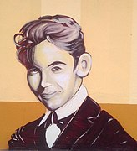
Section B: Reading comprehension
*la obra de teatro = play
PART A Read the text about Federico García Lorca. Number these events in the order that they happened. Write the numbers 1-4 in the boxes on the right (1= happened first, 4 = happened last).
There is a half mark for each item.
Federico García Lorca nació en Andalucía en 1907. Cuando era joven, le gustaba escuchar las canciones populares y leer novelas. Publicó su primer libro de poemas cuando tenía solo diez años. Más tarde, escribió sobre la discriminación y en 1930, viajó a New York para describir como sufría la gente negra en los Estados Unidos.
Es muy conocido por sus obras de teatro* que mostraban las vidas de la gente ‘normal’ de Andalucía. Trató temas como el amor, la muerte y la familia. Murió en 1936. Lo mataron por sus ideas y su sexualidad.
He travelled to New York
He published his first book.
He wrote about love and death.
He wrote about racism.
2
1
4
3
Notes:
Timing: 4 minutes
Aim: to familiarise students with section B, part A (reading task)
Procedure:
Click to show how many marks are available for the question and then again to reveal a short text.
Click again to show the answers for the order of the four events on the right.
Note: in the real test, there will be six answer options rather than four.
Picture by Zarateman free to use by Creative Commons CC0 1.0 Universal Public Domain Dedication. and available at:https://commons.wikimedia.org/wiki/File:Miranda_de_Ebro_-_Graffitis_literarios_02.jpg
Frequency of unknown words and cognates:
homosexual [>5000]; obra [193]; discriminación [3859]

Slide 5
Section B: Reading comprehension
*la obra de teatro = play
Part B
Put a cross (x) in the correct column to show whether the statements below are true (T), false (F), or not mentioned in the text (NM).
There is one mark for each item.
Federico García Lorca nació en Andalucía en 1907. Cuando era joven, le gustaba escuchar las canciones populares y leer novelas. Publicó su primer libro de poemas cuando tenía solo diez años. Más tarde, escribió sobre la discriminación y en 1930, viajó a New York para describir como sufría la gente negra en los Estados Unidos.
Es muy conocido por sus obras de teatro* que mostraban las vidas de la gente ‘normal’ de Andalucía. Trató temas como el amor, la muerte y la familia. Murió en 1936. Lo mataron por sus ideas y su sexualidad.
 | T | F | NM
Federico wanted to study physics.
Federico first book was a novel.
Notes:
Timing: 4 minutes
Aim: to familiarise students with section B, part B (reading task)
Procedure:
Click to show how many marks are available for the question and then again to reveal a short text.
Click again to show the answers for the two missing places.
Note: in the real test, there will be five such questions.
Picture by Zarateman free to use by Creative Commons CC0 1.0 Universal Public Domain Dedication. and available at:https://commons.wikimedia.org/wiki/File:Miranda_de_Ebro_-_Graffitis_literarios_02.jpg
Frequency of unknown words and cognates:
sexualidad [>5000]; obra [193]; discriminación [3859]

Slide 6
Section C: Writing
There is one mark for each item.
PART A
Read Lucía’s article for the school paper. Fill the blanks with a sensible word that starts with the given letter.
NUESTRO PLANETA, NUESTRO FUTURO
Ayer un grupo de c__________ estudiantes de nuestra escuela hizo una manifestación en la ciudad. El grupo c________ desde el castillo y llegó al centro a las dos de la t________ . Sofía García es la chica que organizó el día. Ella quiere ver más acción: “nuestro gobierno debe p_________ el medioambiente, prohibir el uso de bolsas de plástico y resolver problemas g________ como la cantidad de basura en la playa cada fin de semana. En este momento el futuro me d________ miedo."
cien
caminó
tarde
proteger
graves
da
Notes:
Timing: 4 minutes
Aim: to familiarise students with section C, part A (writing task)
Procedure:
Click to show the marks for the exercise
Students fill in the gaps.
Answers are shown by clicking.
Note: there is sometimes more than one possible answer. For example, ‘cien’ could also be ‘catorce’ or ‘cuarenta’. ‘Graves’ could also be ‘grandes’.

Slide 7
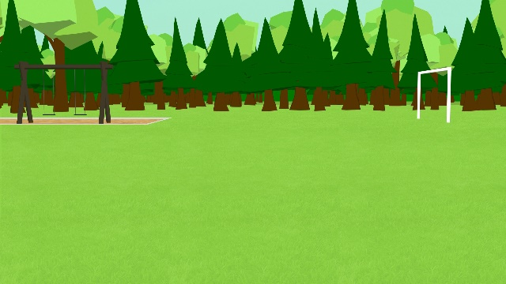
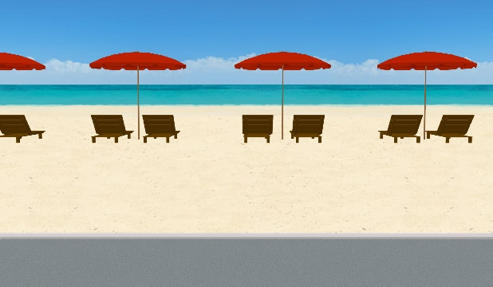
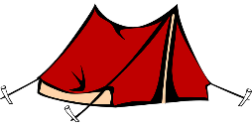
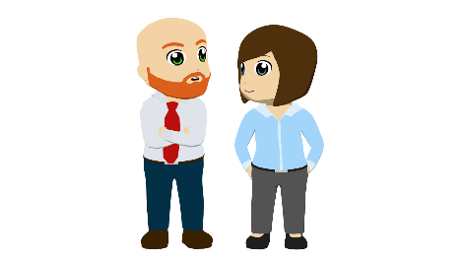
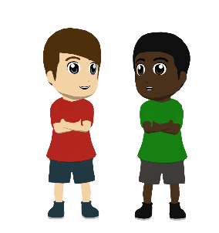
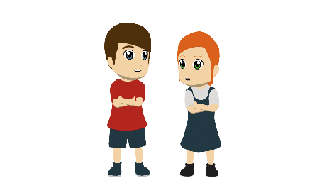
Section C: Writing
1 mark for each word. A mark is given for the use of a word where its meaning is fully and accurately communicated.
PART B
What happened last year? What will happen next year?
Write between one and three sentences in Spanish for each picture. Write your sentences in the blank box on the right. Use all of the Spanish words under the boxes.
Try to show that you know what the words mean by writing full sentences that make sense. Remember that you will need to change the form of some of the words. You can use your imagination if you like!
Last year
viajar / a pesar de / campo / bosque
Next year
nadar / descansar / sol / extranjero
Notes:
Timing: 10 minutes
Aim: to familiarise students with section C, part B (writing task)
Procedure:
Click to show the marks for the exercise
Students write sentences based on the picture stimuli. All of the words under the photos must be used. As this is a creative response, there are many possible answers. A few are listed below. Teachers could perhaps prepare some of their own sentences and listen to a variety of student responses. Students could even share their answers in pairs or groups.
Possible answers:
Viajé al campo con un amigo / con Hugo.
Pasamos mucho tiempo en un bosque.
Disfrutamos del viaje a pesar del tiempo / a pesar de la lluvia.
Jugamos al fútbol y sacamos fotos / usamos la cámara.
Vamos a ir de vacaciones al extranjero.
Voy a ir a la playa con mi familia.
Vamos a descansar y disfrutar del sol.
Mi padre va a nadar en el mar.

Slide 8
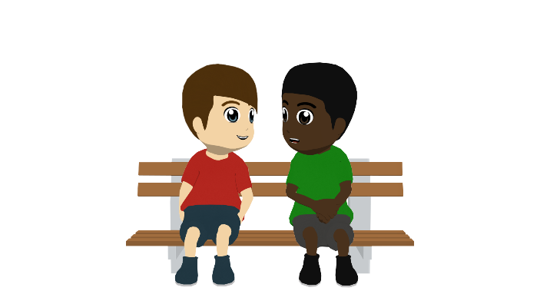
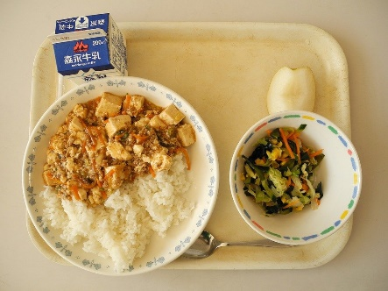
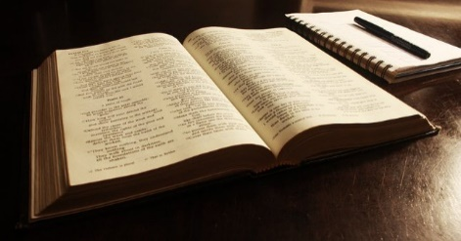
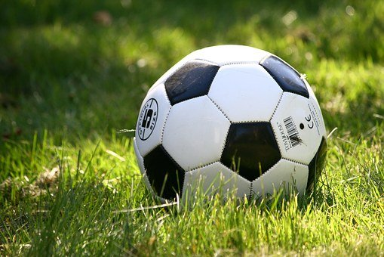
Section D: Speaking
For each sentence you get 2 marks for expressing the meaning and 1 mark for speaking accurately. There are also up to 2 marks for fluency, across the whole task.
You are Daniel. You are telling your family about your day at school yesterday. You have 2 minutes to complete the sentences below before you speak. Pick a different activity and use a different verb for each sentence.
1. |  | Por la mañana yo …
2. |  | Más tarde Hugo…
3. |  | Por la tarde Hugo y yo…
Now, ask Lucía a question about her day in Spanish.
Remember to choose a different activity for each question.
Do your best to say something, even if you’re not totally sure what to say. The main thing is to have a go! You can make up funny sentences if you wish!
1. |  | Lucía, did you …?
Notes:
Timing: 8 minutes
Aim: to familiarise students with section D, part A (speaking task)
Procedure:
Click to show the marks for the exercise.
Teachers can decide how best to carry out this exercise. It may be best for students to work in pairs, taking it in turns to give short answers. Teachers could time the activity to give a feeling of what it will be like in the test. We suggest that pairs could then work in small groups to listen to each other’s answers, and then the teacher can listen to more answers following that. Teachers may like to prepare some other questions to stimulate other possible answers to show just how much could be said about the pictures.
Photos – free to use from Pixabay

Slide 9
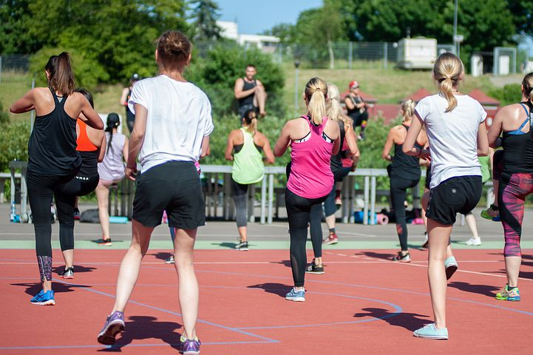
Section E: Reading aloud and comprehension
For each short paragraph in Part A there is 1 mark for comprehensibility and 1 mark for fluency, giving 2 points for each sentence in total.
PART A
Read the following text aloud.
You won’t know some of the words – don’t worry! Just do your best to read them aloud as you think they should sound in Spanish. You will get points for clear and understandable pronunciation.
PART B
Now say, in English, any 2 facts mentioned in the text.
Una disciplina de origen colombiano, la Zumba, es una mezcla de ritmos latinos: salsa, merengue, flamenco, bachata y ejercicios aeróbicos. Es una forma realmente popular de perder peso.
There is 0.5 mark for each fact correctly identified in the text in Part B.
Notes:
Timing: 8 minutes
Aim: to familiarise students with section D, part B (speaking task)
Procedure:
Click to show the marks for the exercise.
Teachers can decide how best to carry out this exercise. It may be best for students to work in pairs, taking it in turns to read the sentences to each other. Then the teacher can choose to listen to several students.
For Part B, students could write down their own answers before the teacher asking for responses.
Photo free to use from https://pixabay.com/photos/zumba-party-marathon-sport-4333580/ by Andzej Rembowski

