Slide 1
National Centre for Excellence in Language Pedagogy
Introduction to NCELP:
Supporting MFL curriculum, resources, and pedagogy
Dr Heike Krüsemann
Talk held: 16 November 2020
Date updated: 10/02/21

Slide 2
Outline of the talk
1/ Pedagogy Review and the setting up of NCELP
2/ The Scheme of Work
3/ Core language knowledge and resources:
Phonics, Vocabulary, Grammar
4/ Where can I find out more information?

Slide 3
All materials shown in this presentation are freely available from: https://resources.ncelp.org/

Slide 4
Languages Pedagogy Review: 13 recommendations for schools:
vast majority should take GCSE (75% in Y10 by 2022, 90% by 2025; now in Ofsted framework)
phonics, vocabulary, grammar taught systematically, with extensive practice
stimulating content without compromising vocab and grammar
materials selected for how well they support a planned teaching of phonics, vocab and grammar
focus on detail through translation, extend vocabulary through short texts and literature, interact with native speakers
know and build on KS2 grammar

Slide 5
Languages Pedagogy Review, Recommendations (cont’d)
know and build on the KS2 languages teaching in feeder schools
plan own and students’ TL use carefully, to reinforce taught language
use errors to inform teaching, without discouragement
integrated teaching of L, S, R, W (they share common knowledge)
2-3 hrs teaching time, in lessons of 40-60 minutes (GCSE = 10% curriculum time)
meet needs of all learners across the ability range
assessment should focus specifically on Phonics, Vocabulary, Grammar taught (achievement tests), with some tasks to compose own sentences and give own oral presentations
Notes:
Today we can’t cover all of these. But you can now find resources on all of them on the ncelp resources portal.
There are professional development power points and there are documents explaining the research that underpins some of the decisions.

Slide 6
What about beyond the NCELP network?
Over 860 materials https://resources.ncelp.org/
Fully resourced SOW + materials for 300 Spanish, French, German lessons
For year 7 and year 8 term 1
Complete to end of year 9 by Sept 2020
Including audio files, homeworks, tests with mark schemes
Oak online national academy videoed lessons
All year 7 and ongoing year 8; using NCELP resources
Years 9, 10, 11; informed by pedagogy review and NCELP principles
BBC Bitesize
NCELP teachers talking about grammar and phonics!
https://www.bbc.co.uk/teach/teacher-support/mfl-teaching-aids/zjfckmn
New content focusing on vocab, phonics, grammar:
French: https://www.bbc.co.uk/bitesize/subjects/zgdqxnb
German: https://www.bbc.co.uk/bitesize/subjects/zcj2tfr
Spanish: https://www.bbc.co.uk/bitesize/subjects/zfckjxs
Gaming Grammar https://www.gaminggrammar.com (+apps)

Slide 7
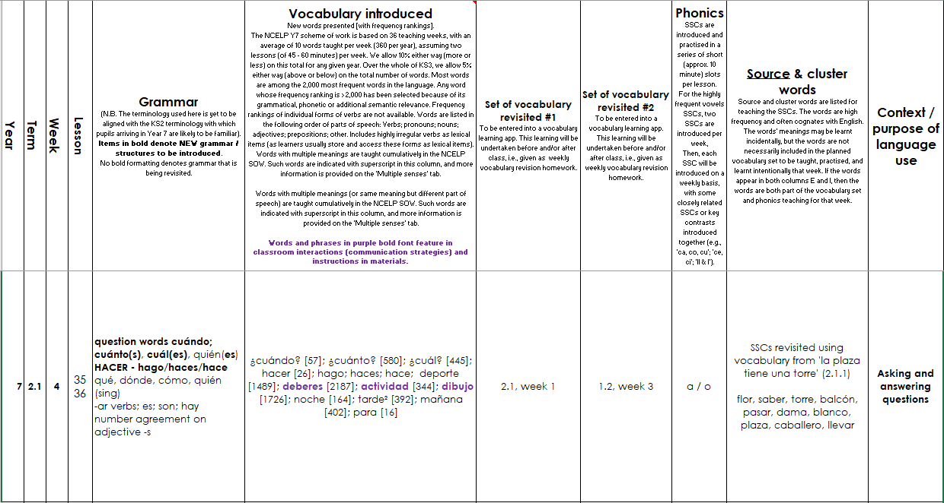
Screen shot of a SOW
Systematic revisiting of vocabulary every 3 weeks and 9 weeks
‘Context’: purpose of the language
e.g., “Asking / answering questions”
phonics practice every lesson
Grammar sequencing is language specific
Extremely high frequency (irregular!) verbs at start
Then highly regular and frequent verbs
Weeks set aside for work on ‘rich texts’
Notes:
This is what a page from Spanish SoW looks like –this is from week 4 of the Spring term
Starts with grammar introduced – question words and use of hacer – 1st 2nd and 3rd person – so high frequency , including high frequency irregular verbs – then we see new vocabulary introduced as well as vocabulary to be revisited – here we have new question words as well as revisited question words and there is also revisiting of previous vocab worked into lesson activities. Then the phonics practiced is laid out – here revisit of a/o . There is still a context – no topic but there is a context asking and answering questions.
At regular intervals there are weeks set aside for some revision and consolidation, assessment (in term 2 and 3) and also for work on “rich” texts or authentic text exploitation.

Slide 8
NCELP curriculum planning
Learning is carefully planned to support progression
Progression is determined by:
functions of grammar,
frequency and usefulness of vocabulary and phonics
Notes:
An example of careful progression planning is to avoid introducing AVOIR first with ages, which introduces an aspect of cross-linguistic difference that continues to trip students up as it is likely to give them the impression that ‘j’ai’ might mean ‘I am’. Instead, at NCELP, AVOIR is introduced with high-frequency nouns and thoroughly practised and embedded with its meaning of ‘HAVE’ before more idiomatic, less straightforward uses of the verb are encountered.

Slide 9
NCELP curriculum planning
Phonics – sequenced explicit teaching of new sound-symbol correspondences (SSC) followed by revisiting and consolidation throughout.
Vocabulary – teaching of ca. ten new words per week, sets of words from different parts of speech, most common verbs, selected on the basis of word frequency.
Grammar – no more than one new grammar function every two weeks. Core grammar taught and revisited several times over KS3 and KS4.

Slide 10
PHONICS
selection and order of Sound – Symbol - Correspondences (SSCs)
high-frequency ‘source’ words
staged roll out
practice activities
systematic revisiting
much more time for French – new SSCs in year 8
Erler, L. and Macaro, E. (2012) ‘Decoding Ability in French as a Foreign Language and Language Learning Motivation’. The Modern Language Journal, 95(4): 496-518.
Porter, A.M. (2014) An early start to French literacy: Learning the spoken and written word simultaneously in English primary schools. PhD thesis, University of Southampton.
Woore, R. (2007) ‘“Weisse Maus in Meinem Haus”: Using Poems and Learner Strategies to Help Learners Decode the Sounds of the L2’. Language Learning Journal, vol. 35, no. 2, pp. 175-188.
Woore, R. (2009) ‘Beginners’ progress in decoding L2 French: some longitudinal evidence from English Modern Foreign Languages classrooms’. Language Learning Journal, vol. 37, no. 1, pp. 3-18.
Woore, R. (2010) ‘Thinking aloud about L2 decoding: an exploration into the strategies used by beginner learners when pronouncing unfamiliar French words’. Language Learning Journal, vol. 38, no. 1, pp. 3-17.
Woore, R. (2011) Investigating and developing beginner learners’ decoding proficiency in second language French: an evaluation of two programmes of instruction. Unpublished PhD thesis, University of Oxford.
Woore, R. (2014) ‘Beginner learners’ progress in decoding L2 French: transfer effects in typologically similar L1-L2 writing systems’. Writing Systems Research, volume 4(2): 167-189.
Woore, R (2018) ‘Learners’ pronunciations of familiar and unfamiliar French words: what can they tell us about phonological decoding in an L2?’ The Language Learning Journal, 46(4):456-69.
Woore, R., Graham, S., Porter, A., Courtney, L. and Savory, C. (2018) Foreign Language Education: Unlocking Reading (FLEUR) - A study into the teaching of reading to beginner learners of French in secondary school. https://ora.ox.ac.uk/objects/uuid:4b0cb239-72f0-49e4-8f32-3672625884f0

Slide 11
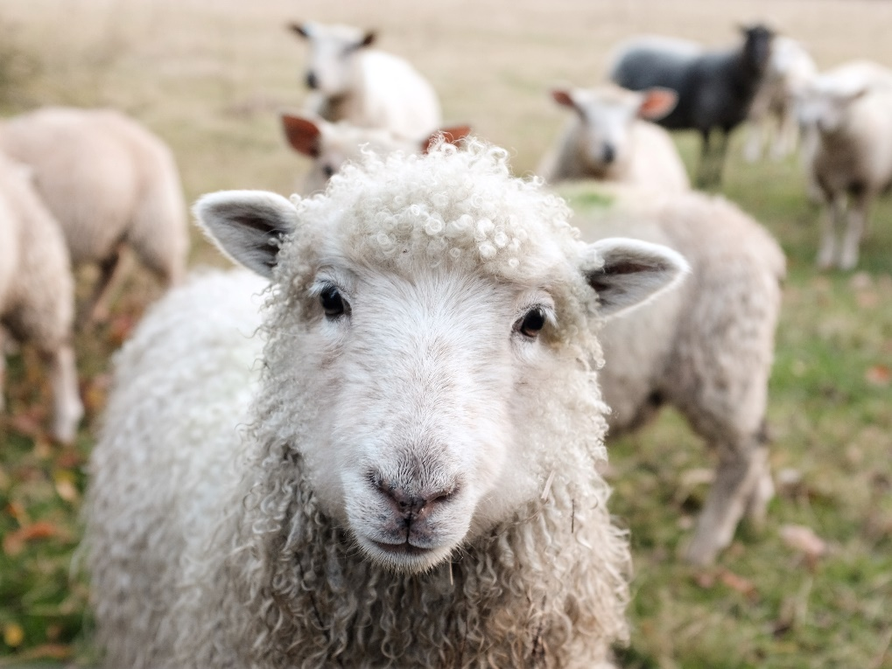
Minimal pairs
Minimal pairs are two similar sounding words that differ in only one phoneme and have distinct meanings.
sheep
ship
Notes:
[Ship] Photo by Peter Hansen on Unsplash [Sheep] Photo by Sam Carter on Unsplash

Slide 12
Pirates!
1
c
w
Riese
leider
Riese
One of the chests contains buried treasure. All the others contain poison!
Listen carefully to the secret code and follow the arrows to find the treasure.
Reise
Lieder
Reise
h
z
Wien
Biene
Feile
v
Wein
Beine
viele
Riese
Biene
Feile
leider
Riese
k
i
Reise
Beine
viele
Lieder
Reise
Riese
leider
Feile
leider
Riese
r
Reise
Lieder
viele
Lieder
Reise
y
Riese
j
q
Reise
Notes:
This task, created by Natalie Finlayson, one of NCELP’s resource developers, is one of my favourites!
Timing: 20-30 seconds per slide
Aim: This activity makes use of minimal pairs of unknown words to compel students to focus on a pair of SSC (sound-symbol correspondence) that often cause difficulty, both in pronunciation, reading aloud of written text, and also in spelling. (Unknown words are used so that pupils focus closely on the sound. Definitions are given on a later slide).
Procedure: Starting on the red square, pupils listen to the words and decide whether they hear /ei/ or /ei/. They follow the arrows indicated by their choice to finish at one of the chests. There is only one correct route per slide, so pupils must correctly identify all words to find the treasure. The order or /ei/ and /ie/ changes (i.e. sometimes /ei/ is on the white square and sometimes on the blue) so the pupils must read the spellings.
Pupils can follow the slide on the projector, or the slide can be printed so they can trace the route with a pen/finger.
Teacher asks ‘Wo bist du?’ Pupils respond ‘Z, W’ etc. to practise the alphabet. Teacher clicks on the chests they say to reveal treasure (or not!)
Audio plays on clicking play. Pupils will probably need to hear the audio at least three times.
Note: Each treasure chest is triggered to reveal what is underneath. You see a hand icon appear when you mouse over it – click and the chest disappears. Each slide only has one treasure chest – the rest reveal skulls.
Transcript:
Wein, Biene, Feile, Lieder, Riese
Treasure is located in chest r

Slide 13
En anglais et en français
lire / écouter
same [ch]
different [ch]
same [ch]
different [ch]
1
chef
6
champagne
2
avalanche
7
chocolat
3
touche
8
champion
4
brochure
9
moustache
5
charge
10
riche
Notes:
This is a slightly different angle, but I’ve included it to show the breadth and depth of NCELP’s phonics work as it’s developed through Y7. Here English has two pronunciations for ‘ch’ where French has one (there’s a reason for that, as where the English and French pronunciations overlap, those are words ‘borrowed’ form French).
Timing: 2 minutes Aim: This activity highlights similarities and differences in the English and French pronunciation of the SSC [ch], using near-cognates which have not been previously taught. Images are provided to aid recognition. The activity aims to show that while the pronunciation of this SSC changes in English, it is consistent in French. Teachers to highlight that, where the sound is ‘sh’ in English, these words are “borrowed” from French (chef, brochure, champagne, moustache).
Procedure: Students write 1-10 in their exercise books and decide if the [ch] in the French word sounds the same as in English, or different from the English. They then listen to the words and check their answers.
TRANSCRIPT:
chef
avalanche
touche
brochure
charge
champagne
chocolat
champion
moustache
riche
Frequency rankings of non-SOW (near-)cognates (1 is the most common word in French):
avalanche [4426], brochure [>5000], champagne [>5000], champion [2443], charge [849], chef [386], chocolat [4556], moustache [>5000], riche [599], touche [3775]
Source: Londsale, D., & Le Bras, Y. (2009). A Frequency Dictionary of French: Core vocabulary for learners London: Routledge

Slide 14
parler
Remember ! Two pronunciations in English, one pronunciation in French!
chef
champagne
avalanche
chocolat
touche
champion
brochure
moustache
charge
riche
Notes:
Timing: 1 minute Aim: To practise the same SSC [ch] in oral modality, productive mode. Procedure: Students now practise saying the words in pairs, each choosing a word from a different side, then swapping sides. Students check each others’ pronunciation, trying to get the longest ‘rally’ of correct pronunciations. The teacher circulates to check that students are drawing on their existing knowledge of French SSCs to pronounce the words accurately and avoid L1 interference.
Before beginning the task, teacher to remind students: two pronunciations in English, one pronunciation in French.

Slide 15
Using unknown words [phonics]
To practise applying SSC (symbol-sound correspondence) knowledge, we need to use unknown words. For example:
Place names
People’s names
Names of other things (e.g. games, bands)
Cognates (not previously-taught)

Slide 16
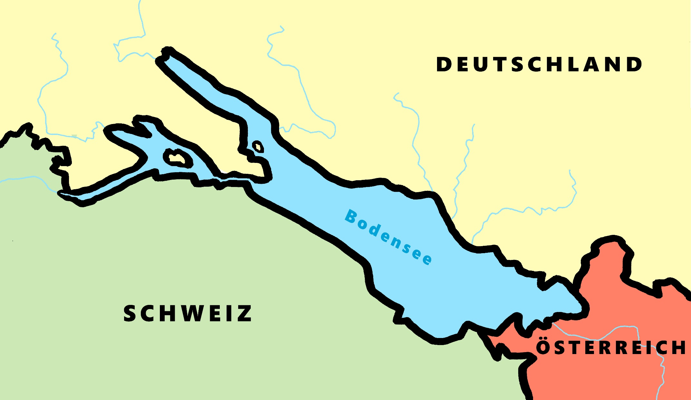
Phonetik - der Bodensee [1/2]
hören / schreiben
[4] Allensba_ _
ch
[5] _allhausen
4
W
5
z
[3] Radolf_ell
3
[6] Hagn_ _
6
au
ch
[7] Fr_ _dri_ _shafen
7
ie
S t
[2] _ _eckborn
eu
2
1
Kr_ _zlingen
[9] _omanshorn
R
9
ei
[8] Altenrh_ _n
8
Notes:
Phonetik [1]
Time: 5 minutes Aim: To practise recognising and transcribing 10 previously taught SSC, in unknown words.
Procedure: 1. Click number to hear the full word. Students listen and transcribe only the missing letters. 2. Animations support item-by-item checking, as instant feedback on each SSC may be particularly helpful for students’ learning. 3. Teachers can additionally ask, Wo liegt [Hagnau]? Es liegt in [Deutschland]… Students have met the use of ‘in’ with die Schweiz. It will be helpful to focus their attention on the use of ‘in’ + der + Schweiz here, reminding them of the ‘in’ + movement (R2-accusative) or location (R3-dative) change. SSC revisited here: [eu] [st-] [z] [ch-hard] [w] [au] [ie] [ch-soft] [ei] [r] Transcript: 1 Kreuzlingen 2 Steckborn 3 Radolfzell 4 Allensbach 5 Wallhausen 6 Hagnau 7 Friedrichshafen 8 Altenrhein 9 Romanshorn

Slide 17
Phonétique
lire / parler
Dis les noms.
Attention! C’est hard [g] ou [j]/soft [g] ?
Mon nom est …
1
Gérard
5
Gilles
9
Jacques
2
Gaelle
6
Julien
10
Jérôme
3
Angéline
7
Joséphine
11
Margaux
4
Agathe
8
Morgane
12
Georges
Notes:
Timing: 8 minutes
Aim: To raise awareness of [j]/soft [g] and hard [g] by using known spelling rules to pronounce these correctly in unknown vocabulary items.
Procedure:
1. Explain that these are popular French names that look like names students may recognise from English, but are pronounced differently.
2. Give students four minutes to work with a partner to decide how to pronounce [j] or [g], and to have a go at sounding out the names. All other SSCs in the words are either known or transferable from English, with the exception of the [ô] in Jérôme.
3. Click on the numbers to hear the names pronounced. The voices indicate whether the name is traditionally a male or female one. Students repeat chorally.
4. Now, teachers encourage students to read the names in increasing speed intervals (30 seconds, 20 seconds, 10 seconds … may vary according to the individual needs of the class) to work on fluency.
Transcript
1. Gérard
2. Gaelle
3. Angéline
4. Agathe
5. Gilles
6. Julien
7. Joséphine
8. Morgane
9. Jacques
10. Jérôme
11. Margaux
12. Georges

Slide 18
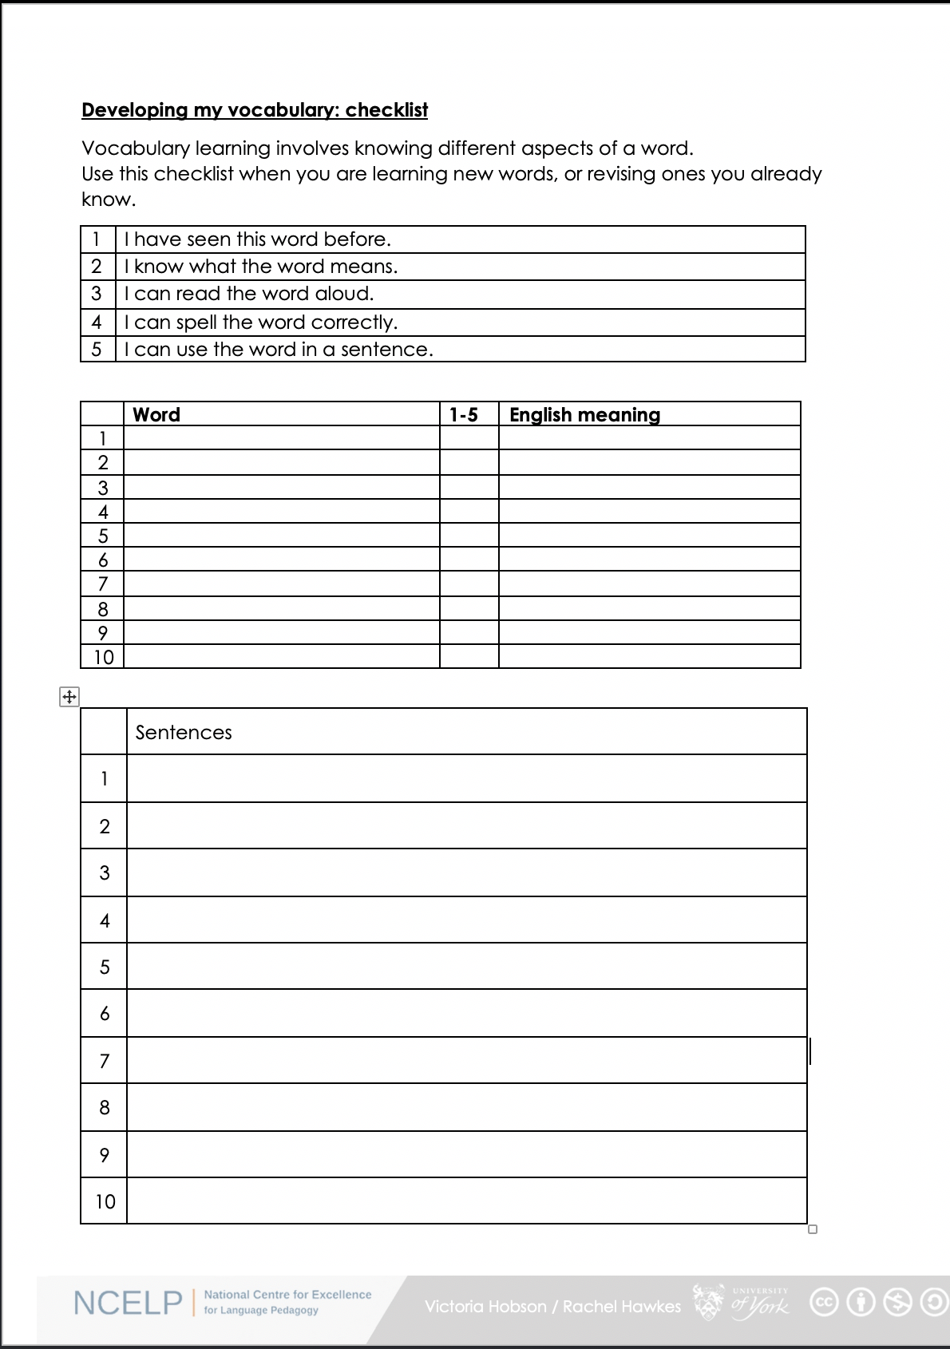
Vocabulary checklist
1. I have seen this word before.
2. I know what the word means.
3. I can read the word aloud.
4. I can spell the word correctly.
5. I can use the word in a sentence.
6. For nouns, I know the gender and the correct word for ‘the’
The checklist on the portal
Notes:
This sheet could be part of a homework task for Week 7 vocabulary, if desired (or a previous week – In week 7 students should also be revisiting Week 3 vocabulary). Scroll down for the link to this resource.
Vocabulary learning involves knowing different aspects of a word. Students can use this checklist when to check what they know when they are learning new words, or revising ones they already know.
For each word the checklist asks students to asses whether the following statement apply:
1. I have seen this word before.
2. I know what the word means.
3. I can read the word aloud.
4. I can spell the word correctly.
5. I can use the word in a sentence.
Students then translate the word and try to use it in a sentence.
We suggest giving students a print out of the template they can refer to throughout the year.
A word template is available on the NCELP resource portal.
https://resources.ncelp.org/concern/resources/gf06g264k?locale=en

Slide 19
VOCABULARY
words that are very high-frequency → most useful!
a wide vocabulary of verbs (meanings)
mixed word class vocabulary sets: 10 per week
developing robust vocabulary knowledge
developing depth of knowledge
Davies, M, & Davies, K.H. (2018). A Frequency Dictionary of Spanish: Core Vocabulary for Learners. Routledge. Häcker, M. (2008). Eleven pets and 20 ways to express one's opinion: the vocabulary learners of German acquire at English secondary schools, The Language Learning Journal, 36:2, 215-226. Jones, R.L. & Tschirner, E. (2006). A frequency dictionary of German: core vocabulary for learners. Routledge. Lonsdale, D. & Le Bras, Y. (2009) A Frequency dictionary for French. Routledge. Marsden, E., & David, A. (2008). Vocabulary use during conversation: a cross-sectional study of development from year 9 to year 13 among learners of Spanish and French. Language Learning Journal, 36(2), 181-198.
Milton, J. (2006). Language Lite? Learning French Vocabulary in School. Journal of French Language Studies, 16,187-205. Milton, J. (2009). Measuring second language vocabulary acquisition. Multilingual Matters Milton, J. (2013). Measuring the contribution of vocabulary knowledge to proficiency in the four skills. Eurosla Monographs Series 2, 57-78. http://www.eurosla.org/monographs/EM02/Milton.pdf
Schmitt, N. (2008). Review Article. Instructed second language vocabulary learning. Language Teaching Research, 12(3), 329–363. https://doi.org/10.1177/1362168808089921 Swan, M. (2008). Talking Sense about Learning Strategies, RELC, Vol 39(2), 262-273.
Notes:
Decisions had to be made about vocabulary teaching
Which vocabulary is carefully selected from the highest frequency words according to a well constructed corpus of millions of words – the words that appear most are the most useful for communication across different situations
We know from research that you need to have a bank of verbs before you can create the sentences you want to create – the meaning of verbs is like the anchor in a sentence. We know that learning mixed sets of words allows you to create a number of sentences very quickly – but if you just know a set of nouns for sports or animals or types of television programmes, it is harder to be creative with what you can understand and say. Also we know that very closely semantically related words (sets of fruits or animals) can be confusing and more difficult to learn than more mixed sets. Research can also tell us what kinds of activities are most efficient for establishing robust knowledge that lasts and can be recalled fast and when under some pressure
And it can tell us about the kinds of activities that can help promote depth of vocabulary knowledge – knowing when to use a word, what its opposites are, which words often occur with it

Slide 20
vocabulario
Lee las frases. ¿Qué significan las palabras?
Write the meaning of the bold words.
 | ¿Qué significan las palabras?
1. Bianca no quiere cenar porque está mala. Solo quiere dormir.
2. Papá está triste, pero quizás su amigo no está así.
3. Según la gente la ciudad es muy bonita. Voy a ir a mediodía.
4. El parque está sucio y la calle está igual.
5. No está lista para escribir una carta.
6. La playa es preciosa, pero no está limpia.
mala =
ill, sick
triste =
sad
así =
like that
quizás =
maybe
según =
according to
gente =
people
sucio =
dirty
igual =
the same
lista =
ready
preciosa =
beautiful
limpia =
clean
Notes:
Timing: 5 minutes
Aim: To further embed the meaning of new vocabulary and present three new words from this week’s set in context.
Procedure:
Read the sentences and try to think of the meaning of the words in bold. Most of these have been presented and practised already this week.
Write the meaning of the bold words in English.
Three words (quizás, así, según) are new this week, so their meanings are given upfront. Teachers should draw students’ attention to these.
Words introduced this week: malo [368]; triste [1371]; quizás [346]; así [67]; según [237]; gente [137]; sucio [1855]; igual [263]; listo [1684]; seguro [407]; precioso [1777]; limpio [1710]
Words revisited from 3.2.6 [revisited in SoW this week]: cenar [3087]; dormir [403]. Other words from the poem are included for further exposure to words that have been previously encountered in the poem: playa [1475]; mediodía [2647]; papá [865]; su [12]
Words revisited from 3.1.5 [revisited in SoW this week]: parque [1354]; correr [343]; escribir [198]; carta [627]
From other Y7 weeks: querer [58]; porque [40]; pero [30]; ciudad [178]; muy [43]; bonito [891]; calle [269]
Source: Davies, M. & Davies, K. (2018). A frequency dictionary of Spanish: Core vocabulary for learners (2nd ed.). Routledge: London

Slide 21
Vokabeln
hören
Hör dir die Wörter an. Hast du diese Wörter auf Deutsch gehört?
x
1
first
zuerst
2
to receive / receiving
erhalten
3
goal
das Ziel
x
4
to mix / mixing
mischen
x
5
in the end
schließlich
Notes:
Timing: 3 minutes Aim: To practise vocabulary in the second revisited set for this week, in the spoken modality. Procedure: 1. Click for the English word to appear.
2. Click on the number to play the sound.
3. Listen to the German words. Was any of the four words the German for the English word shown? 4. On a click an English word will appear. Was the word included in the German set? 5. Click for answers. Note: Increase the challenge by listening first, revealing English word after listening to each set of four words.
Transcript: 1. Später – Danach – Schließlich – jetzt → First
2. Lassen – erhalten – halten – beginnen → To receive
3. das Ziel – die Mitte – der Punkt – der Spieler → the goal
4. Ziehen – nehmen – legen – werfen → to mix
5. deshalb – leider – aber – ziemlich → in the end
7.3.2.4 beginnen [239] erhalten [283] gewinnen [408] legen [296] mischen [2105] werfen [672] ziehen [266] die Mitte [756] der Punkt [427] das Ziel [325] jeder, jede, jedes [88]

Slide 22
escuchar
Escucha. Identifica la imagen correcta y escribe su letra.
1
2
3
4
5
6
7
8
9
10
11
12
F
J
A
G
E
H
B
I
D
L
C
K
A
B
C
D
E
F
[to make an effort]
[to make
noise]
[to go on a long trip]
[to make a
funny gesture]
[to make a great change]
[long hair]
G
H
I
J
K
L
[to go on a short trip]
[a long dialogue]
[to have dinner alone]
[to sleep alone]
[short hair]
[blue sky]
Notes:
Timing: 6 minutes
Aim: to recap vocabulary from this lesson and sets Y8 1.1.5 and Y7 3.2.6 as per the SoW cycle of revisiting.
Procedure:
1. Give students a minute in pairs to try to anticipate the vocabulary items they hear. This gives the teacher a chance to gauge students’ understanding of the pictures and offer help where necessary.
2. Click the number triggers to play the audio.
3. Go through the answers drawing attention to the vocabulary items.
Transcript:
hacer un cambio genial
cenar solo
el pelo largo
hacer un viaje corto
hacer un gesto gracioso
el pelo corto
hacer un esfuerzo
un diálogo largo
hacer un viaje largo
el cielo azul
11) hacer ruido
12) dormir solo
Vocabulary from revisited sets
8.1.1.5: cambio [319]; ruido [1034]; esfuerzo [601]; viaje [519]; gesto [928]; gracioso [3874]; genial [2890];
7.3.2.6: cielo [620]; pelo [873]; cenar [3087]; dormir [403]

Slide 23
eine Geschichte
hören / sprechen
Welcher Satz ist richtig?
 | A party is taking place upstairs in my flat. | A birthday party is taking place downstairs in my house. | A birthday party is taking place upstairs in my flat.
 | Mia is hungry and she is coming later. | Mia is tired and she is coming later. | Mia hat a headache and she is coming later.
 | Mehmet flew by plane from Poland. | Mehmet travelled by train from Switzerland. | Mehmet flew by plane from the south.
 | Katja’s aunt and uncle live in Poland and are bringing Polish food. | Katja’s aunt and uncle are flying from Poland and like eating Polish food. | Katja’s aunt and uncle are coming from Poland and can’t travel by boat.
 | Katja is preparing the food, but she hasn’t found the Küche. | Katja is preparing the food, but she hasn’t found the coffee. | Katja is preparing the party, but she hasn’t found the food.
 | We walked to town, but we still want to dance with Mia! | We went shopping, but now we want to dance with Mia! | We went shopping, but we still want to dance with Mia.
1
2
3
4
5
6
Notes:
Timing: 5 minutes Aim: To practise comprehension and production of most of this week’s revisited vocabulary in sentences. Procedure: 1. Encourage students to recall the vocabulary to predict what they will hear. In number one words that differentiate one sentence from another have been put in bold to facilitate task modelling.
2. Click the action buttons to play each sentence. Students pick which column (A, B or C) is correct.
3. Clicking reveals the answers. 4. Elicit the German for the other two answers each time, to practise productive recall of the vocabulary.
Transcript: 1. Oben in meiner Wohnung findet eine Geburtstagsparty statt.
2. Mia ist müde, und sie kommt später.
3. Mehmet ist mit dem Flugzeug vom Süden aus losgeflogen.
4. Katjas Tante und Onkel fliegen von Polen aus los und essen gern polnisches Essen.
5. Katja bereitet das Essen vor, aber sie hat die Küche nicht gefunden.
6. Wir sind einkaufen gegangen, aber wir haben noch Lust, mit Mia zu tanzen!
Word frequency (1 is the most frequent word in German):
einkaufen [2877] mitbringen [1828] stattfinden [652] vorbereiten [1421] Geburtstag [1766] gegangen [66] gefahren [215] fliegen [824] geflogen [824] Bahn [1415] Flugzeug [1776] Geschichte [262] Onkel [1832] Polen [2023] Süden [1771] Tante [1826] Schiff [1176] polnisch [3237]
gefunden [103] Hunger [2097] Kaffee [1299] Küche [960] Lust [1407] Schmerz [1483] Wohnung [418] müde [2000] noch1 [33] oben [100] unten [590]
Source: Jones, R.L. & Tschirner, E. (2006). A frequency dictionary of German: core vocabulary for learners. Routledge

Slide 24
Vokabeln 2 [1/2]
lesen / schreiben
1. Ein Synonym für bekommen
2. Der letzte Monat im Jahr
3. Ich bin zu Hause …
4. Ein anderes Wort für verstehen
5. Ein Synonym für nochmal
6. Das ist nicht grün
7. Das ist eine Erfahrung
erfahren
kriegen
werden
Dezember
März
Januar
gestiegen
geschwommen
geblieben
begreifen
steigen
eigen
Mal
wieder
für
Pflanze
Wald
Luft
Berg
Fahrt
Schuh
Notes:
Timing: 7 minutes (2 slides) Aim: to practise productive recall of all of this week’s new and revisited vocabulary in the written modality. Procedure: 1. Click for the first word to appear and then disappear. Repeat for 2nd and 3rd words for number 1.
2. Students write down their answer for number 1.
3. Click again for the answer to number 1.
4. Continue with the remainder of the questions on this slide, providing item-by-item feedback.
Word frequency (1 is the most frequent word in German):
8.2.1.1 (introduce) kriegen [724] eigen [166] für [17]
8.1.2.4 (revisit) erfahren [690] geblieben [113] geschwommen [1863] gestiegen [325] steigen [325] Berg [934] die Erfahrung [619] Fahrt [1569] Luft [487] Wald [1028]
8.1.1.5 (revisit) begreifen [1346] Dezember [1527] Jahreszeit [4818] Mal [82] März [987] Pflanze [1667] Schuh [1678] Wechsel [2525] wieder [74]
Source: Jones, R.L. & Tschirner, E. (2019). A frequency dictionary of German: core vocabulary for learners. Routledge

Slide 25
der, die, oder das?
60
die Flasche
der Mann
der Tisch
die Tafel
Sekunden
das Heft
das Fenster
das Paar
die Klasse
0
der Tag
ANFANG
Notes:
Ist es der, die oder das?
This starter presents the nouns with their genders covered up. All nouns were introduced during the previous week and should be familiar to the students. Students have a minute to try to recall them with a partner.
The activity focuses the attention on the take-away grammar point from week 1: grammatical gender. It also revisits the vocabulary that was introduced. Click on ‘Anfang’ when in presentation mode to start the 60 second timer.

Slide 26
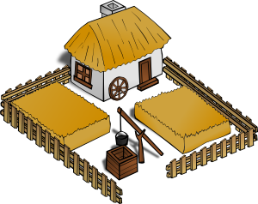
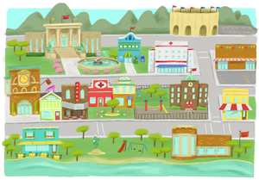
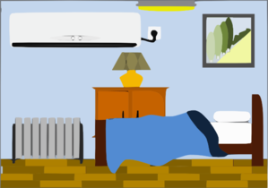
Vocabulary introduction
Trouve l’intrus!
1.
4.
le
le
la
le
la
la
??
2.
5.
le
la
le
la
le
le
3.
6.
der
la
la
le
la
la
le
Notes:
Presentation/introduction to the nouns from the tasks that follow.
Here, pupils find the odd one out by identifying the gender of each noun.

Slide 27
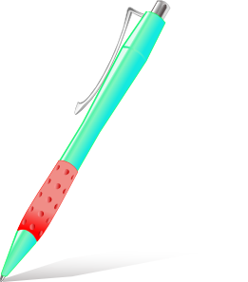
Vocabulario
un
una
Notes:
Students have to predict which pacman will eat the object depending on the noun’s gender.

Slide 28
Grammar
Avoid working with whole paradigms
Learner’s attention is a limited resource!
Focus on one form juxtaposed with another
Provide plenty of practice for each pair of forms
‘Trap the form’: Remove ‘cues’ so learners focus on the target feature
Gradually build up wider system
Rowena Kasprowicz / Emma Marsden
Notes:
Building on the work of Bill VanPatten, (e.g., https://oasis-database.org/concern/summaries/9019s2443?locale=en), researchers have experimented by practising in the input (L & R) many ‘harder to reach’ grammar features, which learners typically don’t just pick up by being asked to understand the main details of a text containing the target feature. Evidence suggests benefits for:
Improving analysis of language
‘Training the ear’ to notice small phonemic differences (e.g. je / j’ai)
Improving comprehension and production
A range of ages, proficiencies, languages, grammar features

Slide 29
GRAMMAR
Upfront explanation of one feature
force students to attach meaning to feature
contrasting pairs of grammar features
activities that make feature ‘essential’
DeKeyser, R. (2005). What makes second-language grammar learning difficult? A review of issues. Language Learning, 55, 1-25. https://doi.org/10.1111/j.0023-8333.2005.00294.x
DeKeyser, R. (2015). Skill acquisition theory. In B. VanPatten & J. Williams (Eds.), Theories in second language acquisition: An introduction (pp. 94–112). London, UK: Routledge.
DeKeyser, R., & Prieto Botana, G. (2015). The effectiveness of processing instruction in L2 grammar acquisition: A narrative review. Applied Linguistics, 36, 290–305. Ellis, N. (2006). Selective attention, and transfer phenomena in L2 acquisition: Contingency, cue competition, salience, interference, overshadowing, blocking, and perceptual learning. Applied Linguistics, 27(2), 164-194. Lichtman, K. (2016). Age and learning environment: Are children implicit second language learners? Journal of Child Language, 43, 707-730. https://doi.org/10.1017/S0305000915000598 Marsden, E. (2006). Exploring input processing in the classroom: An experimental comparison of processing instruction and enriched input. Language Learning, 56, 507–566. Norris, J. & Ortega, L. (2001). Does type of instruction make a difference? Substantive findings from a meta-analytic review. Language Learning, 51, 157-213. https://doi.org/10.1111/j.1467-1770.2001.tb00017.x VanPatten, B. (2002). Processing instruction: An update. Language Learning, 52(4), 755-803.

Slide 30
Present simple or continuous?
grammaire
English has two present tense forms.
I make the bed every week. I am making the bed at the moment.
French has one present tense only. The BE + -ing form does not exist.
Je fais le lit chaque semaine. Je fais le lit en ce moment.
Present simple - normally; routine
Present continuous (BE + -ing) - ongoing; current
Je fais = I make AND
I’m making
Adverbs of time tell us which English tense to choose.
In French, the present simple is used with all adverbs.
Notes:
Timing: 3 minutes
Aim: to describe and explain the metalanguage (present simple, present continuous and adverbs) used to talk about verbs in this and subsequent sequences.
Procedure:
Click to bring up the explanation
Highlight the distinction between present simple for routine actions and present continuous for current/ongoing actions.
Stress the fact that the BE + -ing form is an English construction only. ‘Être’ cannot be used with a verb this way.

Slide 31
Adverbs of time
grammaire
chaque semaine
[every week]
[at the moment]
en ce moment
Notes:
Timing: 1 minute
Aim: To clarify which form of the English present tense is indicated by ‘chaque semaine’ and ‘en ce moment’.
Procedure:
Elicit pronunciation and English meaning from students of ‘chaque semaine’ and ‘en ce moment’.
Clarify that ‘chaque semaine’ indicates routine action and requires present simple in English and ‘en ce moment’ indicates current/ongoing actions and requires present continuous in English.

Slide 32
Present simple or continuous?
lire
Nick, an exchange student, is babysitting for the Petit family. He makes notes about the children, Jacques and Géraldine.
1.1 Choose the correct adverb.
A
Jacques is playing tennis at the moment/every week.
B
Géraldine wears a uniform at the moment/every week.
C
Géraldine is having lunch at the moment/every week.
D
Jacques is doing his homework at the moment/every week.
E
Jacques goes for a walk at the moment/every week.
Notes:
Timing: 3 minutes
Aim: Awareness-raising exercise in English to teach students to connect temporal adverbs with tense.
Procedure:
1. Students read the sentences and choose the correct adverb according to whether the tense is present simple or continuous.
Note:
Choice of French names incorporates this week’s SSCs: Jacques and Géraldine.

Slide 33
Present simple or continuous?
lire
Nick, an exchange student, is babysitting for the Petit family. He makes notes about the children, Jacques and Géraldine.
1.2 Choose present simple (normally; routine) or continuous (ongoing; current).
F
Jacques washes/is washing up at the moment.
G
Géraldine learns/is learning English every week.
H
Géraldine plays/is playing with her friends at the moment.
I
Jacques reads/is reading a book at the moment.
J
Géraldine sings/is singing every week.
Notes:
Timing: 3 minutes
Aim: Awareness-raising exercise in English to teach students to connect temporal adverbs with tense.
Procedure:
1. Students read the sentences and choose the correct tense (present simple or continuous) according to the temporal adverb.

Slide 34
Present simple or continuous?
écouter
Madame Petit calls Nick with more information about her children.
Help Nick take notes. Choose present simple or continuous.
A
Jacques does/is doing his homework.
B
Jacques has/is having an idea.
C
Géraldine does/is doing the housework.
D
Géraldine is/is being naughty.
E
Géraldine cooks/is cooking.
Notes:
Timing: 5 minutes
Aim: to practise translating the present tense successfully from French into English in the oral modality by connecting temporal adverbs with tense.
Procedure:
Click the letter trigger to play the audio for each sentence.
Students listen to the French and decide if the translation required in English is present simple or continuous.
Draw attention to fact that French tense is the same throughout, and that students will have to listen out for the adverb in French to find out this information.
Explain that the temporal adverbs are not given in the English translation because the verb tense provides information about whether things happen routinely, or are ongoing right now.
Answers are revealed on clicks.
Transcript:
A. Jacques fait les devoirs en ce moment.
B. Jacques a une idée chaque semaine.
C. Géraldine fait le ménage en ce moment.
D. Géraldine est méchante chaque semaine.
E. Géraldine fait la cuisine chaque semaine.

Slide 35
Present simple or continuous?
lire/écouter
Nick is talking about the Petit family to his English friends. Decide whether to translate what he says with ‘en ce moment’ or ‘chaque semaine’.
A
Madame Petit fait une visite [en ce moment / chaque semaine] mais elle fait la cuisine [en ce moment / chaque semaine].
B
Monsieur Petit fait le lit [en ce moment / chaque semaine] et fait le ménage [en ce moment / chaque semaine].
C
Géraldine fait un modèle [en ce moment / chaque semaine] et fait une promenade [en ce moment / chaque semaine].
D
Jacques est méchant en [en ce moment / chaque semaine] mais il fait les devoirs [en ce moment / chaque semaine].
Notes:
Timing: 5 minutes
Aim: to practise connecting temporal adverbs with tense.
Procedure:
Click on the letter triggers to play the audio (sentences in English).
Students must work out from the present tense form alone whether these things happen every week, or are happening at the moment. (The adverbs are obscured by noises.)
Answers are revealed on clicks.
Transcript:
A. Mrs Petit goes on a tour [noise] but is cooking [noise].
B. Mr Petit is making the bed [noise] and does the housework [noise].
C. Géraldine is making a model [noise] and goes for a walk [noise].
D. Jacques is being naughty [noise] but does his homework [noise].

Slide 36
The talk covered…
1/ Pedagogy Review and the setting up of NCELP
2/ The Scheme of Work
3/ Core language knowledge and resources:
Phonics, Vocabulary, Grammar
4/ Where can I find out more information?

Slide 37
Want to hear more from NCELP?
Join our online “Introduction to NCELP” conference!
20th November: https://ncelp.org/nov20/
Delivered by our specialist teachers, sessions on:
phonics;
vocabulary;
the lexical profiler to check out whether texts use high frequency words or rare words;
grammar;
NCELP SOW & our programme of computer-assisted vocab practice
Join the mailing list, email: enquiries@ncelp.org for regular bulletins of new research-informed resources arriving on the portal
To get monthly alerts to summaries of new research, visit https://oasis-database.org/ and sign up in 10 seconds!

Slide 38
Questions and comments
Any questions and comments?

