Slide 1
Phonics
SSC /v/
Y7 German
Term 2.1 - Week 6 - Lesson 39
Author name(s): Natalie Finlayson / Rachel Hawkes
Date updated: 26/04/20

Slide 2
v
vor
Notes:
Introduce and elicit the pronunciation of the individual SSC ‘v’ and then present and practise the pronunciation of the source word ‘vor’.
A possible gesture for this would be to hold your hands, left in front of right, in front of your body, palms facing inward. Quickly move the right hand over the top of the left, as you say ‘vor’, to mime ‘in front’.

Slide 3
v
vor
Notes:
With SSC and word but not pictures, to focus more clearly on the sound-writing relationship.

Slide 4
v
vor
Notes:
Without sounds to elicit SSC and source word from students.
Teacher to elicit pronunciation by asking “Wie sagt man …”

Slide 5
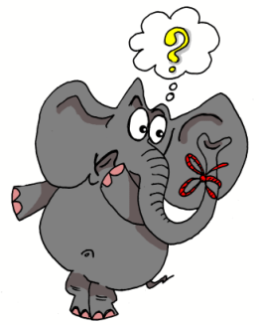
v
positiv
voll
vor
bevor
Vater
vergessen
Rachel Hawkes
Notes:
Introduce and elicit the pronunciation of the individual SSC ‘V’ and then the source word again (with gesture, if using). Then present and elicit the pronunciation of the five cluster words. The cluster words have been chosen for their high-frequency, from a range of word classes, with the SSC (where possible) positioned within a variety of syllables within the words(e.g. initial, 2nd, final etc..) and additionally, we have tried to use words that build cumulatively on previously taught SSCs (see the Phonics Teaching Sequence document) and do not include new SSCs. Where new SSCs are used, they are often consonants which have a similar symbol-sound correspondence in English.
Word frequency rankings (1 is the most common word in German): vor [55]; positiv [690] voll [357]; bevor[541]; vergessen [595]; Vater [216]. Source: Jones, R.L. & Tschirner, E. (2006). A frequency dictionary of German: core vocabulary for learners. Routledge

Slide 6
v
positiv
voll
vor
bevor
Vater
vergessen
Rachel Hawkes
Notes:
Without pictures to focus on the SSC alone.

Slide 7
v
positiv
voll
vor
bevor
Vater
vergessen
Rachel Hawkes
Notes:
Without sound to elicit the pronunciation.

Slide 8
Wie sagt man …?
Volkswagen
Notes:
Students may be surprised to hear the pronunciation of this German car manufacturer! Ask students to sound out the word before leading whole-class pronunciation.
Students may also be interested in the translation of the word (the people’s car)., which is another example of compounding.

Slide 9
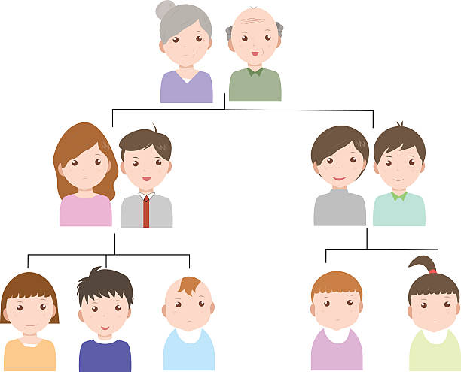
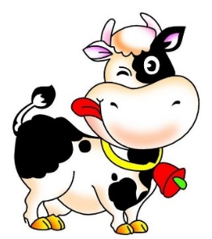
Minimalpaare
hören und sprechen
das Vieh
wie?
der Vetter
das Wetter
das Veilchen
das Weilchen
voll
die Wolle
Notes:
Teacher-led pronunciation practice which draws attention to the importance of individual sounds in creating meaning.

Slide 10
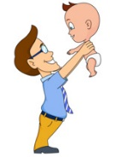
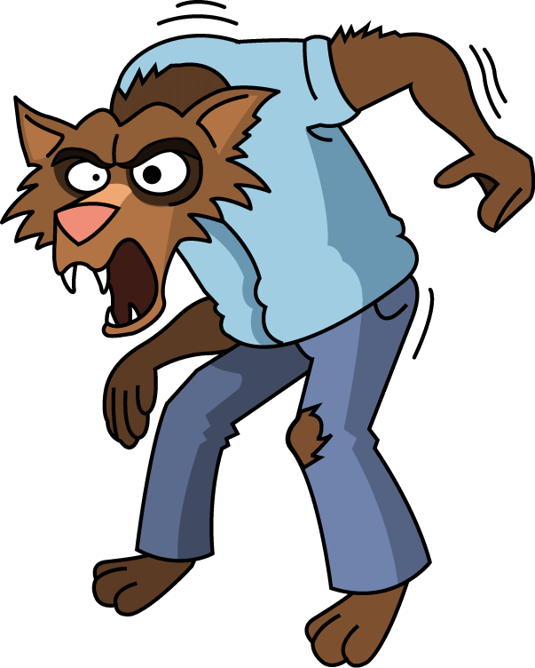
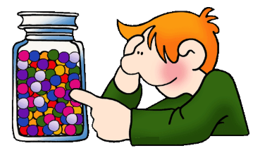
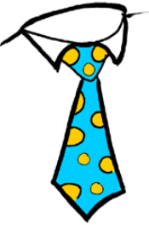
Wie sagt man das?
hören und schreiben
1
d e r W i k i n g e r
6
d e r V a t e r
__
__
2
S c h w e d e n
7
d e r W e r w o l f
__
__
__
3
d e r V o g e l
8
w i e v i e l e ?
__
__
__
4
d i e K r a w a t t e
9
v i e r u n d z w a n z i g
__
__
__
5
d a s V i e r e c k
10
w a r m
__
__
Notes:
This listening exercise both helps students strengthen the association with German SSC [v], and lose the interfering association with the English SSC [v].
Words have been chosen which may have a surprising pronunciation in German (e.g. ‘Sweden vs Schweden’) or because they are pronounced similarly in German to English (e.g. Viking / Wikinger) which may throw students in terms of spelling. Teacher to remind students to resist the temptation to write ‘v’ straight away for words they recognise from English. They must first listen, and focus on the sound.
Audio plays on clicking individual letters. Answers revealed on individual clicks.
Teacher can elicit responses by asking ‘Wie schreibt man das? Mit v oder mit w?’
Transcript
der Wikinger
Schweden
der Vogel
die Krawatte
das Viereck
das Vater
der Werwolf
Wie viele?
Vierundzwanzig
warm

Slide 11
Wie sagt man das?
sprechen
10
d e r W i k i n g e r
d e r V a t e r
S c h w e d e n
d e r W e r w o l f
d e r V o g e l
w i e v i e l e ?
d i e K r a w a t t e
v i e r u n d z w a n z i g
0
d a s V i e r e c k
w a r m
LOS
Notes:
Now, students work in pairs to practise saying the words they have just learned in turn.
Once they have practised a couple of times, the teacher can set the timer to see how many words students can pronounce correctly within ten seconds. Students act as jurors for one another. If a student pronounces a word incorrectly, they must start again! Teacher may wish to run the times several times, depending on the needs of the class.
Transcript
der Wikinger
Schweden
der Vogel
die Krawatte
das Viereck
das Vater
der Werwolf
Wie viele?
Vierundzwanzig
warm

