Slide 1
Describing a place
Plural definite article (los/las)
Singular definite article (el/la)[revisited]
SSC [j]
Y7 Spanish
Term 1.2 - Week 6 - Lesson 25
Victoria Hobson / Nick Avery Artwork: Mark Davies
Date updated: 16/08/21
Notes:
Learning outcomes (lesson 1):
Introduction of SSC [j]
Introduction of plural definite article
Consolidation of singular definite article
Consolidation of es, son and adjectival agreement
Word frequency (1 is the most frequent word in Spanish):
7.1.2.6 (introduce) pueblo [244]; equipo [373]; trabajo¹ [152]; edificio [857]; plato [1808]; familia [233]; película [543]; vista [408]; isla [810]; grande [66]; interesante [616]; de¹ [2]
7.1.2.3 (revisit) hay [13]; mirar [125]; mesa [525]; silla [1271]; ventana [752]; puerta [274]; chica [1129]; persona [108]; chico [727]; aquí [130]; allí [197]; clase [320]; señor² [201]; señora² [509]
7.1.1.5 (revisit) amigo [210]; periódico [1026]; caballo [907]; teléfono [866]; planta [768]; botella [1878]; revista [920]; pregunta [507]; palabra [192]; tarea [995]; también [49]
Source: Davies, M. & Davies, K. (2018). A frequency dictionary of Spanish: Core vocabulary for learners (2nd ed.). Routledge: London

Slide 2
j
ojo
Nick Avery
Notes:
Introduce and elicit the pronunciation of the individual SSC ‘j’ and then present and practise the pronunciation of the source word ‘ojo’.
A possible gesture for this source word would be to point towards your eye

Slide 3
j
ojo
Nick Avery
Notes:
Repeat the sound and elicit the source word.

Slide 4
j
ojo
Nick Avery
Notes:
Repeat the sound and elicit the source word.

Slide 5
j
julio
mejor
rojo
ojo
mujer
dejar
[to leave]
Nick Avery
Notes:
Introduce and elicit the pronunciation of the individual SSC ‘j’ and then the source word again (with gesture, if using). Then present and elicit the pronunciation of the five cluster words.
The cluster words have been chosen for their high-frequency, from a range of word classes, with the SSC (where possible) positioned within a variety of syllables within the words (e.g. initial, 2nd, final etc.). Additionally, we have tried to use words that build cumulatively on previously taught SSCs (see the Phonics Teaching Sequence document) and do not include new SSCs. Where new SSCs are used, they are often consonants which have a similar symbol-sound correspondence in English.

Slide 6
j
julio
mejor
rojo
ojo
mujer
dejar
Nick Avery
Notes:
Without the images, students focus this time again closely on the SSC and the cluster words.

Slide 7
j
julio
mejor
rojo
ojo
mujer
dejar
Nick Avery
Notes:
Without the images or sound, students have to pronounce the words themselves.

Slide 8
Fonética
escuchar / escribir
Escucha. Escribe la frase en español.
¿Cómo se dice en inglés?
1
No hay clase en julio.
There isn’t class in July.
2
La cámara es roja.
The camera is red.
3
Quiero un ejemplo.
I want an example.
4
¿Inglaterra o España? España es mejor.
England or Spain? Spain is better!
5
Es mejor dejar la bolsa en casa.
It’s better to leave the bag at home.
6
Tienes dos ojos.
You have two eyes.
Notes:
Phonics practice activity
Timing: 6 minutes
Aim: to practise mapping sound to spelling with SSC [j]
Procedure:
1. Click on the blue action button to play the audio.
2. Students write each sentence in Spanish.
3. Students translate each sentence into English (in writing or orally)
Transcript:
No hay clase en julio.
La cámara es roja.
Quiero un ejemplo.
¿Inglaterra o España? España es mejor.
Es mejor dejar la bolsa en casa.
Tienes dos ojos.
Word frequency (1 is the most frequent word in Spanish): ojo [169]; julio [659]; rojo [534]; dejar [86]; ejemplo [187]; mejor [116]
Source: Davies, M. & Davies, K. (2018). A frequency dictionary of Spanish: Core vocabulary for learners (2nd ed.). Routledge: London

Slide 9
Vocabulario
hablar
 | Español | Inglés
1 | el pueblo | town, village
2 | el equipo | team
3 | el trabajo | job
4 | el edificio | building
5 | el plato | plate, dish
6 | la familia | family
7 | la película | film
8 | la vista | view
9 | la isla | island
10 | grande | big
11 | interesante | interesting
12 | de | of
60
Segundos
0
INICIO
Notes:
Vocabulario
Timing: 1-4 minutes Aim: To reactivate and strengthen vocabulary knowledge. Procedure: Round 1: Look at the Spanish, recall the English meanings, saying them aloud. [1 minute] Round 2: Look at the English, recall the Spanish meanings, saying them aloud. [1 minute] Repeat for two further minutes, to speed up recall.
Word frequency (1 is the most frequent word in Spanish): pueblo [244]; equipo [373]; trabajo [152]; edificio [857]; plato [1808]; familia [233]; película [543]; vista [408]; isla [810]; grande [66]; interesante [616]; de [2]
Source: Davies, M. & Davies, K. (2018). A frequency dictionary of Spanish: Core vocabulary for learners (2nd ed.). Routledge: London

Slide 10
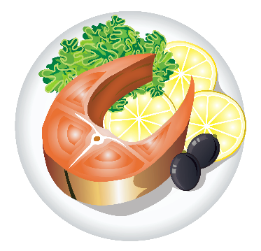
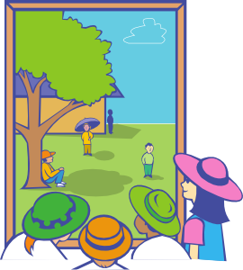
big
el plato
el trabajo
el pueblo
el edificio
el equipo
la familia
la vista
la película
la isla
big
interesting
grande
interesante
Notes:
Vocabulary presentation slide
This slide presents the vocab for this week. Students should know this already so it offers an opportunity as a quick in-class check.

Slide 11
Vocabulario
escribir
big
interesting
interesting
big
big
El plato es grande.
El trabajo es interesante.
El pueblo es interesante.
El edificio es grande.
El equipo es grande.
big
interesting
interesting
big
La familia es grande.
La vista es interesante.
La película es interesante.
La isla es grande.
Notes:
Timing: 5 minutes
Aim: to practise the new vocabulary introduced this week in short sentences.
Procedure:
There are various ways to use this activity:
Students write (either in ex. books or mini whiteboards) the correct sentence.
Pairs turn to each other to say the sentence
Students all say the sentence out loud as a choral response
4) Pairs take it in turns to translate the sentence to their partner. Partner A gives the Spanish and partner B then translates. (Partner B looks away from the board). After all 9 partners swap roles. Players can keep a tally of how many sentences they translate correctly.
Word frequency (1 is the most frequent word in Spanish): pueblo [244]; equipo [373]; trabajo¹ [152]; edificio [857]; plato [1808]; familia [233]; película [543]; vista [408]; isla [810]; grande [66]; interesante [616]
Source: Davies, M. & Davies, K. (2018). A frequency dictionary of Spanish: Core vocabulary for learners (2nd ed.). Routledge: London

Slide 12
Plural definite article
el
la
To say ‘the’ before a singular noun, use _____ or _____.
To say ‘the’ before a plural noun (more than one), use ‘los’ or ‘las’.
Masculine nouns
Feminine nouns
los
the
el
pueblo
s
village
s
las
the
la
s
película
film
s
los
s
equipo
el
the
team
s
vista
las
s
the
la
view
s
los
s
el
edificio
s
las
isla
the
la
building
s
s
the
island
Notes:
Grammar explanation slide

Slide 13
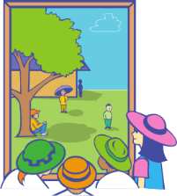
escuchar
Una chica está en España.
Describe unas cosas allí.
Escucha.
¿Es ‘los’ o ‘las’?
Marca la opción correcta.
A
B
A
B
1
5
2
6
3
7
4
8
Notes:
Listening activity
Timing: 7 minutes
Aim: to practise ‘listening out’ for the gender of the definite article and connecting it to the noun
Procedure:
Students listen and decide if the noun that is ‘beeped out’ is ‘A’ or ‘B’.
Teachers may want to break the listening down into two stages, noting the gender of the noun they hear first, then going back to work out which noun it must be (they won’t need to listen again for that stage). Other classes will be able to manage to identify the gender and match it to the correct noun picture in one stage.
Transcript:
1) Las [películas] son buenas.
2) Los [edificios] son grandes.
3) Las [familias] son alegres.
4) Los [trabajos] son importantes.
5) Los [pueblos] son caros.
6) Los [equipos] son famosos.
7) Las [vistas] son interesantes.
8) Las [islas] son bonitas.
Word frequency (1 is the most frequent word in Spanish): pueblo [244]; equipo [373]; trabajo¹ [152]; edificio [857]; plato [1808]; familia [233]; película [543]; vista [408]; isla [810]
Source: Davies, M. & Davies, K. (2018). A frequency dictionary of Spanish: Core vocabulary for learners (2nd ed.). Routledge: London

Slide 14
leer
1 | La | familia / familias | son / es | grandes / grande
2 | La | isla / islas | es / son | pequeña / pequeñas
3 | Las | películas / película | son / es | diferente / diferentes
4 | Las | vistas / vista | son / es | bonita / bonitas
5 | Los | equipo / equipos | es / son | genial / geniales
6 | El | pueblos / pueblo | son / es | famoso / famosos
7 | Los | plato / platos | son / es | importantes / importante
8 | El | trabajos / trabajo | son / es | bueno / buenos
9 | Los | edificios / edificio | es / son | antiguo / antiguos
La chica escribe en un periódico también.
Lee las descripciones y completa la frase con las opciones correctas.
Notes:
Reading activity
Timing: 7 minutes
Aim: to practise attending to the form of the noun (singular, plural) to decide what the definite article must be; to consolidate understanding of ‘es’ vs ‘son’ and adjectival agreement
Procedure:
1. Students write 1-10 and the correct words (or the full sentence).
2. Students could also be asked to give the English translation to check that they have understood the sentence.
Note: ‘Genial’ in Term 2.1, Week 2 vocabulary set. It is included here to vary the adjectives.

Slide 15
escribir
____ edificios
Los
son randes.
____ g_______
Notes:
A speedy two-part choral-repetition/mini whiteboard plenary style activity
Timing: 3 minutes (slides 12-20)
Aim: to practise all four words for ‘the’; to produce the correct verb (es/son); and to apply correct adjective agreement of adjectives ending in-e.
Procedure:
Teachers can use this first slide to model the instructions to the students. Explain that students need to choose between es/son, then one of grande/interesante/alegre/importante with correct number marking on the adjective.
On each slide, elicit the missing Spanish words/letters, either in chorus or as responses (e.g. using mini whiteboard)
Check understanding by asking for the English translation too.
Word frequency (1 is the most frequent word in Spanish): pueblo [244]; equipo [373]; trabajo¹ [152]; edificio [857]; plato [1808]; familia [233]; película [543]; vista [408]; isla [810]; grande [66]; interesante [616]; alegre [2081]; importante [171]
Source: Davies, M. & Davies, K. (2018). A frequency dictionary of Spanish: Core vocabulary for learners (2nd ed.). Routledge: London

Slide 16
____ vista
La
es teresante.
__ in__________

Slide 17
____ trabajos
Los
son portantes.
___ im__________

Slide 18
____ islas
Las
____ g________
son randes.

Slide 19
____ familias
Las
____ a______
son legres.

Slide 20
____ película
La
es teresante.
__ in__________

Slide 21
____ pueblos
Los
son randes.
____ g________

Slide 22
____ equipo
El
es portante.
__ im________

Slide 23
____ platos
Los
son teresantes.
____ in__________

Slide 24
hablar
En parejas
Persona A: Describe las cosas.
Usa ‘el/la/los/las’ + ‘es’ o ‘son’ + adjetivo.
İImportante! Add –s to the adjective when you talk about a plural noun.
Persona B: Escucha.
¿Es una cosa o son unas cosas?
Identifica la imagen correcta. Escribe ‘is’ o ‘are’ y el adjetivo en inglés.
Notes:
Paired speaking/listening activity
Timing: 10 minutes
Aim: to practise teaching points from the previous sequence, now in a paired speaking/listening task.
Procedure:
Teachers use this slide to give instructions and the following slide to show a worked example / model the interaction.
See the next slides for instructions for the activity itself
Notes: The meaning of the near-cognate ‘identifica’ should be clear to students, even though this hasn’t yet appeared in the NCELP SoW.
Word frequency (1 is the most frequent word in Spanish): pueblo [244]; equipo [373]; edificio [857]; plato [1808]; familia [233]; película [543]; grande [66]; interesante [616]; importante [171]; alegre [2081]
Source: Davies, M. & Davies, K. (2018). A frequency dictionary of Spanish: Core vocabulary for learners (2nd ed.). Routledge: London

Slide 25
hablar
Un ejemplo
Persona A (habla)
Persona B (escucha y escribe en inglés)
The island is big.
La isla es grande.
The islands are important.
is big
are important
Las islas son importantes.
Notes:
This slide can be used to model the instructions of the pair work. It shows how the students need to think carefully about the definite article (singular/plural). They will also need to think about the verb (es/son) and adjective agreement.
In order that students focus as much as possible on the definite article, the sentences have been pared down in complexity. The verb choice is only between es/son and the adjective agreement has been kept simple by only including adjectives ending in –e.
Use this slide to model these features with the students, to help them to think about all the parts of the sentence. In-class teacher circulation will be necessary to listen to students and correct as necessary, keeping in mind that accuracy of the definite article is the main goal.

Slide 26
Persona A (habla)
✄
Persona B (escucha)
The village is big.
The films are cheerful.
The buildings are important.
The film is interesting.
The villages are interesting.
The building is big.
[town]
- - - - - - - - - - - - - - - - - - - - - - - - - - - - - - - - - - - - - - - - - -
Notes:
Do not display during the activity. Refer to the Word doc uploaded with this resource for printable speaking cards and listening grids.
Partner A translates their sentences 1- 6 into Spanish whilst Partner B listens and writes down in English what their partner has told them, below the correct image.
E.g
Partner A says: ‘El pueblo es grande.’
Partner B finds the picture of one village (singular) and writes in English below the picture ‘is big’.

Slide 27
Persona A (escucha)
✄
Persona B (habla)
The family is big.
The dishes are big.
The teams are important.
The families are cheerful.
The team is big.
The dish is interesting.
- - - - - - - - - - - - - - - - - - - - - - - - - - - - - - - - - - - - - - - - - -
[team]
Notes:
Do not display during the activity. Refer to the Word doc uploaded with this resource for printable speaking cards and listening grids.
Partner B translates their sentences 1- 6 into Spanish whilst Partner A listens and writes down in English what their partner has told them, below the correct image.
E.g
Partner B says: ‘La familia es grande.’
Partner A finds the picture of one family (singular) and writes in English below the picture ‘is big’.

Slide 28
Persona A
Persona B
is big
are cheerful
are interesting
is big
Las familias son alegres.
Los pueblos son interesantes.
La familia es grande.
El pueblo es grande.
are big
is interesting
is interesting
are
cheerful
Los platos son grandes.
El plato es interesante.
La película es interesante.
Las películas son alegres.
are important
are important
is big
is big
El equipo es grande.
Los equipos son importantes.
Los edificios son importantes.
El edificio es grande.
Notes:
ANSWER SLIDE
At the end, both partners can use their English notes to write full Spanish sentences. They should compare with their partner’s original prompt cards to check that they are correct.
Students can just write these sentences in their exercise books (the completed grids with Spanish sentences here as just for illustrative purposes).

Slide 29
Describing a place [2]
Plural definite article (los/las)
Singular definite articles [revisited]
SSC [j] (cont.)
Y7 Spanish
Term 1.2 - Week 6 - Lesson 26
Victoria Hobson / Nick Avery Artwork: Mark Davies
Date updated: 16/08/21
Notes:
Learning outcomes (lesson 2):
Consolidation of SSC [j]
Consolidation of plural definite article
Consolidation of singular definite article
Consolidation of es, son, number agreement & gender agreement on adjectives
Word frequency (1 is the most frequent word in Spanish):
7.1.2.6 (introduce) pueblo [244]; equipo [373]; trabajo¹ [152]; edificio [857]; plato [1808]; familia [233]; película [543]; vista [408]; isla [810]; grande [66]; interesante [616]; de¹ [2]
7.1.2.3 (revisit) hay [13]; mirar [125]; mesa [525]; silla [1271]; ventana [752]; puerta [274]; chica [1129]; persona [108]; chico [727]; aquí [130]; allí [197]; clase [320]; señor² [201]; señora² [509]
7.1.1.5 (revisit) amigo [210]; periódico [1026]; caballo [907]; teléfono [866]; planta [768]; botella [1878]; revista [920]; pregunta [507]; palabra [192]; tarea [995]; también [49]
Source: Davies, M. & Davies, K. (2018). A frequency dictionary of Spanish: Core vocabulary for learners (2nd ed.). Routledge: London

Slide 30
Fonética
escuchar / escribir
Escucha la conversación entre amigos.
Marca (I I I I) cuando hay una ‘j’.
Escribe la palabra en español.
Escucha otra vez.
Palabra en español
¿Cómo se dice en inglés?
Tick when you hear ‘j’.
mejor (x 2)
better
julio
July
I I I I I I I
deja
he leaves
lejos
far
bajo
short
ojo
eye
rojo
red
Notes:
Phonics practice activity
Timing: 7 minutes
Aim: to raise awareness of SSC [j]; to accurately transcribe and translate words containing this SSC
Procedure:
1. Students first listen and tally the number of times that [J] is heard.
2. The next time they listen, they write the words in Spanish. The teacher can stop the audio after each one to allow time to write.
3. Finally, students translate the words into English. This part could be done orally while going through answers.
Notes:
1. The meaning of ‘cuando’ (in the instructions) may need to be given to students as this word hasn’t yet been taught in NCELP SoW.
Transcript:
¿Quién es tu mejor amigo?
Mi mejor amigo es Daniel. Estudia mucho, pero en julio deja los deberes en casa – no tiene clase y quiere estar lejos.
¿Cómo es?
Es muy bajo.
¿Qué tiene?
Tiene un caballo con sólo un ojo, y ¡es rojo!
Word frequency (1 is the most frequent word in Spanish): quién [289]; es (ser) [7]; tu [53]; mejor [116]; amigo [210]; mi [37]; estudiar [332]; mucho [41]; pero [30]; en [5]; julio [659]; dejar [86]; no [11]; tiene (tener) [19]; clase [320]; y [4]; quiere (querer) [58]; estar [21]; lejos [833]; cómo [151]; muy [43]; bajo [236]; qué [50]; caballo [907]; un [6]; sólo [95]; ojo [169]; rojo [534].
Source: Davies, M. & Davies, K. (2018). A frequency dictionary of Spanish: Core vocabulary for learners (2nd ed.). Routledge: London

Slide 31
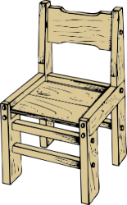
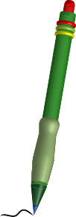
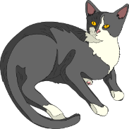
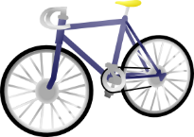
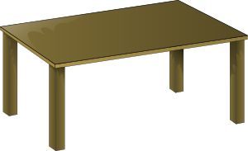
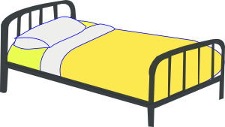
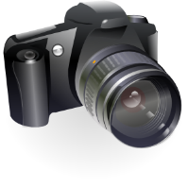
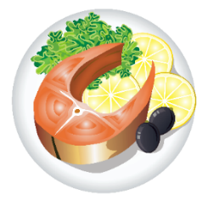
Vocabulary introduction
Vocabulario – pilla al intruso
Vocabulary Introduction
1.
4.
los
los
las
los
las
las
[teams]
[towns]
2.
5.
los
las
los
las
los
los
[jobs]
3.
6.
der
las
las
los
las
las
los
Notes:
Odd one out activity
Timings: 5 minutes
Aim: to recall the nouns, including their gender
Procedure:
Students write 1-6
They look at the pictures and try to remember the Spanish words. It might help them to write them down.
They then decide which is the odd one out. They could label it A, B or C, according to the column
Notes
1. The words included in this activity are largely from weeks 1.1.4 and 1.2.3, which were recently revisited as part of homework.
2. Students will need to use their word knowledge (knowing the gender of each noun) to work out the answer. Here, the word is not supplied so they will have to retrieve the vocabulary from memory. This highlights to students how gender, not just meaning, is important when learning vocabulary.

Slide 32
Vocabulario
 |  |  | el | la | los | las
1 | películas
2 | equipos
3 | platos
4 | edificio
5 | familia
6 | pueblos
7 | vistas
8 | isla
9 | trabajo
films
teams
plates, dishes
building
family
towns, villages
views
island
job
Notes:
Starter
Timing: 3 minutes
Aim: to identify the four words for the to reconnect with the previous lesson’s teaching point before picking up again with the definite article.
Procedure:
1. Students tick the correct box (or write the correct definite article in their ex. books if teachers do not wish to print the table).
2. Teachers can also use this as an opportunity to practise vocabulary and refresh the meaning of these words by quickly asking students to give the English during the feedback.

Slide 33
Nouns ending in a consonant
If a noun ends in a consonant, remember we do not just add ‘s’ but ‘es’:
Masculine nouns
Feminine nouns
el profesor
los profesores
la ciudad
las ciudades
el autor
los autores
la flor
las flores
Notes:
Grammar recap slide
This has been taught in Y7 1.2 week 2, so this slide offers an opportunity to teach this point explicitly again as this will be seen in the input activities to follow e.g. ciudad, autor.

Slide 34
leer
Una familia describe la isla de Ibiza. Lee y marca la opción correcta. ¿Es singular o plural?
1 | La | familia |  | baila mucho en Ibiza.
 |  | familias
2 | Las | islas |  | son muy famosas.
 |  | isla
3 | Las | vista |  | son bonitas.
 |  | vistas
4 | Las | películas |  | en el barco son interesantes.
 |  | película
5 | La | ciudades |  | es tranquila.
 |  | ciudad
6 | La | revista |  | tiene unas frases en español.
 |  | revistas
Escribe las frases en inglés.
The family dances a lot in Ibiza.
The islands are very famous.
The views are pretty.
The films on the boat are interesting.
The city is quiet.
The magazine has some sentences in Spanish.
Notes:
Reading activity [1/2]
Timing: 7 minutes
Aim: to consolidate understanding of definite articles; to consolidate understanding of the vocabulary
Procedure:
1. Students focus on the form of the definite article (plural or singular) to decide what the correct noun must be.
2. The meaning of English sentence can be checked during feedback. Animations support this.
Notes:
1. Although the verb and/or adjective agreement could alert students to whether a singular/plural noun is needed, students will likely refer to the definite article to inform their choice for the noun, since this this is less cognitively demanding,
2. Teachers could ask students to then translate the sentences. The additional vocabulary used here has already been seen by students either in the vocab sets for previous weeks or as source/cluster words.
Word frequency (1 is the most frequent word in Spanish): familia [233]; película [543]; vista [408]; isla [810]; ciudad [178]; revista [920]; interesante [616]; bailar [1323]; famoso [997]; bonito [891]; barco [1384]; tranquilo [1073]; español¹ [262]; frase [1036]
Source: Davies, M. & Davies, K. (2018). A frequency dictionary of Spanish: Core vocabulary for learners (2nd ed.). Routledge: London

Slide 35
leer
En las frases 7-12, una familia describe la isla de Ibiza. Lee y marca la opción correcta. ¿Es singular o plural?
7 | Los | platos |  | no son caros.
 |  | plato
8 | Los | pueblo |  | son antiguos.
 |  | pueblos
9 | Los | trabajos |  | son importantes.
 |  | trabajo
10 | Los | edificios |  | no son muy grandes.
 |  | edificio
11 | El | equipos |  | de fútbol no es muy famoso.
 |  | equipo
12 | El | autor |  | habla mucho de la cultura.
 |  | autores
Escribe las frases en inglés.
The dishes aren’t expensive.
The villages are old.
The jobs are important.
The buildings are not very big.
The football team is not very famous.
The author talks a lot about the culture.
Notes:
Reading activity [2/2]
Word frequency (1 is the most frequent word in Spanish): pueblo [244]; equipo [373]; trabajo¹ [152]; edificio [857]; plato [1808]; autor/a [513]; grande [66]; de¹ [2]; famoso [997]; caro [2179]; antiguo [446]; importante [171]; cultura [469]; persona [108]; fútbol [1471]; hablar [90]
Source: Davies, M. & Davies, K. (2018). A frequency dictionary of Spanish: Core vocabulary for learners (2nd ed.). Routledge: London

Slide 36
Gramática
escuchar
Una familia está de vacaciones en España.
Escucha.
Marca la opción correcta.
Luego completa la frase en español.
la / las | familia / familias
las / la | isla / islas
las / la | películas / película
la / las | vistas / vista
los /el | equipo / equipos
el / los | pueblos / pueblo
los / el | plato / platos
los / el | trabajos / trabajo
1
habla mucho de España.
2
son muy tranquilas.
3
tiene música de Granada.
4
son bonitas.
5
de Barcelona es famoso.
6
está lejos.
7
no son caros.
8
no son malos.
Notes:
Listening task
Timing: 8 minutes
Aim: to connect the definite article form to the noun (both need to be singular or plural); to consolidate understanding of previously taught vocabulary
Procedure:
1. Students first listen out for the definite article to decide whether the noun is singular or plural.
2. Then, they listen again and write the Spanish (i.e., transcription). This should help them to begin to associate singular definite article and plural definite article with the singular and plural forms of the verb (ser) and adjective.
Notes:
1. The word ‘vacaciones’ hasn’t yet been taught; it may need to be given to students.
Transcript:
La [familia] habla mucho de España
Las [islas] son muy tranquilas.
La [película] tiene música de Granada.
Las [vistas] son bonitas.
El [equipo] de Barcelona es famoso.
El [pueblo] está lejos.
Los [platos] no son caros.
Los [trabajos] no son malos.
Word frequency (1 is the most frequent word in Spanish): pueblo [244]; equipo [373]; trabajo¹ [152]; plato [1808]; familia [233]; película [543]; vista [408]; isla [810]; de¹ [2]; famoso [997]; caro [2179]; hablar [90]; lejos [833]; malo [368]; bonito [891]; tranquilo [1073]; música [340]
Source: Davies, M. & Davies, K. (2018). A frequency dictionary of Spanish: Core vocabulary for learners (2nd ed.). Routledge: London

Slide 37
hablar
En parejas
Persona A: Describe las cosas.
Usa ‘es’ o ‘son’ + adjetivo.
simpáticas …………………… | grande …………………..
antiguos ………………….. | buena ……………………
Son antiguos.
Persona B: Escucha.
¿Es singular o plural?
¿Es masculino o femenino?
are old
Identifica la imagen correcta.
Escribe el verbo y el adjetivo en inglés.
Notes:
Paired/listening speaking
Timing: 10 minutes (slides 34-38)
Aim: This follow-up pair work activity builds on the teaching points from the previous sequence, now in a production task.
Procedure:
1. The teacher can use this slide to model the requirements for the pair work task (see next slide). The animation works through one example.
2. Teachers could also work through the other examples on this slide with the class by asking what would be said/written for the other three.
Word frequency (1 is the most frequent word in Spanish):
Source: Davies, M. & Davies, K. (2018). A frequency dictionary of Spanish: Core vocabulary for learners (2nd ed.). Routledge: London

Slide 38
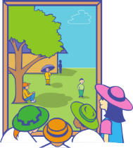
Persona A (habla)
Persona B (escucha y escribe en inglés)
¿Singular o plural?
¿Masculino o femenino?
¿‘Es’ o ‘son’?
[views]
feas | antiguo
tranquilos | bonita
are ugly
is pretty
[towns]
is old
are quiet
Notes:
DO NOT DISPLAY DURING ACTIVITY.
Refer to the Word doc uploaded with this resource for printable speaking cards and listening grids.
Partner A will choose either es or son to start his/her sentence (depending on the adjective given).
Partner B will listen carefully to the adjective ending to ascertain the noun, write down the English underneath the correct picture
Answers:
es bonita [La isla]
es antiguo [El edificio]
son tranquilos [Los pueblos]
son feas [Las vistas]
E.g.
Partner B will start by saying one of his/her selection of 4 adjectives with either es/son e.g. ‘son bonitas’
Partner A will look at his/her first set of pictures, locate the answer and tell it to his/her partner , which in this example is ‘las vistas’
Partner A will write the English underneath the picture ‘pretty’ whilst Partner B writes ‘the views’ in the space underneath ‘bonitas’ on his/her worksheet
Partner B repeats this for the four other adjectives in his/her set.
Partners then swap roles.
Each partner can have two goes at speaking given that there are two sets of cards.

Slide 39
hablar / escuchar
Persona A (habla)
Persona B (escucha y escribe en inglés)
¿Singular o plural?
¿Masculino o femenino?
¿‘Es’ o ‘son’?
caros | buena
simpáticas | pequeño
is good
are expensive
[team]
are nice
is small
Notes:
DO NOT DISPLAY DURING ACTIVITY.
Refer to the Word doc uploaded with this resource for printable speaking cards and listening grids.
Procedure:
1. Partner A will choose either es or son to start his/her sentence (depending on the adjective given).
2. Partner B will listen carefully to the adjective ending to ascertain the noun, write down the English underneath the correct picture.
Answers:
son simpáticas [Las familias ]
son caros [Los platos]
es buena [La película]
es pequeño [El equipo]

Slide 40
Persona A (escucha y escribe en inglés)
¿Singular o plural?
Persona B (habla)
¿Masculino o femenino?
¿‘Es’ o ‘son’?
[team]
nervioso | bonitas
simpática | blancos
is nice
is nervous
[views]
are white
are pretty
Notes:
DO NOT DISPLAY DURING ACTIVITY.
Refer to the Word doc uploaded with this resource for printable speaking cards and listening grids.
Partner B will choose either es or son to start his/her sentence (depending on the adjective given). Partner A will listen carefully to the adjective ending to ascertain the noun, write down the English underneath the correct picture.
Answers:
son blancos [Los edificios]
es nervioso [El equipo ]
es simpática [La familia ]
son bonitas [Las vistas]

Slide 41
Persona A (escucha y escribe en inglés)
¿Singular o plural?
Persona B (habla)
¿Masculino o femenino?
¿‘Es’ o ‘son’?
famosas | tranquilo
antigua | baratos
is old
are cheap
[town]
is quiet
are famous
Notes:
DO NOT DISPLAY DURING ACTIVITY.
Refer to the Word doc uploaded with this resource for printable speaking cards and listening grids.
Partner B will choose either es or son to start his/her sentence (depending on the adjective given). Partner A will listen carefully to the adjective ending to ascertain the noun, write down the English underneath the correct picture.
Answers:
son baratos [Los platos]
son famosas [Las islas]
es antigua [La película ]
es tranquilo [El pueblo ]

Slide 42
Gramática
escribir
En parejas
Escribe unas frases con ‘el’, ‘la’, ‘los’ o ‘las’.
Usa las imágenes y lee las palabras en inglés.
Un ejemplo:
is old
La película es antigua.
Las islas son famosas.
are famous
Notes:
Writing
Timing: 7 minutes (slides 39-40)
Aim: to practise producing the definite article (singular, plural), along with other previously taught features, in writing.
Procedure:
1. Use this slide to explain the writing activity on the next slide
Notes: Before starting this activity, we suggest that the teacher collects the prompt cards used in the speaking/listening activity, as these have the Spanish adjectives. Ideally, students should be able to recall the Spanish translation of the English adjectives here.
Word frequency (1 is the most frequent word in Spanish): pueblo [244]; equipo [373]; edificio [857]; plato [1808]; familia [233]; película [543]; vista [408]; isla [810]; pequeño [202]; bueno [98]; bonito [891]; feo [2373]; caro [2179]; simpático [3349]; tranquilo [1073]; blanco [372]
Source: Davies, M. & Davies, K. (2018). A frequency dictionary of Spanish: Core vocabulary for learners (2nd ed.). Routledge: London

Slide 43
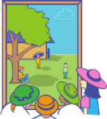
is good
Escribe unas frases.
La película es buena.
Usa ‘el’, ‘la’, ‘los’ o ‘las’.
[views]
are ugly
Las vistas son feas.
is nice
La familia es simpática.
[team]
is small
El equipo es pequeño.
[town]
is quiet
El pueblo es tranquilo.
are white
Los edificios son blancos.
La isla es bonita.
is pretty
are expensive
Los platos son caros.
Notes:
Prompts are taken from each of the sets of cards that students just used for speaking/listening.
Students should therefore be familiar with the meanings of the pictures and vocabulary needed for the activity.

Slide 44
escribir
…son simpáticas.
…es pequeño.
…es barata.
…es feo.
…son altos.
…son caras.
…son feas.
…es bonita.
E.g La planta es bonita.
E.g Los edificios son altos.
Notes:
Writing activity (more challenging option)
Timing: 8 minutes
Aim: to bring together previous learning of several features: 1) definite articles (singular, plural); 2) nouns (singular and plural); 3) and adjective gender agreement. These are used both receptively (as prompts) and in production.
To give students the opportunity to use a range of previously taught nouns.
Procedure:
1. Teacher clicks and one of the blue sentence endings will flash.
2. Students will look at this and create some of their own sentence starters to match it. The sentence starter will need to agree in number and gender with the sentence ending in order to be grammatical.
Word frequency (1 is the most frequent word in Spanish): pequeño [202]; bonito [891]; feo [2373]; caro [2179]; simpático [3349]; alto¹ [231]; barato [2164]
Source: Davies, M. & Davies, K. (2018). A frequency dictionary of Spanish: Core vocabulary for learners (2nd ed.). Routledge: London

Slide 45
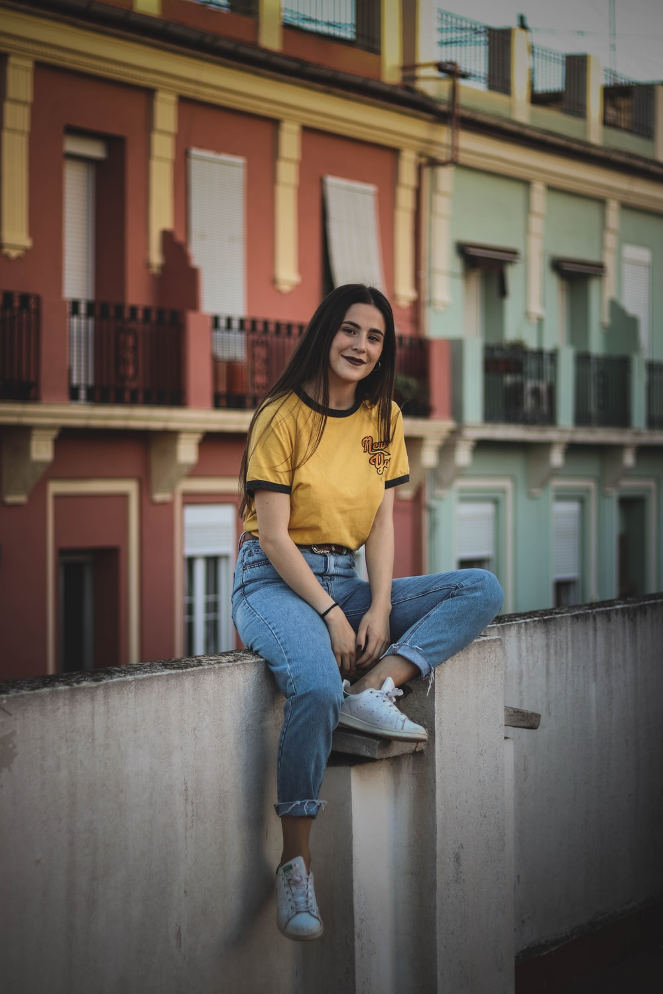
escuchar
Escucha a Sara.
Escribe el inglés.
Note. ¿Qué más? = What else?
siempre = always
Hello, I’m Sarah from Villassar de Mar, a town near Barcelona.
My family has a house and a boat here. The boat is yellow and the doors, tables, beds and windows of the house are also yellow.
My best friends are Pilar, a girl, and Luis and Ángel, two boys. Pilar is in my Taekwondo class.
I collect a lot of things. For example, I have a collection of coins. They’re different: some are small, others are big. Some are new, others are old. Pilar has a collection of pens.
I also study Mandarin. I have a book with some phrases. In Mandarin there are no letters, but there are characters.
What else? Yes, my cat, Misti. She’s always in bed!
Notes:
Timing: 15 minutes
Aim: to consolidate vocabulary from weeks 1.1.4 and 1.2.3, while also recycling a number of previously taught high-frequency verbs: ‘hay’, ‘tengo’, ‘tiene’, ‘soy’, ‘es’, ‘son’ and ‘está’.
Procedure:
Students listen and translate.
The audio here allows the student or teacher to pause and go back to certain points in the recording. We have grouped the text into individual sentences or small paragraphs so that it can be done one part at a time.
Notes:
1. You may find that there isn’t time to also do this translation activity in class. If so, we recommend setting it for homework.
2. We also provide a link to the file online, in case you wish to send it to students by email (and so that they don’t see the translation provided here): https://ncelp.org/audio/SY7T2-1W6_lesson_audio
Image free to use and available on www.unsplash.com

Slide 46
Gaming Grammar
Gaming Grammar mini-games Definite articles: gender and Articles: Number in the ‘Article agreement’ menu practice aspects of this week’s lesson further.
Notes:
This slide links to Gaming Grammar login screen. The appropriate mission can then be selected from the menu page.
Students will progress through the game at their own rate; teachers should use the teacher interface to check progress. This will help to inform future lesson planning.

Slide 47
Deberes
Vocabulary Learning Homework (Y7, Term 1.2, Week 7)
Audio file
Audio file QR code:
Student worksheet
Quizlet link
In addition, revisit: Term 1.2 Week 4
Term 1.1 Week 6

