Slide 1
Vocabulary
Author name(s): Victoria Hobson, Rachel Hawkes
Date updated: 10.01.2020

Slide 2
Vocabulario: Semana 3
60
 | Word | English meaning
1 | alto | tall, high
2 | bajo | short, low
3 | simpático | nice, friendly
4 | alegre | happy, cheerful
5 | guapo | good-looking
Segundos
0
INICIO
Notes:
Vocabulary practice slide: adjectives only Pupils either work by themselves or in pairs, reading out the words and studying their English meaning (1 minute). Then the English meanings are removed and they try to recall them, looking at the Spanish (1 minute). Then the Spanish meaning are removed and they to recall them, looking at the English (1 minute) Further rounds of learning can be facilitated by one pupil turning away from the board, and his/her partner asking him/her the meanings. This activity can work from L2 → L1 or L1 → L2.
Full vocabulary set for week 3:
ser [7]; soy; eres; es; y [4]; alegre [2081]; simpático [3349]; guapo [4192]; alto [231]; bajo [236]
Note: Students will need a little support with the pronunciation of 1] ‘j’ in ‘bajo

Slide 3
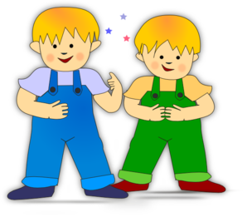
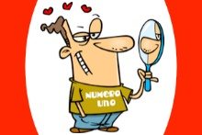
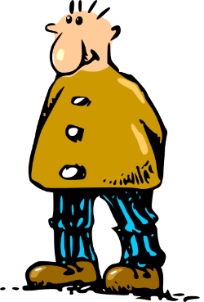
simpático
alegre
guapo
alto
bajo
Notes:
Teachers may wish to use this slide to reinforce the adjectives for Week 3
‘Tranquilo’ will later be recycled from week 2 as this is an example of an adjective which can be used with both estar and ser and is pertinent to the activity.
Pictures appear in order: teacher says them, students repeat.
Words remain only - students pronounce chorally without teacher support.
Question icons elicit the English meanings, one by one.
Pictures appear and disappear, out of sequence, eliciting Spanish.

Slide 4
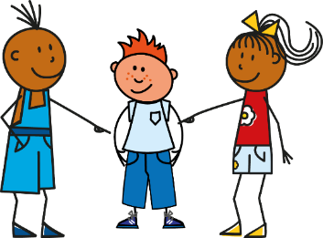
¡Hablamos!
Notes:
This activity practises the use of ‘soy’ and ‘es’ (two grammar features taught this week) with the new adjectives.
Choral responses Group A – (e.g., left-hand side of the class) gives the Spanish. Group B – (e.g., right-hand side) translates into English. Teacher monitors readiness of responses, verb forms and pronunciation.
To be completed before the images stop spinning.
After five, players swap roles.
(Speed up timings to increase the challenge.)
NB: the students who are translating face away from the board.
The Budda image may need to be explained as tranquilo. Teachers could elicit the answer from the students by asking what they think is means. ¿Qué significa el Budda?

