Slide 1
Zeitreisen
Using the conjunction als; saying years
Revisit several SSC
Y9 German
Term 1.1 - Week 6 - Lesson 11
Heike Krüsemann / Rachel Hawkes
Artwork: Steve Clarke
Date updated: 09 / 06 / 21
Notes:
Artwork by Steve Clarke. All additional pictures selected are available under a Creative Commons license, no attribution required.
Native-speaker teacher feedback provided by Stephanie Cross.
Learning outcomes (lesson 1):
Consolidation of several SSC: hard and soft [ch], [sch], [s-], [z], [-d], [ö], [ü], [au], [ie], [ck], [r], [w], [er], [v] Introduction to using als (word order 3 conjunction) to mean when in the past Revisit verb and noun pairs (word families)
Word frequency (1 is the most frequent word in German): Present: beobachten [697] entdecken [743] unterstützen [760] Bewegung [709] Chemie [486] Forscher [1246] Moment [348] Tourist [1318] Vergangenheit [1196] Wissenschaftler [1522] als³ [22] bevor [537] nachdem [528]
Revisit: ihr4 [27] dienen [684] erwarten [389] feiern [869] sammeln [1219] Dienst [1558] Ende [183] Feuer [1576] Gast [576] Holz [2221] woher [1494] Revisit: sollen [60] ich soll du sollst er/sie/es soll kosten [903] lachen [444] teilen [906] verstecken [1575] versuchen [247] Fehler [861] Gefühl [462] Glas [885] Kosten [564] Stunde² [262] etwa [181]
Source: Jones, R.L & Tschirner, E. (2019). A frequency dictionary of German: Core vocabulary for learners. London: Routledge.
The frequency rankings for words that occur in this PowerPoint which have been previously introduced in NCELP resources are given in the NCELP SOW and in the resources that first introduced and formally re-visited those words.
For any other words that occur incidentally in this PowerPoint, frequency rankings will be provided in the notes field wherever possible.

Slide 2
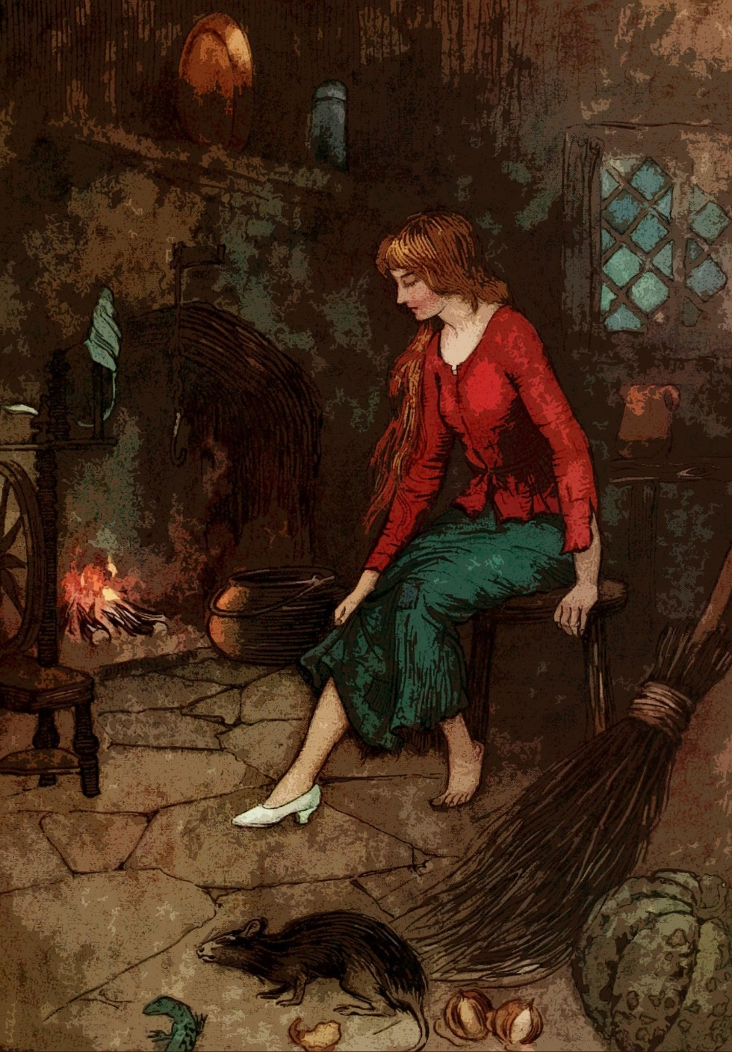
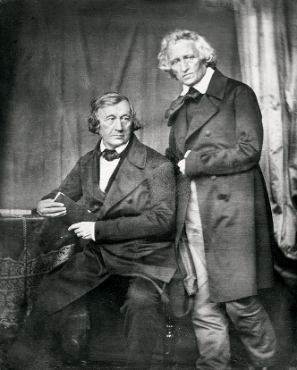
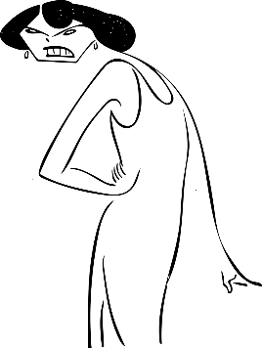
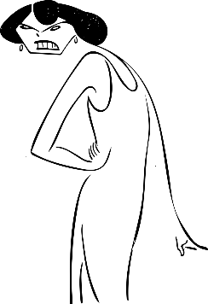
Aschenputtel*
Ich sammle Holz für das Feuer, aber ihr redet über den Ball mit dem Prinzen.
lesen
Ich bereite das Zimmer für den Gast vor, aber ihr erwartet den Ball mit dem Prinzen.
Lies den Text. Was denkt Aschenputtel(Cinderella)?
Schreib den Text auf Englisch.
Die Brüder Grimm waren Autoren und Sprachwissenschaftler. Im 19. Jahrhundert haben sie viele Märchen* und Volksgeschichten gesammelt und veröffentlicht*. Zum Beispiel Aschenputtel (Cinderella), Der Froschkönig (The Frog Prince) und Hänsel und Gretel.
Ich diene stundenlang jeden Tag, aber ihr feiert schon auf dem Ball mit dem Prinzen.
die bösen Schwestern
Oh je! Ich bin hier nur Dienstmädchen! Wann wird es ein Ende geben? … Was?!? Woher sind Sie gekommen? Wer sind Sie?
das Märchen – fairy tale veröffentlichen – to publish
Wie heißen sie in der englischen Version?
Notes:
Timing: 8 minutes Aim: to practise comprehension (written modality) of half of this week’s revisited vocabulary (all of the words from 9.1.1.2) Procedure: 1. Ensure that students are clear that the story is Cinderella.
2. Students translate (either individually or in pairs or chorally, orally or in writing) the four text bubbles.
3. Elicit responses and give oral feedback (see below for English translations, if required).
4. Click to prompt students to give the English translation of ‘die bösen Schwestern’ (ugly sisters) and elicit the difference in meaning. Böse is one of this week’s new vocabulary items. Students have previously learnt hässlich (ugly).
5. Click again to bring up the text introducing the Brüder Grimm, which some students will have heard of. Elicit a brief oral translation of the text (see below) and ask students to tell you any other Grimm fairy tales they may know (e.g. Sleeping Beauty, Little Red Riding Hood, Rapunzel, Rumpelstiltskin).
Text translations: I collect wood for the fire but you (both/all) talk about the ball with the prince. I prepare the room for the guest, but you are expecting the ball with the prince. I serve for hours and hours / hours on end every day, but you are already celebrating at the ball with the prince. Oh dear! When will there be an end? What?!? Where did you come from? Who are you? The Grimm brothers were authors and linguists. In the 19th century they collected and published many fairy tales and folk stories. For example, Cinderella, The Frog Prince and Hansel and Gretel. Word frequency of unknown words (1 is the most frequent word in German): Märchen [4155] veröffentlichen [1453] Source: Jones, R.L. & Tschirner, E. (2019). A frequency dictionary of German: core vocabulary for learners. Routledge
https://upload.wikimedia.org/wikipedia/commons/5/5a/Brothers_Grimm_Blow.jpg Attribution: Hermann Blow, Public domain, via Wikimedia Commons Attribution not legally required

Slide 3
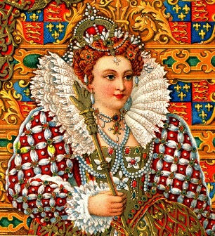
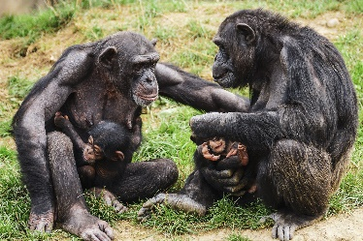
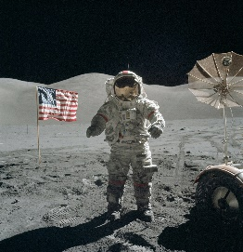
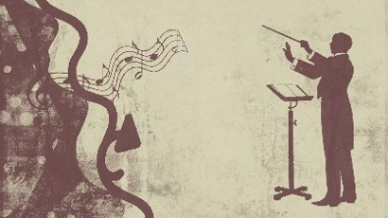
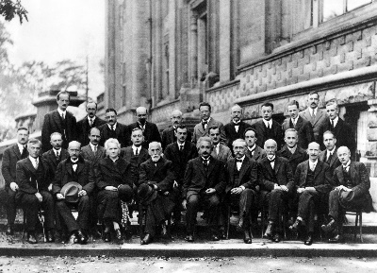
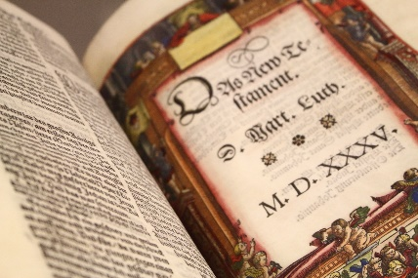
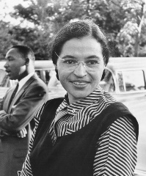
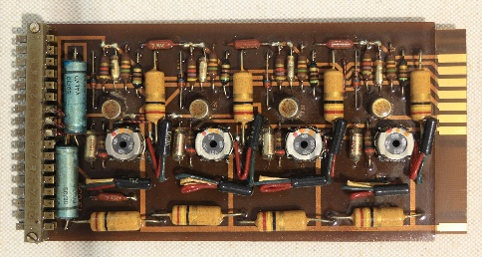
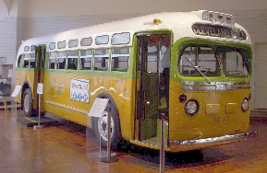
In der Vergangenheit
Hör zu. Schreib die fehlenden Buchstaben* auf.
Phonetik
der Buchstabe – letter
Jane Goodall
Buzz Aldrin / Neil Armstrong
Ludwig van Beethoven
1
2
3
4
die Beoba ch tung von Sch impan s en
die Uraufführung – premiere
_ _
die Kr ö nung von Eli s abeth I
die Ur au fführung von der 9. Sinfon ie
_
_ _
_ _ _
_
die Mondland ung
_
_
_ _ _
_ _
Marie Curie
Martin Luther
Rosa Parks
Konrad Zuse
5
6
7
8
die Entde ck ung von R adium
die Bibel- ü berset z ung
die Bürgerre ch ts- be w egung
die Er findung v om ersten Computer
_ _
_ _
_ _
_
_
_
_
_
das Bürgerrecht – civil right
Notes:
Timing: 10 minutes Aim: to consolidate knowledge of several SSC through transcription: hard and soft [ch], [sch], [s-], [z], [-d], [ö], [ü], [au], [ie], [ck], [r], [w], [er], [v] Procedure: 1. Elicit the meaning of the title (and reason for article spelling change) – die Vergangenheit is one of this week’s vocabulary items.
2. Students listen and transcribe the missing SSC.
3. Click to reveal answers.
4. Teacher to elicit meanings of each event. Where words are not glossed, the words are either part of this week’s vocabulary set (albeit a noun form of the verb or vice versa) or they are cognates or near cognates.
5. Teacher to ask students: Was war früher? Die Krönung von Elisabeth die Erste oder die Uraufführung von der 9. Sinfonie? Was war später…? This is to prime thinking ahead of teaching students how to say years (e.g. 1954) in German, and also to revisit use of ‘als’ for comparatives. Depending on the ability of the class, the teacher could frame this by giving full examples and asking students to agree or disagree. E.g. Die Entdeckung von Radium war früher als die Bibelübersetzung. Was meint ihr? (Note that students have recently learnt the plural ‘ihr’ form so teachers can make frequent use of this structure now in classroom language). Transcript: [1] die Beobachtung von Schimpansen [2] die Krönung von Elisabeth I [3] die Mondlandung [4] die Uraufführung von der 9. Sinfonie [5] die Entdeckung von Radium [6] die Bibelübersetzung [7] die Bürgerrechtsbewegung [8] die Erfindung vom ersten Computer Word frequency of unknown words (1 is the most frequent word in German): Buchstabe [2905] Aufführung [3575] Entdeckung [3447] Übersetzung [2016] Bürger [683] Recht [242] Erfindung [3993]
Word frequency of cognate or near-cognate words (1 is the most frequent word in German):
Schimpanse [>5009] Sinfonie [>5009] Radium [>5009] Bibel [4305] Landung [>5009] Krönung [>5009] Source: Jones, R.L. & Tschirner, E. (2019). A frequency dictionary of German: core vocabulary for learners. Routledge
Rosa Parks Image: Von Autor unbekannt – USIA / National Archives and Records Administration Records of the U.S. Information Agency Record Group 306, Gemeinfrei, https://commons.wikimedia.org/w/index.php?curid=4344206

Slide 4
Wie sagt man die Jahre auf Deutsch?
Vokabeln
To say the years 0 – 1099 in German:
In English, we often say years in two parts: 1066 → ten / sixty-six 1105 → eleven / o five 1980 → nineteen / eighty
1
752
siebenhundert(und)zweiundfünfzig
2
1066
(ein)tausend(und)sechsundsechzig
To say the years 1100 – 1999 in German:
3
1105
elfhundert(und)fünf
In German, always say the hundert or tausend but you can leave out the ein and the und.
4
1314
dreizehnhundert(und)vierzehn
5
1980
neunzehnhundert(und)achtzig
To say the years 2000 – in German:
BC – vor Christus (v. Chr) AD – nach Christus (n. Chr)
6
2005
zweitausend(und)fünf
7
2020
zweitausend(und)zwanzig
Notes:
Timing: 3 minutes Aim: to teach how to say year numbers in German. Procedure: 1. Click to bring up no.1: 752. Elicit how to say this in German. Click on number to play voice recording. Click again to reveal spelling.
2. Repeat for no.2: 1066.
3. Click to bring up call out to compare how years work in English. Click again for call out on leaving out ‘ein’ and ‘und’.
4. Work your way through 3-7 in the same way.
5. Finally, click for call out on v/n. Ch. Also explain that now CE/ BCE (common era/ before common era) tends to be used more than BC/AD.
Transcript:
752 (siebenhundert(und)zweiundfünfzig)
1066 ((ein)tausend(und)sechsundsechzig
3. 1105 (elfhundert(und)fünf)
4. 1314 (dreizehnhundert(und)vierzehn
5. 1980 (neunzehnhundert(und)achtzig)
6. 2005 (zweitausend(und)fünf)
7. 2020 (zweitausend(und)zwanzig)
Word frequency (1 is the most frequent word in German): Source: Jones, R.L. & Tschirner, E. (2019). A frequency dictionary of German: core vocabulary for learners. Routledge

Slide 5
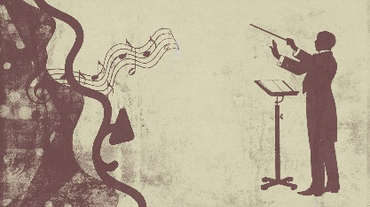
Wann war das?
Partnerarbeit. A: Sag das Jahr. B: Sag den Namen.
sprechen
Jane Goodall
Buzz Aldrin / Neil Armstrong
Ludwig van Beethoven
1
2
3
4
1960
1559
1969
1824
die Beobachtung von Schimpansen
die Krönung von Elisabeth I
die Uraufführung von der 9. Sinfonie
die Mond landung
Marie Curie
Martin Luther
Rosa Parks
Konrad Zuse
5
6
7
8
1902
1521
1939
1955
die Entdeckung von Radium
die Bibel- übersetzung
die Bürgerrechts- bewegung
die Erfindung vom ersten Computer
Notes:
Timing: 10 minutes Aim: to practise oral production of years and to receive additional aural reinforcement
Procedure: 1. Students work in pairs. Student A says a year, student B says the name of the person involved in that year’s event. 2. They swap roles after each item until all eight years have been said. 3. Click the numbers to hear the audio.
Differentiation: If students need more support, they could listen and write the year first, and then practise saying them.
Transcript: [1] neunzehnhundertsechzig [2] fünfzehnhundertneunundfünfzig [3] neunzehnhundertneunundsechzig [4] achtzehnhundertvierundzwanzig [5] neunzehnhundertzwei [6] fünfzehnhunderteinundzwanzig [7] neunzehnhundertfünfundfünfzig [8] neunzehnhunderneununddreißig Word frequency of unknown words (1 is the most frequent word in German): Buchstabe [2905] Aufführung [3575] Entdeckung [3447] Übersetzung [2016] Bürger [683] Recht [242] Erfindung [3993]
Word frequency of cognate or near-cognate words (1 is the most frequent word in German):
Schimpanse [>5009] Sinfonie [>5009] Radium [>5009] Bibel [4305] Landung [>5009] Krönung [>5009] Source: Jones, R.L. & Tschirner, E. (2019). A frequency dictionary of German: core vocabulary for learners. Routledge
Image attributions:
Marie Curie Image: <a href="https://commons.wikimedia.org/wiki/File:Marie_Curie_c1920.jpg">Henri Manuel</a>, Public domain, via Wikimedia Commons
Rosa Parks Image:
Von Autor unbekannt – USIA / National Archives and Records Administration Records of the U.S. Information Agency Record Group 306, Gemeinfrei, https://commons.wikimedia.org/w/index.php?curid=4344206

Slide 6
Person, Sache, Aktion
lesen / schreiben
Schreib die fehlenden Wörter auf.
Person
Sache
Aktion
Beispiel:
der Leser
die Lesung
lesen
die Forschung
forschen
der Forscher
 |  | beobachten
 | die Bewegung
 |  | entdecken
 |  | unterstützen
researcher
research
to research
der Beobachter
die Beobachtung
observer
observation
to observe
der Beweger
bewegen
mover
movement
to move
der Entdecker
die Entdeckung
discoverer
discovery
to discover
der Unterstützer
die Unterstützung
supporter
support
to support
Notes:
Timing: 5 minutes Aim: to practise written recall of six of this week’s new words and strengthen word knowledge by working with two noun –verb patterns to extrapolate meanings of further words (different parts of speech) within the same word family. Procedure: 1. Teacher may want to model with the example or with higher-proficiency learners, the words given in the table may be sufficient.
2. Students then complete the set of meanings, in German and English, in their books.
3. Elicit the German and English orally from students and click to check answers.
Word frequency of unknown words (1 is the most frequent word in German): Forschung [1335] forschen [4222] Beobachter [3908] die Beobachtung [2126] Beweger [>5009] bewegen [561] Entdecker [>5009] Entdeckung [3447] Unterstützer [>5009] (note: Unterstützung was taught in Y8). Source: Jones, R.L. & Tschirner, E. (2019). A frequency dictionary of German: core vocabulary for learners. Routledge

Slide 7
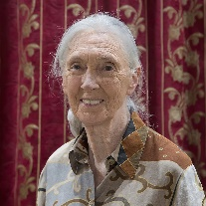
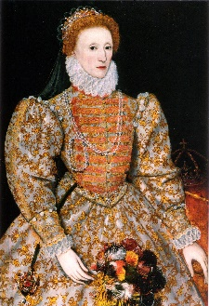
Wichtige Personen
lesen
Übersetze die Wörter 1-10. Wer ist das?
?
Sie hat Radium [1] entdeckt und den Nobelpreis für [2] Chemie dafür gewonnen. Sie war bekannter [3] als ihr Mann. Ihr Mann war auch [4] Wissenschaftler und hat sie [5] unterstützt.
_________
Marie Curie
?
Sie war als [6] Forscherin, nicht als Touristin, in Afrika. Sechzig Jahre lang hat sie in Tansania Tiere bei* vielen besonderen* Momenten [7] beobachtet.
_________
Jane Goddall
Sie ist im Bus nicht für einen Weißen aufgestanden und die Polizei hat sie festgenommen*. Viele Menschen haben sie [8] unterstützt und einen Bus-Boycott gemacht. Dadurch hat sie [9] die Bürgerrechtsbewegung in den USA begonnen.
?
_________
Rosa Parks
[10] Als Kind hat sie Französisch, Italienisch, Latein und Spanisch gelernt. Als Königin hat sie 44 Jahre lang starke Nerven und intelligente Strategien gezeigt.
?
_________
Elizabeth I
*bei³ – during
*besondere(r,s) – special
*festgenommen – arrested
das Bürgerrecht – civil right
Notes:
Timing: 5 minutes (this slide OR the next slide) Aim: to practise written receptive recall of 8 words from this week’s vocabulary set in context. There are two versions of this slide: this one is slightly easier – learners translate the words in bold. The next slide has the words blanked out and learners have to fill the blanks before translating the words. Procedure: 1. Learners read the text in the four boxes and match with four ‘famous people’ encountered on slide 5.
2. Click for answers and images 1-4.
3. Learners translate words 1-10 into English. 4. Answers given in oral feedback, as follows: 1. discovered 2. chemistry 3. than 4. scientist 5. supported 6. researcher 7. observed 8. supported 9. movement 10. as
Image attributions:
Marie Curie Image: Henri Manuel, Public domain, via Wikimedia Commons https://commons.wikimedia.org/wiki/File:Marie_Curie_c1920.jpg
Jane Goddall image: Muhammad Mahdi Karim
https://upload.wikimedia.org/wikipedia/commons/2/26/Jane-goodall.jpg
Rosa Parks Image: Unknown author, Public domain, via Wikimedia Commons (Attribution NOT legally required)
https://commons.wikimedia.org/w/index.php?curid=4344206
Elizabeth I image:
National Portrait Gallery, Public domain, via Wikimedia Commons (Attribution NOT legally required) https://commons.wikimedia.org/w/index.php?curid=4671195
Word frequency of unknown words (1 is the most frequent word in German): Bürger [683] Recht [242] besondere(r,s) [512] festnehmen [3349] Source: Jones, R.L. & Tschirner, E. (2019). A frequency dictionary of German: core vocabulary for learners. Routledge

Slide 8
Wichtige Personen
Schreib die fehlenden Wörter auf (1-10). Wer ist das?
lesen
______
Sie hat Radium [1] entdeckt und den Nobelpreis für [2] Chemie dafür gewonnen. Sie war bekannter [3] als ihr Mann. Ihr Mann war auch [4] Wissenschaftler und hat sie [5] unterstützt.
______
?
_________
_
Marie Curie
______________
_________ .
Sie war nicht als Touristin, sondern als [6] Forscherin in Afrika. Sechzig Jahre lang hat sie in Tansania Tiere bei vielen besonderen Momenten [7] beobachtet.
?
______
_________
Jane Goddall
_________ .
*besondere(r,s) – special
Sie ist im Bus nicht für einen Weißen aufgestanden und die Polizei hat sie festgenommen*. Viele Menschen haben sie [8] unterstützt und einen Bus-Boycott gemacht. Dadurch hat sie [9] die Bürgerrechts*bewegung in den USA begonnen.
?
_________
_________
Rosa Parks
_________
*festgenommen – arrested
[10] Als Kind hat sie Französisch, Italienisch, Latein und Spanisch gelernt. Als Königin hat sie 44 Jahre lang starke Nerven und intelligente Strategien gezeigt.
?
__
_________
Elizabeth I
das Bürgerrecht – civil right
*bei³ – during
als (x2) – unterstützt (x2) – bewegung – entdeckt – beobachtet – Chemie – Forscherin – Forscher
Notes:
Timing: 5 minutes (this slide OR the previous slide) Aim: to practise written receptive recall of 8 words from this week’s vocabulary set in context. This is the more challenging version – the words to be translated are blanked out and learners have to fill the blanks (select from list at the bottom) before translating the words. Procedure: 1. Learners read the text in the four boxes and match with four of the ‘famous people’ encountered on slide 5.
2. Click for answers and images 1-4.
3. Learners fill in the blanks from list at the bottom.
4. Click to reveal answers 1-10.
5. Learners translate words 1-10 into English. 6. Answers given in oral feedback, as follows: 1. discovered 2. chemistry 3. than 4. scientist 5. supported 6. researcher 7. observed 8. supported 9. movement 10. as
Image attributions:
Marie Curie Image: Henri Manuel, Public domain, via Wikimedia Commons https://commons.wikimedia.org/wiki/File:Marie_Curie_c1920.jpg
Jane Goddall image: Muhammad Mahdi Karim
https://upload.wikimedia.org/wikipedia/commons/2/26/Jane-goodall.jpg
Rosa Parks Image: Unknown author, Public domain, via Wikimedia Commons (Attribution NOT legally required)
https://commons.wikimedia.org/w/index.php?curid=4344206
Elizabeth I image:
National Portrait Gallery, Public domain, via Wikimedia Commons (Attribution NOT legally required) https://commons.wikimedia.org/w/index.php?curid=4671195
Word frequency of unknown words (1 is the most frequent word in German): Bürger [683] Recht [242] besondere(r,s) [512] festnehmen [3349] Source: Jones, R.L. & Tschirner, E. (2019). A frequency dictionary of German: core vocabulary for learners. Routledge

Slide 9
conjunction als
Grammatik
You know als means as:
Sie hat als Forscherin gearbeitet.
She worked as a researcher.
You also know als means than:
Sie war bekannter als ihr Mann.
She was more famous than her husband.
Also use als to mean when for a one-off event in the past:
als sends the verb to the end here; it is a WO3 conjunction!
Sie hat Schimpanzen beobachtet, als sie in Tansania war.
She observed Chimpanzees when she was in Tanzania.
But use wenn to mean when for present and future events:
Sie trainiert hart, wenn sie Sport macht.
She trains hard when she does sports.
And wann to mean when for questions:
Wann hat sie den Nobelpreis gewonnen?
When did she win the Nobel prize?
Notes:
Timing: 2 minutes Aim: to recap the two known uses of als and introduce 3rd meaning as a conjunction. Procedure: 1. Click to bring up the first previously taught use of als (as). Click again for example, then again for translation.
2. Follow the same process for the second previously taught use of als (than).
3. Now click to introduce als as a conjunction, meaning when in the past. Click again for example, again for translation. Click once more to bring up call out drawing attention to word order.
4. Click to explain to use wenn (as opposed to als) for present/ future events, click for example, click for translation.
5. Same for using wann meaning when in questions.
Word frequency of cognate or near-cognate words (1 is the most frequent word in German):
Schimpanse [>5009] Source: Jones, R.L. & Tschirner, E. (2019). A frequency dictionary of German: core vocabulary for learners. Routledge

Slide 10
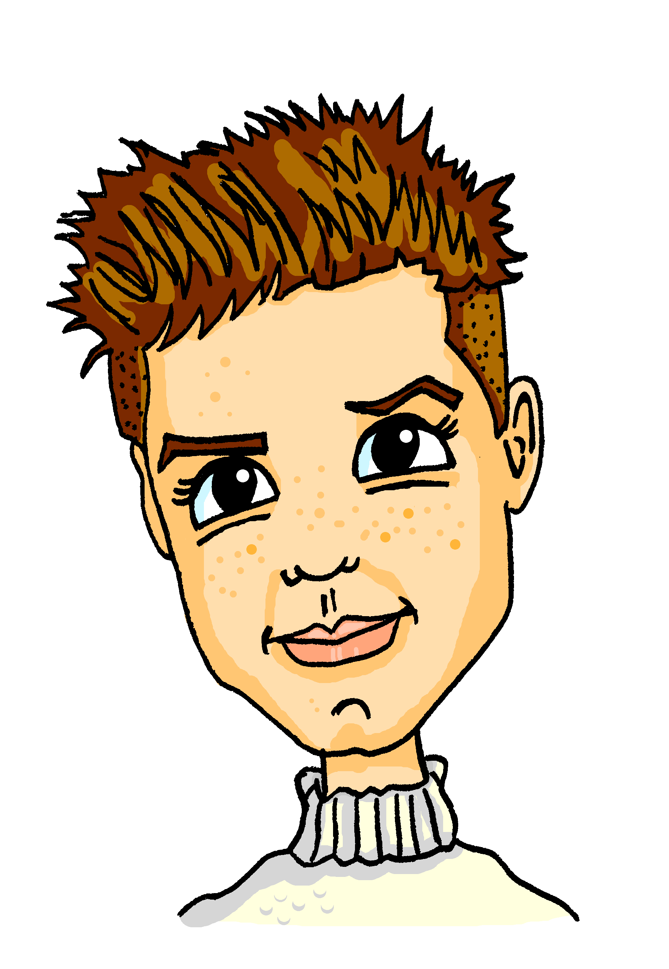
Zeitreisefilm
Ich habe einen tollen Zeitreisefilm gesehen.
Oh, ich liebe Zeitreisefilme! Kannst du mir die Geschichte erzählen, Mia?
lesen
Lies die SMS. Schreib 1 – 8. Ist das als oder denn/und?
Gerne. Ich texte dir.
*halten – to hold *plötzlich – suddenly
1. Ja, also ein Mädchen findet eine magische Uhr, als sie in einem Geschäft war.
5. Sie hat einen alten ägyptischer Gott gesehen, als sie plötzlich* Hunger hatte.
7. Der Gott hat ihre magische Uhr gesehen – und war weg!
3. Sie hat die Pyramiden gesehen, als sie 2060 v. Chr in Ägypten war.
__
__
__
__
8. Das Mädchen ist wieder in das Jahr 2020 zurückgereist, denn sie hatte Hunger und sie hatte keine Zeit mehr!
4. Es war spannend, denn sie war noch nie in der Nähe von den Pyramiden!
6. Sie hat gesagt: “Ich bin aus dem Jahr 2020, und ich komme zu Besuch”.
Hast du etwas zu essen für mich?
__
2. Sie hält die Uhr in der Hand und reist durch die Zeit.
__
__
__
__
Notes:
Timing: 8 minutes Aim: to practice in the reading modality. Based on syntax, students decide whether the missing word is als (WO3) or und/denn (WO1). Procedure: 1. Explain task: Mia has watched a time travel film and is telling Alastair about it via text messages.
2. Elicit answer for 1: als, because the verb has been sent to the end of the clause.
3. Click for answer.
4. Depending on the level of the class, scaffold 2-8 as above, or learners can complete 2-8 individually, in pairs or small groups.
5. Click for answers 2-8. NB: No. 8 has two answers.
Word frequency of unknown or cognate words (1 is the most frequent word in German): Ägypten [>5009] Gott [] Pyramide [>5009] ägyptisch [>5009] pl Source: Jones, R.L. & Tschirner, E. (2019). A frequency dictionary of German: core vocabulary for learners. Routledge

Slide 11
Zeitreisen
Using conjunctions als, nachdem, bevor
Revisit several SSC
Y9 German
Term 1.1 - Week 6 - Lesson 12
Heike Krüsemann / Rachel Hawkes
Artwork: Steve Clarke
Date updated: 09 / 06 / 21
Notes:
Artwork by Steve Clarke. All additional pictures selected are available under a Creative Commons license, no attribution required.
Native-speaker teacher feedback provided by Stephanie Cross.
Learning outcomes (lesson 1):
Consolidation of several SSC
Introduction to using word order 3 conjunctions nachdem and bevor Revisit verb and noun pairs (word families)
Word frequency (1 is the most frequent word in German): Present: beobachten [697] entdecken [743] unterstützen [760] Bewegung [709] Chemie [486] Forscher [1246] Moment [348] Tourist [1318] Vergangenheit [1196] Wissenschaftler [1522] als3 [22] bevor [537] nachdem [528]
Revisit: ihr4 [27] dienen [684] erwarten [389] feiern [869] sammeln [1219] Dienst [1558] Ende [183] Feuer [1576] Gast [576] Holz [2221] woher [1494] Revisit: sollen [60] ich soll du sollst er/sie/es soll kosten [903] lachen [444] teilen [906] verstecken [1575] versuchen [247] Fehler [861] Gefühl [462] Glas [885] Kosten [564] Stunde2 [262] etwa [181]
Source: Jones, R.L & Tschirner, E. (2019). A frequency dictionary of German: Core vocabulary for learners. London: Routledge.
The frequency rankings for words that occur in this PowerPoint which have been previously introduced in NCELP resources are given in the NCELP SOW and in the resources that first introduced and formally re-visited those words.
For any other words that occur incidentally in this PowerPoint, frequency rankings will be provided in the notes field wherever possible.

Slide 12
Vokabeln
schreiben
Schreibe die versteckten Wörter auf.
Beispiel:
enden
der
Fehler [mistake]
der Dienst [service, duty]
das Ende [end]
fehlen
dienen
What do you need to remember when writing nouns in German?
der Versuch
versuchen [to try]
feiern [to celebrate]
die Feier
kosten
wissen
der Wissen-schaftler [scientist]
die Kosten [costs]
das Lachen
das Versteck
die Sammlung
lachen [to laugh]
verstecken [to hide]
sammeln [to collect]
What are the two ways you know to make nouns from verbs in German?
Notes:
Timing: 7 minutes Aim: to practise written productive recall of 13 items vocabulary from the two revisited sets for this week, (and one from the new set), using related words from the same word family. Procedure: The activity is designed like a scratch card. On clicks, the missing words appear in a random order.
1. Click to model, using the example. The noun der Versuch changes colour to orange. Which word from the revisited vocabulary does it relate to? 2. Students write versuchen and the English meaning (to try). Note: they are all noun-verb pairs. 3. Ask Welches Wort ist das? Click again to reveal the answer – German and English. The animation is a slow reveal. Students try to say the word before it is revealed. 4. Continue with items 2-11. Note: Callouts prompt students to 1: pay attention to capital letters on nouns and 2: recognise that they have practised two ways to nominalise verbs – first, to assign the gender das and add a capital letter; second, to take the stem of the verb, add a capital letter and learn the gender (either der or das), e.g. das Spiel / der Fall.
Word frequency of unknown words (1 is the most frequent word in German): enden [1313] die Sammlung [2884] die Feier [>5009] Versteck [>5009] Versuch [792] Source: Jones, R.L. & Tschirner, E. (2019). A frequency dictionary of German: core vocabulary for learners. Routledge

Slide 13
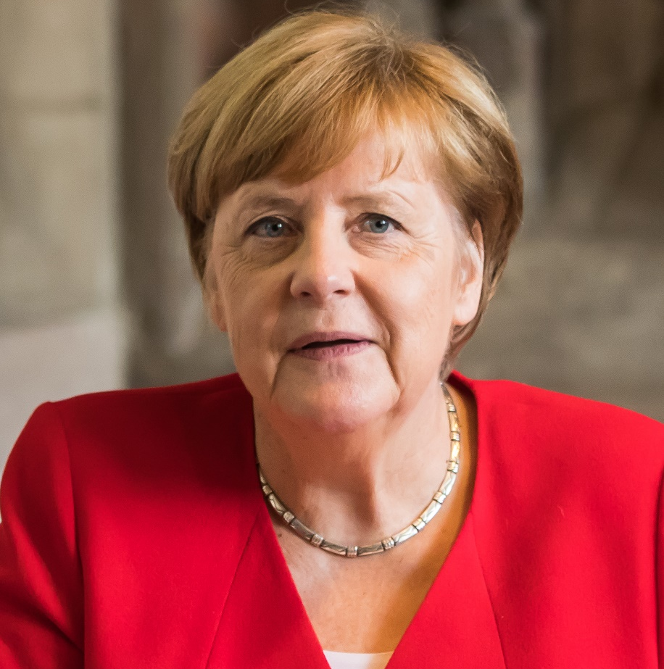
Wer ist das?
hören / sprechen
 | 1 | 2 | 3 | 4
A
B
C
D
audio:
?
?
?
?
before
hour, lesson
feeling
glass
A1
A2
A3
A4
?
?
?
?
relatively
if, when
out, out of, from
about, approximately
B1
B2
B3
B4
career
?
?
?
?
after
should, to ought to
per
C1
C2
C3
C4
free time
tourist
moment
when (past), as, than
?
?
?
?
D1
D2
D3
D4
© Raimond Spekking
Notes:
Timing: 8 minutes
Aim: to recognise 16 words of revisited and new vocabulary at word level.
Procedure:
1. Students volunteer (in German) a letter/number combination relating to a square on the grid.
2. Click the corresponding audio button on the right-hand side.
3. The whole class say the English translation in chorus. Click the blue box to reveal the answer.
4. Continue until all English meanings are showing.
5. Students then produce the German meanings, one by one, chorally. If the teacher judges that the overall knowledge of the word was secure s/he clicks to reveal part of the picture. Any insecure word knowledge and the teacher confirms the German meaning and leaves the picture uncovered until the end, returning to it again for another go.
Transcript:
[A1] bevor
[A2] die Stunde
[A3] das Gefühl
[A4] das Glas
[B1] relativ
[B2] wenn
[B3] aus
[B4] etwa
[C1] sollen
[C2] pro
[C3] die Karriere
[C4] nachdem
[D1] die Freizeit
[D2] der Tourist
[D3] der Moment
[D4] als
Answer: Angela Merkel, Ex-/Altbundeskanzlerin (2005 – 2021)

Slide 14
Karaoke SSC
Sag die Femininform für jedes Wort.
sprechen
Finde eine*n Partner*in.
[ r ] is formed at the back of the throat without using the lips
Add – in to male person nouns to make female nouns.
6
2
Autor
Aktivist
1
Forscher
3
Wissenschaftler
Drop the –e ending first!
das Gendersternchen (Gender Star)
4
Komponist
The * symbol is sometimes used as a more inclusive way of differentiating male/female role nouns, e.g. Lehrer*in not Lehrer/Lehrerin.
It is placed between the m/f forms to symbolise all genders in between and it makes it possible not to specify gender, e.g. Alex ist Künstler*in.
10
Theologe
5
Tourist
9
König
8
Astronaut
7
Erfinder
[inventor]
Notes:
Timing: 5 minutes
Aim: to consolidate the noun rule for the feminisation of masculine people nouns, and to revisit the pronunciation of several SSC but particularly [r] within words, where pronunciation is very different from English, formed at the back of the throat without using the lips at all. Note that three nouns are from this week’s vocabulary set, one was taught in Week 1 (König), five others are cognates and Erfinder appeared in lesson 1, though teachers may want to ensure that the meaning is remembered. Students may not have heard of theologian in English, so teachers may need to explain the meaning.
Procedure:
Click to highlight a word.
Students say the feminine form of the noun out loud, focusing on accurate pronunciation of all the SSC.
Click on the number button next to the word to check pronunciation.
Transcript and word frequency (1 is the most frequent word in German):
1. Forscherin
2. Autorin
3. Wissenschaftlerin
4. Komponistin
5. Touristin
6. Aktivistin
7. Erfinderin
8. Astronautin
9. Königin
10. Theologin Word frequency of unknown or cognate words (1 is the most frequent word in German): Autor [723] Komponist [>5009] Aktivist [>5009] Erfinder [>5009] Astronaut [>5009] Theologe [>5009] Source: Jones, R.L. & Tschirner, E. (2006). A frequency dictionary of German: core vocabulary for learners. Routledge

Slide 15
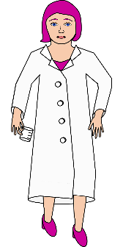
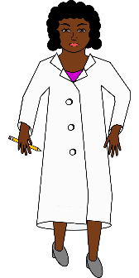
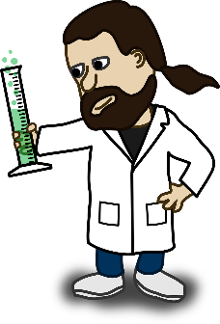
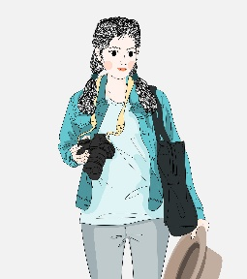
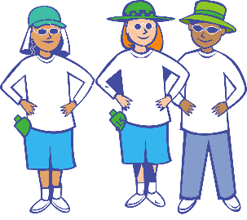
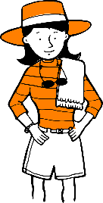
Plural
Grammatik
You can also refer to any plural groups with the Gendersternchen, e.g. Wissenschaftler*innen
We know five ways to form plurals in German. Here is rule 6:
Rule 6
Add –nen to all feminine person nouns ending in –in.
die Wissenschaftlerin →
die Wissenschaftlerinnen
die Wissenschaftler/Wissenschafterinnen
die Touristin →
die Touristinnen
die Touristen
Masculine person nouns ending in –t or –e often end –en in plural.
Remember: the word for ‘the’ is ‘die’ for all plural nouns.
Notes:
Timing: 1 minute Aim: to present plural rule 6. Procedure: 1. Click through the animations. 2. It is animated so that the examples are provided, and students can volunteer English meanings.

Slide 16
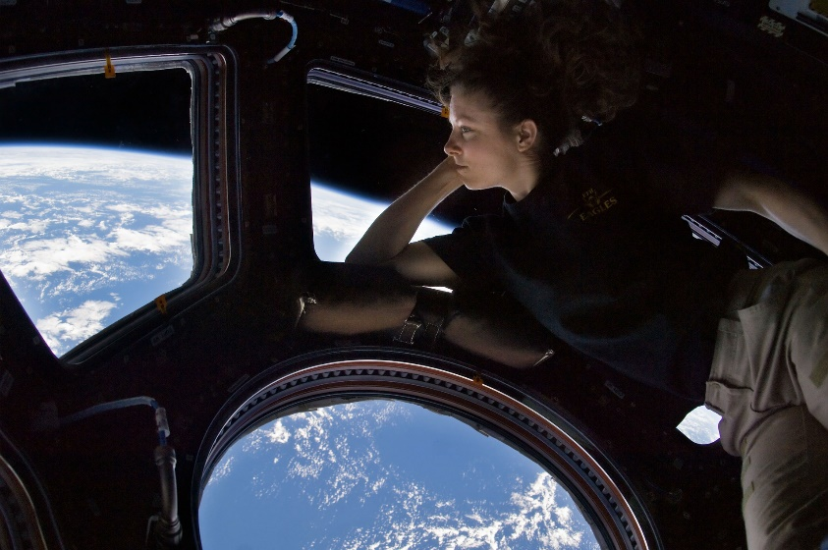
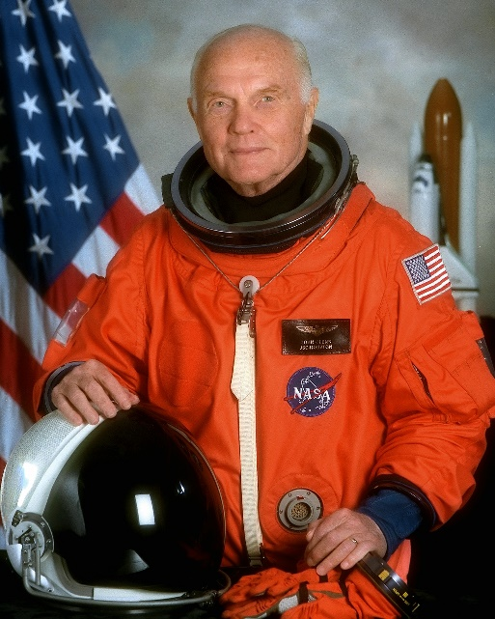
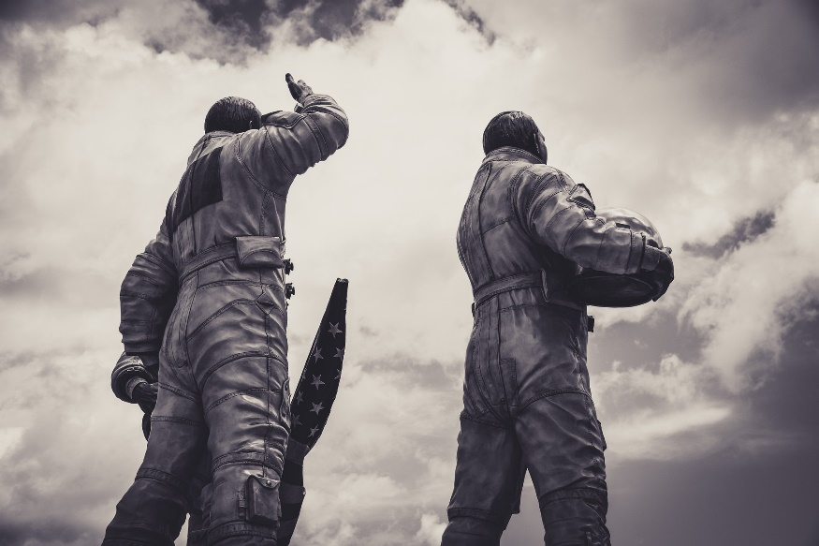
Wer ist das? [1/6]
hören
1
1
Notes:
Timing: 4 minutes (six slides) Aim: to practise aural comprehension of plural rule 6.
Procedure: 1. Click to hear the sentence. 2. Students select the correct option based on the singular or plural form heard. 3. Click to reveal answer. 4. Click to reveal a 2nd audio button to hear the full sentence, for additional reinforcement. Note that verbs are bleeped out to remove additional cues. Transcript: 1. Diese Astronauten [sind] sehr bekannt.

Slide 17
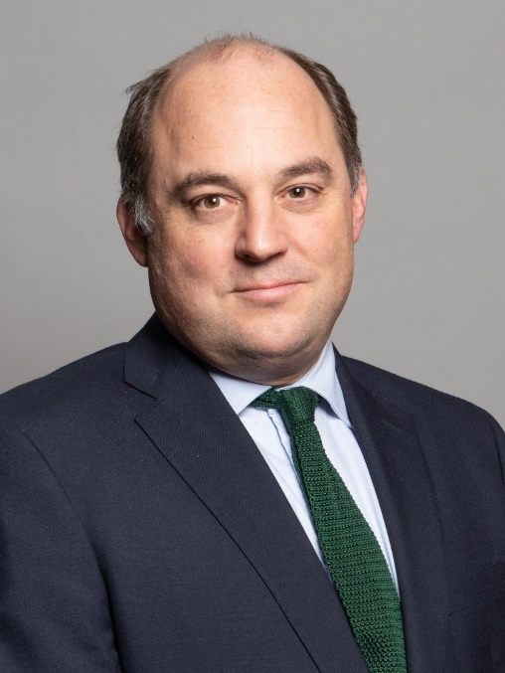
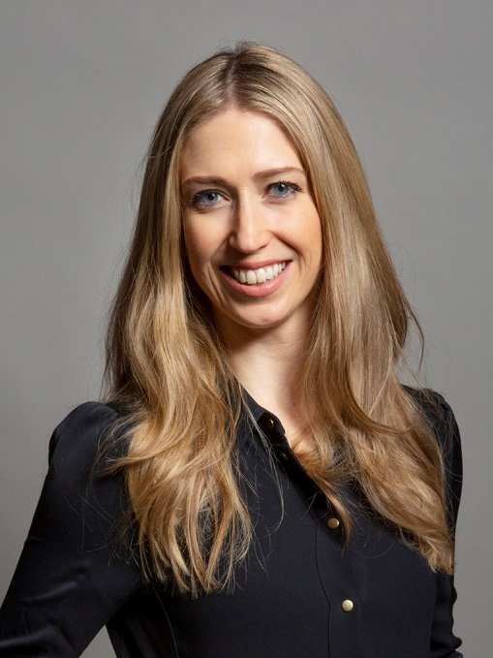
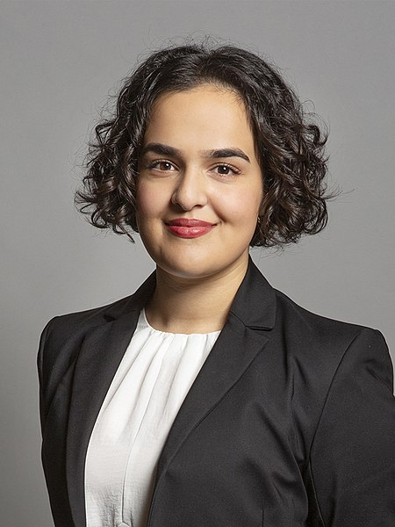
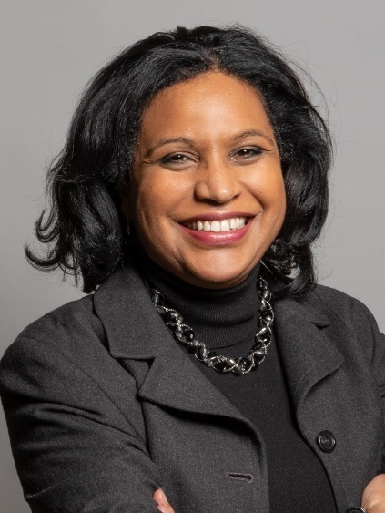
Wer ist das? [2/6]
hören
2
2
Notes:
Transcript: 1. Diese Politikerinnen [sind] stark.

Slide 18
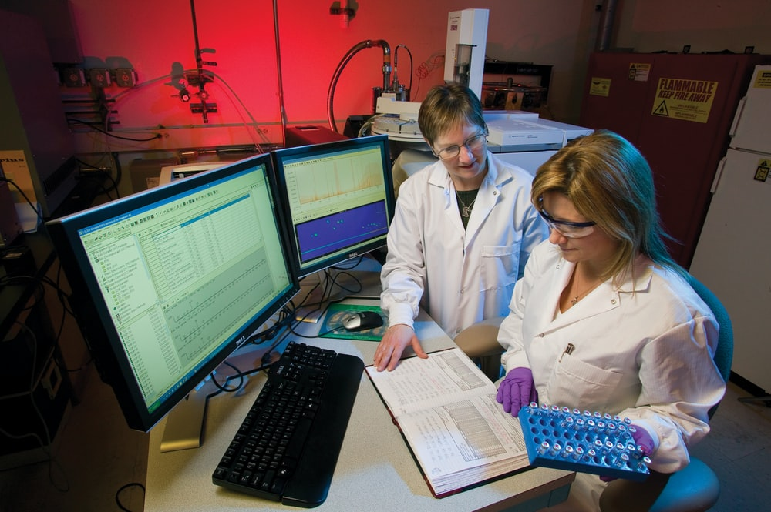
Wer ist das? [3/6]
hören
3
3
Notes:
Transcript: 1. Diese Forscherinnen [arbeiten] mit Chemie.

Slide 19
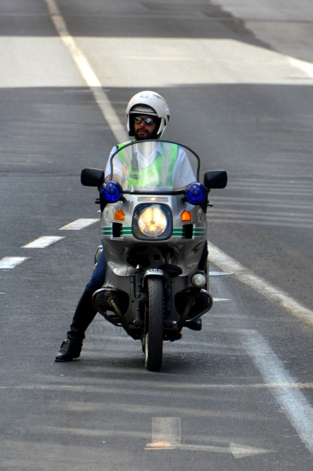
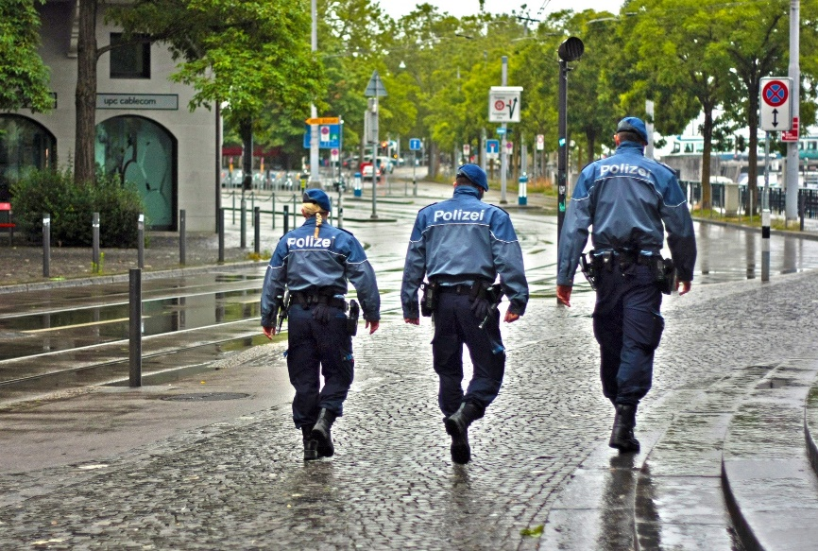
Wer ist das? [4/6]
hören
4
4
Notes:
Transcript: 1. Diese Polizistin [arbeitet] viele Stunden pro Tag.

Slide 20
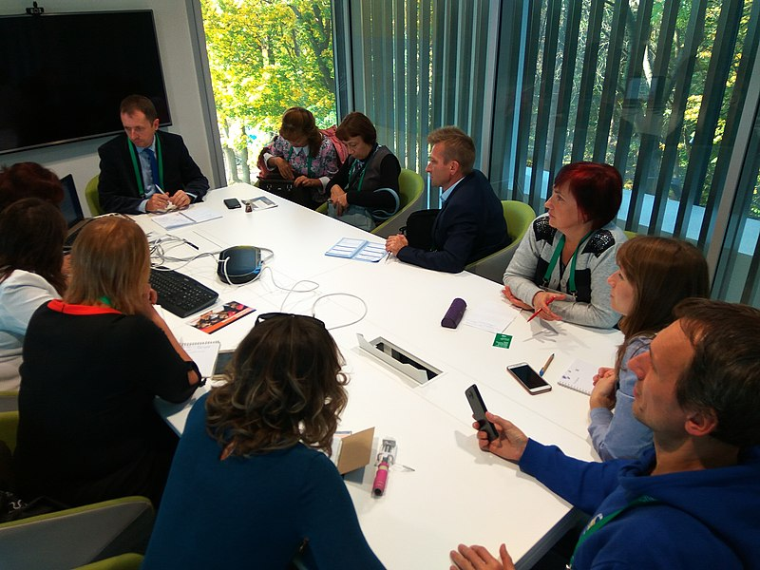
Wer ist das? [5/6]
hören
5
5
Notes:
Transcript: 1. Diese Mathematiker [machen] keine Fehler.

Slide 21
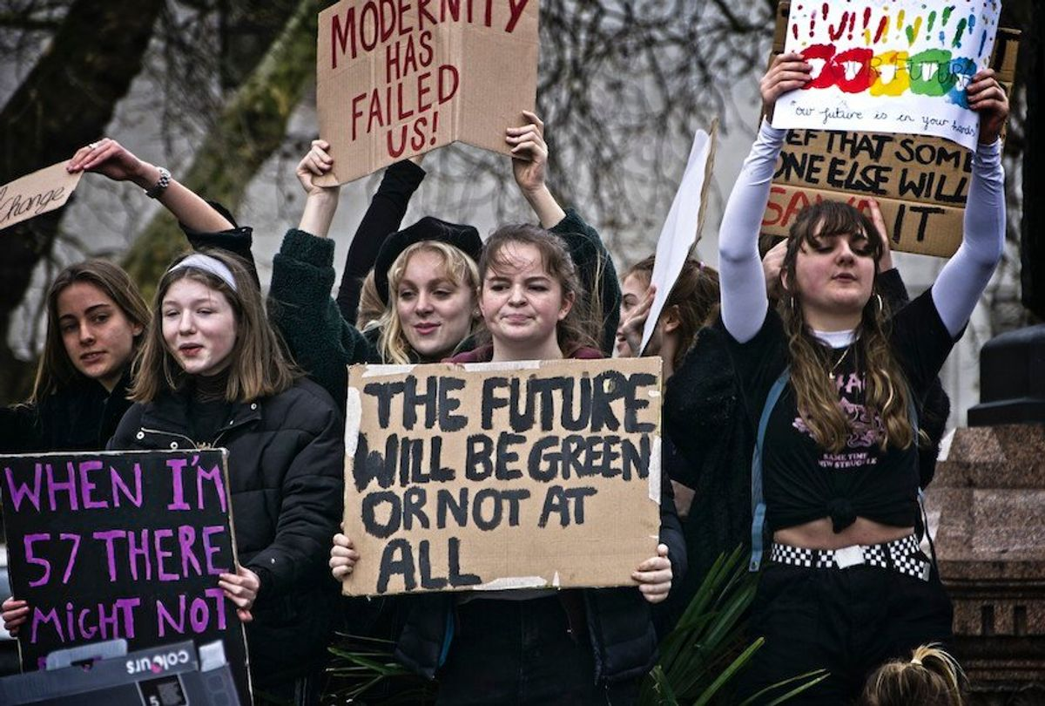
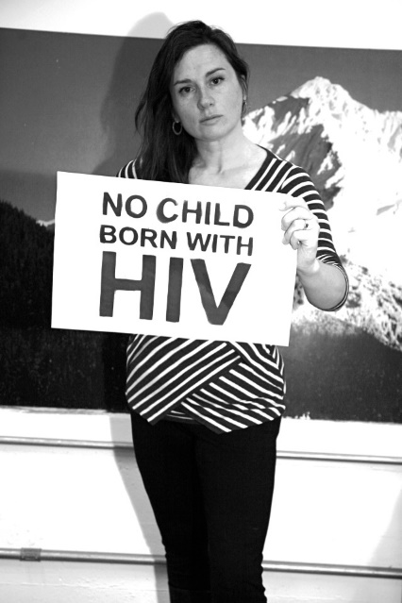
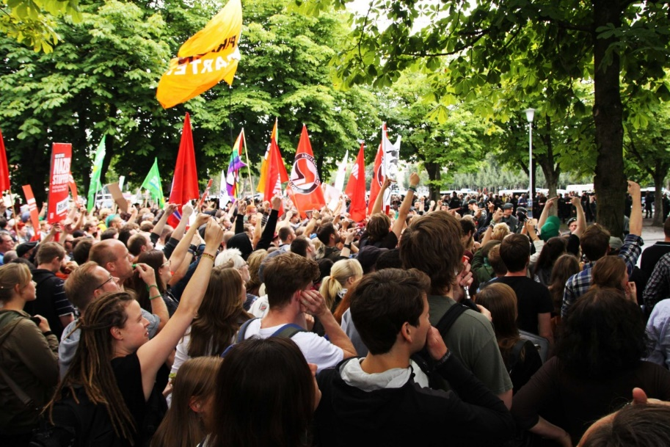
Wer ist das? [6/6]
hören
6
6
Notes:
Transcript: 1. Diese Aktivistin [unterstützt] eine Protestbewegung.

Slide 22
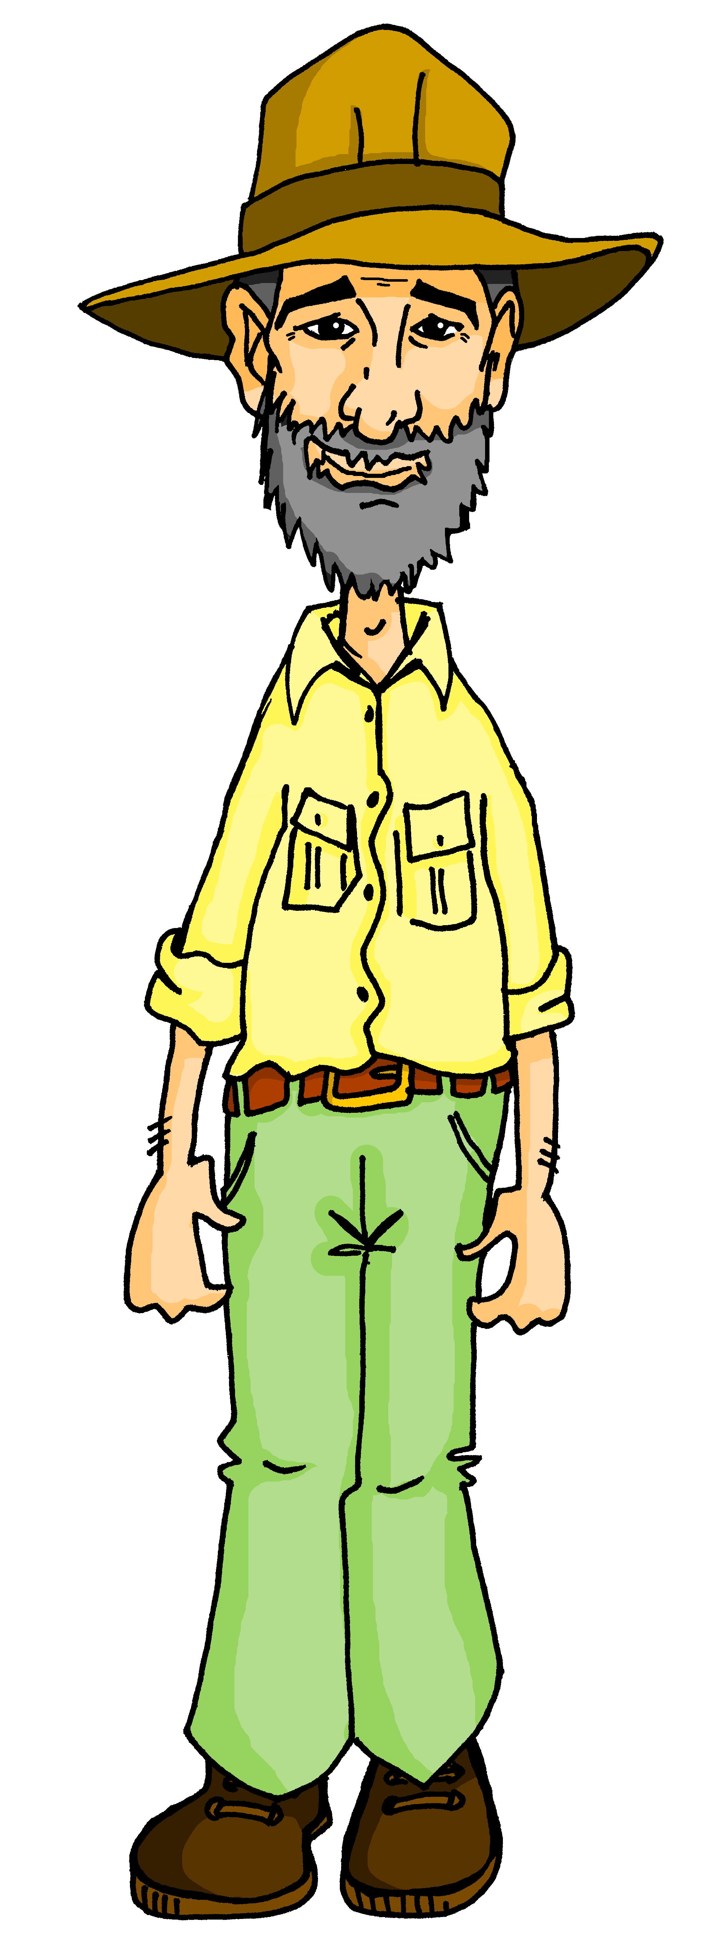
Onkel Heinrich
Onkel Heinrich! Wo warst du? Was hast du in den letzten Jahren gemacht?
hören
Hör zu. Schreib 1-6, als oder denn/und, das Jahr und andere Details auf Englisch.
 | Was hat er gemacht? | als | denn/und | Wann?
 | visited Machu Picchu in Peru |  |  | 2010
 | celebrated his birthday in Tansania |  |  | 1999
 | ate caterpillars in South Africa. |  |  | 2002
 | was on Mount Everest and on Mount Fuji. |  |  | 2013
 | was in Istanbul. |  |  | 2006
 | had a party when he was back home. |  |  | 2020
1
1
2
2
3
3
4
4
5
5
6
6
die Raupe – caterpillar
Notes:
Timing: 8 minutes Aim: to consolidate oral comprehension of word order 3 with als, contrasted with word order 1 with denn/und. Procedure: 1. Explain that Mia and Wolfgang want to know what Onkel Heinrich has been up to on his travels.
2. Click to listen to his accounts of his travels. Students write 1-6, and note als or denn/und, the year and any details of what Heinrich did in English.
3. Do the first item with students to model the task.
4. Complete items 2-6. 5. Elicit answers from students item by item. Note that the order of animations is: conjunction, year, English details.
Transcript: 1. Ich habe Machu Picchu besucht, [denn] ich war 2010 in Peru.
2. Ich habe meinen Geburtstag gefeiert, [als] ich 1999 in Tansania war.
3. Ich habe Raupen gegessen, [als] ich 2002 in Südafrika war.
4. Ich war 2013 auf Mount Everest [und] ich war auch auf Mount Fuji.
5. 2006 war ich in Istanbul, [denn] ich bin gerne in der Türkei.
6. 2020 habe eine tolle Party gemacht, [als] ich wieder zu Hause war!
Word frequency (1 is the most frequent word in German):
Raupe [>5009] Source: Jones, R.L. & Tschirner, E. (2019). A frequency dictionary of German: core vocabulary for learners. Routledge

Slide 23
Conjunctions bevor and nachdem
Grammatik
Prepositions connect nouns.
You already know how to say before and after something, using the prepositions vor and nach:
Ich mache Sport vor der Schule.
I do sports before school.
Ich spiele Keyboard nach der Schule.
I play keyboard after school.
Conjunctions connect clauses (verb phrases).
Here’s how to say before and after using the conjunctions bevor and nachdem:
Ich mache Sport, bevor ich in die Schule gehe.
I do sports before I go to school.
Ich spiele Keyboard, nachdem ich nach Hause komme.
I play keyboard after I come home.
Word order 3 conjunctions send the verb to the end!
Notes:
Timing: 2 minutes Aim: to introduce bevor and nachdem as further WO3 conjunctions.
Procedure: 1. Click to bring up reminder that students already know the prepositions vor and nach to express before and after.
2. Click to bring up an example and the translation for vor.
3. Click and do the same for nach. 4. Click to highlight the function of prepositions.
5. Click to bring up the concept of bevor and nachdem as conjunctions and the function of conjunctions.
6. Click for example and translation each.
7. Point out that these subordinating (WO3) conjunctions send the verb to the end of the dependent clause. Click to bring up call out to demonstrate this.

Slide 24
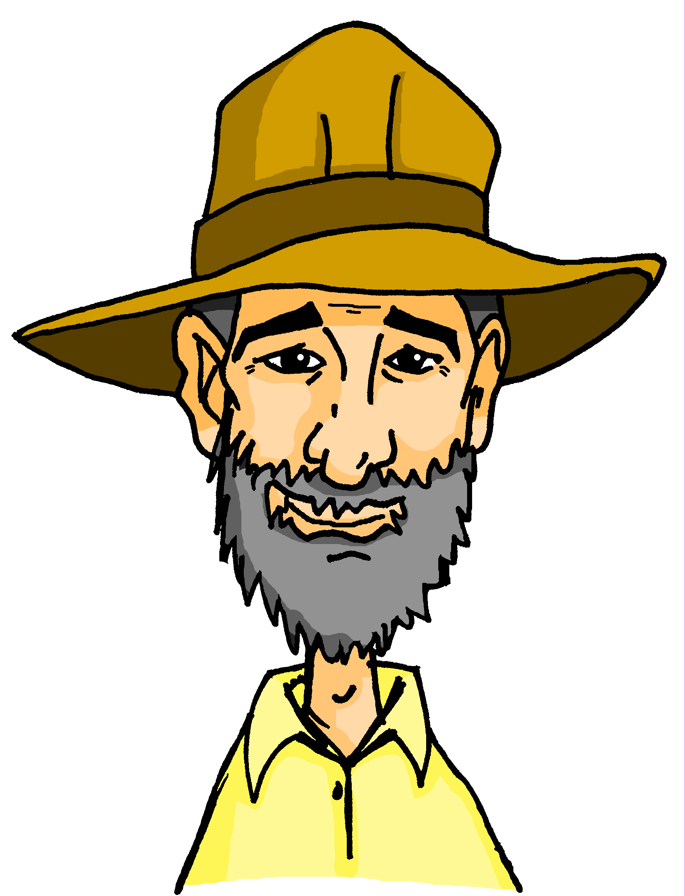
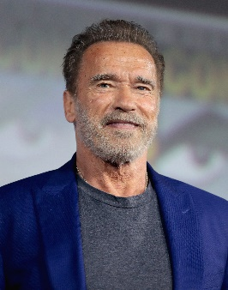
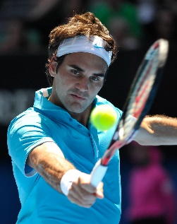
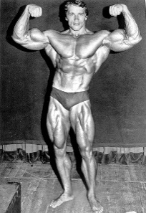
Sie sind bekannt!
Kennst du meine Freunde?
lesen
Schreib 1-8 und die richtige Konjunktion.
Arnold Schwarzenegger
der Zwillinge – twin der Sieger – winner
Roger Federer
Arnold kommt aus Österreich,[1] nachdem / aber er wohnt in den USA.
Roger wohnt in Valbella, [5]
denn / wenn er in der Schweiz ist.
Er war früher Bodybuilder,[2] denn / als er jünger war.
Er hat vier Kinder, [6] weil / denn er hat zweimal Zwillinge.
Er ist ein Tennis-Superstar, [7] weil / und er hat 20 Grand Slams.
Er war dann Schauspieler, [3] bevor / und er auch Politiker war.
Er ist sogar besser als Andy Murray, [8] nachdem / denn er 14 Mal der Sieger war.
Jetzt ist er fast Veganer [4] und / weil er findet Fleisch essen ungesund.
Notes:
Timing: 12 minutes (three slides) Aim: Written recognition of word order 1 and 3 conjunctions and connection with meaning. Procedure:
1. Ensure students understand the premise that Onkel Heinrich is telling us about two famous friends that he has made on his travels. 2. Students write 1-8 and select the correct conjunction, based on syntax. Both conjunctions create meaningful sentences, albeit with slightly different meanings. 3. Elicit the answer to number 1 to check student understanding of the task. Click to reveal the answer. 4. Students complete 2-8. 5. Elicit full sentence answers from students. Click to reveal each answer.
6. Continue to the next slides for text comprehension task.
Image accreditations:
Arnold Schwarzenegger: bodybuilding image
Madison Square Garden Center, Public domain, via Wikimedia Commons
[Attribution not legally required]
Arnold Schwarzenegger: Gage Skidmore CC BY-SA 3.0, via Wikimedia Commons [legally required]
Roger Federer: Esther Lim, CC BY-SA 2.0 via Wikimedia Commons Word frequency of unknown and cognate words(1 is the most frequent word in German): sogar [227] Bodybuilder [>5009] Politiker [1140] Sieger [3503] Superstar [>5009] Veganer [>5009] Zwillinge [>5009] Source: Jones, R.L. & Tschirner, E. (2019). A frequency dictionary of German: core vocabulary for learners. Routledge

Slide 25
Sie sind bekannt!
Beantworte die Fragen auf Deutsch.
lesen
Wo hat er früher gewohnt?
Wieviele Karrieren hat er gehabt?
Welchen Job hatte er, bevor er Schauspieler war?
Welchen Beruf hatte er, nachdem er Schauspieler war?
Laut Arnold, warum soll man wenig Fleisch essen?
Er hat früher in Österreich gewohnt.
Arnold Schwarzenegger
Er hat drei Karrieren gehabt.
Arnold kommt aus Österreich, aber er wohnt in den USA.
Er war früher Bodybuilder, als er jünger war.
Er war früher Bodybuilder.
Er war dann Schauspieler, bevor er auch Politiker war.
Er war Politiker, nachdem er Schauspieler war.
Jetzt ist er fast Veganer und er findet Fleisch essen ungesund.
Er glaubt, Fleisch ist ungesund.
Notes:
Second slide Aim: to understand the detail of the text and to connect the new conjunctions with their meaning.
Procedure: 1. Complete question 1 together with the class to model the two possible answer formats (short phrase vs full sentence). 2. Give students time to complete questions 2-5 and elicit feedback from students, using teacher judgement to differentiate the forms of answer required. Image accreditations:
Arnold Schwarzenegger: bodybuilding image
Madison Square Garden Center, Public domain, via Wikimedia Commons
[Attribution not legally required]
Arnold Schwarzenegger: Gage Skidmore CC BY-SA 3.0, via Wikimedia Commons [legally required]
Word frequency of unknown and cognate words(1 is the most frequent word in German): sogar [227] Bodybuilder [>5009] Politiker [1140] Veganer [>5009] Source: Jones, R.L. & Tschirner, E. (2019). A frequency dictionary of German: core vocabulary for learners. Routledge

Slide 26
Sie sind bekannt!
lesen
der Zwillinge – twin sogar – even der Sieger – winner
Schreib den Text auf Englisch.
Roger Federer
Roger lives in Valbella when(ever) he is in Switzerland. He has four children, as he has two sets of twins. He is a tennis superstar and he has (won) 20 Grand Slams. He is even better than Andy Murray, after he was the winner fourteen times.
Roger wohnt in Valbella, wenn er in der Schweiz ist.
Er hat vier Kinder, denn er hat zweimal Zwillinge.
Er ist ein Tennis-Superstar und er hat 20 Grand Slams.
Er ist sogar besser als Andy Murray, nachdem er 14 Mal der Sieger war.
Notes:
Second slide Aim: to understand the detail of the text and to connect the conjunctions with their meaning.
Procedure: 1. Students translate the text. 2. Click to reveal a translation of the text.
Image accreditations:
Roger Federer: Esther Lim, CC BY-SA 2.0 via Wikimedia Commons Word frequency of unknown and cognate words(1 is the most frequent word in German): sogar [227] Sieger [3503] Superstar [>5009] Zwillinge [>5009] Source: Jones, R.L. & Tschirner, E. (2019). A frequency dictionary of German: core vocabulary for learners. Routledge

Slide 27
Grammatik
Du hast auch eine bekannte Freundin / einen bekannten Freund – was macht sie/er?
schreiben
Schreib acht Sätze und benutze die Konjunktionen.
Er/sie geht oft ins Kino, denn…
Er/sie macht Sport, nachdem…
WO3 | WO 1
weil | und
dass | denn
wenn | oder
als | aber
bevor
nachdem
während
Er/sie ruft mich an und…
Er/sie trinkt keinen Kaffee, weil….
Notes:
Timing: 15 mins (begun in class, finished at home). Aim: to practise the use of conjunctions in the written modality. A freer writing task where students complete a set of sentences using a different conjunction each time. Procedure:
Students imagine they have a celebrity friend (living, dead or imaginary) of their choice, and then write about that person. Each sentence must include a conjunction – watch for word order!

Slide 28
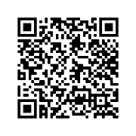
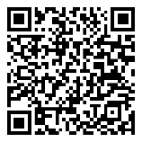
Hausaufgaben
Vocabulary Learning Homework (Term 1.1, Week 7)
Audio file
Audio file QR code:
Student worksheet
Quizlet link
Quizlet QR code:
In addition, revisit: Year 9 Term 1.1 Week 4
Year 8 Term 3.1 Week 5
Notes:
Student worksheet answers: https://resources.ncelp.org/concern/parent/w0892b98r/file_sets/bn999784v

