Slide 1
Towards the new GCSE
The University of York ITT network
15/11/22
15:30-16:30
Authors: Rachel Hawkes / Emma Marsden
Date updated: 19/02/2023

Slide 2
NCELP (Centre for Excellence for Language Pedagogy)
MFL Pedagogy Review (Teaching Schools Council, 2016)
National Centre for Excellence (2018 -)
Notes:
In 2016, the Teaching Schools Council published the MFL Pedagogy Review. It presents evidence about current teaching practice of foreign languages at secondary school level, primarily KS3, and make recommendations for effective pedagogy. Set up in December 2018, the National Centre is funded by the Department for Education to work with researchers, teacher educators and specialist teacher practitioners to support the recommendations for teaching in the review, for teaching of vocabulary, grammar the phonics, or the sound-spelling correspondences of the new language. And the long term aim of the centre, as you can see from the mission statement here from our website, is to improve language curriculum design and pedagogy, leading to a higher uptake and greater success at GCSE.
For the first three years of the ‘pilot’ phase we worked intensively with a group of 45 partner secondary schools across 9 small hubs. In addition, we ran CPD and dissemination from the Centre whenever capacity has permitted, and to date, between 6500 and 7000 teachers have attended NCELP CPD sessions (though there may be some overlap in this feature). However, from January 2022, as we entered our fourth year, the mainstay of our work is running a national CPD programme for teachers with a course of five sessions, run by 12 of our specialist teachers.

Slide 3
Notes:
As you know, the new GCSE (French, German, Spanish) is for first teaching from September 2024, with first examinations in summer 2026. The first cohort to take the new exam will be the students who have just started Y8.
Clearly, any development work that we do needs to have the new GCSE in mind, and today is all about looking at the are steps we can be taking right now with our current Y7s and Y8s, and Y9s next year, as you gear your students up for that first teaching of the new spec in 2024.
So, although it may feel like a fast train is approaching, we hope today to be able to show how NCELP CPD can support you on this journey.

Slide 4
Session overview
Overview of the new subject content for GCSE French, German and Spanish
Principles in practice: SOW development (big picture)
What we can do now (immediate practical steps)
Notes:
As a starting point to inform any development planning, it is probably useful for you to have an overview of the new subject content for GCSE French, German and Spanish.
As part of this we’ll take a brief look at the rationale for the recent GCSE MFL review and then we’ll analyse the main similarities and differences overall, between the current GCSE Subject Content, published in 2015, and that for the new examinations,
We’ll then consider how this can translate into SOW development.
and then look at some practical things we all can be doing now.

Slide 5
Rationale for the GCSE review
make modern foreign language GCSEs more accessible
address teacher concerns about difficulty, particularly in the listening and reading exams
support the government ambition for higher uptake of GCSE languages
Notes:
As a starting point to inform any development planning, it is probably useful for you to have an overview of the new subject content for GCSE French, German and Spanish.
In November 2019, the Department for Education announced that it would be convening an expert panel to test and develop potential changes to the subject content for French, German and Spanish MFL GCSEs only.
The review had the following aims: to make languages GCSEs more accessible
to address teacher concerns about levels of difficulty, particularly in the listening and reading exams and
to support the government ambition for higher uptake at GCSE
The stated position is that the “vast majority” of young people should study a modern foreign language up to the age of 16 and yet, The 2022 British Council’s Language Trends survey reports that entries in GCSE French in 2021 were ‘less than half the number of entries made in 2005’.
The government’s stated ambition is for 90% of pupils in England to be taking all EBacc subjects for GCSE by 2025 (i.e. that 90% Y10 students are beginning their 2-year courses in Ebacc subjects in 2025, with their examination to be two years’ later in 2027). In languages, we are currently some considerable way off this ambition, with entry level hovering around 50% of the whole cohort. (Language Trends Survey 2022)
Source: p.21 https://www.britishcouncil.org/sites/default/files/language_trends_report_2022.pdfs

Slide 6
Areas of continuity between 2015 and 2022
Broad subject aims
develop ability and ambition to communicate in speech and writing
expand students’ horizons
encourage them to step beyond familiar cultural boundaries
develop new ways of seeing the world
provide a strong foundation for further study
Tests of listening & reading comprehension and of spoken & written production with a broadly equal emphasis on each, as before
Language teaching rooted in contexts where language is spoken
Learning will build on knowledge outlined in KS2 and KS3 PoS
Grammar and vocabulary are significant areas of knowledge
Speaking will include role play and talk about visual stimulus/stimuli and conversation elements
Notes:
The new GCSE Subject Content tries to address these issues.
But of course there are some key areas of continuity with the 2015 (the current) subject content.
Let’s look at these first.
The broad subject aims have not changed. The aims are still to:
develop ability and ambition to communicate in speech and writing
expand students’ horizons
encourage them to step beyond familiar cultural boundaries
develop new ways of seeing the world
provide a strong foundation for further study
There is a stated broadly equal emphasis on listening, speaking, reading and writing as before.
Language teaching will be embedded in the contexts where the language is spoken.
Teaching and learning will build on the knowledge set out in the KS2 and KS3 National Curriculum Programmes of Study
Grammar and vocabulary remain significant areas of knowledge, though, as we will see, they are more clearly specified
The speaking component of the exam will still include role play and question and answer based on one or more visual stimuli, and there will still be conversation
Let’s now turn to the main differences.

Slide 7
Main differences in 2022 Subject Content [1/3]
Sound-spelling correspondences (phonics) now included, so students demonstrate ability in:
transcription (dictation) and
decoding (reading aloud)
Vocabulary is specified (1200 [F],1700 [H] words, 85% from most common 2000 words, plus 30 multiword phrases (of up to five words) and 20 cultural / geographical terms
no assumptions are made about KS2/3 vocabulary
Grammar is much more clearly defined, and reduced overall
Ofqual’s assessment objectives now accommodate the ‘mixed skills’ of transcription and read aloud:
45% understand and respond to written language in speaking and in writing;
35% understand and respond to spoken language in speaking and in writing;
20% demonstrate knowledge and accurate application of the grammar and vocabulary prescribed in the specification
Notes:
There are a number of key differences. We summarise them briefly here, and draw out their implications in more detail. Moving beyond the isolated skills of listening, speaking, reading and writing, sound-spelling correspondences (or SSC) are now included in the Subject Content. Students will need to demonstrate ability in
transcription and
decoding (i.e., reading aloud).
(This is the first time that multi-modal assessments have been deliberately and explicitly included in the GCSE, i.e. listening and writing, reading and speaking. Of course, we have long recognised that some of the current GCSE assessments have mixed-skill elements, but this was not explicitly acknowledged or taken account of in the mark schemes – for example, written comprehension of target language role play prompts in the speaking, or target language questions in the listening.)
There will be a defined vocabulary list for the first time. The composition of the list -1200 words at Foundation, 1700 words at higher - with 85% words from the most common 2000 and 15% words of any frequency, plus 30 multiword phrases e.g. ‘il y a’, and 20 cultural items) gives a total word count of 1250 and 1750 words for F and H respectively. There is a lot more detail provided in the Subject Content about this, do explore this further at your leisure.
And it’s important to note that no assumptions are made about vocabulary learnt at KS2 or KS3.
The grammar content has been much more clearly defined. Overall the content has reduced.
Ofqual’s assessment objectives now accommodate the ‘mixed skills’ of transcription and read aloud, so they break down like this:
45% understand and respond to written language in speaking and in writing;
35% understand and respond to spoken language in speaking and in writing;
20% demonstrate knowledge and accurate application of the grammar and vocabulary prescribed in the specification
However, the experience of students taking the exam is likely to feel broadly similar, in terms of listening, speaking, reading and writing tasks.

Slide 8
Main differences in 2022 Subject Content [2/3]
Listening extracts will be at no faster than moderate pace, and contain only language from the defined list
In Reading:
unknown language in H tier and F/H crossover reading texts (up to 2% of a text) will be glossed
cognates can be included, making up to 2% of a text
infer meaning of words that are not on the list, when they are embedded in written sentences that have all other words on the list
derived or base forms of words (where the base or derived form is on the list), following patterns specified in the grammar annexes, can be included
no requirement to include, specifically, literary, authentic texts but they may be included
“Cognates are words in which the substantial majority of letters are the same in English and the assessed language; they have the same meaning in both languages and any difference in spelling should not impede understanding for students entered for GCSE MFL (French, German, Spanish) qualifications.”
Notes:
Continuing with key differences:
In Listening there is a specific requirement limiting the speed of listening passages. There is also the stipulation that listening comprehension questions and the listening extracts themselves will contain only language from the defined list. There are a few new elements to the reading.
First, the permission to gloss up to 2% unknown words in Higher and crossover tier texts. To give you an idea, in a text of 125 words, up to 3 unknown words could be included and glossed.
Second, cognates not on the defined word list may be included, again up to 2% of a text.
This is the definition of cognate from the Subject Content document.
There is the requirement for students to infer plausible meanings of single unknown words when embedded in written sentences. This is somewhat different from the 2015 requirement for students to be able to deduce meaning and draw conclusions. Derived forms of words are created by the addition of affixes (for example, the suffix -able in English, added to comfort(able) or report(able). Developing an understanding of these affixes is less mental work than learning members of the same word family as individual words and is particularly useful in receptive use. The new GCSE Subject Content includes several derivational affixes which are frequent, regular, productive and predictable and these can be tested in reading exams only.
Finally in reading, there is no requirement to include specific types of text, but these may of course be included as long as they contain words from the defined list, and within the parameters for glossing, cognates, inference and derived forms that we’ve just seen.
Broader changes then are that comprehension questions will all be in English and
there is no stipulation to have all tasks at sentence level, which was new to 2015, so there may be both comprehension and production tasks at word and sentence level, as appropriate.
A key change is that all tasks, both comprehension and production, will be able to be carried out successfully with language drawn only from the defined vocabulary and grammar lists
However, full credit will be given for any successful production that uses language beyond the required content.
Finally, in speaking, rubrics and question prompts can be in English. Remember that this has often been an issue highlighted with the current Subject Content.
In addition, there are two conversational elements. The first follows the read aloud and is based on the text itself. The second develops from the talk about the visual stimulus/stimuli. This addresses the issue of over-preparation and memorisation in the current general conversation.
The key wording heading up all three elements in the speaking section is ‘speak using clear and comprehensible language’.
This is because, when speaking is unscripted at this (or perhaps any!) level, it will not be highly polished or disproportionately elaborate or sophisticated. The criteria for its assessment need to reflect that, and the stipulation that students speak clearly and comprehensibly provides the necessary safeguarding to support the requirement for unprepared conversation.

Slide 9
Main differences in 2022 Subject Content [3/3]
Comprehension questions will be in English
Comprehension and production tasks may be at word and sentence level, and longer, as appropriate
Tasks to understand and produce language can be accomplished with language only from the defined vocabulary and grammar lists
Full credit will be given for successful production that uses language beyond the required content
Speaking:
Role Play rubrics in English; question prompts can also be in English;
short, unprepared conversations follow (a) the read aloud and (b) the description of the visual stimulus/stimuli
Notes:
Continuing with key differences:
In Listening there is a specific requirement limiting the speed of listening passages. There is also the stipulation that listening comprehension questions and the listening extracts themselves will contain only language from the defined list. There are a few new elements to the reading.
First, the permission to gloss up to 2% unknown words in Higher and crossover tier texts. To give you an idea, in a text of 125 words, up to 3 unknown words could be included and glossed.
Second, cognates not on the defined word list may be included, again up to 2% of a text.
This is the definition of cognate from the Subject Content document.
There is the requirement for students to infer plausible meanings of single unknown words when embedded in written sentences. This is somewhat different from the 2015 requirement for students to be able to deduce meaning and draw conclusions. Derived forms of words are created by the addition of affixes (for example, the suffix -able in English, added to comfort(able) or report(able). Developing an understanding of these affixes is less mental work than learning members of the same word family as individual words and is particularly useful in receptive use. The new GCSE Subject Content includes several derivational affixes which are frequent, regular, productive and predictable and these can be tested in reading exams only.
Finally in reading, there is no requirement to include specific types of text, but these may of course be included as long as they contain words from the defined list, and within the parameters for glossing, cognates, inference and derived forms that we’ve just seen.
Broader changes then are that comprehension questions will all be in English and
there is no stipulation to have all tasks at sentence level, which was new to 2015, so there may be both comprehension and production tasks at word and sentence level, as appropriate.
A key change is that all tasks, both comprehension and production, will be able to be carried out successfully with language drawn only from the defined vocabulary and grammar lists
However, full credit will be given for any successful production that uses language beyond the required content.
Finally, in speaking, rubrics and question prompts can be in English. Remember that this has often been an issue highlighted with the current Subject Content.
In addition, there are two conversational elements. The first follows the read aloud and is based on the text itself. The second develops from the talk about the visual stimulus/stimuli. This addresses the issue of over-preparation and memorisation in the current general conversation.
The key wording heading up all three elements in the speaking section is ‘speak using clear and comprehensible language’.
This is because, when speaking is unscripted at this (or perhaps any!) level, it will not be highly polished or disproportionately elaborate or sophisticated. The criteria for its assessment need to reflect that, and the stipulation that students speak clearly and comprehensibly provides the necessary safeguarding to support the requirement for unprepared conversation.

Slide 10
KS2
KS3
KS4
https://www.eduqas.co.uk/articles/eduqas-teams-up-with-centre-for-excellence-to-develop-new-gcses-in-modern-foreign-languages/

Slide 11
Overlap between the current and new lists? Not much
An average 61% of the new list overlaps with current lists
An average 39% is unique to the new lists
At foundation: 64% of the new list overlaps with the current list
55% for AQA
77% for Edexcel
59% for NCELP/Eduqas*
At higher: 57% of the new list overlaps with the current list
52% for AQA
70% for Edexcel
50% for NCELP/Eduqas*
A lot has changed.
* Note: Eduqas’s current list was compared with the new ”NCELP/Eduqas” list: Edquas’s list is identical to NCELP’s word list – they are the same!
Notes:
On Friday 11th November, the awarding organisations made their new sample assessment material and specifications available online.
This included their draft word lists.
NCELP have analysed these word lists to compare them to their old lists.
Is there much new in the exams?

Slide 12
Overlap between current and new AQA list
Foundation
479
unique
words
(current)
578
words
in common
472
unique
words
(new)
Only 55% of the new list is on the current list
Notes:
So, 45% of the new list is NOT on the current list.

Slide 13
Overlap between current and new AQA list
Higher
560
unique
words
(current)
764
words
in common
711
unique
words
(new)
Only 52% of the new list is on the current list
Notes:
That is, 48% of the new words are NOT on the current lists.

Slide 14
Overlap between current and new Edexcel list
Foundation
1,094
unique
words
(current)
749
words
in common
222
unique
words
(new)
77% of the new list is on the current list

Slide 15
Overlap between current and new Edexcel list
Higher
1,154
unique
words
(current)
964
words
in common
423
unique
words
(new)
70% of the new list is on the current list

Slide 16
Overlap between AQA and NCELP/Eduqas list
Foundation
157
unique
entries
(AQA)
1081
entries
in common
169
unique
entries
(NCELP/Eduqas)
86-87% of the entries are shared across lists at foundation
Notes:
We also looked at the words that are on the NCELP/Eduqas list and checked whether they were on the draft AQA word list
There is a lot in common!
This is good news for children who have to swap schools, and generally for more parity between what is taught by different teachers, textbooks, schools, allowing greater continuity between primary, secondary.
Also, it means that A level teachers will be more likely to know what their students know on arrival in their lessons.

Slide 17
Overlap between AQA and NCELP/Eduqas list
Higher
120
unique
entries
(AQA)
1630
entries
in common
120
unique
entries
(NCELP/Eduqas)
93% of the entries are shared across lists at higher

Slide 18
Overlap between Edexcel and NCELP/Eduqas list*
Foundation
382
unique
entries
(Edexcel)
868
entries
in common
382
unique
entries
(NCELP/Eduqas)
69% of the entries are shared across lists at foundation
* With anomalies (e.g., duplicate entries) removed and the prescribed list length as the denominator.

Slide 19
Overlap between Edexcel and NCELP/Eduqas list*
Higher
460
unique
entries
(Edexcel)
1,290
entries
in common
460
unique
entries
(NCELP/Eduqas)
74% of the entries are shared across lists at higher
* With anomalies (e.g., duplicate entries) removed and the prescribed list length as the denominator.

Slide 20
Session overview
Overview of the new subject content for GCSE French, German and Spanish
Principles in practice: SOW development (big picture)
What we can do now (immediate practical steps)
Notes:
Now onto considering what this means for curriculum design, how this can translate into SOW development.

Slide 21
KS2
KS3
KS4
Notes:
One of the really exciting things about the new GCSE in French, German and Spanish is the very real opportunity it presents to join up language learning from KS2 to KS4.
The defined word list for GCSE makes it possible (for the first time ever) for the four years of primary language learning to be the foundation on which KS3 and 4 learning is built.
We know that schools that take advantage of a 9-year language curriculum that teaches the defined content will be in a very strong position to improve learning outcomes for their students.
Let’s now consider key principles for this curriculum design.

Slide 22
A language driven curriculum
KS2
KS3
KS4
Notes:
We propose a language-driven curriculum, whereby student progression is underpinned by a developing core knowledge of grammar, vocabulary and phonics which sets them on a path of steadily increasing and ever more confident independent communication.
This is particularly crucial in light of the assessment requirements of the speaking component.
Instead of rewarding rehearsed answers to sets of themed conversation questions, the new GCSE will require students to speak in unrehearsed situations, composing sentences themselves from familiar, (mainly) individual words that they know.
This means that quite a lot of the speaking will be about interaction – students will need to understand what is being said to them, and then use “clear, comprehensible speech”, as we have just seen, when they talk.
When we come on to look at our NCELP speaking activities, this will set their design in context.
Coming back to our language driven curriculum then,
this can be at KS2,
at KS3
and also at KS4

Slide 23
The three knowledge strands
The SOW is driven by the language itself
The three language knowledge strands are phonics, vocabulary and grammar
Logical sequencing
Cohesion of the three strands
Promotes true manipulation of language
Strands image: Steve Clarke & Katie Marsden
Notes:
So, the SOW is driven by the language itself
The three foundational aspects of language knowledge are phonics, vocabulary and grammar
To achieve the most logical sequencing, grammar leads but vocabulary is closely interwoven with the grammar and vocabulary selection based on frequency. Vocabulary items are not chosen for their phonics (i.e. you wouldn’t refrain from introducing a HF word simply because pupils hadn’t explicitly learnt that sound), but phonics source and cluster words are chosen for their frequency.
We use this image frequently to represent the relationship between the strands, the braid signifying, amongst other things, that these strands of language knowledge are interconnected and, taught together in a joined up way, lead to more robust knowledge, much as a braid is stronger than a single thread.
And although topics are not the explicit driver, our schemes cluster together small, feasible sets of vocabulary, from all parts of speech (nouns, verbs, adverbs, adjectives, prepositions) that are likely to belong to one, broadly-conceived semantic field, to allow for sentence creation from the outset and promote true manipulation of language, giving students the tools they need to build their own sentences.
Strands image: Steve Clarke & Katie Marsden

Slide 24
Planned practice
Use a range of types of practice that revisit the same language in different contexts
Provide practice in ‘input language’ (listening and reading) that makes the form-meaning connection task essential
Practise producing the new language in scaffolded writing and speaking activities with small, incremental steps
Involve an element of struggle
Use multi-modal activities
See a gradual move towards freer production
(DeKeyser, 2005; DeKeyser, 2015; Ellis, 2006; Mitchell, Myles, & Marsden, 2019; VanPatten, 2004)
Notes:
Students then need to reinforce this knowledge with extensive planned practice and use it in order to build the skills needed for communication.
The practice principle is the cornerstone of the language learning journey and it is the type or types of practice that determine how successful learners are. Learners need a range of types of practice that revisit the same language in different contexts.
Initially, learners benefit from plentiful practice in listening and reading, through structured tasks that require learners to connect a sound-symbol correspondence, word or structure to its meaning or function. This kind of practice establishes knowledge receptively, before expecting learners to produce it in writing or speaking.
Next, learners benefit from ample practice in producing the new language in writing and speaking activities. Note that the progress from supported to unscripted, authentic communication is gradual.
The practice at this stage is carefully scaffolded to relieve pressure on working memory and allow the automatization of new language. The ‘meaningful’ aspect of this practice is the fact that the student cannot complete the task without fully understanding (connecting form with meaning) what s/he is saying.
Learning is usually most successful at this stage when manipulation of language is required to fill a genuine information gap. Furthermore, it is often preferable for learners to need to (struggle to) retrieve the key language from memory than to have it clearly in view (e.g., in prompt word lists or full speaking/writing frames).
Integrating modes (comprehension and production) and modalities (oral and written) in practice strengthens memory and facilitates more flexible language use. Tasks that involve different combinations of input and output (e.g., reading plus speaking or listening plus writing) are therefore beneficial to learners.
Over time and after sufficient practice, language stored in memory is accessed more rapidly and with less conscious effort. This process facilitates a gradual move towards freer, meaningful production practice. (Skill-acquisition theory, DeKeyser).
Having realistic expectations about the amount and type of practice needed can guide teachers to limit the quantity of new language, in order to help pupils to eventually use language they have already encountered in different contexts more spontaneously, including under time and communicative pressure.

Slide 25
Revisiting: ‘umbrella architecture’
Multiple exposures and use are important to consolidate knowledge and develop fluency, anywhere between 5 – 20 encounters. (Nation, 2001:81)
How many words can you know by GCSE?
Curriculum time available = 168 weeks (36 weeks/year over 5 years, minus one term in year 11)
Based on acquisition of ca. 10 new words/week (e.g., Schmitt 2004), ca. 1680 words if all are retained and can be both understood and produced
Informing suggestion of 1700 target for top of Higher tier
Spaced repetition, 10+ encounters (e.g., Webb, 2007)
‘Recycling is necessary, and if it is neglected, many partially learned words will be forgotten, wasting all the effort already put into learning them ... Recycling has to be consciously built into vocabulary learning programs, and teachers must guard against presenting lexical items once and then forgetting about them, or else their students will likely do the same.’ (Schmitt, 2008:343)
‘the 1500 words contained in the GCSE specification would, if learned, bring these learners of this exam to a level of threshold understanding and put them somewhere near B1 level French learners in other countries’. (Milton, 2015: 117)
Notes:
To know words – to fix them in long-term memory – we have to revisit them, a lot. They do not stick otherwise.
This is what vocabulary experts say. If we accept this, then it follows that we have to prioritise high-frequency words in our curriculum planning/teaching as these are the words that occur in many contexts – otherwise you would just be revisiting the same topic or couple of topics every 3-4 weeks, every term, every year – if you choose rarer words your contexts are more limited, if you choose from the most common words then you find many different contexts in which they are routinely used. (As it is we revisit school, holidays several times over KS3 and KS4 – such that students do find topics repetitive – however we don’t revisit the words enough for them to really learn them, so we currently have the worst of both worlds – as Barry Jones’ work with KS3 learners found in the 80s/early 90s – students find languages boring and difficult – boring as they repeat topics, difficult because they don’t revisit words enough to actually retain them).
So, how many words can you realistically know by GCSE? If we take the total curriculum time over KS3 and KS4 and base the number of new words per week on a recommendation by Schmitt (which is also mentioned in the Pedagogy Review) which is 10 words per hour but extrapolated to 10 words per week if we expect all words to be retained over time
we get a 1700 target for top of higher tier, which is what informed the suggestion for the new GCSE content
Nation, I. S. P. (2001). Learning Vocabulary in Another Language. Cambridge: Cambridge University Press.
Schmitt, N. (2008). Review Article. Instructed second language vocabulary learning. Language Teaching Research, 12(3), 329–363. https://doi.org/10.1177/1362168808089921
Milton, J (2015) "French lexis and formal exams in the British foreign language classroom", Revue française de linguistique appliquée, 2015/1 (Vol. XX), p. 107-119. DOI: 10.3917/rfla.201.0107
Webb, S. (2007) The Effects of Repetition on Vocabulary Knowledge, Applied Linguistics, 28 (1) 46–65, https://doi.org/10.1093/applin/aml048

Slide 26
Tabs in the NCELP SOW
KS3
The grammar tracking tab is a week-by-week overview of the grammar spine, listing the new and revisited grammar features.
Notes:
Let’s move quickly on to KS3. This is the Y8 French Scheme of Work. If you look at the bottom of the SOW Excel document you can see a number of useful tabs. We are going to explore the five main tabs of a Year 8 SOW:
Y8 Grammar tracking
Y8 SOW
Y8 Resources
Y8 Vocabulary List
Y8 multiple senses
Let’s pick out three to look at now, beginning with the grammar tracking tab.

Slide 27
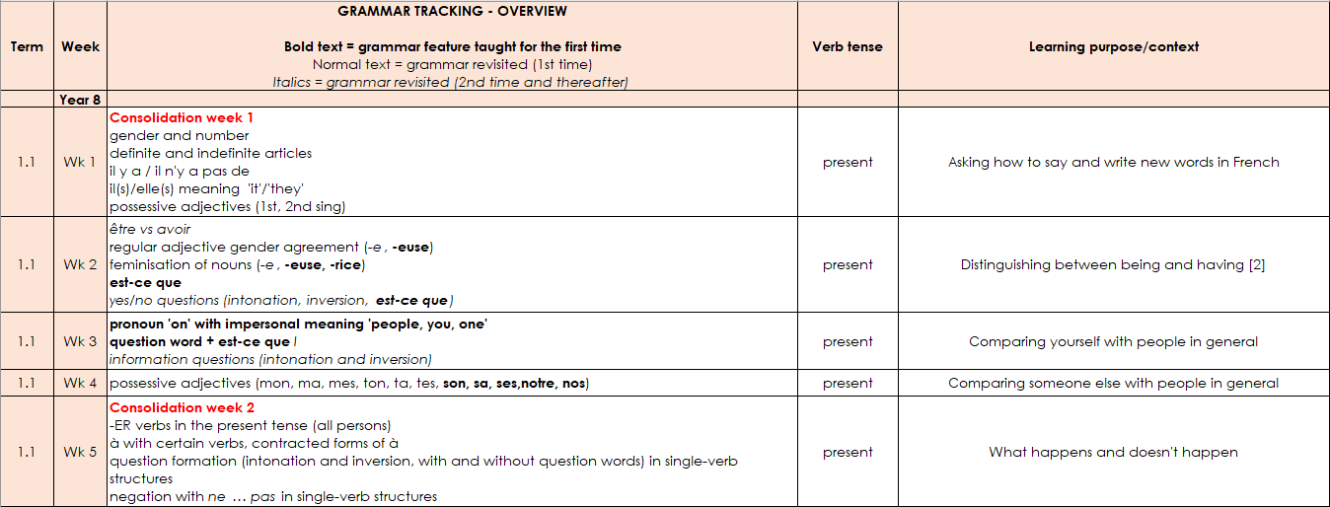
Grammar tracking tab
This column denotes the focus tense for that week.
This column gives the learning context.
KS3
A consolidation week revises vocabulary from Y7 and grammar features from either Y7 or Y8.
New grammar features are in bold type.
Features for 1st time revisiting are in normal type.
2nd and subsequent revisits are in italics.
Extended text exploitation weeks are in blue type.
Notes:
As you can see the grammar tracking tab is a week-by-week overview of the grammar spine, listing the new and revisited grammar features.
Grammar sequencing is language specific.
In terms of verbs, extremely high frequency (irregular) verbs at start.
Then highly regular and frequent verbs.
In all of the KS3 SOW there are weeks set aside for work on rich, more challenging texts.
Developing on from Y7, short and longer texts and spoken passages are integrated into lesson sequences more frequently, supported by students’ growing vocabulary base.
It is this secure, and growing, vocabulary of high frequency words, together with grammar and phonics knowledge, that support the comprehension of longer texts, including authentic, semi-adapted factual and literary texts.
Their readability is checked (using the MultiLingProfiler) to ensure that texts are either 100% comprehensible or 90%+ with key language glossed and/or meanings carefully elicited through the activities in the lesson.

Slide 28
Tabs in the NCELP KS3 SOW
KS2
The Y8 SOW tab is the detailed planning document for each week, with grammar, vocabulary, sounds of the language, and lesson overviews.
Notes:
The Y8 SOW tab is the detailed planning document for each week, with grammar, vocabulary, sounds of the language, and lesson overviews.

Slide 29
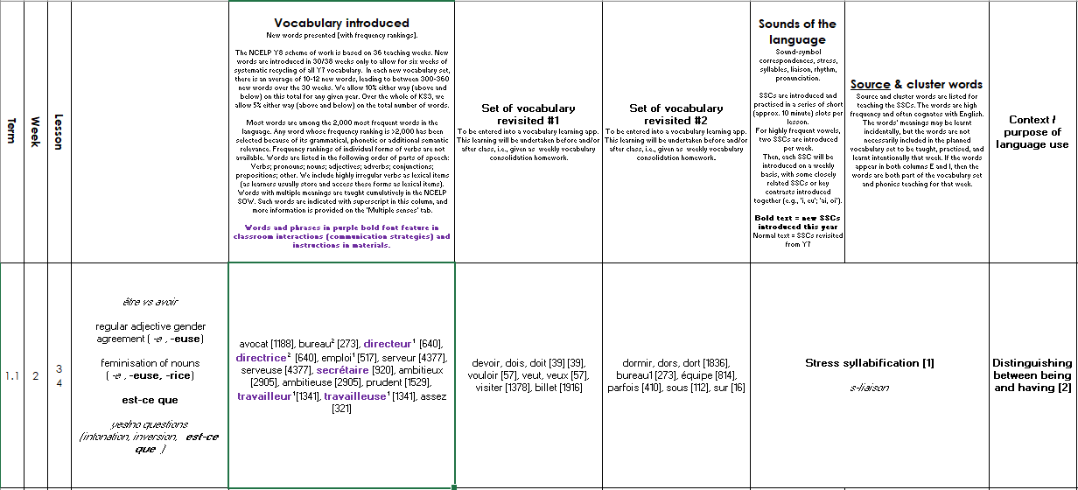
Y8 SOW
Sounds of the language practice in every lesson.
KS2
The grammar column reproduces the
information from the grammar tracking tab.
new | revisit | revisit
new | revisit | revisit
New vocabulary introduced.
Systematic revisiting of vocabulary every 3 weeks and 9 weeks.
Additional notes detailing the context of each lesson.
Systematic revisiting of vocabulary every 3 weeks and 9 weeks.
Notes:
This is what the layout of the Y8 French SoW looks like – this is from week two of the first term.
It starts with grammar introduced – here ‘est-ce que’ – in addition it references the grammar to be revisited, regular adjective gender agreement and the feminisation of nouns. Revisited for the second or subsequent time are yes/no and intonation questions (in italics).
Then we see new vocabulary introduced as well as vocabulary to be revisited – we revisit two sets of vocabulary every lesson from three and nine weeks ago - you can see that the sets differ a little in the number of words in each – the vocabulary is integrated as much as possible, but there are also stand-alone vocabulary tasks, where needed.
Then the sounds of the language, such as sound-symbol correspondences (phonics) but also beginning in Year 8, additional sounds of the language such as stress, syllables, liaison, rhythm, pronunciation.
In this week we are doing stress syllabification and a 2nd revisiting of s-liaison.
Specifically in terms of phonics, one difference between the languages is that new SSCs continue to be introduced in Year 8 French. There are a very few additional SSC in Y8 German (four in total; two new [pf], [kn] and two alternative spellings of existing SSC ([ai] added to [ei], and [y] added to [ü]. For Spanish, all target SSCs are covered in Year 7.
There is still a context – no traditional topic but a context for language use, here it is ‘Distinguishing between being and having’. This particular week is a typical SOW week. In addition, at regular intervals there are weeks set aside for some revision and consolidation, assessment (in term 2 and 3) and also for work on “rich” texts or authentic text exploitation, as we saw on the grammar tracking tab.
In terms of vocabulary the NCELP Y8 scheme of work is based on 36 teaching weeks. New words are introduced in 30/38 weeks only to allow for six weeks of systematic recycling of all Y7 vocabulary. In each new vocabulary set, there is an average of 10-12 new words, leading to between 300-360 new words over the 30 weeks.
Words and phrases in purple bold font feature in classroom interactions (communication strategies) and instructions in materials.

Slide 30
Tabs in the NCELP KS3 SOW
The NCELP Y8 vocabulary list contains all French words taught in Y8, with English meanings, parts of speech and frequency information.
Notes:
The NCELP Y8 vocabulary list contains all French words taught in Y8, with English meanings, parts of speech and frequency information.

Slide 31
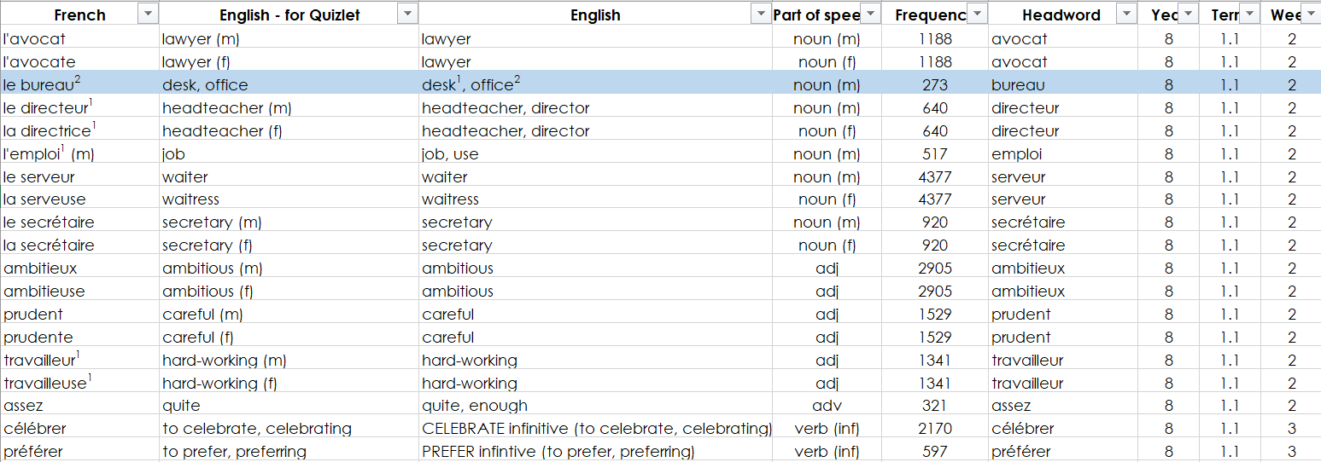
Y8 NCELP vocabulary list
Source of frequency information:
Londsale, D., & Le Bras, Y. (2009). A Frequency Dictionary of French: Core vocabulary for learners London: Routledge.
Frequency ranking of all words is provided, here.
Notes:
Vocabulary selection is based on word frequency and as you can see, within the SOW the frequency ranking of all words is provided.
Small sets of words, of around 10-12 per lesson, from different parts of speech, including the most common verbs, allow students to manipulate verbs and regularly create their own sentences.

Slide 32
Tabs in the KS4 NCELP SOW
Year 10 and Year 11 Grammar Overviews
GCSE SOW
Phonics Tracker
GCSE French Grammar Tracker
GCSE list
KS3 revisits
GCSE Revision Weeks
Notes:
Moving on to KS4 SOW then.

Slide 33
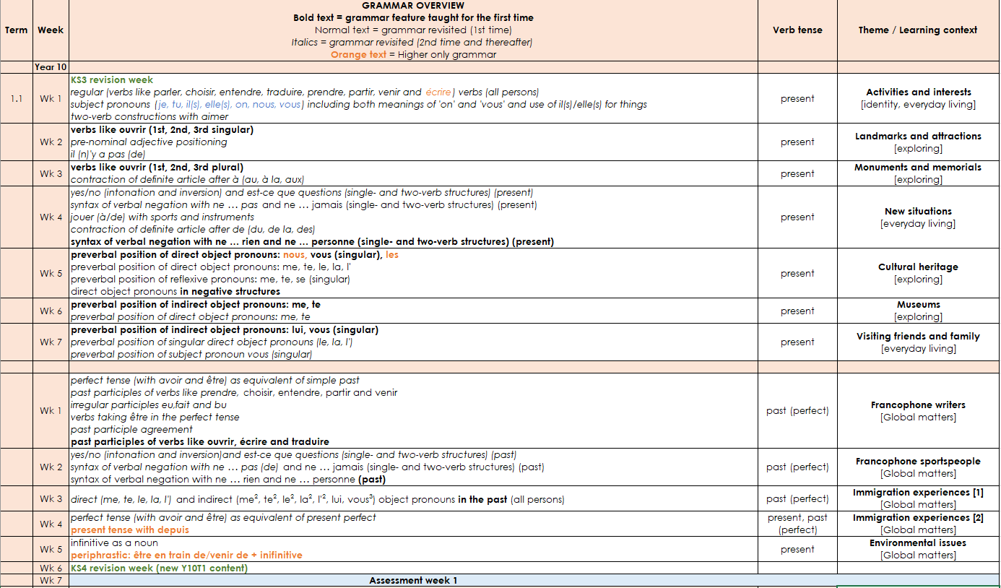
Y10 Grammar Overview
There is continuity from KS3. All non-bold text shows previously-taught knowledge.
This column denotes the focus tense for that week.
This column gives the learning context.
It also gives a GCSE theme.
New grammar features are in bold type.
There are five themes in our SOW: Identity, Everyday living, My future, Exploring, Global matters.
Higher only features are in orange.
Notes:
For our purposes today, we will focus on three tabs. This is the Y10 Grammar Overview tab. There is continuity in the content from KS3. All non-bold text shows previously-taught knowledge.
New grammar features are in bold type.
Higher only features are in orange.
This column denotes the focus tense for that week.
This column gives the learning context.
It also gives a GCSE theme.
There are five themes in our SOW: Identity | Everyday living | My future | Exploring | Global matters.

Slide 34
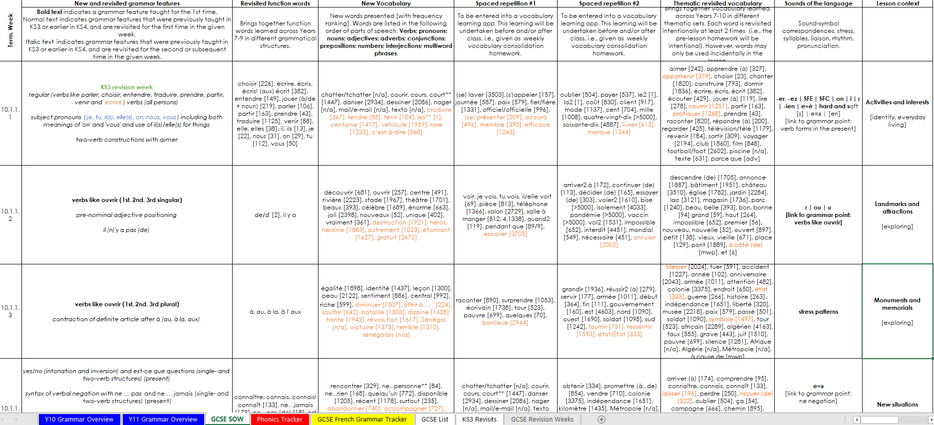
GCSE SOW
The new vocabulary column contains all new KS4 words.
1st and 2nd revisits of new KS4 words.
Phonics and intonation, liaison, stress…
This column repeats the grammar information from the overview tab.
Revisited thematic vocabulary from KS3.
This column lists all of the function words which were taught at KS3 and will be revisited at KS4.
Higher only vocabulary is in orange font.
Weekly context
Each row on the SOW represents one week of teaching, notionally 3 x 50 minute lessons.
GCSE theme
All lesson resources will be free and fully adaptable by teachers for use in their contexts.
Notes:
The GCSE SOW tab is, as you would expect, full and detailed. This column repeats the grammar information from the overview. This column lists all of the function words (the words that are compulsory for all awarding bodies to include) which were taught at KS3 and will be revisited at KS4. They recur multiple times each and are listed every time, for transparency.
The new vocabulary column contains all words that are new to KS4.
Higher only vocabulary is in orange font.
The next two columns show the spaced revisiting schedule for the new KS4 words, which are first revisited after three weeks, and revisited for a 2nd time after nine weeks. The final vocabulary column sets out the words taught at KS3 that have been selected for revisiting in that particular week. All KS3 words are intentionally revisited three times each across KS4, twice as part of themed teaching weeks and again as part of the final nine-week revision schedule in the lead up to the exams. Phonics are set out in the Sounds of the language column, which also includes other elements such as intonation, liaison in French and stress patterns in Spanish and German. The Lesson context column repeats the final column on the Grammar Overview tabs with the weekly lesson context and the overarching GCSE theme it belongs to.

Slide 35
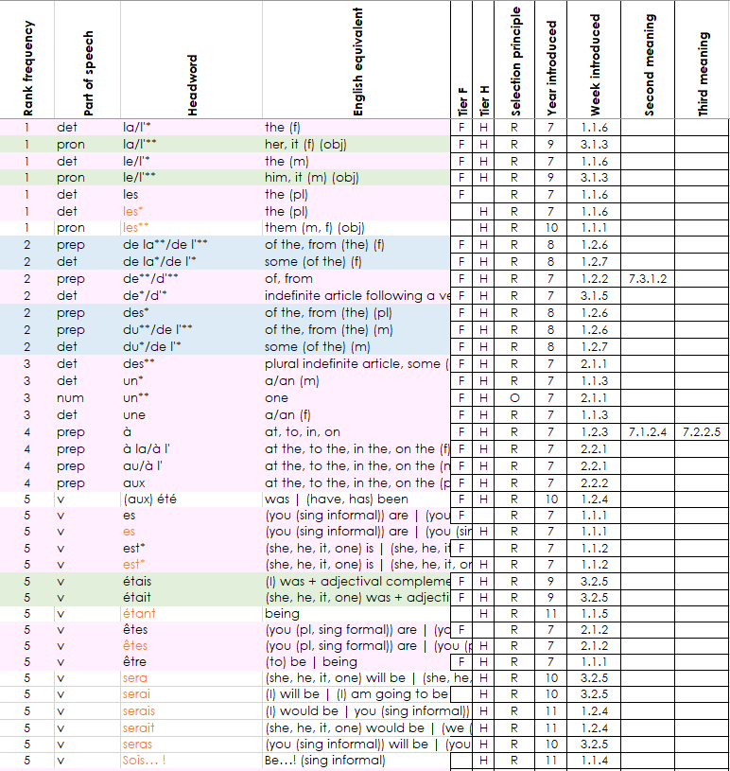
GCSE list
As the list is in excel, it can be easily sorted by or filtered for:
part of speech,
F/H tier,
R (required), O (optional), C (culture), MWP (multiword phrase).
Colour shading denotes year of first teaching: pink = Y7
blue = Y8
green = Y9
Notes:
The GCSE List tab is a full word list for GCSE, and the word list that Eduqas will be using for its new suite of GCSE exams.
As the list is in excel it can be easy sorted or filtered, making it easy to customise the display to show
the different parts of speech,
all the F or H words,
all the ‘R’ (required words – these are the words that are 100% common to all awarding bodies),
the O (optional words) – these are the remaining words up to a total of 1200 F / 1700 H words, of which at least 85% items come from a list of the most common 2000 words, and up to 15% may be of any frequency.
You can also see the ‘C’ (20 cultural terms) and ‘MWP’ (30 Multiword phrases) that make up the final totals of 1250 and 1750.
Colour shading denotes year of first teaching: pink = Y7, blue = Y8, green = Y9
These two columns give the year and the week when words were/are taught,
and you can see that 2nd and 3rd meanings of words are taught and tracked separately.

Slide 36
SOW: big picture
“an example of how language knowledge and practice can be sequenced and re-visited systematically to support progression in the early stages of language development within a low exposure foreign language setting.”
Teaching is carefully planned…
…to compel thinking,
thinking drives learning, and…
success in learning is motivational.
A teacher described the approach as ‘empowering.’
Notes:
The goal (and result) of the knowledge building we have spoken about, that underpins our SOW, is confident communication.
We situate our students’ language learning in relevant and rich cultural contexts.
Lesson by lesson we provide opportunities for our learners to apply their knowledge, to build sentences independently in interaction tasks.
It’s important to say that the SOW are an example of the principles in practice. It’s not an accident that the documents are fully editable, as are the resources. Teachers are of course adapting the SOW and resources for their classes, just like they have always done with textbooks. This is how we describe the SOW on the NCELP resource portal: “an example of how language knowledge and practice can be sequenced and re-visited systematically to support progression in the early stages of language development within a low exposure foreign language setting.”
The overriding impression that I hope you take away from this session and later exploring these SOW is the depth of thinking in its planning, and a sense of the implications this has for student progress and therefore their intrinsic motivation for language learning. One of the teachers involved in the project described the approach as empowering, and I hope that also comes through.

Slide 37
Key principles: summing up
A planned approach to teaching and embedding the sound-writing relationship
A carefully selected core vocabulary (including verbs), based on frequency of use
A clear, progressive, sequenced teaching of grammar, including the chance to process input for meaning
Frequent, planned opportunities for recall, repetition, reuse in a variety of contexts leading over time to mastery
Opportunities to encounter and practise language in engaging contexts, with a particular focus on cultural knowledge
A maximal approach to integrating both receptive and productive modes of language use (i.e., the four ‘skills’)
Notes:
In summing up, these are the things I think we can say when it comes to key principles of curriculum design:
A planned approach to teaching and embedding the sound-writing relationship
A carefully selected core vocabulary (including verbs), based on frequency of use
A clear, progressive, sequenced teaching of grammar, including the chance to process input for meaning
Frequent, planned opportunities for recall, repetition, reuse in a variety of contexts leading over time to mastery
Opportunities to encounter and practise language in engaging contexts, with a particular focus on cultural knowledge
A maximal approach to integrating both receptive and productive modes of language use (i.e. the four ‘skills’)

Slide 38
Session overview
Overview of the new subject content for GCSE French, German and Spanish
Principles in practice: SOW development (big picture)
What we can do now (immediate practical steps)
Notes:
Now let’s take a look at some immediate practical steps we can be taking.

Slide 39
What can we do now? [1/7]: KS3 SOW analysis
KS3 curriculum analysis and development towards the new GCSE
Notes:
To support any development planning for your existing SOW, we have developed an analysis document which could help scaffold your work on this.

Slide 40
What can we do now? [2/7]: KS2-3 planning
Is there anything (more) that could be done pre-transition to lighten the learning load at KS3?
Phonics Some or all of the SSC could be taught and practised in Y3–Y6.
Vocabulary Around 500 words could be taught over 4 years at KS2 at an average rate of 4 words per week. Ideally, these words would be high frequency and would overlap with words on the new GCSE.
Grammar The KS2 National Curriculum includes teaching gender of nouns, singular and plural noun forms, adjective agreement (gender and number) and position, and the conjugation of key verbs. All of these are required content for GCSE.
https://ncelp.org/blog-what-next-for-primary-languages/
Notes:
Consider joining up the KS2 and KS3 curricula, working together with any feeder primary schools locally.
Now that we have a well-defined curriculum for KS4, there is nothing to prevent joining up KS2, 3 and 4. This can be done by agreeing curriculum content, nothing more. Of course, some primary schools may need more support to deliver such a curriculum – but there is support out there, in the form of: 1. SOW, 2. free resources, including audio’d versions for non-language specialist primary colleagues, 3. CPD.
To explore some of the ideas further you might find it useful to read this blog about primary languages.

Slide 41
What can we do now? [3/7]: Develop unscripted speaking opportunities
Information gap tasks that compel one student to listen and understand and the other to speak
Incremental speaking development from structured to freer
Speaking without reliance on written prompts helps students to retain the language
Anticipate greater tolerance than currently for spoken errors to reward more independent production
Alter KS3 tasks and assessments from ‘pre-learnt answers’ to conversation questions to ‘unscripted tasks’
NCELP Production tasks collection
Notes:
Instead of rehearsing answers to conversation questions, the new GCSE will require students to speak in unrehearsed situations, composing sentences themselves from individual words that they know. They will be able to complete all tasks using words from the word list (but if they have learnt other words and use them successfully they will receive equal credit for them). The context for speaking will be largely unprepared, (but with short preparation time to read the read aloud text (in inner voice), to look at the picture(s) and make some notes, and to prepare their responses to the role play prompts).
Two unprepared interactions are included, one about the picture and one following the read aloud.
This means that quite a lot of the speaking will be about interaction – students will need to understand what is being said to them, and then use clear, comprehensible speech when they talk.
We should anticipate more thoughtful communication than currently (likely to be somewhat slower, likely to contain more errors than the delivery of memorised material does) and we should expect the markschemes to reflect this. There won’t be a way to know the questions in advance, so this will come closer to a ‘real’ world conversation in terms of the skills and knowledge needed than we have previously experienced.
(More on this in session 4 on grammar)

Slide 42
What can we do now? [4/7]: Develop knowledge of word patterns and cognate recognition
Look up the GCSE word patterns resources on the NCELP portal
Check own existing KS3 word list for any words that are examples of these patterns – consider adding in valuable activities to introduce and practise word pattern knowledge
GCSE word patterns

Slide 43
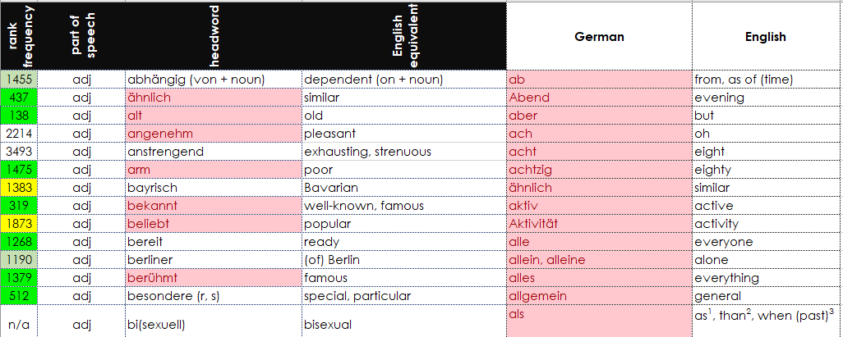
High frequency vocabulary
What can we do now? [5/7]: Consider high frequency vocabulary
V
Pink shows the words taught at KS3 which are also on the freely available NCELP/Eduqas list.
Download the NCELP example GCSE list
Paste your KS3 SOW vocabulary into it
Select columns C and E
Use Conditional formatting 🡪 Highlight rules 🡪 Duplicate cells
Do a manual check of any unhighlighted cells in column E
Notes:
We want to know how much of the current KS3 vocabulary we teach is likely to be on the GCSE word list. The NCELP/ Eduqas list is a very good indication of what a new GCSE word list will look like,
And as we saw there are only about 150 words that would need to be swapped out/in to make the course 100% compatible with AQA.
We should be able to provide these specific words shortly.
One quick check we can do is to compare the NCELP exemplar GCSE list with our own KS3 SOW list of words. This is a rough and ready way to do it (without formulae!) The reason for the manual check is that the format of your KS3 list won’t be exactly the same. E.g. remove any articles from nouns. If any of your words have additional punctuation or brackets within the cell then it won’t show up as an exact duplicate, so worth spending a little time tidying it up to get a more accurate picture. We can use the highlighted KS3 list to prioritise vocabulary for learning and testing.
Even without any other changes to vocabulary content, this initial step is useful. Individual depts will need to decide if to make any further changes (i.e. take out particular vocabulary, put in other high frequency).
You can ask questions such as:
What’s missing?
What isn’t needed? Which words might be using up valuable curriculum time unnecessarily?

Slide 44
What can we do now? Coming up…
P
V
G
Focus on phonics
Consider high frequency vocabulary
Teach grammar for creative manipulation
Notes:
The practical steps do not stop there, of course, and we have three additional sessions as part of our CPD offer to look at these more specifically in terms of phonics, vocabulary and grammar.
Such examples are:
Focus on phonics
Consider high frequency vocabulary
Teach grammar for creative manipulation
For each of these each of these we show you some really useful materials and practical resources and activities, all freely available from our Portal, to support your work in these areas.

Slide 45
Towards the new GCSE
Towards the new GCSE
Announcing our new four-part CPD series, designed to help prepare for the new French, German and Spanish GCSEs.
Four x 90 minute remote twilight sessions will be run across January and February.
With the opportunity to attend a regional end of course in-person Teach-Meet, to network and facilitate collegial support for any curricular and pedagogical developments in light of the CPD.
Notes:
Session 1 crucially sets the scene for this four-part series and sessions 2,3 and 4 prioritise practical teaching activities and ideas in terms of phonics, vocabulary and grammar that can be built in now with Y7 and Y8, laying the foundations for the new GCSE knowledge.

Slide 46
“Next steps” Teach-Meet
Regional Teach-Meet: Towards the new GCSE – a ‘next steps’ collaborative planning session
At the end of course, we offer a variety of regional Teach-Meet sessions. These ‘next-steps’ sessions are hosted by our CPD practitioners and provide the opportunity for teachers to come together and work collaboratively to share ideas on next steps to prepare for the new GCSE as well as develop practice further.
Tickton Grange, Beverley | 28th February 2023 | 16:00-17:30
Huntington School, York | 28th February 2023 | 16:00-17:30
Scalby School, Scarborough | 1st March 2023 | 16:00-17:30
The Laurel Academy, Doncaster | 1st March 2023 | 16:00-17:30
The Ruth Gorse Academy, Leeds | 7th March 2023 | 16:30-18:00

Slide 47
Wealth of material in NCELP collections
NCELP alignment with wider policy
Cultural Collection
Diversity, Inclusion and Representation Collection
Phonics Collection
NCELP rationales, research and guidance
Exemplar Activities Collection
NCELP professional development materials
Production Tasks Collection
MFL GCSE Subject Content – Supporting Resources
Schemes of Work and teaching materials – FRENCH
Schemes of Work and teaching materials – GERMAN
Schemes of Work and teaching materials – SPANISH

