Slide 1
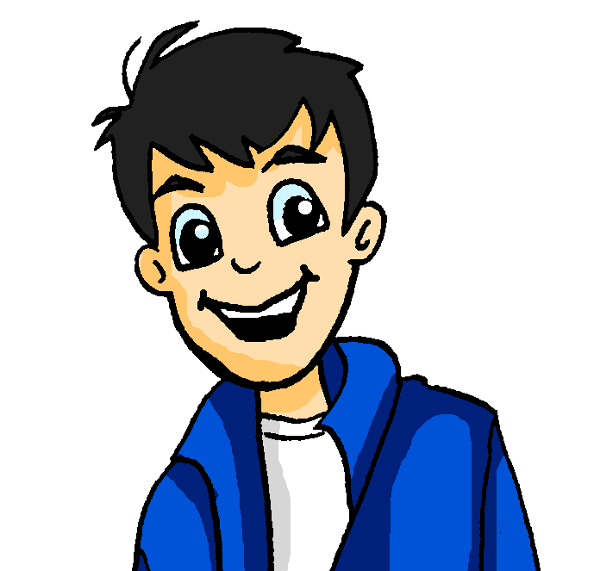
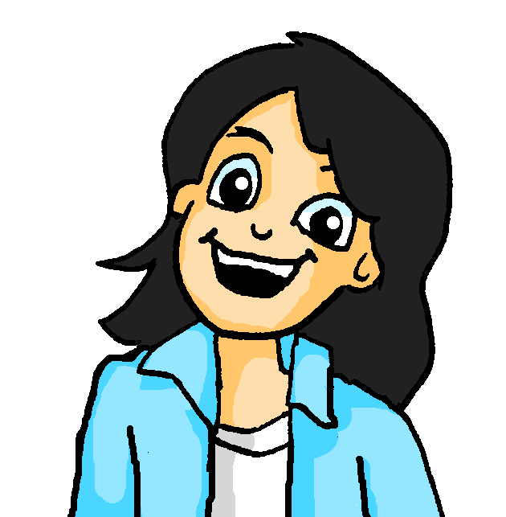
Mein Lieblingspiel
Dobble war früher mein Lieblingsspiel!
lesen
One of the words in circle A has a translation in circle B. Which one?
Shout the word when you’ve found it.
A
B
warm
daughter
der Beruf
room
neighbour
der Arm
führen
modern
die Sachen
music
traditionell
lady
wohin
voice, vote
der Nachbar
well
Notes:
Timing: 8 minutes (3 slides) Aim: to practise written recognition of most of this week’s new and all of this week’s revisited vocabulary. The time element facilitates automisation and fluency. Using a translation means students will have to process meanings rather than simply form spotting. Two versions are provided: a manual and a timed version. Procedure: 1. The circle on the left has eight German words. One of the words has a translation in the English circle on the left. Students try to find the word as quickly as possible. And shout out the word when they have found it. First person to find and shout the word (or translation) gets a point.
2. When the correct word is found click the mouse to change the English words to the next set.
3. The German words change after every four rounds. This change is signalled with a colour change on both circles.
4. Play until all cards have been done.
Words included and their frequency (1 is the most frequent word in German): einschlafen [2680] mitnehmen [1459] konnte, konntest [23] musste, musstest [43] wollte, wolltest [57] April [1004] Mai [1048] jemand [330] niemand [362] Blume [2463] Gegenstand [1308] Juni [1148] Meter [479] Person [357] Zentimeter [1338] gucken/kucken [1362] wachsen [470] aktiv [790] beliebt [1873] meist [705] ungefähr [1458] beobachten [697] entdecken [743] unterstützen [760] Bewegung [709] Chemie [486] Forscher [1246] Moment [348] Tourist [1318] Wissenschaftler [1522] historisch [901] als3 [22] bevor [537] nachdem [528] Source: Jones, R.L & Tschirner, E. (2019). A frequency dictionary of German: Core vocabulary for learners. London: Routledge.

Slide 2
Vokabeln
lesen / sprechen
person
flower
flower
you had to
(der) Juni
historic
object
beobachten
flower
to look, watch
musste
to look, watch
der Zentimeter
moment
der Gegenstand
scientist, scholar
May
chemistry
I, s/he, it had to
scientist,
scholar
I, s/he, it wanted
der Wissenschaftler
I, s/he, it wanted
object
historic
I, s/he, it wanted
I, s/he, it had to
to take along (with)
when (past), as, than
to observe, watch
moment
approximately, about
mostly,
usually
approximately,
about
(der) Mai
to discover, discovering
die Blume
to fall asleep,
falling asleep
bevor
popular
der Tourist
to discover,
discovering
centimetre
wachsen
flower
to discover,
discovering
mostly,
usually
object
I, s/he, it was able, could
someone, somebody
June
you wanted
chemistry
die Chemie
to support,
supporting
movement
tourist
no-one,
nobody
you had to
der Moment
person
konnte
to support, supporting
konntest
mostly, usually
wolltest
ungefähr
der Forscher
active
to observe, watch
you were able to, could
before
metre
you wanted
I, s/he, it was able, could
popular
person
popular
flower
movement
to observe, watch
centimetre
popular
to observe, watch
moment
researcher,
explorer
mostly,
usually
die Person
you were able, could
als³
to look, watch
ungefähr
to support,
supporting
active
moment
centimetre
April
you had to
moment
historic
gucken, kucken
I, s/he, it wanted
konntest
jemand
chemistry
person
jemand
der Meter
chemistry
scientist, scholar
movement
to discover, discovering
approximately, about
after
to fall asleep,
falling asleep
centimetre
May
someone, somebody
to grow, growing
nachdem
I, s/he, it was able, could
wachsen
tourist
before
to discover, discovering
niemand
researcher, explorer
movement
to take along (with)
der Moment
June
before
when (past), as, than
moment
movement
centimetre
mostly, usually
June
tourist
flower
mitnehmen
after
wachsen
to take along (with)
object
beliebt
popular
I, s/he was able, could
metre
no-one, nobody
I, s/he, it wanted
to take along (with)
to support, supporting
when (past), as, than
to grow, growing
metre
June
mostly, usually
researcher, explorer
April
die Bewegung
April
you were able,
could
researcher, explorer
flower
active
metre
to support, supporting
you wanted
active
historic
May
unterstützen
to look, watch
einschlafen
metre
historic
mostly, usually
after
flower
after
(der) April
I, s/he, it wanted
historic
movement
der Wissenschaftler
to look, watch
die Blume
I, s/he, it had to
ungefähr
der Gegenstand
historic
to support,
supporting
you were able, could
I, s/he, it had to
someone,
somebody
tourist
I, s/he, it was able, could
to fall asleep,
falling asleep
to observe, watch
chemistry
you were able, could
April
musstest
you had to
someone, somebody
object
when (past), as, than
approximately, about
to fall asleep,
falling asleep
researcher, explorer
to take along (with)
to look, watch
before
niemand
to fall asleep,
falling asleep
meist
I, s/he, it wanted
mostly, usually
to observe, watch
someone,
somebody
entdecken
to grow, growing
chemistry
to look, watch
movement
I, s/he, it had to
als³
no-one, nobody
(der) Juni
mostly, usually
historisch
movement
May
historic
tourist
object
active
flower
object
Notes:
Words included and their frequency (1 is the most frequent word in German): einschlafen [2680] mitnehmen [1459] konnte, konntest [23] musste, musstest [43] wollte, wolltest [57] April [1004] Mai [1048] jemand [330] niemand [362] Blume [2463] Gegenstand [1308] Juni [1148] Meter [479] Person [357] Zentimeter [1338] gucken/kucken [1362] wachsen [470] aktiv [790] beliebt [1873] meist [705] ungefähr [1458] beobachten [697] entdecken [743] unterstützen [760] Bewegung [709] Chemie [486] Forscher [1246] Moment [348] Tourist [1318] Wissenschaftler [1522] historisch [901] als3 [22] bevor [537] nachdem [528] Source: Jones, R.L & Tschirner, E. (2019). A frequency dictionary of German: Core vocabulary for learners. London: Routledge.

