Slide 1
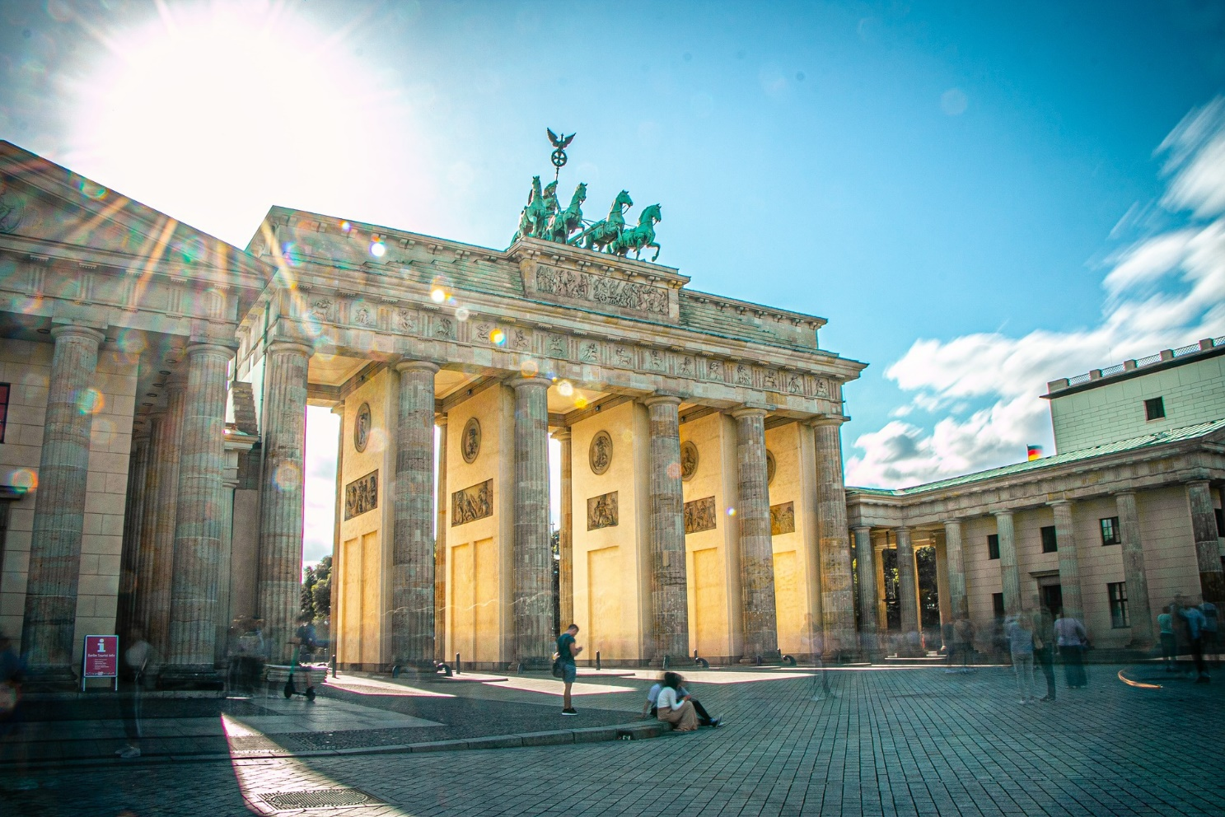
Vokabeln
lesen
Wie heißt das auf Englisch? Was ist auf dem Foto?
 | 1 | 2 | 3
A
B
C
D
since, for
while (noun)
die Weile
die Woche
seit
week
once
kennen
ago, in front of, before
einmal
to know, knowing
vor
same
year
month
gleich
der Monat
das Jahr
die Firma
lawyer
at (the house of)
company
der Anwalt
bei
Notes:
Timing: 3 minutes
Aim: Written recognition of new vocabulary at word level.
Procedure:
1. Students volunteer a letter/number combination relating to a square on the grid.
2. The whole class say the English translation in chorus.
3. Click the blue box to reveal answer.
4. If the majority of the class says the correct answer, click the yellow box to reveal part of the underlying image.
5. Students guess what the image represents as more is revealed.
Answer: Brandenburger Tor
Word frequency (1 is the most frequent word in German): kennen [216] Anwalt [1887] Deutschland [140] Firma [686] Weile [1631] gleich [141] einmal [124] bei [29] seit [130] vor¹ [50] Source: Jones, R.L. & Tschirner, E. (2019). A frequency dictionary of German: core vocabulary for learners. Routledge
Other revisited words: Jahr [53] Monat [316] Woche [219]

Slide 2
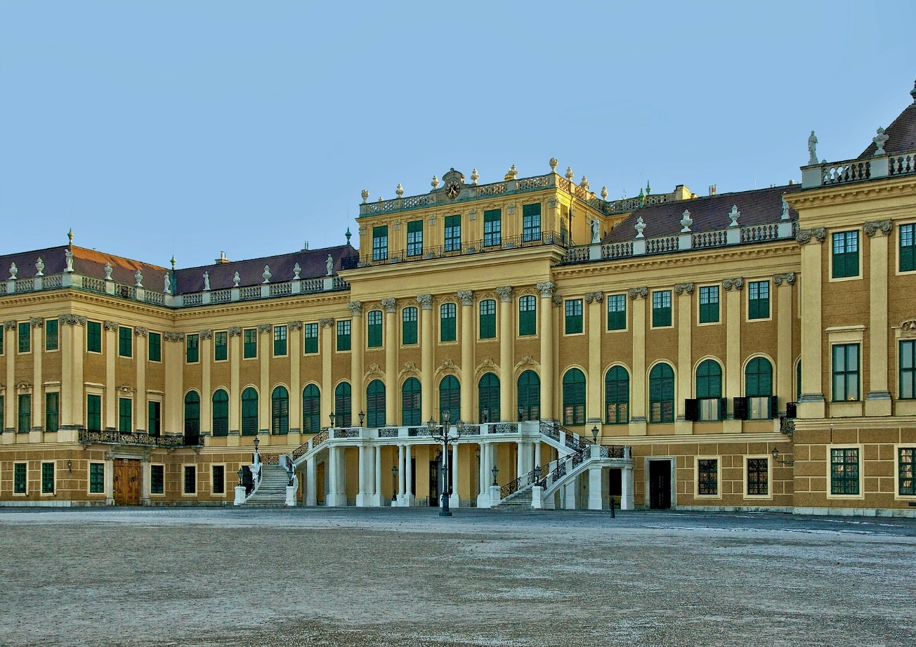
Vokabeln
sprechen
Wie heißt das auf Deutsch? Was ist auf dem Foto?
 | 1 | 2 | 3
A
B
C
D
since, for
while (noun)
seit
die Weile
die Woche
week
ago, in front of, before
einmal
vor
once
to know, knowing
kennen
der Monat
month
same
year
gleich
das Jahr
company
der Anwalt
die Firma
bei
lawyer
at (the house of)
Notes:
Timing: 5 minutes
Aim: Oral production of new vocabulary at word level.
Procedure:
1. Students volunteer a letter/number combination relating to a square on the grid.
2. The whole class say the German translation in chorus.
3. Click the yellow box to reveal answer.
4. If the majority of the class says the correct answer, click the blue box to reveal part of the underlying image.
5. Students guess what the image represents as more is revealed.
Answer: Schönbrunn Palace, Vienna
Word frequency (1 is the most frequent word in German):
8.2.2.5 (introduce) kennen [216] Anwalt [1887] Deutschland [140] Firma [686] Weile [1631] gleich [141] einmal [124] bei [29] seit [130] vor¹ [50] Other revisited words: Jahr [53] Monat [316] Woche [219]

Slide 3
Fonética
escuchar / escribir
Text
Notes:
Timing:
Aim:
Procedure:
1.
2.
3.
4.
5.
Transcript:
Word frequency (1 is the most frequent word in Spanish):
Source: Davies, M. & Davies, K. (2018). A frequency dictionary of Spanish: Core vocabulary for learners (2nd ed.). Routledge: London

Slide 4
Vocabulaire
écouter
Text
Notes:
Timing:
Aim:
Procedure:
1.
2.
3.
4.
5.
Transcript:
Word frequency (1 is the most frequent word in French):
Source: Londsale, D., & Le Bras, Y. (2009). A Frequency Dictionary of French: Core vocabulary for learners London: Routledge.

