Slide 1
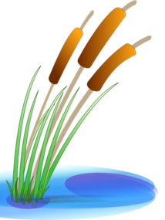
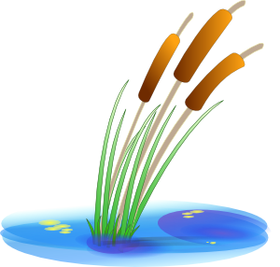
Vokabeln
hören
Choose the right words to cross the river.
Be careful! Some of the rocks are wobbly.
1
2
3
4
5
6
7
arbeiten
viel
billig
die Stimme
der Anwalt
der Ort
verdienen
die Zeitung
die Firma
das Geld
wissen
wenig
gefährlich
die Wahrheit
Notes:
Timing: 5 minutes (two slides) Aim: Aural recognition of new vocabulary; building semantic associations with known vocabulary. Procedure: 1. Click numbers to hear audio.
2. Students pick which word on a rock is most closely associated with the word that they heard.
3. Click on rock to find out if the answer is right or wrong (wrong answers fall into the water).
4. Continue to the next slide to cross the river.
Transcript: 1. das Unternehmen
2. der Euro
3. das Gesetz
4. die Daten
5. die Milliarde
6. der Angriff
7. laut

Slide 2
Vokabeln
hören
Choose the right words to cross the river.
Be careful! Some of the rocks are wobbly.
8
9
10
11
12
13
14
die
Bevölkerung
sitzen
die Musik
für
unter
wer
Geld
hängen
das Bild
das Kind
ohne
auf
an
Musik
Notes:
Transcript: 8. die Wand
9. die Million
10. schützen
11. gegen
12. an
13. hängen
14. verdienen

Slide 3
Fonética
escuchar / escribir
Text
Notes:
Timing:
Aim:
Procedure:
1.
2.
3.
4.
5.
Transcript:
Word frequency (1 is the most frequent word in Spanish):
Source: Davies, M. & Davies, K. (2018). A frequency dictionary of Spanish: Core vocabulary for learners (2nd ed.). Routledge: London

Slide 4
Vocabulaire
écouter
Text
Notes:
Timing:
Aim:
Procedure:
1.
2.
3.
4.
5.
Transcript:
Word frequency (1 is the most frequent word in French):
Source: Londsale, D., & Le Bras, Y. (2009). A Frequency Dictionary of French: Core vocabulary for learners London: Routledge.

