Slide 1
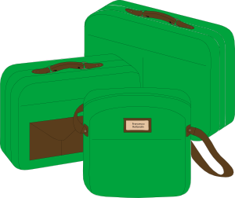
Vocabulary introduction
Adjectives – masculine
Où va l’adjectif ?
bon
bleu
BAGS
moderne
nouveau
noir
vieux
calme
haut
beau
before
after
Notes:
This grammar activity practises the adjective position rules learned last lesson, with the masculine form of the adjectives.
Note: Students can volunteer answers in any order. Words are triggered. Click the word and it flies to before/after.
[Noir [572], omitted from the vocabulary revision exercise for 2.2.3 earlier, is included here].
Timing (total for grammar activities on Slides 36-37): 5 minutes

Slide 2
Vocabulary introduction
Adjectives – feminine
Où va l’adjectif ?
moderne
vieille
BAGS
bonne
noire
bleue
belle
calme
haute
nouvelle
before
after
Notes:
This grammar activity practises the adjective position rules learned last lesson, with the feminine form of the adjectives. The position of each adjective has been altered from that on the previous slide, so that students’ memory of the latter cannot influence their decisions.
Note: Students can volunteer answers in any order. Words are triggered. Click the word and it flies to before/after.
[Noir [572], omitted from the vocabulary revision exercise for 2.2.3 earlier, is included here in its feminine form].

