Slide 1
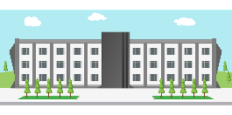
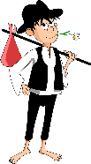
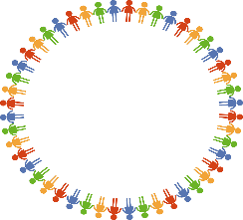
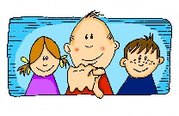
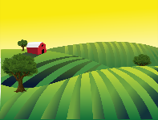
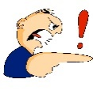
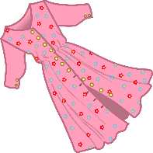
Vokabeln
 | 43 | 34 | 56 | 65 | 78 | 87
f
v
w |  | [about/ approx.] |  |  |  | [to try]
r
k |  |  |  |  |  | [simple]
a |  |  |  |  | [feeling]
sprechen
60 Min.
to cost
lesson
[to hide]
every-thing
all
everyone
€500
exact, exactly
€375
Notes:
Timing: 5 minutes Aim: To practise orally the new and revisited vocabulary for this week, also revisiting some letters and numbers learnt previously. Procedure: 1. Teacher calls co-ordinates.
2. Students have to recall vocabulary at those coordinates.

Slide 2
Fonética
escuchar / escribir
Text
Notes:
Timing:
Aim:
Procedure:
1.
2.
3.
4.
5.
Transcript:
Word frequency (1 is the most frequent word in Spanish):
Source: Davies, M. & Davies, K. (2018). A frequency dictionary of Spanish: Core vocabulary for learners (2nd ed.). Routledge: London

Slide 3
Vocabulaire
écouter
Text
Notes:
Timing:
Aim:
Procedure:
1.
2.
3.
4.
5.
Transcript:
Word frequency (1 is the most frequent word in French):
Source: Londsale, D., & Le Bras, Y. (2009). A Frequency Dictionary of French: Core vocabulary for learners London: Routledge.

