Slide 1
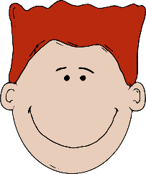
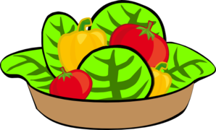
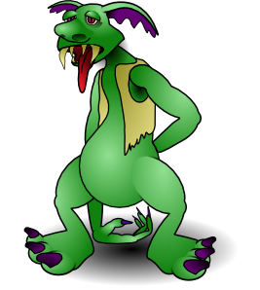
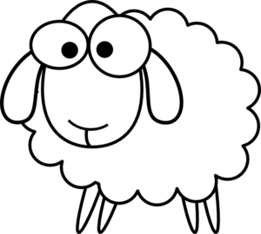
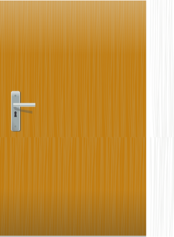
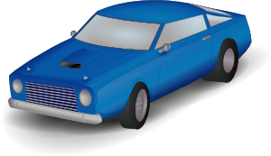
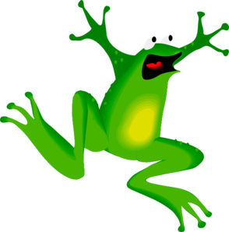
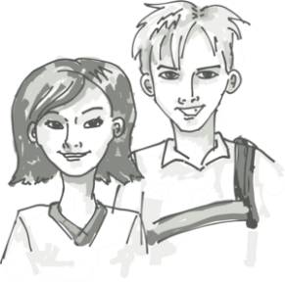
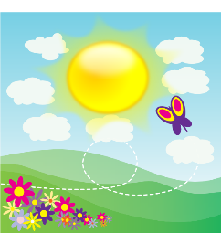
Vokabeln
Welche Nummer ist das? Wie sagt man das auf Deutsch?
sprechen
1 | 2 | 3 | 4
5 | 6 | 7 | 8
9 | 10 | 11 | 12
20
[boy]
[healthy]
[animal]
[ugly]
Sekunden
[true]
[green]
[car]
[door]
0
[yellow]
[fear of]
[siblings]
[beautiful]
LOS!
Notes:
Timing: 5 minutes Aim: to revisit a further 12 words (plus numbers 1-12) from this week’s vocabulary set in oral modality, productive mode. Using the timer in a specific round is a spur to increase the speed of processing. Procedure: 1. Round 1: Teacher says the German, students say number in German, the word in English, then the word in German again, chorally. E.g. Teacher: grün Students: sechs – green – grün Teacher to remind students to give the definite article with nouns.
2. Round 2: Teacher says the number, students say the German, chorally.
3. Round 3: In pairs. Student A mouthes a German word, Student B says it aloud. Continue for 20-second timer. Swap roles.
4. Round 4: Students say all words out loud, in number order, with 20-second timer.
Answers 1. der Junge 2. gesund 3. das Tier 4. hässlich 5. wahr 6. grün 7. das Auto 8. die Tür 9. gelb 10. Angst vor 11. die Geschwister 12. schön

Slide 2
Fonética
escuchar / escribir
Text
Notes:
Timing:
Aim:
Procedure:
1.
2.
3.
4.
5.
Transcript:
Word frequency (1 is the most frequent word in Spanish):
Source: Davies, M. & Davies, K. (2018). A frequency dictionary of Spanish: Core vocabulary for learners (2nd ed.). Routledge: London

Slide 3
Vocabulaire
écouter
Text
Notes:
Timing:
Aim:
Procedure:
1.
2.
3.
4.
5.
Transcript:
Word frequency (1 is the most frequent word in French):
Source: Londsale, D., & Le Bras, Y. (2009). A Frequency Dictionary of French: Core vocabulary for learners London: Routledge.

