Slide 1
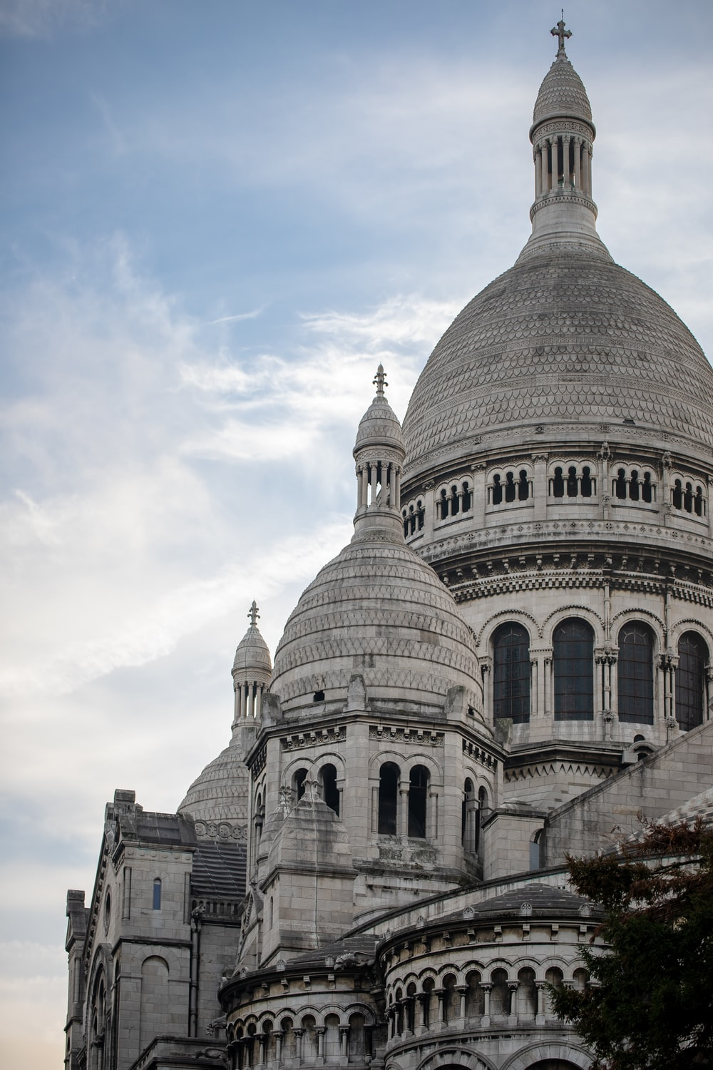
Vocabulaire
lire
C’est quel mot ?
On va visiter le Sacré-______?
- Je ne sais pas __ nous avons le _______ . __________ ?
C’est comment ?
- C’est un grand bâtiment ______ . C’est une église qui __________ à une cathédrale.
- Ah oui ? Qui _______ à la porte ?
Cœur
Pourquoi
si
temps
blanc
ressemble
frappe
Cœur
si
blanc
temps
ressemble
frappe
Pourquoi
Notes:
This slide revises all but one of the words (noir) in one of the other two vocabulary sets prescribed for this week – 2.2.3.
Students complete the dialogue on the theme of visiting a monument in Paris, inserting the correct word in each blank. This can be done orally and/or in writing. The answers are animated. Click on the text to play audio.
2.2.3 - frapper [745], ressembler [1398], cœur [568], temps [65], blanc [708], pourquoi [193], si¹ [34]
Transcript
On va visiter le Sacré-Cœur ?
- Je ne sais pas si nous avons le temps. Pourquoi ?
C’est comment ?
- C’est un grand bâtiment blanc . C’est une église qui ressemble à une cathédrale.
- Ah oui ? Qui frappe à la porte ?

Slide 2
Vocabulario
escuchar
Notes:
Please use this title slide as a template for your activities and grammar explanations.
Please give each activity a title in Spanish where possible. As well as exposing students to the TL, titles act as signposts for clear transitioning between activities.

Slide 3
Vokabeln
hören
Notes:
Please use this title slide as a template for your activities and grammar explanations.
Please give each activity a title in German where possible. As well as exposing students to the TL, titles act as signposts for clear transitioning between activities.

