Slide 1
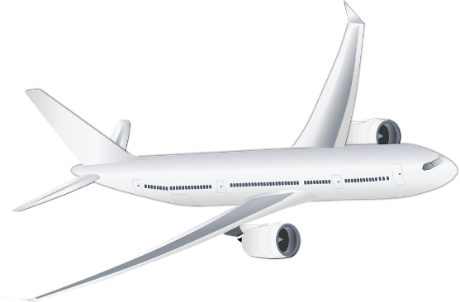
Was steht in den Headlines?
sprechen / hören / schreiben
1.4 billion euros
TUI verliert 1,4 Milliarden Euro
durch Corona
TUI loses 1.4 billion euros due to Corona
Notes:
Timing: 6 minutes (8 slides) Aim: Oral production and aural comprehension of vocabulary (new and revisited) in context. Procedure: 1. Student A copies the sentence (including the gap) and turns away from the board.
2. On a click, the English translation of the missing word(s) appears. Student B reads the full headline out, including the German for the missing word.
3. Student A writes they word they heard in the gap, and turns back to the board.
4. On a second click, the translation is revealed.
5. Students work together to guess the meaning of the headline. As these are authentic news headlines, some of the words are unknown. The teachers can choose to display as many or as few of the suggested pictorial hints as necessary to help students (simply delete as desired).
6. Translation revealed on a third click.
7. Students swap roles.
8. Repeat steps 1-7 for the rest of the activity.
Word frequency unknown words (1 is the most frequent word in German): verlieren [313] Source: Jones, R.L. & Tschirner, E. (2019). A frequency dictionary of German: core vocabulary for learners. Routledge
Source:
https://www.ndr.de/nachrichten/niedersachsen/hannover_weser-leinegebiet/TUI-verliert-14-Milliarden-Euro-durch-Corona,tui560.html

Slide 2
Was steht in den Headlines?
sprechen / hören / schreiben
attack
protect
Hackerangriff: So schütze ich meine Daten
data
Hacker attack:
I protect
my data in this way
Notes:
Word frequency of cognates (1 is the most frequent word in German): Hacker [>5000] Source: Jones, R.L. & Tschirner, E. (2019). A frequency dictionary of German: core vocabulary for learners. Routledge
Source:
https://www.swp.de/panorama/wie-schuetze-ich-meine-daten_-23681309.html

Slide 3
Fonética
escuchar / escribir
Text
Notes:
Timing:
Aim:
Procedure:
1.
2.
3.
4.
5.
Transcript:
Word frequency (1 is the most frequent word in Spanish):
Source: Davies, M. & Davies, K. (2018). A frequency dictionary of Spanish: Core vocabulary for learners (2nd ed.). Routledge: London

Slide 4
Vocabulaire
écouter
Text
Notes:
Timing:
Aim:
Procedure:
1.
2.
3.
4.
5.
Transcript:
Word frequency (1 is the most frequent word in French):
Source: Londsale, D., & Le Bras, Y. (2009). A Frequency Dictionary of French: Core vocabulary for learners London: Routledge.

