Slide 1
Falsche Freunde
Vokabeln
Four words in this week’s vocabulary set look like English words:
der Stoff
das Foto
der Raum
die Dame
Two of these words share a meaning with the English words they look like:
das Foto - photo
der Raum - room
This type of word is called a cognate and can be very useful for learning!
The others have different meanings from the words they look like:
der Stoff - material, cloth (not ‘stuff’)
die Dame - lady (not ‘dame’)
These are called false friends and we have to be careful with them!
Notes:
Timing: 2 minutes Aim: To introduce the concept of false friends and cognates using examples from this week’s new vocabulary set. Procedure: 1. Cycle through the information point by point.

Slide 2
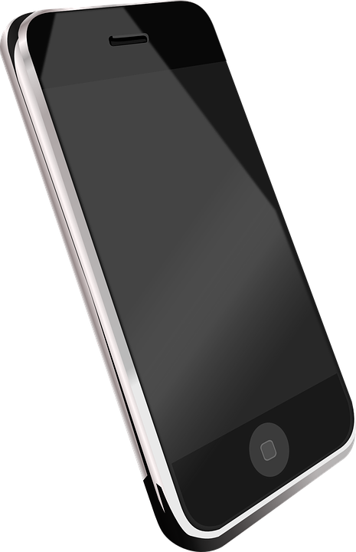
Falsche Freunde (1/8)
lesen
Falscher Freund oder Kognat?
das Handy
falscher Freund
Kognat
Notes:
Timing: 2 minutes [8 slides] Aim: To recall meanings of a set of known vocabulary items and categorise them as cognates or false friends. Procedure: 1. Students match the word to one of the pictures, thereby classing it as either a cognate or false friend.
2. Click to reveal answer.
3. Where a false friend is identified, clarify the English translation.

Slide 3
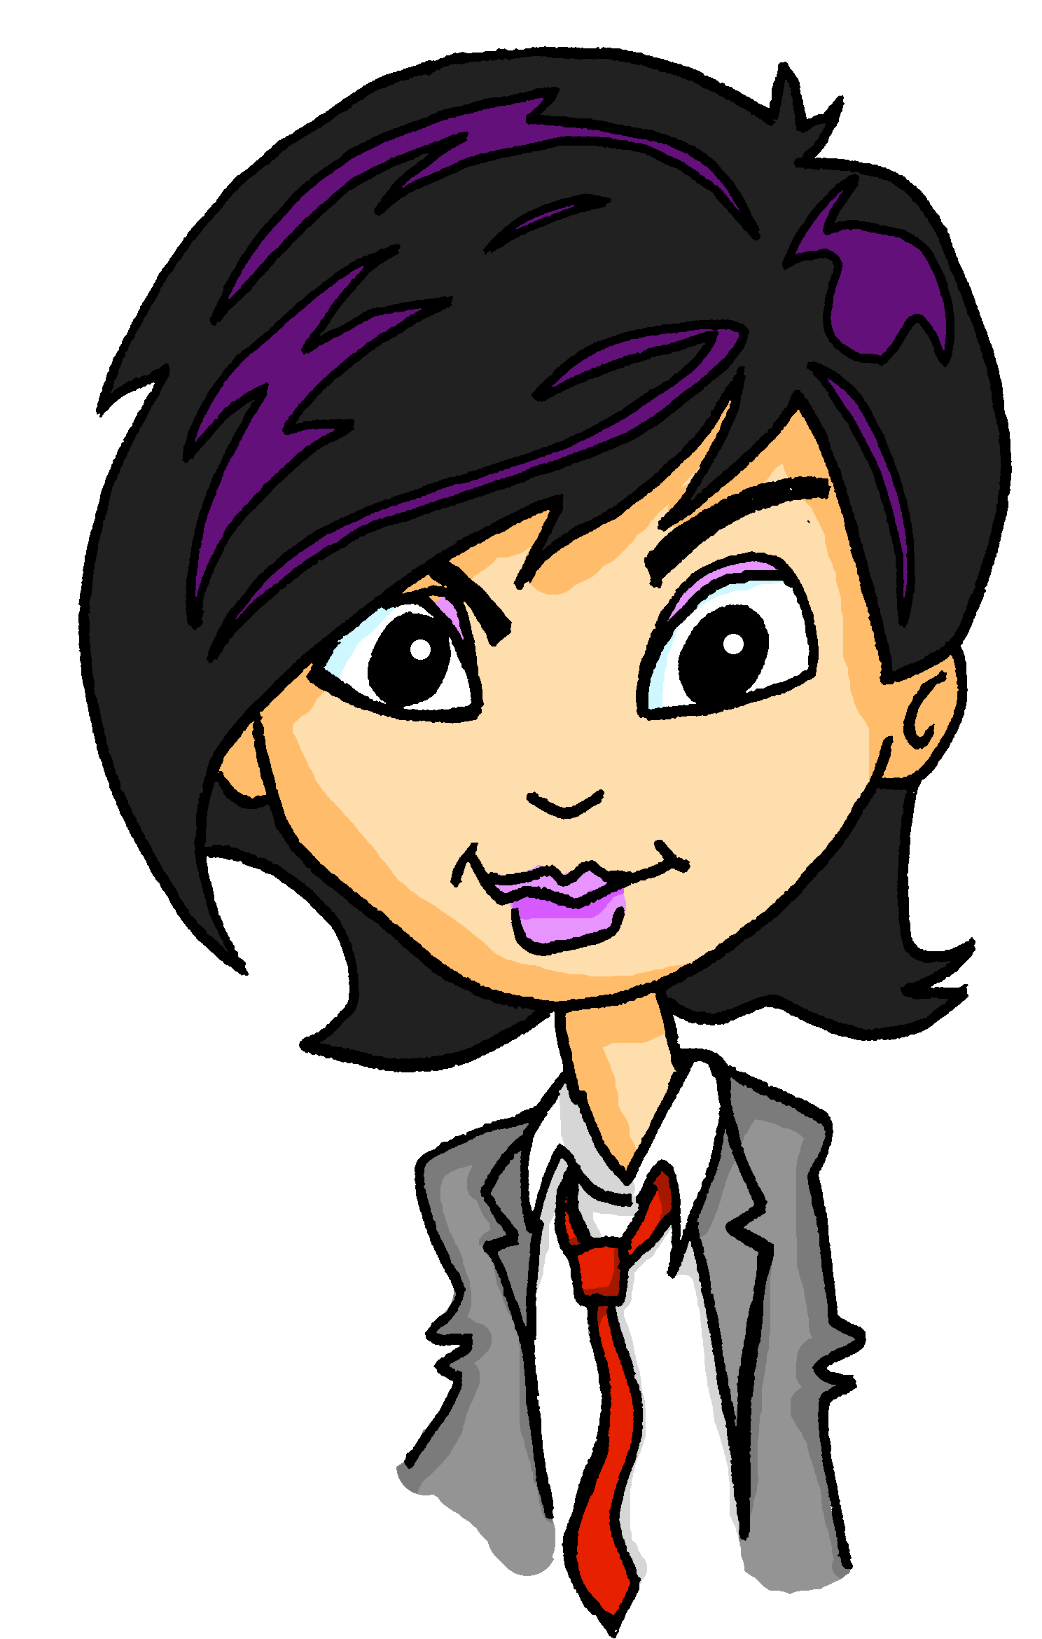
Falsche Freunde
lesen
Mia zeigt Katja das neue Haus. Schreib die Sätze auf Englisch.
Vorsicht vor* den falschen Freunden!
Deutsch | Englisch
Das Haus liegt am See. | The house is near the lake.
Wir sind fast da! | We are nearly there!
Ich will das große Zimmer haben! | I want to have the big room!
Es gibt in jedem Raum Stoff. | There is material in every room.
Ich brauche eine neue Hose. | I need new trousers.
Mutti ist streng, also keine Schuhe im Haus! | Mum is strict, so no shoes in the house!
Die Dame nebenan* verdient viel! | The lady next door earns a lot!
*Vorsicht vor
= watch out for
*nebenan
= next door
Notes:
Timing: 5 minutes Aim: To automatise the correct translation of new and revisited false friends by presenting them in new contexts and practising speed translation. Procedure:
1. At lower levels, explain to students that the words in bold are false friends and they need to be careful of these. At higher levels, remove the bold, and simply tell students that some words are false friends and they should try to spot them while translating.
2. Students translate the first sentence into English. They hold up their English translations on paper/mini whiteboards and try to be one of the first students to complete the translation successfully.
3. Click to reveal a suggested translation. Draw attention to the false friend and English equivalent.
4. Click to move to the next example. Repeat steps 1-5.
5. If necessary, revisit the activity in lesson 2 to consolidate meaning. Word frequency of unknown words used (1 is the most frequent word in German): Vorsicht [3443], nebenan [4567] Source: Jones, R.L. & Tschirner, E. (2019). A frequency dictionary of German: core vocabulary for learners. Routledge
Word frequency of cognates used (1 is the most frequent word in German): cool [>5000] Source: Jones, R.L. & Tschirner, E. (2019). A frequency dictionary of German: core vocabulary for learners. Routledge

Slide 4
Fonética
escuchar / escribir
Text
Notes:
Timing:
Aim:
Procedure:
1.
2.
3.
4.
5.
Transcript:
Word frequency (1 is the most frequent word in Spanish):
Source: Davies, M. & Davies, K. (2018). A frequency dictionary of Spanish: Core vocabulary for learners (2nd ed.). Routledge: London

Slide 5
Vocabulaire
écouter
Text
Notes:
Timing:
Aim:
Procedure:
1.
2.
3.
4.
5.
Transcript:
Word frequency (1 is the most frequent word in French):
Source: Londsale, D., & Le Bras, Y. (2009). A Frequency Dictionary of French: Core vocabulary for learners London: Routledge.

