Slide 1
Everyday life experiences
Separable verbs in the present tense: 1st and 3rd persons plural
Revisit several SSC
Y8 German
Term 2.2- Week 2- Lesson 41
Author name(s): Stephen Owen / Rachel Hawkes
Artwork: Steve Clarke
Date updated: 24 / 09 / 20
Notes:
Artwork by Steve Clarke. All additional pictures selected are available under a Creative Commons license, no attribution required.
Native teacher feedback provided by Stephanie Cross.
Learning outcomes (lesson 1): Consolidation of present tense separable verb 1st, 2nd , 3rd persons singular.
Introduction of present tense separable verb 1st, 3rd persons plural. Consolidate a range of SSC
Word frequency (1 is the most frequent word in German):
8.2.2.1 (introduce) annehmen [523] anschauen [949] aufhören [995] aufstehen [966] aussehen [277] fangen [2044] rufen [531] schauen [510] Preis¹ [334]
8.2.1.3 (revisit) es gab [49] hatte [6] war [4] heiß [1195] kalt [887] nah [480] tief [442] voll [388] wenig [102] damals [286] früher [411] links [893] rechts [829] 8.1.2.3 (revisit) gegangen [66] gefahren [215] fliegen [824] geflogen [824] Bahn [1415] Flugzeug [1776] Geschichte [262] Norden [1516] Onkel [1832] Osten [1208] Polen [2023] Süden [1771] Tante [1826] Schiff [1176] Westen [1010] polnisch [3237]
Source: Jones, R.L & Tschirner, E. (2019). A frequency dictionary of German: Core vocabulary for learners. London: Routledge.
The frequency rankings for words that occur in this PowerPoint which have been previously introduced in NCELP resources are given in the NCELP SOW and in the resources that first introduced and formally re-visited those words.
For any other words that occur incidentally in this PowerPoint, frequency rankings will be provided in the notes field wherever possible.

Slide 2
Phonetik
lesen / schreiben
Schreib 1-18 und ein Wort mit jeder SSC.
hatte
heiß
rufen
links
kurzes [a]
Polen
Onkel
[ei]
langes [u]
kurzes [i]
langes[o]
gefahren
kurzes [o]
Start
langes [a]
tief
Süden
[ie]
Flugzeug
Schiff
schauen
langes [ü]
wenig
[eu]
[sch]
[au]
langes[e]
aufstehen
voll
rechts
aufhören
[w]
[st-]
[v]
[ch]
langes [ö]
Ziel
Westen
Polen | links | schauen | rufen | Süden | Onkel
heiß | Flugzeug | gefahren | Westen | rechts | voll
Schiff | wenig | aufstehen | aufhören | tief | hatte
Notes:
Timing: 8 minutes, including feedback Aim: to consolidate knowledge of 18 different SSC within previously taught vocabulary, and additionally to recall further words with these SSC. Procedure: 1. Write 1-18 and a word from the table with that SSC.
2. Ensure that students know that they should try to use all the words just once each.
3. Challenge them to add a 2nd word with the same SSC from their own vocabulary knowledge.
4. Elicit the answers from students, providing a further opportunity to produce the words orally.
Word frequency (1 is the most frequent word in German):
8.2.2.1 (introduce)] aufhören [995] aufstehen [966] rufen [531] schauen [510] 8.2.1.3 (revisit) hatte [6] heiß [1195] tief [442] voll [388] wenig [102] links [893] rechts [829] 8.1.2.3 (revisit) gefahren [215] Flugzeug [1776] Onkel [1832] Polen [2023] Süden [1771] Schiff [1176] Westen [1010] polnisch [3237]
Source: Jones, R.L & Tschirner, E. (2019). A frequency dictionary of German: Core vocabulary for learners. London: Routledge.

Slide 3
Phonetik
Sag diese deutschen Wörter.
lesen / sprechen
die Adresse
20
wild
der Start
total
ideal
August
regional
Sekunden
die Basis
der Winter
April
die Definition
0
die Phase
LOS!
Notes:
Timing: 1 minute Aim: to practise pronouncing German cognates, applying known SSC. Procedure: 1. Working individually, students have 20 seconds to pronounce all of the words.
2. Tell them that if they pronounce one in an English way they should go back to the start and do them all again.
3. Alternatively, they could work in pairs, conditions permitting.
4. Teacher to click to elicit the pronunciation of each word chorally from the class to check their SSC knowledge.
Word frequency (1 is the most frequent word in German):
Start [1946] wild [1643] total [1021] Adresse [2739] ideal [1234] August [1929] regional [2011] Basis [1333] Winter [1206] April [1004] Phase [732] Definition [1056] Source: Jones, R.L. & Tschirner, E. (2019). A frequency dictionary of German: core vocabulary for learners. Routledge

Slide 4
Vokabeln [1/4]
lesen / sprechen
Person A
Ich bin … gefahren.
Person B
Norden
früher
nach Polen
Tante
rechts
nach Osten
mit dem Flugzeug
damals
mit der Bahn
Schiff
Notes:
Timing: 4 minutes (for next 4 slides)
Aim: to revisit vocabulary from 8.1.2.3 and 8.1.2.3 as per the cycle of revisiting in the SoW
Procedure:
1. Click to reveal the first text box.
2. Student A says this to their partner.
3. Click to reveal the options.
4. Student B then says all the possible answers that fit.
5. Click to reveal the answers.
6. After the next slide, partners will swap roles. (Each student has two turns at asking and two turns at answering).
Word frequency (1 is the most frequent word in German):
8.2.1.3 (revisit) damals [286] früher [411] rechts [829] 8.1.2.3 (revisit) gefahren [215] Bahn [1415] Flugzeug [1776] Norden [1516] Osten [1208] Polen [2023] Tante [1826] Schiff [1176]
Source: Jones, R.L & Tschirner, E. (2019). A frequency dictionary of German: Core vocabulary for learners. London: Routledge.

Slide 5
Vokabeln [2/4]
lesen / sprechen
Person A
Ich muss früher …
Person B
fliegen
rufen
gegangen
kalt
links
aufstehen
polnisch reden
nach Süden fahren
geflogen
schauen
Notes:
Timing: 4 minutes (for next 4 slides)
Aim: to revisit vocabulary from 8.1.2.3 and 8.1.2.3 as per the cycle of revisiting in the SoW
Procedure:
1. Click to reveal the first text box.
2. Student A says this to their partner.
3. Click to reveal the options.
4. Student B then says all the possible answers that fit.
5. Click to reveal the answers.
6. Partners now swap roles. (Each student has two turns at asking and two turns at answering).
Word frequency (1 is the most frequent word in German):
8.2.2.1 (introduce) aufstehen [966] rufen [531] schauen [510]
8.2.1.3 (revisit) kalt [887] links [893]
8.1.2.3 (revisit) gegangen [66] fliegen [824] geflogen [824] Süden [1771] polnisch [3237]
Source: Jones, R.L & Tschirner, E. (2019). A frequency dictionary of German: Core vocabulary for learners. London: Routledge.

Slide 6
Vokabeln [3/4]
lesen / sprechen
Person B
Das Wasser war mir…
Person A
heiß
zu kalt
Geschichte
nah
Westen
zu tief
zu wenig
geflogen
voll
angenehm
Notes:
Timing: 4 minutes (for next 4 slides)
Aim: to revisit vocabulary from 8.1.2.3 and 8.1.2.3 as per the cycle of revisiting in the SoW
Procedure:
1. Click to reveal the first text box.
2. Student B says this to their partner.
3. Click to reveal the options.
4. Student A then says all the possible answers that fit.
5. Click to reveal the answers.
(Each student has two turns at asking and two turns at answering).
Word frequency (1 is the most frequent word in German):
8.2.1.3 (revisit) war [4] heiß [1195] kalt [887] nah [480] tief [442] voll [388] wenig [102]
8.1.2.3 (revisit) geflogen [824] Geschichte [262] Westen [1010]
Source: Jones, R.L & Tschirner, E. (2019). A frequency dictionary of German: Core vocabulary for learners. London: Routledge.

Slide 7
Vokabeln [4/4]
lesen / sprechen
Person B
Die Geschichte hatte…
Person A
fangen
einen Onkel
wenige Details
früher
eine Mitte
ein Ende
ein Schiff
voll
eine Tante
Notes:
Timing: 4 minutes (for next 4 slides)
Aim: to revisit vocabulary from 8.1.2.3 and 8.1.2.3 as per the cycle of revisiting in the SoW
Procedure:
1. Click to reveal the first text box.
2. Student B says this to their partner.
3. Click to reveal the options.
4. Student A then says all the possible answers that fit.
5. Click to reveal the answers.
(Each student has two turns at asking and two turns at answering).
Word frequency (1 is the most frequent word in German):
8.2.2.1 (introduce) fangen [2044]
8.2.1.3 (revisit) hatte [6]] voll [388] wenig [102] früher [411] 8.1.2.3 (revisit) Geschichte [262] Onkel [1832] Tante [1826] Schiff [1176]
Source: Jones, R.L & Tschirner, E. (2019). A frequency dictionary of German: Core vocabulary for learners. London: Routledge.

Slide 8
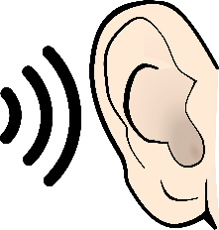
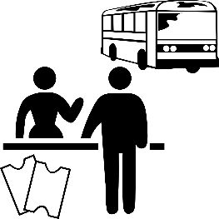
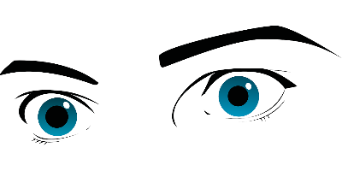
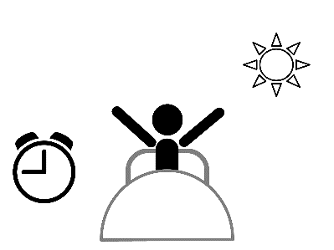
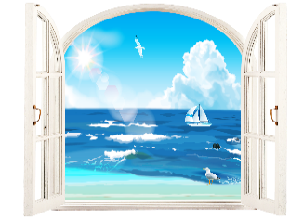
Vokabeln
Hör zu. Schreib den richtigen Buchstaben – A, B, C …
hören
1
D
A
B
C
D
E
2
B
3
E
4
G
[to take]
[to hear]
[to call]
[to see]
[to stop]
5
C
6
A
F
G
H
I
J
7
J
8
N
9
K
[to watch]
[to phone]
[to accept]
[to catch]
[to stand]
10
F
11
M
K
L
M
N
H
12
13
L
[to start]
[to look, appear]
[to look]
[to get up]
14
I
Notes:
Timing: 3 minutes
Aim: aural recognition of key verbs from this week’s vocabulary set, and their connection with verbs that have the same stem, but no separable prefix.
Procedure:
1. Click on the numbers to play each vocabulary item
2. Students match the audio to the correct picture by writing the letter.
3. Elicit the answers/alphabet practice by asking ‘Nummer 1 – welcher Buchstabe ist das?’ Students respond with the German letter name.
Transcript:
1. sehen 2. hören 3. aufhören 4. anrufen 5. rufen 6. nehmen 7. stehen 8. aufstehen 9. anfangen 10. anschauen 11. schauen 12. annehmen 13. aussehen 14. fangen Word frequency (1 is the most frequent word in German): 8.2.2.1 (introduce) annehmen [523] anschauen [949] aufhören [995] aufstehen [966] aussehen [277] fangen [2044] rufen [531] schauen [510] previously taught: nehmen [142] hören [146] anfangen [497] stehen [85] sehen [79] Source: Jones, R.L. & Tschirner, E. (2019). A frequency dictionary of German: core vocabulary for learners. Routledge

Slide 9
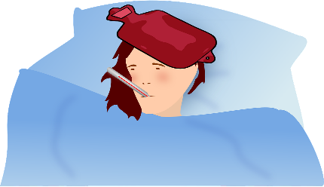
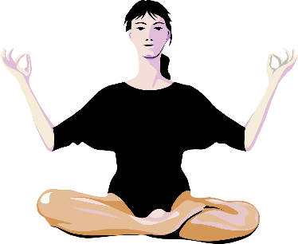
aussehen
[to appear, look]
sieht…aus
[appears, looks]
Notes:
Timing: 3 minutes for sequence of six slides
Aim: to introduce the verb aussehen more explicitly. Sehen is one of the 25 most frequently used verbs in German. This sequence practises the use of the separable prefix aus with sehen. Both long form (infinitive, 3rd person plural) and short form (3rd person singular) are introduced in order to familiarise students with various forms of the same verb.
Procedure
Bring up the word aussehen on its own, say it, students repeat it, and remind them of the phonics. Draw attention to long [e].
Try to elicit the meaning from the students. Students have had explicit teaching that the present tense in German communicates two different present tense meanings in English. This reinforces that learning. Emphasise the two meanings for the long form, reminding students that German only has one form and does not have a direct equivalent of the grammar for ‘is + ing’, the continuous form (as covered in previous weeks).
Bring up the picture, and, if using gestures, a possible gesture would be [to mime posing for a camera].
Then bring up the English translations. Emphasise the two meanings for the infinitive.
Bring up the short form sieht aus, say it, students repeat it. Draw attention to change from long [e] to [ie].
Try to elicit the meaning from the students. Emphasise the two meanings for the short form.
Word frequency (1 is the most frequent word in German):
8.2.2.1 (introduce) aussehen [277] Source: Jones, R.L & Tschirner, E. (2019). A frequency dictionary of German: Core vocabulary for learners. London: Routledge.

Slide 10
aussehen
[to appear, look]
sieht…aus
[appears, looks]
Notes:
Cycle through the long and short form again.
Word frequency (1 is the most frequent word in German):
8.2.2.1 (introduce) aussehen [277] Source: Jones, R.L & Tschirner, E. (2019). A frequency dictionary of German: Core vocabulary for learners. London: Routledge.

Slide 11
sieht…aus
[appears, looks]
Sie sieht krank aus.
[She appears/looks ill.]
Notes:
Introduce the short form in a sentence.
Word frequency (1 is the most frequent word in German):
8.2.2.1 (introduce) aussehen [277] Source: Jones, R.L & Tschirner, E. (2019). A frequency dictionary of German: Core vocabulary for learners. London: Routledge.

Slide 12
aussehen
[to appear, look]
Sie will gesund aussehen.
[She wants to appear/look healthy.]
Notes:
Introduce the long form in a sentence.
Word frequency (1 is the most frequent word in German):
8.2.2.1 (introduce) aussehen [277] Source: Jones, R.L & Tschirner, E. (2019). A frequency dictionary of German: Core vocabulary for learners. London: Routledge.

Slide 13
sieht…aus
[appears/looks]
sieht
Sie ____ krank ___.
aus
[She appears/looks ill.]
Notes:
Cycle through the short form in context again.
Word frequency (1 is the most frequent word in German):
8.2.2.1 (introduce) aussehen [277] Source: Jones, R.L & Tschirner, E. (2019). A frequency dictionary of German: Core vocabulary for learners. London: Routledge.

Slide 14
aussehen
[to appear, look]
Sie will gesund __________.
aussehen
[She wants to appear/look healthy.]
Notes:
Cycle through the long form in context again.
Word frequency (1 is the most frequent word in German):
8.2.2.1 (introduce) aussehen [277] Source: Jones, R.L & Tschirner, E. (2019). A frequency dictionary of German: Core vocabulary for learners. London: Routledge.

Slide 15
annehmen
[to accept]
nimmt…an
[accepts]
Notes:
Timing: 3 minutes for sequence of six slides
Aim: to introduce the verb annehmen more explicitly. Nehmen is one of the 25 most frequently used verbs in German. This sequence practises the use of the separable prefix an with nehmen. Both long form (infinitive, 3rd person plural) and short form (3rd person singular) are introduced in order to familiarise students with various forms of the same verb.
Procedure
Bring up the word annehmen on its own, say it, students repeat it, and remind them of the phonics. Draw attention to long [e].
Try to elicit the meaning from the students. Students have had explicit teaching that the present tense in German communicates two different present tense meanings in English. This reinforces that learning. Emphasise the two meanings for the long form, reminding students that German only has one form and does not have a direct equivalent of the grammar for ‘is + ing’, the continuous form (as covered in previous weeks).
Bring up the picture, and, if using gestures, a possible gesture would be [to mime accepting a prize in the hands].
Then bring up the English translations. Emphasise the two meanings for the infinitive.
Bring up the short form nimmt an, say it, students repeat it. Draw attention to change from long [e] to [i].
Try to elicit the meaning from the students. Emphasise the two meanings for the short form.
Word frequency (1 is the most frequent word in German):
8.2.2.1 (introduce) annehmen [523]
Source: Jones, R.L & Tschirner, E. (2019). A frequency dictionary of German: Core vocabulary for learners. London: Routledge.

Slide 16
annehmen
[to accept]
nimmt…an
[accepts]
Notes:
Cycle through the long and short form again.
Word frequency (1 is the most frequent word in German):
8.2.2.1 (introduce) annehmen [523]
Source: Jones, R.L & Tschirner, E. (2019). A frequency dictionary of German: Core vocabulary for learners. London: Routledge.

Slide 17
nimmt…an
[accepts]
Er nimmt den Preis an.
[He accepts the prize.]
Notes:
Introduce the short form in a sentence.
Word frequency (1 is the most frequent word in German):
8.2.2.1 (introduce) annehmen [523] Preis [334] Source: Jones, R.L & Tschirner, E. (2019). A frequency dictionary of German: Core vocabulary for learners. London: Routledge.

Slide 18
annehmen
[to accept]
Er will den Preis annehmen.
[He wants to accept the prize.]
Notes:
Introduce the long form in a sentence.
Word frequency (1 is the most frequent word in German):
8.2.2.1 (introduce) annehmen [523] Preis [334] Source: Jones, R.L & Tschirner, E. (2019). A frequency dictionary of German: Core vocabulary for learners. London: Routledge.

Slide 19
nimmt…an
[appears/looks]
nimmt
an
Er ______ den Preis ___.
[He accepts the prize.]
Notes:
Cycle through the short form in context again.
Word frequency (1 is the most frequent word in German):
8.2.2.1 (introduce) annehmen [523] Preis [334] Source: Jones, R.L & Tschirner, E. (2019). A frequency dictionary of German: Core vocabulary for learners. London: Routledge.

Slide 20
annehmen
[to accept]
Er will den Preis ___________.
annehmen
[He wants to accept the prize.]
Notes:
Cycle through the long form in context again.
Word frequency (1 is the most frequent word in German):
8.2.2.1 (introduce) annehmen [523] Preis [334] Source: Jones, R.L & Tschirner, E. (2019). A frequency dictionary of German: Core vocabulary for learners. London: Routledge.

Slide 21
Separable verbs
The particle often changes the meaning of the verb, a little or a lot!
Grammatik
Remember that separable verbs are made up of two parts: a particle and the main verb:
auf
stehen
auf
hören
aus
sehen
to stand up / get up
to stand
to stop
to hear
to appear / look
to see
What are the singular verb endings in the present tense?
Remember: in the present tense the particle moves to the end of the clause.
Ich
stehe
früh
auf.
I get / am getting up early.
Du
stehst
früh
auf.
You get / are getting up early.
Er/sie/es
steht
früh
auf.
S/he it gets / is getting up early.
Notes:
Timing: 3 minutes Aim: To remind students what separable verbs are and how they work in the present tense. Procedure: 1. Cycle through the information on the slide using the animation sequence. Word frequency (1 is the most frequent word in German):
aufstehen [653] aufhören[1828] aussehen [1421] Source: Jones, R.L. & Tschirner, E. (2006). A frequency dictionary of German: core vocabulary for learners. Routledge

Slide 22
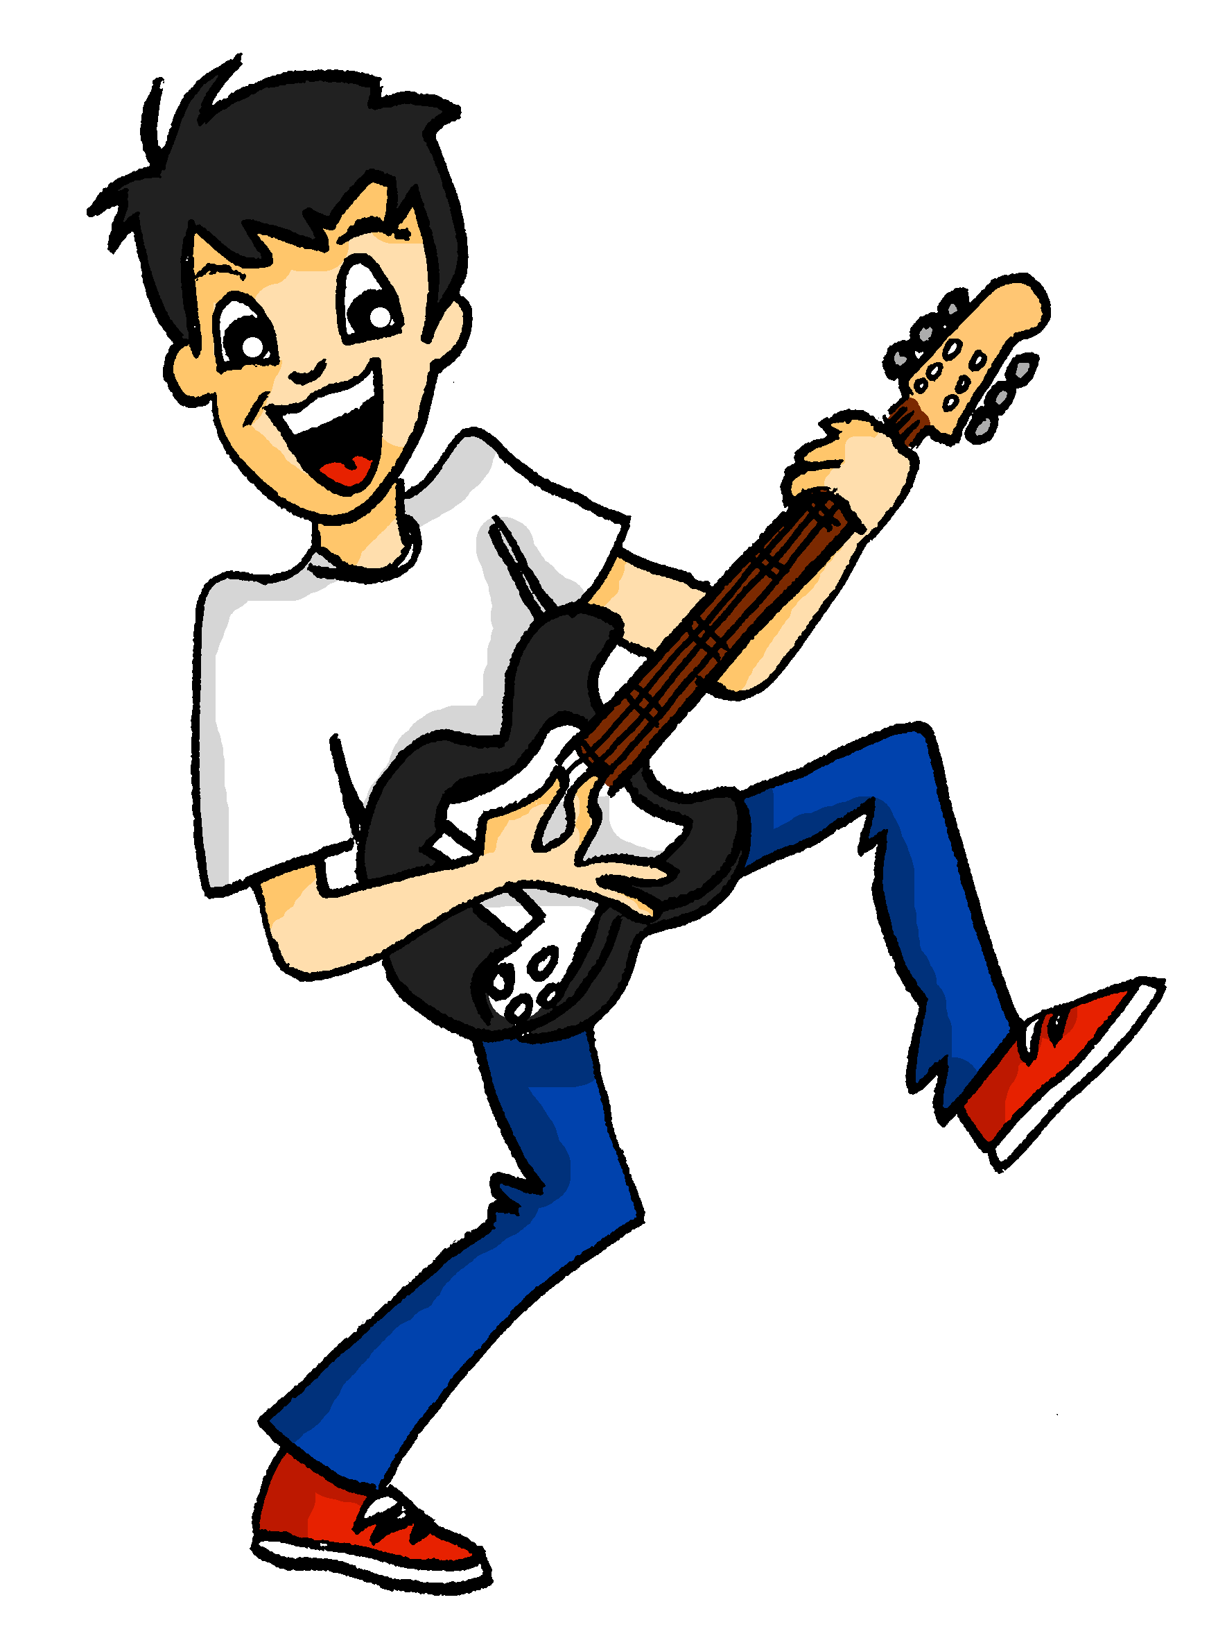
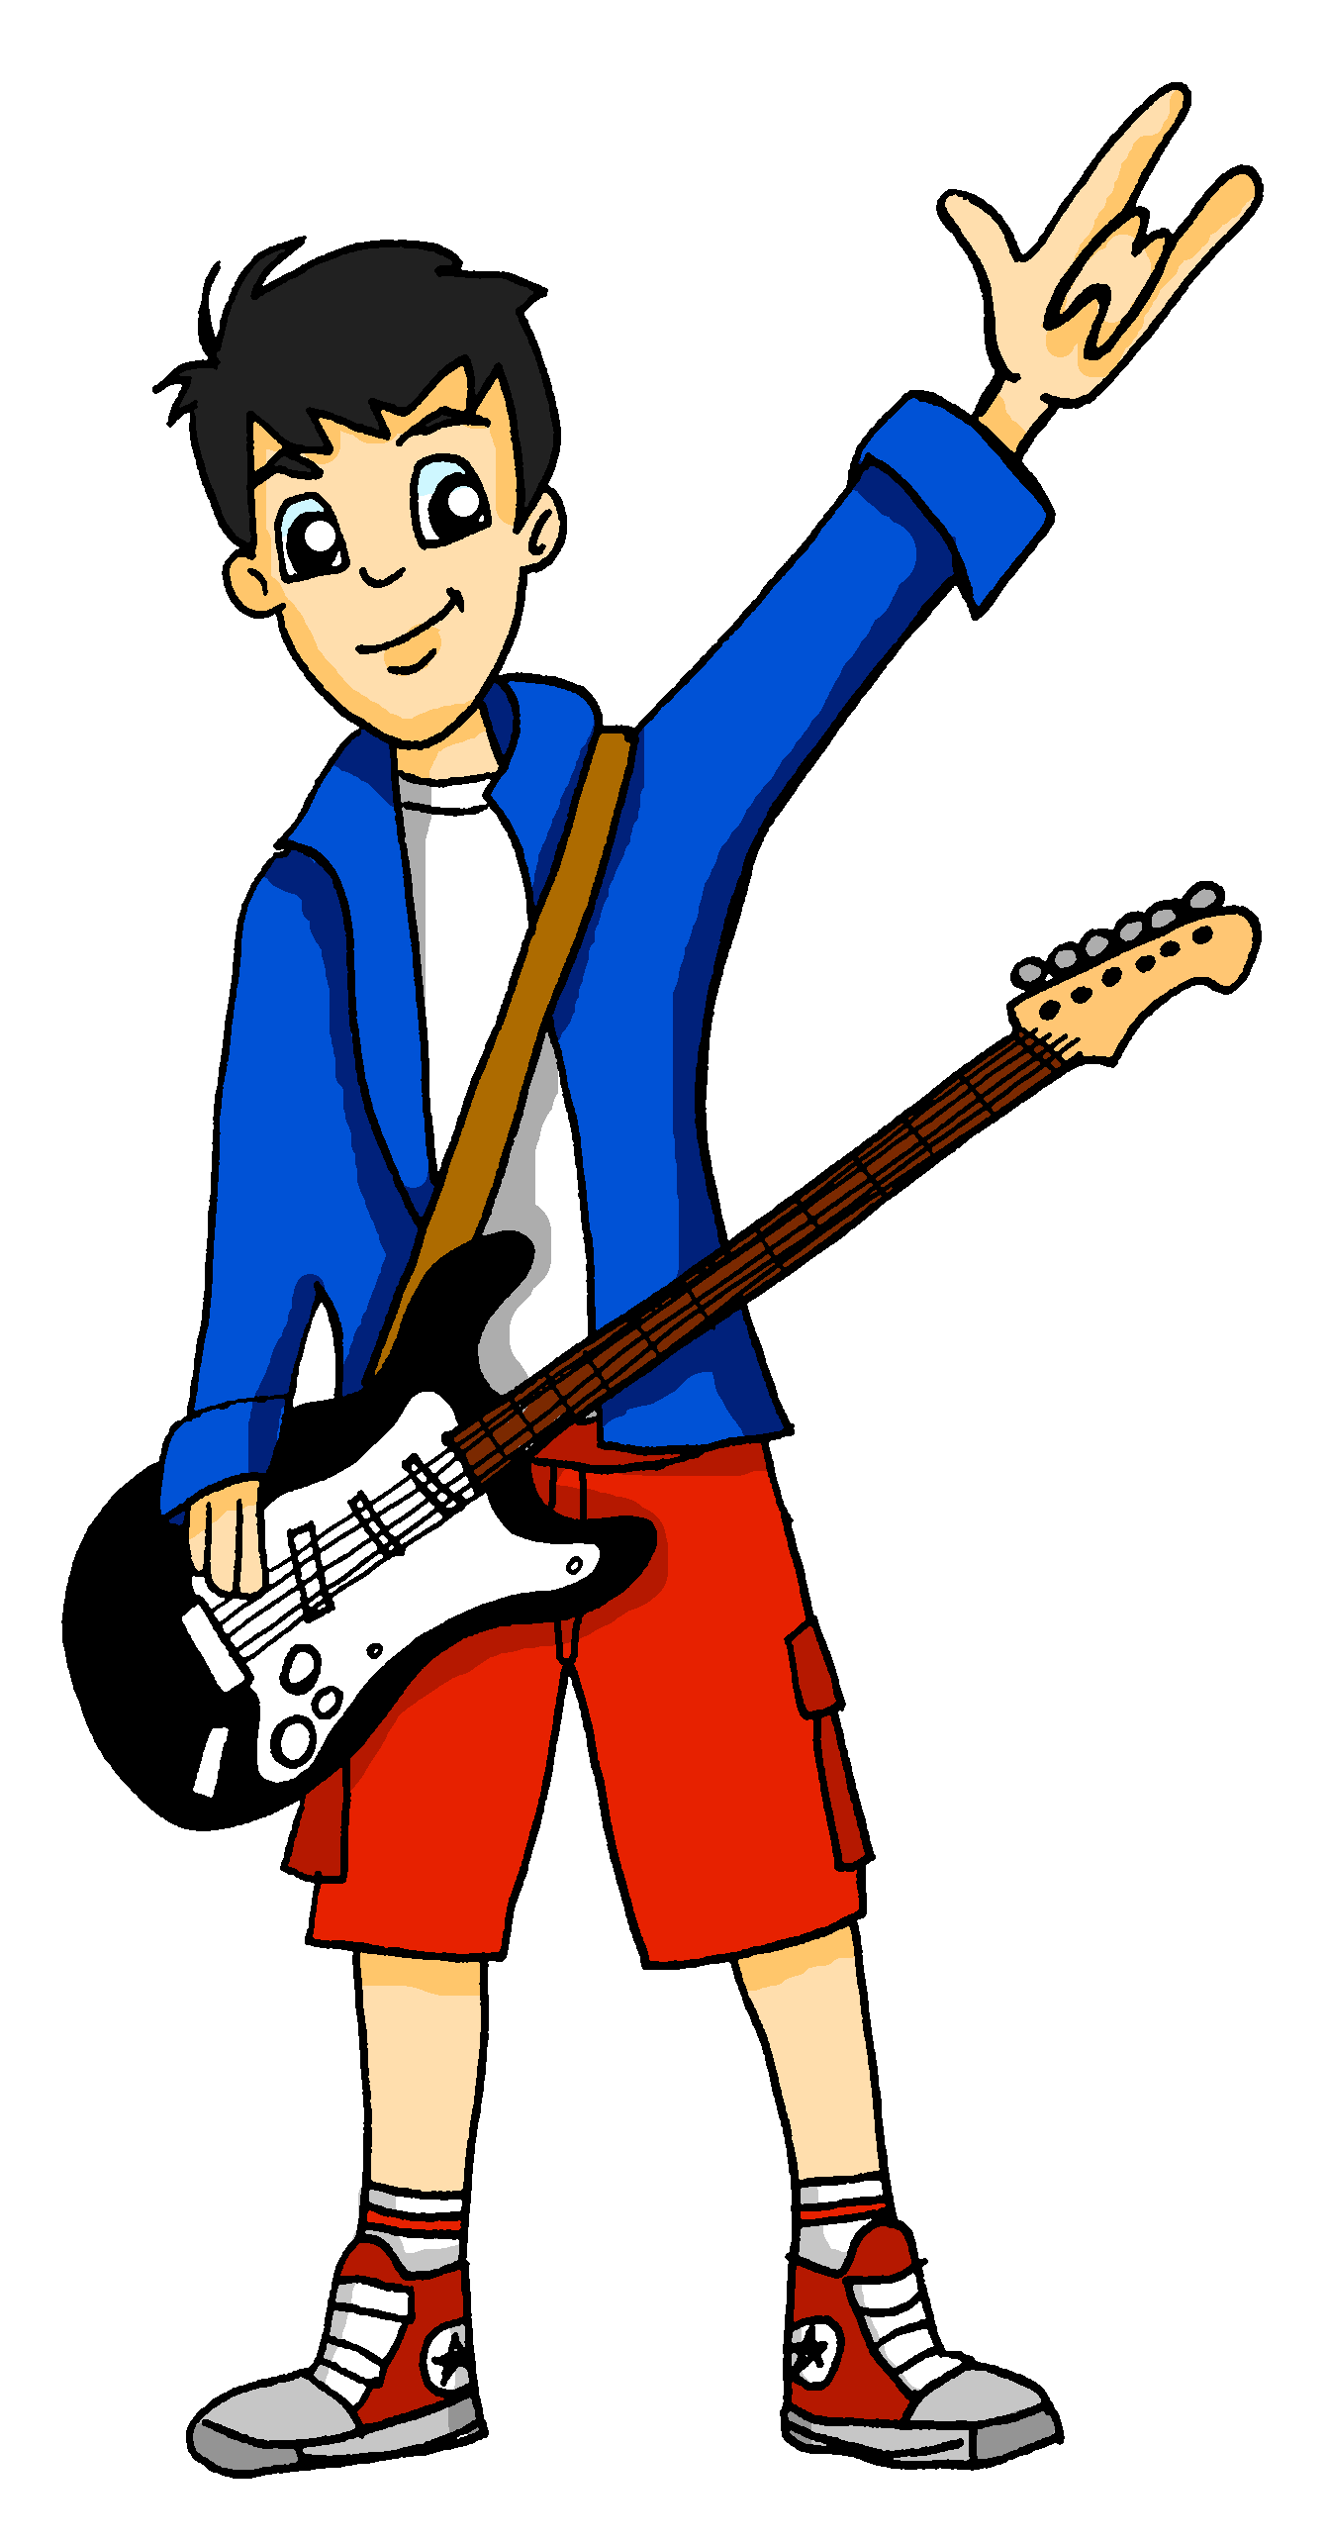
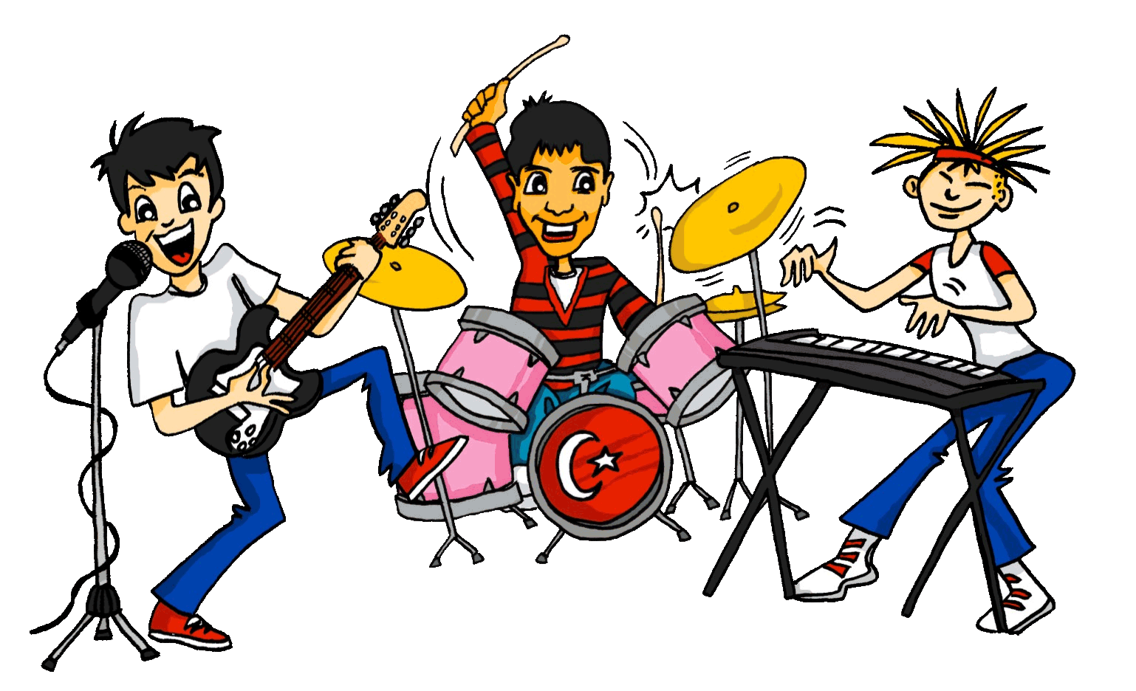
Wolfgang ist ein Superstar
lesen
Wolfgang träumt… Lies die Sätze. Schreib an, auf oder – am Ende.
4
5
Am nächsten Tag ruft man mich an .
Ich singe mein neues Lied.
___.
___
6
Ich gewinne den IMA Musikpreis !
3
Meine Show fängt um drei Uhr an .
___
___ !
2
7
Ich nehme den Preis an .
Ich schaue die Leute an .
___
___
1
8
Juhu! Ich höre mit der Schule auf .
Ich stehe mit meiner Gitarre auf der Straße .
___.
___
Notes:
Timing: 5 minutes Aim: To practise written recognition of separable and non-separable verb forms based on comprehension of the verbs in context.. Procedure: 1. Read the dream sequence. For each item decide if the sentence ends with a separable particle an/auf or nothing.
2. For items 1-4, click to reveal and check answers after each item.
3. Students complete 5-8 themselves.
4. Click to reveal and check answers 5-8. 5. The next slide provides the opportunity for students to translate the text into English.
Word frequency (1 is the most frequent word in German): Show [3367] Source: Jones, R.L. & Tschirner, E. (2019). A frequency dictionary of German: core vocabulary for learners. Routledge

Slide 23
Wolfgang schreibt Alastair.
erzählen – to tell, narrate
lesen
Wolfgang will Alastair seinen Traum erzählen*. Kannst du ihm helfen? Schreib den Traum auf Englisch.
Ich stehe mit meiner Gitarre auf der Straße.
Am nächsten Tag ruft man mich an.
An: Alastair
Wolfie21@hello.de
Hi Alastair, How’s it going? So, my weird dream…
Ich schaue die Leute an.
Ich gewinne den IMA Musikpreis!
I’m standing in the street with my guitar.
Meine Show fängt um drei Uhr an.
Ich nehme den Preis an.
I’m looking at the people.
My show starts at 3 o’clock.
Ich singe mein neues Lied.
Juhu! Ich höre mit der Schule auf!
I sing my new song.
The next day they call me.
I win the IMA music prize!
I accept the award.
Yay! I’m stopping / quitting school!
Notes:
Timing: 5 minutes Aim: To understand the detail of sentences with key separable verbs from this week’s vocabulary set. Procedure: 1. Students translate the 8 sentences into English.
2. Remind them that the present tense in German can translate as the simple present (does) or the present continuous (is doing) and that in a dream sequence / story they should use what sounds right to them – sometimes, both are equally possible.
3. Check the answers.
Word frequency (1 is the most frequent word in German):
8.2.2.1 (introduce) annehmen [523] anschauen [949] aufhören [995] fangen [2044] rufen [531] schauen [510] Preis¹ [334]
Source: Jones, R.L. & Tschirner, E. (2019). A frequency dictionary of German: core vocabulary for learners. Routledge

Slide 24
Mutti hat einen neuen Job
hören
Hör zu. Mutti will nichts vergessen. Was sagt sie? Schreib die richtigen Wörter.
eine Stunde
um sechs Uhr
den Direktor
„Hallo”
Dann rufe ich den Direktor an.
1
1
Ich stehe um sechs Uhr auf.
5
5
durch das Fenster
mich
den Job
ein Taxi
Ich sage ihm, ich nehme den Job an.
2
2
6
6
Ich schaue mich an.
mein Handy
gut
im Februar
Musik
Ich höre im Februar auf.
3
3
7
7
Ich sehe gut aus.
den Bus
den Job
Ich nehme den Bus zur Arbeit.
den Ball
im März
4
4
8
8
Ich fange im März an.
Notes:
Timing: 8 minutes Aim: To practise understanding sentences containing separable verbs (listening modality). The contrast here is semantic – between the separable and non-separable pairs of verbs - with an element of syntax as the separable verbs’ prefix is what students must listen out for, in order to know which of the two options completes the utterance correctly. Procedure: 1. Click on the first column of audio buttons to play each sentence with a word/phrase obscured.
2. Students listen to each sentence and select the appropriate missing words from the two options provided.
3. Click on the second column of audio buttons (which appears as part of the animation to the left of the first) to play each sentence in full.
4. Click to reveal the correct answer and to see the sentence in writing.
Transcript: 1. Ich stehe [um sechs Uhr] auf.
2. Ich schaue [mich] an. 3. Ich sehe [gut] aus.
4. Ich nehme [den Bus] zur Arbeit. 5. Dann rufe ich [den Direktor] an. 6. Ich sage ihm, ich nehme [den Job] an. 7. Ich höre [im Februar] auf. 8. Ich fange [im März] an.
Word frequency (1 is the most frequent word in German):
8.2.2.1 (introduce) annehmen [523] anschauen [949] aufhören [995] aufstehen [966] aussehen [277] fangen [2044] rufen [531]
Source: Jones, R.L. & Tschirner, E. (2019). A frequency dictionary of German: core vocabulary for learners. Routledge

Slide 25
Separable verbs
Grammatik
The we and they/you (polite) forms of the verb are the same as the infinitive:
Wir
stehen
früh
auf.
We get / are getting up early.
sie / Sie
stehen
früh
auf.
They/you (polite) get / are getting up early.
Remember that sie (they) and Sie (you – formal) sound the same!
It is the context that tells you the correct meaning.
Notes:
Timing: 3 minutes Aim: To introduce two plural separable verb forms. Procedure: 1. Cycle through the information on the slide using the animation sequence. Word frequency (1 is the most frequent word in German):
aufstehen [653] Source: Jones, R.L. & Tschirner, E. (2006). A frequency dictionary of German: core vocabulary for learners. Routledge

Slide 26
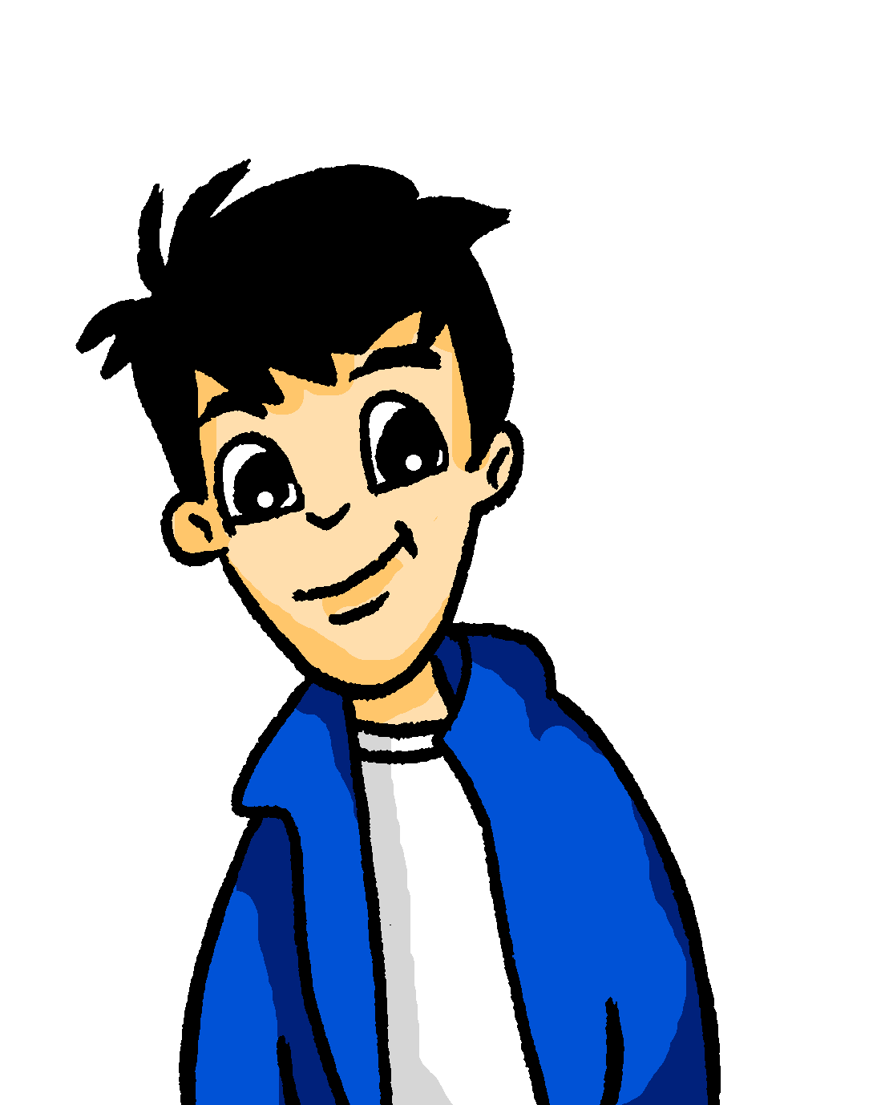
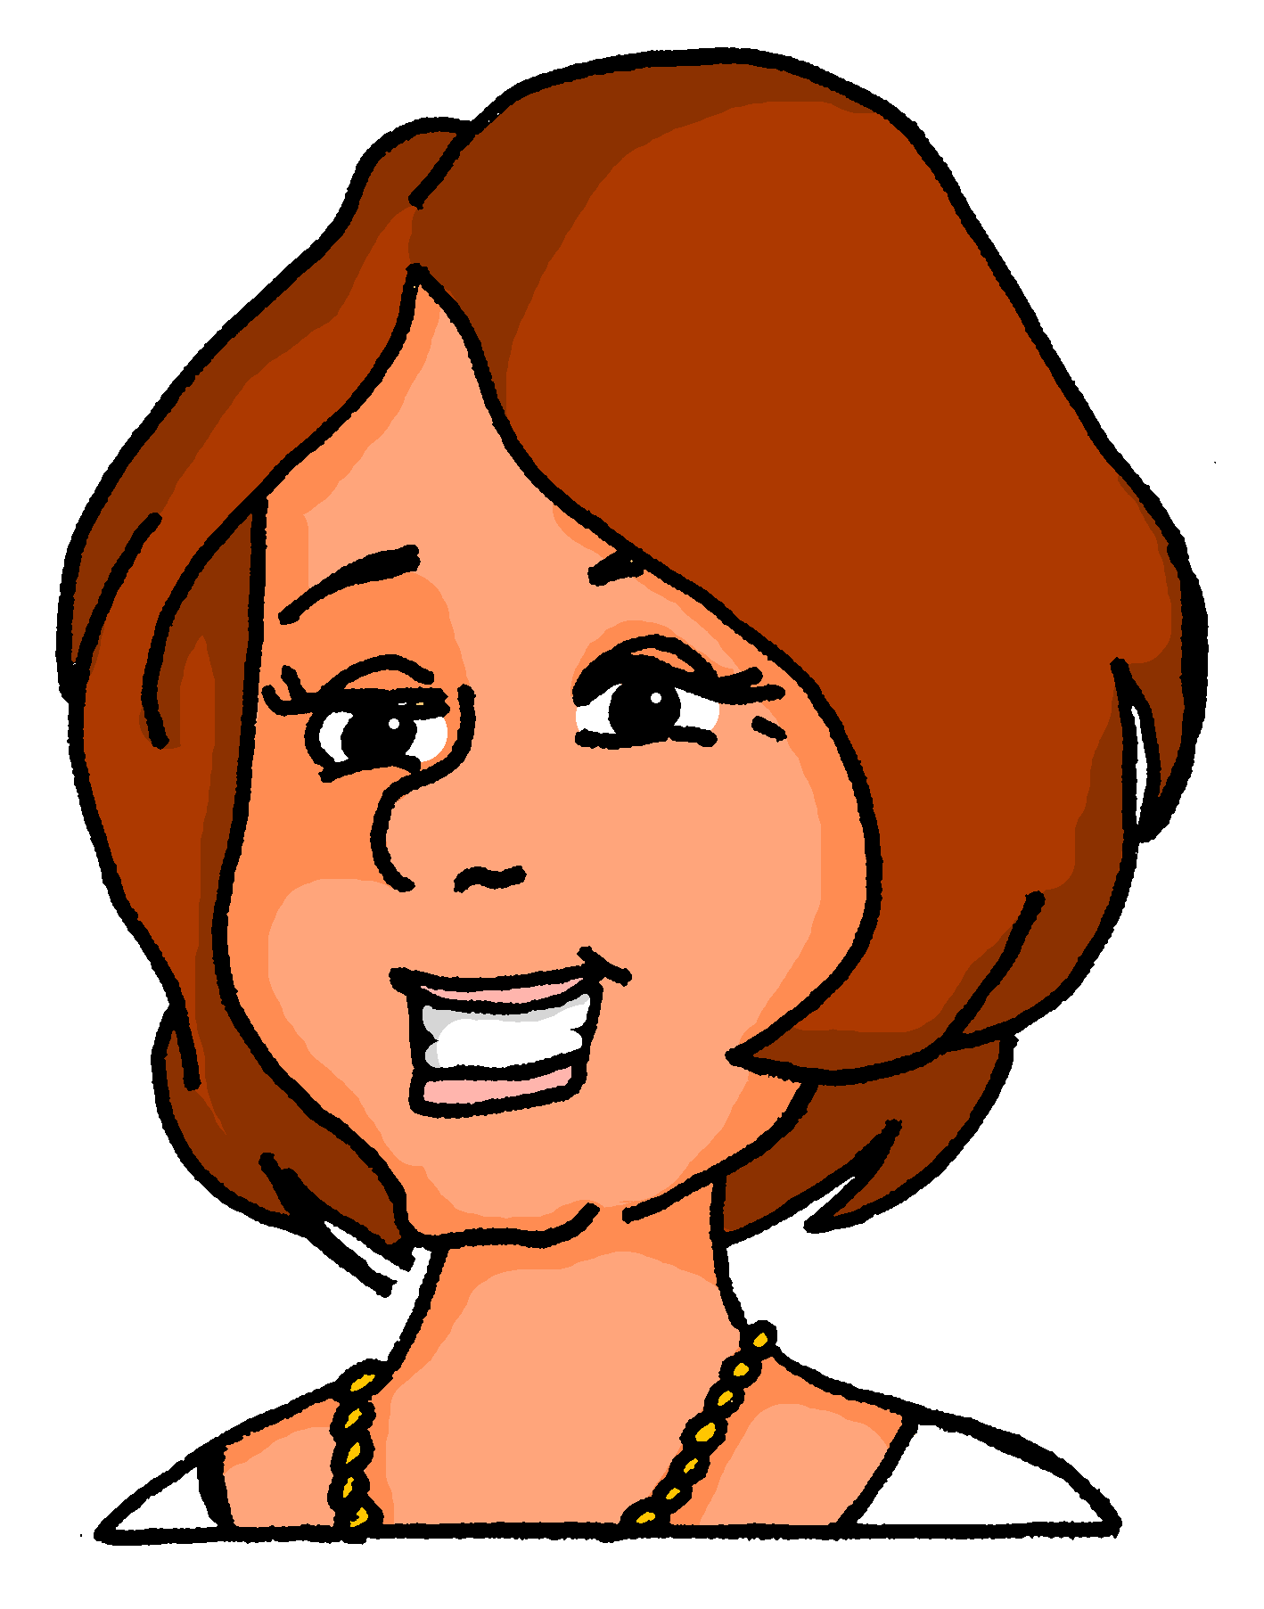
Sie oder sie?
hören / schreiben
Wolfgang redet mit Frau Nowak. Hör zu und schau das Bild an. Fragt er „Sie” (you, polite) oder „sie”(they)? Schreib die Frage auf Deutsch und auf Englisch.
1
Fliegen Sie gern?
Do you like flying?
Notes:
Timing: 5 minutes (8 slides) Aim: To practise distinguishing between ‘Sie’ and ‘sie’. Procedure: 1. Click on the numbered audio buttons to play the questions.
2. Click to reveal which referent ‘Frau Nowak’ or ‘Katja und Heidi’ is being addressed. 3. Students then transcribe the German sentence heard, also writing its meaning in English, taking care to use the correct form of Sie (you, formal) /sie (they).
4. Click to reveal first the German sentence, then the English translation.
Transcript: 1. Fliegen Sie gern?

Slide 27
Sie oder sie?
hören / schreiben
Wolfgang redet mit Frau Nowak. Hör zu und schau das Bild an. Fragt er „Sie” (you, polite) oder „sie”(they)? Schreib die Frage auf Deutsch und auf Englisch.
2
Stehen Sie früh auf?
Do you get up early?
Notes:
As for previous slide.
Transcript: 2. Stehen Sie früh auf? Word frequency (1 is the most frequent word in German):
8.2.2.1 (introduce) aufstehen [966]
Source: Jones, R.L. & Tschirner, E. (2019). A frequency dictionary of German: core vocabulary for learners. Routledge

Slide 28
Sie oder sie?
hören / schreiben
Wolfgang redet mit Frau Nowak. Hör zu und schau das Bild an. Fragt er „Sie” (you, polite) oder „sie”(they)? Schreib die Frage auf Deutsch und auf Englisch.
3
Arbeiten sie viel?
Do they work much?
Notes:
As for previous slide.
Transcript: 3. Arbeiten sie viel?

Slide 29
Sie oder sie?
hören / schreiben
Wolfgang redet mit Frau Nowak. Hör zu und schau das Bild an. Fragt er „Sie” (you, polite) oder „sie”(they)? Schreib die Frage auf Deutsch und auf Englisch.
4
Was essen sie gern?
What do they like eating?
Notes:
As for previous slide.
Transcript: 4. Was essen sie gern?

Slide 30
Sie oder sie?
hören / schreiben
Wolfgang redet mit Frau Nowak. Hör zu und schau das Bild an. Fragt er „Sie” (you, polite) oder „sie”(they)? Schreib die Frage auf Deutsch und auf Englisch.
5
Schauen Sie gern Filme an?
Do you like watching films?
Notes:
As for previous slide.
Transcript:
5. Schauen Sie gern Filme an? Word frequency (1 is the most frequent word in German):
8.2.2.1 (introduce) anschauen [949]
Source: Jones, R.L. & Tschirner, E. (2019). A frequency dictionary of German: core vocabulary for learners. Routledge

Slide 31
Sie oder sie?
hören / schreiben
Wolfgang redet mit Frau Nowak. Hör zu und schau das Bild an. Fragt er „Sie” (you, polite) oder „sie”(they)? Schreib die Frage auf Deutsch und auf Englisch.
6
Lesen sie Geschichten?
Do they read stories?
Notes:
As for previous slide.
Transcript: 6. Lesen sie Geschichten?

Slide 32
Sie oder sie?
hören / schreiben
Wolfgang redet mit Frau Nowak. Hör zu und schau das Bild an. Fragt er „Sie” (you, polite) oder „sie”(they)? Schreib die Frage auf Deutsch und auf Englisch.
7
Fahren Sie oft mit dem Schiff?
Do you often travel by boat?
Notes:
As for previous slide.
Transcript: 7. Fahren Sie oft mit dem Schiff?

Slide 33
Sie oder sie?
hören / schreiben
Wolfgang redet mit Frau Nowak. Hör zu und schau das Bild an. Fragt er „Sie” (you, polite) oder „sie”(they)? Schreib die Frage auf Deutsch und auf Englisch.
8
Nehmen sie die Bahn?
Are they taking the train?
Notes:
As for previous slide.
Transcript:
8. Nehmen sie die Bahn?

Slide 34
Everyday life experiences
Separable verbs in the present tense: 3rd person singular vs plural, questions
Revisit several SSC
Y8 German
Term 2.2- Week 2- Lesson 41
Author name(s): Stephen Owen / Rachel Hawkes
Artwork: Steve Clarke
Date updated: 24 / 09 / 20
Notes:
Artwork by Steve Clarke. All additional pictures selected are available under a Creative Commons license, no attribution required.
Native teacher feedback provided by Stephanie Cross.
Learning outcomes (lesson 1): Consolidation of present tense separable verb 1st, 2nd , 3rd persons singular.
Introduction of present tense separable verb 1st, 3rd persons plural. Consolidation of a range of SSC
Word frequency (1 is the most frequent word in German):
8.2.2.1 (introduce) annehmen [523] anschauen [949] aufhören [995] aufstehen [966] aussehen [277] fangen [2044] rufen [531] schauen [510] Preis¹ [334]
8.2.1.3 (revisit) es gab [49] hatte [6] war [4] heiß [1195] kalt [887] nah [480] tief [442] voll [388] wenig [102] damals [286] früher [411] links [893] rechts [829] 8.1.2.3 (revisit) gegangen [66] gefahren [215] fliegen [824] geflogen [824] Bahn [1415] Flugzeug [1776] Geschichte [262] Norden [1516] Onkel [1832] Osten [1208] Polen [2023] Süden [1771] Tante [1826] Schiff [1176] Westen [1010] polnisch [3237]
Source: Jones, R.L & Tschirner, E. (2019). A frequency dictionary of German: Core vocabulary for learners. London: Routledge.
The frequency rankings for words that occur in this PowerPoint which have been previously introduced in NCELP resources are given in the NCELP SOW and in the resources that first introduced and formally re-visited those words.
For any other words that occur incidentally in this PowerPoint, frequency rankings will be provided in the notes field wherever possible.

Slide 35
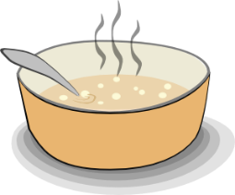
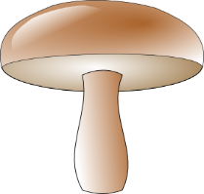
Phonetik
Deutsches [z] ist wie das Englische‘ts’. Deutsches [s-] ist wie das Englische ‘z’.
hören / schreiben
Hör zu. Schreib 1-9 und [z] oder [s].
_
_
_
7
E s el
Zirkus
4
1
Hei z ung
_
_
_
5
Pil z
2
Suppe
Zahn
8
Salat
_
_
9
_
3
Sahne
6
Amei s e
Notes:
Timing: 5 minutes Aim: To practise distinguishing between [z] and [s] Procedure: 1. Click on the numbered audio buttons to play each word.
2. Students write 1-9 and for each word note either ‘z’ or ‘s’ as the missing letter, according to what they hear.
3. Click to reveal the correct answers.
Transcript: 1. Zirkus 2. Suppe 3. Sahne 4. Heizung 5. Zahn 6. Ameise 7. Esel 8. Pilz 9. Salat Word frequency (1 is the most frequent word in German): Zirkus [>5009] Rose [3266] Suppe [>5009] Sahne [>5009] Heizung [>5009] Zahn [1871] Ameise [>5009] Esel [>5009] Pilz [3216] Salat [>5009]
Source: Jones, R.L. & Tschirner, E. (2019). A frequency dictionary of German: core vocabulary for learners. Routledge

Slide 36
Phonetik
lesen / sprechen
Remember - ‘tion’ words sound like ‘tsyon’in German!
20
1. sinken
7. Option
2. Tradition
8. angesichts
3. Kompetenz
9. Qualifikation
Sekunden
4. Zucker
10. absolut
5. sogar
11. tausend
0
6. Gesetz
12. Demonstration
LOS!
Notes:
Timing: 3 minutes Aim: To practise producing the [z] and [s (sounded like English ‘z’)] sounds in German Procedure: 1. Click on the ‘Los!’ button to start the timer.
2. Partners alternate in reading aloud the words – A reads out the odd numbers, B the even numbers. They aim to have read out all the words within the 20 seconds on the timer. Word frequency (1 is the most frequent word in German): Demonstration [3235] Option [3364] Qualifikation [3600] Zucker [2559] Kompetenz [2556] sogar [226] Gesetz [578] absolut [823] angesichts [1165] tausend [1177]
Source: Jones, R.L. & Tschirner, E. (2019). A frequency dictionary of German: core vocabulary for learners. Routledge

Slide 37
Vokabeln
schreiben
Schreib Vokabeln zu den Themen.
Familie
Transport
Wetter
c h i f f
S_ _ _ _ _
e i ß
T_ _ _ _
h_ _ _
a n t e
a h n
n k e l
B_ _ _
a l t
O_ _ _ _
k_ _ _
l u g z e u g
F_ _ _ _ _ _ _
Länder
Sprachen
Kardinalpunkte
o l e n
o l n i s c h
o r d e n
P_ _ _ _
p_ _ _ _ _ _ _
N_ _ _ _ _
ü d e n
S_ _ _ _
s t e n
O_ _ _ _
Notes:
Timing: 5 minutes Aim: To revise 12 vocabulary items from this week’s revisited sets and prompt students to link these words to some other previously-learnt vocabulary that fits these semantic fields. Procedure: 1. Students try to recall items of vocabulary from this week’s revisited sets, prompted by the category and first letter of each.
2. Students write the words.
3. Where there are gaps, students should be encouraged to recall other countries, languages, family members etc., that they know.
4. Click to reveal the correct spelling of each word.
Word frequency (1 is the most frequent word in German):
8.2.1.3 (revisit) heiß [1195] kalt [887] 8.1.2.3 (revisit) Bahn [1415] Flugzeug [1776] Norden [1516] Onkel [1832] Osten [1208] Polen [2023] Süden [1771] Tante [1826] Schiff [1176] Westen [1010] polnisch [3237]
Source: Jones, R.L & Tschirner, E. (2019). A frequency dictionary of German: Core vocabulary for learners. London: Routledge.

Slide 38
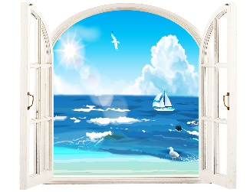
Vokabeln
schreiben
4a
4b
Schreib die Verben!
s_ _ _ _
ehen
ussehen
1b
a_ _ _ _ _ _ _
1a
5a
5b
ehmen
n_ _ _ _ _
a_ _ _ _ _ _ _
nnehmen
tehen
s_ _ _ _ _
a_ _ _ _ _ _ _ _
ufstehen
2a
2b
6a
6b
a_ _ _ _ _ _ _ _
chauen
nschauen
s_ _ _ _ _ _
ören
h_ _ _ _
a_ _ _ _ _ _ _
ufhören
3a
3b
7a
7b
angen
f_ _ _ _ _
ufen
nfangen
r_ _ _ _
a_ _ _ _ _ _ _
a_ _ _ _ _ _
nrufen
Notes:
Timing: 5 minutes Aim: To recall productively in written form the meanings of this week’s new verbs and connect them to verbs with the same stem but without a separable prefix. e.g. hören / aufhören, noticing where meanings are similar or completely different. Procedure: 1. Students try to write each verb, prompted by the picture and first letter.
2. click to reveal the answers one by one, in order.
Word frequency (1 is the most frequent word in German): 8.2.2.1 (introduce) annehmen [523] anschauen [949] aufhören [995] aufstehen [966] aussehen [277] fangen [2044] rufen [531] schauen [510] previously taught: nehmen [142] hören [146] anfangen [497] stehen [85] sehen [79] Source: Jones, R.L. & Tschirner, E. (2019). A frequency dictionary of German: core vocabulary for learners. Routledge

Slide 39
Starke Verben
Grammatik
Remember that strong verbs change their spelling in the du and er/sie/es forms.
This is true for both separable and inseparable verbs:
The verb ending here tells you this ‘sie’ means ‘they’.
Remember: this ‘sie’ means ‘she’.
sie nimmt den Zug sie nehmen den Zug
sie nimmt den Preis an sie nehmen den Preis an
sie fängt den Ball sie fangen den Ball
sie fängt um elf Uhr an sie fangen um elf Uhr an
sie sieht das Flugzeug sie sehen das Flugzeug
sie sieht gesund aus sie sehen gesund aus
But remember: Sie nehmen → you (formal) take
Notes:
Timing: 3 minutes Aim: To remind students that strong verbs change their spelling in the du and er/sie/es forms and remind students again about the three meanings of ‘sie (she), sie (they) and Sie (you, formal)’.
Procedure: 1. Cycle through the information on the slide using the animation sequence. 2. Elicit the English for each German example, to provide additional reinforcement of some of this week’s key vocabulary. Word frequency (1 is the most frequent word in German):
8.2.2.1 (introduce) annehmen [523] aussehen [277] fangen [2044] Preis¹ [334]
8.1.2.3 (revisit) Flugzeug [1776]
Source: Jones, R.L & Tschirner, E. (2019). A frequency dictionary of German: Core vocabulary for learners. London: Routledge.

Slide 40
eine Schifffahrt
lesen
Mia und ihre Mutti machen eine Schifffahrt. Wer macht was? Schreib 1-8, a oder b oder a+b.
Sie sehen schön aus. |  | Sie liest Geschichten. |  | Sie fahren nach Norden.
1a | 1b | 4a | 4b | 7a | 7b
Sie steh? früh auf. |  | Sie fängt einen Fisch. |  | Sie essen etwas.
2a | 2b | 5a | 5b | 8a | 8b
Sie schau? das Meer* an. |  | Sie ruf? Wolfgang an. |  | Sie komm? gut an.
3a | 3b | 6a | 6b | 9a | 9b
_
_
_
_
_
_
_
_
_
*das Meer - sea
Notes:
Timing: 5 minutes Aim: This is a referential activity in the written modality to practise noticing whether the verb is strong or weak as well as the implications for meaning – ‘she’, ‘they’ or ‘she + they’. Procedure: 1. Students number 1-8, and write ‘a’, ‘b’ or ‘a+b’ to indicate the correct picture description. NB: This compels the student to notice the stem of the verb and the implication for meaning. Even without the verb ending, a change of spelling in the stem would indicate ‘she’ meaning, whilst no change with a strong verb indicates ‘they’, and with a weak verb, the answer must be ‘she’ + ‘they’ because it could be either.
2. Click to make the verb ending (or ?) appear for each item in turn.
3. Click a second time to reveal the correct answer for each item. 4. Elicit the English meanings for the sentences. Word frequency (1 is the most frequent word in German): 8.2.2.1 (introduce) anschauen [949] aufstehen [966] aussehen [277] fangen [2044] rufen [531]
Other: Fisch [1959] Meer [852] Source: Jones, R.L. & Tschirner, E. (2019). A frequency dictionary of German: core vocabulary for learners. Routledge

Slide 41
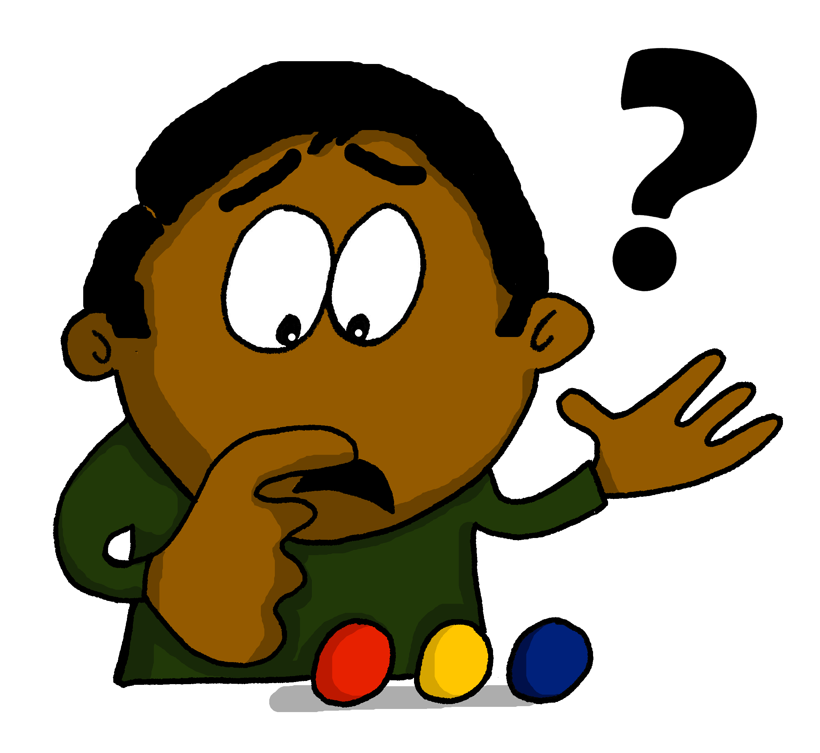
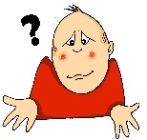
Fragewörter
Wie sagt man... ?
Grammatik
 | what?
 | where?
 | when?
 | why?
 | which?
 | who/whom?
 | how?
was?
Warum
1) _______ stehst du um 6 Uhr auf?
wo?
Wann
2) ______ kommt dein Freund an?
wann?
Wo
3) ____ fängt die Tour an?
warum?
Was
4) ____ nehmen wir an?
welcher
welche
welches?
Welcher
5) _________ Preis ist das?
Wie
6) _____ fahren wir?
Nehmen wir die Bahn?
wer/wen/wem?
Wen
7) _____ rufst du an?
wie?
Notes:
Timing: 3 minutes Aim: To revise the question words met so far. Procedure: 1. Elicit the German for each question word in English in the table on the right.
2. Click to bring up the German question words one by one, completing the table.
3. Click again to bring up the first gapped sentence. Challenge students to suggest the missing question word.
4. Click to bring up the missing question word.
5. Repeat steps 3 and 4 above for the remaining six sentences.
Word frequency (1 is the most frequent word in German): 8.2.2.1 (introduce) annehmen [523] aufstehen [966] fangen [2044] rufen [531] Preis¹ [334]
Source: Jones, R.L. & Tschirner, E. (2019). A frequency dictionary of German: core vocabulary for learners. Routledge
wo (94) wer (173) was (39) wann (583) wie (283) warum (246) welcher (138) Source: Jones, R.L., & Tschirner, E. (2009). A Frequency Dictionary of German. Routledge

Slide 42
Wie heißen die Fragen?
hören / schreiben
Schreib die Fragen!
1
Ich komme um neun Uhr an.
1
Wann kommst du an?
2
Sie bereitet das Essen vor.
2
Was bereitet sie vor?
3
Sie stehen spät auf, denn sie sind müde.
Warum stehen sie spät auf?
3
4
Sie nehmen den Preis an.
4
Was nehmen sie an?
5
Ja, sie hört gern Musik.
5
Hört sie gern Musik?
6
Er hört um fünf Uhr auf.
6
Wann hört er auf?
7
Sie bringen die Bücher mit.
7
Was bringen sie mit?
8
Sie ruft ihre Freundin an.
8
Wen ruft sie an?
Notes:
Timing: 8-10 minutes Aim: To practise question formation using known question words and forms (written modality). Procedure: 1. Click on the numbered audio buttons in the first column to hear the statements, which are all answers to questions.
2. Students listen to each statement in turn, then write the question which would lead to that answer.
3. Click to bring up each statement in writing, followed by the suggested question.
4. Click on the numbered audio buttons in the second column to listen to the questions.
Transcript: 1. Ich komme um neun Uhr an. (Wann kommst du an?) 2. Sie bereitet das Essen vor. (Was bereitet sie vor?) 3. Sie stehen spät auf, denn sie sind müde. (Warum stehen sie spät auf?) 4. Sie nehmen den Preis an. (Was nehmen sie an?)
5. Ja, sie hört gern Musik. (Hört sie gern Musik?)
6. Er hört um fünf Uhr auf. (Wann hört er auf?)
7. Sie bringen die Bücher mit. (Was bringen sie mit?)
8. Sie ruft ihre Freundin an. (Wen ruft sie an?)
Word frequency (1 is the most frequent word in German): 8.2.2.1 (introduce) annehmen [523] aufhören [995] aufstehen [966] rufen [531] Preis¹ [334]
Source: Jones, R.L. & Tschirner, E. (2019). A frequency dictionary of German: core vocabulary for learners. Routledge

Slide 43
Fragen, Fragen!
Deine deutsche Cousine kommt morgen an! Du hast viele Fragen!
sprechen
Stell diese Fragen. Schreib die Antworten auf Deutsch!
Partner A
1. When do you begin?
Antworten
(Partner A spricht; Partner B schreibt!)
1. ______________________
2. ______________________
3. ______________________
4. ______________________
5. ______________________
Beispiel:
Ich fange um acht Uhr an.
Wann fängst du an?
Notes:
EXAMPLE SLIDE
Timing: 2 minutes Aim: To illustrate the speaking task on the following two slides (see also handout available on NCELP Resource Portal)
Procedure: 1. Distribute Partner A and Partner B sections of handout available on NCELP Resource Portal.
2. Cycle through the example on the slide using the animation sequence, in order to illustrate the task.

Slide 44
Fragen, Fragen!
Deine deutsche Kusine kommt morgen an! Du hast viele Fragen!
sprechen
Stell diese Fragen. Schreib die Antworten auf Deutsch!
Partner A
1. How are you travelling?
2. When are you arriving?
3. What is your mobile number?
4. What do you like eating?
5. When do you usually go to bed?
Antworten
1. ______________________
2. ______________________
3. ______________________
4. ______________________
5. ______________________
Fragen:
Wie fährst du?
Wann kommst du an?
Was ist deine Handynummer?
Was isst du gern?
Wann gehst du normalerweise ins Bett?
Notes:
DO NOT DISPLAY DURING THE TASK
Timing: 8 minutes Aim: To practise question formation using known question words and forms (oral modality). Procedure: 1. A printed handout for this task is available for download on the NCELP Resource Portal.
2. Partner A asks Partner B the five questions on this card in turn in German.
3. Partner A then notes down Partner B’s answers in German.
4. Swap roles and repeat with the next set of five questions (see next slide).
5. Clicking on this slide will bring up the correct form of the questions in German, which may be useful in going over the task afterwards.

Slide 45
Fragen, Fragen!
Deine deutsche Kusine kommt morgen an! Du hast viele Fragen!
sprechen
Stell diese Fragen. Schreib die Antworten auf Deutsch!
Partner B
1. When do you get up?
2. What do you look like?
3. When are you phoning me?
4. Do you like listening to music?
5. Do you like watching films?
Antworten
1. ______________________
2. ______________________
3. ______________________
4. ______________________
5. ______________________
Fragen:
Wann stehst du auf?
Wie siehst du aus?
Wann rufst du mich an?
Hörst du gern Musik?
Schaust du gern Filme an?
Notes:
DO NOT DISPLAY DURING THE TASK
Timing: 8 minutes Aim: To practise question formation using known question words and forms (oral modality). Procedure: 1. Partners have now swapped roles.
2. Partner B asks Partner A the five questions on this card in turn in German.
3. Partner B then notes down Partner A’s answers ain German.
4. Clicking on this slide will bring up the correct form of the questions in German, which may be useful in going over the task afterwards.
5. Teachers could consider giving a short, additional written homework to write up their partner’s answers in the 3rd person singular, in order to report back.
Word frequency (1 is the most frequent word in German):
8.2.2.1 (introduce) anschauen [949] aufstehen [966] aussehen [277] rufen [531]
Source: Jones, R.L & Tschirner, E. (2019). A frequency dictionary of German: Core vocabulary for learners. London: Routledge.

Slide 46
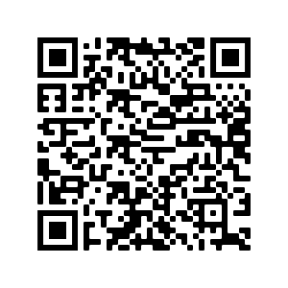
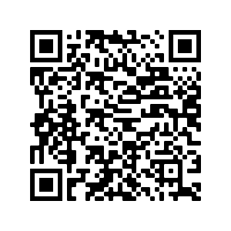
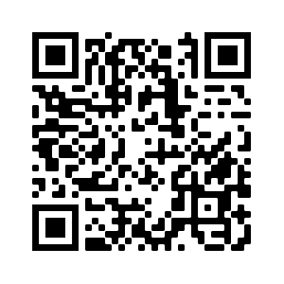
Hausaufgaben
Pre-learning for lesson: Year 8 German Term 2.2 Week 2
Revisit 1: [Year 8 German Term 2.1 Week 5]
Revisit 2: [Year 8 German Term 1.2 Week 4]

Slide 47
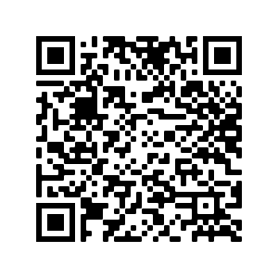
Hausaufgaben
Vocabulary Learning Homework (Y8, Term 2.2, Week 3)
Audio file
Audio file QR code:
Student worksheet
Quizlet link
In addition, revisit: Term 2.1 Week 5
Term 1.2 Week 4
Notes:
Link to answers: https://resources.ncelp.org/concern/resources/tx31qj54c?locale=en

