Slide 1
Practice Assessment
Year 8 French
Term 3 Applying Your Knowledge Test
Date updated: 14/06/21
Notes:
Notes:
These practice assessment questions closely mirror the format of the various sections in the Term 3 ‘Applying your knowledge’ Assessments. However, there are only a few question items per section in this practice sequence. The rubrics are almost exactly as they would appear in the real test.
The timings for each section have been left as for the real thing, in order for students to gain an appreciation of how long they would be working on each type of question. Please point out to them that working through the two example questions here may not take as long (though with any explanation and discussion as may be useful with the class factored in, it may be that longer is actually spent on each section than would be the case for the real test).
For the listening section, the audio is accessible via the ‘player’ button on the slide. The text is recorded only once; please click the play button again after 20 seconds have elapsed. N.B. Please advise students that the text is shorter than the one in the real assessment.
All of the vocabulary items are taken from the NCELP scheme of work leading up to the assessment week; these are not therefore frequency-referenced here.

Slide 2
Section A (Listening)
Part A
You will hear Abdel talk about going on holiday. Here are some activities he mentions (plus some that she does not mention!). You have 10 seconds to read the activities.
go on holiday with family / go on holiday alone / travel to Italy / travel to England / speak English / speak Italian
Write one activity into each space in the grid below. You must decide who does the activity, and when.
You will hear the story twice, with a 20 second gap in between.
 | in the past | in general | in the future
Abdel | 1. _____________ | 1. _____________ | 1. _____________
Abdel’s friend | 1. _____________ | 1. _____________ | 1. _____________
Abdel and his friend | 1. _____________ | 1. _____________ | 1. _____________
Notes:
Parfois, je pars seul en vacances, et parfois, je pars avec des amis. L’année dernière, en septembre, J’ai fait un voyage en Angleterre. J’ai voyagé en avion. L’année prochaine, nous allons en Italie parce que je veux apprendre la langue. Mon ami parle bien l’italien.

Slide 3
Section A (Listening)
1 mark = correctly assigning an activity to a person(s)
1 mark = correctly assigning an activity to a time period.
ANSWERS
 | in the past | in general | in the future
Abdel | 1. travel to England | 1. go on holiday alone | 1. going to England
Abdel’s friend | 1. _____________ | 1. speak Italian | 1. _____________
Abdel and his friend |  | 1. _____________ | 1. travel to Italy

Slide 4
Section A (Listening)
Part B
Now listen for a third time. Answer the questions in English.
 |  | Write as many details as you can. (2 marks per question)
a) | When and how did Abdel go on holiday last year? | Italy (1 mark), in September (1 mark)
b) | Why is Abdel going on holiday next year? | to learn (1 mark) the language(1 mark)

Slide 5
Section B (Reading)
0.5 marks per item
Part A
You are staying with a friend in France. She gives you a map of the town, but it isn’t very clear! Read the text and write the English for the words in bold in the right places.
J’habite dans une grande rue. Si tu sors de la maison, tu vas trouver trois bâtiments. Il y a une école entre une église et un marché.
Pour aller à la plage, on doit prendre le petit train. Le train attend à côté du marché.
Près de l’église, il y a beaucoup d’arbres. Devant les arbres, tu trouves un vieux pont.
house
Notes:
Word frequency (1 is the most frequent word in French): Plan [164]
Source: Londsale, D., & Le Bras, Y. (2009). A Frequency Dictionary of French: Core vocabulary for learners London: Routledge.

Slide 6
Section B (Reading)
Part A
You are staying with a friend in France. She gives you a map of the town, but it isn’t very clear! Read the text and write the English for the words in bold in the right places.
bridge
J’habite dans une grande rue. Si tu sors de la maison, tu vas trouver trois bâtiments. Il y a une école entre une église et un marché.
Pour aller à la plage, on doit prendre le petit train. Le train attend à côté du marché.
Près de l’église, il y a beaucoup d’arbres. Devant les arbres, tu trouves un vieux pont.
church
house
school
market
Notes:
Word frequency (1 is the most frequent word in French): Plan [164]
Source: Londsale, D., & Le Bras, Y. (2009). A Frequency Dictionary of French: Core vocabulary for learners London: Routledge.

Slide 7
Section B (Reading)
0.5 marks per item
Your friend texts you more information about the town. Read her message and answer the questions that follow.
Part B
Put a tick next to the things that can be found in this town at the moment.
Le musée est excellent. Il y a souvent des événements pour les enfants. Ils ont organisé plusieurs fêtes, et aujourd’hui, ils montrent un film en anglais. On va célébrer le 14 juillet au musée aussi. C’est une fête nationale en France.
À côté du musée, il y a un collège. Il n’y a pas d’université ici. C’est triste parce qu’il y a beaucoup de jeunes personnes ici.
a university
a secondary school
a museum
lots of young people
Notes:
Word frequency (1 is the most frequent word in French): Plan [1225]
Source: Londsale, D., & Le Bras, Y. (2009). A Frequency Dictionary of French: Core vocabulary for learners London: Routledge.

Slide 8
Section B (Reading)
Your friend texts you more information about the town. Read her message and answer the questions that follow.
Part C
Number these events in the order they happen. Write the numbers 1-3 in the boxes on the right (1 = happened first; 3 = will happen last).
Le musée est excellent. Il y a souvent des événements pour les enfants. Ils ont organisé plusieurs fêtes, et aujourd’hui, ils montrent un film en anglais. On va célébrer le 14 juillet au musée aussi. C’est une fête nationale en France.
À côté du musée, il y a un collège. Il n’y a pas d’université ici. C’est triste parce qu’il y a beaucoup de jeunes personnes ici.
parties for the children | 1
the 7th July celebration | 3
the English film | 2
Notes:
Word frequency (1 is the most frequent word in French): Plan [1225]
Source: Londsale, D., & Le Bras, Y. (2009). A Frequency Dictionary of French: Core vocabulary for learners London: Routledge.

Slide 9
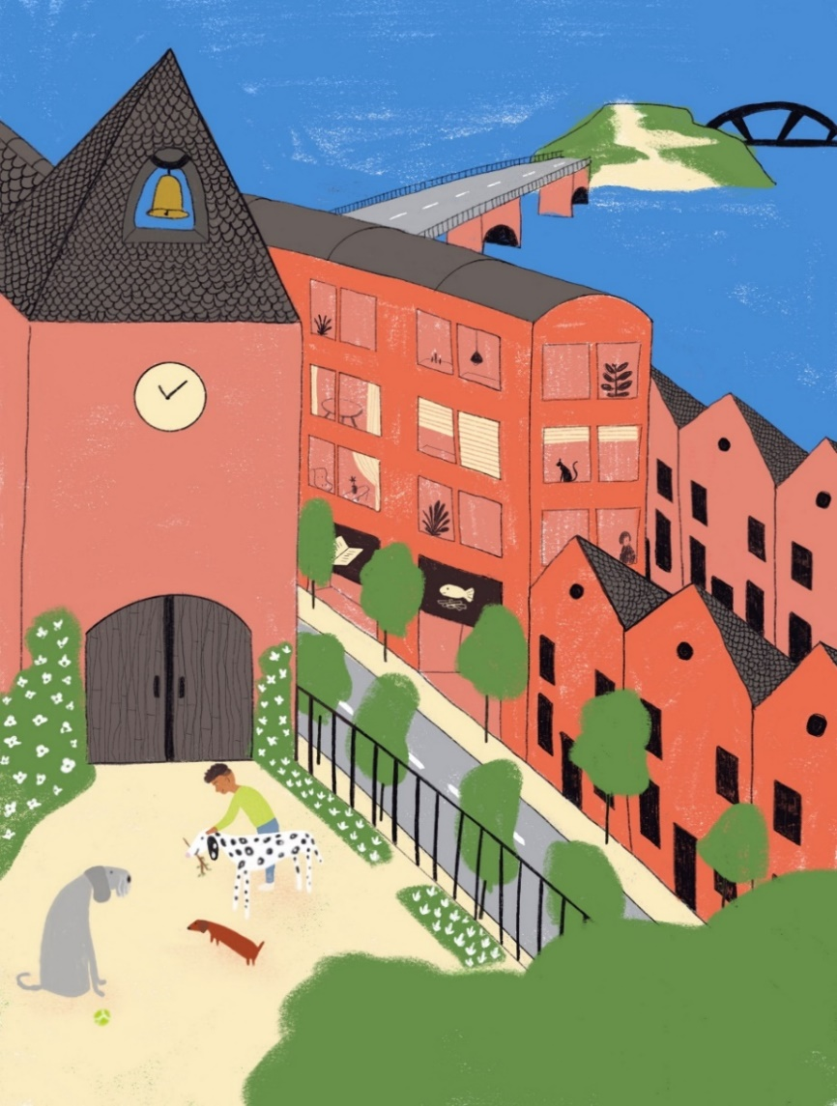
Section C (Writing)
Part A
Look at the picture and complete the missing words in the text. The number of gaps tell you how many letters are missing.
Amir est en v _ _ _ _ _ _ _ avec sa famille en ce moment. Il r _ _ _ _ dans un grand appartement avec t_ _ _ _ chiens. Il aime bien jouer avec les chiens dans le jardin. Le jardin est d _ _ _ _ _ _ _ l’appartement.
Aujourd’hui, Amir va sortir avec les chiens. Ils v _ _ _ à la plage.

Slide 10
Section C (Writing)
0.5 marks for an otherwise correctly-spelled word with a missing accent, or with an unnecessary accent added to a non-accented letter.
1 mark for an otherwise correctly-spelled word with an incorrect type of accent but on the appropriate letter.
Part A
Look at the picture and complete the missing words in the text. The number of gaps tell you how many letters are missing.
Amir est en vacances avec sa famille en ce moment. Il reste dans un grand appartement avec trois chiens. Il aime bien jouer avec les chiens dans le jardin. Le jardin est derrière l’appartement.
Aujourd’hui, Amir va sortir avec les chiens. Ils vont à la plage.

Slide 11
Section C (Writing)
0 marks for where knowledge of the meaning and use of a word is not demonstrated.
0.5 marks for where the meaning of a word is communicated but it is not used accurately (e.g., the tense or person is inaccurate).
1 mark for the use of a word where its meaning is fully and accurately communicated.
Part B
What happened last week? What will happen next week?
Write between one and three sentences in in French for each picture. Use all of the French words under the pictures. Write your sentences in the blank box on the right.
Try to show that you know what the words mean by writing full, interesting, and varied sentences that make sense. You can use your imagination if you like.
Last week
jouer / dernier / piano | Le garçon a joué du piano la semaine dernière. Il joue bien la musique.

Slide 12
Section C (Writing)
0 marks for where knowledge of the meaning and use of a word is not demonstrated.
0.5 marks for where the meaning of a word is communicated but it is not used accurately (e.g., the tense or person is inaccurate).
1 mark for the use of a word where its meaning is fully and accurately communicated.
Part B (continued)
What happened last week? What will happen next week?
Write between one and three sentences in French for each picture. Use all of the French words under the pictures. Write your sentences in the blank box on the right.
Try to show that you know what the words mean by writing full, interesting, and varied sentences that make sense. You can use your imagination if you like.
Next week
pour / magasins / samedi | Example: La fille va faire les magasins samedi prochain. Elle doit acheter un cadeau pour une amie.

Slide 13
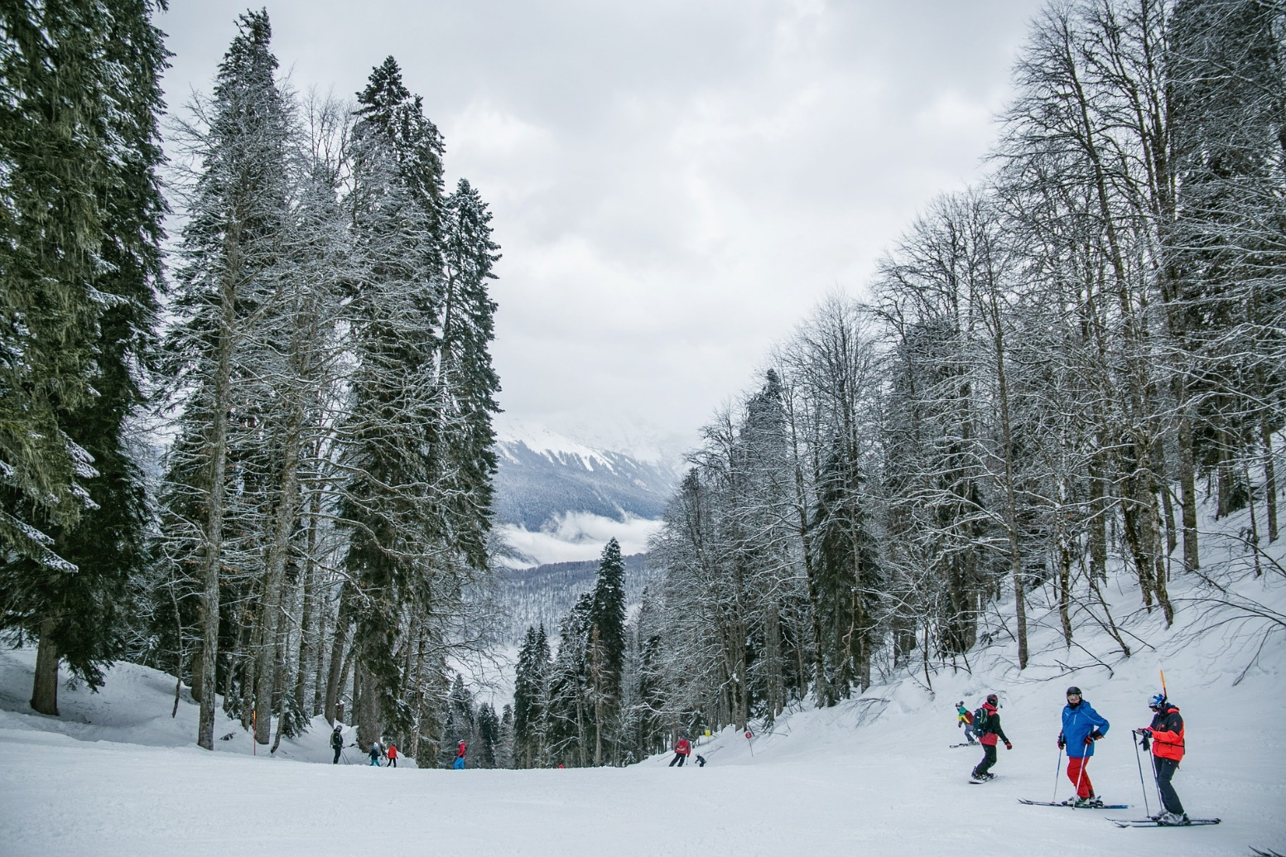
Section D (Speaking)
Look at the photo and follow the instructions below. For each idea you say, you will get 2 marks for expressing the meaning, and 1 mark for speaking accurately. In total (parts A & B combined), you will get 2 marks for speaking fluenty.
You have 2 minutes to prepare all of your answers before you speak. It doesn’t matter if you make mistakes! Just try to keep going and say something that you know how to say.

Slide 14
Section D (Speaking)
PART A
What can you see in this photo? Try to say at least 4 different things. (12 marks)
Here are some ideas about what you could say. You can say different things if you wish!
Say something about the weather.
Say what there is in the area.
Describe the people on the right.
Say where the people are.

Slide 15
Section D (Speaking)
PART B
Ask the man on the right 2 different questions. (6 marks).

Slide 16
Section D (Speaking)
For meaning:
2 marks awarded where the meaning of the idea is communicated with little effort required on the part of the listener.
1 mark awarded where the meaning of the idea is communicated with some effort required on the part of the listener.
0 marks awarded where the meaning of the sentence is not communicated.

Slide 17
Section D (Speaking)
For accuracy:
1 mark awarded where all or most of the features (vocabulary, grammar, pronunciation, intonation) are accurately produced.
0.5 mark awarded where some of the features (vocabulary, grammar, pronunciation, intonation) are accurately produced.
0 marks awarded where few or none of the features (vocabulary, grammar, pronunciation, intonation) are accurately produced.

Slide 18
Section D (Speaking)
For fluency for both parts A & B combined:
2 mark awarded where speech does not contain many hesitations in between clauses and/or only contains a small number of self-corrections.
1 mark awarded where there are a few hesitations and/or self-corrections
0 marks awarded where speech contains many hesitations or self-corrections.

Slide 19
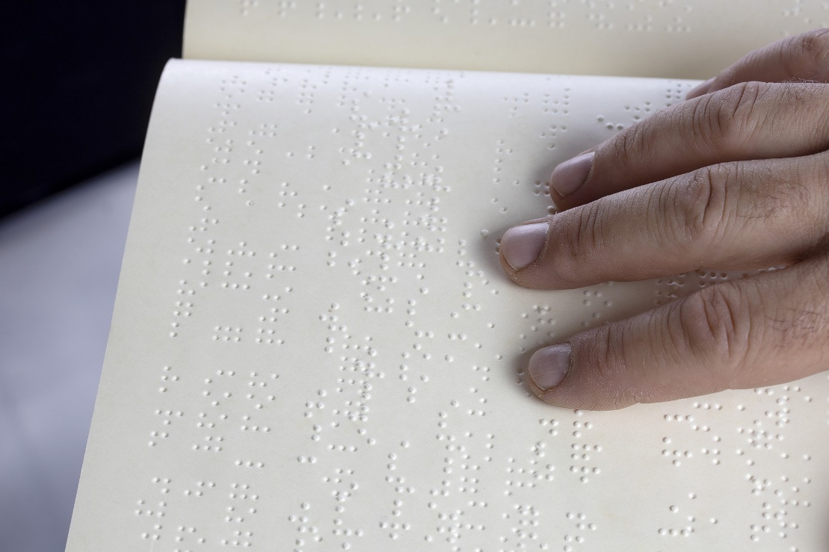
Section E (Reading Aloud and Comprehension)
PART A
Read the following text aloud.
You won’t know some of the words – don’t worry! Just do your best to read them aloud as you think they should sound in French.
You will get marks for understandable and fluent pronunciation.
PART B
Now say, in English, any 2 facts mentioned in the text about Louis Braille.
Louis Braille est un professeur et inventeur français. Il a créé un système d’écriture pour les hommes et les femmes qui n’ont pas le sens de la vue.
Notes:
Word frequency (1 is the most frequent word in French): inventeur [>5000], système [289], écriture [2716], sens [243]
Source: Londsale, D., & Le Bras, Y. (2009). A Frequency Dictionary of French: Core vocabulary for learners London: Routledge.

Slide 20
Section D (Speaking)
PART A (MARKING)
1 mark awarded where words are pronounced very clearly and comprehensibly, with all or most of the features (SSCs, liaison, stress patterns) accurately produced.
Plus 1 mark awarded where the sentence is read very fluently (with few hesitations and/or self-corrections)
Plus 0.5 mark awarded where the sentence is read quite fluently (with some hesitations and/or self-corrections).
0.5 mark awarded where words are pronounced quite clearly and comprehensibly, with most of the features (SSCs, liaison, stress patterns) accurately produced.
Plus 1 mark awarded where the sentence is read very fluently (with few hesitations and/or self-corrections).
Plus 0.5 mark awarded where the sentence is read quite fluently (with some hesitations and/or self-corrections).
0 marks awarded where words are pronounced neither clearly nor comprehensibly, with few of the features (SSCs, liaison, stress patterns) accurately produced.
0 marks awarded for fluency where the unit is not awarded any marks for comprehensibility.

Slide 21
Section D (Speaking)
This text is composed of roughly 80% words which have been covered in the NCELP Scheme of Work up to the point of these assessments. The other 20%, which have not yet been covered, are shaded grey in the marking grid below. These unfamiliar words are transparent cognates of English, whose SSCs have been covered in the SoW to date. The cognates provide a good test of SSC knowledge (as learners must inhibit their English SSCs), and aid comprehension for Part B where they must demonstrate understanding.
 | Idea | Notes on tolerance
1. | Louis Braille est un professeur et inventeur français. | liaison is required with ‘est un’
2. | Il a créé un système d’écriture
3. | pour les hommes et les femmes qui n’ont pas le sens de la vue. | liaison is required with ‘les hommes’

Slide 22
Section D (Speaking)
PART B (MARKING)
Award 0.5 marks for each idea correctly identifies in the text, up to a maximum of 1 point for ideas from a single sentence.
The ideas can be expressed using any reasonable English formulation. Given the use of narrative present in the text, it is OK if the present tense is used in the English renderings (or the past, or a mixture).
1 | Louis Braille is a [French] [teacher] and [inventor].
2 | He [created] a [writing system] for men and women who [don’t have] a [sense of sight]
Notes:
When you do this part of the test, you will probably want to record it to send to your teacher. There are many ways to record and send audio. Make sure you use the one your teacher recommends. If she or he doesn’t have a preference, there is a suggested platform to use given in the instructions on the test that you are now ready to download. Good luck for your test. Now, close the video and click next on the page to download and complete your assessment.

