Slide 1
Phonics
SSC /eu/
Y7 German
Term 2.2 - Week 4 - Lesson 45
Author name(s): Inge Alferink / Rachel Hawkes
Date updated: 25/03/20

Slide 2
eu
Deutschland
Notes:
Introduce and elicit the pronunciation of the individual SSC ‘eu’ and then present and practise the pronunciation of the source word ‘Deutschland’.
A possible gesture for this would be to act as though you are addressing Germany, saying ‘Oy! Deutschland!’ and jabbing your finger into the air (joyfully) twice, once on ‘Oy!’ and once on the first syllable of Deutschland.

Slide 3
eu
Euro
heute
[today]
Deutschland
Freund
Leute
neu
Notes:
Introduce and elicit the pronunciation of the individual SSC ‘eu’ and then the source word again (with gesture, if using). Then present and elicit the pronunciation of the five cluster words. The cluster words have been chosen for their high-frequency, from a range of word classes, with the SSC (where possible) positioned within a variety of syllables within the words(e.g. initial, 2nd, final etc..) and additionally, we have tried to use words that build cumulatively on previously taught SSCs (see the Phonics Teaching Sequence document) and do not include new SSCs. Where new SSCs are used, they are often consonants which have a similar symbol-sound correspondence in English.
Word frequency rankings (1 is the most common word in German): Deutschland [N/A proper noun]; Euro [333] heute [121]; Freund [327]; neu [80]; Leute[163]. Source: Jones, R.L. & Tschirner, E. (2006). A frequency dictionary of German: core vocabulary for learners. Routledge

Slide 4
eu
Euro
heute
Deutschland
Freund
Leute
neu
Notes:
Without pictures to focus on the SSC alone.

Slide 5
eu
Euro
heute
Deutschland
Freund
Leute
neu
Notes:
Without sound to elicit the pronunciation.

Slide 6
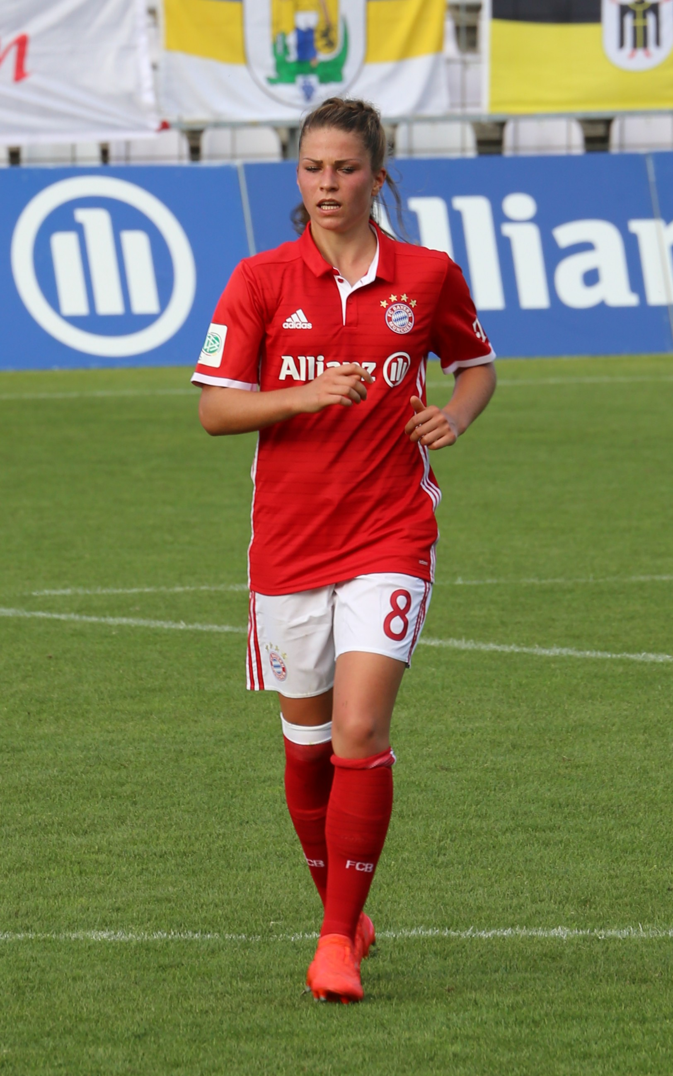
Phonetik
sprechen
Ich heiße Melanie Leupolz. Ich spiele für Deutschland Fußball aber ich spiele heute mit neun Freunden Schlagzeug!
Notes:
Phonetik Read aloud task focusing on this week’s SSC. Melanie Leupolz does play football for the German national team and Bayern München. However, the drum playing with nine friends is poetic licence, and includes all of the words from this week’s sequence that contain the SSC EU!
Rufus46 / CC BY-SA (https://creativecommons.org/licenses/by-sa/3.0)
Click the speech bubble to hear the recording. Transcript:
Ich heiße Melanie Leupolz. Ich spiele Fußball für Deutschland aber ich spiele heute mit neun Freunden Schlagzeug!

