Slide 1
Phonics: ‘GA’, ‘GO’, ‘GU’ SSCs
Updated: 17/11/2019
Nick Avery & Rachel Hawkes

Slide 2
ga
gato
ganar
amiga
Notes:
Introduce and elicit the pronunciation of the individual SSC ‘ga’ and then the source word again (with gesture, if using). Then present and elicit the pronunciation of the five cluster words.
The cluster words have been chosen for their high-frequency, from a range of word classes, with the SSC (where possible) positioned within a variety of syllables within the words (e.g. initial, 2nd, final etc..) and additionally, we have tried to use words that build cumulatively on previously taught SSCs (see the Phonics Teaching Sequence document) and do not include new SSCs. Where new SSCs are used, they are often consonants which have a similar symbol-sound correspondence in English.

Slide 3
ga
gato
ganar
amiga
Notes:
Without the images, students focus this time again closely on the SSC and the cluster words.

Slide 4
ga
gato
ganar
amiga
Notes:
Without the images or sound, students have to pronounce the words themselves.

Slide 5
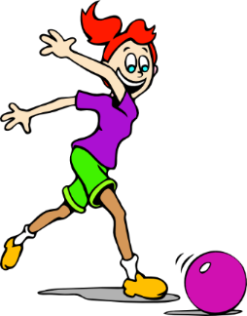
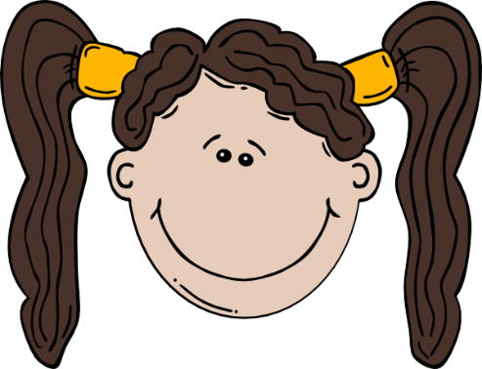
go
largo
gol
conmigo
[with me]
Notes:
Introduce and elicit the pronunciation of the individual SSC ‘go’ and then the source word again (with gesture, if using). Then present and elicit the pronunciation of the five cluster words.
The cluster words have been chosen for their high-frequency, from a range of word classes, with the SSC (where possible) positioned within a variety of syllables within the words (e.g. initial, 2nd, final etc..) and additionally, we have tried to use words that build cumulatively on previously taught SSCs (see the Phonics Teaching Sequence document) and do not include new SSCs. Where new SSCs are used, they are often consonants which have a similar symbol-sound correspondence in English.

Slide 6
go
largo
gol
conmigo
Notes:
Without the images, students focus this time again closely on the SSC and the cluster words.

Slide 7
go
largo
gol
conmigo
Notes:
Without the images or sound, students have to pronounce the words themselves.

Slide 8
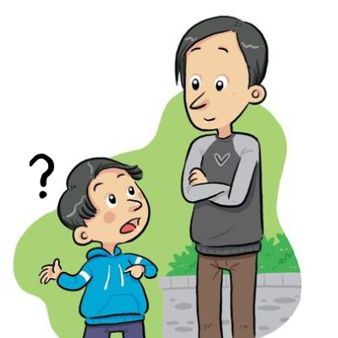
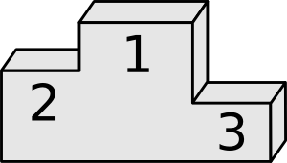
gu
segundo
seguro
[sure, safe]
preguntar
Notes:
Introduce and elicit the pronunciation of the individual SSC ‘gu’ and then the source word again (with gesture, if using). Then present and elicit the pronunciation of the five cluster words.
The cluster words have been chosen for their high-frequency, from a range of word classes, with the SSC (where possible) positioned within a variety of syllables within the words (e.g. initial, 2nd, final etc..) and additionally, we have tried to use words that build cumulatively on previously taught SSCs (see the Phonics Teaching Sequence document) and do not include new SSCs. Where new SSCs are used, they are often consonants which have a similar symbol-sound correspondence in English.

Slide 9
gu
segundo
seguro
preguntar
Nick Avery
Notes:
Without the images, students focus this time again closely on the SSC and the cluster words.

Slide 10
gu
segundo
seguro
preguntar
Nick Avery
Notes:
Without the images or sound, students have to pronounce the words themselves.

Slide 11
Escucha.
Marca ‘GA’, ‘GA’ o ‘GU’.
Escucha otra vez.
Escribe la palabra.
escuchar
 | GA | GO | GU
¿Cómo se dice en inglés?
go
1
conmi___
with me
se___ro
gu
sure, safe
2
go
3
___l
goal
ga
4
__to
cat
pre___ntar
5
gu
to ask
se___ndo
second
6
gu
ami__
7
ga
(female) friend
__nar
8
ga
to win
go
9
lar__
long
lu___r
10
ga
place
Notes:
These are high-frequency words that some students will acquire incidentally. They are not counted within the core expected learning of 400 words in Y7, so the additional challenge of translating into English shouldn’t be seen as a test, but as an additional opportunity.
See the next slide for a variation of this activity.

Slide 12
Escucha.
Marca ‘GA’, ‘GA’ o ‘GU’.
Escucha otra vez.
Escribe la palabra.
escuchar
 | GA | GO | GU
¿Cómo se dice en inglés?
1
conmigo
with me
seguro
sure, safe
2
3
gol
goal
4
gato
cat
5
preguntar
to ask
6
segundo
second
7
amiga
(female) friend
8
ganar
to win
9
largo
long
10
lugar
place
Notes:
Variation: students have to write the whole word.
These are high-frequency words that some students will acquire incidentally. They are not counted within the core expected learning of 400 words in Y7, so the additional challenge of translating into English shouldn’t be seen as a test, but as an additional opportunity.

Slide 13
escuchar
¿Qué escuchas? ‘GA’, ‘GO’ o ‘GU’?
GU
1
Pregunta mucho en clase.
S/he asks a lot in class.
Notes:
Sentence-level phonics practice (whole class activity). Students first listen and decide which target SSC(s) they hear. They are then shown the sentence. Before showing its translation, it is worth seeing if it can be elicited from students. On the next slide, the same sentence appears with target SSCs missing. Students have to read the sentence aloud in chorus, recalling the missing SSCs as they read aloud.

Slide 14
leer / hablar
gu
Pre___nta mucho en clase.
1

Slide 15
escuchar
¿Qué escuchas? ‘GA’, ‘GU’ o ‘GA’ y ‘GU’?
2
GA y GU
No quiero un gato. Estoy seguro.
I don’t want a cat. I’m sure.

Slide 16
leer / hablar
ga
No quiero un ___to. Estoy se___ro.
gu
2

Slide 17
escuchar
¿Qué escuchas? ‘GA’, ‘GO’ o ‘GA’ y ‘GO’?
3
GA y GO
Una amiga estudia conmigo.
A (female) friend studies with me.

Slide 18
leer / hablar
ga
go
Una ami___ estudia conmi___.
3

Slide 19
escuchar
¿Qué escuchas? ‘GA’, ‘GO’ o ‘GA’ y ‘GO’?
GA y GO
4
¡Gol! ¡Gana el Real Madrid!
Goal! Real Madrid win!

Slide 20
leer / hablar
Go
Ga
___l! ¡___na el Real Madrid!
4

Slide 21
escuchar
¿Qué escuchas? ‘GA’, ‘GU’ o ‘GA’ y ‘GU’?
GU
5
‘B’ es la segunda letra.
‘B’ is the second letter.

Slide 22
leer / hablar
‘B’ es la se___nda letra.
gu
5

