Slide 1
Phonics
Revisiting SSCs [l], [ll]
Y7 Spanish
Term 3.1 - Week 3
Author names: Nick Avery /Rachel Hawkes
Date updated: 16/05/20

Slide 2
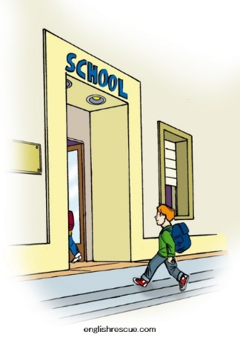
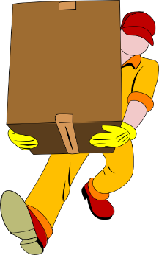
ll
llegar
llave
© www.englishrescue.com
llamar
llevar
amarillo
ella
Notes:
Introduce and elicit the pronunciation of the individual SSC ‘LL’ and then the source word again (with gesture, if using). Then present and elicit the pronunciation of the five cluster words.
The cluster words have been chosen for their high-frequency, from a range of word classes, with the SSC (where possible) positioned within a variety of syllables within the words(e.g. initial, 2nd, final etc..) and additionally, we have tried to use words that build cumulatively on previously taught SSCs (see the Phonics Teaching Sequence document) and do not include new SSCs. Where new SSCs are used, they are often consonants which have a similar symbol-sound correspondence in English.

Slide 3
ll
llegar
llave
llamar
llevar
amarillo
ella
Notes:
Without the images, students focus this time again closely on the SSC and the cluster words.

Slide 4
ll
llegar
llave
llamar
llevar
amarillo
ella
Notes:
Without the images or sound, students have to pronounce the words themselves.

Slide 5
l
salir
palabra
lista
libro
luz
luego
[then]
Notes:
Introduce and elicit the pronunciation of the individual SSC ‘L’ and then the source word again (with gesture, if using). Then present and elicit the pronunciation of the five cluster words.
The cluster words have been chosen for their high-frequency, from a range of word classes, with the SSC (where possible) positioned within a variety of syllables within the words(e.g. initial, 2nd, final etc..) and additionally, we have tried to use words that build cumulatively on previously taught SSCs (see the Phonics Teaching Sequence document) and do not include new SSCs. Where new SSCs are used, they are often consonants which have a similar symbol-sound correspondence in English.

Slide 6
l
salir
palabra
lista
libro
luz
luego
Notes:
Without the images, students focus this time again closely on the SSC and the cluster words.

Slide 7
l
salir
palabra
lista
libro
luz
luego
Notes:
Without the images or sound, students have to pronounce the words themselves.

Slide 8
Escucha y completa las frases.
¿Qué tipo de palabra(s) es/son?
¿Las palabras tienen [L] o [LL]?
¿Cómo se dice en inglés?
nombre
nombre
pronombre
1
llamar
Es normal ________ por la mañana.
verbo
adjetivo
verbo
It’s normal to call in the morning.
2
luz
¿Dónde está la ____? ¡Está muy oscuro aquí!
Where’s the light? It’s very dark here!
3
amarillos
La persona sólo da libros __________ a los chicos.
The person only gives yellow books to the boys.
4
ella
¿Cómo está? … ¿Quién, _____? Está bien.
¿How is s/he? … Who, her? She’s well/fine.
5
lista
¿Tienes una _____ de películas nuevas?
Do you have a list of new films?
6
Salir
______ los lunes por la noche no es normal.
Going out on Monday nights isn’t normal.
Notes:
Ask students to write the missing word. Then ask them to give the English translation and word class of the phonics word. See next slide for a variation of the same activity.
All words included in this activity are previously taught vocabulary items or phonics words. ‘Normal’ [1000] is a cognate.
Weeks in which vocabulary items were taught:
mañana, noche – 2.1.4
dónde, está – 1.1.1
cómo, muy – 1.1.2
aquí, chico – 1.2.3
oscuro – 2.2.5
profesor/a – 1.2.2
sólo, amarillo – 2.1.3
da, a – 1.2.7
quién, bien – 1.1.6
tienes, nuevo – 1.1.4
película – 1.2.6
lunes – 2.2.3
no – 1.2.1

Slide 9
Escucha y completa las frases.
¿Qué tipo de palabra(s) es/son?
¿Las palabras tienen [L] o [LL]?
¿Cómo se dice en inglés?
nombre
nombre
pronombre
1
Es normal llamar por la mañana.
verbo
adjetivo
verbo
It’s normal to call in the morning.
2
¿Dónde está la luz? ¡Está muy oscuro aquí!
Where’s the light? It’s very dark here!
3
La persona sólo da libros amarillos a los chicos.
The person only gives yellow books to the boys.
4
¿Cómo está? … ¿Quién, ella? Está bien.
¿How is s/he? … Who, her? She’s well/fine.
5
¿Tienes una lista de películas nuevas?
Do you have a list of new films?
6
Salir los lunes por la noche no es normal.
Going out on Monday nights isn’t normal.
Notes:
Ask students to write the missing word. Then ask them to give the English translation and word class of the phonics word. See next slide for a variation of the same activity.
All words included in this activity are previously taught vocabulary items or phonics words. ‘Normal’ [1000] is a cognate.
Weeks in which vocabulary items were taught:
mañana, noche – 2.1.4
dónde, está – 1.1.1
Cómo, muy – 1.1.2
Aquí, chico – 1.2.3
oscuro – 2.2.5
persona – 1.2.3
sólo, amarillo – 2.1.3
da, a – 1.2.7
quién, bien – 1.1.6
tienes, nuevo – 1.1.4
película – 1.2.6
lunes – 2.2.3
no – 1.2.1

Slide 10
Escucha y escribe las palabras en la columna correcta. Luego, escribe también la palabra en inglés.
escuchar
[L] |  | [LL]
español | inglés | español | inglés
listo
ready
llave
key
letra
letter
botella
bottle
regalo
gift
llamar
to call, calling
tranquilo
calm
amarillo
yellow
julio
July
paella
paella
iglesia
church
caballo
horse
Notes:
The activity aims to help students practise distinguishing between between the SCCs revisited this week, [LL] and [L]. Students listen to the recording and write down the words in the corresponding column. Then, students can write the meaning in English.
Answers appear in the order in which words are said in the audio recording.
All words included in this activity are previously taught vocabulary items or phonics words. ‘Paella’ is a word that might be challenging. It has appeared in one activity in 2.2.3.
Weeks in which vocabulary items were taught:
listo [1684] – 1.1.2
letra [977]– 1.1.4
regalo [1986]– 1.2.7
iglesia [437]– 1.2.5
tranquilo [1073] – 1.1.2
julio [659]– 3.1.1
llave– SCC 1.1.4 and 3.1.3
botella [1878]– 1.1.5
llamar – SCC 1.1.4 and 3.1.3
amarillo [1381]– 2.1.3
caballo [907] – 1.1.5

Slide 11
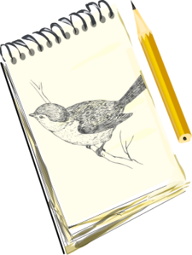
¿Qué es, y cómo es?
escribir
[interesting]
Es una película interesante.
Es un bolígrafo amarillo.
Es una p_ _ _ _ _ _ _ i_ _ _ _ _ _ _ _ _ _
1
Es un b_ _ _ _ _ _ _ _ a_ _ _ _ _ _ _
5
[beautiful]
Es un edificio feo.
2
Es un e_ _ _ _ _ _ _ f_ _
Es una v_ _ _ _ h_ _ _ _ _ _
6
Es una vista hermosa.
[ugly]
Es un periódico barato.
3
Es un p_ _ _ _ _ _ _ _ b_ _ _ _ _
Es un p_ _ _ _ a_ _ _
7
Es un plato azul.
[cheap]
Es una ventana grande.
4
Es una v_ _ _ _ _ _ g_ _ _ _ _
Es un d_ _ _ _ _ f_ _ _ _ _
Es un dibujo famoso.
8
[big]
[famous]
Notes:
Vocabulary revision activity. This activity revisits a number of previously taught nouns and adjectives. It can be used to also remind students of post-nominal position of adjectives in Spanish and gender agreement (where relevant).
Extension: ask students for their own examples of such noun-verb combinations.
Word, when previously taught and frequency ranking:
bolígrafo 1.1.4 [>5000]
amarillo 2.1.3 [1381]
edifico 1.2.6 [857]
feo 1.2.4 [2373]
periódico 1.1.5 [1026]
barato 1.2.4 [2164]
película 1.2.6 [543]
interesante 1.2.6 [616]
vista 1.2.6 [408]
hermoso 2.1.2 [980]
plato 1.2.6 [1808]
azul 2.1.3 [811]
dibujo 2.1.4 [1726]
famoso 1.2.4 [997]

