Slide 1
Phonics
Revision of long and short vowels
Y7 German
Term 2.2 - Week 5 - Lesson 49
Author name(s):
Jenny Hopper / Rachel Hawkes /Stephen Owen
Date updated: 25/04/20

Slide 2
Wie sagt man das?
German vowels (with or without umlauts) can be ____ or ____ .
short
long
Vowels are short when followed by more than one __________, e.g., lassen, trinken, Kirche, fünf.
consonant
Vowels are long when:
there is a double ______
or when followed by the letter ___
or by a single ___________
vowel (no examples of ‘uu’ in German)
‘h’, e.g., Uhr, nehmen
consonant, e.g., absolut, spät.
Notes:
Students met this concept in Week 1, when they were taught the long/short ‘a’ SSC. It is revisited here, with further explanation. The next two slides will practise differentiating these sounds in common words.

Slide 3
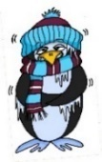
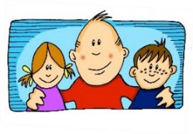
e
e
a
a
sagen
kalt
geben
denken
i
i
o
o
u
wir
u
finden
wo?
Kopf
ü
ü
ö
ö
fünf
du
Punkt
Tür
ä
ä
schön
plötzlich
spät
lächeln
Notes:
The long and short vowel sounds in German are practised here in familiar words, with audio. Students should listen and repeat.

Slide 4
e
e
a
a
sagen
kalt
geben
denken
i
i
o
o
u
wir
u
finden
wo?
Kopf
ü
ü
ö
ö
fünf
du
Punkt
Tür
ä
ä
schön
plötzlich
spät
lächeln
Notes:
This version of the slide is without audio; students should chant the words chorally first, as they appear, then perhaps individually (the teacher quizzing students on individual words; it will be important to continue to juxtapose the long and short forms of each vowel in this practice).

Slide 5
Phonetik
hören
Wie sagt man das?
 | i [lang] | i [kurz]
 | o [lang] | o [kurz]
1
Linz
1
Iserlohn
2
Ingolstadt
2
Ingolstadt
3
Iserlohn
Oberammergau
3
4
Interlaken
Oldenburg
4
5
Innsbruck
Ottendorf
5
Notes:
Phonetik - Listen first, then read aloud This is a phonics recap of long and long and short i and o: Towns listed are from Germany, Austria and Switzerland. Students may like to do an extension research task to identify which towns they know (e.g from the football team) and/or where the towns are situated.
Students are asked to listen and decide if they hear long or short ‘I’ and ‘o’.
The city names appear together with the answer. Students can have one minute in pairs to re-read aloud all the cities for additional practice.
Note: Students are not expected to transcribe the cities.

Slide 6
Phonetik
lesen / sprechen
Wie sagt man das?
 | a [lang] | a [kurz]
Hamburg
Graz
Kassel
Hannover
Aachen
 | e [lang] | e [kurz]
Genf
Bremen
Gelsenkirchen
Essen
Regensburg
1
1
2
2
3
3
4
4
5
5
Notes:
Phonetik - Read aloud This is a phonics recap of long and short a and e: Towns listed are from Germany, Austria and Switzerland. Students may like to do an extension research task to identify which towns they know (e.g from the football team) and/or where the towns are situated.
Students are asked to read aloud each city, either chorally or in pairs. The table prompts ‘lang’ and ‘kurz’ are there to remind students to think about their vowels before saying them.
Audio to check is then available upon clicking each word, and answers are animated.
Note: Two of the towns have examples of both long and short ‘e’.

Slide 7
Was passt nicht in die Reihe?
Phonetik
1
1.
Saal
deshalb
sagen
2.
bisschen
Familie
trinken
3.
sechs
elf
zehn
4.
schlafen
halten
lassen
5.
nehmen
geben
helfen
Notes:
Odd One Out Students should be encouraged to practise pronouncing these words out loud, individually or in pairs, to decide which is the odd one out in each row (Reihe). Students have met this task type before and the instruction ‘Was passt nicht?’ Teachers can elicit the instruction meaning from students. Answers are animated to shade the odd one out. Words are taken from this week’s three vocabulary sets and additionally from phonics cluster words. Teachers may want to elicit meanings, though they will only expect students to know those that are in this week’s sequence.

Slide 8
Was passt nicht in die Reihe?
Phonetik
2
6.
offen
groß
locker
7.
zuerst
hundert
Uhr
8.
mögen
zwölf
öffnen
9.
lspät
fährt
lässt
10.
führen
Küche
fünf
Notes:
This slide continues the exercise from the previous one.

Slide 9
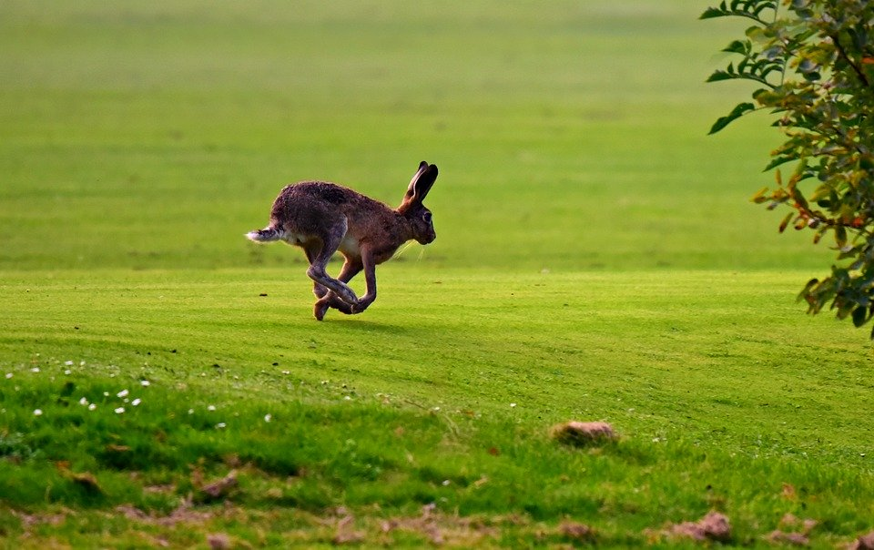
Zungenbrecher
Phonetik
Auf dem Rasen rasen Hasen, atmen rasselnd durch die Nasen.
Notes:
Opportunity to practise long and short ‘a’ sounds, but note that ‘atmen’ does not follow the standard rules owing to its Sanskrit origins. Auf dem Rasen rasen Hasen, atmen rasselnd durch die Nasen.
There are two recordings of this tongue twister – one slower, one faster.
Frequency: der Rasen [>4029]; rasen [>4029]; atmen [2454]; durch [56]; rasselnd[>4029] die Nase [1530]
Translation: On the lawn hares are racing, breathing raspingly?noisily? through their noses
Images from www.pixabay.com
https://creativecommons.org/licenses/by-nd/2.0/legalcode

Slide 10
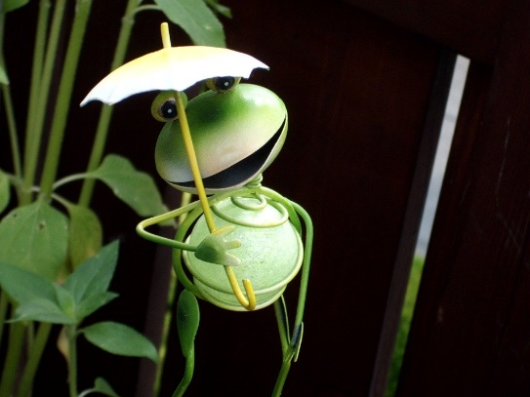
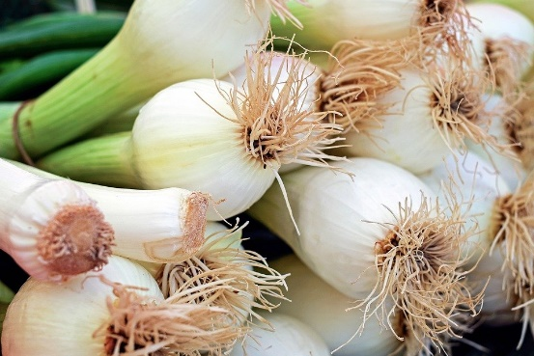
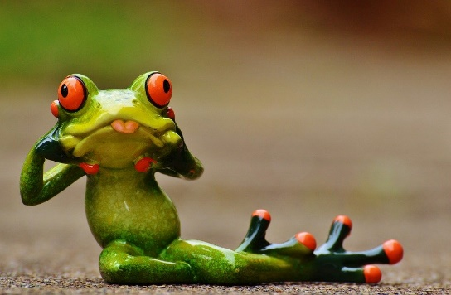
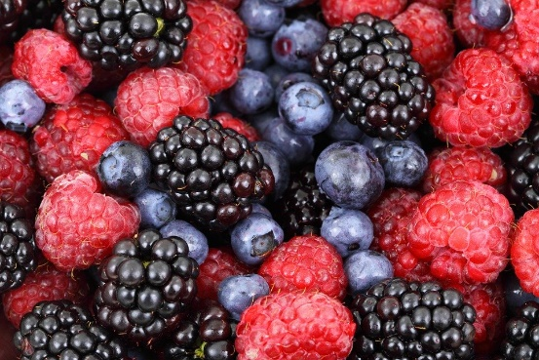
Zungenbrecher
Phonetik
Fromme Frösche fressen
frische Frühlingszwiebeln,
aber freche Frösche fressen
frische Früchte.
Notes:
SSCs: o - ö - i - ü - e Frequency:
fromm [>4029] Frosch [>4029] fressen [3448] frisch [1297] Frühling [3975] Zwiebel [3382] aber [32] frech [>4029] Frucht [3876]
There are two recordings of this tongue twister – one slower, one faster.
Translation:
Pious frogs eat
fresh spring onions,
but eat naughty frogs
fresh fruits.
Images www.pixabay.com

