Slide 1
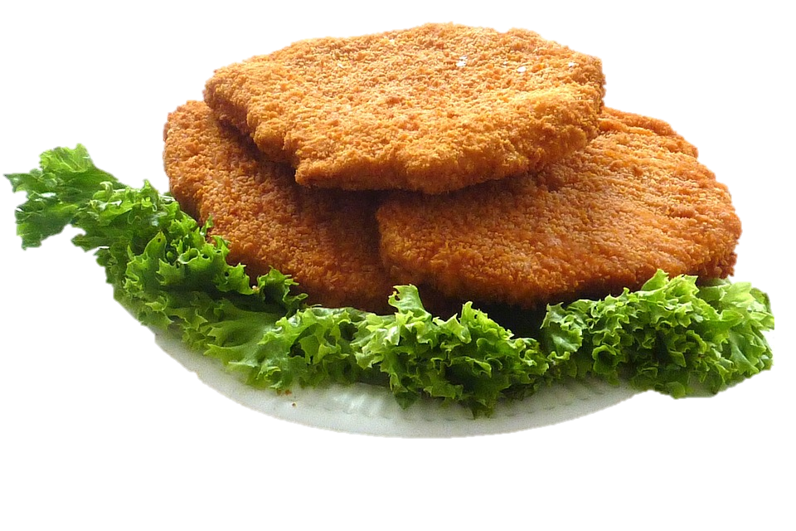
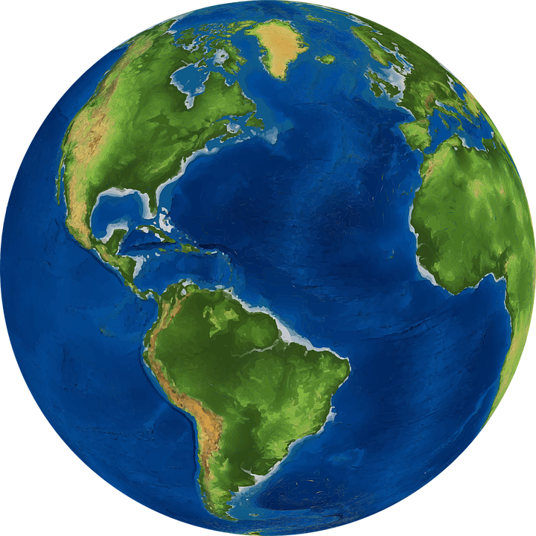
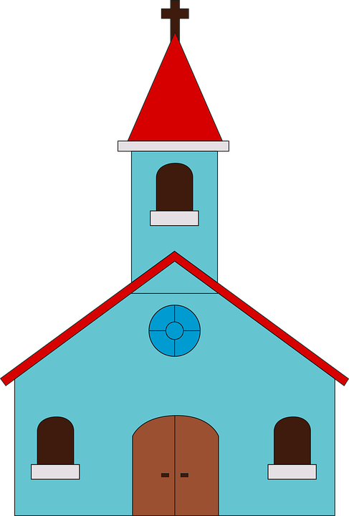
Person A
Person B
 | du sagst/fragst: | du antwortest:
1 |  | six worlds
2 |  | ten churches
3 | x13 | two windows
4 | x 7 | eight schnitzels
5 |  | eleven tables
6 |  | nine arms
 | du sagst/fragst: | du antwortest:
1 | x 9 | ten heads
2 |  | two stones
3 | x 5 | three pupils
4 |  | four bodies
5 |  | sixteen suns
6 | x 17 | five religions

