Slide 1
Identität:
Das Oktoberfest in Deutschland
Year 10 Term 1.1 Week 2 Lesson 3
Charlotte Moss / Janine Turner / Rachel Hawkes
Artwork: Steve Clarke
Date updated: 30/1/2023
Notes:
Artwork by Steve Clarke. All additional pictures selected are available under a Creative Commons license, no attribution required. Native-speaker teacher feedback provided by Stephanie Cross.
Learning outcomes
Revisit: Plural rules 1-3
Revisit: WH-questions Revisit: WO2
Revisit: Numbers
Phonics: SSC: [w] vs [v]
[link to grammar: question words]
[z]
[link to grammar: numbers 20+]
New vocabulary: Bayern [624] Bodensee [n/a] Donau [n/a] Köln [n/a] München [n/a] Ostsee [n/a] Rhein [n/a] Schnitzel [n/a] U-Bahn [n/a] Volk [1032] Weise [468] Wurst [3923] national [891] Minderheit (H) [4256] bayrisch (H) [1383] Berliner (H) [1190] speziell (H) [815] ursprünglich (H) [1332]
Thematic revisited vocabulary: liegen [6] Art [260] Grund [249] Kleidung [2820] Kultur [594] Milliarde, Mrd. [453] Million, Mio. [209] Norden, Nord- [1516] Nummer [806] Osten, Ost- [1208] Projekt [720] Religion [1976] Schloss [1907] Stein [1181] Süden, Süd- [1771] Vergleich [383] Welt [164] Westen, West- [1010] bekannt [319] eigen [166] einzig [343] oft [223] acht [645] achtzig [3301] drei [106] dreißig [2046] dreizehn [4772] eins [774] elf [1507] fünf [274] fünfzig [2390] hundert [1107] neun [1053] neunzig [3028] null [1680] sechs [428] sechzehn [4924] sechzig [2448] sieben [611] siebzehn [n/a] siebzig [2609] tausend [1177] vier [200] vierzig [2907] zehn [333] zwanzig [1359] zwei [70] zwölf [1080] was für? [n/a]
Revisited function words: einige, wann, was, was für, wer, wie, wo, woher, wohin, viel(e), oft, warum Source: Jones, R.L & Tschirner, E. (2019). A frequency dictionary of German: Core vocabulary for learners. London: Routledge.
The frequency rankings for words that occur in this PowerPoint which have been previously introduced in NCELP resources are given in the NCELP SOW and in the resources that first introduced and formally re-visited those words.
For any other words that occur incidentally in this PowerPoint, frequency rankings will be provided in the notes field wherever possible.

Slide 2
Hausaufgaben
 | Antwort | benutzen | Personen | Wörter
heißt |  |  |  |  | positiv
einfacher |  |  |  |  | Leute
benutzt |  |  |  |  | unmöglich
bleibt |  |  |  |  | denken
ganz inklusiv |  |  |  |  | unterr-ichten
In der deutschen Sprache haben Substantive* unterschiedlichen* Formen, wie „Freunde“ für Männer und „Freundinnen“ für Frauen. Aber was soll man sagen, wenn man über alle Menschen reden will? Einige Personen sagen, dass „Freunde“ Menschen aller Gender bedeutet*. Für andere bedeutet das nur Männer, und sie sagen lieber „Freundinnen und Freunde“. Für andere Personen sind Gendersternchen, wie „Freund*innen“ eine gute Lösung, weil das alle Gender bedeutet. Aber das ist nicht die einzige Lösung. Seit 2019 ist die Sprache in Hannover offiziell genderneutral. Dort benutzt man Formen wie „Studentinnen und Studenten“ nicht. Man empfiehlt* Wörter, die aus dem Verb stammen, wie „Studierende“ für Menschen, die studieren, und „Lehrende“ für Menschen, die lehren. Das ist leichter zu sagen und schreiben als „Lehrer*innen“ und ist immer noch genderneutral. Aber wenn Wörter wie „Lehrende“ nicht möglich sind, empfiehlt die Stadt das Gendersternchen.
Notes:
Timing: 5 minutes
Aim: to recap the homework.
Procedure: Teachers to revisit last week’s homework with students, as appropriate to their classes. Note: the full 10.1.1.1 homework sheet is here: https://resources.ncelp.org/concern/parent/p8418q90p/file_sets/kh04ds12s

Slide 3
Plural rules 1-3
Grammatik
You know six ways to form plurals in German. Here are the first three:
Rule 1
Add –e at the end (with or without an umlaut).
>90% masculine nouns >75% neuter nouns
der Grund→
die Gründe
Rule 2
Words ending in –EL or –EN or –ER may not change.
masculine/neuter
das Schnitzel→
die Schnitzel
Rule 3
Add either –n or –en to feminine nouns.
90% feminine nouns
die Weise →
die Weisen
Notes:
F+H
Timing: 3 minutes Aim: to recap plural noun formation for rules 1-3. Procedure: Click through the recap.

Slide 4
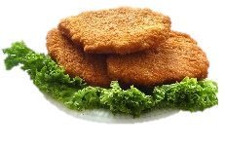
Was siehst du?
Frage deinen Partner und beantworte die Fragen.
sprechen
1. Ich sehe vier Schnitzel. Was siehst du?
2. Ich sehe fünf Schnitzel! Ich sehe drei Religionen. Was siehst du?
Person B
Person A
3. Ich sehe fünf Religionen. Ich sehe zwei Steine. Was siehst du?
4. Ich sehe auch zwei Steine! Ich sehe neun Köpfe. Was siehst du?
5. Ich sehe sieben Köpfe! Ich sehe drei Welten. Was siehst du?
6. Ich sehe elf Welten! Ich sehe zwei Fenster. Was siehst du?
 | du sagst/fragst | du antwortest
1 | x 4 | seven heads
2 |  | four windows
3 |  | five religions
 | du sagst/fragst | du antwortest
1 |  | eleven worlds
2 |  | five schnitzels
3 |  | two stones
7. Ich sehe vier Fenster!
x 9
Notes:
F+H
Timing: 8 minutes Aim: to practise plural noun formation for rules 1-3. This slide models the task for students. The next slide shows the student task, which is available as a separate handout. NB: the items under ‘du antwortest’ are jumbled so students have to identify the correct items. Procedure: Model pairwork activity, making sure students have understood how it works. Then use handouts for pairwork.

Slide 5
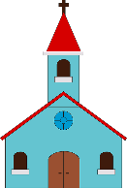
Person A
Person B
 | du sagst/fragst: | du antwortest:
1 |  | six worlds
2 |  | ten churches
3 | x13 | two windows
4 | x 7 | eight schnitzels
5 |  | eleven tables
6 |  | nine arms
 | du sagst/fragst: | du antwortest:
1 | x 9 | ten heads
2 |  | two stones
3 | x 5 | three pupils
4 |  | four bodies
5 |  | sixteen suns
6 | x 17 | five religions
Notes:
DO NOT DISPLAY DURING THE TASK

Slide 6
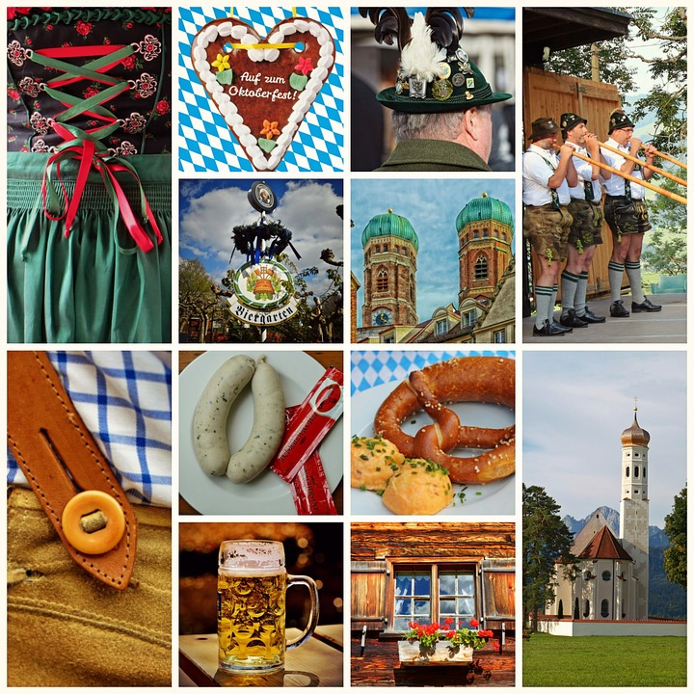
Oktoberfest
Übersetze den Oktoberfesttext ins Englische.
lesen
German | English
Was ist größer, das Oktoberfest in München oder der Weihnachtsmarkt in Nürnberg? | What is bigger, the Oktoberfest in Munich or the Christmas market in Nürnberg?
Jedes Jahr kommen mehr als sieben Millionen Personen zum nationalen Oktoberfest! | Every year more than seven million people come to the national Oktoberfest.
Im Dezember besuchen zwei Millionen Personen Nürnberg. | In December, two million people visit Nürnberg.
Warum heißt es Oktoberfest, wenn es im September beginnt? | Why is it called Oktoberfest when it begins in September?
Das erste Oktoberfest war am siebzehnten Oktober 1800. | The first Oktoberfest was on the 17th of October 1800.
Aber in München ist das Wetter oft schlecht im Oktober, deshalb beginnt das Volksfest jetzt am dritten Sonntag im September. | But in Munich the weather is often bad in October, so the Folk festival now starts on the third Sunday in September.
Notes:
H+F
Timing: 10 minutes
Aim: to practise some of this week’s grammar and vocabulary in a German to English translation task.
Procedure:
Students read the German sentences and translate them into English.
Click to reveal model answers.
Note:
i) The layout of the task mirrors that used in professional translating; the side-by-side and sentence-by-sentence format may help students to ensure that they pay attention to the detail of the text and account for every word, which will be important in GCSE translation tasks.
ii) There will be several correct ways of translating each sentence. The model answers provide a guide, but will not be the only correct answers.

Slide 7
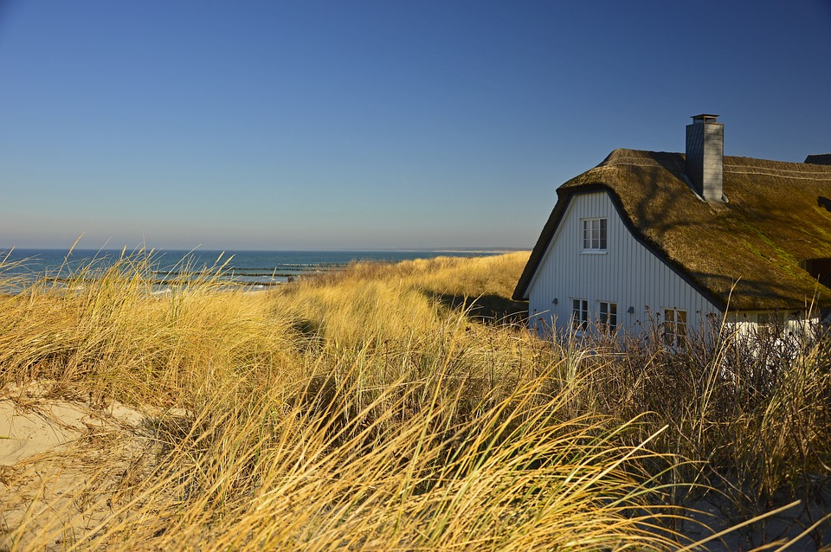
Die Ostsee
Using your knowledge of WO2, translate the sentences into German. Start each sentence with the part in bold.
schreiben
*birds – Vögel
English | German
You can walk 1130 kilometres at the Baltic Sea in North Germany. | An der Ostsee in Norddeutschland kann man 1130 Kilometer wandern.
Long beaches and beautiful coasts lie here. | Hier liegen lange Strände und schöne Küsten.
Where can you travel to, if you like water sports, if you like to eat fish? To Pelzerhaken!! | Wohin kann man fahren, wenn man Wassersport mag, wenn man gerne Fisch isst? Nach Pelzerhaken!
The Baltic Sea is famous for its birds* and for its beautiful coast. | Bekannt ist die Ostsee für ihre Vögel und für ihre schöne Küste.
Can you plan the weather there? No. | Kann man das Wetter dort planen? Nein.
There are places on the Baltic coast, like Usedom, which are called FKK (Freikörperkultur). Many holiday makers in Usedom wear no clothing. | An der Ostsee gibt es Orte, wie Usedom, die FKK heißen. In Usedom tragen viele Urlaubmacher keine Kleidung.
Notes:
H+F
Timing: 10 minutes
Aim: to practise WO2, WH- and yes/no questions, plurals, and some of this week’s vocabulary in an English to German translation activity.
Procedure:
Students read the sentences in English and translate them into German. They write the parts in bold at the beginning of their German sentences so that they use WO2.
Click to reveal model answers. Note: there will be several correct ways of translating each sentence. The model answers provide a guide, but will not be the only correct answers.
Word frequency of unknown words (1 is the most frequent word in German): Vogel [1701]
Source: Jones, R.L. & Tschirner, E. (2019). A frequency dictionary of German: core vocabulary for learners. Routledge

Slide 8
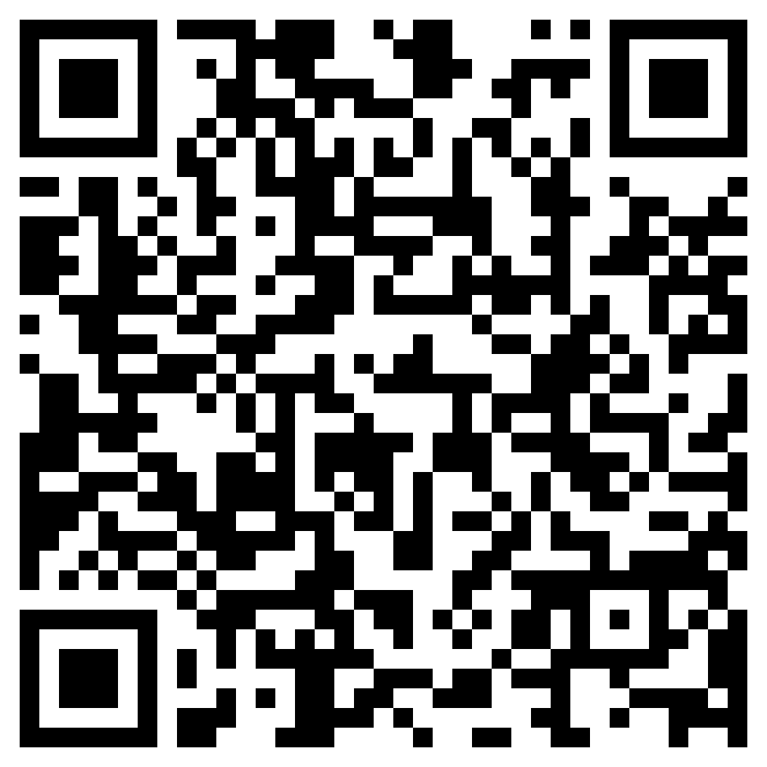
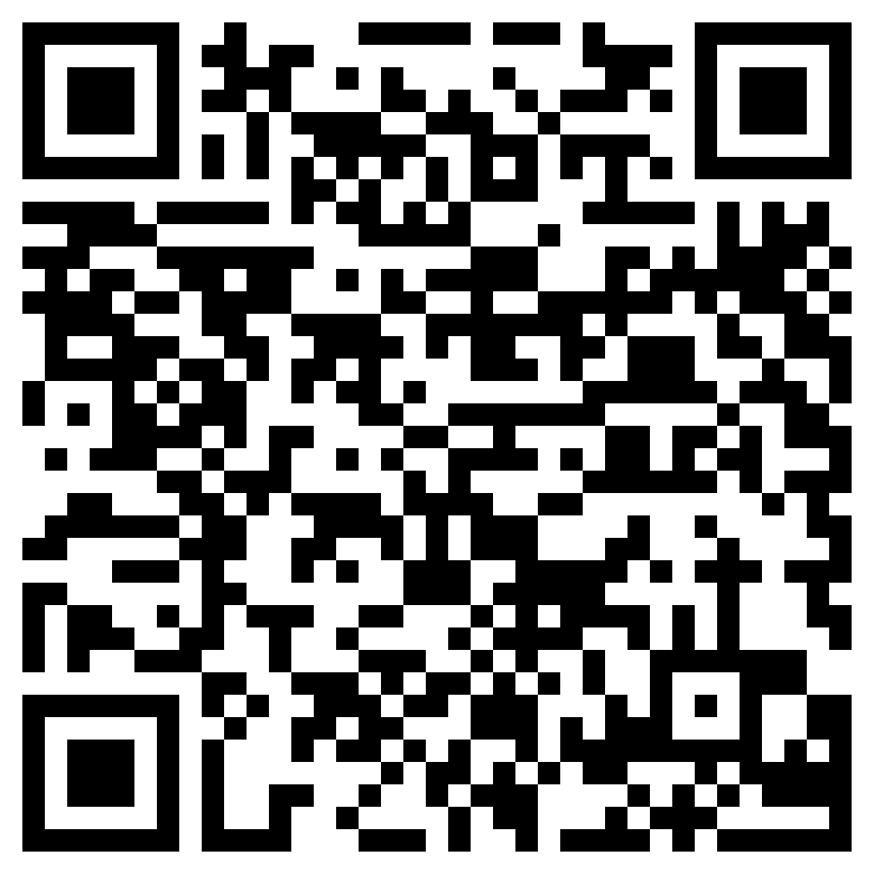
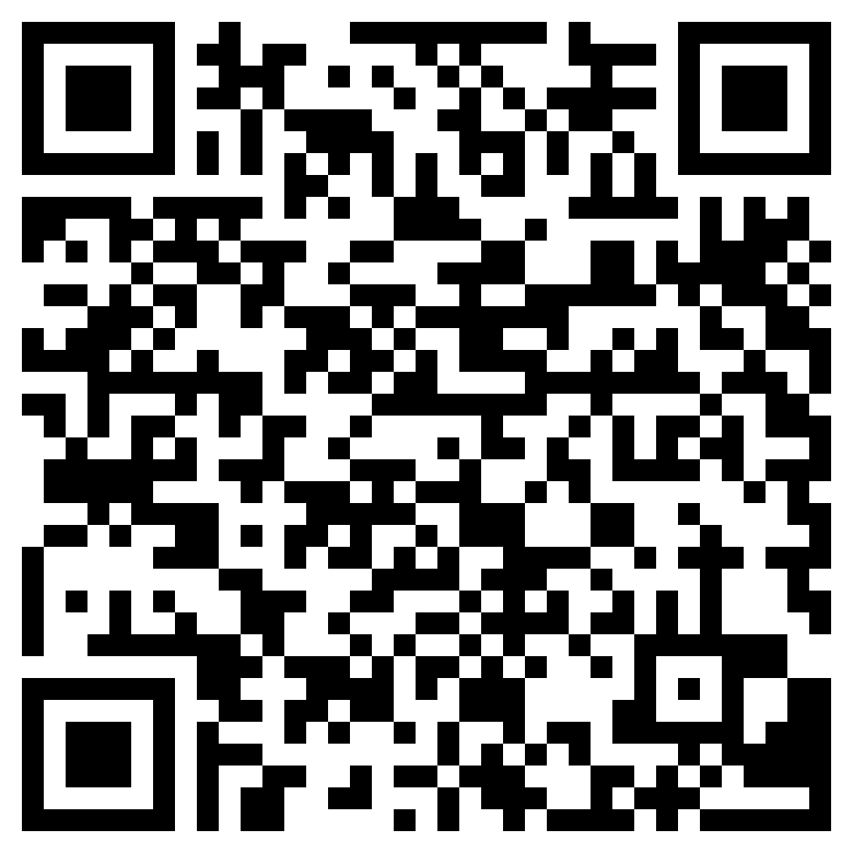
Hausaufgaben
New vocabulary:
Foundation
Higher
Revisited vocabulary:
Foundation | Higher
Notes:
Timing: 2 minutes Aim: to set homework for the following week.,
Note: the vocabulary learning is pre-learning for Y10.1.1 Week 3. Procedure: 1. Display the slide. Explain the tasks. 2. Post this slide or its information for students, using the usual school system for this.
Notes: A regular feature of the scheme of work (as for KS3) is that students spend time learning the vocabulary for the following week’s lessons. This can be done using any platform. We provide the words on Quizlet. Most lists are also available (free to all schools, not just subscribers) on LanguageNut. Teachers may of course create their own versions of vocabulary learning activities in any of the different platforms available. At KS4, there are several sets for learning/revisiting: 1. The new vocabulary for the following week. 2. The revisited thematic vocabulary (from KS3 SOW) assigned to the week. 3. The systematic revisiting (at +3 and +9 weekly intervals) of new vocabulary.
In the KS4 SOW every word from the GCSE vocabulary list has been tracked to ensure that: 1. New words are introduced, revisited twice at intervals during the course, and once again during the final 9-week revision phase. 2. KS3 revisited thematic vocabulary is revisited twice during the course, and once again during the final 9-week revision phase. 3. KS3 function words (listed as R(equired) on Annex E of the GCSE Subject Content are all revisited multiple times (Column D on the KS4 SOW) and the revisits are also tracked on the KS4 Vocabulary tracker.
We anticipate that students will spend on average 2 hours on homework per week at KS4. As a general rule, one hour would be assigned to vocabulary learning (and ideally this time will be spread across the week). The aim at KS3 was to establish a ‘little and often’ approach to vocabulary learning, using an app to facilitate this. This learning habit will hopefully continue into KS4. The 2nd hour will generally include additional reading, listening, speaking tasks. Teachers will be best placed to decide whether to include extended writing tasks for homework. However, given the availability of online translation tools and the strong temptation to use them, such tasks might best be undertaken in class, where teachers can replicate the conditions for written language production that will apply for students at GCSE.

Slide 9
Deutsche Eiche
*die Eiche – oak * eigentlich – actually
*amerikanisch – American
lesen
Normalerweise hat jedes Land einen Nationalbaum. Oft steht er als eine Art Symbol für die Geschichte und die Kultur von dem Land. Welche Nationalbäume kennst du? Der Nationalbaum von den USA ist: die Eiche*. Für England ist es: die Eiche! Und Deutschland nennt seinen Nationalbaum: Eiche! Ja, eigentlich* haben alle drei Länder die Eiche als Nationalbaum. Und auch Frankreich hat einen Teil von der Eiche in seinem nationalen Symbol. Warum, meinst du, ist das wohl so? Warum gibt es eine deutsche, eine englische und eine amerikanische* Nationaleiche? Und warum lieben so viele Personen und Völker auf der Welt die Eiche? Stark ist sie bestimmt. Sehr alt kann sie auch werden, zum Beispiel ist die Bräutigamseiche in Eutin über 500 Jahre alt! Auch in der Religion und in der Geschichte und in der Kultur ist die Eiche oft sehr wichtig. Wollen wir darüber sprechen? Ja – treffen wir uns an der Eiche!
die Bräutigamseiche – name of a famous oak tree Eutin – city in Germany
Notes:
Possible additional homework
Teachers may like to make use of this text, which uses mostly previously taught language, setting comprehension questions, creating a gap-fill or other suitable activity.
Word frequency of unknown words (1 is the most frequent word in German):
eigentlich [151] Eiche [>5009] amerikanisch [836]
Source: Jones, R.L. & Tschirner, E. (2019). A frequency dictionary of German: core vocabulary for learners. Routledge

