Slide 1
Examples
production
Role play tasks (including transactional)

Slide 2
Ein Interview machen
Partnerarbeit
hören / sprechen
Person A stellt eine Frage. Person B antwortet mit dem Adverb 1 oder 2. (You can choose which adverb to answer with!)
Person A schreibt die Antwort auf Englisch.
Beispiel:
Gehst du ins Fitnessstudio?
Ja, ich gehe jetzt ins Fitnessstudio.
Person A
Do you go / are you going to the gym?
1 | 2
jede Woche | jetzt
is going to the gym now.
Notes:
9.1.1.1
Timing: 8 minutes (three slides) Aim: To model the speaking/listening activity. Procedure: Click through the animations carefully to show the steps for the activity.
Word frequency of cognates and unknown words (1 is the most frequent word in German): Fitnessstudio [>5009]
Source: Jones, R.L. & Tschirner, E. (2019). A frequency dictionary of German: core vocabulary for learners. Routledge

Slide 3
ein Interview machen
Person A stellt Fragen 6 – 1.
sprechen
Person B schreibt die Optionen.
1 | 2
jetzt | manchmal
nie | im Moment
jedes Jahr | jetzt
heute | oft
jetzt | immer
am Wochenende | normalerweise
1 Are you doing / do you do other interviews?
2 Are you understanding / do you understand my English?
3 Do you use / are you using the computer for your music?
Person A schreibt Notizen auf Englisch.
Person B antwortet.
4 Are you coming / do you come to Berlin?
5 Do you lose / are you losing things?
6 Are you having / do you have problems in the band?
Notes:
9.1.1.1
Aim: to practise spoken production of prepared questions, without reference to notes, but with English translations as support. Procedure: 1. Partner B copies his/her six sets of response prompts down and turns away from the board.
2. Click for these to disappear and the English question prompts to appear.
3. Partner A asks questions in reverse order 6 – 1. This is to ensure that Partner B has to listen and understand, rather than remember what s/he has seen.
4. Partner B responds, giving full sentence replies with one of the two adverbs.
5. Partner A notes responses in English, paying attention to which use of English (simple present or present continuous) is required.
Note: the task has been prepared in this way to avoid printing, and handing out copies. If preferred, teachers could print and distribute the handout provided.

Slide 4
ein Interview machen
Person A schreibt die Optionen.
sprechen
Person B stellt Fragen 6 – 1.
1 | 2
immer | heute
dieses Jahr | normalerweise
manchmal | im Moment
im Moment | jede Woche
oft | im Moment
einmal im Jahr | heute
1 Do you play / are you playing here?
2 Are you using / do you use other instruments in the band?
3 Do you talk / are you talking with your family?
4 Do you live / are you living together with friends?
Person A antwortet.
Person B schreibt Notizen auf Englisch.
5 Are you earning / do you earn lots of money?
6 Do you do / are you doing something special there?
Notes:
9.1.1.1
Procedure: 1. Partner A copies his/her six sets of response prompts down and turns away from the board.
2. Click for these to disappear and the English question prompts to appear.
3. Partner B asks questions in reverse order 6 – 1.
4. Partner A responds, giving full sentence replies with one of the two adverbs.
5. Partner B notes responses in English, paying attention to which use of English (simple present or present continuous) is required.

Slide 5
Was hast du gemacht? [1 of 3]
sprechen
Rede mit deinen Partnern / deinen Partnerinnen.
Partner A
Fragen:
1.
2.
3.
Antworten:
1.
2.
3.
Was [did you all] früher gern gespielt?
Wo [did you all] früher geschwommen?
Wo [did you all] früher getanzt?
We liked playing cards.
We used to swim in the lake.
We used to dance in the disco*.
*die Disco – disco
Notes:
9.1.1.5
Timing: 12 minutes (all three slides) Aim: to practice the spoken production of the correct ihr form auxillary in the perfect tense.
Procedure: 1. Students work in groups of three.
2. Student A says the first question (which appears upon clicking the mouse) to the two partners in German, inserting the correct form of the auxillary – ihr habt or ihr seid :
e.g. 1. Was habt ihr früher gern gespielt?
3. Student A then turns away from the board, and Students B and C answer in German according to the corresponding English prompt, which appears upon the next mouse click
– e.g. 1. Wir haben früher gern Karten gespielt.
4. Student A notes the response down in English, then turns round to face the board again, to check.
5. Repeat the above steps for the other two questions on the slide.
6. Advance to the next slide for Student B to ask his/her questions, then to the following one for Student C.

Slide 6
Was hast du gemacht? [2 of 3]
sprechen
Rede mit deinen Partnern / deinen Partnerinnen.
Partner B
Fragen:
1.
2.
3.
Antworten:
1.
2.
3.
Wie [did you all] früher auf Urlaub gefahren?
Wo [did you all] früher in der Stadt gewohnt?
Was [did you all] früher gern gegessen?
We used to go by plane.
We used to live by the swimming pool.
We used to like eating cake.
Notes:
9.1.1.5
As for previous slide.

Slide 7
Was hast du gemacht? [3 of 3]
sprechen
Rede mit deinen Partnern / deinen Partnerinnen.
Partner C
Fragen:
1.
2.
3.
Antworten:
1.
2.
3.
Wie [did you all] früher Fußball gefunden?
Was [did you all] früher gern getrunken?
Wohin [did you all] früher mit dem Bus gefahren?
We used to like playing football.
We used to like drinking coffee.
We used to go into town by bus.
Notes:
9.1.1.5
As for previous slide.
Draw students’ attention to the MP consideration in Answer 3. They have previously learnt that adverbs of manner go before place (and also that adverbs of time go before manner). Later in Y9 they will bring all three together.

Slide 8
Wann hast du das gemacht?
schreiben / sprechen
Bereite deine Fragen und Antworten vor.
Dann rede mit deinem Partner / deiner Partnerin.
Partner A:
When did you write your first story?
…
…
…
…
…
When I was one.
…
Partner B:
When did you learn to speak?
…
…
…
When I was seven.
…
…
…
Wann hast du deine erste Geschichte geschrieben?
Wann hast du sprechen gelernt?
Als ich siebenJahre alt war.
Als ich ein Jahr alt war.
Notes:
9.1.1.7
SPEAKING MODELLING SLIDE
Timing: 10 minutes (all four slides) Aim: to practise the correct use of wann for questions and als for events in the past. Procedure: 1. Model the task using the example on this slide. Click through the animations. 2. Then give out the A5 handout to students (as shown on next slide, which mustn’t be shown to the class).
3. Students individually translate their prompt cards into German.
4. Then they work in pairs: Partner A asks questions and Partner B answers with the relevant sentence from their card and vice versa
5. Answers are on the next slides.

Slide 9
Wann hast du das gemacht?
schreiben / sprechen
✄
Partner A:
When did you learn to cycle?
When did you use to go home?
When did you go on holiday?
When did you get your first pet?
When I was hungry.
When I was six. That’s normal*.
When I was in school.
When I was very young, four years old.
Partner B:
When did you learn to swim?
When did you use to play tennis?
When did you eat cake?
When did you learn to read?
When I was five. That’s normal.
When I had no school.
When I was nine.
When I was tired.
Notes:
9.1.1.7
DO NOT DISPLAY THIS SLIDE

Slide 10
Wann hast du das gemacht?
schreiben / sprechen
When did you learn to cycle?
When did you use to go home?
When did you go on holiday?
When did you get your first pet?
Partner A:
When I was five. That’s normal.
d) When I was tired.
b) When I had no school.
c) When I was nine.
c) When I have more time.
Partner B:
Wann hast du Rad fahren gelernt?
Als ich fünf war. Das ist normal.
Wann bist du früher nach Hause gegangen?
Als ich müde war.
Wann bist du früher in Urlaub gefahren?
Als ich keine Schule hatte.
Als ich neun (Jahre alt) war.
Wann hast du dein erstes Haustier bekommen?
Notes:
9.1.1.7
Example Answers to Partner A questions
Procedure:
Elicit German questions from Partner A students.
Click to reveal translation of question to German.
Click to reveal answer in English.
Elicit German answer from Partner B students. Click to reveal translation of answer to German.
Repeat for the remaining items.

Slide 11
Wann hast du das gemacht?
schreiben / sprechen
When did you learn to swim?
When did you use to play tennis?
When did you eat cake?
When did you learn to read?
Partner A:
Partner B:
b) When I was six. That’s normal.
c) When I was in school.
a) When I was hungry.
d) When I was very young, four years old.
Wann hast du schwimmen gelernt?
Als ich sechs war. Das ist normal.
Wann hast du früher Tennis gespielt?
Als ich in der Schule war.
Wann hast du früher Kuchen gegessen?
Als ich Hunger hatte.
Wann hast du lesen gelernt?
Als ich sehr jung war, vier Jahre alt.
Notes:
9.1.1.7
Example Answers to Partner B questions
Procedure:
Elicit German questions from Partner B students.
Click to reveal translation of question to German.
Click to reveal answer in English.
Elicit German answer from Partner A students. Click to reveal translation of answer to German.
Repeat for the remaining items.

Slide 12
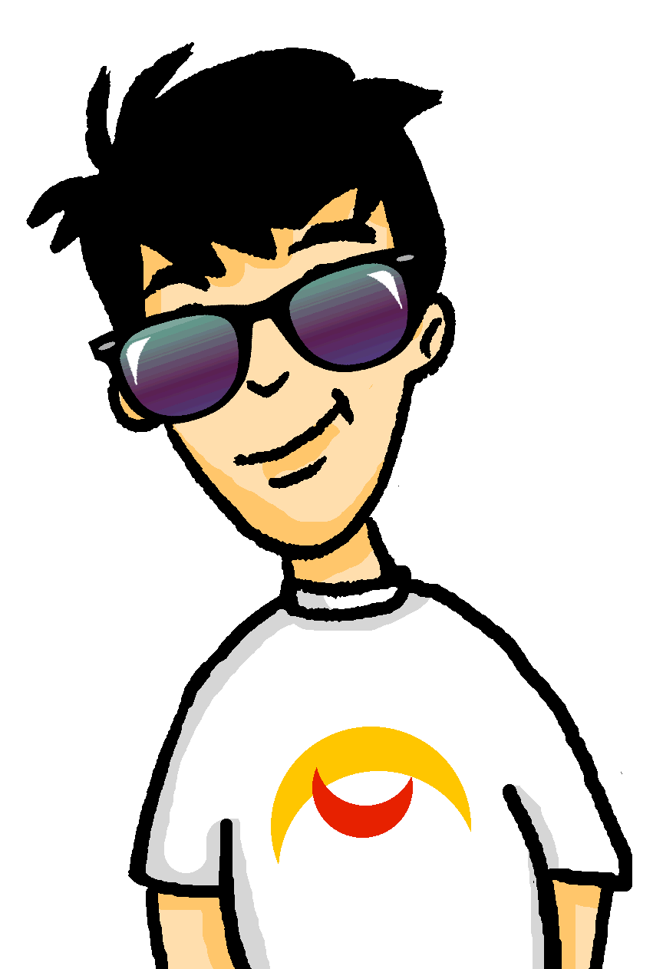
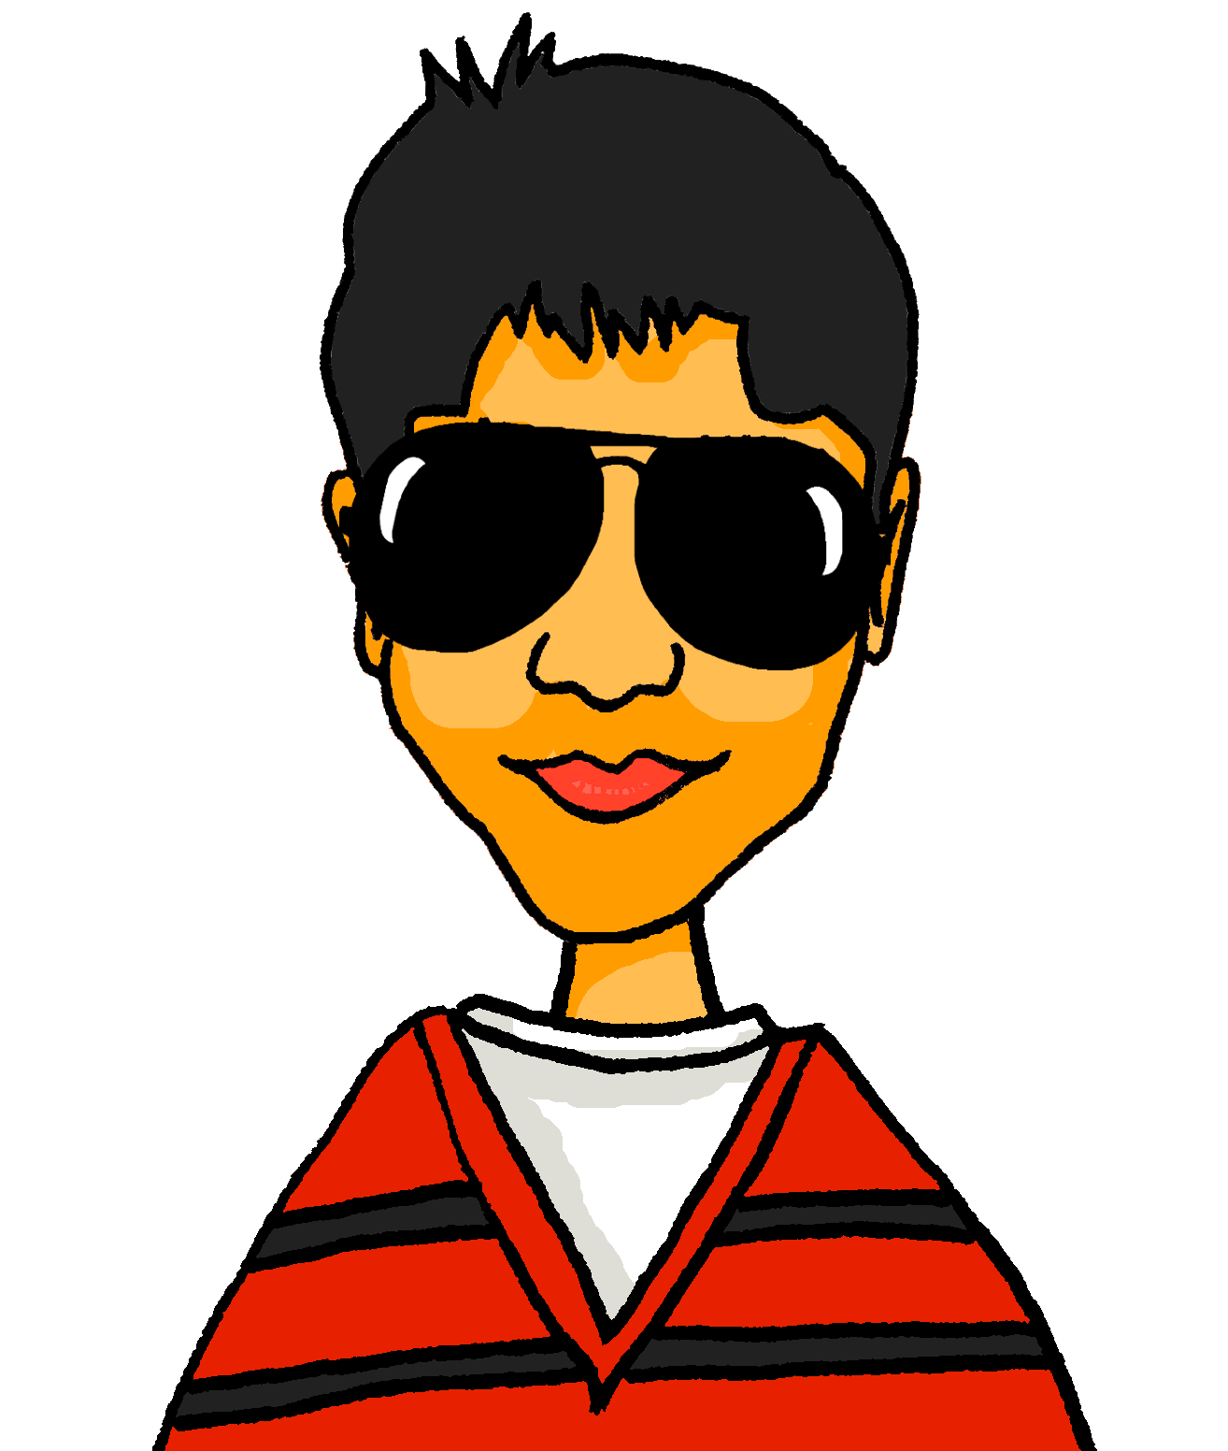
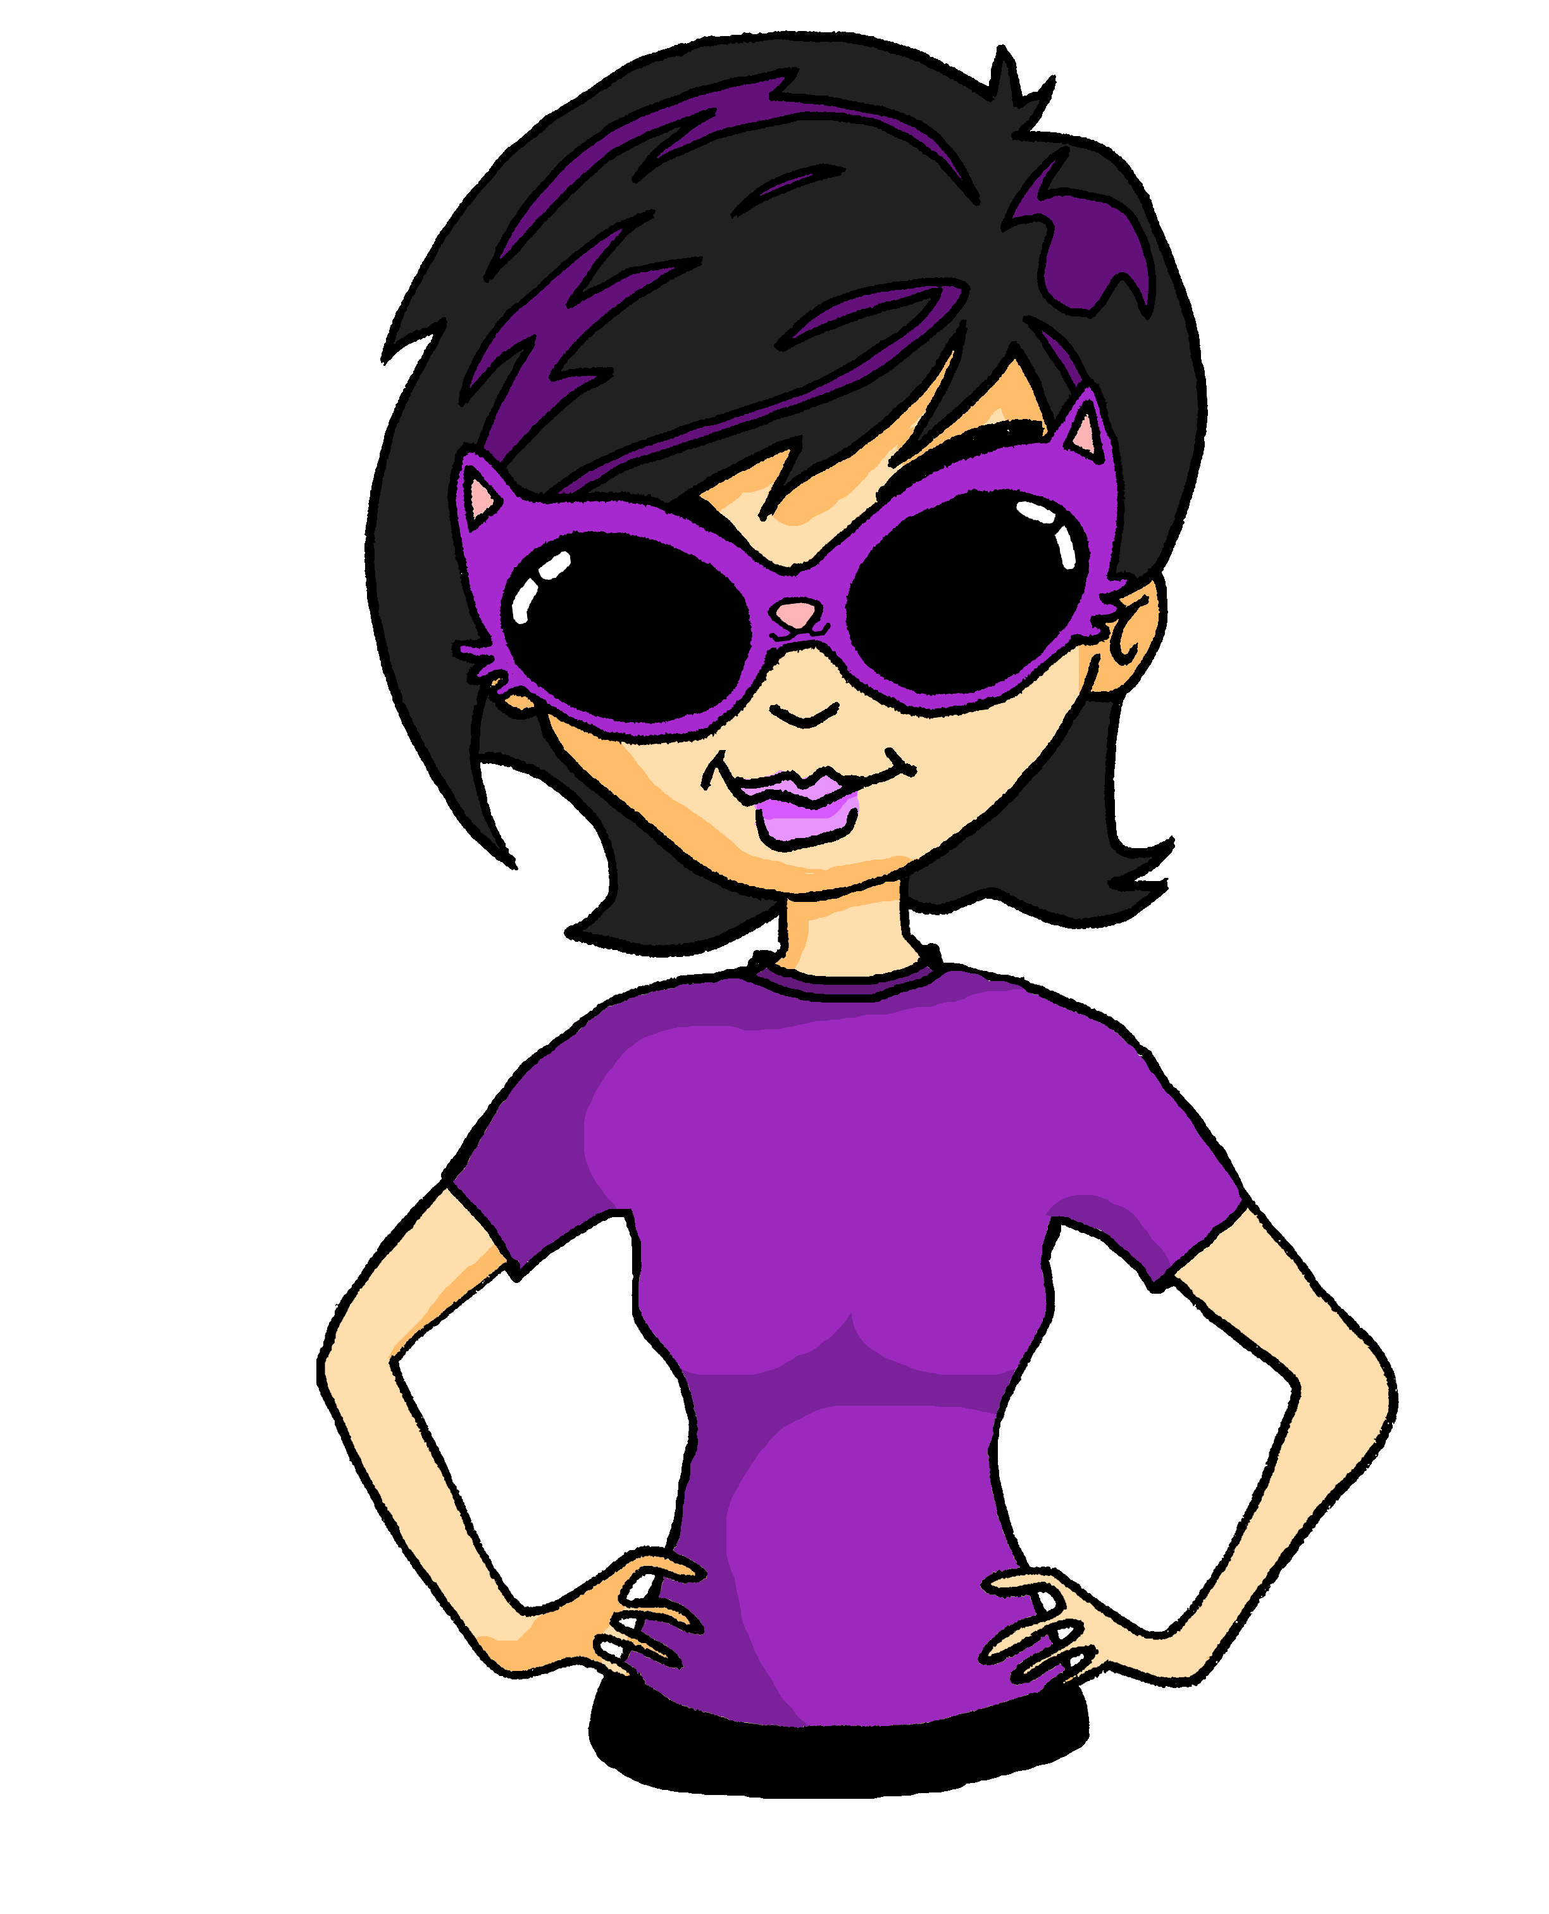
Auf dem Karneval
hören / sprechen / schreiben
are having a chat | are meeting up | are reporting a problem | are entertaining the people
[Katja] und [Mehmet] unterhalten sich.
[Katja] und [Mehmet] treffen sich.
[Katja] und [Mehmet] melden kein Problem.
[Katja] und [Mehmet] unterhalten die Leute.
Unterhaltet ihr euch?
Trefft ihr euch?
Meldet ihr ein Problem?
Unterhaltet ihr die Leute?
Ja, wir unterhalten uns.
Ja, wir treffen uns.
Nein, wir melden kein Problem.
Ja, wir unterhalten die Leute.
Notes:
9.1.2.7
Timing: 10 minutes
Aim: to comprehend and produce questions and statements containing plural forms of verbs used reflexively and non-reflexively
Procedure:
1. Students work in pairs. Each pair is given a role card (see next slide) with ticks and crosses to show what they are / are not doing
2. Students sketch a 4x4 grid as shown on this slide. Explain that the aim is to find four pairs of students who do each thing.
3. Prepare students for the task by clicking to run through the demonstration on this slide.
4. Students circulate and talk to other pairs, trying to find a match for each square. They also answer questions from other pairs based on what their role cards say.
5. Students take notes on their 4x4 grids in the 3rd person plural.
6. The first pair to fill their card and correctly report back with sentences in the 3rd person plural wins.

Slide 13
rolecards
Rolecards for printing
are having a chat | are meeting up | are reporting a problem | are entertaining
are having a chat | are meeting up | are reporting a problem | are entertaining
are having a chat | are meeting up | are reporting a problem | are entertaining
are having a chat | are meeting up | are reporting a problem | are entertaining
are having a chat | are meeting up | are reporting a problem | are entertaining
are having a chat | are meeting up | are reporting a problem | are entertaining
are having a chat | are meeting up | are reporting a problem | are entertaining
are having a chat | are meeting up | are reporting a problem | are entertaining
are having a chat | are meeting up | are reporting a problem | are entertaining
are having a chat | are meeting up | are reporting a problem | are entertaining
are having a chat | are meeting up | are reporting a problem | are entertaining
are having a chat | are meeting up | are reporting a problem | are entertaining
Notes:
9.1.2.7
Role cards – do not display. Print and distribute, one strip per pair.

Slide 14
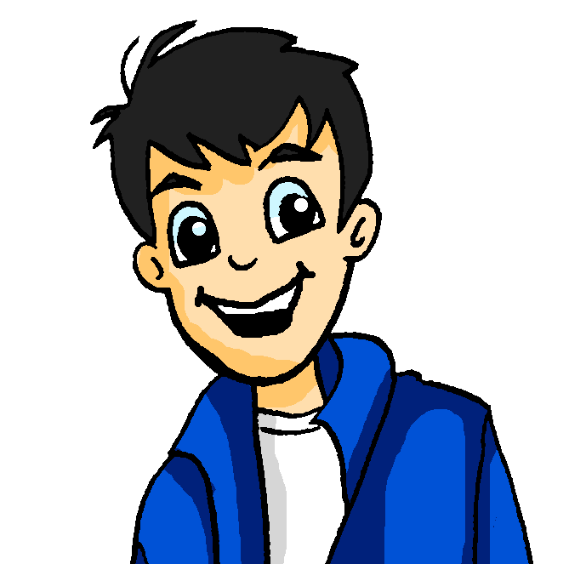
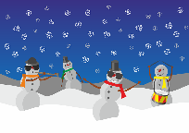
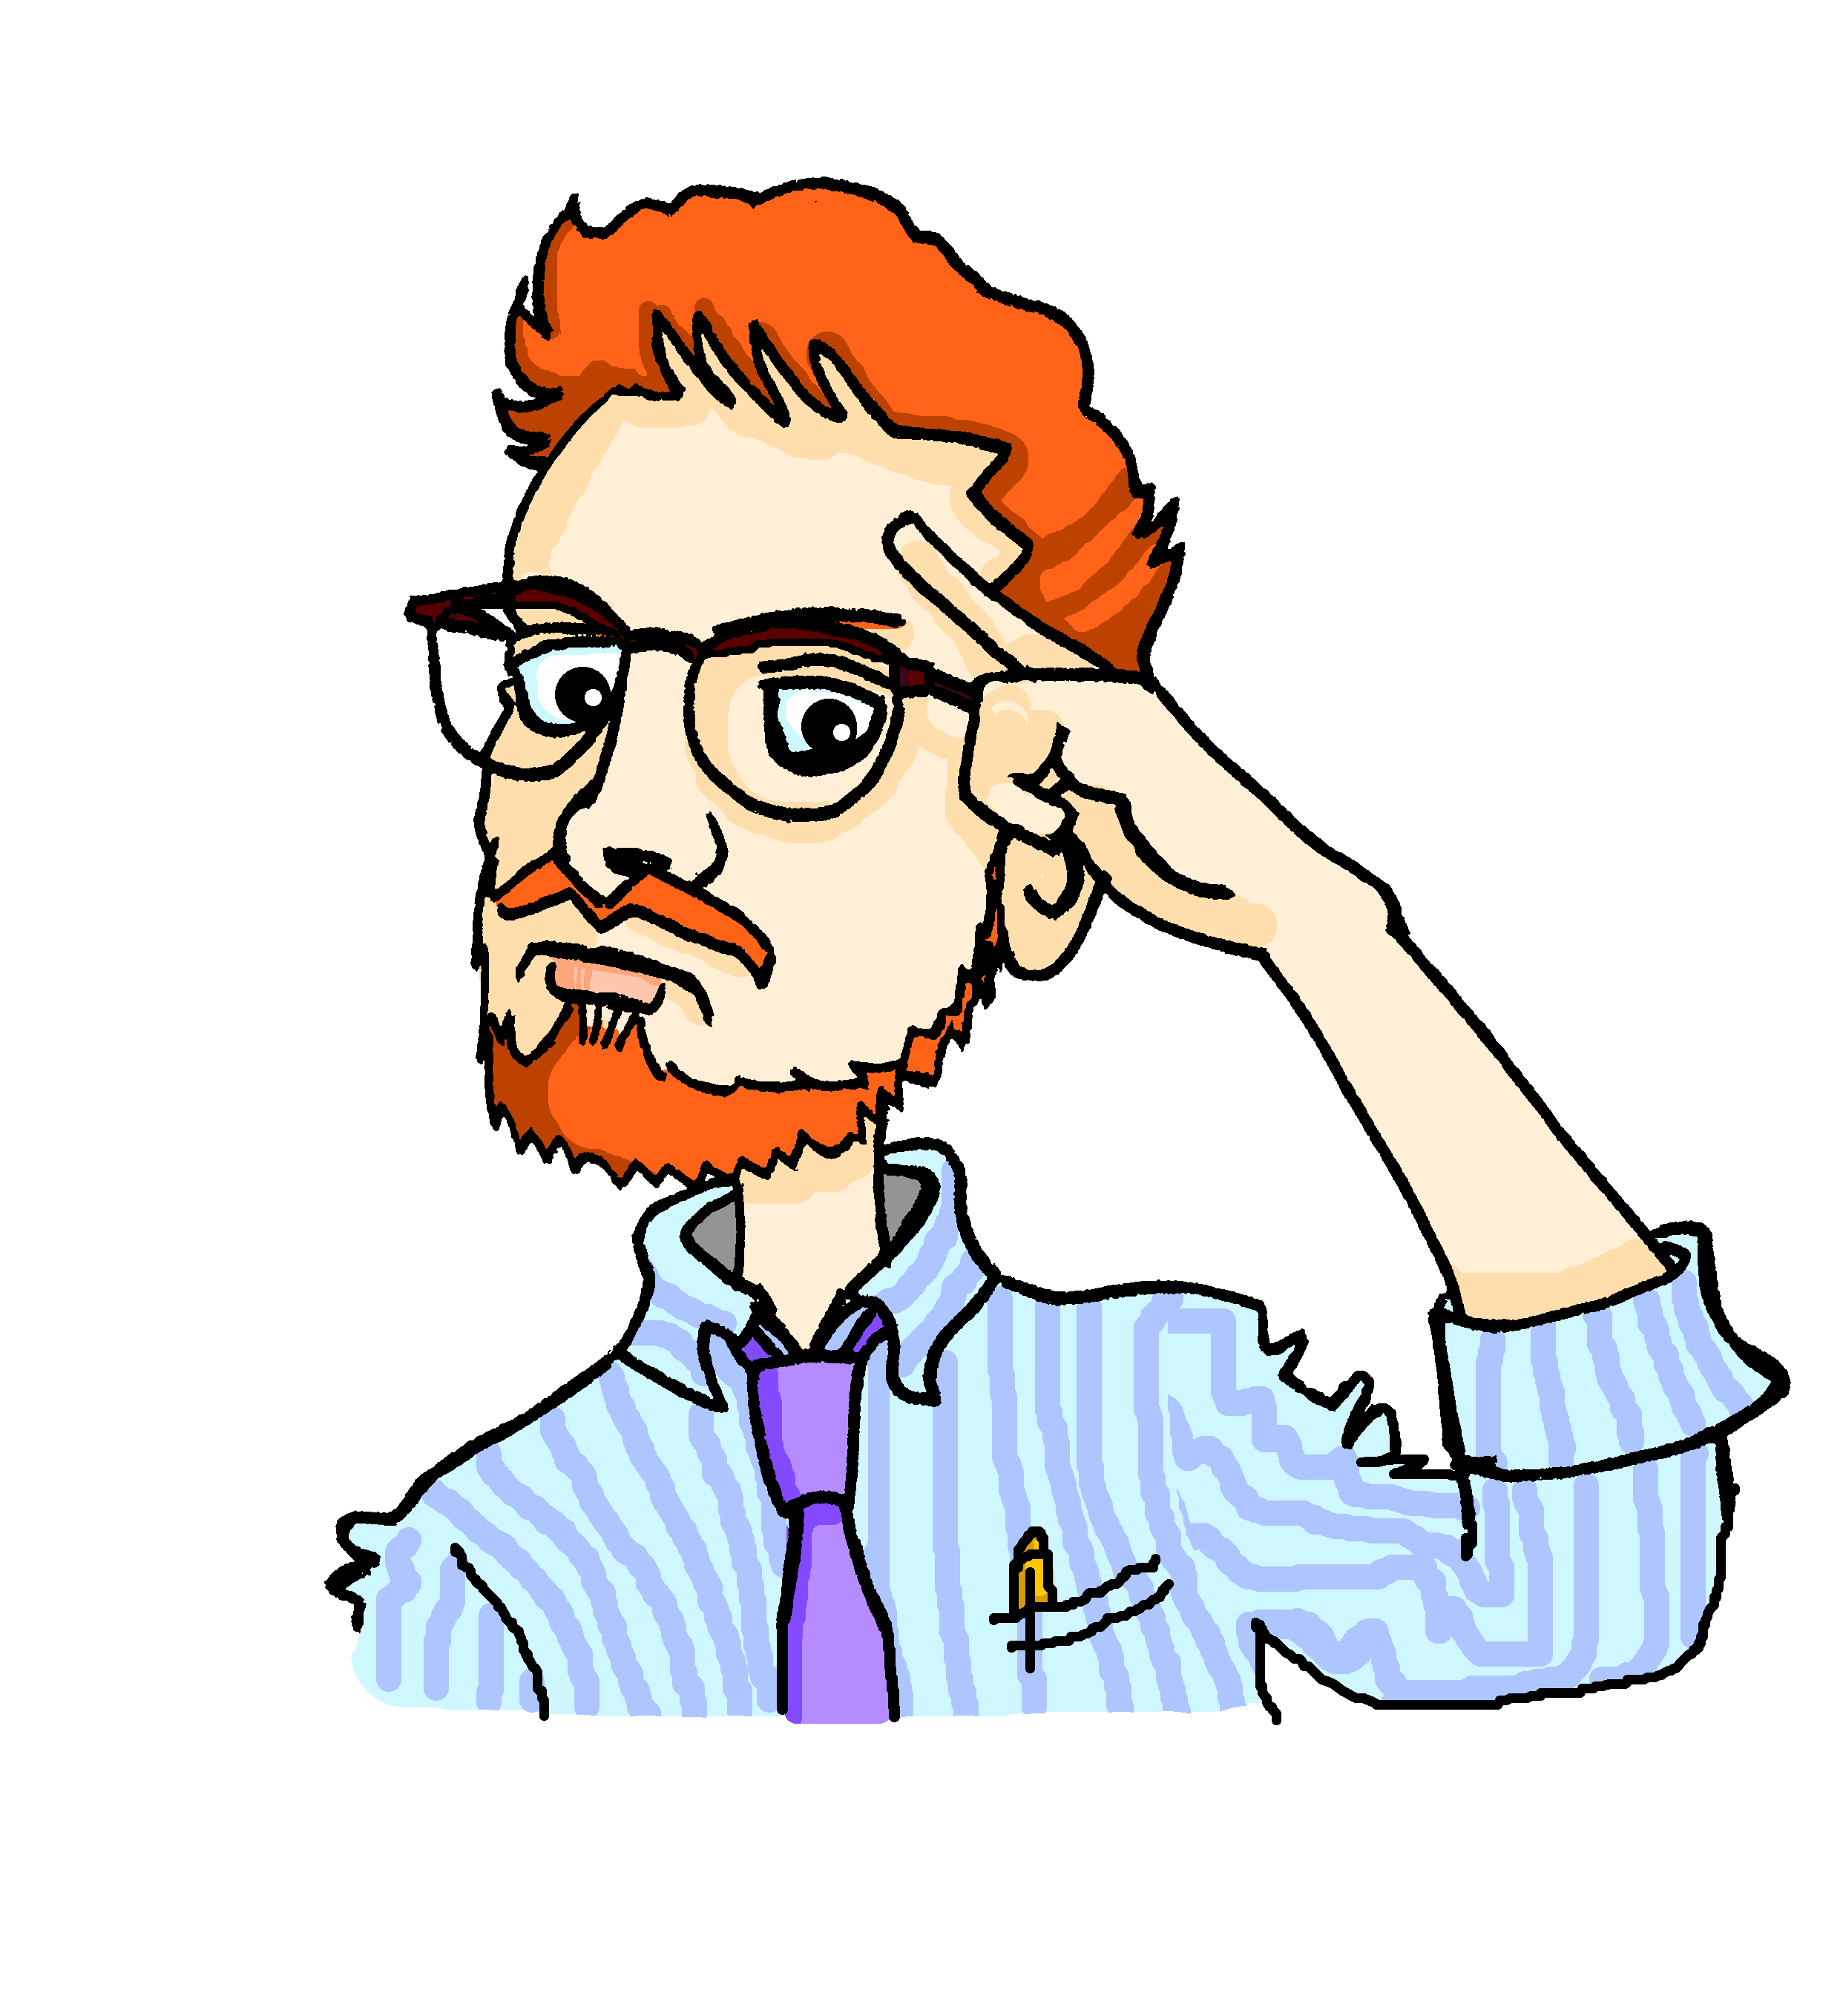
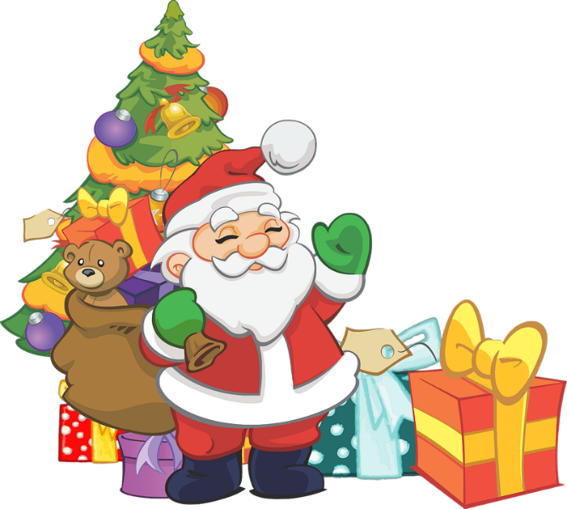
Auf dem Weihnachtsmarkt [1/3]
Du bist Mia. Aber redest du mit Herrn Mürrisch oder Wolfgang?
sprechen
1. dieses Weihnachtslied singen
2. in diesen Laden gehen
Partner B
Partner A
Möchtest du in diesen Laden gehen?
___________ in diesen Laden gehen?
_________ dieses Weihnachtslied singen?
Möchten Sie dieses Weihnachtslied singen?
Partner B
Partner A
The pronoun needs to match the noun.
Nein, ich möchte nicht in diesen Laden gehen, weil er langweilig ist.
Ja, ich möchte dieses Weihnachtslied singen, weil es schön ist.
Nein, ich möchte nicht in diesen Laden gehen, weil er langweilig ist.
Notes:
9.2.1.1
LESS CHALLENGING VERSION Timing: 8 minutes
There are two versions of the next 3 slides: the current ones are less challenging as the cues/infinitives are given in German. Aim: to practise asking möcht- questions with formal and informal you, and to practise giving a range of affirmative and negative responses, extending with spontaneous reasons using weil. This is the model slide with two turns as examples. Procedure: 1. Partner A decides if s/he is talking to the teacher or a friend, and uses the formal or informal form of the verbs to ask the question. Here we assume partner A chooses formal – click to bring up orange highlight around ‘formal’ box. (Note: Herr Mürrisch is Wolfgang’s maths teacher who has accompanied the group on this day trip to the Christmas market). 2. Click to bring up bubble with the verb from blanked out, elicit answer. Click again to bring up complete question.
3. Partner B listens and responds according to the indicated answer, as in the example modelled here. Click to bring up response. Click to bring up bubble to remind students that the pronoun needs to match the noun! Here: das Lied – ‘es’. 4. Then do the same process with the second set of pictures. Click to bring up the highlighting box around the informal question, and the remaining prompts.
5. Ensure that students know that there are two ‘rounds’ of speaking activity. The first slide Partner A is Mia and asks all the questions. The second slide Partner B is Mia and asks the questions.

Slide 15
Auf dem Weihnachtsmarkt [2/3]
Du bist Mia. Aber redest du mit Herrn Mürrisch oder Wolfgang?
sprechen
3. dieses Gericht probieren
4. diesen Punsch trinken
5. diesen Kuchen genießen
6. ein Weihnachtsgeschenk auswählen
7. einen neuen Stadtteil entdecken
8. den Weihnachtsbaum schmücken
decorate the Christmas tree – den Weihnachtsbaum schmücken
hässlich
lecker
teuer
günstig
traditionell
schön
Notes:
9.2.1.1
[2/3] Partner A asks, Partner B answers.
Word frequency (1 is the most frequent word in German):
schmücken [>5009] Source: Jones, R.L. & Tschirner, E. (2019). A frequency dictionary of German: core vocabulary for learners. Routledge

Slide 16
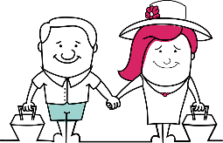
Auf dem Weihnachtsmarkt [3/3]
Du bist Mia. Aber redest du mit Herrn Mürrisch oder Wolfgang?
sprechen
9. watch the tourists
10. read these scientists
11. study at this university
12. get out of the way*
13. bake a cake
14. sell Lebkuchen
an die Seite gehen – get out of the way
lecker
teuer
günstig
traditionell
schön
Notes:
9.2.1.1
[3/3]
Partner B asks, Partner A answers.

Slide 17
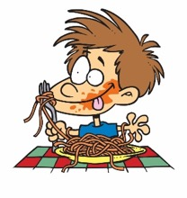
Du sprichst mit deiner/m Partner*in über Freunde.
lesen / sprechen
Use your cards to
ask questions in German.
answer questions. Is your partner asking about you (singular) or you all (plural)?
Your partner will also ask you. Take turns.
Choose your answer depending on the verb in the question.
Zum Beispiel:
Wo hast du gegessen?
Person A
(Frage):
Im Stadtzentrum.
Person B
(Antwort):
Ask your partner these questions.
Listen for whether it’s du or ihr and then give the information in German.
Write down the answer.
1. Where did you eat?
Partner asks about…
‘you’
‘you all’
In the city centre.
[where?]
in the city centre
on the beach
Notes:
9.2.1.4
Do EITHER this more challenging version (slides 38-40) OR the alternative, supported version (42-43).
Note: if the teacher is conducting speaking assessments and doesn’t want the additional noise generated by this speaking task, then students could write the questions instead, as further perfect tense revision.
Timing: 8 minutes
Aim:
to practise producing and understanding verbs in the perfect past tense in both the du (you, singular) and ihr (you, plural) forms.
to also consolidate use of question words and vocabulary (oral modality).
Procedure:
Person A uses their cards to ask a question in German.
Student B listens and says the corresponding answer depending on the question – does the question refer to ‘you’ singular (du hast/ist) or to ‘you all’ (ihr habt/seid)
Student A then writes down their answer in German.
Teacher uses the answer slide to give feedback.

Slide 18
Person A
Ask your partner these questions.
Listen for whether it’s du or ihr and then give the information in German.
Write down the answer.
1. When did you get that from me?
Partner asks about…
‘you’
‘you all’
1.
[when?]
in June
in July
2. Where did you all travel in your free time?
2.
[where?]
in Germany
in France
3. How many trips did you do with him?
3.
[how many?]
2
5
4. How did you all go into town?
4.
[how?]
walked
with the train
5. How often did you go to the swimming pool with him?
5.
[how often?]
every weekend
every month
6.
[what?]
nothing
wrote ideas
6. What did you all show him?
7.
[who?]
Wolfgang
Mia
7. Who did you kiss goodbye?
8.
[why?]
nice
funny
8. Why did you all go to the lesson without him?
Notes:
9.2.1.4
DO NOT DISPLAY DURING ACTIVITY
Slide can be printed as handout.

Slide 19
Person B
Ask your partner these questions.
Listen for whether it’s du or ihr and then give the information in German.
Write down the answer.
Partner asks about…
‘you’
‘you all’
1. When did you visit the castle?
1.
[when?]
yesterday
last month
2. Where did you all do a bike tour?
2.
[where?]
to Germany
to France
3. How many letters did you write to her?
3.
[how many?]
10
8
4. How did you all go to the cinema?
[how?]
4.
with the bus
with the car
5. How often did you laugh with her?
[how often?]
5.
every day
every week
6. What did you do for the task?
6.
[what?]
a picture
the answer
7. With whom did you all study?
7.
[who?]
a friend
my Gran
8. Why did you all do the activity?
8.
[why?]
didn’t do that
forgot
Notes:
9.2.1.4
DO NOT DISPLAY DURING ACTIVITY
See accompanying Word doc for printable version.

Slide 20
Partnerarbeit
sprechen
Sprich mit einem Partner.
Person A
Person B
1. Was machst du, um nett zu sein?
2. Ich… . Warum backst du Kuchen?
3. Ich … . Was machst du, um gesund zu bleiben?
4. Ich… . Was machst an Weihnachten?
5. Ich … . Warum nimmst du an einem Lauf teil?
6. Ich… . Warum arbeitest du in einem Laden?
7. Ich … . Warum gehst du mit deiner Oma aus?
8. Ich… . Was machst du, um die Stadt sauber zu machen?
Zum Beispiel:
die Leute freundlich begrüßen – Müll aufsammeln – Geld für einen guten Zweck sammeln – früh einschlafen – jede Woche einen 5km-Lauf machen – lokalen Betrieben helfen – für … einkaufen – die Umwelt schützen – in einem Chor singen – Familie besuchen
Notes:
9.3.1.1
Note: this is the easier version of this activity with prompts in German.
Timing: 6 minutes Aim: to practise asking and answering what and why questions, using um..zu (and/or denn clauses) in a more open-ended context. Procedure: 1. Students split into pairs and ask and answer questions, paying attention to whether the question asks was or warum.
Word frequency (1 is the most frequent word in German): aufsammeln [>5009] Source: Jones, R.L. & Tschirner, E. (2019). A frequency dictionary of German: core vocabulary for learners. Routledge

Slide 21
Partnerarbeit
sprechen
Sprich mit einem Partner.
Person A
Person B
1. Was machst du, um nett zu sein?
2. Ich… . Warum backst du Kuchen?
3. Ich … . Was machst du, um gesund zu bleiben?
4. Ich… . Was machst an Weihnachten?
5. Ich … . Warum nimmst du an einem Lauf teil?
6. Ich… . Warum arbeitest du in einem Laden?
7. Ich … . Warum gehst du mit deiner Oma aus?
8. Ich… . Was machst du, um die Stadt sauber zu machen?
Zum Beispiel:
greet people in friendly way – pick up rubbish – collect money for a good cause – go to sleep early – go for a 5k run every morning – help local businesses – go shopping for … – protect the environment – sing in a choir – visit family
Notes:
9.3.1.1
Note: this is the easier version of this activity with prompts in German.
Timing: 6 minutes Aim: to practise asking and answering what and why questions, using um..zu (and/or denn clauses) in a more open-ended context. Procedure: 1. Students split into pairs and ask and answer questions, paying attention to whether the question asks was or warum.
Word frequency (1 is the most frequent word in German): aufsammeln [>5009] Source: Jones, R.L. & Tschirner, E. (2019). A frequency dictionary of German: core vocabulary for learners. Routledge

Slide 22
Was machst du in Liechtenstein?
sprechen
Person A sieht die Tabelle an und stellt eine Was…? Frage. Person B antwortet mit einem vollen Satz. Person A schreibt die Details, die fehlen. Dann tauscht die Rollen.
mit dem Bus
Wer? | Wann? | Wie? | Wo?
du |  |  | nach Malbun
gern
Wer? | Wann? | Wie? | Wo?
ihr | morgens
morgens
nachmittags
wir fahren
nach Vaduz
ich fahre
mit dem Bus
nachmittags
gern
nach Malbun
nach Vaduz
Was machst du in Malbun?
Was macht ihr morgens?
Ich fahre nachmittags mit dem Bus nach Malbun.
Wir fahren morgens gern nach Vaduz
Notes:
Timing: 9 minutes (3 slides) Aim: To practise TMP in a spoken context. Procedure: 1. Explain the task using this model slide. Each partner will have a handout with a table with missing gaps. They are to ask their partner questions to fill in the gaps, their partner will answer using the blue boxes on the board.
2. Click through the examples on this slide to show how the task will work.
3. Click to bring up the next slide.
4. Partner A turns away from the board.
5. They look at the table on the handout and ask their partner ‘was…?’ questions to find out the missing information.
6. Partner B looks at the blue boxes on the board to respond. The information in each blue box is jumbled. Using their knowledge of TMP, they must create sentences using the correct word order.
7. Partner A fills in their table based on what Partner B has said.
8. Click to bring up the next slide. Partners swap roles.

Slide 23
Was machst du in Liechtenstein?
sprechen
Person A
mit Freunden
ich gehe
am Dienstag
ich besuche
in den Bergen wandern
meistens
am Nachmittag
morgens
ein Schloss in Balzers
im Rhein
immer
wir schwimmen
nach Feldkirch in Österreich
ich gehe
mit dem Fahrrad
mit meiner Familie
nachmittags
heute Abend
ich fahre
mit dem Zug
ins Theater
wir fahren
am Samstag
nach Schaan
Notes:
Slide 2

Slide 24
Was machst du in Liechtenstein?
sprechen
Person B
mit einer Freundin
wir gehen
morgens
ich besuche
in Liechtenstein bergsteigen
mit Freunden
am Nachmittag
heute
im See
das Postmuseum
verantwortlich
ich schwimme
nach Buchs in der Schweiz
wir fahren
allein
mit dem Bus
nachmittags
am Montag
ich fahre
zur Kirche in Triesen
mit dem Zug
ich fahre
abends
nach Vaduz
Notes:
Slide 3

Slide 25
Wohin bist du gefahren?
sprechen
Ask your partner about a journey they have been on recently using the questions below in German:
Where did you go?
When did you go?
How did you travel?
What did you do there?
Who did you go with?
Notes:
9.3.1.2
There is a less challenging version of this task on the next slide.
Timing: 5 minutes Aim: to practise using TMP more freely in a spoken context. Procedure: 1. Explain the task. In pairs, take it in turns to ask each other about a journey you have been on recently.
2. Partner B asks Partner A a question. They try to give as much detail as possible to prevent the partner B from needing to ask more questions.
3. Once partner B knows the answer to all of the questions on the board, the partners swap roles.
4. Whoever receives the fewest questions wins.

Slide 26
Wohin bist du gefahren?
sprechen
Ask your partner about a journey they have been on recently using the questions below:
Wo bist du gefahren?
Wann bist du gefahren?
Wie bist du gefahren?
Was hast du dort gemacht?
Mit wem bist du gefahren?
Notes:
9.3.1.2
Alternative less challenging version with German questions provided. Timing: 5 minutes Aim: to practise using TMP more freely in a spoken context. Procedure: 1. Explain the task. In pairs, take it in turns to ask each other about a journey you have been on recently.
2. Partner B asks Partner A a question. They try to give as much detail as possible to prevent the partner B from needing to ask more questions.
3. Once partner B knows the answer to all of the questions on the board, the partners swap roles.
4. Whoever receives the fewest questions wins.

