Slide 1
Examples
production
Role play tasks (including transactional)

Slide 2
Wie geht’s? [1/2]
sprechen
Du oder Sie?
Sind Sie müde?
Nein, ich bin nicht müde.
Partner A
Partner B
Notes:
8.1.1.3
Timing: 8 minutes Aim: To practise asking questions with formal and informal you, and to practise using structures with haben and sein in the affirmative and negative. Procedure: 1. Partner A decides that s/he is talking to an older person or a friend, and uses the formal or informal form of haben or sein to ask the question. 2. Partner B listens and responds according to the indicated answer, as in the example modelled here. 3. Then do the same process with the other five sets of pictures. Note that the sets of pictures are not numbered so that students also have to understand the vocabulary.
On the next slide students swap roles. Word frequency (1 is the most frequent word in German): Source: Jones, R.L. & Tschirner, E. (2006). A frequency dictionary of German: core vocabulary for learners. Routledge

Slide 3
Wie geht’s? [2/2]
sprechen
Du oder Sie?
Hast du Schmerzen?
Nein, ich habe keine Schmerzen.
Partner B
Partner A
Notes:
8.1.1.3
Note: the cues have been jumbled.

Slide 4
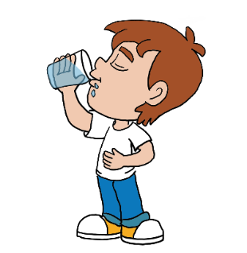
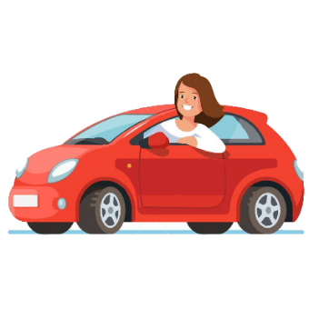
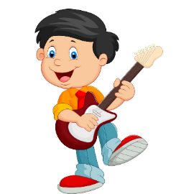
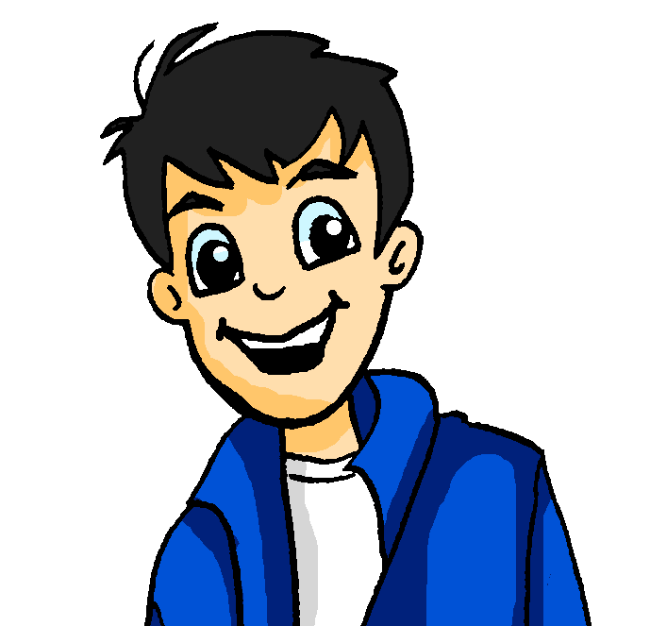
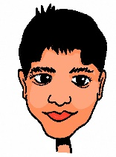
Wie sagt man das auf Englisch?
sprechen
Du kommst aus Deutschland und lernst Englisch. Wie heißen die Dinge?
Frag auf Deutsch und vergiss den Artikel (der, die oder das) nicht!
[verb]
[noun]
[noun]
[verb]
[verb]
[noun]
[verb]
[noun]
[verb]
[verb]
[noun]
[verb]
Notes:
8.1.1.4
Timing: 5 mins Aim: Oral and aural recall of twelve of this week’s revisited words. Oral production of the new ‘Wie sagt man […] auf Englisch?’ phrase to ask what unknown words mean. Procedure: 1. Tell students they are now going to take on the roles of Mia and Andrea (see previous slide) They will take it in turns to ask questions about the words on the screen in German, and answer in English.
2. Student A chooses a picture that they know the German word for. Pretending to be Mia, they ask e.g. ‘Wie sagt man fahren auf Englisch?’
3. Student B replies ‘to go by transport’.
4. Student B chooses a picture and asks the German question.
5. Student A responds.
6. Continue until all pictures have been used.

Slide 5
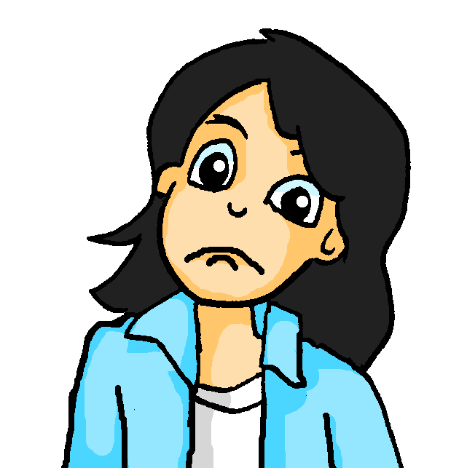
Wer macht was? [1/2]
Mia vergisst alles! Du oder Sie?
sprechen
1. einkaufen
2. um 2 Uhr ankommen
3. Opa und Oma mitbringen
4. die Gäste anrufen
5. die Geschenke mitbringen
6. die Musik organisieren
Partner A
Kaufen Sie ein?
Ja, ich kaufe ein.
Partner B
Notes:
8.1.2.7
Timing: 8 minutes Aim: To practise asking questions with formal and informal you, and to practise using separable verbs with questions and answers in the affirmative and negative. Procedure: 1. Partner A decides that s/he is talking to an older person or a friend, and uses the formal or informal form of the verbs to ask the question. 2. Partner B listens and responds according to the indicated answer, as in the example modelled here. 3. Then do the same process with the other five sets of pictures. Note that the infinitive phrases are provided to scaffold the task and enable students to focus their full attention on forming questions with separable verbs in the ‘du’ and ‘Sie’ forms, and responding with affirmative and negative answers.
On the next slide students swap roles. Word frequency (1 is the most frequent word in German): Source: Jones, R.L. & Tschirner, E. (2006). A frequency dictionary of German: core vocabulary for learners. Routledge

Slide 6
Wer macht was? [2/2]
Mia vergisst alles! Du oder Sie?
sprechen
1. das Essen kaufen
2. das Banner mitbringen
3. um 5 Uhr ankommen
4. die Dekoration vorbereiten
5. den Kuchen backen
6. die weiteren Rezepte vorbereiten
Kaufst du das Essen?
Nein, ich kaufe das Essen nicht.
Partner B
Partner A
Notes:
8.1.2.7

Slide 7
Welches Land? Welche Stadt? Welcher Fluss?
sprechen
Partner B chooses one of the eight rivers. Partner(in) A stellt Fragen mit Komparativen. Partner(in) B antwortet ‘ja’ oder ‘nein’.
(klein)
84,000 km²
357,000 km²
41,000 km²
Salzburg Bevölkerung: 152.367
Koblenz Bevölkerung: 112.586
München Bevölkerung: 1.472.000
Zürich Bevölkerung: 341.730
Bern Bevölkerung: 121.631
(groß)
die Saalach 106 km
die Würm 50 km
die Emme 80 km
(lang)
die Elz 59km
die Mosel 544 km
die Isar 295 km
die Limmat 36 km
die Reuss 164 km
die Aare 292 km
Notes:
8.2.1.6
Timing: 7-8 minutes (2 slides) Aim: To practise comparatives in a sentence context in speech using real-life information. No printing needed. There is no modelling slide for this activity as the slide can be used multiple times. Teacher to model a full round of the activity with ‘die Würm’: Frage 1: Ist das Land kleiner als Österreich? Nein. Frage 2: Ist die Bevölkerung größer als in Salzburg? Ja. Frage 3: Ist der Fluss länger als die Saalach? Nein Procedure: 1. Work in pairs.
2. One student is Partner(in) A and one student is Partner(in) B.
3. Person B picks a river.
4. Person A asks questions comparing two options in the flow chart using the comparative forms of the adjectives provided.
5. Person B answers yes or no (ja oder nein)
Word frequency (1 is the most frequent word in German): 8.2.1.5 (introduce) lang [97] als² [22]
8.2.1.1 (revisit) antworten [826
8.1.2.1 revisit) Bevölkerung [1018] fünfzig [2390] achtzig [3301]
Source: Jones, R.L. & Tschirner, E. (2019). A frequency dictionary of German: core vocabulary for learners. Routledge

Slide 8
Welches Land? Welcher See? Welche Temperatur?
sprechen
Partner A chooses one of the eight temperatures. Partner(in) B stellt Fragen mit Komparativen. Partner(in) A antwortet ‘ja’ oder ‘nein’.
(groß)
84,000 km²
357,000 km²
41,000 km²
Steiermark Erlaufsee 38 m
Bayern Königssee 98 m
Hessen Grüner See 12 m
Zürich Greifensee 34 m
Bern Thunersee 215 m
(tief)
heute 22 Grad
17 Grad
18 Grad
(warm)
19 Grad
23 Grad
21 Grad
24 Grad
20 Grad
25 Grad
Notes:
8.2.1.6
Timing: 7-8 minutes (2 slides) Aim: To practise comparatives in a sentence context in speech using real-life information. No printing needed. This activity works in the same way as the previous one, but using different adjectives / comparatives. Procedure: 1. Person A and B swap roles.
2. Person A picks a temperature.
3. Person A asks questions comparing two options in the flow chart using the comparative forms of adjectives provided.
4. Person B answers yes or no (ja oder nein)
Word frequency (1 is the most frequent word in German): 8.2.1.5 (introduce) als² [22]
8.2.1.1 (revisit) antworten Source: Jones, R.L. & Tschirner, E. (2019). A frequency dictionary of German: core vocabulary for learners. Routledge

Slide 9
Fragen, Fragen!
Deine deutsche Kusine kommt morgen an! Du hast viele Fragen!
sprechen
Stell diese Fragen. Schreib die Antworten auf Deutsch!
Partner A
1. How are you travelling?
2. When are you arriving?
3. What is your mobile number?
4. What do you like eating?
5. When do you usually go to bed?
Antworten
1. ______________________
2. ______________________
3. ______________________
4. ______________________
5. ______________________
Fragen:
Wie fährst du?
Wann kommst du an?
Was ist deine Handynummer?
Was isst du gern?
Wann gehst du normalerweise ins Bett?
Notes:
8.2.2.1
DO NOT DISPLAY DURING THE TASK
Timing: 8 minutes Aim: To practise question formation using known question words and forms (oral modality). Procedure: 1. A printed handout for this task is available for download on the NCELP Resource Portal.
2. Partner A asks Partner B the five questions on this card in turn in German.
3. Partner A then notes down Partner B’s answers in German.
4. Swap roles and repeat with the next set of five questions (see next slide).
5. Clicking on this slide will bring up the correct form of the questions in German, which may be useful in going over the task afterwards.

Slide 10
Fragen, Fragen!
Deine deutsche Kusine kommt morgen an! Du hast viele Fragen!
sprechen
Stell diese Fragen. Schreib die Antworten auf Deutsch!
Partner B
1. When do you get up?
2. What do you look like?
3. When are you phoning me?
4. Do you like listening to music?
5. Do you like watching films?
Antworten
1. ______________________
2. ______________________
3. ______________________
4. ______________________
5. ______________________
Fragen:
Wann stehst du auf?
Wie siehst du aus?
Wann rufst du mich an?
Hörst du gern Musik?
Schaust du gern Filme an?
Notes:
8.2.2.1
DO NOT DISPLAY DURING THE TASK
Timing: 8 minutes Aim: To practise question formation using known question words and forms (oral modality). Procedure: 1. Partners have now swapped roles.
2. Partner B asks Partner A the five questions on this card in turn in German.
3. Partner B then notes down Partner A’s answers ain German.
4. Clicking on this slide will bring up the correct form of the questions in German, which may be useful in going over the task afterwards.
5. Teachers could consider giving a short, additional written homework to write up their partner’s answers in the 3rd person singular, in order to report back.
Word frequency (1 is the most frequent word in German):
8.2.2.1 (introduce) anschauen [949] aufstehen [966] aussehen [277] rufen [531]
Source: Jones, R.L & Tschirner, E. (2019). A frequency dictionary of German: Core vocabulary for learners. London: Routledge.

Slide 11
Wann oder seit wann?
sprechen
Partner A fragt auf Deutsch:
→
Wann hast du das gemacht? oder
Listen carefully! Wann + perfect tense tells you the activity was over some time ago. Seit + present tells you it has been ongoing for some time.
→
Seit wann machst du das?
Partner B antwortet.
Beispiel:
Wann hast du das gemacht?
Partner A sagt:
Partner B sagt die richtige Antwort:
Ich habe vor fünf Jahren Gitarre gespielt.
1
1
When did you do that?
[play guitar for 5 years]
[play guitar 5 years ago]
Notes:
8.2.2.5
Timing: 10 minutes (including the explanation) Aim: To practise vor / seit in a spoken sentence context. Procedure: 1. Model the speaking task using this example slide.
2. Ensure that students are clear about the task.

Slide 12
Person A
sprechen
1
Frage:
2
Frage:
1
2
When did you do that?
For how long have you been doing that?
[play basketball for 3 weeks]
[play basketball 3 weeks ago]
[visit Berlin a year ago]
[visit Berlin for a year]
3
Frage:
4
Frage:
3
¡Hola!
4
For how long have you been doing that?
When did you do that?
[learn Spanish for 2 months]
[learn Spanish 2 months ago]
[cook for 3 hours]
[cook 3 hours ago]
5
Frage:
6
Frage:
5
6
For how long have you been doing that?
When did you do that?
[travel for a week]
[travel a week ago]
[run 8 hours ago]
[run for 8 hours]
Notes:
8.2.2.5
DO NOT DISPLAY DURING ACTIVITY There is a printable version of this activity

Slide 13
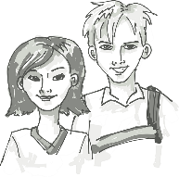
Person B
sprechen
1
Frage:
2
Frage:
1
2
For how long have you been doing that?
When did you do that?
[read book for a week]
[read book a week ago]
[live here ten years ago]
[live here for ten years]
3
Frage:
4
Frage:
3
4
When did you do that?
For how long have you been doing that?
[visit brother for 6 months]
[visit brother 6 months ago]
[ride bike for an hour]
[ride bike a hour ago]
5
Frage:
6
Frage:
5
6
For how long have you been doing that?
When did you do that?
[play volleyball for 7 weeks]
[play volleyball 7 weeks ago]
[eat Italian 5 months ago]
[eat Italian for 5 months]
Notes:
8.2.2.5
DO NOT DISPLAY DURING ACTIVITY
There is a printable version of this activity

Slide 14
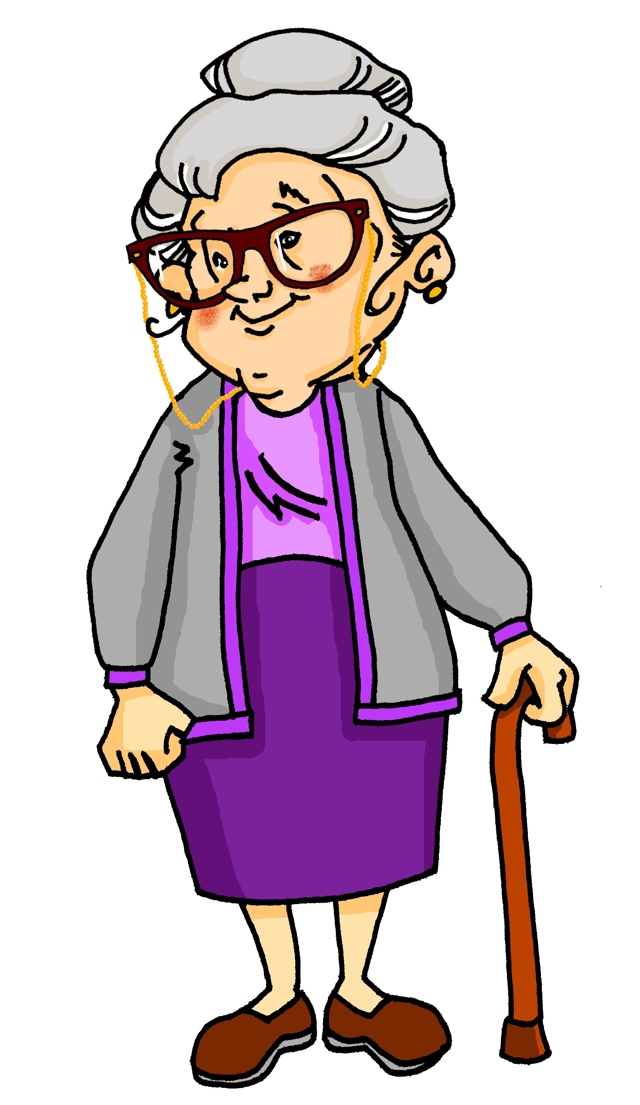
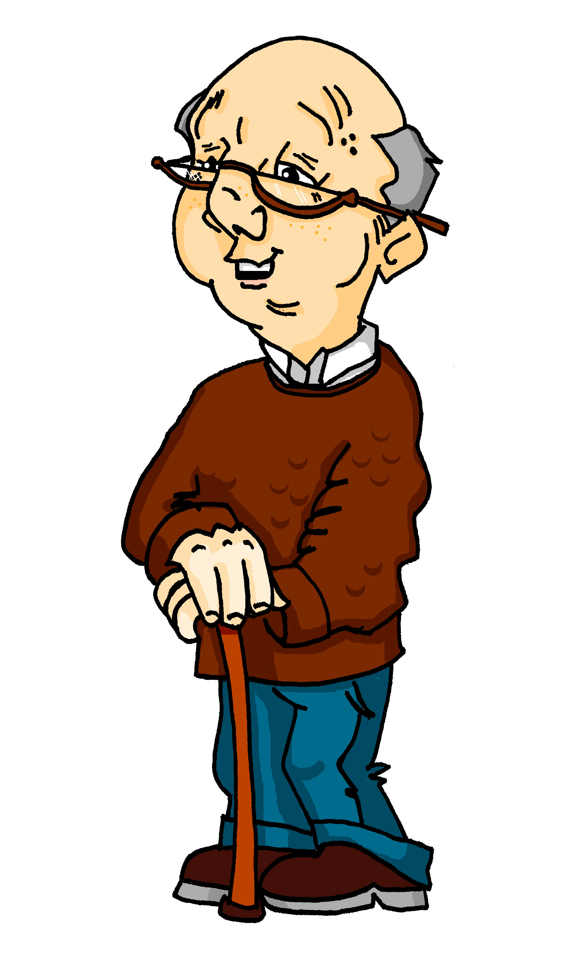
Was haben sie gemacht?
sprechen
Oma hat heute den Tag alleine verbracht. Opa auch.
By chance, they did a few of the same things at the same time.
Compare Oma and Opa’s activities and timings to find the THREE overlap activities.
Partner / Partnerin A
Partner / Partnerin B
Um halb sieben hat Oma Obst gegessen.
Um halb acht hat Opa Obst gegessen.
Notes:
8.3.2.1
Timing: 8 minutes (this slide models the activity) Aim: Oral production of on the hour and half past time with the perfect tense. This is a spot the difference task (information gap). Students work in pairs. Each student has a sheet with eight cards. Partners exchange information to find the three same activities they did at the same time.
Procedure: 1. Use this slide to model the task (click to reveal pictures and model questions/answers).
2. Distribute the sheets on the next two slides.
3. Student A narrates an activity that Oma did.
4. Student B checks if the information on his/her card is the same and responds accordingly. 5. The student B offers a piece of information and so on until all cards have been discussed and the differences found.

Slide 15
Partner(in) A
sprechen
bought a present
did an art course
ate cake
took photos
drank tea
caught a fish
went to café
went to beach
Notes:
8.3.2.1
NOT FOR DISPLAY DURING THE ACTIVITY This slide and the next are available as handouts.
The three activities in common, at the same time are: ate cake, went to café, took photos Common activities at different times: went to beach Common time for different activity: 5:30 drank tea / coffee, 11:30 did a yoga / art course Completely different activities and times: Oma caught a fish bought a present Opa bought some trousers went to cinema

Slide 16
Partner(in) B
sprechen
did a yoga course
drank coffee
went to beach
went to cinema
went to café
ate cake
bought trousers
took photos
Notes:
8.3.2.1
NOT FOR DISPLAY DURING THE ACTIVITY

Slide 17
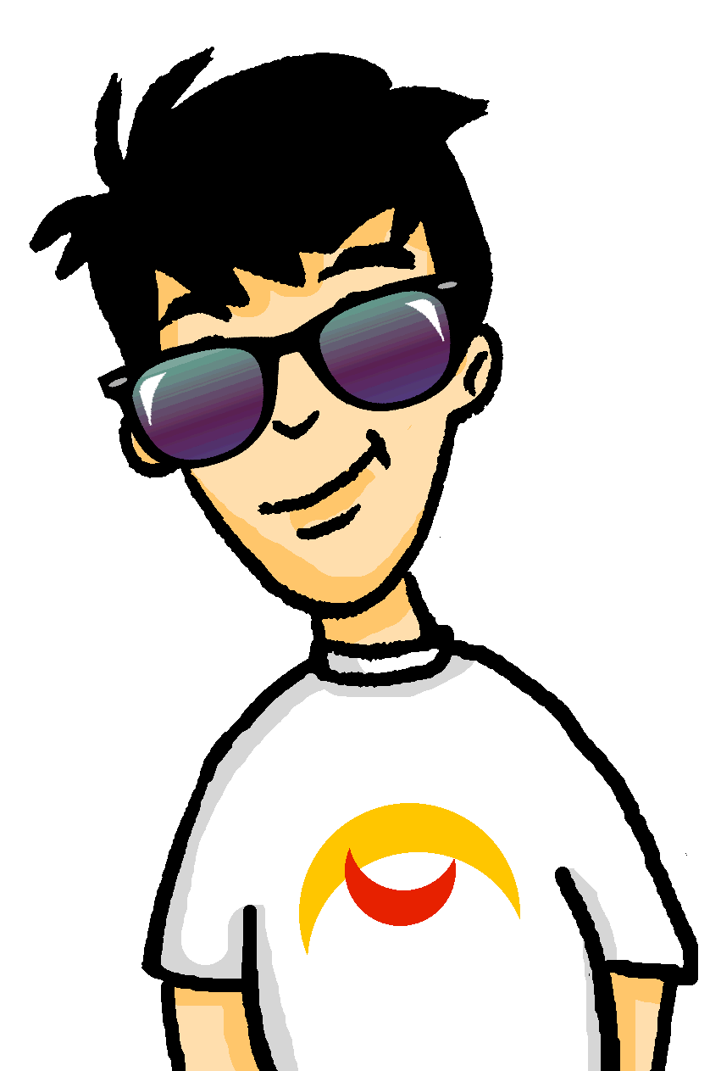
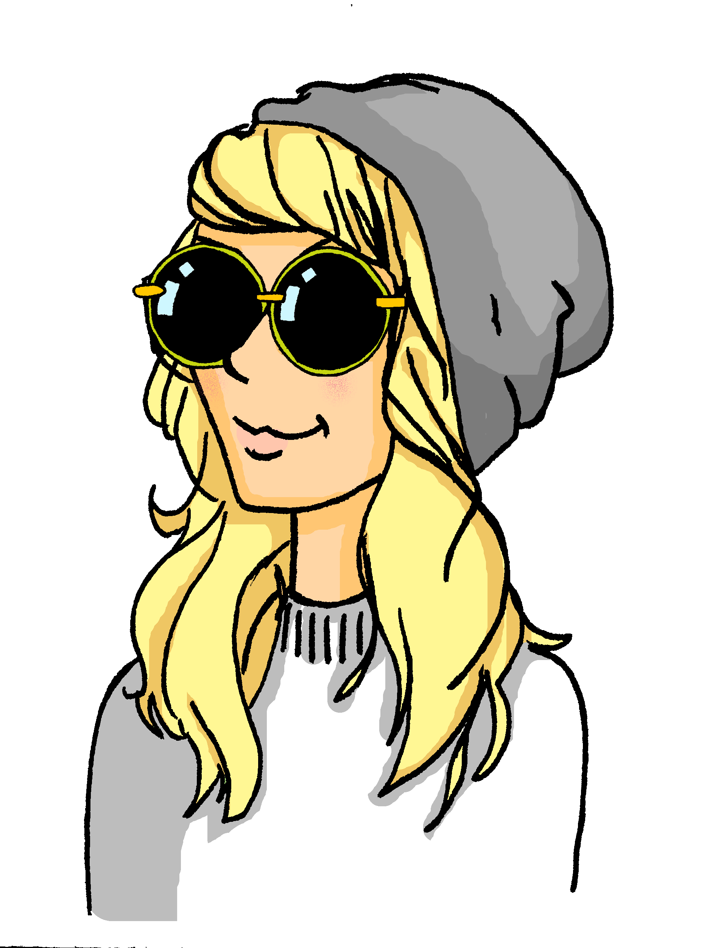
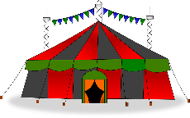
Wo sind sie?
* anschauen = to look at
hören / sprechen
Heidi hat Wolfgang verloren. Was sagt sie über WhatsApp?
Person A liest. Person B (ohne die Tafel anzuschauen*) schreibt die Nummern auf. Dann bist du Heidi.
Person A [Heidi]
Person B [Wolfgang]
Wo bist du? Hör mal, ich stehe am Kiosk 35. Vor mir ist die Bühne 11. Hinter mir sind die Toiletten. Das ist Nummer 27 auf dem Plan. Ich sehe auch das Geschäft, Nummer 36. Das nächste Konzert beginnt in 16 Minuten!
die Bühne [stage]
der Plan [map]
das Zirkuszelt [circus tent]
die Fußmassage [foot massage]
Hi! ich stehe neben dem Zirkuszelt. Das ist Nummer 17 auf dem Plan. Vor mir sehe ich das Café, Nummer 23. Da ist auch die Fußmassage, Nummer 39… Jetzt haben wir nur 12 oder 13 Minuten!
Notes:
8.3.2.2
Timing: 4 minutes (including feedback)
Aim: A paired read aloud task to practise oral production and recognition of words for numbers at text level. There are some unknown words to pronounce in the text, too.
Procedure:
1. Ask the students to read the instructions and check their understanding. At this point, advise student B to turn away from the board.
2. Click to bring up the text for student A.
3. Student A reads the text to student B who writes down all the numbers (in digits).
4. Click again to hide the text that was just used.
5. Students then swap roles.
6. Click on the speech bubbles to hear the texts.
7. Teachers can use the answer slide (next slide) to bring the activity to a close. Elicit the pronunciations of each number from students chorally.
Transcript:
Wo bist du? Hör mal, ich stehe am Kiosk 35. Vor mir ist die Bühne 11. Hinter mir sind die Toiletten. Das ist Nummer 27 auf dem Plan. Ich sehe auch das Geschäft, Nummer 36. Das nächste Konzert beginnt in 16 Minuten!
Hi! ich stehe neben dem Zirkuszelt. Das ist Nummer 17 auf dem Plan. Vor mir sehe ich das Café, Nummer 23. Da ist auch die Fußmassage, Nummer 39… Jetzt haben wir nur 12 oder 13 Minuten!

Slide 18
Antworten
Person A
Person B
17
siebzehn
35
fünfunddreißig
23
dreiundzwanzig
11
elf
39
neununddreißig
27
siebenundzwanzig
12
zwölf
36
sechsunddreißig
13
dreizehn
16
sechzehn
Notes:
8.3.2.2
Timing: 2 minutes
Aim: To provide the answers to the activity on the previous slide.
Procedure: 1. Click to bring up the suggested answers one by one.
2. Elicit the numbers chorally from the class for additional practice, as required.

Slide 19
Wann machst du was?
schreiben /sprechen
When are you getting a new mobile phone?
Wann bekommst du ein neues Handy?
When I lose this one.
Wenn ich dieses verliere.
Wann? + WO2
Wenn + WO3
Notes:
Timing: 10 minutes. This is slide 1/4. Aim: Written and/or oral production of sentences containing wenn and wann to translate ‘when’; revision of WO2 with questions; revision of WO3 with subordinating conjunctions. Procedure: 1. Use this slide to model the task. Explain to students they will have to translate the questions and answers on their role cards, and use these translations to engage in a dialogue with a partner.
2. Click to reveal an English question. Students translate into German. Click to reveal suggested translation.
3. Repeat step 2 for an English statement.
4. Split into pairs, and display slide 21 or distribute printed role cards.
5. Students individually translate their sentences into German (in writing).
6. Partner A asks questions and Partner B answers with the relevant sentence from their card. At higher levels, you may wish to skip the writing stage, and/or encourage students to provide their own answers with wenn + WO3.
7. Students swap roles.
8. Answers on slides 3/4 and 4/4.

Slide 20
Wann machst du was?
schreiben /sprechen
Partner A:
When are you going on holiday?
When do you do do your homework?
When do you watch TV?
When are you finding a job?
When I am hungry.
When I earn enough money.
When it is warm.
When I find my new dress.
Partner B:
When I am older.
When it is summer.
When I have more time.
When I get home.
When are you buying a house?
When are you coming to the party?
When are you eating your sandwich?
When are you going hiking?
Notes:
8.3.2.6
Role cards for printing or display. This is slide 2/4.

Slide 21
Wann machst du was?
schreiben /sprechen
Partner A:
When are you going on holiday?
When do you do your homework?
When do you watch TV?
When are you looking for a job?
Partner B:
When it is Summer.
d) When I get home.
c) When I have more time.
a) When I am older.
Wann fährst du in Urlaub?
Wenn es Sommer ist.
Wann machst du deine Hausaufgaben?
Wenn ich nach Hause komme.
Wann siehst du fern?
Wenn ich mehr Zeit habe.
Wann suchst du einen Beruf?
Wenn ich älter bin.
Notes:
8.3.2.6
Example Answers to Partner A questions – this is slide 3/4.
Procedure:
1. Click to reveal German translation of question.
2. Click to reveal matching English answer.
3. Click to reveal German translation of answer.

Slide 22
Wann machst du was?
schreiben /sprechen
Partner B:
When are you buying a house?
When are you coming to the party?
When are you eating your sandwich?
When are you going hiking?
Partner A:
b) When I earn enough money.
d) When I find my new dress.
When I am hungry.
c) When it is warm.
Wann kaufst du ein Haus?
Wenn ich genug Geld verdiene.
Wann kommst du zur Party?
Wenn ich mein neues Kleid finde.
Wann isst du dein Butterbrot?
Wenn ich Hunger habe.
Wann gehst du wandern?
Wenn es warm ist.
Notes:
8.3.2.6
Example Answers to Partner B questions – this is slide 4/4.

Slide 23
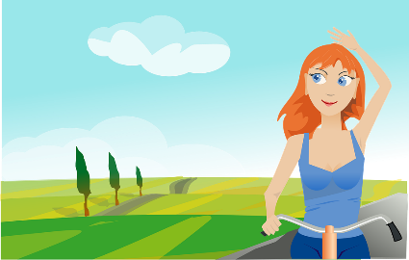
Partnerarbeit
Stelle und beantworte diese drei Fragen. Wiederhole mit zwei anderen Personen.
sprechen
Person A:
1. Was macht dich glücklich? 2. Was ist dir wichtig? 3. Hast du Angst vor …
What makes you happy?
What is important to you?
Are you scared of…?
Person B:
1. Singen macht mich glücklich. 2. Sport ist mir wichtig. 3. Ich habe Angst vor… Clowns.
1. Was macht dich glücklich? 2. Was ist dir wichtig? 3. Hast du Angst vor …
What makes you happy?
What is important to you?
Are you scared of…?
Notes:
8.3.2.7
Timing: 6 minutes Aim: Oral practice of the previously learnt/revised content.
Procedure: 1. Teacher elicits the German forms of the three questions from all students. The animations are set so that this can be done twice before the start of the task. 2. Each student asks one other student the three questions on the slide, and notes the answers.
3. Swap roles.
4. Time allowing, students could either ask a certain number of people (e.g. five), or ask as many other people as they can within the time limit (five minutes).

