Slide 1
Examples
production
Role play tasks (including transactional)

Slide 2
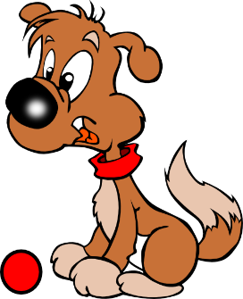
Vokabeln
sprechen
You are organising a garage sale for charity.
Person A has a list of all the items you’re selling and person B knows who is donating what.
Was hat Niko?
Niko has das Tier und die Flasche.
PERSON B
+
PERSON A
Niko
Notes:
7.1.1.5
Timing: 10 minutes Aim: To provide production (speaking) practice in the use of the correct form of the definite article with nouns.
Note: This slide explains the task - the cards themselves are on following two slides.
Procedure: 1. You are organising a garage sale for charity. Person A has a list of all the items you’re collecting and person B knows who is donating what. 2. Person A: Was hat Niko? (alternative: Hat Niko x?)
3. Person B: Niko hat das Tier und die Flasche.
4. Person A: writes down Niko’s items on the response grid (…hat das Tier. … hat die Flasche.)
Which items are left over at the end?
5. Note: this activity combines speaking, listening, and writing. The teacher can remind students that the masculine article ‘der’ changes after a verb.

Slide 3
Vokabeln
sprechen
PERSON A
Person | Ding
Hannah
Julius
Noah
Sarah
Notes:
This is Person A’s card.

Slide 4
Vokabeln
sprechen
PERSON B
+
+
Hannah
Julius
+
+
Noah
Sarah
Notes:
This is person B’s card. Each box shows a person and the two items s/he is donating.

Slide 5
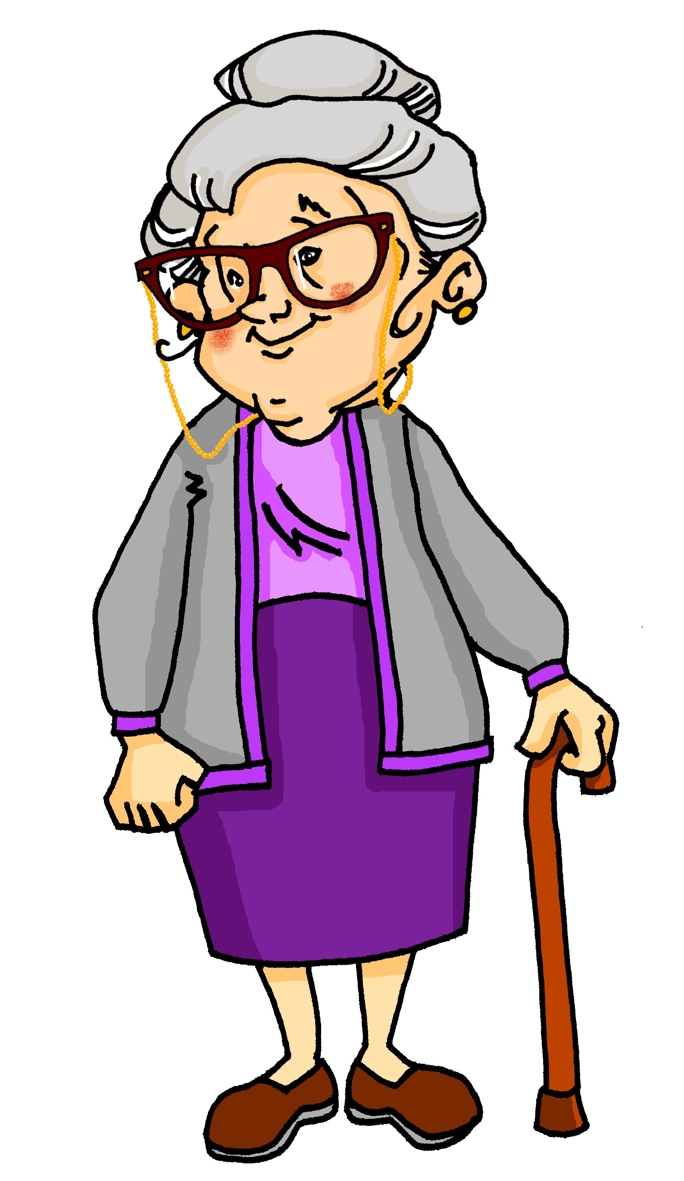
Wer arbeitet zu Hause?
sprechen / hören
Oma (granny) says Wolfgang and Mia don’t help at home.
Partner A: You are Mia. Tell your granny what you (me) and your brother (he) do at home.
Partner B: Make a note of who does what, according to Mia.
Notes:
7.2.1.2
Timing: 5 minutes Aim: To practise oral sentence production using the first and third person singular forms of the verb Procedure: 1. Elicit the meaning of the TL title. All language has been previously taught.
2. Go through the instructions, which here are given in English, for clarity (information gap tasks can be tricky to explain).

Slide 6
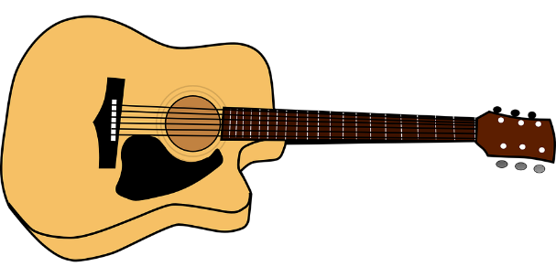
Partner A
sprechen / hören
me
work in garden
2. me
clean floor
3. he
play guitar
4. he
sing
5. he
do sport
6. me
make the bed
7. me
clean the room
8. he
sit in the garden
Notes:
7.2.1.2
This is Partner A’s card.

Slide 7
Partner B
sprechen / hören
Write who does what. Write 1-8, ‘Mia’ or ‘he’ and the activity.
1
2
3
4
5
6
7
8
Notes:
7.2.1.2
This is Partner B’s card.
Note: This slide does not need printing. Students write 1-8 in their books and complete the activity.

Slide 8
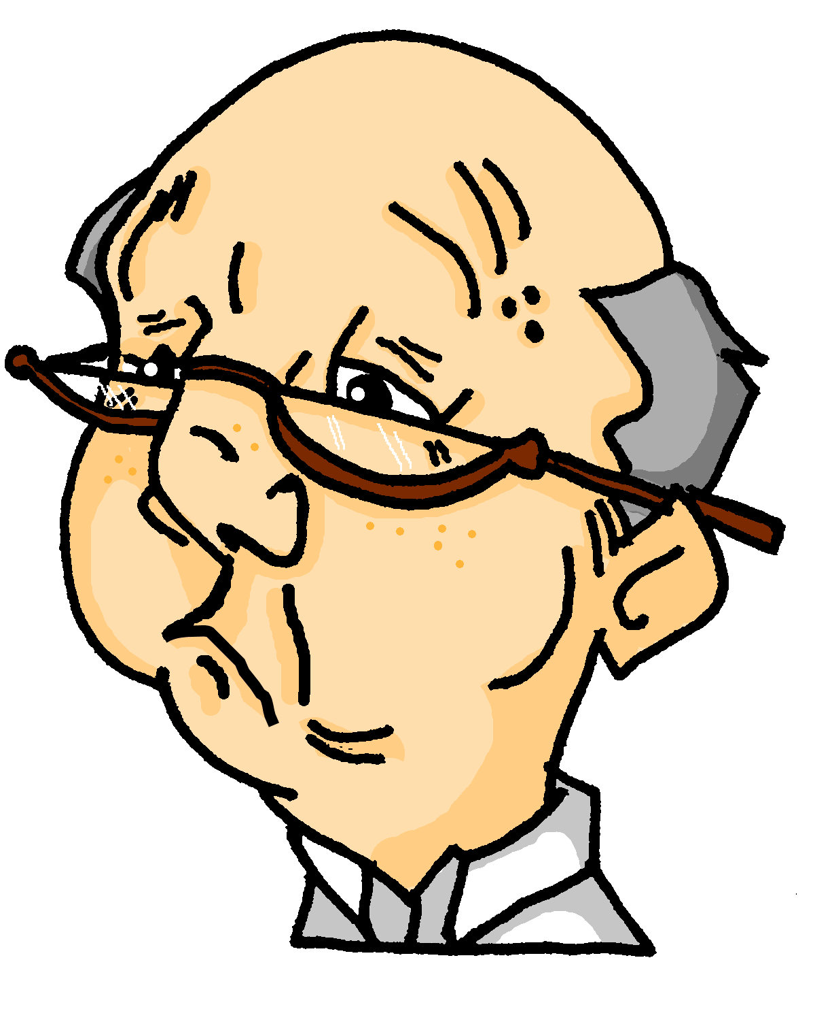
Das ist falsch!
sprechen / hören
Das ist falsch!
Opa (grandpa)arrives.
He says he and Oma do it all.
Partner B: You are Opa. Say what you do (me) and what Oma does (she).
Partner A: Make a note of who does what, according to Opa.
Notes:
7.2.1.2
This side explains what happens when the partners swap roles.

Slide 9
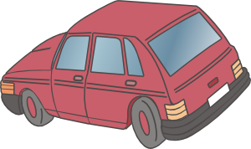
Partner B
sprechen / hören
me
clean car
2. she
cook
3. she
clean the floor
4. me
sit in the garden
5. me
write a list
6. me
make the bed
7. she
works in the garden
8. me
work on computer
Notes:
7.2.1.2
This is Partner B’s card for the second round.

Slide 10
Partner A
sprechen / hören
Write who does what. Write 1-8, ‘Opa’ or ‘she’ and the activity.
1
2
3
4
5
6
7
8
Notes:
7.2.1.2
This is Partner A’s card for the second round.
Note: This slide does not need printing. Students write 1-8 in their books and complete the activity.

Slide 11
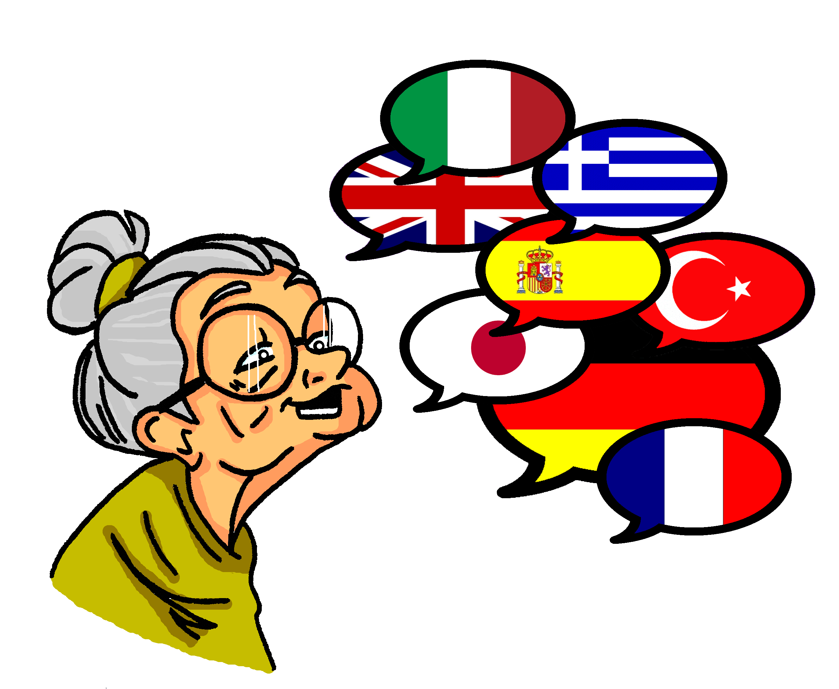
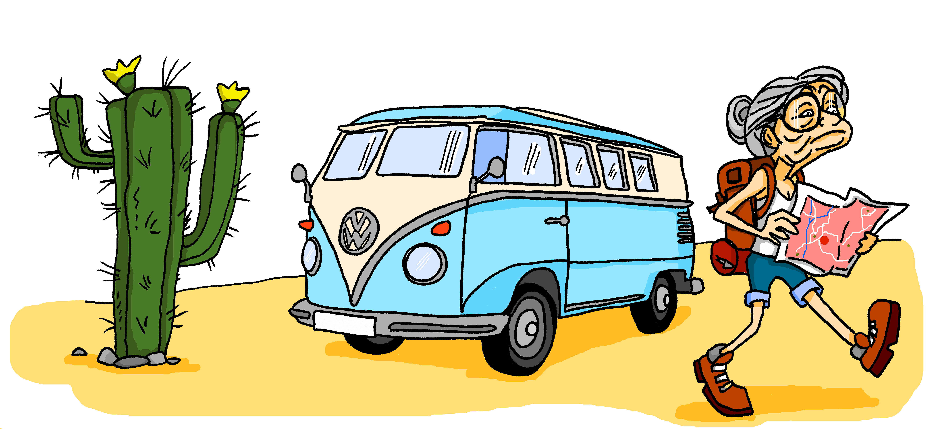
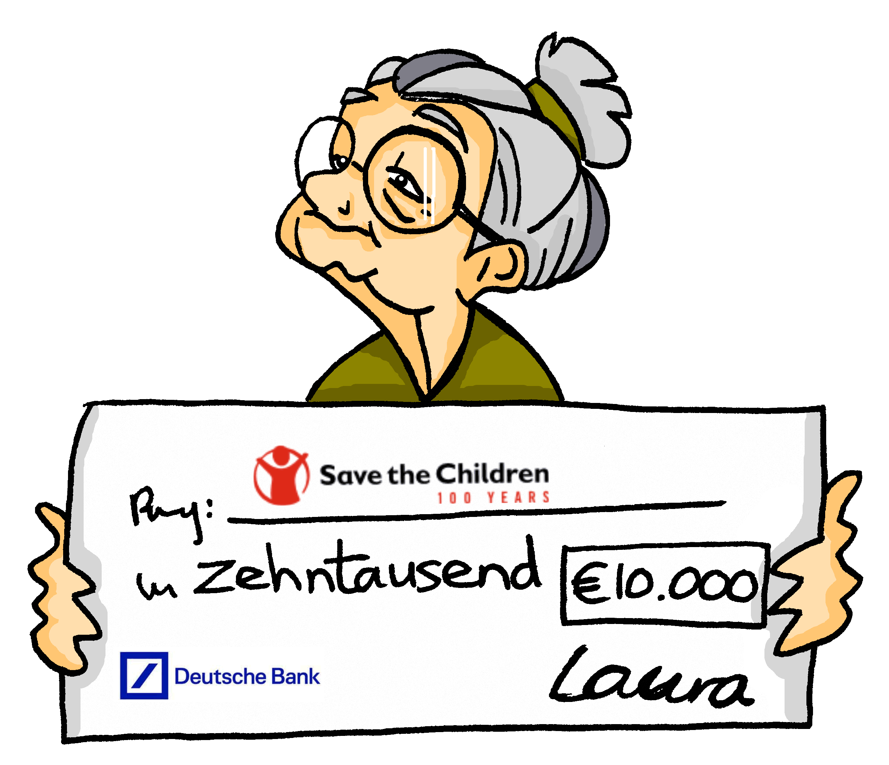
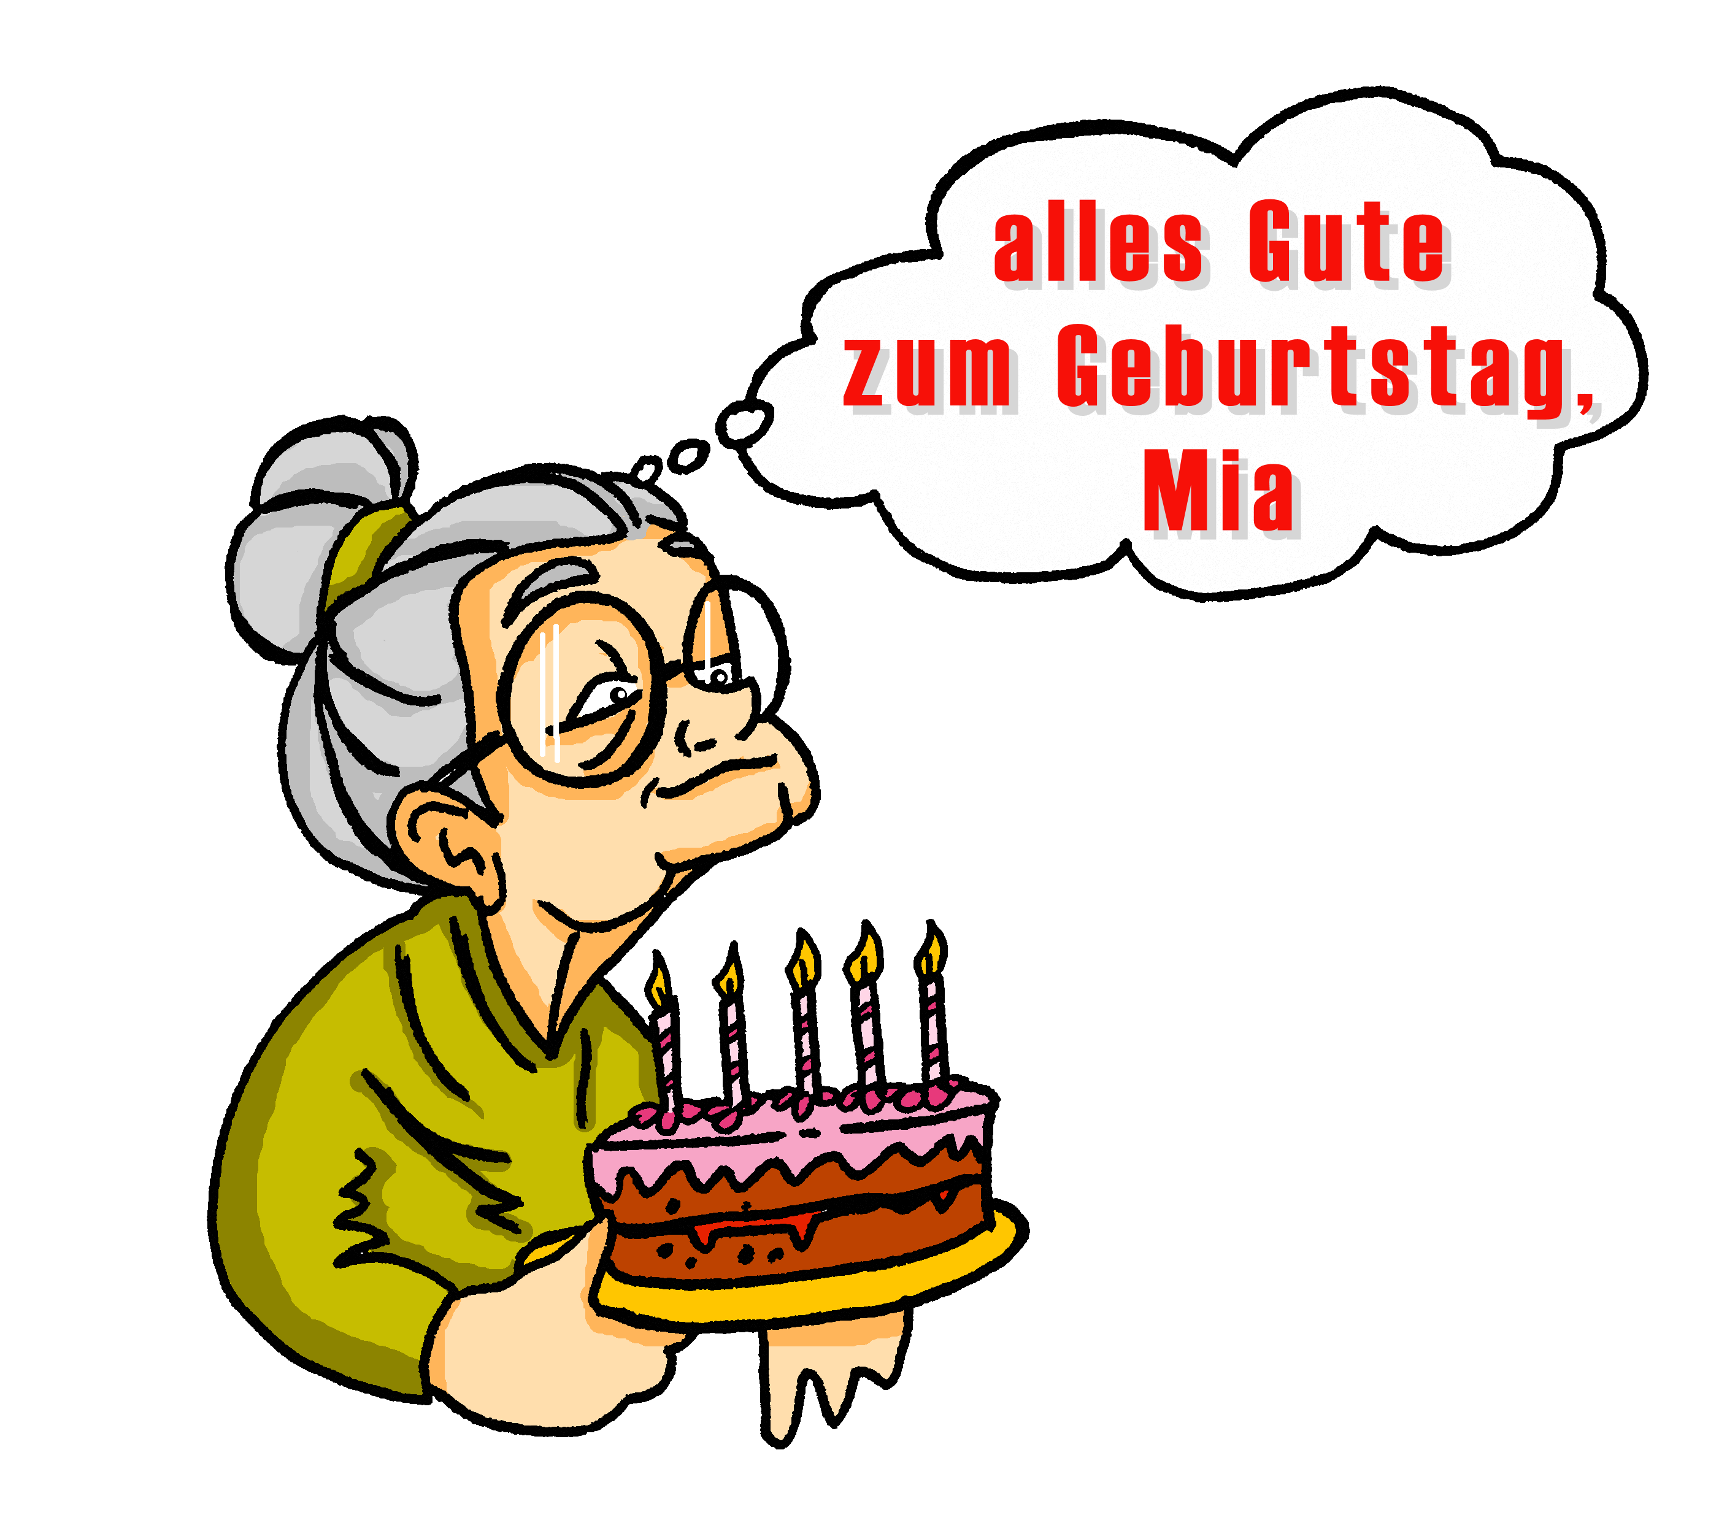
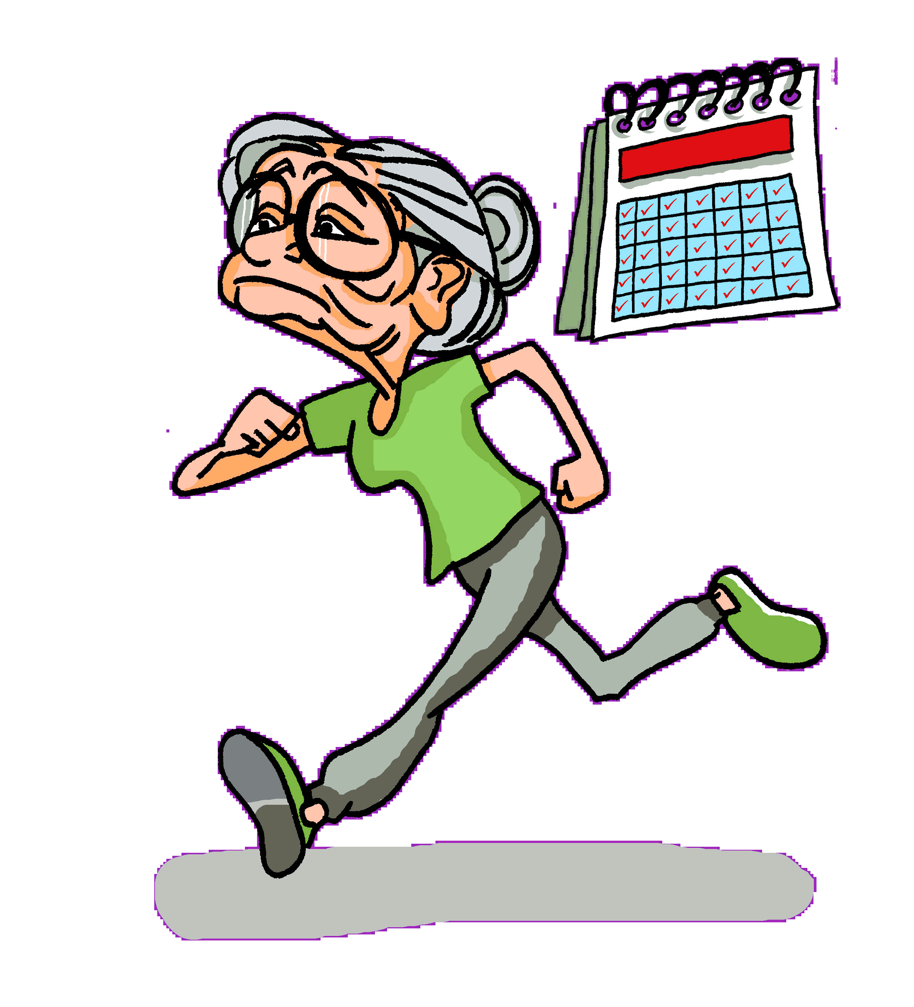
PERSON A
sprechen
vergessen
sprechen
fahren
laufen
geben
Notes:
7.2.2.3
Timing: 10 minutes
Aim: To practise spoken production of strong verb forms (1st and 3rd person singular).
Note: Tante Laura defies expectations! She lives an active and busy life.
This is Student A’s card.
Note: This speaking activity intentionally requires each learner to produce just one verb form at a time, for a few sentences, before swapping to the other form. Then, in the next activity, more ‘desirable difficulty’ is built in as they have to actively choose which form they use each time they make a sentence.
Procedure:
Students work in pairs.
Person A and person B have a different set of pictures.
Person A describes one of their pictures (Tante Laura….).
Person B finds the corresponding picture for Mia and describes it from Mia’s perspective (Ich…).
Then person A starts with the next picture.
Repeat until all pictures have been described.
Activity could be repeated in different order with roles swapped.

Slide 12
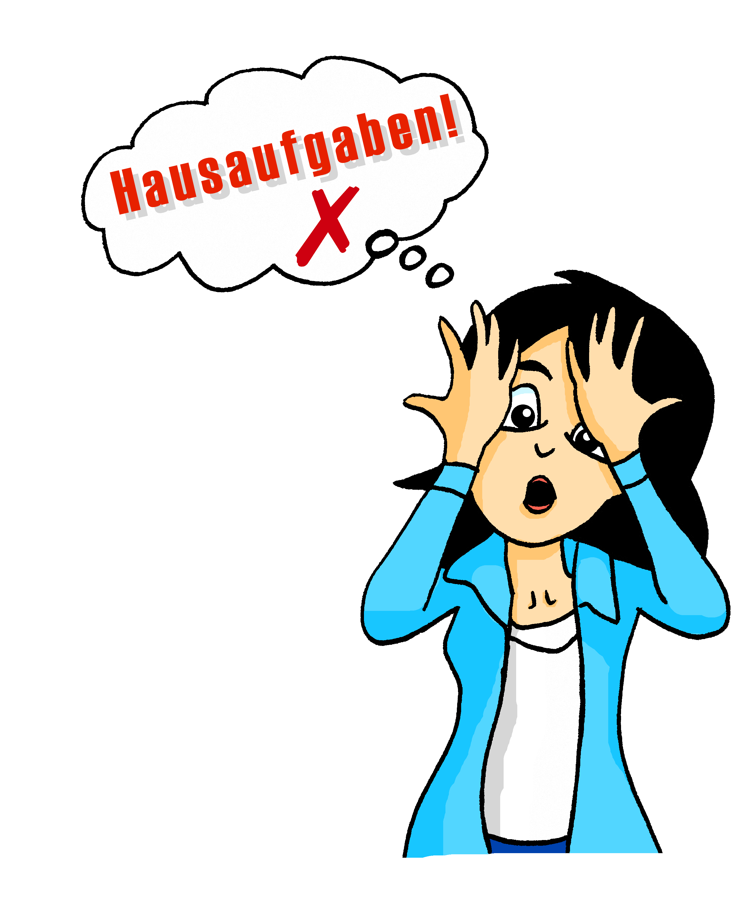
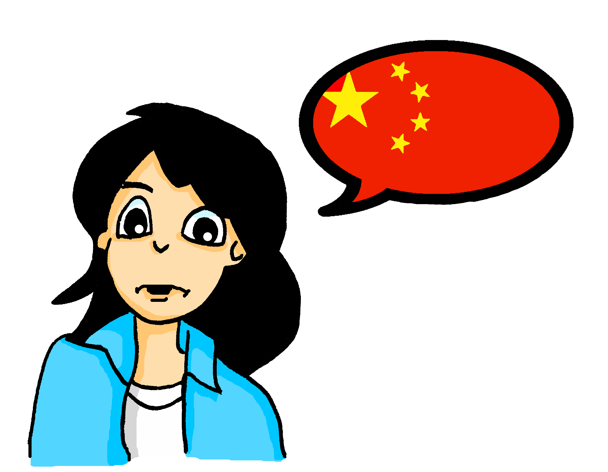
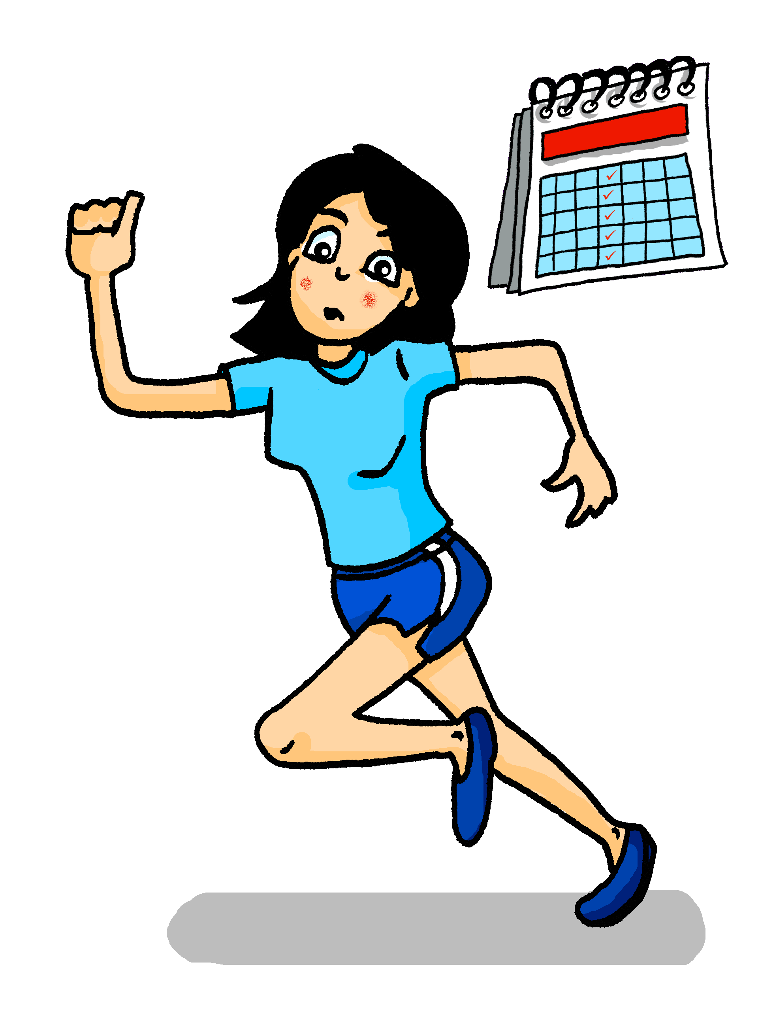
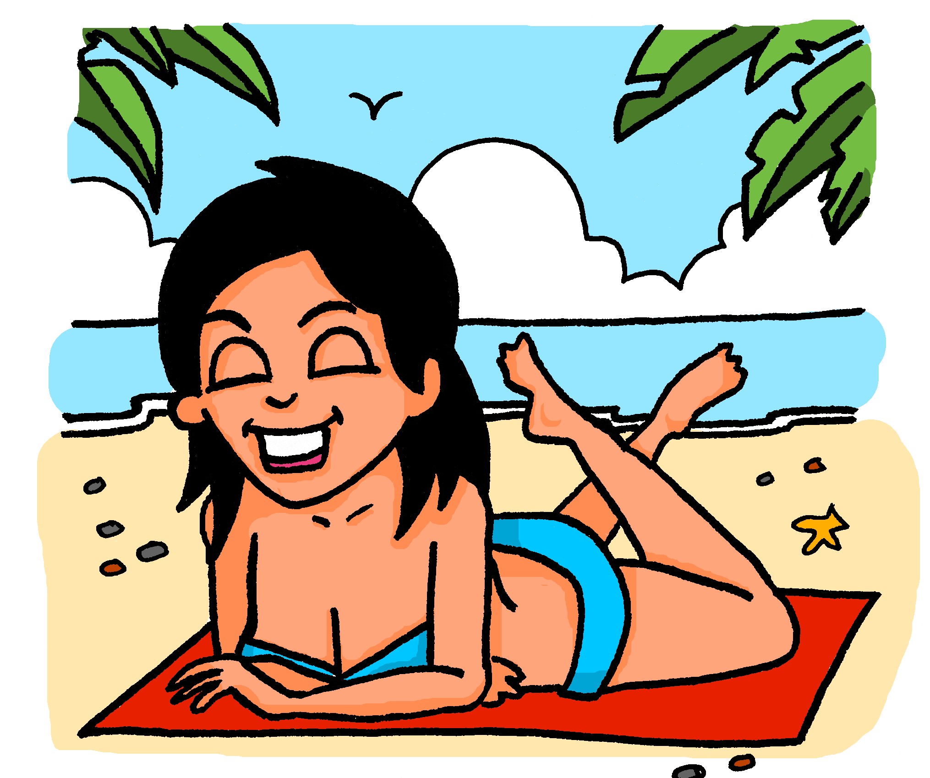
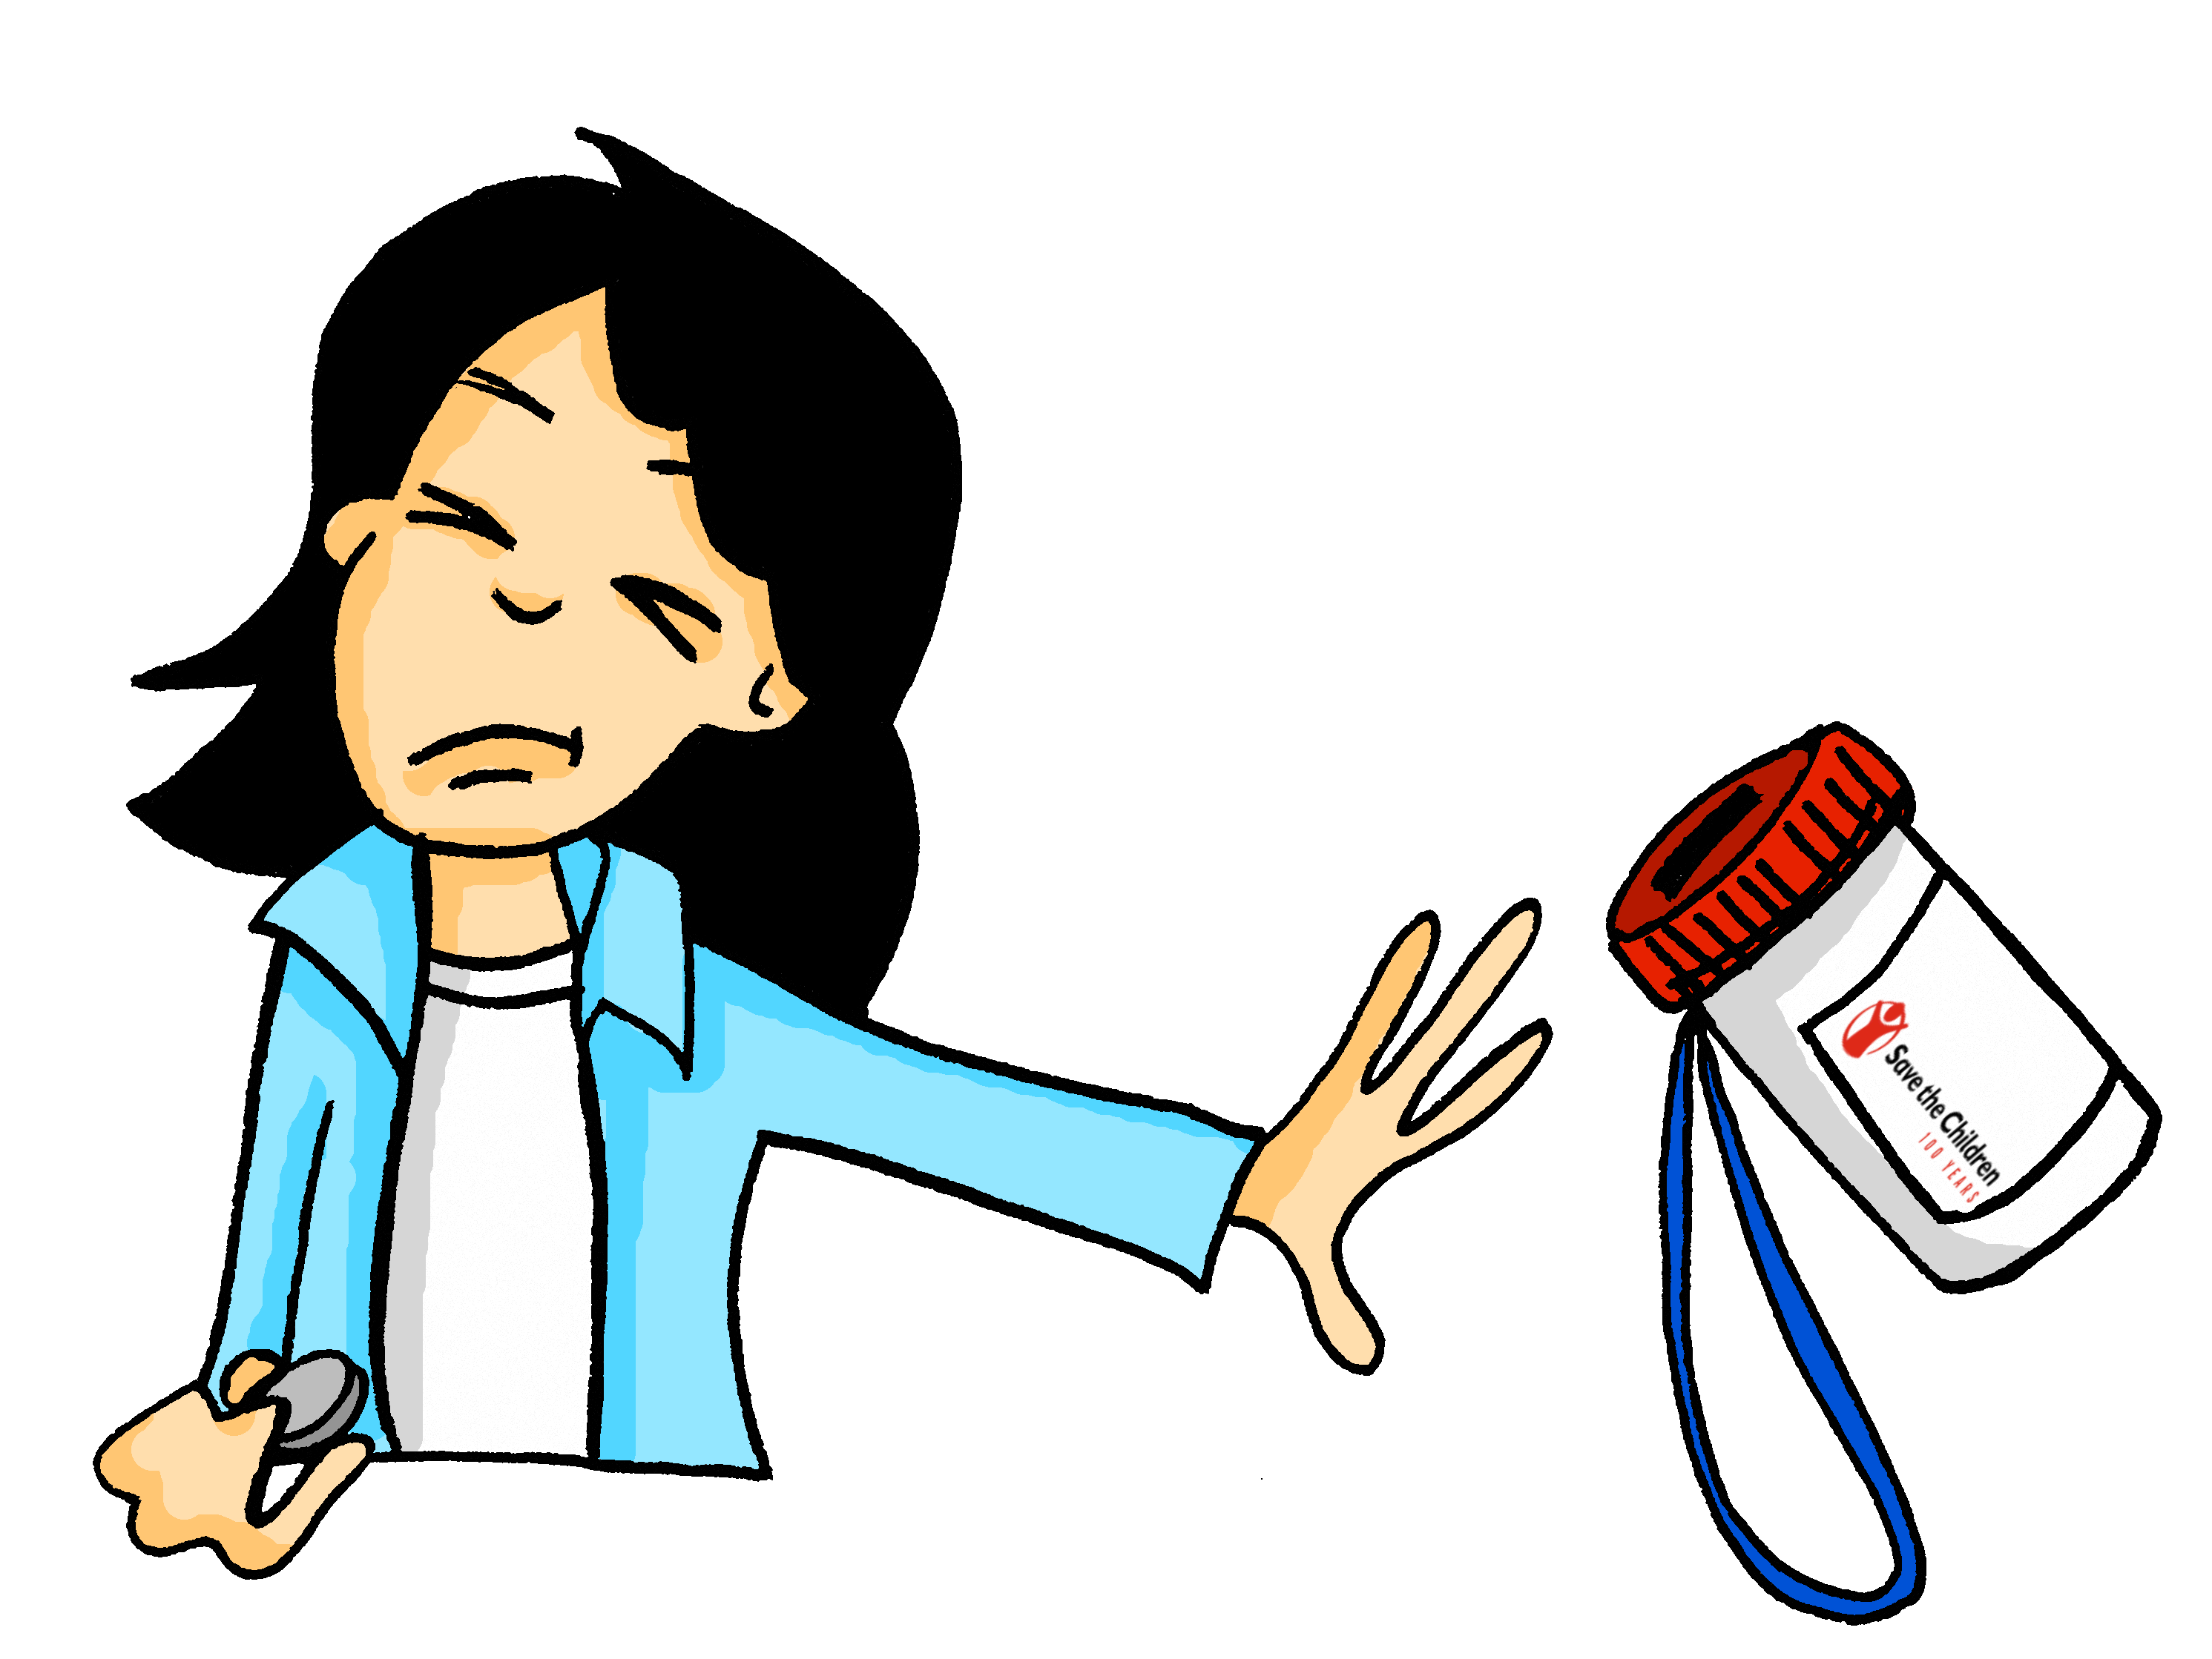
PERSON B
sprechen
vergessen
sprechen
schlafen
laufen
geben
Notes:
7.2.2.3
This is Student B’s card.

Slide 13
Neue Freunde finden
hören / sprechen
Person B gibt Infos über die 3 Personen:
Person A ist Mehmet und fragt.
Dieter
Claudia
Kurt
Ich spiele XXX. Was spielst du, Dieter?
… spiele XXX.
… spiele XXX.
… spiele XXX.
Notes:
7.2.2.4
Timing: 15 minutes
Aim: To model the speaking task.
Note: Speaking, listening. Scenario - neue Freunde finden (SSC –[eu]). Mehmet and Mia are looking to find some new friends. They have filled out a profile and each have three potential matches.
Students will need one A4 handout (which has the information needed for both rounds of the task).
Procedure:
Students make three columns and write each name at the top. The names revise SSC vowel and/or vowel combinations IE / AU / U.
Person A asks for information about each of the categories. They will need to ask each question three times (Ich spiele Saxophon. Was spielst du + name of person 1, 2, 3 ?)
Person B answer the questions from the information on their card., as that person (i.e. in the 1st person).
When all the information has been exchanged person A picks the best match for Mehmet.
The activity is then repeated for Mia with the roles swapped.
Note: there is a mix of strong and weak verbs. There is no card with a 100% match. The task is to find the best match, not a 100% match.

Slide 14
Person A
Mehmet
Dieter | Claudia | Kurt
Schlagzeug spielen
oft Pizza essen
Ski fahren + einmal
die Woche laufen
Bücher lesen
Deutsch und
Türkisch
jeden Tag einen Rücksack tragen
Hunde mögen
Notes:
7.2.2.4
DO NOT DISPLAY
Person A card (Mehmet)

Slide 15
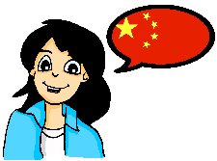
Person B
Mia
Frieda | Ulrike | August
Klarinette spielen
oft Gemüse essen
Skateboard fahren +
einmal die Woche
schwimmen
Bücher lesen
Deutsch und
Chinesisch
jeden Tag eine Tasche tragen
Katzen mögen
Notes:
7.2.2.4
DO NOT DISPLAY
Person B card (Mia)
Repeat the task with swapped roles.

Slide 16
Person A
Frieda
Ulrike
August
Schlagzeug spielen
Klarinette spielen
Schlagzeug spielen
oft Fleisch essen
oft Gemüse essen
oft Eis essen
Rad fahren
Skateboard fahren +
jeden Tag schwimmen
Rad fahren + jeden Tag laufen
Bücher lesen
Zeitungen lesen
Zeitungen lesen
Deutsch und ein
bisschen Englisch
Deutsch
Deutsch und ein
bisschen Chinesisch
jeden Tag eine Tasche tragen
jeden Tag eine Tasche tragen
jeden Tag einen Rücksack tragen
Katzen mögen
Hunde mögen
Katzen mögen
Notes:
7.2.2.4
DO NOT DISPLAY
Person A cards (Mia)

Slide 17
Person B
Dieter
Klaudia
Kurt
Schlagzeug spielen
Saxophon spielen
Saxophon spielen
oft Pizza essen
oft Pizza essen
oft Eis essen
Ski fahren +
jeden Tag laufen
Rad fahren + jeden
Tag laufen
Ski fahren + einmal
die Woche laufen
Bücher lesen
Zeitungen lesen
Zeitungen lesen
Deutsch und ein
bisschen Türkisch
Deutsch und ein
bisschen Englisch
Deutsch und ein
bisschen Englisch
jeden Tag einen Rücksack tragen
jeden Tag einen Rücksack tragen
jeden Tag eine Tasche tragen
Katzen mögen
Katzen mögen
Katzen mögen
Notes:
7.2.2.4
DO NOT DISPLAY
Person B cards (Mehmet)

Slide 18
Meine Woche und deine Woche
schreiben / sprechen / hören
Was macht dein Partner/deine Partnerin? Mach Notizen!
Mo | Di | Mi | Do | Fr | Sa | So
Notes:
7.3.1.1
Timing: 10 minutes
Aim: To practise oral production and comprehension and written production of previously taught vocabulary. In this multimodal activity, students revise vocabulary introduced in week 3.1.1. They will extend their knowledge of these words in this lesson.
Procedure: 1. Students have not yet encountered the word Notiz [>4034], used in the task rubric. Teacher to encourage students to draw on knowledge of English to infer the meaning of the instruction (take notes).
Note: Students should have already prepared sentences describing what they do each day, as this was set for homework in 3.1.1.
2. Students sketch grids as shown above, and work with a partner to find out about their week. They take it in turns to ask Was machst du am Montag, am Dienstag etc., taking notes on what they hear. If a student says something their partner doesn’t understand (a new word they have found in the dictionary), the partner should be encouraged to ask Was heißt/wie sagt man das auf Englisch? to find out the meaning, and to ask Wie schreibt man das? to find out the spelling.
3. Students will use their answers in the written exercise on the next slide.

Slide 19
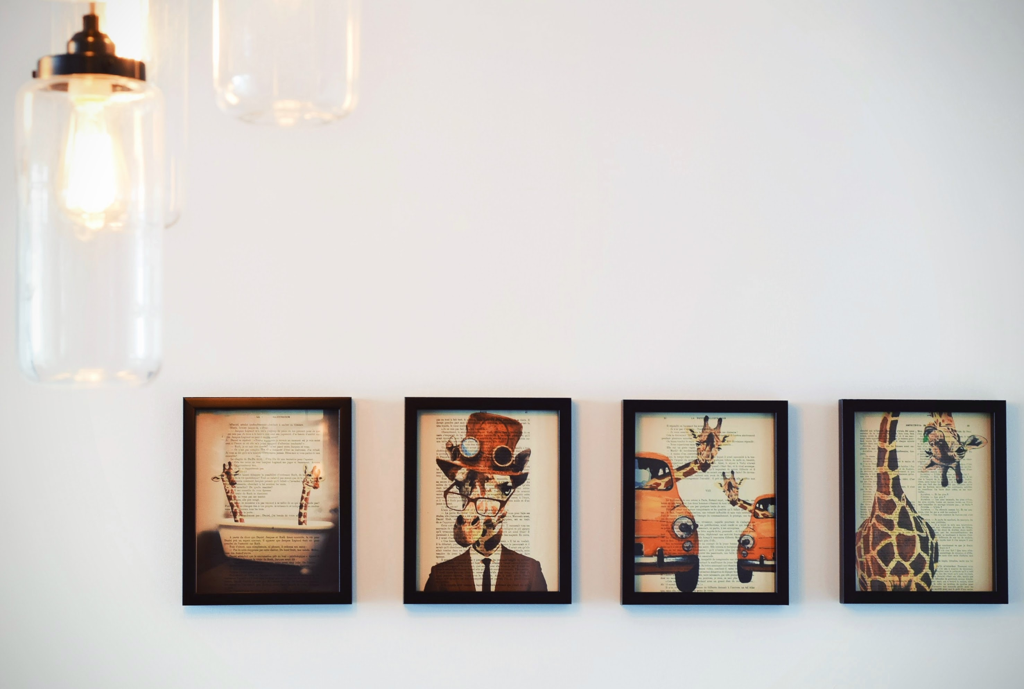
Am Wochenende
sprechen / schreiben
Ich schwimme oft.
Person B
Sie schwimmt oft.
Person A
(Anna)
Anna
Noah
Mutti
Vati
Notes:
7.3.1.5
Timing: 5 minutes
Aim: To provide paired speaking/listening/ writing practice, which re-uses the statements in the previous listening activity.
Note: Students will have to pay attention to:
person and number marking
picking the correct possessive adjectives
choosing the correct word order
Procedure:
Person A
1. Retell what Anna’s family does on a typical Saturday.
2. Use the prompts and pictures to help you recreate the sequence.
3. Use Anna’s perspective (i.e., retell it as if you were Anna – Ich schwimme oft)
Person B
1. Listen to person A
2. Write down the information.
3. Use the perspective of a reporter (i.e., like you are reporting what is being said -- Anna schwimmt oft).
Note: the activity can be simplified by using Mutti, Vati, and Noah instead of meine Mutter, mein Vater, and mein Bruder.

Slide 20
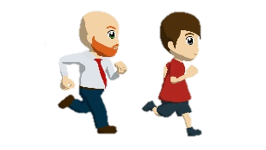
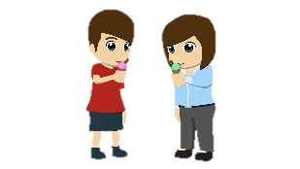
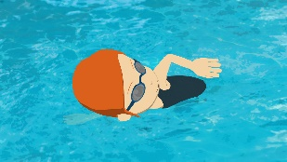
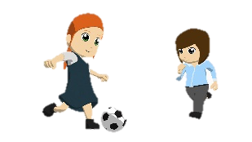
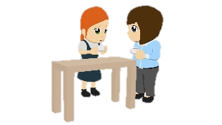
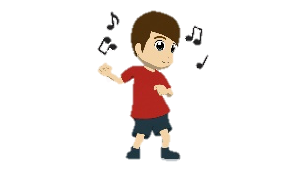
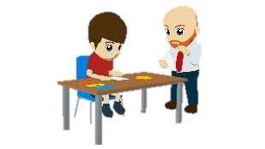
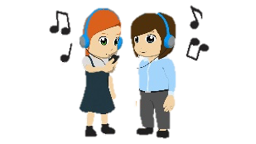
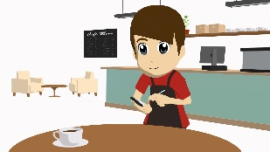
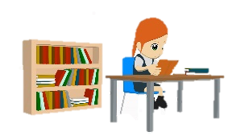
PERSON A
1
Zuerst …
6
Danach …
2
…
7
Am Nachmittag …
3
Am Morgen …
8
…
4
…
9
…
5
Am Nachmittag …
10
Schließlich …
Notes:
7.3.1.5
Person A – Cues and pictures
***Don’t show this slide***
The worksheet will also be available in a printable format.

Slide 21
German
PERSON B
Was machen Anna und ihre Familie am Sonntag?.
1
Zuerst laufen ihr Vater und ihr Bruder (10 km).
2
Sie schwimmt.
3
Am Morgen trinken ihre Mutter und sie Kaffee.
4
Ihr Vater und Bruder schreiben oft Briefe.
5
Am Nachmittag arbeitet ihr Bruder in einem Café.
6
Danach essen ihre Mutter und ihr Bruder Eis.
7
Am Nachmittag spielen ihre Mutter und sie auch Fußball.
8
Am Abend tanzt ihr Bruder.
9
Ihre Mutter und sie hören Musik.
10
Schließlich liest sie ein Buch.
Notes:
7.3.1.5
Timing: 3 minutes
Aim: To provide the answers to the activity on the previous slide.
Note: This slide can be used as a self-study support. Student A can check that they gave the correct sentence prompts by clicking on each of the numbers. They can then click to see what their partner would have written down.
Procedure:
1. Click to bring up the answers one by one.
Note: Clicking on each number activates the audio for each sentence, so that students who are studying at home can have a second opportunity to generate the spoken sentences, (using the previous slide’s prompts and taking the role of Person B, too).
This is what Person B would then say:
Zuerst laufen mein Vater und mein Bruder 10 Kilometer.
Ich schwimme.
Am Morgen trinken meine Mutter und ich auch Kaffee zusammen.
mein Vater und mein Bruder schreiben oft Briefe.
Am Nachmittag arbeitet mein Bruder in einem Café.
Danach essen meine Mutter und mein Bruder Eis.
Am Nachmittag spielen meine Mutter und ich auch Fußball.
Mein Bruder mag tanzen und er macht das am Abend.
Meine Mutter und ich hören Musik
Schließlich lese ich ein Buch.

Slide 22
Am Wochenende
sprechen / schreiben
Ich schwimme oft
Person A
Person B
(Noah)
Er schwimmt oft
Anna
Noah
Mutti
Vati
Notes:
7.3.1.5
Timing: 5 minutes
Aim: To provide paired speaking/listening/writing activity using the same format as the previous activity.
Note: Person A and person B swap roles. This time B discusses what Anna & Noah’s family do on a Sunday and from Noah’s perspective. Some of the verbs are re-used from the previous activity and some are new. Where they have been re-used, they appear in a different form.
Procedure: Person B
Describe what Noah’s family does on a typical Sunday.
Use the prompts and pictures to help you create the sequence.
Use Noah’s perspective (i.e., retell it as if you were Noah – Ich schwimme oft)
Person A
Listen to person A
Write down the information
Use the perspective of a reporter (i.e., like you a reporting what is being said - Noah schwimmt oft).
Note: the activity can be simplified by using Mutti, Vati, and Noah instead of meine Mutter, mein Vater, and mein Bruder.

Slide 23
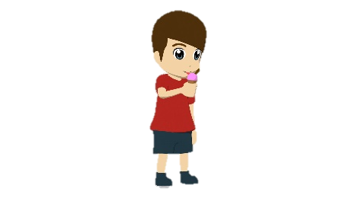
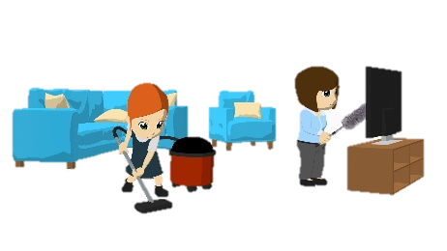
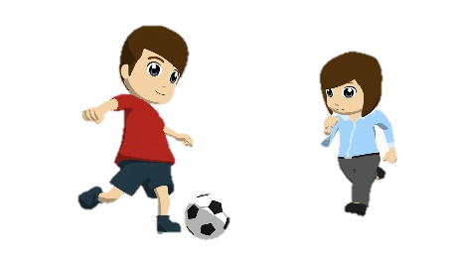
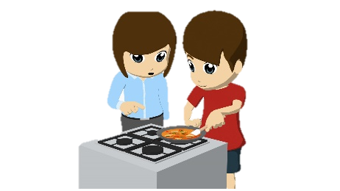
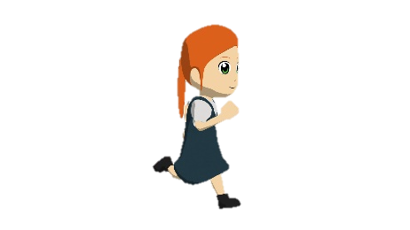
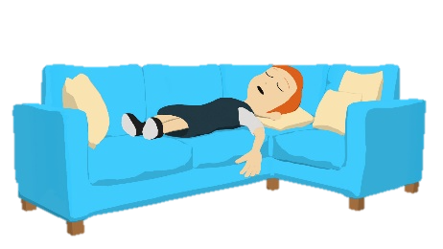
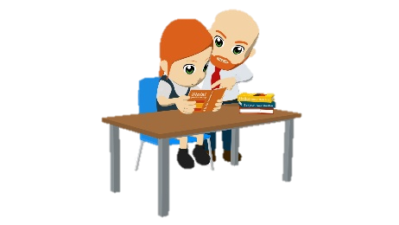
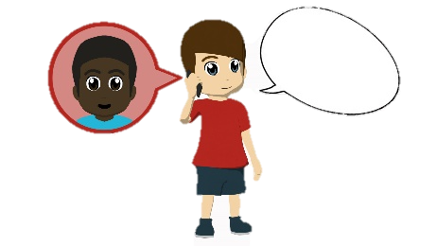
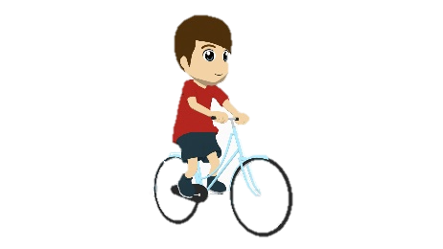
PERSON B
1
Jeden Sonntagmorgen …
6
…
2
Danach …
7
…
3
…
8
Dann …
4
Später …
9
Am Abend …
5
Am Nachmittag …
10
…
Notes:
7.3.1.5
Person B – Cues and pictures
***Don’t show this slide***
The worksheet will also be available in a printable format.
What Person B says:
Jeden Sonntagmorgen esse ich Eis.
Danach spielen meine Mutter und ich Fußball.
Meine Schwester läuft.
Später lesen meine Vater und Schwester en Buch.
Am Nachmittag fahre ich Rad.
Meine Schwester und meine Mutter putzen das Wohnzimmer.
Meine Mutter und ich kochen das Essen.
Dann schläft meine Schwester.
Am Abend spreche ich it Freunden.
Meine Mutter und ich zeigen Bilder.

Slide 24
Was ist die Frage?
sprechen
Jede Person hat fünf Antworten auf der Karte.
Person A sagt die erste Antwort.
Person B muss eine Frage stellen.
Person B sagt die erste Antwort.
Person A muss eine Frage stellen….
Notes:
7.3.2.4
Timing: 6 minutes
Aim: To practise oral production of questions and revisit vocabulary from the two revisited sets for this week.
Note: This task requires the separate speaking worksheet downloadable from the NCELP Resource Portal. A/B roles are on one A4 sheet, to be cut in half. Instructions for the task are in English.
Procedure: 1. Person A and B both have five answers on a card.
Note: they have completely different answers from each other.
2. Person A gives person B one of the answers. Person B then comes up with a suitable question that would generate that answer.
3. Then person B gives person A an answer and s/he generates a suitable question.
4. They continue taking turns until all answers have been used, and ten questions generated.
5. Teachers will want to circulate to give support where necessary.
Examples:
Man mischt blau und gelb. Wie macht man grün?
Das kommt aus 1907. Wie alt ist Mensch, ärgere dich nicht!?

