Slide 1
Phonics: SSCs [a] and [o] (revisited)
Y7 Spanish
Term 2.1 - Week 4 – Lesson 35
Victoria Hobson / Nick Avery / Rachel Hawkes
Date updated: 30/03/20
Notes:
Learning outcomes
Revisiting of SSC : [a] [o]
Frequency rankings of vocabulary introduced this week (1 is the most common word in Spanish):
vocab set:¿cuándo? [57]; ¿cuánto? [580]; ¿cuál? [445]; hacer [26]; hago; haces; hace; deporte [1489]; deberes [2187]; actividad [344]; dibujo [1726]; noche [164]; tarde [392]; mañana [402]; de [2]; para [16]
Frequency rankings of vocabulary revisited this week (1 is the most common word in Spanish):
1.2, week 3: hay [13]; mirar [125]; mesa [525]; silla [1271]; ventana [752]; puerta [274]; chica [1129]; persona [108]; chico [727]; aquí [130]; allí [197]; clase [320]
2.1 week 1: balcón [3133]; dama [2062]; torre [2138]; caballero [2056]; saber [44]; pasar [68]; blanco [372]; flor [739]; plaza [806]; llevar [101];

Slide 2
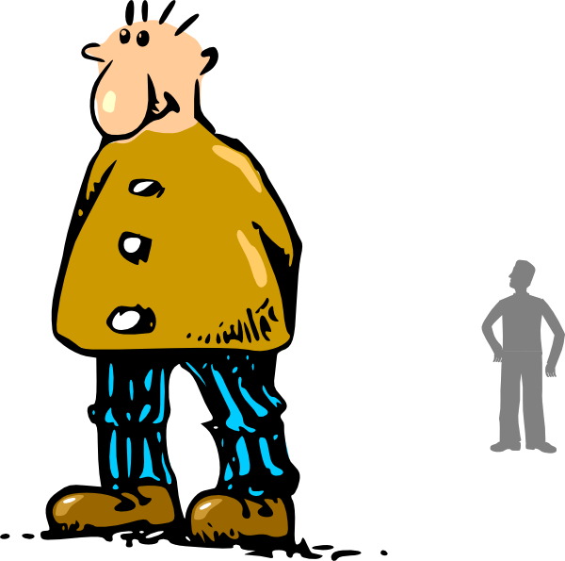
a
alto
Notes:
A refresh of the SSC ‘a’ ahead of the phonics consolidation activity

Slide 3
o
yo
Notes:
A refresh of the SSC ‘o’ ahead of the phonics consolidation activity

Slide 4
Escucha. Escribe la letra correcta y la palabra en inglés.
 | Palabra | Traducción
 | fl__r
 | s__ber
 | t__rre
 | b__lcón
 | p__s__r
 | Palabra | Traducción
 | d__m__
 | bl__nc__
 | pl__z__
 | c__b__ller__
 | llev__r
1
o
flower
6
a
a
lady
2
a
to know
7
a
o
white
3
o
tower
8
a
a
square
a
balcony
9
a
a
o
gentleman/knight
4
5
a
a
to pass
10
a
to carry/wear
Notes:
TRANSCRIPT
flor
saber
torre
balcón
pasar
dama
blanco
plaza
caballero
llevar
Vocabulary revisted from 2.1 week 1, as per cycle of revisiting in vocabulary learning homework for this week.
balcón [3133]; dama [2062]; torre [2138]; caballero [2056]; saber [44]; pasar [68]; blanco [372]; flor [739]; plaza [806]; llevar [101];

