Slide 1
Asking and answering questions about having
VSO questions; negation with
kein + nouns R2 (accusative); mein/meine/mein R1 (nominative)
SSC [ie]
Y7 German
Term 1.1 - Week 7 - Lesson 13
Natalie Finlayson / Rachel Hawkes
Artwork: Steve Clarke
Date updated: 15/12/21
Notes:
Artwork by Steve Clarke. All additional pictures selected are available under a Creative Common license; no attribution required.
Learning outcomes (lesson 1):
Introduction of SSC [ie]
Introduction of VSO (verb-subject-object) questions;
Word frequency (1 is the most frequent word in German):
7.1.1.7 (introduce) Band [<5009] Buch [300] Film [505] Lehrerin [695] Lied [1733] Sänger [3029] Sängerin [3916] leider [643] Lieblings- [n/a]
7.1.1.4 (revisit) wissen [78] bist [4] du [54] Farbe [1079] Nummer [806] Ort [341] Tier [614] aber [31] kein [46] ich weiß nicht [n/a] wie sagt man [n/a] wie schreibt man [n/a] das ist (nicht) klar
Source: Jones, R.L. & Tschirner, E. (2019). A frequency dictionary of German: core vocabulary for learners. Routledge

Slide 2
Vokabeln
sprechen
Wie sagt man…?
Notes:
Timing: 1 minute
Aim: To revise use of ‘wie sagt man...?’ Procedure: 1. Revise use of ‘wie sagt man…’ and responses ‘ich weiß/ich weiß nicht’ in whole class feedback.

Slide 3
Vokabeln
sprechen
die Lehrerin
Notes:
Timing: 1 minute Aim: To introduce the new vocabulary for this week. Procedure: 1. Ask ‘Wie sagt man female teacher auf Deutsch?’
-‘Ich weiß! die Lehrerin’ 2. Ensure that students give the correct definite article as per the Quizlet set. 3. Answer revealed on click.
4. Draw attention to the –in suffix. Ask: ‘Und wie sagt man male teacher auf Deutsch?’

Slide 4
Vokabeln
sprechen
der Sänger
Notes:
Timing: 1 minute Aim: To introduce the new vocabulary for this week. Procedure: 1. Ask ‘Wie sagt man ... auf Deutsch?’
-‘Ich weiß! ....’ 2. Ensure that students give the correct definite article as per the Quizlet set. 3. Answer revealed on click.

Slide 5
Vokabeln
sprechen
die Sängerin
Notes:
Timing: 1 minute Aim: To introduce the new vocabulary for this week. Procedure: 1. Ask ‘Wie sagt man ... auf Deutsch?’
-‘Ich weiß! ....’ 2. Ensure that students give the correct definite article as per the Quizlet set. 3. Answer revealed on click.

Slide 6
Vokabeln
sprechen
der Film
Notes:
Timing: 1 minute Aim: To introduce the new vocabulary for this week. Procedure: 1. Ask ‘Wie sagt man ... auf Deutsch?’
-‘Ich weiß! ....’ 2. Ensure that students give the correct definite article as per the Quizlet set. 3. Answer revealed on click.

Slide 7
Vokabeln
sprechen
die Band
Notes:
Timing: 1 minute Aim: To introduce the new vocabulary for this week. Procedure: 1. Ask ‘Wie sagt man ... auf Deutsch?’
-‘Ich weiß! ....’ 2. Ensure that students give the correct definite article as per the Quizlet set. 3. Answer revealed on click.

Slide 8
Vokabeln
sprechen
das Buch
Notes:
Timing: 1 minute Aim: To introduce the new vocabulary for this week. Procedure: 1. Ask ‘Wie sagt man ... auf Deutsch?’
-‘Ich weiß! ....’ 2. Ensure that students give the correct definite article as per the Quizlet set. 3. Answer revealed on click.

Slide 9
Vokabeln
sprechen
Wie schreibt man…?
Notes:
Timing: 1 minute Aim: To revise use of ‘wie schreibt man...?’ Procedure: 1. Revise use of ‘wie schreibt man…?’ in whole class feedback.

Slide 10
Vokabeln
sprechen
das Lied
L – I – E - D
Notes:
Timing: 1 minute Aim: To introduce the new vocabulary for this week. Procedure: 1. Ask: ‘Wie schreibt man song auf Deutsch?’
2. Students respond: - ‘Ich weiß – L-I-E-D’, spelling out the word.
3. The contrast between this and the next slide provides a useful introduction to this week’s SSC. Draw attention to the [ie] combination. Take the opportunity to emphasise the SSC ‘ie’ by repeating and eliciting the spelling from students, pointing out each letter. This is one of the trickiest SSCs for students learning German, so it’s worth taking every opportunity to reinforce it.

Slide 11
Vokabeln
sprechen
[unfortunately]
leider
L – E – I – D – E - R
Notes:
Timing: 1 minute Aim: To introduce the new vocabulary for this week. Procedure: 1. Ask: ‘Wie schreibt man unfortunately auf Deutsch?’
2. Students respond: - ‘Ich weiß – L-E-I-D-E-R’, spelling out the word.
3. The contrast between this and the next slide provides a useful introduction to this week’s SSC.

Slide 12
Vokabeln
sprechen
Lieblings-
L – I – E – B – L – I – N – G - S
Notes:
Timing: 1 minute Aim: To introduce the new vocabulary for this week. Procedure: 1. Ask: ‘Wie schreibt man favourite auf Deutsch?’
2. Students respond: - ‘Ich weiß – L-I-E-B-L-I-N-G-S’, spelling out the word.
3. The contrast between this and the previous slide provides a useful introduction to this week’s SSC. Draw attention to the [ie] combination.

Slide 13
Vokabeln
sprechen
 | Word | English meaning
1 | der Sänger | singer (m)
2 | der Film | film
3 | die Band | band
4 | die Lehrerin | teacher (f)
5 | die Sängerin | singer (f)
6 | das Buch | book
7 | das Lied | song
8 | Lieblings- | favourite
9 | leider | unfortunately
Notes:
Timing: 2 minutes Aim: To consolidate knowledge of this week’s new vocabulary. Procedure: 1. Students spend 2 minutes creating their own paper flashcards with words only (English words on one side German on the other).
Note: We are not expecting at this stage that students can write all of these words accurately in German/English. Therefore provide access to a list of the vocabulary. It does make sense, however, to make this a learning activity, rather than just a copying one. One way to do this is to provide access to the English meanings first, give students 1 minute to write those on each portion of their paper (which they’ve folded into 9 equal rectangular shapes), then to tear them up. Then provide the German list. Students will then need to ensure that they select the correct English piece to write the matching German meaning on the back.
Word frequency (1 is the most frequent word in German): 7.1.1.7 (introduce) Band [<4034] Buch [295] Film [524] Lehrerin [2696] Lied [1726] Sänger [3916] Sängerin [3916] leider [642] Lieblings- [>4034]
Source: Jones, R.L. & Tschirner, E. (2011). A frequency dictionary of German: core vocabulary for learners. Routledge

Slide 14
Vokabeln
1
hören
A
B
C
book
singer (m.)
unfortunately
D
E
F
film
favourite
band
G
H
I
song
teacher (f.)
singer (f.)
Notes:
Timing: 2 minutes Aim: To provide practice in recognising the new vocabulary in the listening modality. Procedure: 1. Explain to students that they are going to hear nine German words, and that they should arrange their cards in a 3x3 grid as shown (working from A-I), English-side up, in the order they hear the words.
NB: Students don’t add letters to their flashcards, these are just to show the order that they need to place the cards in, according to the order in which the teacher says the words. It’s easier to model this task than explain too much about it. The first time students do it, a few might be unsure, but after the first time, they will immediately know from this slide exactly what they have to do. It’s worth reassuring them of this, the first time you do it!
2. Teacher reads the transcript.
3. Teacher then asks the students ‘Was ist A? Was ist B?’ to elicit the response ‘A ist das Buch, B ist der Sänger etc.. Note: The answers appear in English on the screen under each letter, so all can see/read/check their answers and know if they heard correctly, BUT this task additionally elicits the German from students that can already produce it, so it offers ideal differentiation. On the other hand, if the whole class is already able to produce the language, then the teacher can elicit the answers chorally from the whole class.
4. Answers revealed by clicking the letter.
Transcript:
das Buch, der Sänger, leider, der Film, Lieblings-, die Band, das Lied, die Lehrerin, die Sängerin.

Slide 15
Vokabeln
2
hören
A
B
C
band
song
favourite
D
E
F
film
book
singer (m.)
G
H
I
singer (f.)
unfortunately
teacher (f.)
Notes:
Timing: 2 minutes Aim: To provide practice in recognising the new vocabulary in the listening modality.
1. As an alternative, or additional version, the teacher can give students the transcript to read to a partner, rather than reading it themselves.
2. Students listen to the words and arrange their flashcards in a 3 x 3 grid as shown, in the order they hear the words (from A – I).
3. Teacher then asks the students ‘Was ist A? Was ist B?’ to elicit the response ‘‘A ist die Band, B ist das Lied etc..
4. Answers revealed on clicking the letter.
Transcript:
die Band, das Lied, Lieblings-, der Film, das Buch, der Sänger, die Sängerin, leider, die Lehrerin

Slide 16
Vokabeln
3
hören
A
B
C
singer (m.)
teacher (f.)
band
D
E
F
film
book
singer (f.)
G
H
I
song
unfortunately
favourite
Notes:
Timing: 2 minutes Aim: To provide practice in recognising the new vocabulary in the listening modality. Procedure: 1. This third slide could either be a 2nd slide for pairs to swap roles, or the teacher can do a quicker, whole class round, speeding up delivery and reducing the pauses between each vocabulary item to increase the processing challenge for students.
2. Students listen to the words and arrange their flashcards in a 3 x 3 grid as shown, in the order they hear the words (from A – I).
3. Teacher then asks the students ‘Was ist A? Was ist B?’ to elicit the response ‘A ist der Sänger, B ist die Lehrerin’ etc.
4. Answers revealed on clicking the letter.
Transcript:
der Sänger, die Lehrerin, die Band, der Film, das Buch, die Sängerin, das Lied, leider, Lieblings-

Slide 17
Asking questions
Grammatik
Word order
To ask a ‘yes/no’ question in English, ‘do you..’ is followed by a verb.
Note that when you hear questions, you get an extra clue from the intonation, and when you read, you see the question mark.
Statement
You | have | a football.
Question
Do you | have | a football?
In German, just swap the verb and subject (e.g. ‘du’ (you), like this:
Statement
Du | hast | einen Fußball.
Question
Hast | du | einen Fußball?
→
Do you | have | a bottle?
Hast | du | eine Flasche?
Notes:
Timing: 2 minutes Aim: To introduce VSO (verb-subject-object) questions. Procedure: 1. Click to animate the explanation.
2. Check students’ understanding at each stage. 3. Tell students that they might find it tricky to remember this because a) the English construction is different, and b) additional clues are provided by intonation in spoken form, and punctuation in written form.

Slide 18
Grammatik
lesen
Frau Organisiert is texting Herr Organisiert to plan the shopping. He is confused as there is no punctuation!
Help Herr Organisiert. Write "?" after questions and "." after statements.
1. Hast du eine Flasche Cola __
4. Hast du ein Heft __
7. Du hast ein Lied __
2. Du hast einen Fußball __
5. Du hast eine Wasserflasche __
8. Hast du einen Film __
3. Hast du ein Buch __
6. Du hast einen Tisch __
9. Hast du eine Frage __
Notes:
Timing: 3 minutes Aim: To provide practice in recognising VSO questions (reading modality). Procedure: 1. Students can do the task by writing numbers 1-9 and noting ? or . next to each.

Slide 19
Grammatik - Antworten
lesen
Frau Organisiert is texting Herr Organisiert to plan the shopping. He is confused as there is no punctuation!
Help Herr Organisiert. Write "?" after questions and "." after statements.
1. Hast du eine Flasche Cola __
4. Hast du ein Heft __
7. Du hast ein Lied __
?
?
.
2. Du hast einen Fußball __
5. Du hast eine Wasserflasche __
8. Hast du einen Film __
.
.
?
3. Hast du ein Buch __
6. Du hast einen Tisch __
9. Hast du eine Frage __
?
.
?
Notes:
Timing: 2 minutes Aim: To provide the answers to the task on the previous slide. Procedure: 1. Teacher elicits responses by asking ‘Ist das eine Frage?’ (Ja/nein) and pointing to the item. Students already know ‘Frage’, and the grammatical focus of this week is yes/no questions so the use of those here in input serves to reinforce the pattern. The word for sentence ‘Satz’ [582] is also a high-frequency word, and some teachers might find themselves naturally introducing it here. Note: Students have not yet been taught numbers in the SOW so at this point there is no direction to use them. Depending on the class, some teachers may feel that they can begin to use them in tasks receptively, priming for subsequent teaching.
2. Click to reveal answers one at time.

Slide 20
Questions and statements
hören
Zorg likes earth. He knows a lot of words but his voice is flat.
Is Zorg asking a question or making a statement? Write ? or .
?
.
A
B
C
D
E
F
G
H
I
Notes:
Timing: 2 minutes Aim: To explain the task which follows.
Procedure: 1. NB: This slide is an example to do first with students and correct. It has the answers for A and B.
2. Then go to the next slide for the full exercise. The next slide has the audio and the answers.
3. NB: If it seems strange to students that we have so many appearances from Zorg, the robot, explain that it is important that we remove the audible clues (i.e. raised intonation) that come with questions, so that they only focus on the syntax. Transcript:
a) Hast du ein Haustier
b) Du hast einen Lehrer
c) Hast du eine Hand
d) Hast du einen Tisch
e) Du hast eine Tafel
f) Du hast ein Haus
g) Du hast ein Fenster
h) Hast du ein Heft
i) Hast du einen Freund

Slide 21
Ist das eine Frage?
hören
Zorg likes earth. He knows a lot of words but his voice is flat.
Is Zorg asking a question or making a statement? Write ? or .
?
.
C
?
A
B
?
?
.
D
E
F
.
?
?
G
H
I
Notes:
Timing: 4 minutes Aim: To provide practice in recognising VSO questions (listening modality). Procedure: 1. Again, students can do the task by writing numbers 1-9 and noting ? or . next to each.
2. Audio is activated by clicking the individual letters.
3. Answers revealed on clicking the gaps. Teacher elicits responses by asking ‘Ist A eine Frage?’ (Ja/nein)
Transcript:
a) Hast du ein Haustier
b) Du hast einen Lehrer
c) Hast du eine Hand
d) Hast du einen Tisch
e) Hast du eine Tafel
f) Du hast ein Haus
g) Du hast ein Fenster
h) Hast du ein Heft
i) Hast du einen Freund

Slide 22
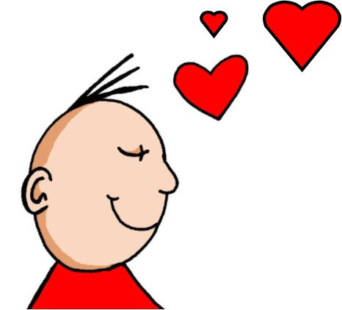
ie
Liebe
Notes:
Timing: 1 minute
Aim: To introduce/consolidate SSC [ie]
Procedure: 1. Present the letter(s) and say the [ie] sound first, on its own. Students repeat it with you. 2. Bring up the word ”Liebe” on its own, say it, students repeat it, so that they have the opportunity to focus all of their attention on the connection between the written word and its sound.
3. A possible gesture for this would be to fold both hands over your heart, and smile!
4. Roll back the animations and work through 1-3 again, but this time, dropping your voice completely to listen carefully to the students saying the [ie] sound, pronouncing ”Liebe” and, if using, doing the gesture. Word frequency (1 is the most frequent word in German): Liebe [843]
Source: Jones, R.L. & Tschirner, E. (2006). A frequency dictionary of German: core vocabulary for learners. Routledge

Slide 23
ie
Liebe
Notes:
With sound and no pictures to focus all attention on the sound-symbol correspondence.

Slide 24
ie
Liebe
Notes:
Without sound to elicit pronunciation (without first hearing the teacher).
Teacher to elicit pronunciation by asking “Wie sagt man…”

Slide 25
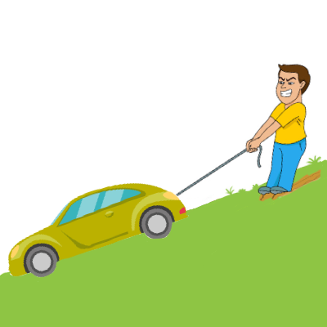
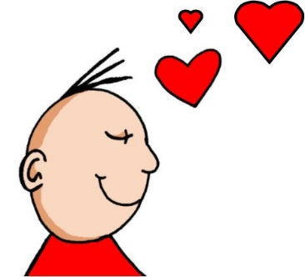
ie
ziehen
sie
Liebe
tief
Brief
liegen
2000 Kilometer
Notes:
Timing: 2 minutes
Aim: To introduce/consolidate SSC [ie]
Procedure:
Introduce and elicit the pronunciation of the individual SSC [ie] and then the source word again ‘Liebe’ (with gesture, if using).
Then present and elicit the pronunciation of the five cluster words.
The cluster words have been chosen for their high-frequency, from a range of word classes, with the SSC (where possible) positioned within a variety of syllables within the words (e.g. initial, 2nd, final etc.). Additionally, we have tried to use words that build cumulatively on previously taught SSCs (see the Phonics Teaching Sequence document) and do not include new SSCs. Where new SSCs are used, they are often consonants which have a similar symbol-sound correspondence in English.
Word frequency (1 is the most frequent word in German): Liebe [843]; ziehen[266] sie [10]; tief [506]; liegen [118]; Brief [813].
Source: Jones, R.L. & Tschirner, E. (2006). A frequency dictionary of German: core vocabulary for learners. Routledge

Slide 26
ie
ziehen
sie
Liebe
tief
Brief
liegen
Notes:
With sound and no pictures to focus all attention on the sound-symbol correspondence.

Slide 27
ie
ziehen
sie
Liebe
tief
Brief
liegen
Notes:
Without sound to elicit pronunciation (without first hearing the teacher).
Teacher to elicit pronunciation by asking “Wie sagt man…”

Slide 28
Phonetik
Hör zu. Ist es [ie] oder [ee]? Schreib das Wort.
hören / schreiben
 | Kaffee |  | Krie g
 | See |  | Tee
 | Sie g |  | nee!
 | nie mand |  | Frie den
1
_ _
5
_ _
[war]
2
_ _
6
_ _
3
_ _
[victory]
7
_ _
4
_ _
8
_ _
[peace]
[no-one]
Notes:
AUDIO TO BE ADDED
Timing: 5 minutes Aim: To provide aural practice in distinguishing between this week’s SSC [ie] and the previously taught SSC long [e], here represented by the letters ee, specifically because this SSC is pronounced in English in the same way as [ie] in German. Procedure: 1. Students write 1-8, listen to each unknown word and transcribe the missing letters (or the whole word). 2. Click to reveal answers. 3. Pictures and/or words are provided to make meanings clear to students.
Transcript: 1. Kaffee 2. See 3. Sieg 4. niemand 5. Krieg 6. Tee 7. Nee! 8. Frieden
Word frequency of unknown words (1 is the most frequent word in German): Kaffee [1299] See [1317] Sieg [1040] niemand [362] Krieg [575] Tee [2617] nee [148] Frieden [1696]
Source: Jones, R.L. & Tschirner, E. (2019). A frequency dictionary of German: core vocabulary for learners. Routledge

Slide 29
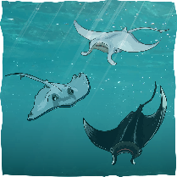
Phonetik
Person A schreibt 5 Wörter. Person B muss alle 5 Wörter sagen.
sprechen
40
[sie]
[Schnee]
[Lied]
[Tee]
[ziehen]
[niemand]
[Nee!]
[Idee]
[Meer]
[Liebe]
Sekunden
[Frieden]
[Kaffee]
[Krieg]
[Brief]
[See]
2000 Kilometer
[Haustier]
0
[Armee]
LOS!
[Sieg]
[Wie?]
[tief]
Notes:
Timing: 5 minutes Aim: To provide spoken production practice of SSC [ie] and [ee] in a range of unknown words and words from this week’s vocabulary list. Procedure: 1. Student A selects five words and writes them down, without Student B’s knowledge. 2. Student B has 40 seconds to pronounce correctly all five words on Student A’s list by saying as many of the words as s/he can as quickly as s/he can.
3. If Student B pronounces a word incorrectly, Student A may interrupt to correct, thereby taking up some of Student B’s task time. 4. The number of words Student B correctly pronounces (from Student A’s selection) is the score to beat. 5. Students then swap roles.
Word frequency (1 is the most frequent word in German): Lied [1726] Liebe [843] Brief [813] sie [10] Haustier [>5000] wie [28] ziehen [266] tief [506] Kaffee [1299] See [1317] Sieg [1040] niemand [362] Krieg [575] Tee [2617] nee [148] Frieden [1696] Armee [2209] Schnee [1761] Meer [852] Idee [451]
Source: Jones, R.L. & Tschirner, E. (2019). A frequency dictionary of German: core vocabulary for learners. Routledge

Slide 30
Asking and answering questions about having
VSO questions; negation with
kein + nouns R2 (accusative); mein/meine/mein R1 (nominative)
SSC [ie]
Y7 German
Term 1.1 - Week 7 - Lesson 14
Natalie Finlayson / Rachel Hawkes
Artwork: Steve Clarke
Date updated: 15/12/21
Notes:
Artwork by Steve Clarke. All additional pictures selected are available under a Creative Common license; no attribution required.
Learning outcomes (lesson 2):
Consolidation of SSC [ie]
Consolidation of VSO questions
Introduction of negation with kein + nouns R2 (accusative)
Introduction of mein/meine/mein R1 (nominative)
Word frequency (1 is the most frequent word in German):
7.1.1.7 (introduce) Band [<5009] Buch [300] Film [505] Lehrerin [695] Lied [1733] Sänger [3029] Sängerin [3916] leider [643] Lieblings- [n/a]
7.1.1.4 (revisit) wissen [78] bist [4] du [54] Farbe [1079] Nummer [806] Ort [341] Tier [614] aber [31] kein [46] ich weiß nicht [n/a] wie sagt man [n/a] wie schreibt man [n/a] das ist (nicht) klar
Source: Jones, R.L. & Tschirner, E. (2019). A frequency dictionary of German: core vocabulary for learners. Routledge

Slide 31
Phonetik
lesen / sprechen
Liebe
ei
kein
die
ie
weiß
Brief
ich heiβe
Lieblings-
Wie schreibt man das?
Frankreich
sie
Haustier
leider
ein
wie sagt man …
hier
klein
ziehen
die Schweiz
Lied
Polizei
tief
Notes:
Timing: 5 minutes Aim: To provide practice in distinguishing between this week’s SSC [ie] and the SSC [ei]. Procedure: 1. This is a paired read aloud task. The students use different colours to play. Pupil A says one of the words/phrases and pupil B has 3 seconds to locate it and cross it off with their colour. If the pupil takes longer than 3 seconds pupil A can steal the point. Clearly, the classroom conditions need to be right with the individual class for friendly competition.
2. Alternatively, they can do it more slowly and carefully, scrutinising each other’s pronunciation. If one makes a mistake (quite common with ei/ie), then the other pupil corrects and crosses off in his/her colour. Note: Not all of these words have been taught before, so there is the opportunity for some genuine decoding.
Word frequency (1 is the most frequent word in German): Lied [1726] leider [642] Lieblings- [>4034] kein [50] weiß [563] heiße [123] schreibt [245] Liebe [843] Brief [813] sie [10] hier [71] Haustier [>5000] wie [28] ziehen [266] tief [506]
Source: Jones, R.L. & Tschirner, E. (2011). A frequency dictionary of German: core vocabulary for learners. Routledge

Slide 32
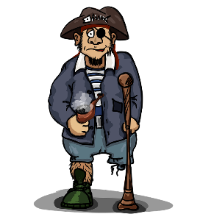
Pirates!
1
c
hören
w
Riese
leider
Riese
One of the chests contains buried treasure. All the others contain poison!
Listen carefully to the secret code and follow the arrows to find the treasure.
Reise
Lieder
Reise
h
z
Wien
Biene
Feile
v
Wein
Beine
viele
Riese
k
Riese
Biene
Feile
leider
i
Reise
Beine
viele
Lieder
Reise
Riese
leider
Feile
leider
Riese
r
Reise
Lieder
viele
Lieder
Reise
Riese
y
j
q
Reise
Notes:
Timing: 3 minutes Aim: To provide practice in distinguishing between this week’s SSC [ie] and the SSC [ei].
Note: This slide and the two that follow are three versions of the activity with different solutions.
The game makes use of minimal pairs of unknown words (unknown words are used so that pupils focus on the sound. Definitions are given on a later slide).
Procedure: 1. Starting on the red square, pupils listen to the words and decide whether they hear /ei/ or /ei/. They follow the arrows indicated by their choice to finish at one of the chests. There is only one correct route per slide, so pupils must correctly identify all words to find the treasure. The order or /ei/ and /ie/ changes (i.e. sometimes /ei/ is on the white square and sometimes on the blue) so the pupils must read the spellings. Pupils can follow the slide on the projector, or the slide can be printed so they can trace the route with a pen/finger.
2. Teacher asks ‘Wo bist du?’ Pupils respond ‘Z, W’ etc. to practise the alphabet. Teacher clicks on the chests they say to reveal treasure (or not!)
3. Audio plays on clicking play. Pupils will probably need to hear the audio at least three times.
Note: Each treasure chest is triggered to reveal what is underneath. You see a hand icon appear when you mouse over it – click and the chest disappears. Each slide only has one treasure chest – the rest reveal skulls.
Transcript:
Wien, Biene, Feile, Lieder, Reise
Treasure is located in chest W.
Word frequency (1 is the most frequent word in German): Riese [2794] Reise [786] leider [642] Lieder [Lied 1726] Wien [n/a] Wein [1640] Biene [>5000] Beine [940] viele [viel 60] Feile [>5000] Source: Jones, R.L. & Tschirner, E. (2011). A frequency dictionary of German: core vocabulary for learners. Routledge

Slide 33
Pirates!
2
c
hören
w
Riese
leider
Riese
Reise
Lieder
Reise
One of the chests contains buried treasure. All the others contain poison!
Listen carefully to the secret code and follow the arrows to find the treasure.
h
z
Wien
Biene
Feile
v
Wein
Beine
viele
Riese
k
Riese
Biene
Feile
leider
i
Reise
Beine
viele
Lieder
Reise
Riese
leider
Feile
leider
Riese
r
Reise
Lieder
viele
Lieder
Reise
Riese
y
j
q
Reise
Notes:
Alternative: Give pupils a copy of the transcript below on a slip of paper and ask them to read to a partner.
Transcript:
Wein, Beine, viele, Lieder, Reise
Treasure is located in chest Y.

Slide 34
Pirates!
3
c
hören
w
Riese
leider
Riese
Reise
Lieder
Reise
One of the chests contains buried treasure. All the others contain poison!
Listen carefully to the secret code and follow the arrows to find the treasure.
h
z
Wien
Biene
Feile
v
Wein
Beine
viele
Riese
k
Riese
Biene
Feile
leider
i
Reise
Beine
viele
Lieder
Reise
Riese
leider
Feile
leider
Riese
r
Reise
Lieder
viele
Lieder
Reise
Riese
y
j
q
Reise
Notes:
Alternative: Give pupils a copy of the transcript below on a slip of paper and ask them to read to a partner.
Transcript:
Wein, Biene, Feile, leider, Riese
Treasure is located in chest K.

Slide 35
Phonetik
lesen / sprechen
Wien
[Vienna]
Wein
[wine]
Beine
[legs]
Biene
[bee]
viele
[many]
Feile
[file]
Lieder
[songs]
leider
[unfortunately]
Riese
[giant]
Reise
[journey]
Notes:
Timing: 2 minutes Aim: To introduce the concept of minimal pairs. Procedure: 1. Teacher introduces students to the concept of minimal pairs and the importance of connecting sound to meaning.
2. Teacher-led pronunciation practice.

Slide 36
Vokabeln
sprechen
Wie sagt man…?
Wie sagt man... ?
der Film
leider
How do you say... ?
film
unfortunately
Wie schreibt man das?
die Nummer
How do you write that?
number
der Ort
ich weiß nicht
die Sängerin
kein
Lieblings-
place
I don’t know
female singer
not a
favourite
die Lehrerin
der Sänger
aber
die Band
das Tier
female teacher
male singer
but
band
animal
du bist
wissen
das Buch
you are
to know
book
das Lied
die Farbe
song
colour
Notes:
Timing: 4 minutes
Aim: To revise this week’s vocabulary, new and revisited.
Procedure: 1. Elicit the German for the words shown in turn, working down each column, top to bottom and then left to right.
2. Click to check answers one by one, in the same order.

Slide 37
Vokabeln
sprechen
8. Lieblings-
6. der Film
1. die Lehrerin
4. das Buch
5. die Sängerin
3. das Lied
2. die Band
9. der Sänger
7. leider
Notes:
Timing: 4 minutes
Aim: To provide production (speaking) practice with the new vocabulary. Procedure: 1. Students write 1-9 in books.
2. Ask students to write down the English translation before the word has faded away. They are then going to translate these back orally into German.
4. The answers are on the next slide.

Slide 38
Vokabeln
sprechen
Antworten:
8. Lieblings-
6. der Film
1. die Lehrerin
4. das Buch
5. die Sängerin
3. das Lied
2. die Band
9. der Sänger
7. leider
Notes:
Timing: 2 minutes
Aim: To provide the answers to the activity on the previous slide
Procedure: 1. Check answers (see below) by eliciting the German from students, with the definite article as applicable (i.e. so that they are translating back from their written English into spoken German).
Note: Students have not yet done numbers but will be taught them explicitly in Week 9. However, in the next few weeks, certain activities will prepare for them. Here the teacher can say the number when eliciting the answers, but support understanding by holding up the appropriate number of fingers each time. Obviously, the items proceed in number order in any case, so the finger gesture is more to draw learners attention to the sound – meaning connection of the number with the German word for that number.
2. After students have spoken their answer, click to bring up the correct answers, one by one.
3. Pay particular attention to the correct recall of the genders. It’s all too easy for students to lose the connection between the gender and the noun.
ANSWERS 1. die Lehrerin 2. die Band 3. das Lied 4. das Buch 5. die Sängerin 6. der Film
7. leider
8. Lieblings-
9. der Sänger

Slide 39
Using kein after haben
Grammatik
Saying you have a/one thing
As you know, an indefinite article is used after haben to say you have a/one thing.
eine
ein
Hast du … einen Fußball? _____ Flasche? _____ Buch?
einen
eine
ein
Ja. Ich habe … ______ Fußball. _____ Flasche. _____ Buch.
Saying you don’t have a/one thing
Kein is used after haben to say you don’t have a/one thing.
Like ein, it matches the gender of the noun.
Hast du … einen Fußball? eine Flasche? ein Buch?
keinen
keine
kein
Nein. Ich habe … ______ Fußball. _______ Flasche. _____ Buch.
Notes:
Timing: 2 minutes Aim: To introduce the use of kein after haben.
Procedure: 1. Click to animate the explanation.
2. Explain that this happens because of the verb haben, and draw attention to the Row 2 gender pattern, which mirrors that of einen, eine, ein, which they have already encountered.
3. Elicit the missing articles (revealed on click) from the full class in chorus.
4. Draw comparisons between the ‘I have no football’ structure and the English ‘I have no idea’ (see week 5 grammar explanation), while acknowledging that this may be confusing because the typical English construction is ‘I don’t have’.

Slide 40
Lieblingsdinge
hören
Frau Organisiert is talking to granddaughter, Heike, about favourite things. The line is bad. Listen and decide whether Heike does (✔) or does not (✖) have a favourite.
A
Have you got … ?
I’ve got / I haven’t got …
B
C
D
E
Notes:
Timing: 2 minutes Aim: To provide practice in noticing negation with kein. Procedure: 1. This listening activity and the reading activity that follows focus on connecting articles ein- and kein- to nouns, in order to decide what someone does and doesn’t have. The articles are all in accusative (Row 2).
2. The nouns in the recording are obscured by noises. The students decide based on the article they hear whether Heike has a favourite or not. The objects in each pair have different genders to allow for this.
3. The order in which nouns with ein- and kein- appear varies so that students cannot guess based o:n word order. It is worth telling students this. ie. In the answer the noun on the right could be mentioned first.
4. Recording plays on clicking individual letters.
5. Note: point out pronunciation of ‘Heike’.
Transcript:
a. Hast du ein Lieblingsbuch oder einen Lieblingsfilm?
Ich habe einen ____ [Lieblingsfilm] aber ich habe kein ____ [Lieblingsbuch].
b. Hast du einen Lieblingssänger oder eine Lieblingssängerin?
Ich habe keinen ____ [Lieblingssänger ] aber ich habe eine ____ [Lieblingssängerin].
c. Hast du ein Lieblingslied oder eine Lieblingsband?
Ich habe keine [Lieblingsband] aber ich habe ein ____ [Lieblingslied].
d. Hast du eine ____ [Lieblingslehrerin] oder einen ____ [Lieblingslehrer]?
Ich habe keine [Lieblingslehrerin] aber ich habe einen ____ [Lieblingslehrer].
e. Hast du ein _____ [Lieblingstier] oder einen [Lieblingsort]?
Ich habe einen ____ [Lieblingsort] aber kein ___ [Lieblingstier].

Slide 41
Lieblingsdinge - Antworten
hören
Frau Organisiert is talking to granddaughter, Heike, about favourite things. The line is bad. Listen and decide whether Heike does (✔) or does not (✖) have a favourite.
A
✖
✔
Have you got … ?
I’ve got / I haven’t got …
B
✖
✔
C
✔
✖
D
✖
✔
E
✖
✔
Notes:
Timing: 2 minutes Aim: To provide the answers to the acivity on the previous slide. Procedure: 1. Full recording (including answers) plays on clicking individual letters.
2. Correct answers revealed one at a time on click.
Transcript:
a. Hast du ein Lieblingsbuch oder einen Lieblingsfilm?
Ich habe einen Lieblingsfilm aber ich habe kein Lieblingsbuch.
b. Hast du einen Lieblingssänger oder eine Lieblingssängerin?
Ich habe keinen Lieblingssänger aber ich habe eine Lieblingssängerin.
c. Hast du ein Lieblingslied oder eine Lieblingsband?
Ich habe keine Lieblingsband aber ich habe ein Lieblingslied.
d. Hast du eine Lieblingslehrerin oder einen Lieblingslehrer?
Ich habe keine Lieblingslehrerin aber ich habe einen Lieblingslehrer.
e. Hast du ein Lieblingstier oder einen Lieblingsort?
Ich habe einen Lieblingsort aber kein Lieblingstier].

Slide 42
Grammatik
lesen
Oh je! Frau Organisiert listed Heike’s favourite things, but smudged the articles! Help her complete the sentences.
kein
keinen
ein
keine
kein
Lieblingsbuch aber
Lieblingssänger aber
Lieblingslied aber
Lieblingslehrerin aber
Lieblingstier aber
einen
eine
keine
einen
einen
Lieblingsfilm.
Lieblingssängerin.
Lieblingsband.
Lieblingslehrer.
Lieblingsort.
Notes:
Timing: 5 minutes Aim: To provide production practice (writing) of the use of kein versus the indefinite article. Procedure: 1. Students need to use their answers to the listening to complete this, by writing ein(e) or kein(e) before each item as appropriate, according to whether Heike does or does not have a favourite.
2. Answers revealed on click.

Slide 43
My → mein, mein, meine
Grammatik
Ja, m___ L______________ i__ Star Wars.
Ja, mein Lieblingsfilm ist Star Wars.
Add the prefix Lieblings- to a noun to talk about your favourite things. Introduce them using mein/meine.
Mein Lieblingsbuch ist …
Ja, mein Lieblingslied ist Rocket Man.
Ja, m___ L______________ i__ Rocket Man.
Ja, meine Lieblingslehrerin ist Frau Schmidt.
Ja, m___ L______________ i__ Frau Schmidt.
Zorg, hast du eine Lieblingsband?
Zorg, hast du eine Lieblingslehrerin?
Zorg, hast du ein Lieblingslied?
Zorg, hast du einen Lieblingsfilm?
Nein, ich habe keine Lieblingsband!
Notes:
Timing: 2 minutes Aim: To introduce mein/meine.
Note: This is not a full introduction of possessive adjectives here. Mein/meine are introduced here because: a) they are communicatively important and students will often ask how to say ‘my’ now that they know a bank of nouns b) the words themselves are easy to remember and say, as mein sounds like ‘my’ and acts like ‘ein’. c) students have had a thorough grounding in definite and indefinite articles and the implications of noun gender, so that, with some inevitable reminding, they will use them accurately and begin to apply them to the nouns they know well. Procedure: 1. Click to animate the explanation.
2. Check students’ understanding at each stage.

Slide 44
Do you have a favourite...?
sprechen
Ask your partner.
If yes, write (✔) and their answer.
If no, write (✘).
1. Favourite book?
2. Favourite band?
3. Favourite film?
4. Favourite singer?
5. Favourite song?
6. Favourite place?
7. Favourite teacher?
Notes:
Timing: 5 minutes Aim: To provide practice (speaking modality) in asking and answering questions about having (favourite things).
Procedure: 1. Students to ask/answer each other’s questions following the model on the previous slide. 2. Depending on the class, the teacher could choose to prime students for this task by eliciting the questions chorally from students, giving them a drei-zwei-eins countdown to think/construct the question in their heads, then s/he can offer an answer to model the task. Sample dialogue:
Teacher: Ok. Frage eins. Drei-zwei-eins… Students all together: Hast du ein Lieblingsbuch? Teacher: Ja, mein Lieblingsbuch ist Born to run. Also, drei-zwei-eins… Students: Hast du eine Lieblingsband? Teacher: Nein, ich habe leider keine Lieblingsband.
Etc…

Slide 45
Favourite things
schreiben
Write sentences to describe your partner’s favourite things.
1.
2.
3.
4.
5.
6.
Mias Lieblingsbuch ist Harry Potter.
Mias Lieblingsband ist Silbermond.
Mia hat keinen Lieblingsfilm.
Mias Lieblingsbuch [Mia’s favourite book]. No apostrophe in German.
Notes:
Timing: 5 minutes Aim: To provide practice (writing modality) in answering questions about having (favourite things). Procedure: 1. This task may be an additional homework task, if lesson time is short. Students write sentences to describe their partner’s favourite things.
2. The first three answers are modelled to give full sentence examples.
3. This can be expanded into a speaking activity in which answers are presented orally. The teacher asks students about their partners’ favourite things. Where the pupil does not have a favourite thing, use this as a chance to practise ‘leider’ e.g. ‘Wolfgang, hat Mia ein Lieblingsbuch?’ ‘Ja, Mias Lieblingsbuch ist …’ / ‘Leider nicht’

Slide 46
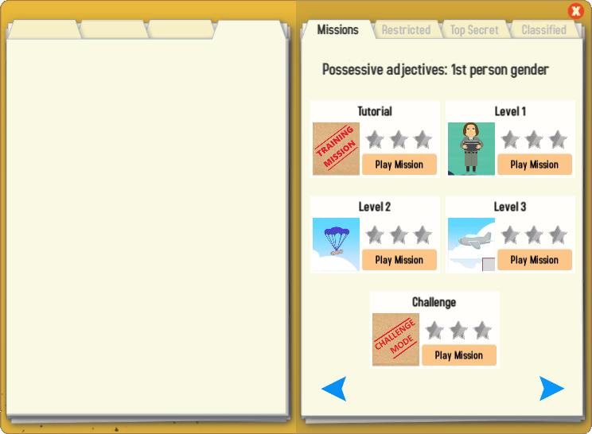
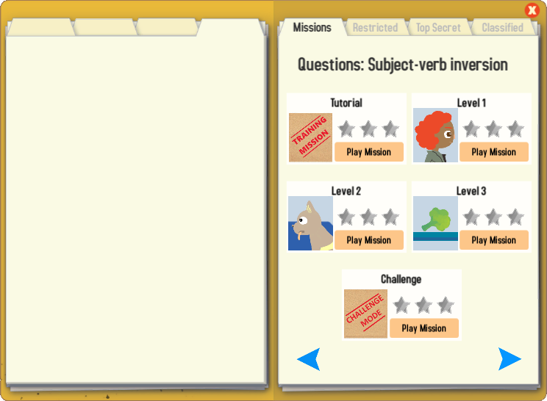
Gaming Grammar
Try the following Gaming Grammar missions to practise:

Slide 47
Hausaufgaben
Vocabulary Learning Homework (Y7, Term 1.2, Week 1)
Audio file
Audio file QR code:
Student worksheet
Quizlet link
In addition, revisit: Term 1.1 Week 4
Notes:
Use this slide to set the homework.

