Slide 1
Work on a challenging text
Bolivia: un país diverso
Y8 Spanish
Term 1.2 - Week 6 – Lesson 25
Amanda Izquierdo / Nick Avery / Jack Peacock Date updated: 11/10/20
Notes:
With thanks to Rachel Hawkes and Emma Marsden for reviewing the text and lesson material.
Learning outcomes (lesson 1):
Introduction of new vocabulary items and consolidation of those previously taught
Consolidation of present tense –er/–ir verbs in 3rd person singular and plural (-e, -en);
Consolidation of SSCs [l], [ll]
Word frequency (1 is the most frequent word in Spanish):
New vocabulary (introduce, lesson 1): el paisaje [1685]; desaparecer [655]; seco [1183]; la lluvia [986]; el clima [1675]; la frontera [1507]; mil [191]; la altura [970]; suficiente [781]
Revisited vocabulary:
Y8 1.2.3: cine [952]; abierto [654]; cerrado [1201]; miedo (de algo) [491]; razón [360]; suerte [723]; éxito [708]; sueño [450]; calor [945]; en cambio² [cambio-329]
numbers 13-20: trece [2700]; catorce [2411]; quince [1215]; dieciséis [3373]; diecisiete [3430]; dieciocho [2730]; diecinueve [4232]; veinte [819]
Y8 1.1.5: cambio [319]; ruido [1034]; esfuerzo [601]; viaje [519]; gesto [928]; amable [2707]; genial [2890]; mientras que [mientras-127]; entonces [74]; subject pronouns yo [28]; tú [184] él [9]; ella [72]; nosotros/as [164]; ellos/as [9-él]
Source: Davies, M. & Davies, K. (2018). A frequency dictionary of Spanish: Core vocabulary for learners (2nd ed.). Routledge: London
Note: The following sources were consulted in writing the text.
https://www.theguardian.com/environment/2016/nov/28/shrinking-glaciers-state-of-emergency-drought-bolivia
http://documents1.worldbank.org/curated/en/997641468187732081/pdf/97834-REVISED-BRI-PUBLIC-ADD-AUTHORS-Box393179B.pdf
https://worldpopulationreview.com/languages/bolivia

Slide 2
Fonética
escuchar / escribir
Escucha y escribe la palabra. ¿Es ‘l’ o ‘ll’? Luego, escribe la frase en inglés.
palabras
lista
largas
1
Las _________ en la _____ son ______.
The words on the list are long.
llevar
amarillos
I want to wear yellow shoes.
2
Quiero_______ zapatos __________ .
She is going to go out, then she is going to dance.
3
Ella
salir
luego
bailar
____ va a ____, ______ va a ______.
4
llegar
llaves
Es importante ______ con las ______ .
It is important to arrive with the keys.
luz
leer
libro
I need light (in order) to read my book.
5
Necesito ___ para _____ mi _____ .
6
llamar
¿Cuándo puedes _______?
When can you call?
Notes:
Timing: 7 mins.
Aim: to accurately spell words that contain SSCs [l] and [ll]. Audio is provided to reinforce the sound of the SSC and to give a cue for correct spelling.
Procedure:
1. Students listen and write the missing words.
2. The teacher goes through the answers for each sentence, one by one, including eliciting the English meanings.
3. For additional reinforcement, the teacher can play the audio again each time so that students can listen and read at the same time.
Note: This sentence level transcription task includes some known words and some less familiar cluster words from Year 7 that were only used for phonics practice. As such, it is a hybrid phonics/vocabulary practice task.
Transcript:
Las palabras en la lista son largas.
Quiero llevar zapatos amarillos.
Ella va a salir, luego va a bailar.
Es importante llegar con las llaves.
Necesito luz para leer mi libro.
¿Cuándo puedes llamar?

Slide 3
Vocabulario
trip, journey
hablar
he
we (f)
so
funny
gesture
we (m)
effort
she
you
they (f)
noise
change
I
great
whereas
they (m)
e_ _ _ _ _ _ _
e_ _ _ _
entonces
ellos
tú
t_
g_ _ _ _ _
genial
gracioso
g _ _ _ _ _ _ _
el e_ _ _ _ _ _ _
ellas
mientras que
el esfuerzo
e_ _ _ _
m_ _ _ _ _ _ _ q _ _
e_ _ _
é_
el r_ _ _ _
ella
él
el ruido
el g_ _ _ _
el gesto
el c_ _ _ _ _
el cambio
n_ _ _ _ _ _ _
nosotros
yo
el v_ _ _ _
n_ _ _ _ _ _ _
y_
el viaje
nosotras
Notes:
Timing: 4 minutes
Aim: to revise items of vocabulary from one of this week’s revisited vocabulary sets. Only the first letter is provided so that students have to recall the word.
Procedure:
1. The teacher clicks for the English prompt to appear.
2. Students say the word in Spanish in choral response to match the English.
3. Clicking again reveals the answer.
Note: the vocabulary activity on the next slide revisits the same set of words. We recommend therefore either doing the activity on slide 3 OR 4/5.
Vocabulary from revisited sets: 8.1.1.5: cambio [319]; ruido [1034]; esfuerzo [601]; viaje [519]; gesto [928]; gracioso [3874]; genial [2890]; mientras que [mientras-127]; entonces [74]; yo [28]; tú [184] él [9]; ella [72]; nosotros/as [164]; ellos/as [9-él]

Slide 4
Vocabulario
escribir
Completa las frases con las palabras que no están.
Ella
ruido
yo
gestos
graciosos
1
______hace_______en clase y _____hago_______ ___________ .
She makes noise in class and I make funny gestures.
cambios
El ______ en autobús es _______. Sin embargo hay muchos _________ .
2
viaje
genial
The bus journey is great. However, there are many changes.
esfuerzo
tú
______hacen un _________, ______________ ___ haces poco.
3
Ellas
mientras que
They (f) make an effort, while you do little.
ellos
¡__________ necesitamos jugar un partido, pero ______ no pueden!
4
Nosotras
We (f) need to play a match, but they can’t!
cine
cerrado
__________, ¿___ quiere ir a la playa porque el ______ está _________?
5
Entonces
él
So, does he want to go to the beach because the cinema is closed?
Notes:
Timing: 7 mins
Aim: to recall the revisited vocabulary for this week and spell it accurately.
Procedure:
1. Students complete the Spanish translations of the English sentences, filling in the missing words from the revisited vocabulary sets. They can simply write the answers in note form, e.g., (1. ella, ruido, yo, gestos, graciosos)
2. Reveal answers at the end of the exercise with each click.
3. Audio is provided for further reinforcement
Note: the vocabulary activity on this revisits the same set of words as on slide 3 (with two additions). A variation is also provided on the next slide.
Transcript:
Ella hace ruido en clase y yo hago gestos graciosos.
El viaje en autobús es genial. Sin embargo, hay muchos cambios.
Ellas hacen un esfuerzo, mientras que tú haces poco.
¡Nosotras necesitamos jugar un partido, pero ellos no pueden!
Entonces, ¿él quiere ir a la playa porque el cine está cerrado?
Vocabulary from revisited sets:
Y8 1.2.3: cine [952]; cerrado [1201];
Y8 1.1.5: cambio [319]; ruido [1034]; esfuerzo [601]; viaje [519]; gesto [928]; gracioso [3874]; genial [2890]; mientras que [mientras-127]; entonces [74]; yo [28]; tú [184] él [9]; ella [72]; nosotros/as [164]; ellos/as [9-él]

Slide 5
Vocabulario
escribir
Escribe las frases.
1
Ella hace ruido en clase y yo hago gestos graciosos.
She makes noise in class and I make funny gestures.
2
El viaje en autobús es genial. Sin embargo, hay muchos cambios.
The bus journey is great. However, there are many changes.
3
Ellas hacen un esfuerzo, mientras que tú haces poco.
They (f) make an effort, while you do little.
4
¡Nosotras necesitamos jugar un partido, pero ellos no pueden!
We (f) need to play a match but they can’t!
5
Entonces, ¿él quiere ir a la playa porque el cine está cerrado?
So, does he want to go to the beach because the cinema is closed?
Notes:
VARIATION
In this variation of the activity, students translate the whole sentence. Teachers can decide which is more appropriate, depending on the ability of the group.
Note that this variation of the activity may take longer than the gap fill version on the previous slide, given that full sentences are to be written.

Slide 6
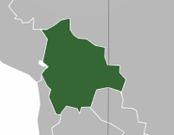
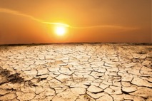
Vocabulario
hablar
el clima
el paisaje
[weather, climate]
[landscape]
‘Suficiente’ is an adjective, so it needs to agree in number with the noun:
suficiente agua = enough water
suficientes árboles = enough trees
‘Suficiente’ often goes before the noun, but you might sometimes see it after.
la frontera
desaparecer
[border]
mil
[to disappear]
seco, seca
la altura
[dry]
[height, altitude]
la lluvia
suficiente
[rain]
Notes:
Timing: 3 minutes
Aim: to introduce and embed the new vocabulary
Procedure: 1. Pupils either work by themselves or in pairs, reading out the words and recapping their English meaning (1 minute). 2. Then the teacher removes the English words or pictures (one by one) and they try to recall the English orally (chorally), looking at the Spanish (1 minute). 3. Then the Spanish meanings are removed (one by one) and they to recall them orally (again, chorally), looking at the English (1 minute) 4. Further rounds of learning can be facilitated by one pupil turning away from the board, and his/her partner asking him/her the meanings (‘Cómo se dice X en español?’). This activity can work from L2 → L1 or L1 → L2.
Note: ‘suficiente’ may be used before or after the noun in Spanish with broadly synonymous meaning. It is frequently used before the noun in the same way as other quantifiers (demasiado, mucho, poco) that refer to an indeterminate quantity. When used after the noun, the word may suggest a more precise meaning (‘enough’, in relation to a specific point of reference, e.g, a previously mentioned figure). However, there is no hard and fast rule. Some native speakers may also choose to use ‘suficiente’ postnominally for stylistic or discursive reasons. Given the dependency of its use on context, and the subtlety of meaning, we don’t go into detail on this in the lesson material, but do highlight that students may encounter the word in both positions.
Word frequency (1 is the most frequent word in Spanish):
New vocabulary (introduce): el paisaje [1685]; desaparecer [655]; seco [1183]; la lluvia [986]; el clima [1675]; la frontera [1507]; mil [191]; la altura [970]; suficiente [781]

Slide 7
Hoy vamos a leer un texto sobre un país de Sudamérica.
leer
Lee las frases. ¿Qué país es?
1. El español es un idioma oficial.
Venezuela
2. Es un país en el centro de Sudamérica.
Colombia
Ecuador
3. No tiene costa.
Brasil
Perú
Bolivia
4. Tiene una frontera con Perú, Chile, Argentina, Paraguay y Brasil.
Paraguay
Chile
Uruguay
B_ _ _ _ _ _
Argentina
Bolivia
Notes:
Timing: 2 minutes
Aim: to create a sense of anticipation and to reactivate prior knowledge of concepts relevant to the text.
Procedure 1. Reveal each sentence to give information about the country.
2. Students can volunteer answers.

Slide 8
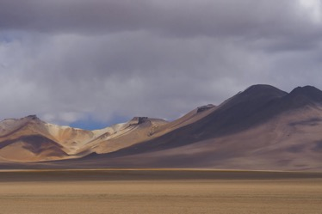
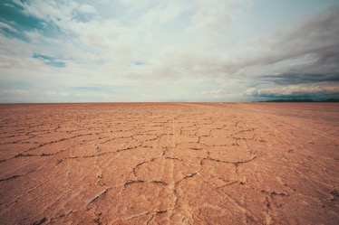
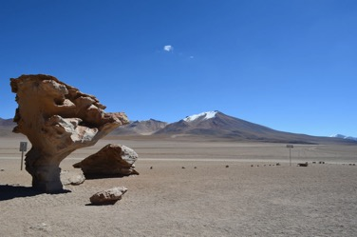
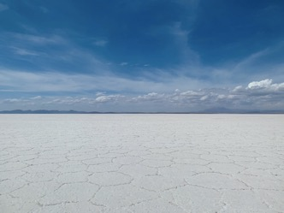
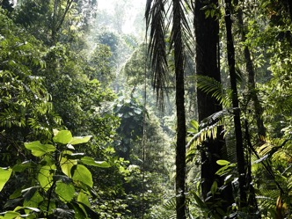
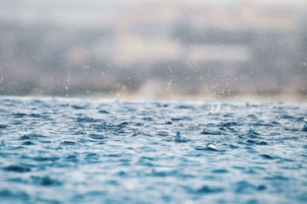
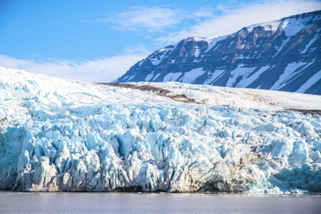
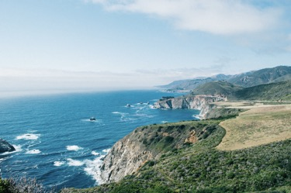
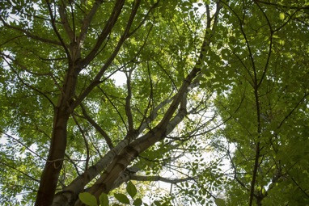
¿Cómo es Bolivia?
hablar
Mira las fotos, ¡hacemos predicciones!
Bolivia (no) tiene / es...
En Bolivia (no) hay...
Ejemplo: En Bolivia no hay lluvia.
montañas
seca
paisajes diferentes
selva
lluvia
glaciares
costa
árboles
Notes:
Timing: 3 minutes
Aim: To predict some of the content in the first text of the lesson. To recycle irregular verbs from Y7 (es, está, tiene, hay) and to support understanding of relevant vocabulary.
Procedure 1. Look at the pictures and try to make some predictions about what Bolivia is like before reading the text.
2. Formulate predictions using the structures ‘Bolivia (no) tiene / es’, ‘En Bolivia (no) hay...’.
Pictures from Unsplash:
Photo of mountains in Bolivia by @sthomanns
Photo of dry Bolivia by @tobey_j
Photo of glacier in Bolivia @vincegx
Photo of the Salar de Uyuni by @agnieszkam
Photo of Stone tree by @gabrielrojas
Photo of rain by @fivepointseven
Photo of coast @gregjjurgajtis
Photo of trees @calvoregis

Slide 9
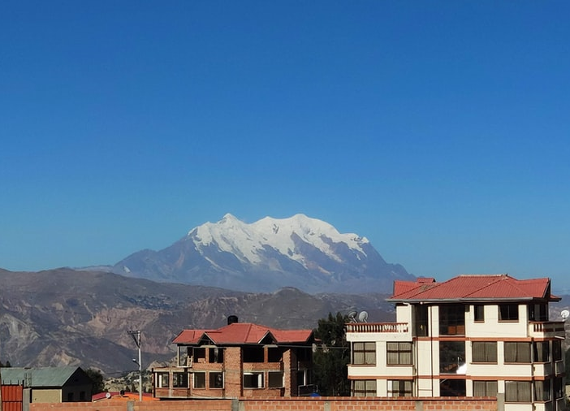
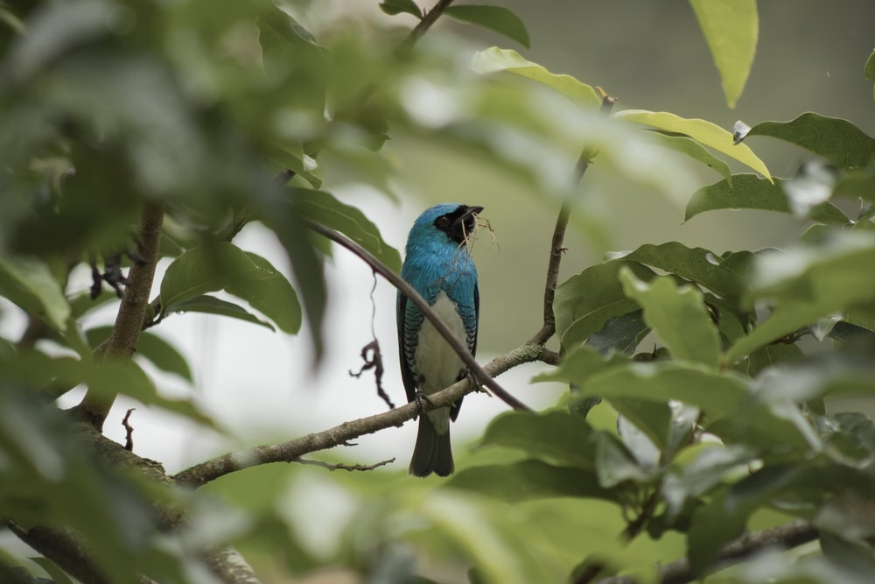
Geografía
leer
Lee el texto. ¿Tus predicciones son correctas?
Bolivia es un país en el centro de Sudamérica. Tiene una frontera con Perú, Chile, Argentina, Paraguay y Brasil. No tiene costa.
Una parte de Bolivia está en los Andes. Las montañas son muy altas allí. ¡Muchas tienen una altura de cinco o seis mil metros! La región alta de Bolivia es bastante seca. A veces no tiene mucha agua porque desaparecen los glaciares.
Otra parte de Bolivia está en el Amazonas. Los paisajes y el clima son completamente diferentes allí. En la selva, hay ríos, árboles y normalmente mucha lluvia. La selva cubre todo el este de Bolivia.
Notes:
Timing: 6 minutes
Aim: to verify predictions and to learn about the geography of Bolivia.
Procedure 1. Students read the text.
2. Students check if their predictions about what Bolivia is like are true or false.
The teacher should actively engage students here, asking, e.g.,
¿Cómo es la region alta (=bastante seca)
¿Hay glaciares? (=Sí, pero desaparecen)
¿Tiene paisajes diferentes? (=Sí, en el Amazonas hay… y en los Andes hay…).
3. The teacher can also ask the students what else the text says about the geography of Bolivia.
Pictures from Unsplash:
Photo by Jose David on Unsplash
Photo by Harold Martinez on Unsplash

Slide 10
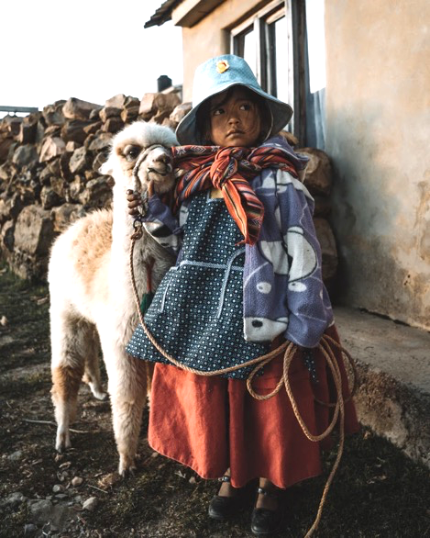
Idiomas y educación
leer
Lee el texto. ¿Cuántos verbos terminan en –e o –en?
El español es un idioma oficial de Bolivia, aunque otros idiomas existen. Mucha gente de origen indígena habla aymara y quechua, dos idiomas muy antiguos. El idioma puede ser una parte importante de su identidad y cultura.
En muchas escuelas, la educación cambia: ahora, los estudiantes deben aprender español y también un idioma indígena*. Sin embargo, a veces no hay suficientes profesores para enseñar los idiomas indígenas.
*indigenous
Remember, use the verb ending –e to mean ______ or ____ with present tense –er / –ir verbs.
Use the verb ending –en to mean to mean ______.
‘s/he’
‘it’
‘they’
Notes:
Timing: 5 minutes
Aim: to learn about language education in Bolivia; to refresh students’ understanding of two previously taught features ahead of the next activity.
Procedure 1. Students read the text and try identify as many examples as they can of verbs ending in –e and –en.
2. The teacher then brings up the text box at the bottom and elicits the meanings of the two verb endings. 3. To ensure understanding of the information in the text, do one of the following or use another preferred task: i. whole class oral English translation, phrase by phrase ii. Individual summary of the text, with the instruction – Note three key facts from the first paragraph and two from the second paragraph about languages in Bolivia. ii. Ask direct questions to elicit the key information. 1. How many languages are mentioned as being spoken in Bolivia? 2. Which? 3. What does it say about Aymara and Quechua in the first paragraph? 4. What are languages important for? 5. Why is it not straightforward for students to learn Quechua or Aymara at school?
Note: Many Y8 students will not be clear on the meaning of ‘indigenous’ in English, perhaps, so worth checking and giving a definition, if needed: Indigenous peoples are ethnic groups who are the original or earliest known inhabitants of an area, in contrast to groups that have settled, occupied or colonized the area more recently.
Pictures taken from Unsplash:
Photo of Bolivian child by @alexazabache

Slide 11
Escucha información sobre Bolivia. ¿El sujeto es singular o plural? Luego, busca el sujeto. En la frase tres, dos sujetos son posibles.
escuchar
 | ¿El sujeto es singular (‘it’) o plural (‘they’)? | El sujeto
el aymara
las escuelas
el glaciar
la montaña
1
singular
el aymara
Perú
todas las regiones
2
plural
los estudiantes
el estudiante
3
singular
la selva, la región alta
las selvas
la selva
4
plural
las escuelas
Perú y Chile
las regiones
5
singular
Perú
las montañas
la escuela
6
plural
los glaciares
la región alta
los estudiantes
7
plural
las montañas
el aymara y el quechua
8
singular
la región alta
los glaciares
Notes:
Timing: 8 min.
Aim: to consolidate understanding of 3rd person singular vs plural verb forms of –er and –ir verbs in the oral modality; to check understanding of factual information about Bolivia on previous slides.
Procedure:
Students listen to the audio and decide if it refers to a singular or a plural subject.
Students listen again and decide which of the words on the right hand side is the subject of the sentence. The correct answer will be true of the two texts that students just read.
Some students may be able to complete parts 1 and 2 at the same time.
Note: If students require further support with the task, they could be given the answer options in a table, like this: 1. el aymara / el aymara y el quechua 2. los estudiantes / el estudiante 3. las selvas / la selva | la región alta / todas las regiones
Transcript:
Existe en Bolivia, y el español también.
Pueden aprender dos idiomas.
Cubre una parte grande del país.
No tienen suficientes profesores de idiomas indígenas.
Tiene una frontera con Bolivia.
Desaparecen por los cambios del clima.
Cubren la parte alta de Bolivia.
Debe tener poca lluvia porque todo está muy seco allí.
Vocabulary from revisited sets:
Y8 1.1.5: cambio [319]

Slide 12
Hablamos sobre Bolivia en parejas.
leer / escuchar
Persona A: lee la frase.
Persona B: escucha y elige la opción correcta para completar la frase.
Luego, escribe la frase en inglés.
Ejemplo:
Estudiante A
Estudiante B
1 | Las montañas pueden…
1 | ser muy altas.
The mountains can be very high.
Notes:
There are two options for the pair work at the end of the lesson. We recommend only doing ONE of these. Slides 12-15 are a paired read aloud/listening activity, with L2->L1 written translation. Slides 16-19 are a paired speaking/listening activity, which offers a more challenging alternative.
Timing: 10 min.
Aim: to correctly match the sentence halves, working in pairs; to then accurately translate the sentences into English.
Procedure:
Students A and B are given their prompt cards.
The first time round, Student A reads the sentence fragment aloud (e.g. Las montañas pueden…). Student B listens and searches for and then says the correct sentence ending (ser muy altas).
The students then work together to translate the sentence into Spanish.
Students repeat for the rest of items 1-5, then swap roles. This time, Student B will repeat the sentence starter and Student A will listen and complete it.

Slide 13
Estudiante A
Estudiante B
1. El calor…
tienen una altura de seis mil metros.
2. Un paisaje seco…
cubre la parte alta de la región.
3. Bolivia…
pueden ser importantes en las escuelas.
4. Las montañas…
tiene una frontera con cinco países.
5. El aymara y el quechua…
desaparece en la parte alta del país.
Estudiante B
Estudiante A
6. La selva…
puede cambiar mucho, según la región.
7. Colombia…
deben aprender español y otro idioma.
8. El clima…
no tiene una frontera con Bolivia.
9. Los estudiantes…
desaparecen en las montañas.
10. Los paisajes verdes…
puede tener mucha lluvia.
Notes:
DO NOT DISPLAY DURING ACTIVITY
Read aloud cards

Slide 14
Solución
[1/2]
1. El calor desaparece en la parte alta del país.
The heat disappears in the high part of the country.
2. Un paisaje seco cubre la parte alta de la región.
The dry landscape covers the high part of the región.
3. Bolivia tiene una frontera con cinco países.
Bolivia has a border with five countries.
4. Las montañas tienen una altura de seis mil metros.
The mountains have an altitude of six thousand metres.
5. El aymara y el quechua pueden ser importantes en las escuelas.
Aymara and Quechua can be important in schools.

Slide 15
Solución
[2/2]
6. La selva puede tener mucha lluvia.
The rainforest can have a lot of rain.
7. Colombia no tiene una frontera con Bolivia.
Colombia doesn’t have a border with Bolivia.
8. El clima puede cambiar mucho, según la región.
The climate can change a lot, according to the region.
9. Los estudiantes deben aprender y otro idioma.
The students must learn Spanish and another language.
10. Los paisajes verdes desaparecen en las montañas.
The green landscapes disappear in the mountains.

Slide 16
Hablamos sobre Bolivia en parejas.
hablar / escuchar
Persona A: tiene unas frases en inglés. Lee las frases en español.
Persona B: escucha las frases en español y escribe en inglés.
Persona A y B: ven los resultados, ¿están bien?
Ejemplo:
¡Atención! ¿Es singular? → -e
¿Es plural? → -en
Bolivia tiene un clima seco en las montañas.
Estudiante A
Estudiante B
 | Lee las frases en español
1 | Bolivia has a dry climate in the mountains.
1 | Bolivia tiene un clima seco en las montañas.
Notes:
There are two options for the pair work at the end of the lesson. We recommend only doing ONE of these. Slides 12-15 are a paired read aloud/listening activity, with L2->L1 written translation. Slides 16-19 are a paired speaking/listening activity, which offers a more challenging alternative.
Timing: 10 min.
Aim: to use the new grammar and vocabulary in oral production; to further practise listening out for 3rd person singular and plural verb endings –e and –en and connecting these with their meanings.
Procedure:
The teacher runs through the worked example with students on this slide.
In the paired activity, student A reads the sentences aloud in Spanish. Student B listens and writes the sentence in English.
Students then swap roles.

Slide 17
Persona A
Persona B
 | Lee las frases en español
1 | Aymara and quechua can be important in schools.
2 | The mountains have an altitude of six thousand metres.
3 | A dry landscape covers the high part of the region.
4 | Bolivia has a border with five countries.
5 | The heat disappears in the high part of the country.
 | Lee las frases en español
1 | The climate can change a lot.
2 | The students in the school must learn Spanish and another language.
3 | Colombia does not have a border with Bolivia.
4 | The green landscapes disappear in the mountains.
5 | The jungle can have a lot of rain.
Notes:
SPEAKING CARDS - DO NOT DISPLAY DURING ACTIVITY.

Slide 18
Persona A
Respuestas
1
2
3
4
5
1
2
3
4
5
Persona B
El aymara y el quechua pueden ser importantes en las escuelas.
El clima puede cambiar mucho.
Las montañas tienen una altura de seis mil metros.
Los estudiantes en la escuela deben aprender español y otro idioma.
Un paisaje seco cubre la parte alta de la región.
Colombia no tiene una frontera con Bolivia.
Bolivia tiene una frontera con cinco países.
Los paisajes verdes desaparecen en las montañas.
El calor desaparece en la parte alta del país.
La selva puede tener mucha lluvia.
Notes:
ANSWERS
The teacher can use this slide to give students feedback on their answers. Answers are animated to appear one by one.

Slide 19
Work on challenging text [2]
Bolivia: un país diverso
Y8 Spanish
Term 1.2 - Week 6 – Lesson 26
Amanda Izquierdo / Nick Avery / Jack Peacock Date updated: 11/10/20
Notes:
Learning outcomes (lesson 2):
Introduction of new vocabulary items and consolidation of those previously taught
Introduction of suffixes –ía and –ia, including their difference in stress
Consolidation of use of ‘de’ between two nouns
Consolidation of 3rd person singular/plural forms of different verbs
Consolidation of ‘para’ + infinitive
Consolidation of SSC [ll]
New vocabulary (introduce, lesson 2): crecer [560]; mejor [116]; ganar² (to win, to earn) [295]; dice [decir-31]; más [23]; la vida [85]
Vocabulary from revisited sets:
Y8 1.2.3: cine [952]; abierto [654]; cerrado [1201]; miedo (de algo) [491]; razón [360]; suerte [723]; éxito [708]; sueño [450]; calor [945]; en cambio² [cambio-329]
numbers 13-20: trece [2700]; catorce [2411]; quince [1215]; dieciséis [3373]; diecisiete [3430]; dieciocho [2730]; diecinueve [4232]; veinte [819]
Y8 1.1.5: cambio [319]; ruido [1034]; esfuerzo [601]; viaje [519]; gesto [928]; amable [2707]; genial [2890]; mientras que [mientras-127]; entonces [74]; subject pronouns yo [28]; tú [184] él [9]; ella [72]; nosotros/as [164]; ellos/as [9-él]

Slide 20
La llama amarilla llega tarde por la lluvia y no tiene llave. Llama a las otras llamas, pero no están. ¿Por qué las otras llamas no llevan la llave a la llama amarilla?
hablar
La llama amarilla
1
2
3
Notes:
A tonguetwister
Timing: 5 mins
Aim: to gain confidence in practising the SSC [ll] in sentences
Procedure:
The teacher first asks students to read the short text and think about what it means.
The teacher reads the text aloud in fragments, eliciting the meanings from students. Note that all words have been previously taught as vocabulary items or used for phonics practice. ‘Llama’ (animal) is a cognate.
Students then practise saying the sentence in pairs, at increasing speed.
The teacher can challenge students to listen to a native speaker read the text at three different speeds (1=slow; 3=very fast). Each time, students can be challenged to say it at the same speed.
Note: the personal ‘a’ is used with the verb ‘llamar’. This will be unfamiliar to students. However, it doesn’t need to be dwelt on; students are likely to still understand the sentence without knowing why it is used here.

Slide 21
¡Practicamos los números!
hablar
A
B
C
D
E
12
16
6
8
15
F
G
H
I
J
13
20
9
10
18
K
L
M
N
O
17
7
19
14
11
Notes:
Vocabulary practice slide (productive mode)
Timing: 4 minutes
Aim: To revise in productive mode/oral modality the numbers 6-20. Numbers 13-20 were introduced in 8.1.2.3. 6-12 were introduced in Year 7 and are also included here given their relevance.
Procedure:
1. Click to reveal a number (6-20). It will disappear after 3 seconds. Note that the numbers do not appear in numerical order to increase the challenge.
2. Students say the Spanish number aloud before it has faded away.
Words from revisited vocabulary sets:
8.1.2.3: seis [438]; siete [603]; ocho [641]; nueve [991]; diez [449]; once [1700]; doce [1138]; trece [2700]; catorce [2411]; quince [1215]; dieciséis [3373]; diecisiete [3430]; dieciocho [2730]; diecinueve [4232]; veinte [819]

Slide 22
leer
Remember, the translation of some Spanish nouns can depend on whether they appear with ‘tener’ or not.
Escribe en inglés las partes subrayadas*.
[1/3]
1
Por qué está aquí? Pues, hay muchas razones.
reasons.
Why is he/she here? Well, there are many __________.
Tienes razón, no es una buena idea.
You’re right
____________, it’s not a good idea.
2
Siempre hay miedo en la ciudad.
fear
There is always ________ in the city.
¿Ella tiene miedo? Yo no.
Is she scared
_______________? I’m not.
*underlined
Notes:
Timing: 7 mins (slides 17-19)
Aim: To identify the two meanings of each Spanish noun, depending on whether or not it is accompanied by ‘tener’.
Procedure:
1. Students translate the underlined parts of the Spanish sentences, taking note of the context (specifically, whether ‘tener’ accompanies the noun). They do not need to write the full sentence.
2. Reveal answers at the end of the exercise with each click.
Note: The activity could easily be adapted for higher ability groups by requiring the full sentence to be written, rather than just the gaps.
Words from revisited vocabulary sets:
8.1.2.3 miedo (de algo) [491]; razón [360];

Slide 23
leer
Escribe en inglés las partes subrayadas.
[2/3]
3
La suerte va a decidir el partido.
_______ is going to decide the match.
Luck
Tienes suerte, puedes ir al cine sin tus padres.
You’re lucky
_____________, you can go to the cinema without your parents.
4
La película es un éxito.
success
The film is a ___________.
Cada estudiante quiere tener éxito en la escuela.
to succeed
Every student wants ____________ at school.
Notes:
2/3
Words from revisited vocabulary sets:
8.1.2.3: suerte [723]; éxito [708]; cine [952]

Slide 24
Vocabulario
leer
Escribe en inglés las partes subrayadas.
[3/3]
5
El sueño es un problema en clase.
Sleepiness
___________ is a problem in class.
¡El teatro está finalmente abierto, pero ahora tienes sueño!
you are sleepy
The theatre is finally open, but now _______________!
6
El calor hoy es intenso. ¿Dónde están las bebidas?
heat
The ________ today is intense. Where are the drinks?
Las tiendas están cerradas. Sin embargo, tenemos calor, así que vamos a ir a la playa.
we are hot
The shops are closed. However,____________, so we are going to go to the beach.
Notes:
3/3
Words from revisited vocabulary sets:
8.1.2.3: sueño [450]; calor [945]; en cambio² [cambio-329]; abierto [654]; cerrado [1201]

Slide 25
Vocabulario
hablar
It says
He says
She says
dice
crecer
[to grow, growing]
mejor
más
ganar
la vida
[to win, to earn]
Notes:
Timing: 2 minutes
Vocabulary practice slide
Procedure 1. Pupils either work by themselves or in pairs, reading out the words and recapping their English meaning (1 minute). 2. Then the teacher removes the English words or pictures (one by one) and they try to recall the English orally (chorally), looking at the Spanish (1 minute). 3. Then the Spanish meanings are removed (one by one) and they to recall them orally (again, chorally), looking at the English (1 minute) 4. Further rounds of learning can be facilitated by one pupil turning away from the board, and his/her partner asking him/her the meanings (‘Cómo se dice X en español?’). This activity can work from L2 → L1 or L1 → L2.
Word frequency (1 is the most frequent word in Spanish):
New vocabulary (introduce): crecer [560]; mejor [116]; ganar² (to win, to earn) [295]; dice [decir-31]; más [23]; la vida [85]
Source: Davies, M. & Davies, K. (2018). A frequency dictionary of Spanish: Core vocabulary for learners (2nd ed.). Routledge: London

Slide 26
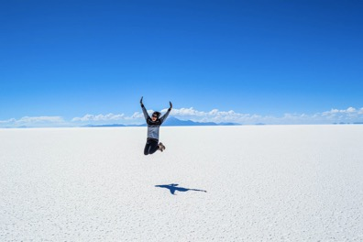
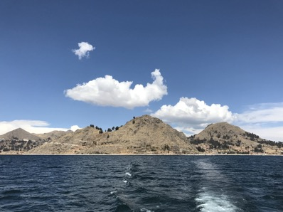
Bolivia: un país diverso
leer / escuchar
Economía
Muchos bolivianos trabajan en la agricultura, aunque ganan poco y el clima es muy variable. Otros trabajan en la minería*. Hay mucho debate sobre la protección de los recursos* naturales. Mucha gente dice que el país no debe exportar el gas natural y los minerales preciosos al extranjero.
El turismo crece. Muchos turistas van a Bolivia para visitar el Salar de Uyuni, un desierto blanco, o para subir las montañas altas. Otros turistas van para ver las aguas del Lago Titicaca en la frontera con Perú.
1
4
2
5
3
6
Salar de Uyuni
Lago Titicaca
*minería = mining; recurso = resource
Notes:
Timing: 8 minutes
Aim: to help students to connect the spoken and written forms of the language more securely; to consolidate vocabulary and grammar knowledge by eliciting suggested changes to the text.
Procedure:
Click on the audio button to play the text. Read and listen.
Note: There is a full version of the audio top right with a player. Alternatively the audio is in 6 sections with a pause just after the words 1-5 below, to facilitate easy stop/start.
To support segmentation, stop the audio and ask students to say: a) the next word b) the previous word
In addition, to develop understanding, vocabulary and grammar knowledge, pause at key points and ask students to suggest an alternative word that could replace the next word. This is a chance to draw on previously taught grammar and vocabulary knowledge.
muchos bolivianos…..(students volunteer third person plural form of a verb in the present tense).
mucha gente… (students volunteer the third person singular form of a verb in the present tense). This can also help to remind students that ‘people’ is a singular noun in Spanish.
el turismo…. (students volunteer the third person singular form of a verb in the present tense).
muchos turistas van a Bolivia para…… (students are prompted to volunteer a verb infinitive, following ‘para’);
o para…. (again, students are prompted to volunteer a verb infinitive, following ‘para’)
Transcript
Economía. Muchos bolivianos trabajan en la agricultura, aunque ganan poco y el clima es muy variable. Otros trabajan en la minería. Hay mucho debate sobre la protección de los recursos naturales. Mucha gente dice que el país no debe exportar el gas natural y los minerales preciosos al extranjero. El turismo crece. Muchos turistas van a Bolivia para visitar el Salar de Uyuni, un desierto de sal, o para subir las montañas altas. Otros turistas van para ver las aguas del Lago Titicaca en la frontera con Perú.
Pictures taken from Unsplash:
Photo of Uyunu by @alanaut24
Photo of Lake Titicaca by @gcoppa

Slide 27
Las palabras con –ía y –ia
hablar
economy
economía.
All –ía or –ia words in Spanish are feminine, so use ‘la’ for ‘the’ and ‘una’ for ‘a, an’.
geography
geografía.
-y at the end of an English word often changes to –ía or –ia in Spanish.
Notes:
Timing: 1 minute
Aim: to explain the ‘–ía’ or ‘–ia’ suffix in Spanish and its correspondence to ‘–y’ in English.
Procedure:
Teacher elicits the Spanish for ‘economy’ and ‘geography’ (the words appeared in texts in lesson 1 and 2).
Teacher reads through the follow-up explanations.
Note: the two words given here both have final syllable stress. Words ending in –ia, however, have stress on the penultimate syllable (frecuencia; democracia; colonia; gloria; victoria).

Slide 28
Comparamos la pronunciación de las palabras con –ía y –ia.
Words ending in –ía have stress on the final syllable.
An accent is needed on the final vowel.
1
economía
2
geografía
Words ending in –ia have stress on the penultimate syllable.
No accent is needed.
3
familia
4
frecuencia
Notes:
Timing: 1 minute
Aim: to make explicit the difference in stress patterns between words that end in -ía and -ia
Procedure:
The teacher brings up the explanation and goes through it with students.
Students listen to the pronunciation modelled by a native speaker.

Slide 29
¡Pronunciamos las palabras!
hablar
Note: ‘ph’ in English becomes ‘f’ in Spanish!
familia
compañía
industria
filosofía
victoria
tecnología
fotografía
memoria
Notes:
Timing: 3 minutes
Aim: to pronounce words with ‘–ía’ and ‘–ia’ in Spanish with stress in the correct position
Procedure:
In pairs, or as a whole-class activity, students read the words aloud, paying particular attention to whether the word ends in -ia or –ía, as this determines the position of stress (final syllable or penultimate syllable)
Draw students’ attention to spelling changes: ‘ñ’ in ‘compañía’ and ‘f’ in ‘filosofía’ and ‘fotografía’.
Further words in most frequent 2000 words with the same pattern: energía [664]; teoría [851]; frecuencia [1309]; democracia [1484]; colonia [1960]; gloria [1915]; victoria [1266].

Slide 30
¡A escribir!
escribir
Escribe en español:
Remember, Spanish uses ‘de’ and changes the order of the two nouns.
e.g. Spanish class = clase de español
A trip with the family is great.
2) She is very successful in the company.
3) He makes an effort to study philosophy.
4) We work in the technology industry, whereas they work in the energy industry.
Un viaje con la familia es genial.
Tiene mucho éxito en la compañía.
Hace un esfuerzo para estudiar filosofía.
Nosotros trabajamos en la industria de tecnología, mientras que ellos trabajan en la industria de energía.
Notes:
Timing: 5 minutes
Aim: to use words with ‘–ía’ and ‘–ia’ in context, plus other words from this week’s revisited vocabulary sets.
Procedure:
1. Students translate the sentences into Spanish.
2. Teachers reveal the answers on a mouse click.
Vocabulary from revisited sets:
Y8 1.2.3: éxito [708];
Y8 1.1.5: esfuerzo [601]; viaje [519]; genial [2890]; subject pronouns nosotros/as [164]; ellos/as [9-él]

Slide 31
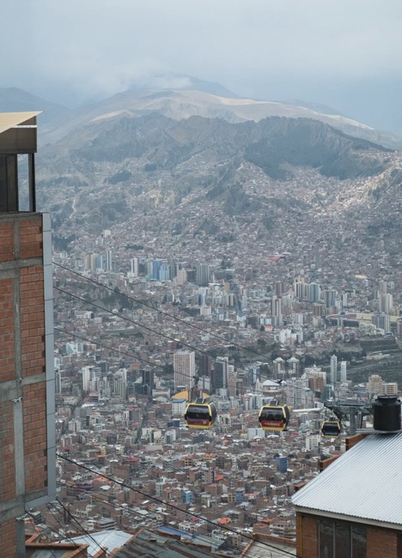
Bolivia: un país diverso
leer / escuchar
Lee y escucha el texto. ¿Puedes escribir las palabras que no están?
La ciudad y el campo
Ahora la población de las ciudades crece mucho. Un factor es que mucha gente del campo busca una vida mejor allí. Hay más ________________________ y servicios públicos. Sin embargo, no todas las ciudades son seguras, y hay __________________ y contaminación.
oportunidades de trabajo
problemas de ruido
¿Cómo dices las frases subrayadas en inglés?
oportunidades de trabajo →
job opportunities
problemas de ruido →
noise problems
La Paz, la capital de Bolivia
Notes:
Timing: 5 minutes
Aim: to consolidate understanding of how ‘de’ is used between two nouns (this was previously taught in 8.1.2.2).
Procedure:
Click on the audio button to play the text. Read and listen.
Write the two missing noun phrases.
Write those phrases in English.
Transcript
La ciudad y el campo. Ahora la población de las ciudades crece mucho. Un factor es que mucha gente del campo busca una vida mejor allí. Hay más oportunidades de trabajo y servicios públicos. Sin embargo, no todas las ciudades son seguras, y hay problemas de ruido y contaminación.
Vocabulary from revisited sets
Y8 1.1.5: ruido [1034];
Pictures taken from Unsplash:
Photo of La Paz by @sanderlenaerts

Slide 32
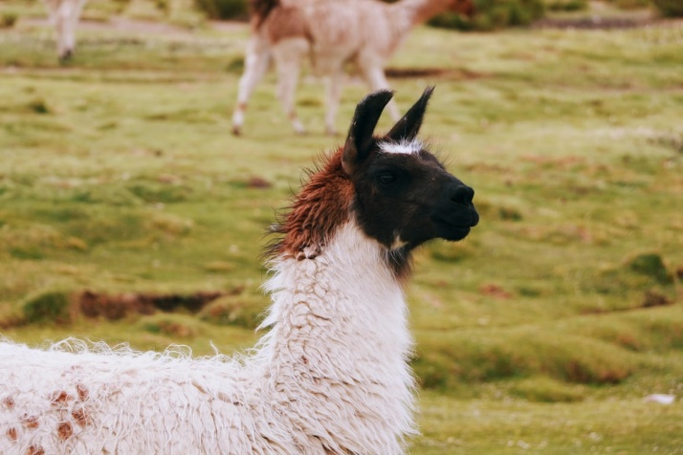
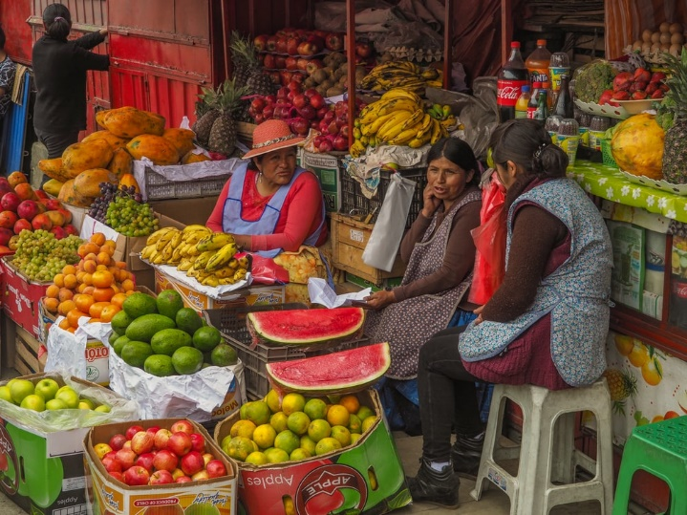
escribir
Vamos a escribir las frases en español.
Usa la palabra ‘de’.
 | En inglés | En español
1 | Quechua teacher
2 | landscape photography
3 | country life (Hint: use the word for ‘countryside’!)
4 | food market
5 | technology company
6 | summer rain
profesor de quechua
fotografía de paisaje(s)
la llama, un animal típico del campo
vida de campo
mercado de comida
compañía de tecnología
lluvia de verano
un mercado de comida en La Paz
Notes:
Timing: 5 minutes
Aim: to practise translating English noun phrases into Spanish using ‘de’.
Procedure:
Students translate each noun phrase into Spanish. They will need to remember to use ‘de’ and to change the order of the two nouns, so the task may be slightly trickier than it appears.

Slide 33
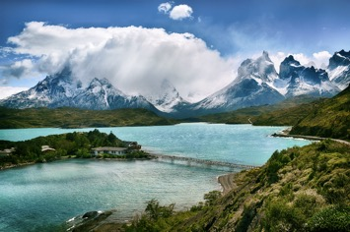
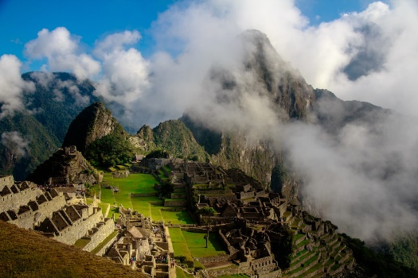
Deberes
escribir
Ahora puedes escribir tu propio texto sobre otro país de Sudamérica.
Si quieres, puedes encontrar inspiración en el texto de Bolivia.
Quizás puedes intentar contestar unas preguntas:
¿Cómo es la geografía?
¿Tiene fronteras con otros países?
Chile
¿Cuántos idiomas existen allí?
¿Hay mucho turismo? ¿Por qué (no)?
¿Cuáles son las industrias importantes?
Perú
Notes:
OPTIONAL
Aim: To produce the new and revisited features in writing about another Spanish speaking country.
Procedure:
Go through all the prompts to ensure that each is understood.
Encourage students to write their own text about another South American country based on the text about Bolivia.
Note: There may be time to begin this activity in class, but it can otherwise be set as homework.
Pictures taken from Unsplash:
Photo of Chile by @stalskaya
Photo of Peru by Scott Umstattd

Slide 34
Deberes
Vocabulary Learning Homework
There is no vocabulary learning homework this week, but go to Quizlet for a Year 7 vocabulary mash-up.
Quizlet QR code:
In addition, revisit: Y8 Term 1.2 Week 4
Y8 Term 1.1 Week 6

