Slide 1
French question words Practice
Images - Steve Clarke

Slide 2
Quelle est la question?
Que fais-tu?
Quel est ton mot préféré?
Quand commence le film?
Comment vas-tu au collège?
Où est Amélie?
Combien de chiens as-tu?
Pourquoi aimes-tu ça?
Qui est tu prof de maths?
Quelle photo aimes-tu?
Rachel Hawkes
Notes:
These repeat the questions from the learning presentation. It would of course be possible to use completely different questions and create a higher level of challenge.

Slide 3
who?
what?
where?
how many?
when?
which?
how much?
how?
why?
Rachel Hawkes
Notes:
Noughts and crosses game. Note: How much and how many are the same word in French (combien) but it’s important that pupils know this!

Slide 4
how? | what? | … | … | … | … | … | … | …
Rachel Hawkes
Notes:
Students can also draw a 3 x 2 grid and choose six of the nine question words for a bingo. Strip bingo is even better. Students write all of the nine question words in their own chosen order from left to right in English. Teacher (or another student) calls out the question words in Spanish. Pupils can only tear off from either end. The player who has nothing left on his/her strip first, wins.

Slide 5
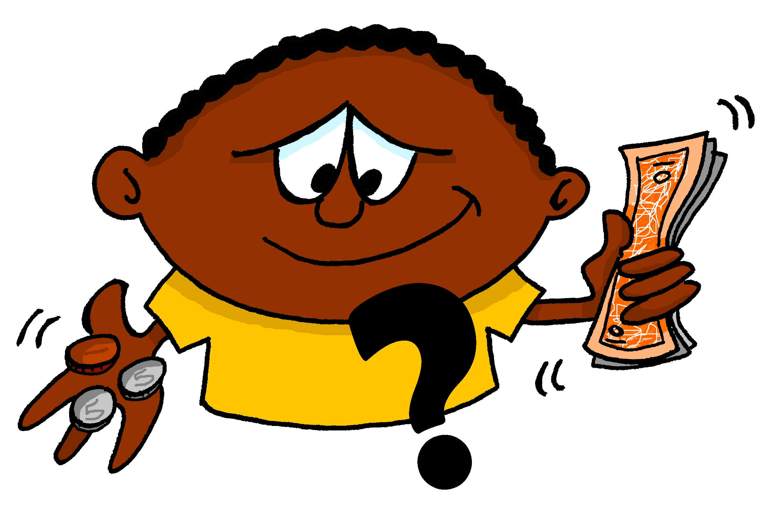
A | B | C
D | E | F
G | H | I
Rachel Hawkes
Notes:
Use the images to elicit the question words and/or a whole question (can easily differentiate – a bonus point can be offered for those who are able to create new questions).

Slide 6
Comment?
Qui?
Que?
Pourquoi?
Où?
Quel? Quelle?
Quand?
Combien?
Rachel Hawkes

Slide 7
C_______?
Q__?
Q__?
P_______?
O_?
Q___? Q_____?
Q_____?
C_______?
Rachel Hawkes

Slide 8
when?
who?
how much?
how much?
which?
how?
why?
where?
how many?
when?
where?
why?
which?
how?
how many?
what?
who?
what?
Rachel Hawkes
Notes:
Slap the board. Could also be done the other way around for reading practice.

Slide 9
Quelle est la question?
Je joue au football.
?
au collège.
Où
Rachel Hawkes
Notes:
This activity doesn’t use all of the question words, but is a very useful one for practising questions in a scaffolded, yet ‘contingent’ context. Students only know which question word to use by looking at both lines of dialogue either side and processing for meaning. As the first line is repeated each time, the cognitive load is firmly focused on the 3rd utterance to cue the correct question word.
Using the Q words in context to reinforce their meaning. Lines 1 – 3 are there. Students supply the question word orally. Do a couple first to model, then give each pair 20 seconds to say each dialogue first before taking the answer whole class for the rest of the slides.

Slide 10
Quelle est la question?
Je joue au football.
?
le samedi.
Quand?
Rachel Hawkes

Slide 11
Quelle est la question?
Je joue au football.
?
JE JOUE AU FOOTBALL!
Comment?
Rachel Hawkes
Notes:
This is an additional use of ‘comment’ we are introducing here.

Slide 12
Quelle est la question?
Je joue au football.
?
C’est génial!
Pourquoi?
Rachel Hawkes

Slide 13
Quelle est la question?
Je joue au football.
?
mes amis.
Avec qui?
Rachel Hawkes
Notes:
This is a way to introduce a variant of ‘’qui’ and one that is very useful for students, when talking about what they do with their friends / family.

Slide 14
On va parler!
J’apprends le français.
?
Avec qui?
Quand?
Pourquoi?
Comment?
Où?
ma classe | J’APPRENDS LE FRANÇAIS! | le vendredi
au collège |  | c’est très important
Rachel Hawkes
Notes:
Pair work Question words are spontaneous Responses are then supported.
After students have tried this out for themselves, use the animations to elicit their responses as a whole class orally and give them feedback.
Students can then create their own sequences of questions and answers, starting with a different statement. Their partner has to select the answer that has to be given.

