Slide 1
Talking about where you went and what you did
-ER verbs taking être in the perfect tense
SSCs [e], [è/ê], [a]
Y9 French
Term 2.1 - Week 2 - Lesson 29
Catherine Salkeld / Louise Bibbey
Artwork by: Chloé Motard
Date updated: 04/02/22
Notes:
Artwork by Chloé Motard. All additional pictures selected are available under a Creative Commons license, no attribution required.
Native speaker feedback provided by Sarah Brichory.
With thanks to Rachel Hawkes and Emma Marsden for their input on the lesson material.
Learning outcomes (lesson 1):
Consolidation of SSC [e] and [ê/è]
Learning to differentiate between the two sounds to prepare for learning tu as, il/elle/on a and tu es, il/elle/on est
Introduction of –er verbs taking être in the perfect tense (singular)
Word frequency (1 is the most frequent word in French):
apprendre [327], commencer [139], nourrir [1251], préparer [368], proposer¹ [338], rester [100], elle sait [67], tu veux [57], l'Algérie (f) [N/A], une amie [467], l'autobus (m) [4216], la banque [774], le café1 [1886], le cours [169], la cuisine¹ [2618], la cuisine² [2618], l'Écosse (f) [N/A], l'église (f) [1782], la fête [1490], l'hiver (m) [1586], l'hôtel (m) [1774], le jardin [2284], le jour [78], le matin [442], la mère [645], la minute [375], le musée [2216], les oiseaux [2435], le parc [1240], les parents (m pl) [546], le passé [501], le père [569], un peu [91], le piano [4967], le repas [2948], le réveillon [n/a], la saison [1667], le temps [65], le thé [3517], la tradition [1371], la viande [2625], un vélo [4594], une voiture [881], dernier [87], intéressante [1244], nationale [227], premier [56], suisse [2241], aujourd’hui [233], au revoir [1274], beaucoup [150], chez¹ [206], déjà¹ [58], douze [1664], en retard [7/1278], en2 [7], ici [167], parce que [N/A], Paris [N/A], pas encore [18/51], salut¹ [2205], seize [3285], treize [3245], trois [115], vingt [1273]
Source: Lonsdale, D., & Le Bras, Y. (2009). A Frequency Dictionary of French: Core vocabulary for learners London: Routledge.
The frequency rankings for words that occur in this PowerPoint which have been previously introduced in NCELP resources are given in the NCELP SOW and in the resources that first introduced and formally re-visited those words.
For any other words that occur incidentally in this PowerPoint, frequency rankings will be provided in the notes field wherever possible.

Slide 2
Devoirs
Personne A lit sa version du texte.
Personne B écoute et prend des notes.
Quelles sont les différences ?
parler
demandé
la sœur
amusante
le repas
Mon père vient d’Écosse, et ma mère est suisse . Le réveillon est une tradition très importante et intéressante en Écosse. Aujourd’hui, je vais chez mes parents pour la fête . Cette année, j’ai proposé à une amie de venir chez nous pour la première fois. Ma mère sait faire la cuisine de l’Écosse. J’aime bien la viande ! Normalement, ma sœur est très en retard ! On passe le prochain jour ensemble, et on aime aller au café dans le parc le matin. En général, ma saison préférée est l’hiver, parce que je peux passer du temps avec ma famille .
l’hôtel
française
fête
amusante
Demain
le repas
le fromage
demandé
les parents
sœur
le fromage
mon frère
un peu
l’hôtel
française
la fête
mes parents
le frère
demain
un peu
Notes:
Timing: 10 minutes Aims: i) to review the homework task set last week (9.2.1.1).
ii) to develop fluency in decoding by reading aloud the student versions. iii) to listen attentively, noting differences in the original text. iv) to make judgements about the replacements made by a peer, and engage in peer feedback.
Procedure:
Student A reads his/her adapted homework text.
Student B follows along with the original and makes a note of any substituted words s/he hears (on his/her copy of the homework sheet)
Swap roles.
Compare and contrast the two versions. Scrutinise any differences and offer opinions about the correctness of the choices.
On successive clicks the bold words replaced with the appropriate substitute word.
Note that sometimes changes are needed to other words in the sentence. All of these changes revisit previously taught grammar, which teachers can elicit and/or explain as needed.
Note that alternative substitutions are possible. Teachers should make this clear and elicit students’ suggestions.
Note: the HW task set a time limit and asked students to try to replace at least ten of the words, so it’s to be expected that they might not have got them all.
Word frequency of cognates used (1 is the most frequent word in French):
version [1165]; différence [738]
Source: Lonsdale, D., & Le Bras, Y. (2009). A Frequency Dictionary of French: Core vocabulary for learners London: Routledge.

Slide 3
e
je
Notes:
Timing: 1 minute [2 slides]
Aim: To consolidate SSC [e]
Procedure: 1. Present the letter(s) and say the [e] sound first, on its own. Students repeat it with you. 2. Bring up the word ”je” on its own, say it, students repeat it, so that they have the opportunity to focus all of their attention on the connection between the written word and its sound.
3. A possible gesture for this would be to point to oneself.
Word frequency (1 is the most frequent word in French):
je [22] Source: Lonsdale, D., & Le Bras, Y. (2009). A Frequency Dictionary of French: Core vocabulary for learners London: Routledge.

Slide 4
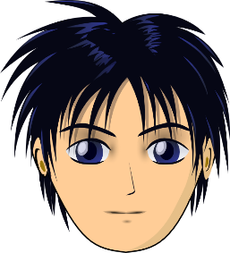
ê/è
[head]
tête
Notes:
Aim: To consolidate SSC [ê/è]
Procedure: 1. Present the letter(s) and say the [ê/è] sound first, on its own. Students repeat it with you. 2. Bring up the word ”tête” on its own, say it, students repeat it, so that they have the opportunity to focus all of their attention on the connection between the written word and its sound.
3. A possible gesture for this would be to point to one’s head.
Word frequency (1 is the most frequent word in French):
tête [343]. Source: Lonsdale, D., & Le Bras, Y. (2009). A Frequency Dictionary of French: Core vocabulary for learners London: Routledge.

Slide 5
SSC [e] ou [ê/è] ?
phonétique
Je suis avec mon chat, Pacha
As you have already learned, some French words containing an unaccented ‘e’ are not pronounced like je.
Some sound like ê/è, such as in avec [with].
Listen to the difference here between the ‘e’ in je and the ‘e’ in avec.
Notes:
Timing: 1 minute
Aim: Raising awareness of different sounds represented by the SSC [e].
Procedure:
Explain that an e without an accent is not always pronounced like je, giving the example of avec.
Listen to the audio, and students repeat the sentence, emphasizing the pronunciation of je and avec.
Transcript:
Je suis avec mon chat, Pacha

Slide 6
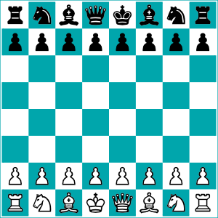
SSC [e] ou [ê/è] ?
Listen carefully to the pronunciation. Do you hear [e] or [ê/è]?
écouter
1
tunnel
2
chenille
[e] | [ê/è]
[e] | [ê/è]
3
melon
4
*échecs
[e] | [ê/è]
[e] | [ê/è]
*échecs = chess
Notes:
Timing: 8 minutes. Slide 1/3.
Aim: to practise aural recognition of SSCs [e/ê/è].
NB: unknown words
Procedure:
1. Click numbers to hear a word.
2. Students tick whether they hear the [e] or [ê/è] sound.
3. Click to reveal answers.
4. Listen again, this time drawing attention to the e sounds. Students repeat.
5. Students say the words one more time, emphasizing the correct e sound.
Transcript:
tunnel
chenille
melon
échecs
Word frequency of unknown words used (1 is the most frequent word in French):
chenille [>5000], échecs [>5000]
Source: Lonsdale, D., & Le Bras, Y. (2009). A Frequency Dictionary of French: Core vocabulary for learners London: Routledge.
Word frequency of cognates used (1 is the most frequent word in French): tunnel [3386], melon [>5000]
Source: Lonsdale, D., & Le Bras, Y. (2009). A Frequency Dictionary of French: Core vocabulary for learners London: Routledge.

Slide 7
SSC [e] ou [ê/è] ?
Listen carefully to the pronunciation. Do you hear [e] or [ê/è]?
écouter
1
renard
2
cheval
[e] | [ê/è]
[e] | [ê/è]
3
*bec
4
carrousel
[e] | [ê/è]
[e] | [ê/è]
*bec = beak
Notes:
Slide 2/3
Transcript:
renard
cheval
bec
carrousel
Word frequency of unknown words used (1 is the most frequent word in French): renard [>5000], cheval [2220], bec [>5000]
Source: Lonsdale, D., & Le Bras, Y. (2009). A Frequency Dictionary of French: Core vocabulary for learners London: Routledge.
Word frequency of cognates used (1 is the most frequent word in French): carrousel [>5000]
Source: Lonsdale, D., & Le Bras, Y. (2009). A Frequency Dictionary of French: Core vocabulary for learners London: Routledge.

Slide 8
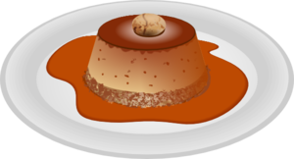
SSC [e] ou [ê/è] ?
Have you noticed any spelling patterns which could help you identify whether to use the [e] or [ê/è] sound?
Listen carefully to the pronunciation. Do you hear [e] or [ê/è]?
écouter
caramel
chaussette
1
2
[e] | [ê/è]
[e] | [ê/è]
peluche
3
*vitesse
4
[e] | [ê/è]
[e] | [ê/è]
*vitesse = speed
Notes:
Slide 3/3
Do you notice any patterns emerging for words containing an e which is not pronounced like je?
Point out there is a rule in French for this: This pronunciation comes before double consonants e.g. –ette, and when it is a closed syllable (a syllable ending in a consonant sound), e.g. caramel, bec. Teachers can use following slide for add-on activity.
Transcript:
caramel
chaussette
vitesse
peluche
Word frequency of unknown words used (1 is the most frequent word in French): chaussette [>5000], vitesse [1065], peluche [>5000]
Source: Lonsdale, D., & Le Bras, Y. (2009). A Frequency Dictionary of French: Core vocabulary for learners London: Routledge.
Word frequency of cognates used (1 is the most frequent word in French): caramel [>5000]
Source: Lonsdale, D., & Le Bras, Y. (2009). A Frequency Dictionary of French: Core vocabulary for learners London: Routledge.

Slide 9
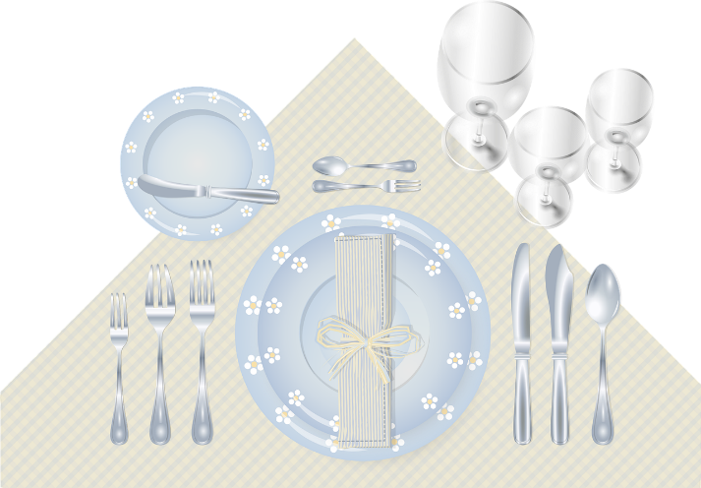
SSC [e] ou [ê/è] ?
phonétique
In French, the e is usually pronounced as in avec [ê/è] when:
It comes before a double consonant, such as vitesse [speed]
It comes before a ‘c’ or ‘l’ in the last syllable, such as bec [beak]
Following this guide, decide whether the unaccented e makes the [e] or [ê/è] sound, and say the words. Check by listening to the native speaker.
1
assiette [plate]
repos [rest]
vaisselle [crockery]
verre [glass]
culturel [cultural]
première [first]
2
3
4
5
6
Notes:
[Optional] Timing: 3 minutes
Aim: Raising awareness of differences between different ‘e’ sounds.
Procedure:
In French, the e is usually pronounced as in avec [ê/è] when:
It comes before a double consonant, such as vitesse [speed]
It comes before a ‘c’ or ‘l’ in the last syllable, such as bec [beak]
Students say the words, applying the rule.
Listen to the native speaker to check.
Transcript:
assiette
verre
repos
culturel
vaisselle
première
Word frequency of unknown words used (1 is the most frequent word in French):
assiette [3756], verre [2174], repos [2731], vaisselle [>5000], première [56]
Source: Lonsdale, D., & Le Bras, Y. (2009). A Frequency Dictionary of French: Core vocabulary for learners London: Routledge.
Word frequency of cognates used (1 is the most frequent word in French): culturel [1495]
Source: Lonsdale, D., & Le Bras, Y. (2009). A Frequency Dictionary of French: Core vocabulary for learners London: Routledge.

Slide 10
The perfect tense: Saying what you did
grammaire
As you know, we usually use the present tense of avoir to make the first part of the perfect tense.
All the verbs that take être express movement or a change of state, except for rester, which expresses a lack of movement.
Some verbs take être instead of avoir in the perfect tense, such as:
aller je suis allé(e)
I went
We add ‘e’ to the past participle if the subject is feminine.
arriver tu es arrivé(e)
you _{[sing. informal]} arrived
rester il/elle est resté(e)
he/she stayed
aller on est allé
one went
Notes:
Timing: 3 minutes
Aim: Introduction of –er verbs taking être in the perfect tense
Procedure:
1. Click to reveal explanations and examples.
2. Ensure understanding.
N.B. The translation of on as ‘we’ will be addressed in 9.2.1.3 to go with other plural forms and the appropriate past participle agreements.

Slide 11
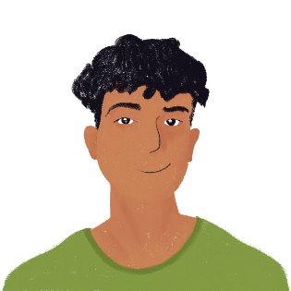
Le Réveillon d’Amir
écouter
Amir a célébré le réveillon avec Océane. Écoute. Qui a fait quoi ? Choisis Amir (je) ou Océane (elle). Écris l’activité en anglais.
Q | Amir | Océane | anglais | R
 |  |  | went to a friend’s party
 |  |  | also went to the party
 |  |  | arrived by bike
 |  |  | went to the supermarket
 |  |  | arrived early
 |  |  | arrived late
 |  |  | stayed in the kitchen
 |  |  | went to the garden
1
1
2
2
3
3
4
4
5
5
6
6
7
7
8
8
Notes:
Timing: 8 minutes
Aim: Aural recognition of the perfect tense with être in the first and third person singular
Procedure:
1. Click buttons on the left to play audio with [je] or [elle] missing.
2. Students tick Amir or Océane.
3. Click to play audio again.
4. Students note the English for each activity.
5. Click to reveal answers.
6. Click buttons on the right to play full audio.
Transcript:
[Je] suis allé à la fête d’une amie.
[Elle] est allée à la fête aussi.
[Elle] est arrivée en vélo.
[Je] suis allé au supermarché.
[Elle] est arrivée tôt.
[Je] suis arrivé en retard.
[Elle] est restée dans la cuisine.
[Je] suis allé au jardin.

Slide 12
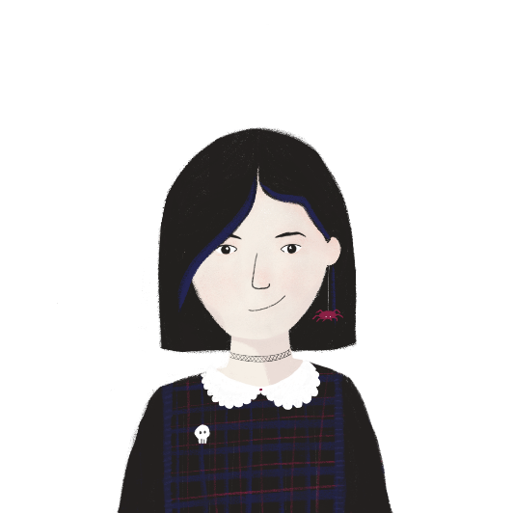
Un message pour Léa
lire
Sophie écrit un message à Léa. Écris je, tu ou elle.
Salut, Léa
Tu es allée chez la famille de Stéphanie pour le réveillon. Tu es allée chez elle sans dire au revoir. Je suis restée à la maison. Je suis allée chez ta famille ce matin, mais tu n’es pas encore arrivée. Es-tu allée à une fête à Tours avec Stéphanie ? Est-elle allée à l’église ? Je suis restée dans ma chambre, triste sans ma meilleure amie.
Sophie
1
2
3
4
5
6
7
8
Notes:
Timing: 8 minutes [slide 1/3]
Aim: Written recognition of singular forms of –er verbs that take être in the perfect tense
Procedure:
1. Students write 1-8 and write je, tu, or elle.
2. Click to reveal answers.
3. Students answer questions in English from slide 13.
4. Check answers on slide 14.

Slide 13
Un message pour Léa
lire
Réponds aux questions en anglais.
Salut, Léa
Tu es allée chez la famille de Stéphanie pour le réveillon. Tu es allée sans dire au revoir. Je suis restée à la maison. Je suis allée chez ta famille ce matin, mais tu n’es pas encore arrivée. Es-tu allée à une fête à Tours avec Stéphanie ? Est-elle allée à l’église ? Je suis restée dans ma chambre, triste sans ma meilleure amie.
Sophie
What did Léa do for New Year?
What did Sophie do?
What happened this morning? (two details)
Why is Sophie upset? (two details)
What does Sophie ask about Léa’s trip? (two details)
Notes:
Timing: 8 minutes [slide 2/3]

Slide 14
Un message pour Léa
lire
Réponds aux questions en anglais.
What did Léa do for New Year?
What did Sophie do?
What happened this morning? (two details)
Why is Sophie upset? (two details)
What does Sophie ask about Léa’s trip? (two details)
1. Léa went to Stéphanie’s family’s house.
2. Sophie stayed at home.
3. Sophie went to Léa’s house, but Léa wasn’t there.
4. Léa went without saying goodbye and Sophie was sad without her.
5. Did Léa go to a party in Tours? Did Stéphanie go to church?
Notes:
Timing: 8 minutes [slide 3/3]

Slide 15
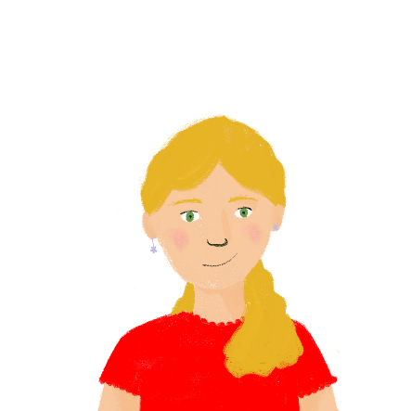
Un message pour Sophie
écrire
Léa répond à Sophie. Traduis les verbes en français.
Salut, Sophie !
Je suis allée en Touraine pour le Réveillon à la dernière minute !
La mère de Stéphanie est arrivée tôt du travail et je suis allée dans sa voiture. Je suis allée à la cathédrale de Tours avec Stéphanie.
Je suis arrivée à Paris en train à 15h, mais Stéphanie est restée en Touraine un peu plus de temps. Es-tu allée en ville aujourd’hui ? Je suis arrivée au café, si tu veux venir.
Léa
1. I went
2. arrived
3. I went
4. I went to
5. I arrived
6. stayed
7. Did you go
8. I have arrived
Notes:
Timing: 4 minutes
Aim: Written production of singular forms of –er verbs taking être in the perfect tense
Procedure:
1. Students translate the verbs into French.
2. Click to reveal answers.
3. Ensure understanding of feminine agreement of past participles.
Word frequency of cognates used (1 is the most frequent word in French): verbe [>5000]
Source: Lonsdale, D., & Le Bras, Y. (2009). A Frequency Dictionary of French: Core vocabulary for learners London: Routledge.

Slide 16
Le week-end dernier
parler
Répond aux questions de ton/ta partenaire. Écris les réponses que tu entends.
Où es-tu allée ?
Je suis allée au parc.
where they went
Notes:
Timing: 8 minutes [slide 1/2]
Aim: Oral production of singular forms of verbs that take être and avoir in the perfect tense.
Procedure:
Print the role cards from side 17.
Model the task using the example on this slide.
Students ask each other questions to find the information required.
Students make notes on each other’s answers.
Suggested answers are provided on slide 18.

Slide 17
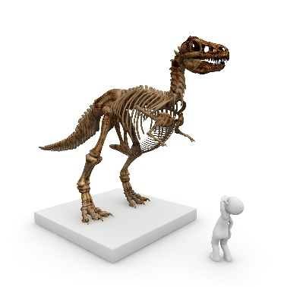
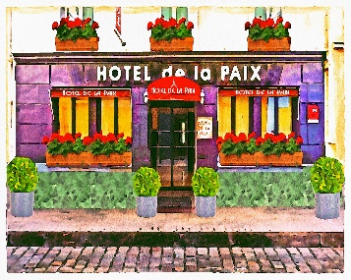
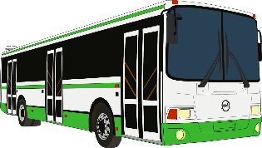
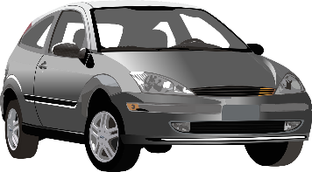
Le réveillon
parler
Tu parles du réveillon avec un(e) ami(e). Qu’est-ce qu’il/elle a fait ?
Partenaire A:
Réponds aux questions de ton/ta partenaire.
Ask your partner:
Where they went
How they arrived
Where their brother stayed
Where their brother went
Partenaire B:
Réponds aux questions de ton/ta partenaire:
Ask your partner:
Where they went
How they arrived
Where their brother went
How long they stayed
3 days
Notes:
ROLECARDS FOR PRINTING

Slide 18
Les réponses
parler
Tu parles du réveillon avec un(e) ami(e). Qu’est-ce qu’il/elle a fait ?
Partenaire A:
Réponds aux questions de ton/ta partenaire.
Je suis allé(e) en Écosse.
Je suis arrivé(e) en bus.
Il est allé au musée.
Je suis resté trois jours.
Partenaire B:
Réponds aux questions de ton/ta partenaire:
Je suis allé(e) en ville.
Je suis arrivé(e) en voiture.
Il est resté dans un hôtel.
Il est allé à la banque.
3 days
Notes:
SUGGESTED ANSWERS [slide 2/2]

Slide 19
Talking about where you went and what you did
-ER verbs taking être in the perfect tense
SSCs [e], [è/ê], [a]
Y9 French
Term 2.1 - Week 2 - Lesson 30
Catherine Salkeld / Louise Bibbey
Artwork by: Chloé Motard
Date updated: 04/12/21
Notes:
Artwork by Chloé Motard. All additional pictures selected are available under a Creative Commons license, no attribution required.
Native speaker feedback provided by Sarah Brichory.
With thanks to Rachel Hawkes and Emma Marsden for their input on the lesson material.
Learning outcomes (lesson 2):
Consolidation of SSC [e] and [ê/è]
Consolidation of –er verbs taking être in the perfect tense (singular)
Word frequency (1 is the most frequent word in French):
apprendre [327], commencer [139], nourrir [1251], préparer [368], proposer¹ [338], rester [100], elle sait [67], tu veux [57], l'Algérie (f) [N/A], une amie [467], l'autobus (m) [4216], la banque [774], le café1 [1886], le cours [169], la cuisine¹ [2618], la cuisine² [2618], l'Écosse (f) [N/A], l'église (f) [1782], la fête [1490], l'hiver (m) [1586], l'hôtel (m) [1774], le jardin [2284], le jour [78], le matin [442], la mère [645], la minute [375], le musée [2216], les oiseaux [2435], le parc [1240], les parents (m pl) [546], le passé [501], le père [569], un peu [91], le piano [4967], le repas [2948], le réveillon [n/a], la saison [1667], le temps [65], le thé [3517], la tradition [1371], la viande [2625], un vélo [4594], une voiture [881], dernier [87], intéressante [1244], nationale [227], premier [56], suisse [2241], aujourd’hui [233], au revoir [1274], beaucoup [150], chez¹ [206], déjà¹ [58], douze [1664], en retard [7/1278], en2 [7], ici [167], parce que [N/A], Paris [N/A], pas encore [18/51], salut¹ [2205], seize [3285], treize [3245], trois [115], vingt [1273]
Source: Lonsdale, D., & Le Bras, Y. (2009). A Frequency Dictionary of French: Core vocabulary for learners London: Routledge.
The frequency rankings for words that occur in this PowerPoint which have been previously introduced in NCELP resources are given in the NCELP SOW and in the resources that first introduced and formally re-visited those words.
For any other words that occur incidentally in this PowerPoint, frequency rankings will be provided in the notes field wherever possible.

Slide 20
a
animal
Notes:
Timing: 1 minute
Aim: To introduce/consolidate SSC [a]
Procedure: 1. Present the letter(s) and say the [a] sound first, on its own. Students repeat it with you. 2. Bring up the word ”animal” on its own, say it, students repeat it, so that they have the opportunity to focus all of their attention on the connection between the written word and its sound.
3. A possible gesture for this would be to mimic an animal’s motion, perhaps holding ones arms and hands close to the chest as ‘paws’. 4. Roll back the animations and work through 1-3 again, but this time, dropping your voice completely to listen carefully to the students saying the [a] sound, pronouncing ”animal” and, if using, doing the gesture.
Word frequency (1 is the most frequent word in French):
animal [1002]
Source: Londsale, D., & Le Bras, Y. (2009). A Frequency Dictionary of French: Core vocabulary for learners London: Routledge.

Slide 21
ê/è
[head]
tête
Notes:
Aim: To consolidate SSC [ê/è]
Procedure: 1. Present the letter(s) and say the [ê/è] sound first, on its own. Students repeat it with you. 2. Bring up the word ”tête” on its own, say it, students repeat it, so that they have the opportunity to focus all of their attention on the connection between the written word and its sound.
3. A possible gesture for this would be to point to one’s head.
Word frequency (1 is the most frequent word in French):
tête [343]. Source: Lonsdale, D., & Le Bras, Y. (2009). A Frequency Dictionary of French: Core vocabulary for learners London: Routledge.

Slide 22
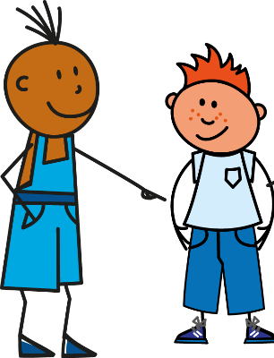
SSC [a] ou [ê/è] ?
phonétique
Listen carefully, then practise saying these words:
1
Tu as [you have]
2
Il/elle/on a [he/she/one has]
3
Tu es [you are]
4
Il/elle/on est [he/she/one is]
Notes:
Timing: 1 minute
Aim: To differentiate between the [a] or [ê/è] sounds
Procedure:
Click on the numbers to hear the native speaker, then students repeat.
Transcript:
Tu as
Il/elle/on a
Tu es
Il/elle/on est

Slide 23
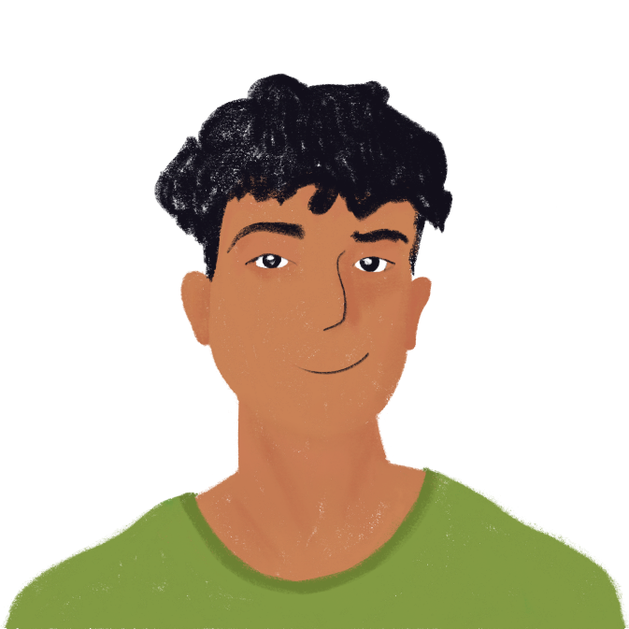
SSC [a] ou [ê/è] ?
phonétique
Listen to Amir and Océane’s words and thoughts.
Do you hear the [a] or [ê/è] sound before the beep?
Choose the correct option for the missing sentence ending.
2
1
Il est ennuyeux*!
_____
Tu es belle
___________
________________
1
belle | un chat
2
un chien | ennuyeux
*ennuyeux = annoying
Notes:
Timing: 5 minutes. Slide 1/4
Aim: To differentiate between the [a] or [ê/è] sounds
Procedure:
Explain that students will hear complete sentences, which include either a, as, es or est, and that the final part of each sentence is beeped out.
Click on the numbers above the images to hear the beeped out sentences.
Students decide whether they hear the [a] or [ê/è] sound for each one.
Students then decide which sentence ending best fits with the [a] or [ê/è] sound that they heard.
Click to reveal if their answer is correct
Click on the number next to the option boxes to hear the complete sentences, asking students to repeat what they hear.
Transcript:
Tu es belle.
Il est ennuyeux.
Word frequency of unknown words used (1 is the most frequent word in French):
ennuyer [3480],
Source: Lonsdale, D., & Le Bras, Y. (2009). A Frequency Dictionary of French: Core vocabulary for learners London: Routledge.

Slide 24
SSC [a] ou [ê/è] ?
*souris = mouse
phonétique
Listen to Amir and Océane’s words and thoughts.
Do you hear the [a] or [ê/è] sound before the beep?
Choose the correct option for the missing sentence ending.
1
2
Elle a un chat
Mon chat est gentil
____
______________
_______________
1
gentille | un chat
2
une souris* | gentil
Notes:
Slide 2/4
Transcript:
Elle a un chat.
Mon chat est gentil.
Word frequency of unknown words used (1 is the most frequent word in French):
souris [4328],
Source: Lonsdale, D., & Le Bras, Y. (2009). A Frequency Dictionary of French: Core vocabulary for learners London: Routledge.

Slide 25
SSC [a] ou [ê/è] ?
*amusée = amused
*amusant =amusing
*nez = nose
phonétique
Listen to Amir and Océane’s words and thoughts.
Do you hear the [a] or [ê/è] sound before the beep?
Choose the correct option for the missing sentence ending.
2
1
Oui, il est amusant!
Tu as un chien?
____
________
______________
__________
1
un chien | amusée?
2
amusant | un nez rouge
Notes:
Slide 3/4
Transcript:
Tu as un chien?
Oui, il est amusant.
Word frequency of unknown words used (1 is the most frequent word in French): nez [2661]
Source: Lonsdale, D., & Le Bras, Y. (2009). A Frequency Dictionary of French: Core vocabulary for learners London: Routledge.
Word frequency of cognates used (1 is the most frequent word in French): amuser [2538]
Source: Lonsdale, D., & Le Bras, Y. (2009). A Frequency Dictionary of French: Core vocabulary for learners London: Routledge.

Slide 26
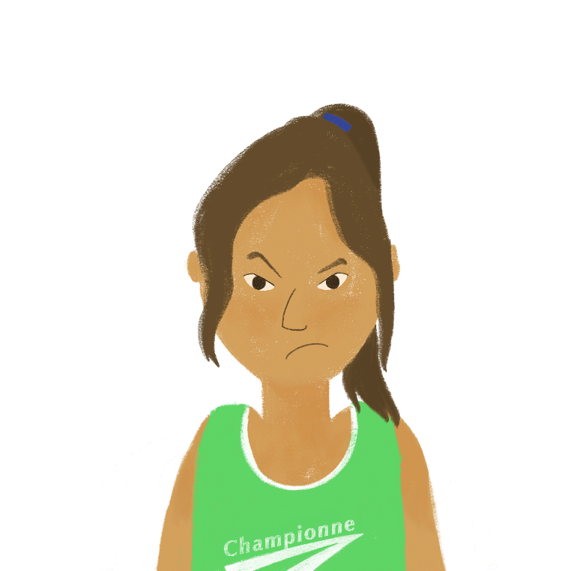
SSC [a] ou [ê/è] ?
phonétique
2
Listen to Amir and Océane’s words and thoughts.
Do you hear the [a] or [ê/è] sound before the beep?
Choose the correct option for the missing sentence ending.
Non, on n’est pas ensemble!
1
___________
On est ensemble
________
_____________
_________________
1
deux chiens | ensemble
2
pas ensemble | pas deux chiens
Notes:
Slide 4/4
Transcript:
On est ensemble
Non, on n’est pas ensemble!

Slide 27
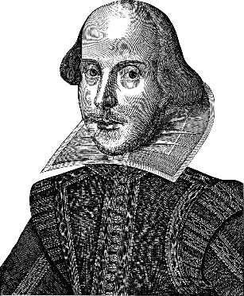
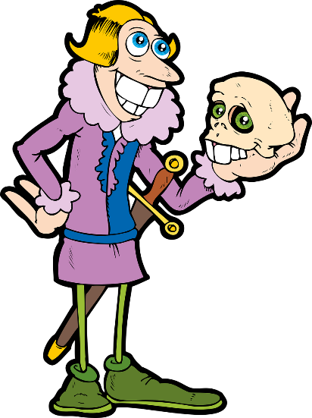
L’accent circonflexe*
Info
The Tempest (meaning The Storm) is a play by William Shakespeare.
In French, it is translated as La Tempête.
Notice the circumflex accent ˆ over the [e].
Vowels with circumflex accents are often used to indicate where letters have been removed from French words of Latin origin.
Latin: tempestas
English: tempest
French: tempête
Which letter in tempest has been removed to make tempête?
To circumflex or not to circumflex, that is the question!
In French, the [s] has been replaced with a circumflex over the [e].
In English, the letter [s] has been retained from the Latin.
*l’accent circonflexe = circumflex accent
Notes:
Timing: 2 minutes
Aim: To explain word patterns using the circumflex (using cross-curricular references to Shakespeare and the Latin origins of some European languages)
Procedure:
Click through the script, pointing out the Latin roots of the words.
Put the question to the class: which letter in ‘tempest’ has been removed to make the French form?
Click to reveal the answer.
Word frequency of cognates used (1 is the most frequent word in French):
tempête [2695], circonflexe [>5000], accent [1694]
Source: Lonsdale, D., & Le Bras, Y. (2009). A Frequency Dictionary of French: Core vocabulary for learners London: Routledge.

Slide 28
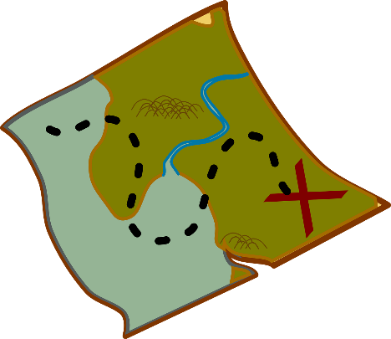
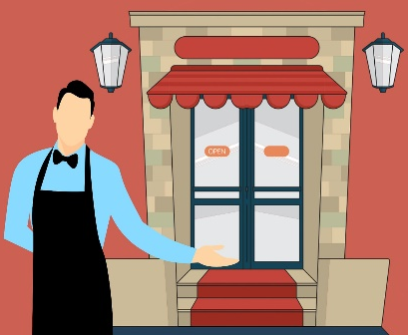
L’accent circonflexe, c’est facile!
vocabulaire
Now you know about one of the functions of the circumflex accent, can you figure out these translations from French to English and English to French?
Notice that many French cognates have [-e] at the end where the English words do not. Remember that [-t] at the end of a French word is an SFC, so the final [-e] on these words forces you to pronounce the [-t-].
français
anglais
anglais
français
quête
quest
conquest
conquête
hôte
host
hostess
hôtesse
Notes:
Slide 1 of 2
Timing: 4 minutes
Aim: For students to practise applying their knowledge of circumflex word patterns to work out French<>English translations.
Procedure:
Click to reveal the words to be translated.
Ask the students to translate into English or French (using whiteboards would be effective for AfL here).
Click to reveal the answers.
Click to reveal the note about the spelling of cognates, connecting with rules they have learned about SFC.
Word frequency of cognates used (1 is the most frequent word in French):
quête [2672], conquête [3177], hôte/hôtesse [3780]
Source: Lonsdale, D., & Le Bras, Y. (2009). A Frequency Dictionary of French: Core vocabulary for learners London: Routledge.

Slide 29
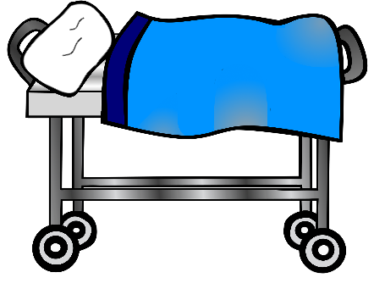
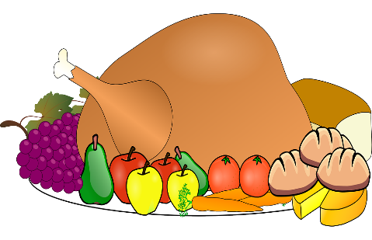
L’accent circonflexe, c’est facile!
vocabulaire
français
anglais
anglais
français
The French word for coast is côte!
forêt
forest
hospital
hôpital
The circumflex replaces the [as] in feast and beast. Following the same pattern, can you work out the French word for coast?
Attention here! The circumflex can replace more than one letter…
fête
feast
beast
bête
Notes:
Slide 2 of 2
Procedure:
This slide contains an extra challenge: Click to reveal the beast’s question and put it to the students (again, a whiteboard would be useful here).
Click to reveal the answer.
Word frequency of cognates used (1 is the most frequent word in French):
bête [2591]
Source: Lonsdale, D., & Le Bras, Y. (2009). A Frequency Dictionary of French: Core vocabulary for learners London: Routledge.

Slide 30
Perfect tense: Saying what you did and where you went
grammaire
Remember, most verbs take ‘avoir’ in the perfect tense, but some verbs take ‘être’. Compare these examples:
Je suis allé(e) I went
J’ai mangé I ate
Tu as regardé you _{[sing. informal]} watched
Tu es resté(e) you _{[sing. informal]} stayed
Il a joué he played
Il est arrivé he arrived
Verbs that take ‘avoir’ in the perfect tense don’t involve moving from one place to another.
Verbs that take ‘être’ in the perfect tense usually involve moving from one place to another.
Notes:
Timing: 2 minutes
Aim: Recap of singular forms of –er verbs taking être in the perfect tense
Procedure:
1. Click to reveal explanations and examples.
2. Ensure understanding.

Slide 31
Un message d’Amir
écouter
Amir laisse un message pour Abdel. Écoute. Choisis le bon verbe.
Q | A | B | R
 | célébré | allé
 | fait la cuisine | resté
 | allé | dansé
 | mangé | arrivé
 | travaillé | allé
 | resté | préparé
 | arrivé | pris
 | allé | voyagé
1
1
2
2
3
3
4
4
5
5
6
6
7
7
8
8
Notes:
Timing: 8 minutes
Aim: Aural recognition of verbs taking être in the perfect tense contrasted with verbs taking avoir.
Procedure:
1. Click buttons on left to play audio.
2. Students choose the correct verb to follow they auxiliary they hear.
3. Click to reveal answers.
4. Click buttons on right to play full audio.
Transcript:
Salut, Abdel ! Tu as [célébré] le réveillon algérien avec ta famille ?
Tu es [resté] à la maison…
…ou tu es [allé] en ville avec tes amis ?
Tu as [mangé] un bon repas ?
Tu es [allé] à des cours de cuisine à l’université !
Tu as [préparé] le repas ?
Tu es [arrivé] en train…
…ou tu as [voyagé] en autobus ?

Slide 32
Le Réveillon en Algérie
Choisis le bon verbe.
lire
*berbère = Amazigh (an ethnic group in North Africa)
Salut, Amir !
Tu as déjà [1] appris/arrivé un peu sur le réveillon algérien de ton père, mais il n’a jamais [2] célébré/allé le réveillon moderne ! Le gouvernement algérien a [3] fait/resté du réveillon berbère* un jour de vacances en 2018 ! J’ai [4] commencé/arrivé la fête le douze janvier. Je suis [5] mangé/allé chez mes parents. Ma grand-mère est [6] arrivée/parlé et elle a [7] porté/arrivée des vêtements traditionnels. Ma mère a [8] restée/préparé le repas, parce que je suis [9] voyagé/arrivé en retard. Ma grand-mère est [10] travaillé/allée au jardin pour nourrir les oiseaux, car c’est traditionnel. Je suis [11] allé/étudié à l’université le treize janvier, mais j’ai [12] fait/resté la fête avec mes amis. Abdel
Notes:
Timing: 8 minutes
Aim: Written recognition of verbs taking être and avoir in the perfect tense.
Procedure:
1. Students choose the correct verb to go with each auxiliary.
2. Click to reveal answers.
3. Oral translation of text if time allows.
Word frequency of unknown words used (1 is the most frequent word in French): berbère [>5000]
Source: Lonsdale, D., & Le Bras, Y. (2009). A Frequency Dictionary of French: Core vocabulary for learners London: Routledge.

Slide 33
Le Réveillon algérien
*le peuple berbère = the Amazigh people
*le poulet =chicken
écrire
Léa ne connaît pas bien le réveillon algérien.
Amir écrit un message. Choisis entre les deux options pour 1-10.
En Algérie, Yennayer, le réveillon algérien, a commencé le douze janvier. L’hiver est arrivé, et le peuple berbère* a célébré cette saison avec de bons repas de viande, normalement du poulet*. La tradition berbère est restée très importante en Algérie et le gouvernement a proposé une fête nationale en 2018. J’ai appris beaucoup sur Yennayer parce que j’ai parlé avec Abdel. Il est resté avec sa famille pour le premier jour de la fête. Tu es allée en vacances pour le réveillon ? Tu es arrivée à la maison avec des histoires intéressantes ?
1. a/est
1
2. a/est
2
3
3. a/est
4. a/est
4
5
5. a/est
6
6. j’ai/je suis
7. j’ai/je suis
7
8
8. a/est
9
9. as/es
10
10. as/es
Notes:
Timing: 8 minutes
Aim: Written production of singular forms of être and avoir as auxiliaries in the perfect tense
Procedure:
1. Students choose the correct auxiliary for each perfect tense verb.
2. Click to reveal answers.
3. Oral translation of text if time allows.
Word frequency of unknown words used (1 is the most frequent word in French): peuple [378], berbère [>5000], poulet [4222]
Source: Lonsdale, D., & Le Bras, Y. (2009). A Frequency Dictionary of French: Core vocabulary for learners London: Routledge.

Slide 34
Le week-end dernier
parler
Répond aux questions de ton/ta partenaire. Écris les réponses que tu entends.
À quelle heure es-tu arrivée ?
Je suis arrivée à cinq heures.
what time they arrived
5:00
Notes:
Timing: 8 minutes [slide 1/2]
Aim: Oral production of singular forms of verbs that take être and avoir in the perfect tense.
Procedure:
Print the role cards from side 35.
Model the task using the example on this slide.
Students ask each other questions to find the information required.
Students make notes on each other’s answers.
Suggested answers are provided on slide 36.

Slide 35
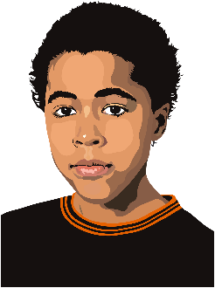
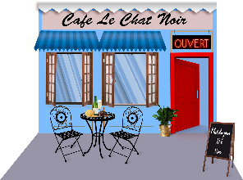
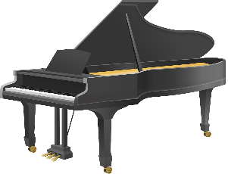
Le week-end dernier
parler
Partenaire A
Ask your partner:
Where they went
Who they went with
What they looked at
What time they arrived
Answer your partner’s questions:
Partenaire B
Ask your partner:
Where they went
How they travelled
What they drank
What time they arrived
Answer your partner’s questions:
[brother]
[Swiss piano]
[tea]
16:00
20:00
Notes:
ROLECARDS FOR PRINTING

Slide 36
Le week-end dernier
parler
Partenaire A
Ask your partner:
Where they went
Who they went with
What they looked at
What time they arrived
Answer your partner’s questions:
Je suis allé(e) au café.
J’ai voyagé en bus.
J’ai bu un thé.
Je suis arrivé(e) à vingt heures.
Partenaire B
Ask your partner:
Where they went
How they travelled
What they drank
What time they arrived
Answer your partner’s questions:
Je suis allé(e) au musée.
Mon frère est allé au musée aussi.
J’ai regardé un piano suisse.
Je suis arrivé(e) à seize heures.
Notes:
SUGGESTED ANSWERS [slide 2/2]

Slide 37
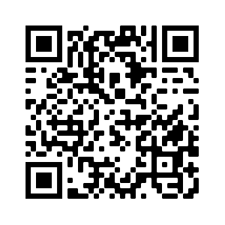
Devoirs
Vocabulary Learning Homework (Y9, Term 2.1, Week 3)
Quizlet link: Y9 Term 2.1 Week 3
Quizlet QR code:
Notes:
The answer sheet for the 9.2.1.3 vocabulary learning homework is here: https://resources.ncelp.org/concern/resources/1j92g8992?locale=en

