Slide 1
Grammar
Plural forms of AVOIR
Y7 French
Term 2.1 - Week 3
Natalie Finlayson / Emma Marsden / Rachel Hawkes
Date updated: 24/01/20

Slide 2
Saying what people have: nous and vous
Saying what people have: nous and vous
grammaire
As you know, the verb avoir changes form to match the subject.
J’ai des chiens. Tu as des chiens. Il/elle a des chiens.
I have dogs. You have dogs. He/she has dogs.
To say ‘we’ + avoir (first person plural):
Nous avons des chiens. We have dogs.
To say ‘you’ (more than one person) + avoir (second person plural):
Vous avez des chiens. You (plural) have dogs.
__
__
__
__
__
Notes:
Students have had a lot of practice with pronouns nous and vous in previous weeks, so they are presented together here. Teacher to remind students of the meaning of the pronouns.
Teacher to remind students of the meaning of the indefinite plural article des. The examples given illustrate its absence in English. Note the SFC in the plural chiens.
Teacher to point out that avoir is highly irregular in French. As with être, there is a different form for each pronoun.
The liaison which occurs in nous avons and vous avez is explained in the next slide.

Slide 3
Saying what people have: nous and vous
La liaison
prononciation
Nous avons des chiens. We have dogs.
The final –s in avons is a Silent Final Consonant.
But …
Nous avons des chiens. We have dogs.
The final consonant in nous is not an SFC!
Because the -s is followed by a vowel, it is pronounced like the English ‘z’.
This pronunciation change is known as liaison.
Notes:
Pronunciation practice of nous avons and vous avez appears in the slides that follow.

Slide 4
Saying what people have: nous and vous
prononcer
nous avons
we have
Notes:
Listen and repeat.
Highlight that nous avons sounds like one word, rather than two.

Slide 5
Saying what people have: nous and vous
prononcer
vous avez
you (pl) have
Notes:
Listen and repeat.
Highlight that vous avez sounds like one word, rather than two.

Slide 6
Saying what people have: nous and vous
prononcer
nous avons
we have
Notes:
Listen and repeat.
Highlight that nous avons sounds like one word, rather than two.

Slide 7
Saying what people have: nous and vous
prononcer
vous avez
you (pl) have
Notes:
Listen and repeat.
Highlight that vous avez sounds like one word, rather than two.

Slide 8
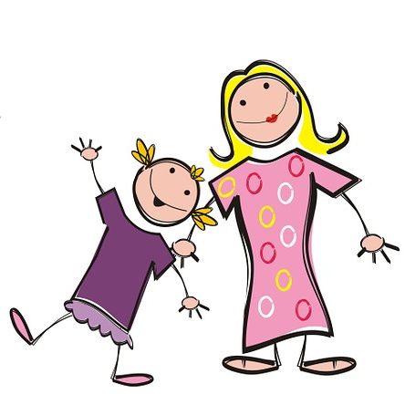
Saying what people have: nous and vous
prononcer
Saying what people have: nous and vous
Nous avons deux sœurs.
We have two sisters.
Notes:
Note the SFC in the plural noun.
1/ Listen and repeat.
2/ Ask students to translate the sentence.
3/ Reveal picture on a click, ask students to check their translations.
4/ Reveal English translation on click.

Slide 9
Saying what people have: nous and vous
prononcer
Saying what people have: nous and vous
Vous avez des vélos.
You (pl) have bikes.
Notes:
Note the SFC in the plural noun.
1/ Listen and repeat.
2/ Ask students to translate the sentence.
3/ Reveal picture on a click, ask students to check their translations.
4/ Reveal English translation on click.

Slide 10
Saying what people have: nous and vous
prononcer
Saying what people have: nous and vous
Nous avons des rêves.
We have dreams.
Notes:
Note the SFC in the plural noun.
1/ Listen and repeat.
2/ Ask students to translate the sentence.
3/ Reveal picture on a click, ask students to check their translations.
4/ Reveal English translation on click.

Slide 11
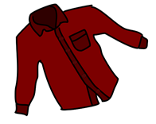
Saying what people have: nous and vous
prononciation
Saying what people have: nous and vous
Vous avez des chemises.
You (pl) have shirts.
Notes:
Listen and repeat.
1/ Listen and repeat.
2/ Ask students to translate the sentence.
3/ Reveal picture on a click, ask students to check their translations.
4/ Reveal English translation on click.

Slide 12
Saying what people have: nous and vous
prononcer
Saying what people have: nous and vous
Nous avons un problème.
We have a problem.
Notes:
An example with nous avons + un to further illustrate liaison before indefinite article.
NB: Teacher to explain to students that they may also hear ‘avons un(e)’ without the liaison, as both pronunciations are considered correct and pronunciation varies by individual speaker. The liaison is included here to provide maximal practice opportunities for students to recognise both variants.
1/ Listen and repeat.
2/ Ask students to translate the sentence.
3/ Reveal picture on a click, ask students to check their translations.
4/ Reveal English translation on click.

Slide 13
Saying what people have: nous and vous
prononcer
Saying what people have: nous and vous
Vous avez des enfants.
You (pl) have children.
Notes:
Note the SFC in the plural noun.
1/ Listen and repeat.
2/ Ask students to translate the sentence.
3/ Reveal picture on a click, ask students to check their translations.
4/ Reveal English translation on click.

Slide 14
Saying what people have: nous and vous
prononcer
Saying what people have: nous and vous
Nous avons une famille.
We have a family.
Notes:
An example with nous avons + une to further illustrate liaison before indefinite article.
NB: Teacher to explain to students that they may also hear ‘avons un(e)’ without the liaison, as both pronunciations are considered correct and pronunciation varies by individual speaker. The liaison is included here to provide maximal practice opportunities for students to recognise both variants.
1/ Listen and repeat.
2/ Ask students to translate the sentence.
3/ Reveal picture on a click, ask students to check their translations.
4/ Reveal English translation on click.

Slide 15
Saying what people have: nous and vous
prononcer
Saying what people have: nous and vous
Vous avez une maison.
You (pl) have a house.
Notes:
An example with vous avez + une to illustrate lack of liaison before indefinite article.
NB: Teacher to explain to students that they may also hear ‘avez un(e)’ without the liaison, as both pronunciations are considered correct and pronunciation varies by individual speaker. The liaison is included here to provide maximal practice opportunities for students to recognise both variants.
1/ Listen and repeat.
2/ Ask students to translate the sentence.
3/ Reveal picture on a click, ask students to check their translations.
4/ Reveal English translation on click.

Slide 16
Saying what people have: nous and vous
prononcer
Nous avons une solution.
We (pl) have a solution.
Notes:
An example with nous avez + une to illustrate lack of liaison before indefinite article.
NB: Teacher to explain to students that they may also hear ‘avons un(e)’ without the liaison, as both pronunciations are considered correct and pronunciation varies by individual speaker. The liaison is included here to provide maximal practice opportunities for students to recognise both variants.
1/ Listen and repeat.
2/ Ask students to translate the sentence.
3/ Reveal picture on a click, ask students to check their translations.
4/ Reveal English translation on click.

Slide 17
Saying what people have: nous and vous
prononcer
Vous avez une solution.
You (pl) have a solution.
Notes:
NB: Teacher to explain to students that they may also hear ‘avez un(e)’ without the liaison, as both pronunciations are considered correct and pronunciation varies by individual speaker. The liaison is included here to provide maximal practice opportunities for students to recognise both variants.
1/ Listen and repeat.
2/ Ask students to translate the sentence.
3/ Reveal picture on a click, ask students to check their translations.
4/ Reveal English translation on click.

Slide 18
Deux villes françaises
lire
Students in Paris and Nice are chatting about their cities. Both groups think their city is best!
Who has what in their city? Lis et écris nous (we) ou vous (you pl.)
@6ème_paris: Nous avons la Tour Eiffel et l'Arc de Triomphe ici!
@6ème_nice: Oui, vous avez des monuments mais nous avons le ciel bleu ici!
@6ème_paris: D’accord, vous avez du sable et des bateaux, mais nous avons une histoire riche!
@6ème_nice: OK, vous avez une culture unique. Mais nous avons les Alpes ici!
@6ème_paris: Bah … nous avons des restaurants excellents et des magasins modernes!
@6ème_nice: Euh … nous avons des restaurants excellents et des magasins modernes aussi!
______
______
______
______
______
______
______
______
______
Notes:
Students complete the activity by simply writing nous, vous, nous etc. in their workbooks. They address the ‘who has what?’ part of the question by writing the items down in English.
It would make sense for the teacher to do number one with the class to model the format: 1. Nous – Eiffel tower, Arc de Triomphe 2. Vous – monuments, nous – blue sky 3. Vous – sand, boats, nous – rich history 4. Vous – unique culture, nous – Alps 5. Nous – excellent restaurants and modern shops 6. Nous – excellent restaurants and modern shops
Answers revealed on individual clicks. Teacher elicits answers by pointing at a gap and asking ‘Nous ou vous?’ Then s/he elicits the English for ‘who has what’.
The exercise, which gives students an insight into the cultures of two major French cities, is constructed from known vocabulary items and cognates. Teacher to draw attention to the following points:
Ville is a false friend – teacher to ask students what they think the word might mean, given the context, and correct/explain as appropriate. La ville [260] is introduced as a vocabulary item in 2.2.2.
French spelling/pronunciation of la Tour Eiffel, l’Arc de Triomphe and les Alpes.
6ème – touch briefly on structure of the French school system. Explain that these students will be around the same age as students in Year 7 in the UK.
Students have not yet encountered cognates riche, culture or unique, but should be able to infer the meanings.
Students have not yet encountered an irregular plural ending – point this out and the SFC in bateaux. Ask students what they think this word means. Explain that some nouns have irregular plural endings, and that further examples will be encountered in future weeks.
Last week, students were taught regular plural adjective agreement as complement to the verb être. They have previously been taught postnominal adjective agreement with singular nouns. (Week 1.1.4). Teacher to draw students’ attention to the spelling of ‘excellents’ and ‘modernes’ and elicit the reason for this.

Slide 19
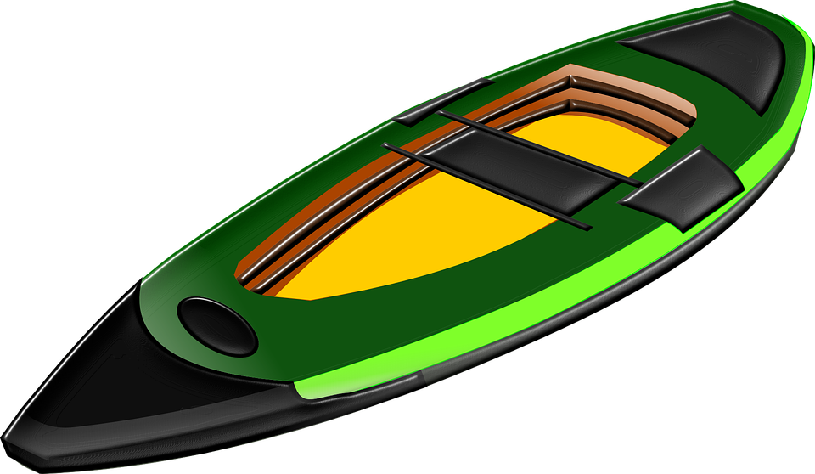
Deux chambres différentes
écouter
Léa and Manon are speaking to their cousins about their rooms. Who has what? Coche.
 | Léa et Manon (nous - we) | les cousins (vous – you pl.)
 | Léa et Manon (nous - we) | les cousins (vous – you pl.)
Notes:
This longer listening exercises consists of known vocabulary along with cognate le T-shirt. The dialogue contains a mix of singular and plural nouns so students practice hearing nous avons un(e) with the liaison, and nous avons des without it.
Transcript (plays on clicking the play button):
[beep] avons des livres et [beep] avons aussi une radio. [beep] avez un vélo et [beep] avons un kayak. [beep] avons des lits bleus et [beep] avez des lits verts. [beep] avez des T-shirts et [beep] avons des chemises. [beep] avez une télé et [beep] avons un ordinateur. [beep] avez deux ordinateurs mais [beep] avons un chien!

Slide 20
Deux chambres différentes
écouter
Léa and Manon are speaking to their cousins about their rooms. Who has what? Coche.
 | Léa et Manon (nous - we) | les cousins (vous – you pl.)
 | Léa et Manon (nous - we) | les cousins (vous – you pl.)
Notes:
Transcript (plays on clicking the play button):
Nous avons des livres et nous avons aussi une radio. Vous avez un vélo et nous avons un kayak. Nous avons des lits bleus et vous avez des lits verts. Vous avez des T-shirts et nous avons des chemises. Vous avez une télé et nous avons un ordinateur. Vous avez deux ordinateurs mais nous avons un chien!

Slide 21
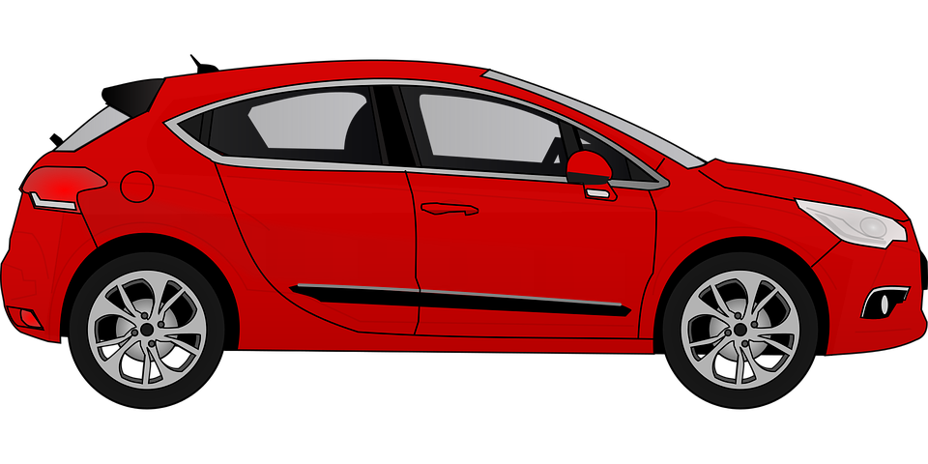
Nous ou vous?
parler / écouter (1/2)
Who has what? Étudiant(e) A parle. Étudiant(e) B écoute et écrit ‘nous’ ou ‘vous’.
nous (we) vous (you pl.)
nous (we) vous (you pl.)
nous (we) vous (you pl.)
nous (we) vous (you pl.)
nous (we) vous (you pl.)
nous (we) vous (you pl.)
nous (we) vous (you pl.)
nous (we) vous (you pl.)
nous (we) vous (you pl.)
nous (we) vous (you pl.)
nous (we) vous (you pl.)
nous (we) vous (you pl.)
Notes:
In this spoken activity, students work in pairs to decide whether sentences are written in the first or second person plural.
Before beginning the activity, the teacher may wish to:
revise use of un/une and des, ensuring students know when to use each here;
remind students to be aware of liaison use. A mixture of definite and indefinite articles are included here so students have to think about whether a liaison is required or not.
1/ Teacher distributes 2.1.3 grammar practice role cards, found on the portal alongside this sequence, among students.
2/ Student A reads the sentences on their card, omitting the pronoun in brackets.
3/ Student B writes nous or vous in their workbooks.
4/ Answers revealed on clicks.
5/ Teacher says each sentence again. Students repeat.
6/ (Optional writing activity) Both students write two sentences, one beginning with nous and the other with vous, summarising who has what.
Transcript (student A)
[Nous] avons une télé.
[Nous] avons des portables.
[Vous] avez des radios.
[Nous] avons un bateau.
[Vous] avez une voiture.
[Nous] avons des livres.

Slide 22
Nous ou vous?
parler / écouter (2/2)
Who has what? Étudiant(e) B parle. Étudiant(e) A écoute et écrit ‘nous’ ou ‘vous’.
nous (we) vous (you pl.)
nous (we) vous (you pl.)
nous (we) vous (you pl.)
nous (we) vous (you pl.)
nous (we) vous (you pl.)
nous (we) vous (you pl.)
nous (we) vous (you pl.)
nous (we) vous (you pl.)
nous (we) vous (you pl.)
nous (we) vous (you pl.)
nous (we) vous (you pl.)
nous (we) vous (you pl.)
Notes:
1/ Student A reads the sentences on their card, omitting the pronoun in brackets.
2/ Student B writes nous or vous in their workbooks.
3/ Answers revealed on clicks.
4/ Teacher says each sentence again. Students repeat.
5/ (Optional writing activity) Both students write two sentences, one beginning with nous and the other with vous, summarising who has what.
Transcript (student B)
[Nous] avons une télé.
[Vous] avez des portables.
[Nous] avons des radios.
[Vous] avez un bateau.
[Nous] avons une voiture.
[Nous] avons des livres.

Slide 23
Vocabulaire
Saying what people have: ils and elles
grammaire
To say one person has something, use il (m.) or elle (f.) with the correct form of avoir.
Il a des chiens. Elle a des chiens.
He has dogs. She has dogs.
To say ‘they’ + avoir (third person plural):
Ils ont des chiens. They (m. pl.) have dogs.
They (mixed pl.) have dogs.
Elles ont des chiens. They (f. pl.) have dogs.
Marc et Léa ont des chiens. Marc and Léa have dogs.
__
__
The final –t in ont
is a Silent Final Consonant.
The final consonant in ils and elles is not an SFC here! Because the -s is followed by a vowel, liaison occurs.
__
__
___________
Notes:
Students have had a lot of practice with pronouns ils and elles in previous weeks, so they are presented together here. Teacher to remind students of the meaning of the pronouns. Teacher to highlight that groups of named people (e.g. Marc and Léa) also need the 3rd person plural form.
Teacher to remind students of the meaning of the indefinite plural article des. The examples given illustrate its absence in English. Note the SFC in the plural chiens.
Teacher to point out that avoir is highly irregular in French. As with être, there is a different form for each pronoun.
Teacher to draw attention to the pronunciation (SFC on the verb, but not the pronoun). Explain that a liaison sometimes occurs when SFCs appear before a vowel, and that this can lead to a change in pronunciation in the consonant (here, like the English ‘z’.) Additional pronunciation practice of nous avons and vous avez appears in the slides that follow.

Slide 24
Vocabulaire
Saying what people have: ils and elles
prononcer
ils ont
they (m or m/f) have
Notes:
Listen and repeat.
Highlight that ils ont sounds like one word, rather than two.

Slide 25
Vocabulaire
Saying what people have: ils and elles
prononcer
elles ont
they (f) have
Notes:
Listen and repeat.
Highlight that elles ont sounds like one word, rather than two.

Slide 26
Vocabulaire
Saying what people have: ils and elles
prononcer
ils ont
they (m or m/f) have
Notes:
Listen and repeat.
Highlight that ils ont sounds like one word, rather than two.

Slide 27
Vocabulaire
Saying what people have: ils and elles
prononcer
elles ont
they (f) have
Notes:
Listen and repeat.
Highlight that elles ont sounds like one word, rather than two.

Slide 28
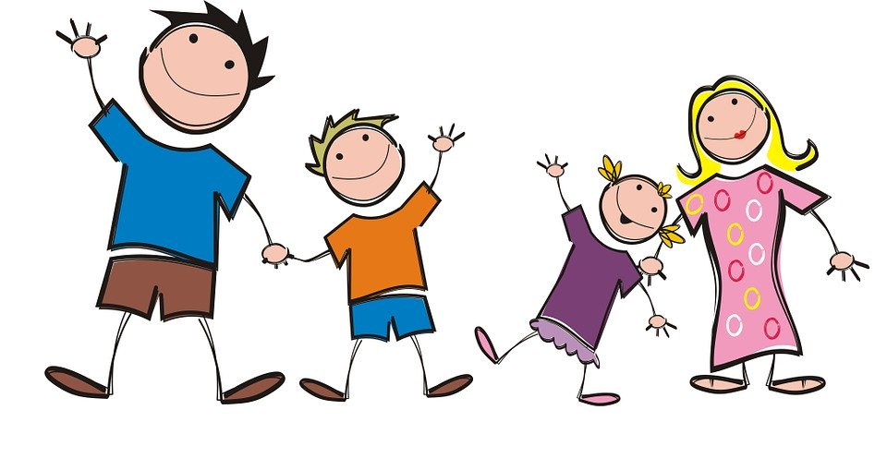
Vocabulaire
Saying what people have: ils and elles
prononcer et traduire
Ils ont deux sœurs.
They (m/f) have two sisters.
Notes:
Note the SFC in the plural noun.
1/ Listen and repeat.
2/ Ask students to translate the sentence.
3/ Reveal picture on a click, ask students to check their translations.
4/ Reveal English translation on click.

Slide 29
Vocabulaire
Saying what people have: ils and elles
prononcer et traduire
Elles ont des vélos.
They (f) have bikes.
Notes:
Note the SFC in the plural noun.
1/ Listen and repeat.
2/ Ask students to translate the sentence.
3/ Reveal picture on a click, ask students to check their translations.
4/ Reveal English translation on click.

Slide 30
Vocabulaire
Saying what people have: ils and elles
prononcer et traduire
Ils ont des rêves.
They (m/f) have dreams.
Notes:
Note the SFC in the plural noun.
1/ Listen and repeat.
2/ Ask students to translate the sentence.
3/ Reveal picture on a click, ask students to check their translations.
4/ Reveal English translation on click.

Slide 31
Vocabulaire
Saying what people have: ils and elles
prononcer et traduire
Elles ont des chemises.
They (f) have shirts.
Notes:
Note the SFC in the plural noun.
1/ Listen and repeat.
2/ Ask students to translate the sentence.
3/ Reveal picture on a click, ask students to check their translations.
4/ Reveal English translation on click.

Slide 32
Vocabulaire
Saying what people have: ils and elles
prononcer et traduire
Ils ont un problème.
They (m) have a problem.
Here, there is a liaison between –t and the vowel which follows.
Notes:
An example with ils ont + un to illustrate -t liaison.
1/ Listen and repeat.
2/ Ask students to translate the sentence.
3/ Reveal picture on a click, ask students to check their translations.
4/ Reveal English translation on click.

Slide 33
Vocabulaire
Saying what people have: ils and elles
prononcer et traduire
Elles ont une maison.
They (f) have a house.
Notes:
An example with elles ont + une to illustrate -t liaison.
1/ Listen and repeat.
2/ Ask students to translate the sentence.
3/ Reveal picture on a click, ask students to check their translations.
4/ Reveal English translation on click.

Slide 34
Vocabulaire
Saying what people have: ils and elles
prononcer et traduire
Elles ont une famille.
They (f) have a family.
Notes:
An example with elles ont + une to illustrate t- liaison.
1/ Listen and repeat.
2/ Ask students to translate the sentence.
3/ Reveal picture on a click, ask students to check their translations.
4/ Reveal English translation on click.

Slide 35
Vocabulaire
Saying what people have: ils and elles
prononcer et traduire
Ils ont un enfant.
They (m, m/f) have a child.
Notes:
An example with ils ont + un to illustrate -t liaison.
1/ Listen and repeat.
2/ Ask students to translate the sentence.
3/ Reveal picture on a click, ask students to check their translations.
4/ Reveal English translation on click.

Slide 36
Il, elle, ils ou elles?
Q
A
écouter, écrire et parler
Whose things are these? Écoute, écris et parle!
Ils ont
une voiture.
elle (she)
ils (they)
Notes:
Audio (without pronoun) plays on clicking ‘Q’ in the top right.
1/ Students listen and decide whether they hear the third person singular or plural form of avoir.
2/ Students write what they hear in their workbooks.
3/ Teacher elicits the answer by asking ‘Elle ou ils?’ Tell students they should answer in a full sentence, and pay attention to any necessary liaisons.
4/ Students respond ‘Ils ont une voiture.’
5/ Answer revealed on click.
6/ Teacher clicks on ‘A’ in the top right to play the recording including the pronoun.
7/ Students repeat for additional pronunciation practice.
Transcript
Q. [beep] ont une voiture.
A. Ils ont une voiture.

Slide 37
Il, elle, ils ou elles?
Q
A
écouter, écrire et parler
Whose things are these? Écoute, écris et parle!
Il a
une idée
il (he)
elles (they)
Notes:
Audio (without pronoun) plays on clicking ‘Q’ in the top right.
1/ Students listen and decide whether they hear the third person singular or plural form of avoir.
2/ Students write what they hear in their workbooks.
3/ Teacher elicits the answer by asking ‘Il ou elles?’ Tell students they should answer in a full sentence, and pay attention to any necessary liaisons.
4/ Students respond ‘Il a une idée.’
5/ Answer revealed on click.
6/ Teacher clicks on ‘A’ in the top right to play the recording including the pronoun.
7/ Students repeat for additional pronunciation practice.
Transcript
Q. [beep] a une idée.
A. Il a une idée.

Slide 38
Il, elle, ils ou elles?
Q
A
écouter, écrire et parler
Whose things are these? Écoute, écris et parle!
Elle a
un bateau.
elle (she)
elles (they)
Notes:
Audio (without pronoun) plays on clicking ‘Q’ in the top right.
1/ Students listen and decide whether they hear the third person singular or plural form of avoir.
2/ Students write what they hear in their workbooks.
3/ Teacher elicits the answer by asking ‘Elle ou elles?’ Tell students they should answer in a full sentence, and pay attention to any necessary liaisons.
4/ Students respond ‘Elle a un bateau.’
5/ Answer revealed on click.
6/ Teacher clicks on ‘A’ in the top right to play the recording including the pronoun.
7/ Students repeat for additional pronunciation practice.
Transcript
Q. [beep] a un bateau.
A. Elle a un bateau.

Slide 39
Il, elle, ils ou elles?
Q
A
écouter, écrire et parler
Whose things are these? Écoute, écris et parle!
Ils ont
une chambre.
il (he)
ils (they)
Notes:
Audio (without pronoun) plays on clicking ‘Q’ in the top right.
1/ Students listen and decide whether they hear the third person singular or plural form of avoir.
2/ Students write what they hear in their workbooks.
3/ Teacher elicits the answer by asking ‘Il ou ils?’ Tell students they should answer in a full sentence, and pay attention to any necessary liaisons.
4/ Students respond ‘Ils ont une chambre.’
5/ Answer revealed on click.
6/ Teacher clicks on ‘A’ in the top right to play the recording including the pronoun.
7/ Students repeat for additional pronunciation practice.
Transcript
Q. [beep] ont une chambre.
A. Ils ont une chambre.

Slide 40
Il, elle, ils ou elles?
Q
A
écouter, écrire et parler
Whose things are these? Écoute, écris et parle!
Elles ont
un livre.
il (he)
elles (they)
Notes:
Audio (without pronoun) plays on clicking ‘Q’ in the top right.
1/ Students listen and decide whether they hear the third person singular or plural form of avoir.
2/ Students write what they hear in their workbooks.
3/ Teacher elicits the answer by asking ‘Il ou elles?’ Tell students they should answer in a full sentence, and pay attention to any necessary liaisons.
4/ Students respond ‘Elles ont un livre.’
5/ Answer revealed on click.
6/ Teacher clicks on ‘A’ in the top right to play the recording including the pronoun.
7/ students repeat for additional pronunciation practice.
Transcript
Q. [beep] a un livre.
A. Elles ont un livre.

Slide 41
Il, elle, ils ou elles?
Q
A
écouter, écrire et parler
Whose things are these? Écoute, écris et parle!
Elle a
un chien.
elle (she)
ils (they)
Notes:
Audio (without pronoun) plays on clicking ‘Q’ in the top right.
1/ Students listen and decide whether they hear the third person singular or plural form of avoir.
2/ Students write what they hear in their workbooks.
3/ Teacher elicits the answer by asking ‘Elle ou ils?’ Tell students they should answer in a full sentence, and pay attention to any necessary liaisons.
4/ Students respond ‘Elle a un chien’.
5/ Answer revealed on click.
6/ Teacher clicks on ‘A’ in the top right to play the recording including the pronoun.
7/ Students repeat for additional pronunciation practice.
Transcript
Q. [beep] a un chien.
A. Elle a un chien.

Slide 42
Il, elle, ils ou elles?
Q
A
écouter, écrire et parler
Whose things are these? Écoute, écris et parle!
Elles ont
un ordinateur.
elle (she)
elles (they)
Notes:
Audio (without pronoun) plays on clicking ‘Q’ in the top right.
1/ Students listen and decide whether they hear the third person singular or plural form of avoir.
2/ Students write what they hear in their workbooks.
3/ Teacher elicits the answer by asking ‘Elle ou elles?’ Tell students they should answer in a full sentence, and pay attention to any necessary liaisons.
4/ Students respond ‘Elles ont un ordinateur.’
5/ Answer revealed on click.
6/ Teacher clicks on ‘A’ in the top right to play the recording including the pronoun.
7/ Students repeat for additional pronunciation practice.
Transcript
Q. [beep] ont un ordinateur.
A. Elles ont un ordinateur.

Slide 43
Vocabulaire
Une situation d'urgence à l'école
lire, écouter et parler
Écoute et lis l’histoire.
Les professeurs de 6ème organisent un concert pour les enfants. Le concert est grand et important et les enfants sont très enthousiastes.
Les chanteurs sont drôles et très amusants. Ils chantent en anglais. Mais les professeurs ont un problème. Les chanteurs sont malades! La situation est très difficile.
Les professeurs ont une idée. Ils sont drôles et amusants, et ils parlent très bien anglais aussi …
Les professeurs portent des uniformes violets et ils chantent au concert. Ils sont des acteurs fantastiques!
Les enfants sont contents. La solution est super!
Notes:
This multimodal exercise is designed to enable practice in segmenting (splitting up the audio into words). It is constructed from known vocabulary and cognates organiser, concert, important and enthousiaste.
This segmentation task is the first in a series of exercises relating to this longer text. The meaning of the text as a whole will be considered in the translation exercise which follows.
Teachers play the recording whilst students read the text. The audio is paused just before the words in bold. Note: the words are in bold below for the teacher’s purpose. Students read along with the text without bold so that they are required to practise segmentation.
Les professeurs de 6ème organisent un concert pour les enfants. Le concert est grand et important et les enfants sont très enthousiastes.
Les chanteurs sont drôles et très amusants. Ils chantent en anglais. Mais les professeurs ont un problème. Les chanteurs sont malades! La situation est très difficile. Les professeurs ont une idée. Ils sont drôles et amusants, et ils parlent très bien anglais aussi …
Les professeurs portent des uniformes violets et ils chantent au concert. Ils sont des acteurs fantastiques!
Les enfants sont contents. La solution est super!
The teacher then asks: 1/ What is the next word? The students then read the next word out loud, practising segmentation skills. Check that students understand the meaning. 2/ What type of word is it? The students then identify the word as a noun, verb, adjective or adverb, practising grammar knowledge. 3/ What other word could be used instead? The students then offer an alternative word of the same word class that makes sense in context, practising vocabulary knowledge. Some suggestions below:
Le concert est petit/intéressant/super/excellent
Les chanteurs sont drôles et aimables/puissants/sympas
Ils chantent en français
La situation est mauvaise/intéressante
Les professeurs ont une solution
Les professeurs d’anglais portent des chemises violets

Slide 44
Vocabulaire
Une situation d'urgence à l'école
lire
Trouve 16 verbes dans le texte.
Les professeurs de 6ème organisent un concert pour les enfants. Le concert est grand et important et les enfants sont très enthousiastes.
Les chanteurs sont drôles et très amusants. Ils chantent en anglais. Mais les professeurs ont un problème. Les chanteurs sont malades! La situation est très difficile.
Les professeurs ont une idée. Ils sont drôles et amusants, et ils parlent très bien anglais aussi …
Les professeurs portent des uniformes violets et ils chantent au concert. Ils sont des acteurs fantastiques!
Les enfants sont contents. La solution est super!
Notes:
In the second of a series of scaffolded activities based on this text, students are asked to identify all examples of verbs. They can do this by circling/underlining on a printed copy, or by writing a list in their workbooks. All verbs included are regular in the present tense, with the exception of être and avoir. Remind students of the –ent ending on regular verbs in the third person plural, and that forms of être and avoir are also verbs. Point out that ‘to be’ and ‘to have’ are verbs in English.
Answers on next slide.

Slide 45
Vocabulaire
Une situation d'urgence à l'école
lire
Trouve 16 verbes dans le texte.
Les professeurs de 6ème organisent un concert pour les enfants. Le concert est grand et important et les enfants sont très enthousiastes.
Les chanteurs sont drôles et très amusants. Ils chantent en anglais. Mais les professeurs ont un problème. Les chanteurs sont malades! La situation est très difficile.
Les professeurs ont une idée. Ils sont drôles et amusants, et ils parlent très bien anglais aussi …
Les professeurs portent des uniformes violets et ils chantent au concert. Ils sont des acteurs fantastiques!
Les enfants sont contents. La solution est super!
Notes:
Teacher to check that the meaning of the verbs is known.

Slide 46
Vocabulaire
Une situation d'urgence à l'école
traduire
Écris l’histoire en anglais! Attention aux verbes au présent! Simple or continuous?
Les professeurs de 6ème organisent un concert pour les enfants. Le concert est grand et important et les enfants sont très enthousiastes.
Les chanteurs sont drôles et très amusants. Ils chantent en anglais. Mais les professeurs ont un problème. Les chanteurs sont malades! La situation est très difficile.
Les professeurs ont une idée. Ils sont drôles et amusants, et ils parlent très bien anglais aussi …
Les professeurs portent des uniformes violets et ils chantent au concert. Ils sont des acteurs fantastiques!
Les enfants sont contents. La solution est super!
Notes:
Students can attempt this translation individually at first, and then compare translations with a partner.
Teacher to tell students to think carefully about how to translate the verbs into English. Recap the difference between the simple and continuous forms in English, and remind students that one form in French translates two in English. Students always have to decide between simple and continuous forms when translating into English.
Note: The text can easily be divided up (with one half of the class working on the first page, and the other on the second).

Slide 47
Vocabulaire
Une situation d'urgence à l'école
Here, the verb is in the continuous form because the action is current and ongoing.
traduire
Écris l’histoire en anglais! Attention aux verbes au présent! Simple or continuous?
Les professeurs de 6ème organisent un concert pour les enfants.
Le concert est grand et important et les enfants sont très enthousiastes.
Les chanteurs sont drôles et très amusants.
Ils chantent en anglais.
Mais les professeurs ont un problème. Les chanteurs sont malades!
La situation est très difficile.
The Year 7 teachers are organising a concert for the children.
The concert is big and important and the students are very enthusiastic.
The singers are funny and very entertaining.
They sing in English.
But the teachers have a problem.
The singers are ill!
The situation is very difficult.
Here, the verb is in the simple form because the action is routine.
Notes:
Note: This is answer slide 1 of 2. Suggested English sentences appear on clicks.
Teacher draws attention to the verb translation. Simple or continuous in English? Teacher can present these suggested translations after eliciting suggestions from students. Teacher may wish to collect ideas from the class and come up with a class translation on the board instead. Teacher to stress that there could be several solutions, and to encourage and praise structurally sound alternative suggestions.

Slide 48
Vocabulaire
Une situation d'urgence à l'école
traduire
Écris l’histoire en anglais! Attention aux verbes au présent! Simple or continuous?
Here, the verb is in the simple form because the action is routine.
Les professeurs ont une idée.
Ils sont drôles et amusants, et ils parlent très bien anglais aussi …
Les professeurs portent des uniformes violets et ils chantent au concert.
Ils sont des acteurs fantastiques!
Les enfants sont contents.
La solution est super!
The teachers have an idea.
They are funny and entertaining, and they speak English very well too …
The teachers wear/are wearing purple uniforms and sing/are singing at the concert. They are fantastic actors!
The children are happy.
The solution is brilliant!
Here, the verbs can be either in the simple or continuous form. What difference does the tense make to the meaning?
Notes:
Note: This is answer slide 2 of 2. Suggested English sentences appear on clicks. Teacher can present these suggested translations after eliciting suggestions from students. Teacher may wish to collect ideas from the class and come up with a class translation on the board instead. Teacher to stress that there could be several solutions, and to encourage and praise structurally sound alternative suggestions.
Teacher to discuss the difference in meaning between wear/are wearing and sing/are singing. Our choices in English can be subjective – here choosing to use the continuous form conveys immediacy/it is happening right now! it's so exciting! its a narrative device that we have in English.

Slide 49
Vocabulaire
Une situation d'urgence à l'école
écrire
Imagine you are telling the story from the teacher’s point of view. What changes?
Les professeurs de 6ème organisent un concert à l'école. Le concert est grand et important et les enfants sont enthousiastes.
Les chanteurs sont drôles et amusants. Ils chantent en anglais. Mais les professeurs ont un problème. Les chanteurs sont malades! La situation est problematique.
Les professeurs ont une idée. Ils sont drôles et amusants aussi, et ils parlent anglais …
Les professeurs portent des uniformes violets et ils chantent au concert. Ils sont des bons acteurs!
Les enfants sont contents. La solution est super!
Nous organisons un concert pour les enfants. Le concert est grand et important et les enfants sont très enthousiastes.
Nous avons une idée. Nous sommes drôles et amusants, et nous parlons très bien anglaise aussi …
Nous portons des uniformes violets et nous chantons au concert. Nous sommes des acteurs fantastiques!
Les enfants sont contents. La solution est super!
Les chanteurs sont drôles et très amusants. Ils chantent en anglais. Mais nous avons un problème. Les chanteurs sont malades! La situation est très difficile.
Notes:
In this exercise, students practise changing verbs and subjects from 3rd person plural to first person plural. It revises forms of regular verbs, avoir and être in the third person plural.
Teacher to remind students that not all verbs and subjects need to change, only those relating to the teachers (highlighted in the text). Note that a mix of full nouns and pronouns are used to remind students that both require the third person plural form.
Answers to individual paragraphs revealed on clicks.

